Slide 1

AI: Representation and Problem Solving
Particle Filtering
Instructors: Tuomas Sandholm and Vincent Conitzer
Slide credits: CMU AI and http://ai.berkeley.edu

Slide 2
Logistics
HW10 (written, online) due Thursday April 17
P5 due Thursday April 24
HW11 (online, not yet released) due Thursday April 24
TA interview scheduling coming soon for those who applied

Slide 3

Hidden Markov Models
Usually the true state is not observed directly
Hidden Markov models (HMMs)
Underlying Markov chain over states X
You observe evidence E at each time step
X_{t} is a single discrete variable; E_{t} may be continuous and may consist of several variables
X₀
X₁
X₂
X₃
X₅
E₁
E₂
E₃
E₅

Slide 4
Recall: HMM Queries
Filtering: P(X_{t}|e_{1:t})
Prediction: P(X_{t+k}|e_{1:t})
X₁
X₂
X₃
X₄
X₁
X₂
X₃
X₄
X₅
e₁
e₂
e₃
e₄
e₁
e₂
e₃
Smoothing: P(X_{k}|e_{1:t}), k<t
Explanation: P(X_{1:t}|e_{1:t})
X₁
X₂
X₃
X₄
X₁
X₂
X₃
X₄
e₁
e₂
e₃
e₄
e₁
e₂
e₃
e₄

Slide 5
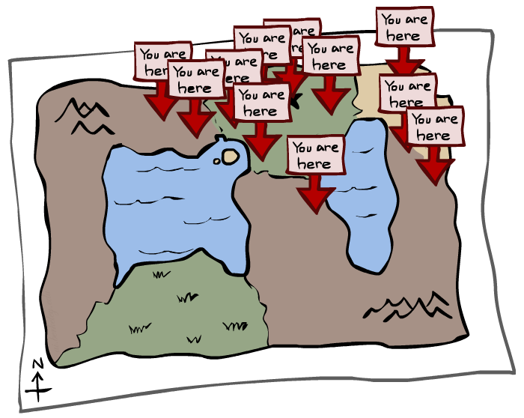
Particle Filtering

Slide 6

Particle Filtering

Slide 7
Belief States
When predicting the actual location we’re in at each time step, X_{k …}
… really, what we’re doing is maintaining a probability distribution over all possible states
This distribution is called a belief state, it represents the belief of where we are
We denote the belief state for X at time 3 by b(X₃) = P(X₃ | e₁, e₂, e₃)
X₀
X₁
X₂
X₃
E₁
E₂
E₃

Slide 8
We need a new algorithm!
When |X| is more than 10⁶ or so (e.g., 3 ghosts in a 10x20 world), exact inference to compute the belief state becomes infeasible
We could try to sample our Bayes net to compute b(X)
Likelihood weighting fails completely – number of samples needed grows exponentially with T
X₀
X₁
X₂
X₃
E₁
E₂
E₃

Slide 9
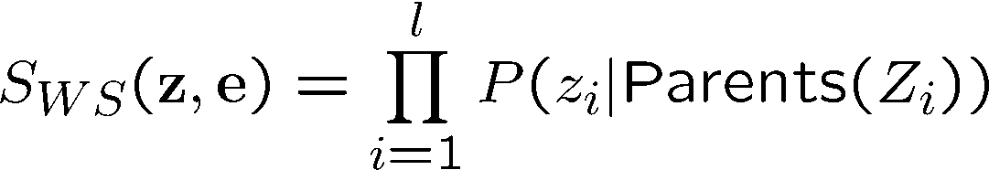
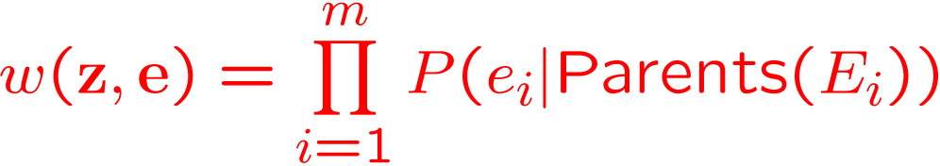
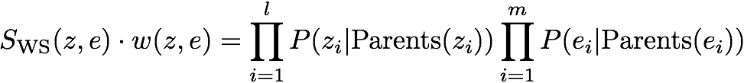

Recall: Likelihood Weighting
Sampling distribution if z sampled and e fixed evidence
Now, samples have weights
Together, weighted sampling distribution is consistent
Cloudy
C
S
R
W

Slide 10
We need a new idea!
t=2
t=7
Idea: Sample in the first state, and then move those samples by sampling the transition function
The problem: sample state trajectories go off into low-probability regions, ignoring the evidence; should reweight, but anyway too few “reasonable” samples
Solution: get rid of the bad ones, make more of the good ones. This way the population of samples stays in the high-probability region.
This is called resampling or survival of the fittest

Slide 11
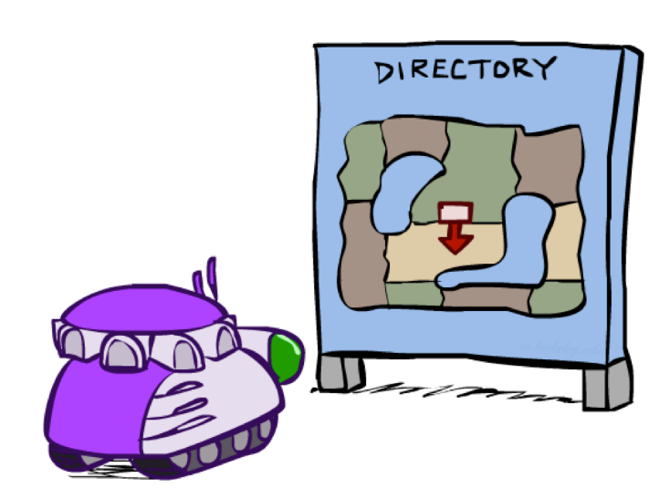
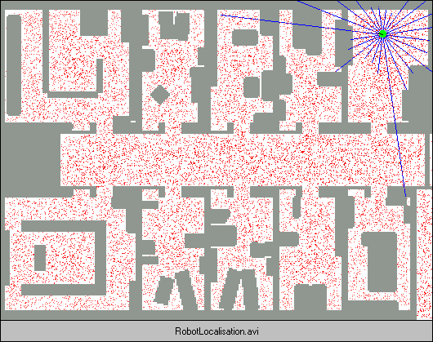
Robot Localization
In robot localization:
We know the map, but not the robot’s position
Observations may be vectors of range finder readings
State space and readings are typically continuous (works basically like a very fine grid) and so we cannot store B(X)
Particle filtering is a main technique

Slide 12

Particle Filter Localization (Sonar)
[Dieter Fox, et al.]
[Video: global-sonar-uw-annotated.avi]

Slide 13
Particle Filtering
Represent belief state by a set of samples
Samples are called particles
Time per step is linear in the number of samples
But: number needed may be large
This is how robot localization works in practice
0.0
0.1
0.0
0.0
0.0
0.2
0.0
0.2
0.5

Slide 14
Representation: Particles
Our representation of P(X) is now a list of N particles (samples)
Generally, N << |X|
Storing dictionary mapping from X to counts would defeat the point
P(x) approximated by number of particles with value x
So, many x may have P(x) = 0!
More particles, more accuracy
Usually we want a low-dimensional marginal
E.g., “Where is ghost 1?” rather than “Are ghosts 1,2,3 in {2,6], [5,6], and [8,11]?”
For now, all particles have a weight of 1
Particles:
(3,3)
(2,3)
(3,3)
(3,2)
(3,3)
(3,2)
(1,2)
(3,3)
(3,3)
(2,3)

Slide 15
Particle Filtering: Propagate forward (“Predict”)
A particle in state x_{t} is moved by sampling its next position directly from the transition model:
x_{t+1} ~ P(X_{t+1} | x_{t})
In this example, most samples move clockwise, but some move in another direction or stay in place
This captures the passage of time
With enough samples, close to exact values before and after (consistent)
Particles:
(3,3)
(2,3)
(3,3)
(3,2)
(3,3)
(3,2)
(1,2)
(3,3)
(3,3)
(2,3)
Particles:
(3,2)
(2,3)
(3,2)
(3,1)
(3,3)
(3,2)
(1,3)
(2,3)
(3,3)
(2,2)

Slide 16
Particle Filtering: Observe/Weight (“Update” part 1)
Particles:
(3,2)
(2,3)
(3,2)
(3,1)
(3,3)
(3,2)
(1,3)
(2,3)
(3,2)
(2,2)
Slightly trickier:
Don’t sample observation, fix it
Similar to likelihood weighting, weight samples based on the evidence
W = P(e_{t}| x_{t})
Normalize the weights: particles that fit the data better get higher weights, others get lower weights
Particles:
(3,2) w=.9
(2,3) w=.2
(3,2) w=.9
(3,1) w=.4
(3,3) w=.4
(3,2) w=.9
(1,3) w=.1
(2,3) w=.2
(3,3) w=.4
(2,2) w=.4

Slide 17
Particle Filtering: Resample (“Update” part 2)
Rather than tracking weighted samples, we resample
We have an updated belief distribution based on the weighted particles
We sample N new particles from the weighted belief distributions
Now the update is complete for this time step; continue with the next one
Particles:
(3,2) w=.9
(2,3) w=.2
(3,2) w=.9
(3,1) w=.4
(3,3) w=.4
(3,2) w=.9
(1,3) w=.1
(2,3) w=.2
(3,3) w=.4
(2,2) w=.4
(New) Particles:
(3,2)
(2,2)
(3,2)
(2,3)
(3,3)
(3,2)
(1,3)
(2,3)
(3,2)
(3,2)

Slide 18
Summary: Particle Filtering
Particles: track samples of states rather than an explicit distribution
Propagate forward
based on transition function
Weight based on observation function
Resample using weighted particles
Particles:
(3,3)
(2,3)
(3,3)
(3,2)
(3,3)
(3,2)
(1,2)
(3,3)
(3,3)
(2,3)
Particles:
(3,2)
(2,3)
(3,2)
(3,1)
(3,3)
(3,2)
(1,3)
(2,3)
(3,2)
(2,2)
Particles:
(3,2) w=.9
(2,3) w=.2
(3,2) w=.9
(3,1) w=.4
(3,3) w=.4
(3,2) w=.9
(1,3) w=.1
(2,3) w=.2
(3,3) w=.4
(2,2) w=.4
(New) Particles:
(3,2)
(2,2)
(3,2)
(2,3)
(3,3)
(3,2)
(1,3)
(2,3)
(3,2)
(3,2)
Consistency: see proof in AIMA Ch. 14
[Demos: ghostbusters particle filtering (L15D3,4,5)]

Slide 19
Weighting and Resampling
How to compute a belief distribution given weighted particles
Weight
Particles:
(3,2) w=.9
(2,3) w=.2
(3,2) w=.9
(3,1) w=.4
(3,3) w=.4
(3,2) w=.9
(1,3) w=.1
(2,3) w=.2
(3,3) w=.4
(2,2) w=.4

Slide 20
Poll 1
If we only have one particle which of these steps are unnecessary?
Select all that are unnecessary.
Propagate forward
Weight
Resample
None of the above
Propagate forward
Weight
Resample

Slide 21
Poll 1
If we only have one particle which of these steps are unnecessary?
Select all that are unnecessary.
Propagate forward
Weight
Resample
None of the above
Propagate forward
Weight
Resample
Unless the weight is zero, in which case, you’ll want to resample from the beginning ☹

Slide 22
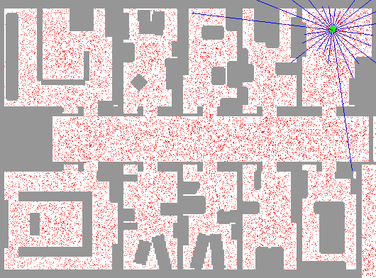
Particle Filter Localization (Laser)
[Dieter Fox, et al.]
[Video: global-floor.gif]

Slide 23

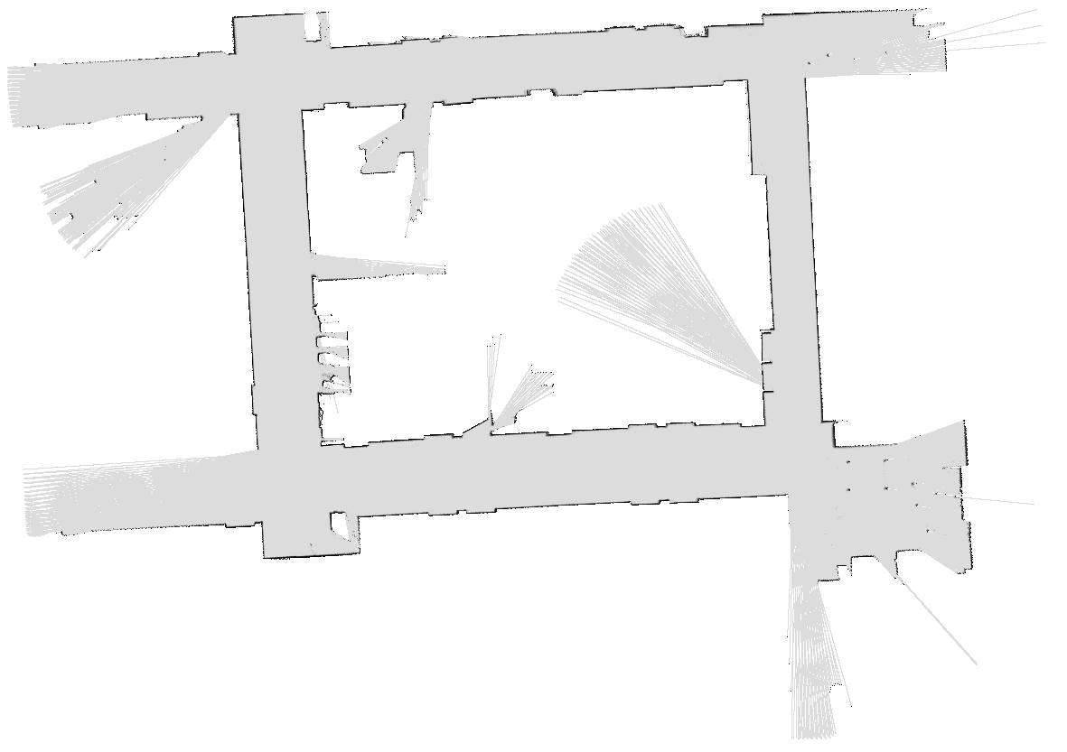
Robot Mapping
SLAM: Simultaneous Localization And Mapping
We do not know the map or our location
State consists of position AND map!
Main techniques: Kalman filtering (Gaussian HMMs) and particle methods
DP-SLAM, Ron Parr
[Demo: PARTICLES-SLAM-mapping1-new.avi]

Slide 24

Particle Filter SLAM – Video 1
[Sebastian Thrun, et al.]
[Demo: PARTICLES-SLAM-mapping1-new.avi]

Slide 25

Particle Filter SLAM – Video 2
[Dirk Haehnel, et al.]
[Demo: PARTICLES-SLAM-fastslam.avi]

Slide 26

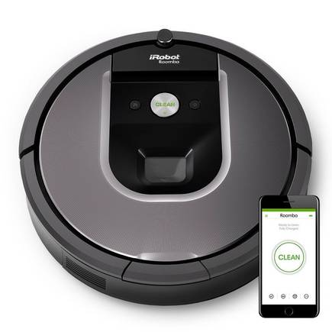
SLAM
https://www.irobot.com/

Slide 27
In Class Activity
Use Python random.random() or Google to sample
Given the following starting particles, transition model, and e₁ and e₂ observed at time 1 and time 2, what is the approximate belief state at time 2?
y
T=0
P(X_{t+1}|X_{t} in middle row)
P(X_{t+1}|X_{t} in top row)
P(X_{t+1}|X_{t} in bottom row)
0.15
0.1
0.1
3
2
0.8
0.7
0.8
1
0.1
0.15
0.1
1
2
3
x
P(e₁|X₁)
P(e₂|X₂)
.3
.5
.05
.4
.5
.5
.3
.5
.2
.5
.05
.2
Notes:
Row 3 (top row):
P((k,2) | (k,3)) = .8
P((k,3) | (k,3)) = .1
P((k+1,3) | (k,3)) = .1
Row 2 (middle row):
P((k+1,2) | (k,2)) = .7
P((k+1,1) | (k,2)) = .15
P((k+1,3) | (k,2)) = .15
Row 1 (bottom row):
P((k,2) | (k,1)) = .8
P((k,1) | (k,1)) = .1
P((k+1,1) | (k,1)) = .1

Slide 28
In Class Activity
Use random.random() or Google to sample
Given the following starting particles, transition model, and e₁ observed at time 1, what is the approximate belief state at time 1?
y
T=0
T=1
3
2
Propagate forward
Weight based on e₁
Resample
1
1
2
3
x
P(e₁|X₁)
.3
.5
.5
.5
.2
.5
Notes:
Row 3 (top row):
P((k,2) | (k,3)) = .8
P((k,3) | (k,3)) = .1
P((k+1,3) | (k,3)) = .1
Row 2 (middle row):
P((k+1,2) | (k,2)) = .7
P((k+1,1) | (k,2)) = .15
P((k+1,3) | (k,2)) = .15
Row 1 (bottom row):
P((k,2) | (k,1)) = .8
P((k,1) | (k,1)) = .1
P((k+1,1) | (k,1)) = .1

Slide 29
In Class Activity
Use random.random() or Google to sample
Given the particles at T=1, transition model, and e₂ observed at time 2, what is the approximate belief state at time 2?
y
T=1
T=2
How many samples at (3,2)?
3
2
Propagate forward
Weight based on e₂
Resample
1
1
2
3
x
P(e₂|X₂)
.05
.4
.3
.5
.05
.2
Notes:
Row 3 (top row):
P((k,2) | (k,3)) = .8
P((k,3) | (k,3)) = .1
P((k+1,3) | (k,3)) = .1
Row 2 (middle row):
P((k+1,2) | (k,2)) = .7
P((k+1,1) | (k,2)) = .15
P((k+1,3) | (k,2)) = .15
Row 1 (bottom row):
P((k,2) | (k,1)) = .8
P((k,1) | (k,1)) = .1
P((k+1,1) | (k,1)) = .1

Slide 30
In Class Activity – Example Solution
Use random.random() to sample
Given the following starting particles, transition model, and e₁ observed at time 1, what is the approximate belief state at time 1?
y
T=0
T=1
3
0
.5
Propagate forward
1.5
Resample
2
Weight based on e₁
.5
1
0
0
1
2
3
x
P(e₁|X₁)
.3
.5
.5
.5
.2
.5
Notes:
Row 3 (top row):
P((k,2) | (k,3)) = .8
P((k,3) | (k,3)) = .1
P((k+1,3) | (k,3)) = .1
Row 2 (middle row):
P((k+1,2) | (k,2)) = .7
P((k+1,1) | (k,2)) = .15
P((k+1,3) | (k,2)) = .15
Row 1 (bottom row):
P((k,2) | (k,1)) = .8
P((k,1) | (k,1)) = .1
P((k+1,1) | (k,1)) = .1

Slide 31
In Class Activity – Example Solution
Use random.random() to sample
Given the T=1 particles, transition model, and e₂ observed at time 2, what is the approximate belief state at time 2?
y
T=1
T=2
How many samples at (3,2)?
3
0
.4
2
Propagate forward
Weight based on e₂
2.1
1.0
Resample
1
0
0
1
2
3
x
(2,2) = 2.1/3.5 = .6
(3,2) = 1.0/3.5 = .29
(3,3) = .4/3.5 = .11
P(e₂|X₂)
.05
.4
.3
.5
.05
.2
Notes:
Row 3 (top row):
P((k,2) | (k,3)) = .8
P((k,3) | (k,3)) = .1
P((k+1,3) | (k,3)) = .1
Row 2 (middle row):
P((k+1,2) | (k,2)) = .7
P((k+1,1) | (k,2)) = .15
P((k+1,3) | (k,2)) = .15
Row 1 (bottom row):
P((k,2) | (k,1)) = .8
P((k,1) | (k,1)) = .1
P((k+1,1) | (k,1)) = .1

Slide 32

A different type of self-locating belief: Sleeping Beauty problem [Piccione and Rubinstein’97, Elga’00]
There is a participant in a study (call her Sleeping Beauty)
On Sunday, she is given drugs to fall asleep
A coin is tossed (H or T)
If H, she is awoken on Monday, then made to sleep again
If T, she is awoken Monday, made to sleep again, then again awoken on Tuesday
Due to drugs she cannot remember what day it is or whether she has already been awoken once, but she remembers all the rules
Imagine you are SB and you’ve just been awoken. What is your (subjective) probability that the coin came up H?
Sunday
Monday
Tuesday
H
T
don’t do this at home / without IRB approval…

