Slide 1

Warm-up:
What is the relationship between number of constraints and number of possible solutions?
In other words, as the number of the constraints increases,
does the number of possible solutions:
Increase
Decrease
Stay the same
Notes:
0=7, R=4, W=6, U=2, T=8, F=1; 867 + 867 = 1734

Slide 2
Announcements
Midterm 1 Exam
Tue 10/1, in class
Assignments:
HW3
    Due tonight, 10 pm
HW4
    Due Tue 9/24, 10 pm
P2: Logic and Planning
    Out Thu 9/19
    Due Thu 10/3, 10 pm
Recitation and feedback survey on Piazza
Due tomorrow, 10 pm
Sat 10/5, 10 pm

Slide 3

AI: Representation and Problem Solving
Propositional Logic
Instructors: Pat Virtue & Fei Fang
Slide credits: CMU AI, http://ai.berkeley.edu

Slide 4
Logical Agents
Logical agents and environments
Agent
Environment
Sensors
Percepts
Knowledge Base
Inference
?
Actuators
Actions

Slide 5
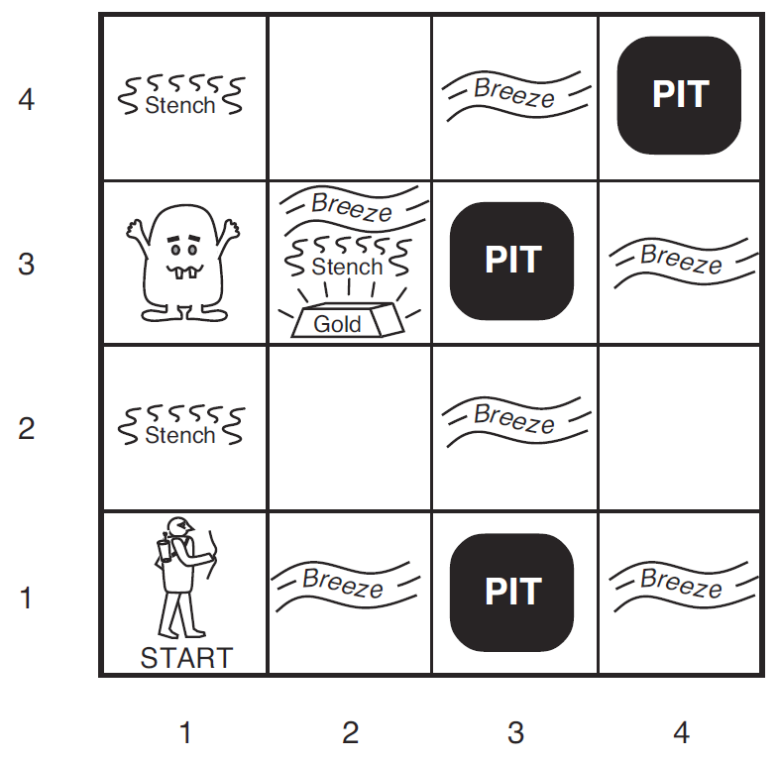
Wumpus World
Logical Reasoning as a CSP
B_{ij} = breeze felt
S_{ij} = stench smelt
P_{ij} = pit here
W_{ij} = wumpus here
G = gold
http://thiagodnf.github.io/wumpus-world-simulator/

Slide 6
A Knowledge-based Agent
function KB-AGENT(percept) returns an action
persistent: KB, a knowledge base
t, an integer, initially 0
TELL(KB, PROCESS-PERCEPT(percept, t))
action ← ASK(KB, PROCESS-QUERY(t))
TELL(KB, PROCESS-RESULT(action, t))
t←t+1
return action

Slide 7
Logical Agents
So what do we TELL our knowledge base (KB)?
  Facts (sentences)
      The grass is green
      The sky is blue
  Rules (sentences)
      Eating too much candy makes you sick
      When you’re sick you don’t go to school
  Percepts and Actions (sentences)
      Pat ate too much candy today
What happens when we ASK the agent?
  Inference – new sentences created from old
      Pat is not going to school today

Slide 8
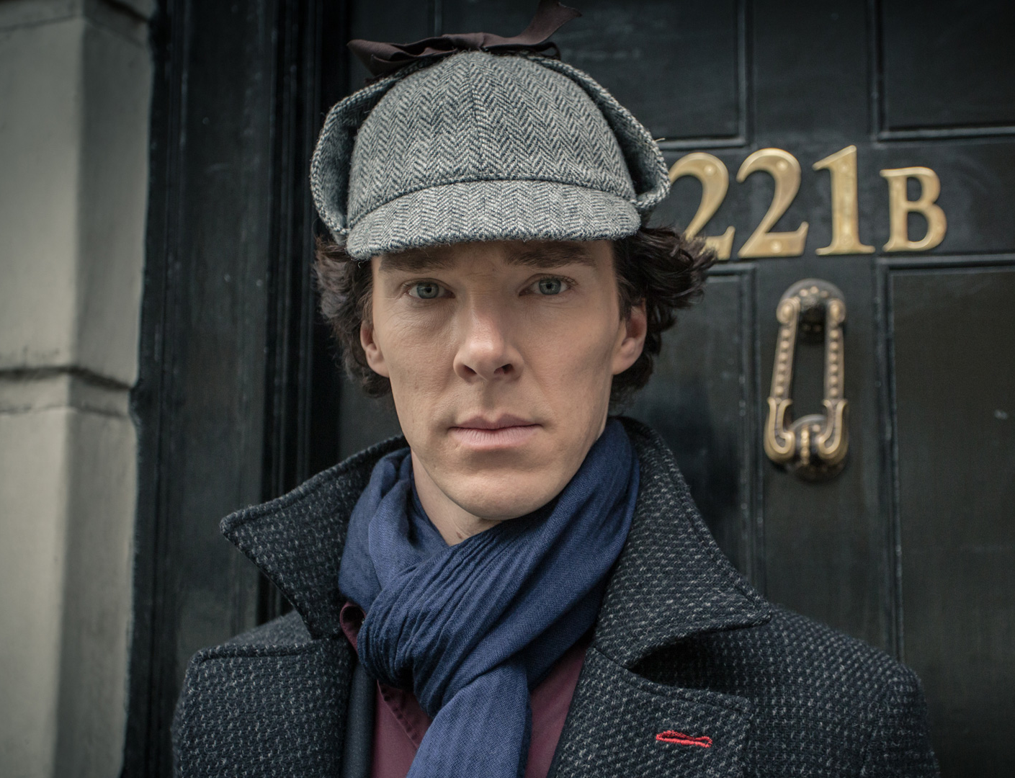

Logical Agents
Sherlock Agent
  Really good knowledge base
    Evidence
    Understanding of how the world works (physics, chemistry, sociology)
  Really good inference
    Skills of deduction
    “It’s elementary my dear Watson”
Dr. Strange?
Alan Turing?
Kahn?

Slide 9

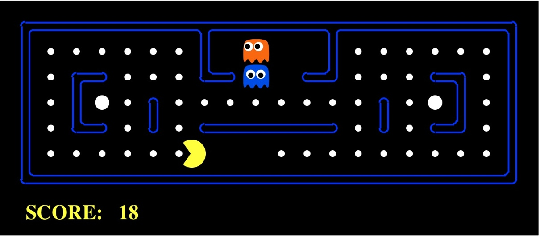
Worlds
What are we trying to figure out?
  Who, what, when, where, why
  Time: past, present, future
  Actions, strategy
  Partially observable? Ghosts, Walls
Which world are we living in?

Slide 10
Models
How do we represent possible worlds with models and knowledge bases?
How do we then do inference with these representations?

Slide 11
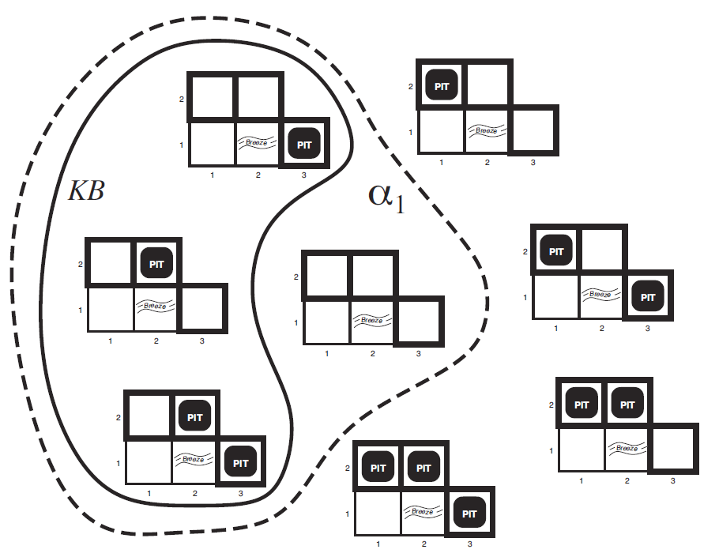


Wumpus World
Possible Models
P_{1,2} P_{2,2} P_{3,1}

Slide 12

Wumpus World
Possible Models
P_{1,2} P_{2,2} P_{3,1}
Knowledge base
    Nothing in [1,1]
    Breeze in [2,1]

Slide 13
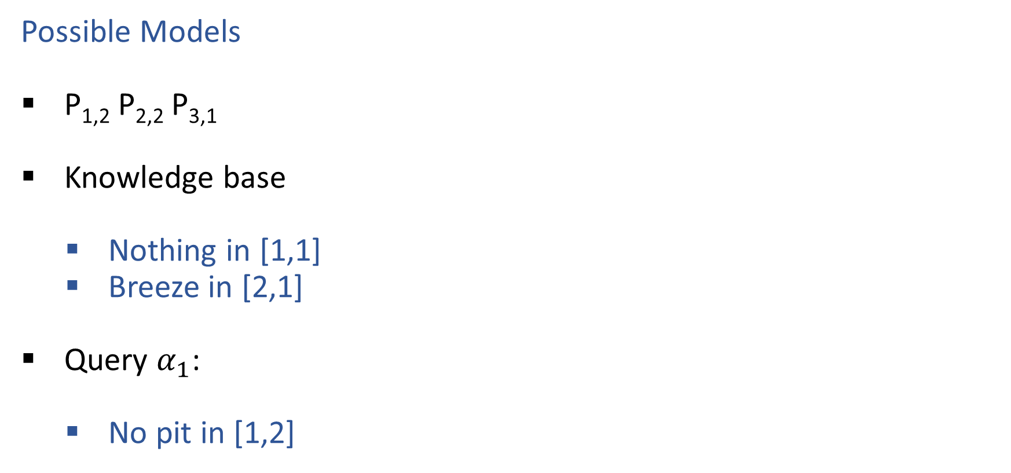
Wumpus World
Possible Models
P_{1,2} P_{2,2} P_{3,1}
Knowledge base
    Nothing in [1,1]
    Breeze in [2,1]
Query $α_{1}$:
    No pit in [1,2]

Slide 14
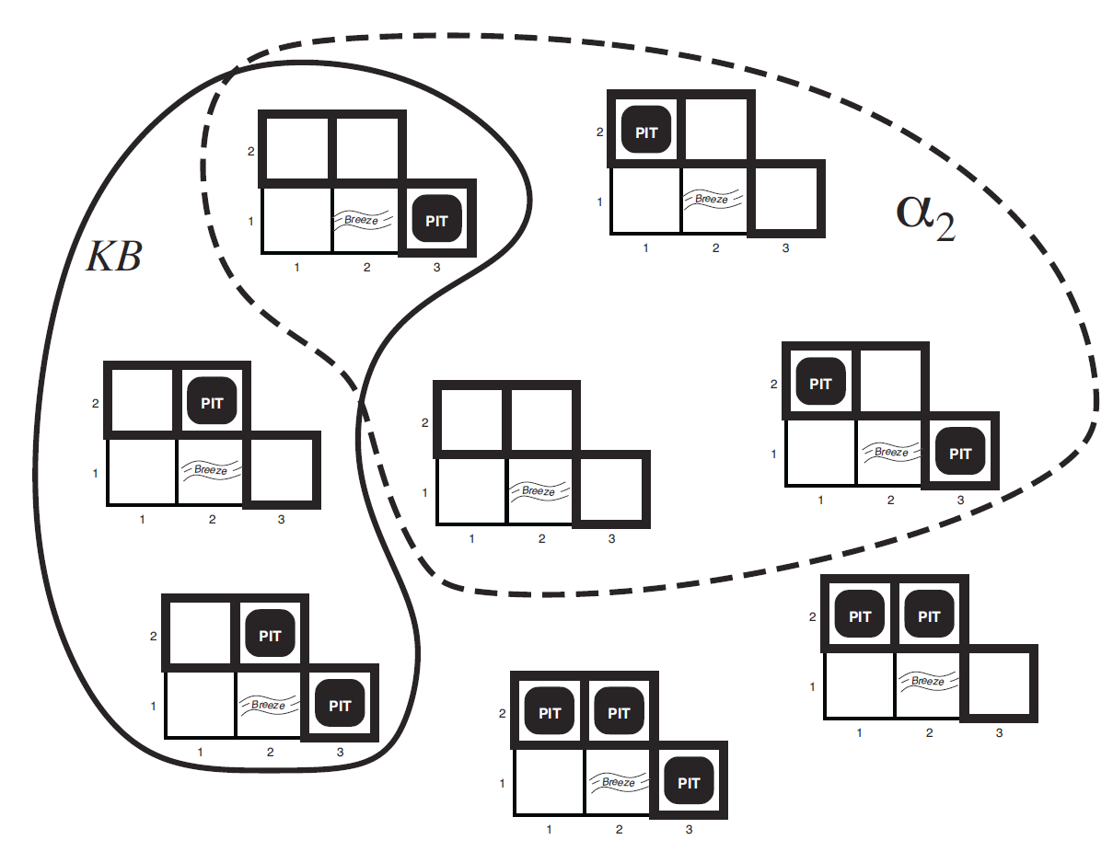

Wumpus World
Possible Models
P_{1,2} P_{2,2} P_{3,1}
Knowledge base
    Nothing in [1,1]
    Breeze in [2,1]
Query $α_{2}$:
    No pit in [2,2]

Slide 15
Logic Language
Natural language?
Propositional logic
  Syntax: P ∨ (¬Q ∧ R); X₁ ⇔ (Raining ⇒ Sunny)
  Possible world: {P=true, Q=true, R=false, S=true} or 1101
  Semantics: α ∧ β is true in a world iff is α true and β is true (etc.)
First-order logic
  Syntax: ∀x ∃y P(x,y) ∧ ¬Q(Joe,f(x)) ⇒ f(x)=f(y)
  Possible world: Objects o₁, o₂, o₃; P holds for <o₁,o₂>; Q holds for <o₃>; f(o₁)=o₁; Joe=o₃; etc.
  Semantics: φ(σ) is true in a world if σ=o_{j} and φ holds for o_{j}; etc.

Slide 16
Propositional Logic

Slide 17
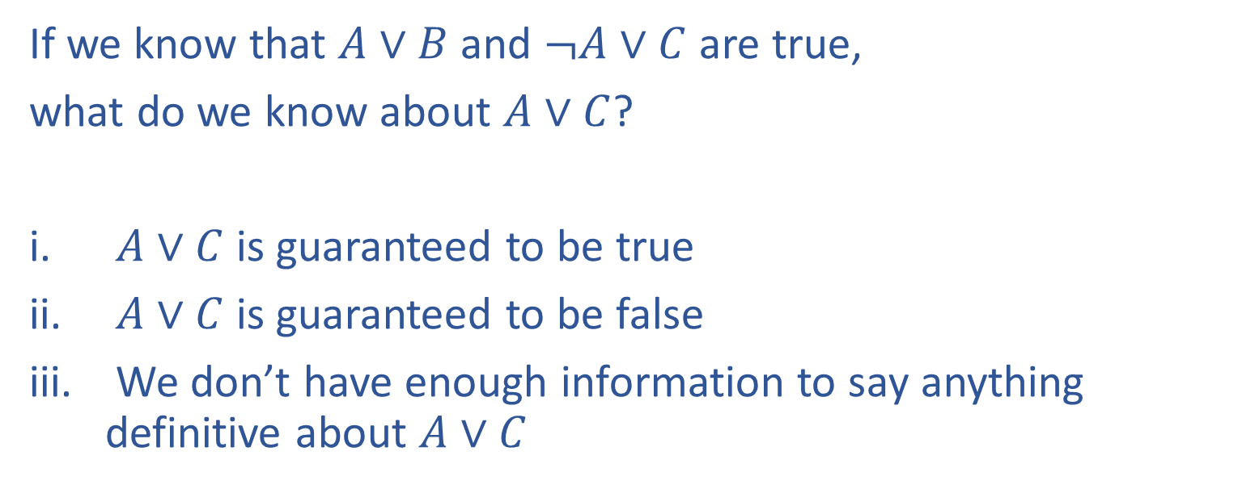

Piazza Poll 1
If we know that $A∨B$ and $¬A∨C$ are true,
what do we know about $A∨C$?
$A∨C$ is guaranteed to be true
$A∨C$ is guaranteed to be false
We don’t have enough information to say anything definitive about $A∨C$

Slide 18
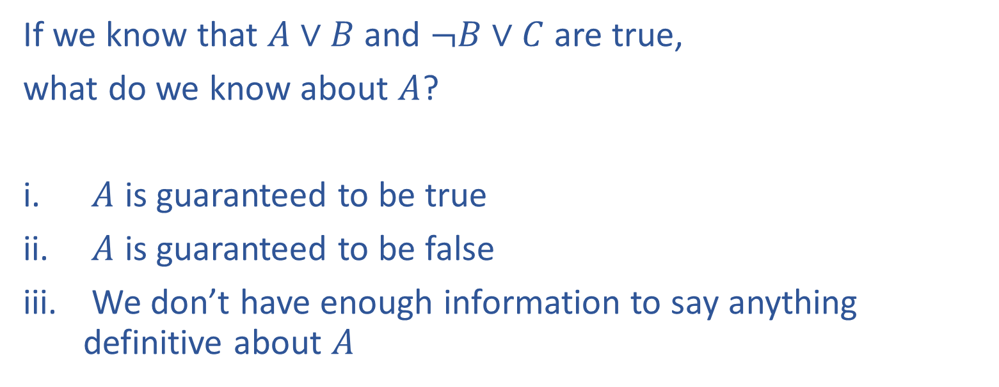
Piazza Poll 2
If we know that $A∨B$ and $¬B∨C$ are true,
what do we know about $A$?
$A$ is guaranteed to be true
$A$ is guaranteed to be false
We don’t have enough information to say anything definitive about $A$

Slide 19
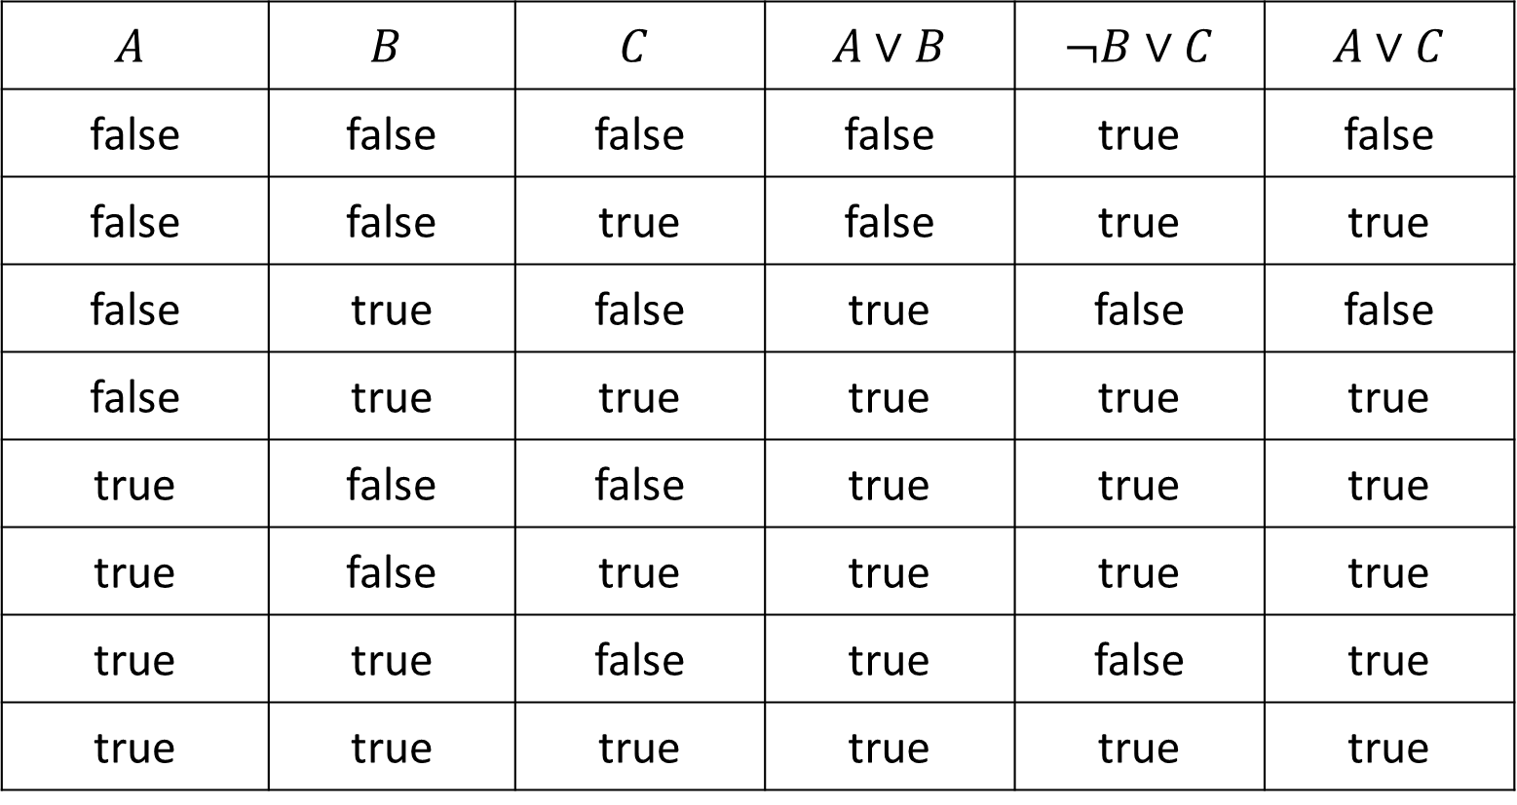

Piazza Poll 1
If we know that $A∨B$ and $¬A∨C$ are true, what do we know about $A∨C$?
$$A$$ | $$B$$ | $$C$$ | $A∨B$ | $¬B∨C$ | $A∨C$
false | false | false | false | true | false
false | false | true | false | true | true
false | true | false | true | false | false
false | true | true | true | true | true
true | false | false | true | true | true
true | false | true | true | true | true
true | true | false | true | false | true
true | true | true | true | true | true

Slide 20
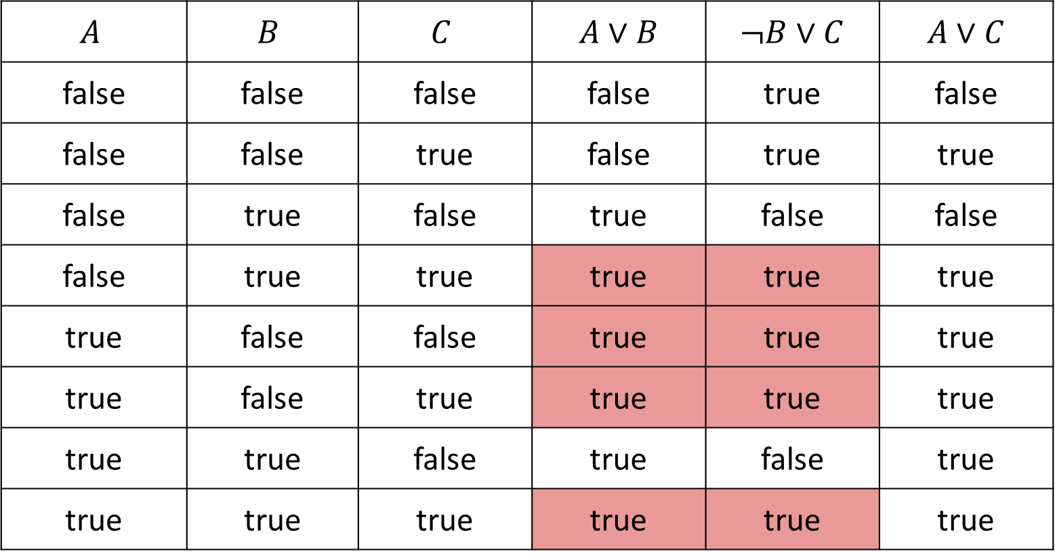

Piazza Poll 1
If we know that $A∨B$ and $¬A∨C$ are true, what do we know about $A∨C$?
$$A$$ | $$B$$ | $$C$$ | $A∨B$ | $¬B∨C$ | $A∨C$
false | false | false | false | true | false
false | false | true | false | true | true
false | true | false | true | false | false
false | true | true | true | true | true
true | false | false | true | true | true
true | false | true | true | true | true
true | true | false | true | false | true
true | true | true | true | true | true

Slide 21

Piazza Poll 2
If we know that $A∨B$ and $¬B∨C$ are true, what do we know about $A$?
$$A$$ | $$B$$ | $$C$$ | $A∨B$ | $¬B∨C$ | $A∨C$
false | false | false | false | true | false
false | false | true | false | true | true
false | true | false | true | false | false
false | true | true | true | true | true
true | false | false | true | true | true
true | false | true | true | true | true
true | true | false | true | false | true
true | true | true | true | true | true

Slide 22
Propositional Logic
Symbol:
Variable that can be true or false
We’ll try to use capital letters, e.g. A, B, P_{1,2}
Often include True and False
Operators:
¬ A: not A
A ∧ B: A and B (conjunction)
A ∨ B: A or B (disjunction) Note: this is not an “exclusive or”
A ⇒ B: A implies B (implication). If A then B
A ⇔ B: A if and only if B (biconditional)
Sentences

Slide 23
Propositional Logic Syntax
Given: a set of proposition symbols {X₁, X₂, …, X_{n}}
    (we often add True and False for convenience)
X_{i} is a sentence
If α is a sentence then ¬α is a sentence
If α and β are sentences then α ∧ β is a sentence
If α and β are sentences then α ∨ β is a sentence
If α and β are sentences then α ⇒ β is a sentence
If α and β are sentences then α ⇔ β is a sentence
And p.s. there are no other sentences!

Slide 24
Notes on Operators
𝛂 ∨ 𝛃 is inclusive or, not exclusive

Slide 25
Truth Tables
𝛂 ∨ 𝛃 is inclusive or, not exclusive
𝛂 | 𝛃 | 𝛂 ∧ 𝛃
F | F | F
F | T | F
T | F | F
T | T | T
𝛂 | 𝛃 | 𝛂 ∨ 𝛃
F | F | F
F | T | T
T | F | T
T | T | T

Slide 26
Notes on Operators
𝛂 ∨ 𝛃 is inclusive or, not exclusive
𝛂 ⇒ 𝛃 is equivalent to ¬𝛂 ∨ 𝛃
Says who?

Slide 27
Truth Tables
𝛂 ⇒ 𝛃 is equivalent to ¬𝛂 ∨ 𝛃
𝛂 | 𝛃 | 𝛂 ⇒ 𝛃 | ¬𝛂 | ¬𝛂 ∨ 𝛃
F | F | T | T | T
F | T | T | T | T
T | F | F | F | F
T | T | T | F | T

Slide 28
Notes on Operators
𝛂 ∨ 𝛃 is inclusive or, not exclusive
𝛂 ⇒ 𝛃 is equivalent to ¬𝛂 ∨ 𝛃
Says who?
𝛂 ⇔ 𝛃 is equivalent to (𝛂 ⇒ 𝛃) ∧ (𝛃 ⇒ 𝛂)
Prove it!

Slide 29

Truth Tables
𝛂 ⇔ 𝛃 is equivalent to (𝛂 ⇒ 𝛃) ∧ (𝛃 ⇒ 𝛂)
𝛂 | 𝛃 | 𝛂 ⇔ 𝛃 | 𝛂 ⇒ 𝛃 | 𝛃 ⇒ 𝛂 | (𝛂⇒𝛃) ∧ (𝛃⇒𝛂)
F | F | T | T | T | T
F | T | F | T | F | F
T | F | F | F | T | F
T | T | T | T | T | T
Equivalence: it’s true in all models. Expressed as a logical sentence:
(𝛂 ⇔ 𝛃) ⇔ [(𝛂 ⇒ 𝛃) ∧ (𝛃 ⇒ 𝛂)]

Slide 30
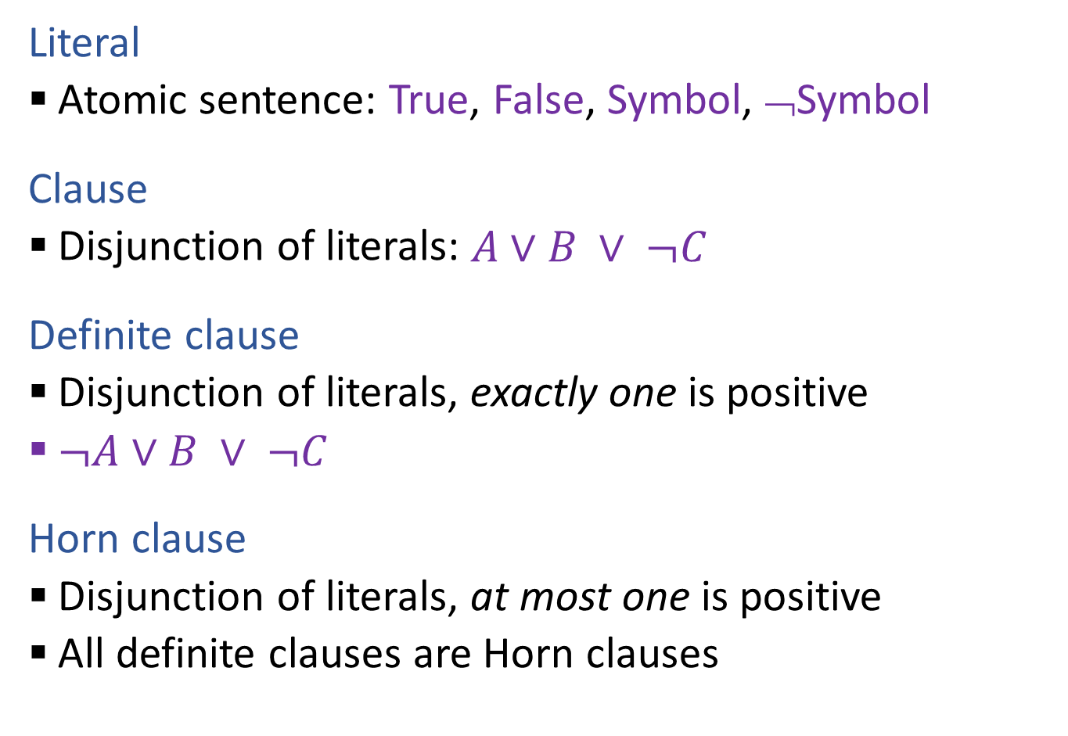

Propositional Logical Vocab
Literal
  Atomic sentence: True, False, Symbol, ¬Symbol
Clause
  Disjunction of literals: $A∨B ∨ ¬C$
Definite clause
  Disjunction of literals, exactly one is positive
  $¬A∨B ∨ ¬C$
Horn clause
  Disjunction of literals, at most one is positive
  All definite clauses are Horn clauses
Vocab Alert!

Slide 31

Propositional Logic
Check if sentence is true in given model
In other words, does the model satisfy the sentence?
function PL-TRUE?(α,model) returns true or false
if α is a symbol then return Lookup(α, model)
if Op(α) = ¬ then return not(PL-TRUE?(Arg1(α),model))
if Op(α) = ∧ then return and(PL-TRUE?(Arg1(α),model),
PL-TRUE?(Arg2(α),model))
etc.
(Sometimes called “recursion over syntax”)

Slide 32
Monty Python Inference
There are ways of telling whether she is a witch

Slide 33
Warm-up:
What is the relationship between number of constraints and number of possible solutions?
In other words, as the number of the constraints increases,
does the number of possible solutions:
Increase
Decrease
Stay the same
Where is the knowledge in our CSPs?
Notes:
0=7, R=4, W=6, U=2, T=8, F=1; 867 + 867 = 1734

Slide 34

Piazza Poll 3
What is the relationship between the size of the knowledge base and number of satisfiable models?
In other words, as the number of the knowledge base rules increases,
does the number of satisfiable models:
Increase
Decrease
Stay the same
Notes:
0=7, R=4, W=6, U=2, T=8, F=1; 867 + 867 = 1734

Slide 35

Piazza Poll 3
What is the relationship between the size of the knowledge base and number of satisfiable models?
In other words, as the number of the knowledge base rules increases,
does the number of satisfiable models:
Increase
Decrease
Stay the same
Notes:
0=7, R=4, W=6, U=2, T=8, F=1; 867 + 867 = 1734

Slide 36
Sentences as Constraints
Adding a sentence to our knowledge base constrains the
number of possible models:
KB: Nothing
Possible
Models
P | Q | R
false | false | false
false | false | true
false | true | false
false | true | true
true | false | false
true | false | true
true | true | false
true | true | true

Slide 37
Sentences as Constraints
Adding a sentence to our knowledge base constrains the
number of possible models:
KB: Nothing
KB: [(P ∧ ¬Q) ∨ (Q ∧ ¬P)] ⇒ R
Possible
Models
P | Q | R
false | false | false
false | false | true
false | true | false
false | true | true
true | false | false
true | false | true
true | true | false
true | true | true

Slide 38
Sentences as Constraints
Adding a sentence to our knowledge base constrains the
number of possible models:
KB: Nothing
KB: [(P ∧ ¬Q) ∨ (Q ∧ ¬P)] ⇒ R
KB: R, [(P ∧ ¬Q) ∨ (Q ∧ ¬P)] ⇒ R
Possible
Models
P | Q | R
false | false | false
false | false | true
false | true | false
false | true | true
true | false | false
true | false | true
true | true | false
true | true | true

Slide 39
Sherlock Entailment
“When you have eliminated the impossible, whatever remains, however improbable, must be the truth” – Sherlock Holmes via Sir Arthur Conan Doyle
(Not quite)
Knowledge base and inference allow us to remove impossible models, helping us to see what is true in all of the remaining models

Slide 40
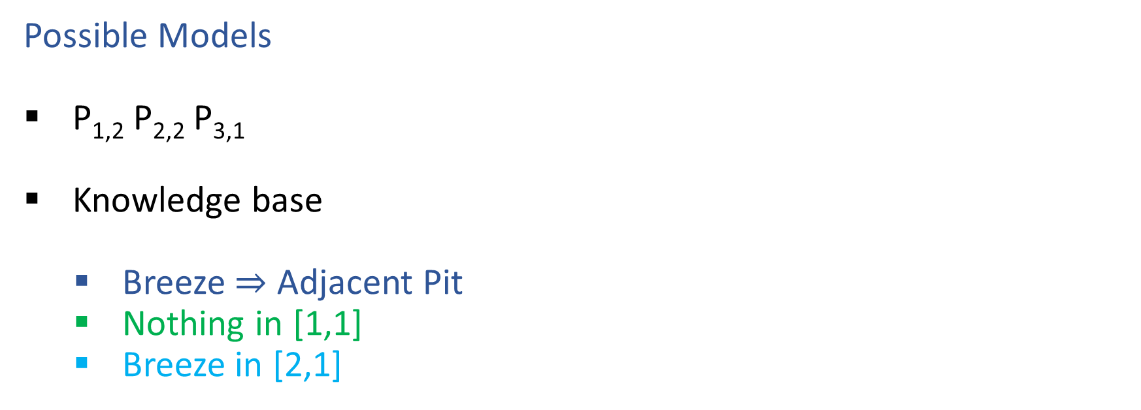

Wumpus World
Possible Models
P_{1,2} P_{2,2} P_{3,1}
Knowledge base
    Breeze $⇒$ Adjacent Pit
    Nothing in [1,1]
    Breeze in [2,1]

Slide 41
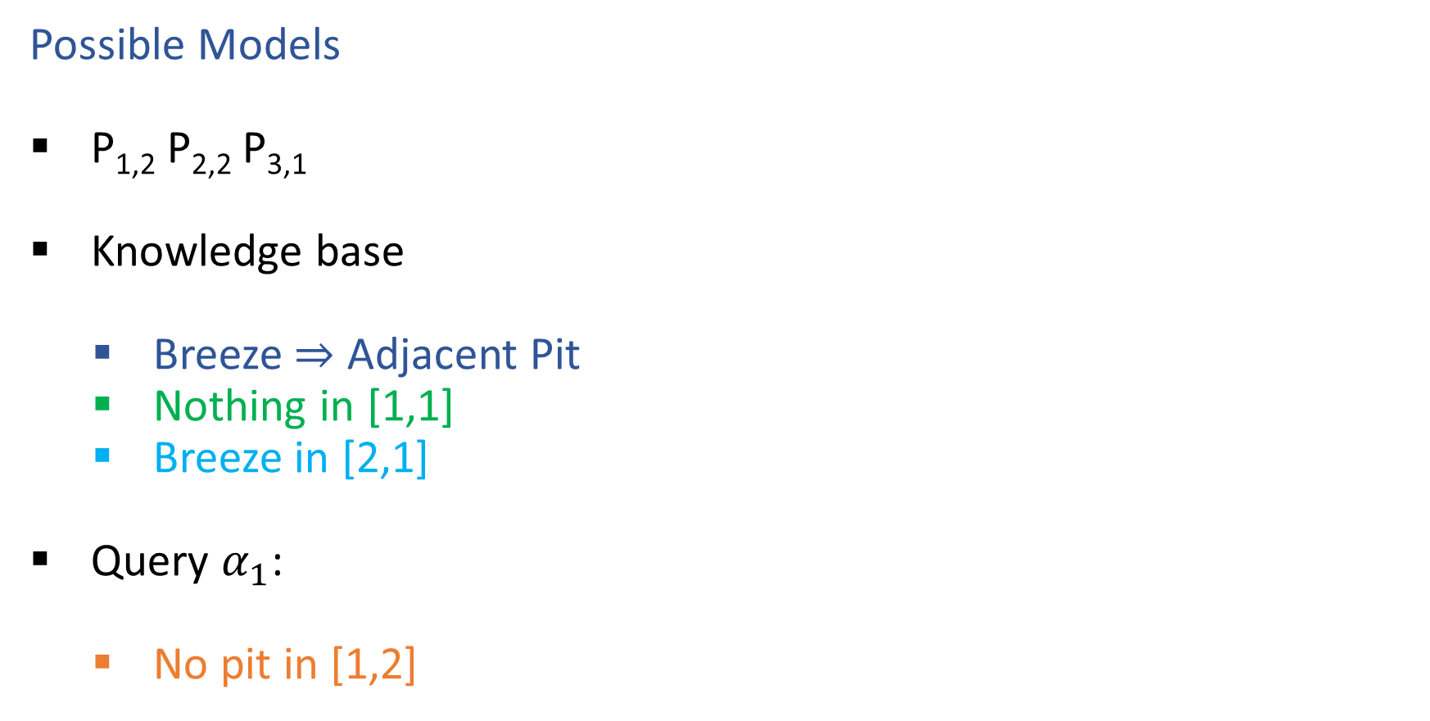
Wumpus World
Possible Models
P_{1,2} P_{2,2} P_{3,1}
Knowledge base
    Breeze $⇒$ Adjacent Pit
    Nothing in [1,1]
    Breeze in [2,1]
Query $α_{1}$:
    No pit in [1,2]

Slide 42
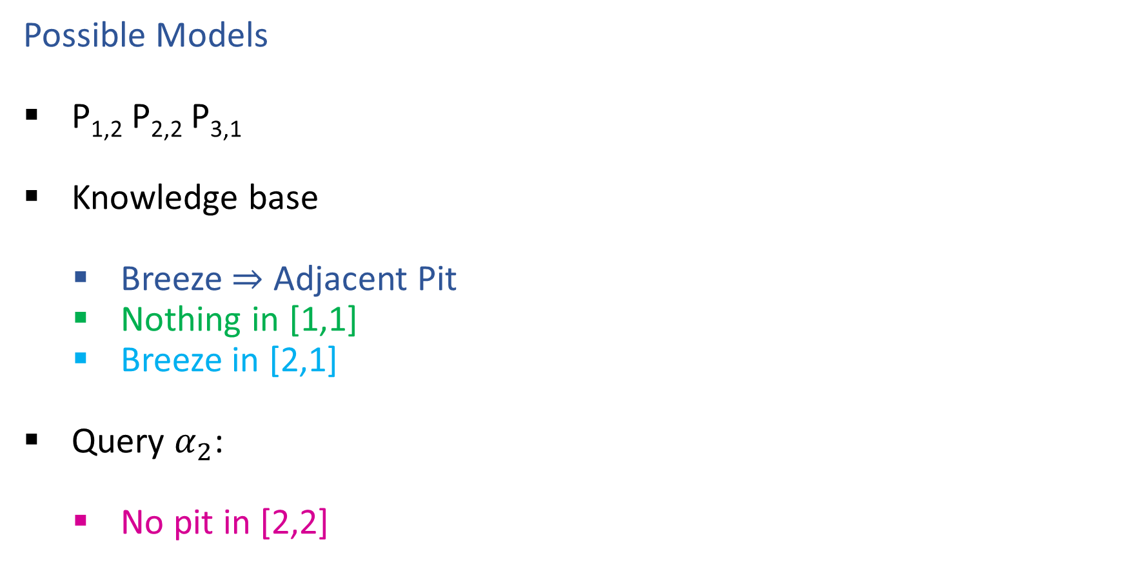
Wumpus World
Possible Models
P_{1,2} P_{2,2} P_{3,1}
Knowledge base
    Breeze $⇒$ Adjacent Pit
    Nothing in [1,1]
    Breeze in [2,1]
Query $α_{2}$:
    No pit in [2,2]

Slide 43

Entailment
Entailment: α |= β (“α entails β” or “β follows from α”) iff in every world where α is true, β is also true
    I.e., the α-worlds are a subset of the β-worlds [models(α) ⊆ models(β)]
Usually we want to know if KB |= query
  models(KB) ⊆ models(query)
  In other words
    KB removes all impossible models (any model where KB is false)
    If β is true in all of these remaining models, we conclude that β must be true
Entailment and implication are very much related
  However, entailment relates two sentences, while an implication is itself a sentence (usually derived via inference to show entailment)

Slide 44

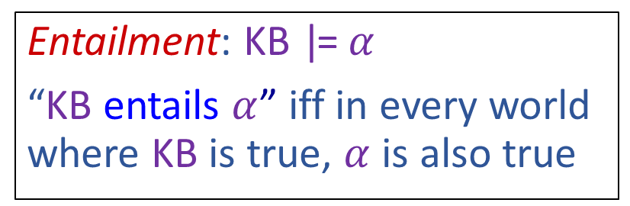
Wumpus World
Possible Models
P_{1,2} P_{2,2} P_{3,1}
Knowledge base
    Breeze $⇒$ Adjacent Pit
    Nothing in [1,1]
    Breeze in [2,1]
Entailment: KB |= $α$
“KB entails $α$” iff in every world where KB is true, $α$ is also true

Slide 45

Wumpus World
Possible Models
P_{1,2} P_{2,2} P_{3,1}
Knowledge base
    Breeze $⇒$ Adjacent Pit
    Nothing in [1,1]
    Breeze in [2,1]
Query $α_{1}$:
    No pit in [1,2]
Entailment: KB |= $α$
“KB entails $α$” iff in every world where KB is true, $α$ is also true

Slide 46

Wumpus World
Possible Models
P_{1,2} P_{2,2} P_{3,1}
Knowledge base
    Breeze $⇒$ Adjacent Pit
    Nothing in [1,1]
    Breeze in [2,1]
Query $α_{2}$:
    No pit in [2,2]
Entailment: KB |= $α$
“KB entails $α$” iff in every world where KB is true, $α$ is also true

Slide 47

Propositional Logic Models
All Possible Models
A | 0 | 0 | 0 | 0 | 1 | 1 | 1 | 1
B | 0 | 0 | 1 | 1 | 0 | 0 | 1 | 1
C | 0 | 1 | 0 | 1 | 0 | 1 | 0 | 1
Model Symbols

Slide 48
Piazza Poll 4
Entailment: α |= β
“α entails β” iff in every world where α is true, β is also true
Does the KB entail query C?
All Possible Models
A | 0 | 0 | 0 | 0 | 1 | 1 | 1 | 1
B | 0 | 0 | 1 | 1 | 0 | 0 | 1 | 1
C | 0 | 1 | 0 | 1 | 0 | 1 | 0 | 1
A | 0 | 0 | 0 | 0 | 1 | 1 | 1 | 1
B⇒C | 1 | 1 | 0 | 1 | 1 | 1 | 0 | 1
A⇒B∨C | 1 | 1 | 1 | 1 | 0 | 1 | 1 | 1
C | 0 | 1 | 0 | 1 | 0 | 1 | 0 | 1
Model Symbols
Knowledge Base
Query

Slide 49
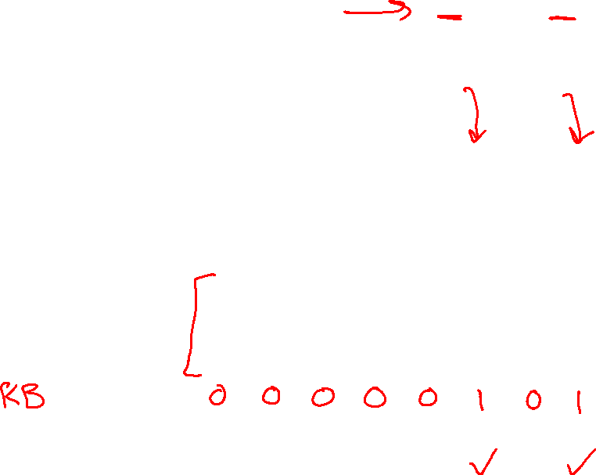

Piazza Poll 4
Entailment: α |= β
“α entails β” iff in every world where α is true, β is also true
Does the KB entail query C?
All Possible Models
A | 0 | 0 | 0 | 0 | 1 | 1 | 1 | 1
B | 0 | 0 | 1 | 1 | 0 | 0 | 1 | 1
C | 0 | 1 | 0 | 1 | 0 | 1 | 0 | 1
A | 0 | 0 | 0 | 0 | 1 | 1 | 1 | 1
B⇒C | 1 | 1 | 0 | 1 | 1 | 1 | 0 | 1
A⇒B∨C | 1 | 1 | 1 | 1 | 0 | 1 | 1 | 1
C | 0 | 1 | 0 | 1 | 0 | 1 | 0 | 1
Model Symbols
Knowledge Base
Query

Slide 50
Entailment
How do we implement a logical agent that proves entailment?
  Logic language
    Propositional logic
    First order logic
  Knowledge Base
    Add known logical rules and facts
  Inference algorithms
    Theorem proving
    Model checking

Slide 51
Simple Model Checking
function TT-ENTAILS?(KB, α) returns true or false

Slide 52
Simple Model Checking, contd.
Same recursion as backtracking
P₁=true
P₁=false
P₂=true
P₂=false
P_{n}=true
P_{n}=false
KB?
α?
11111…1
0000…0

Slide 53
Simple Model Checking
function TT-ENTAILS?(KB, α) returns true or false
return TT-CHECK-ALL(KB, α, symbols(KB) U symbols(α),{})
function TT-CHECK-ALL(KB, α, symbols,model) returns true or false
if empty?(symbols) then
if PL-TRUE?(KB, model) then return PL-TRUE?(α, model)
else return true
else
P ← first(symbols)
rest ← rest(symbols)
return and (TT-CHECK-ALL(KB, α, rest, model ∪ {P = true})
TT-CHECK-ALL(KB, α, rest, model ∪ {P = false }))

Slide 54
Simple Model Checking, contd.
Same recursion as backtracking
O(2^{n}) time, linear space
Can we do better?
P₁=true
P₁=false
P₂=true
P₂=false
P_{n}=true
P_{n}=false
KB?
α?
11111…1
0000…0

Slide 55

Inference: Proofs
A proof is a demonstration of entailment between α and β
Method 1: model-checking
  For every possible world, if α is true make sure that is β true too
  OK for propositional logic (finitely many worlds); not easy for first-order logic
Method 2: theorem-proving
  Search for a sequence of proof steps (applications of inference rules) leading from α to β
  E.g., from P ∧ (P ⇒ Q), infer Q by Modus Ponens
Properties
Sound algorithm: everything it claims to prove is in fact entailed
Complete algorithm: every sentence that is entailed can be proved

Slide 56

Simple Theorem Proving: Forward Chaining
Forward chaining applies Modus Ponens to generate new facts:
  Given X₁ ∧ X₂ ∧ … X_{n} ⇒ Y and X₁, X₂, …, X_{n}
  Infer Y
Forward chaining keeps applying this rule, adding new facts, until nothing more can be added
Requires KB to contain only definite clauses:
  (Conjunction of symbols) ⇒ symbol; or
  A single symbol (note that X is equivalent to True ⇒ X)

Slide 57
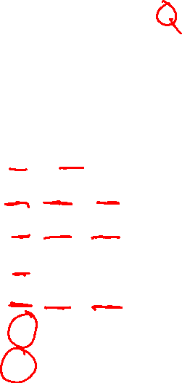
Forward Chaining Algorithm
function PL-FC-ENTAILS?(KB, q) returns true or false
Clauses
P ⇒ Q
L ∧ M ⇒ P
B ∧ L ⇒ M
A ∧ P ⇒ L
A ∧ B ⇒ L
A
B

Slide 58

Forward Chaining Algorithm
function PL-FC-ENTAILS?(KB, q) returns true or false
count ← a table, where count[c] is the number of symbols in c’s premise
inferred ← a table, where inferred[s] is initially false for all s
agenda ← a queue of symbols, initially symbols known to be true in KB
Clauses
Count
Inferred
Agenda
P ⇒ Q
L ∧ M ⇒ P
B ∧ L ⇒ M
A ∧ P ⇒ L
A ∧ B ⇒ L
A
B
1
2
2
2
2
0
0
A false
B false
L false
M false
P false
Q false

Slide 59
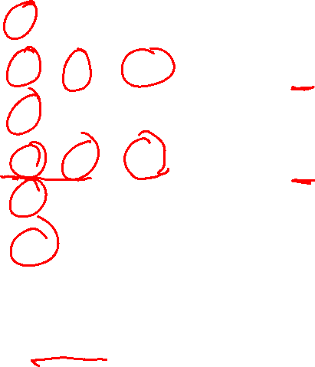
Forward Chaining Example: Proving Q
Clauses
Count
Inferred
1
2
2
2
2
0
0
A false
B false
L false
M false
P false
Q false
P ⇒ Q
L ∧ M ⇒ P
B ∧ L ⇒ M
A ∧ P ⇒ L
A ∧ B ⇒ L
A
B
// 0
xxxx true
// 1
xxxx true
// 0
// 0
xxxx true
// 1
// 0
xxxx true
// 1
xxxx true
// 0
// 1
xxxx true
Agenda
x
x
Q
x
L
x
x
x
M
P
A B
x
L

Slide 60
Forward Chaining Algorithm
function PL-FC-ENTAILS?(KB, q) returns true or false
count ← a table, where count[c] is the number of symbols in c’s premise
inferred ← a table, where inferred[s] is initially false for all s
agenda ← a queue of symbols, initially symbols known to be true in KB
while agenda is not empty do
p ← Pop(agenda)
if p = q then return true
if inferred[p] = false then
inferred[p]←true
for each clause c in KB where p is in c.premise do
decrement count[c]
if count[c] = 0 then add c.conclusion to agenda
return false

Slide 61
Properties of forward chaining
Theorem: FC is sound and complete for definite-clause KBs
Soundness: follows from soundness of Modus Ponens (easy to check)
Completeness proof:
1. FC reaches a fixed point where no new atomic sentences are derived
2. Consider the final inferred table as a model m, assigning true/false to symbols
3. Every clause in the original KB is true in m
Proof: Suppose a clause a₁∧... ∧a_{k} ⇒ b is false in m
Then a₁∧... ∧a_{k} is true in m and b is false in m
Therefore the algorithm has not reached a fixed point!
4. Hence m is a model of KB
5. If KB |= q, q is true in every model of KB, including m
A false
B false
L false
M false
P false
Q false
xxxx true
xxxx true
xxxx true
xxxx true
xxxx true
xxxx true

Slide 62

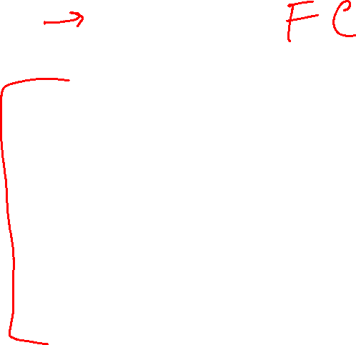
Inference Rules
Modus Ponens
$\frac{α⇒β, α}{β}$
Unit Resolution
$\frac{a∨b, ¬b∨c}{a∨c}$
General Resolution
$\frac{a_{1}∨…∨a_{m}∨b, ¬b∨c_{1}∨…∨c_{n}}{a_{1}∨…∨a_{m}∨c_{1}∨…∨c_{n}}$
Notation Alert!

Slide 63
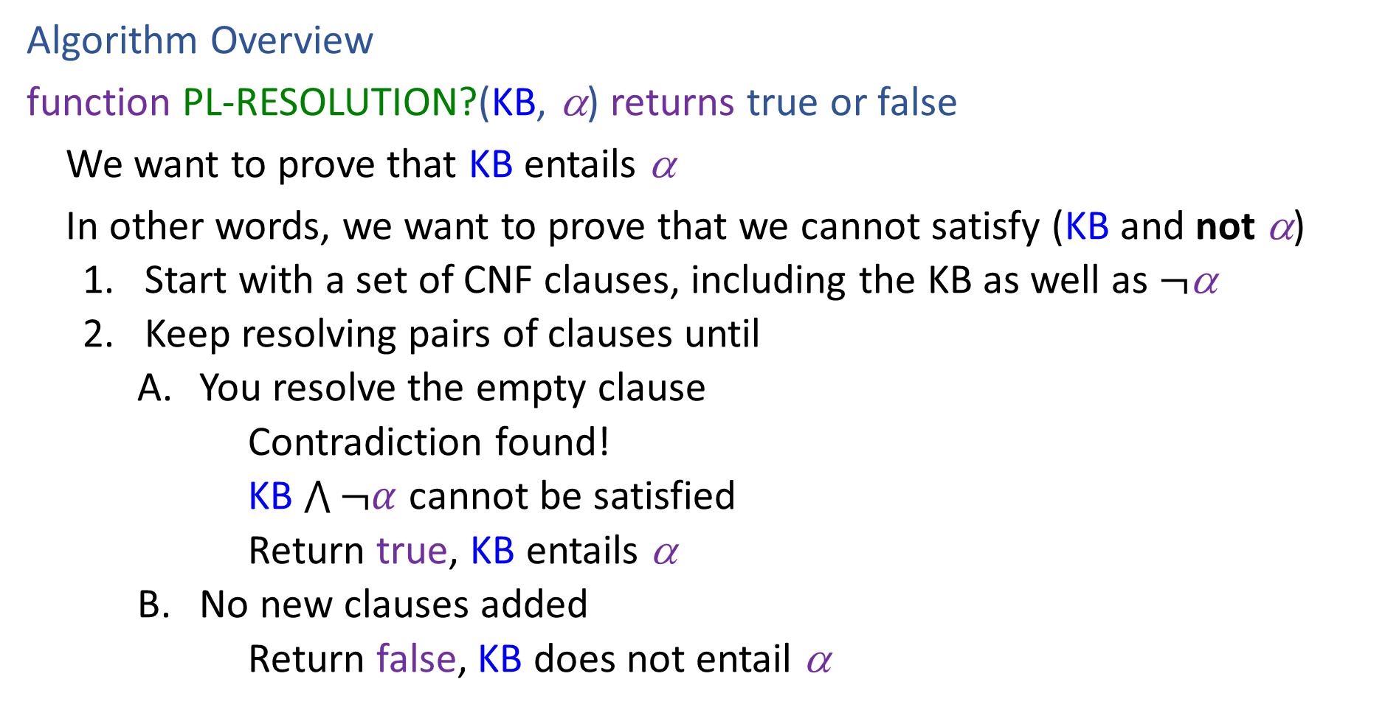
Resolution
Algorithm Overview
function PL-RESOLUTION?(KB, α) returns true or false
We want to prove that KB entails α
In other words, we want to prove that we cannot satisfy (KB and not α)
    Start with a set of CNF clauses, including the KB as well as $¬$α
    Keep resolving pairs of clauses until
        You resolve the empty clause
        Contradiction found!
        KB $\bigwedge{¬α}$ cannot be satisfied
        Return true, KB entails α
        No new clauses added
        Return false, KB does not entail α

Slide 64
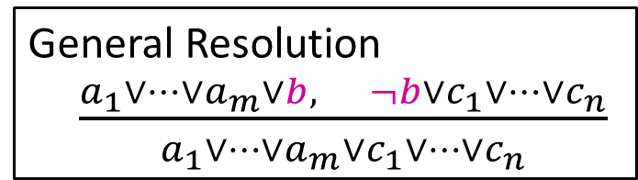






Resolution
General Resolution
$\frac{a_{1}∨…∨a_{m}∨b, ¬b∨c_{1}∨…∨c_{n}}{a_{1}∨…∨a_{m}∨c_{1}∨…∨c_{n}}$
Example trying to prove $¬P_{1,2}$
Knowledge Base
$$¬P_{2,1}∨B_{1,1}$$
$$¬B_{1,1}∨P_{1,2}∨P_{2,1}$$
$$¬P_{1,2}∨B_{1,1}$$
$$¬B_{1,1}$$
$$¬¬P_{1,2}$$

Slide 65







Resolution
General Resolution
$\frac{a_{1}∨…∨a_{m}∨b, ¬b∨c_{1}∨…∨c_{n}}{a_{1}∨…∨a_{m}∨c_{1}∨…∨c_{n}}$
Example trying to prove $¬P_{1,2}$
Knowledge Base
$$¬P_{2,1}∨B_{1,1}$$
$$¬B_{1,1}∨P_{1,2}∨P_{2,1}$$
$$¬P_{1,2}∨B_{1,1}$$
$$¬B_{1,1}$$
$$P_{1,2}$$
$$¬B_{1,1}∨P_{1,2}∨B_{1,1}$$
$$P_{1,2}∨P_{2,1}∨¬P_{2,1}$$
$$¬B_{1,1}∨P_{2,1}∨B_{1,1}$$
$$P_{1,2}∨P_{2,1}∨¬P_{1,2}$$
$$¬P_{2,1}$$
$$¬P_{1,2}$$

Slide 66
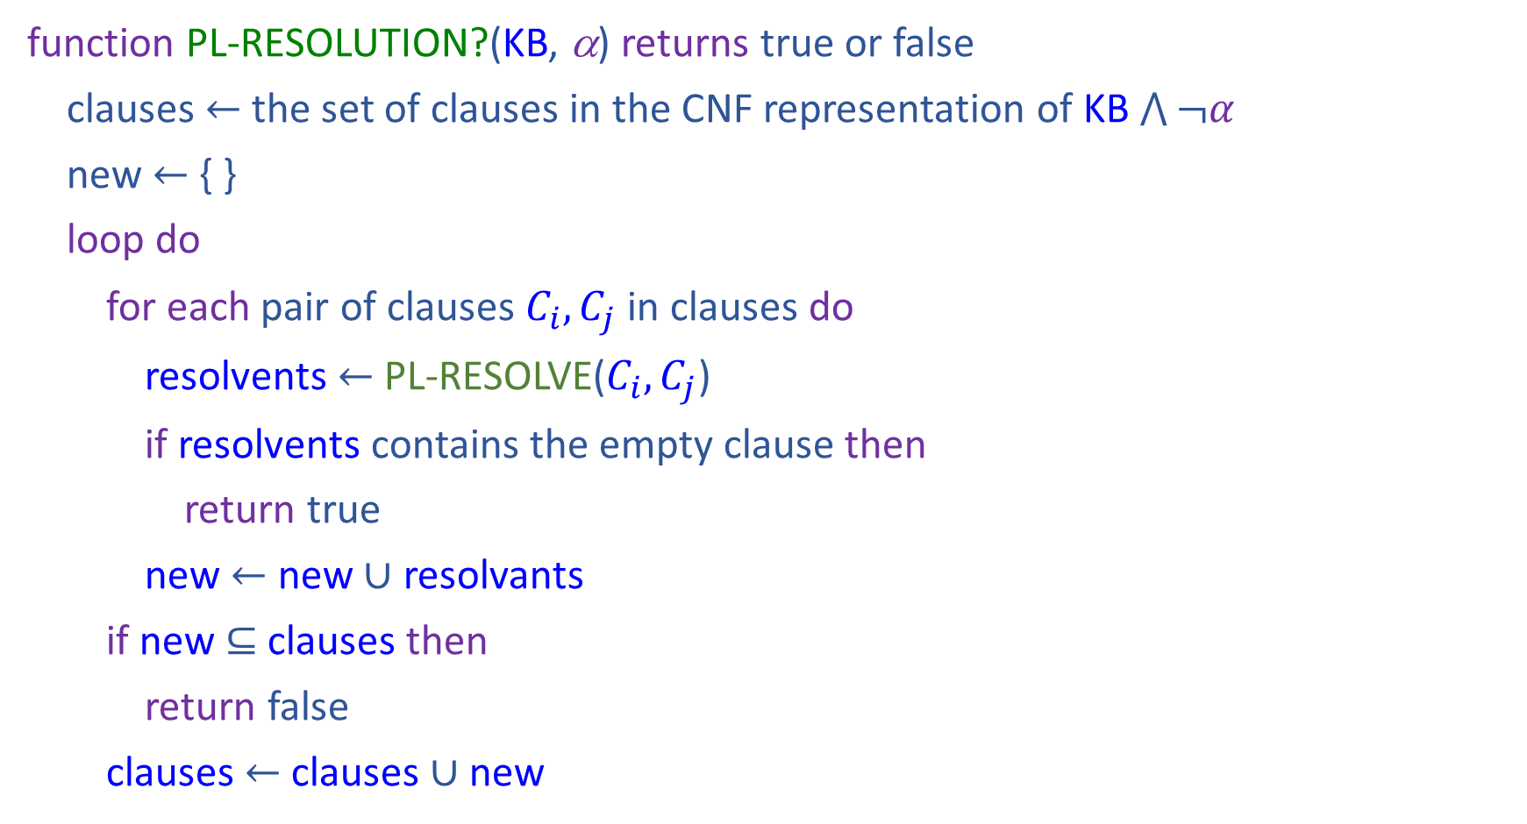
Resolution
function PL-RESOLUTION?(KB, α) returns true or false
clauses $←$ the set of clauses in the CNF representation of KB $\bigwedge{¬α}$
new $←${ }
loop do
for each pair of clauses $C_{i}, C_{j}$ in clauses do
resolvents $←$ PL-RESOLVE($C_{i}, C_{j}$)
if resolvents contains the empty clause then
return true
new $←$ new $∪$ resolvants
if new $⊆$ clauses then
return false
clauses $←$ clauses $∪$ new

Slide 67
Properties
Forward Chaining is:
Sound and complete for definite-clause KBs
Complexity: linear time
Resolution is:
Sound and complete for any PL KBs!
Complexity: exponential time ☹

