Slide 1
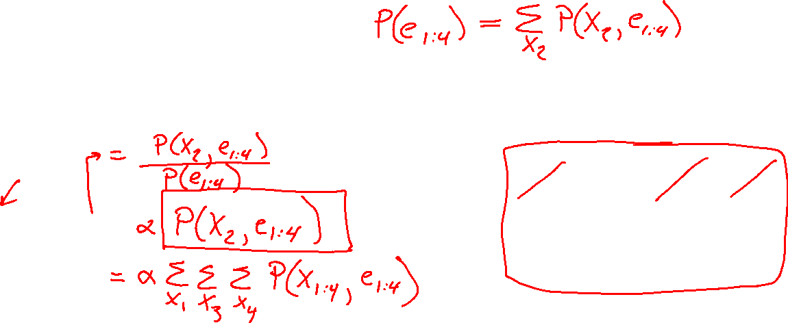
Warm-up as you walk in
For the following Bayes net, write the query P(X₂ | e_{1:4}) in terms of the conditional probability tables associated with the Bayes net.
P(X₂ | e₁,e₂,e₃,e₄) =
X₁
X₂
X₃
X₄
e₁
e₂
e₃
e₄

Slide 2
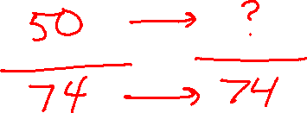
Announcements
Assignments
HW10
    Due Wed 11/20
P5
    Due Mon 11/25
HW11
    Out tonight
    Due Tue 11/28 Wed 11/27
In-class Polls
Denominator capped after 11/14 lecture, 74 polls

Slide 3

AI: Representation and Problem Solving
HMMs and Particle Filters
Instructors: Pat Virtue & Fei Fang
Slide credits: CMU AI and http://ai.berkeley.edu

Slide 4
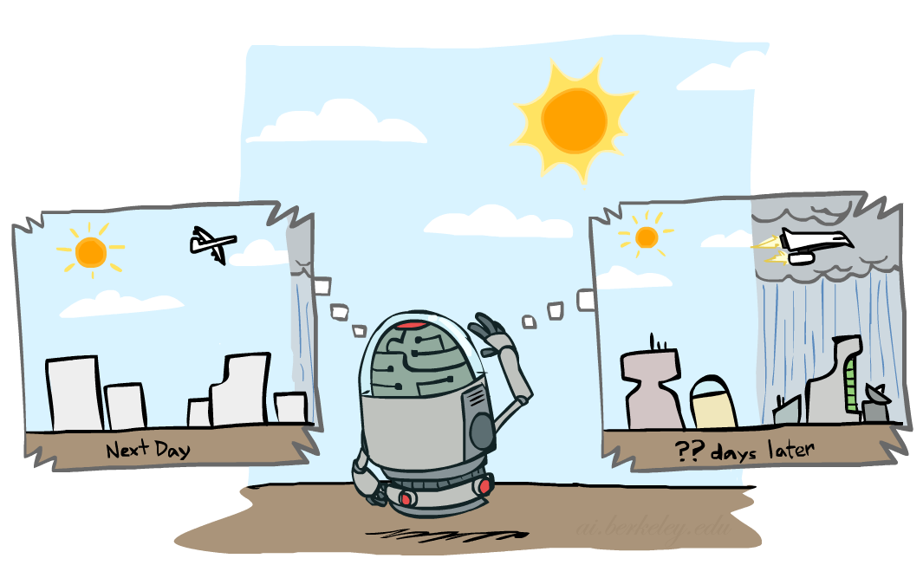
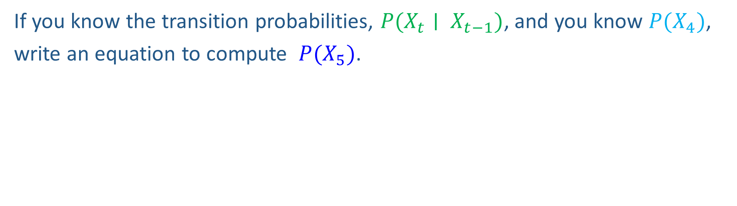
Markov chain warm-up
X₁
X₂
X₃
X₄
If you know the transition probabilities, $P(X_{t}∣ X_{t−1})$, and you know $P(X_{4})$,
write an equation to compute $P(X_{5})$.

Slide 5
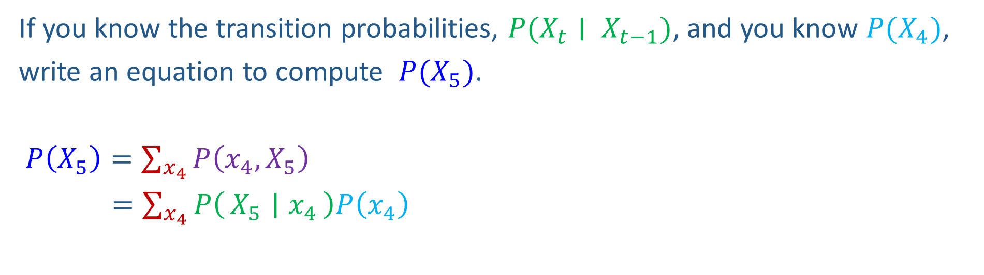
Markov chain warm-up
X₁
X₂
X₃
X₄
If you know the transition probabilities, $P(X_{t}∣ X_{t−1})$, and you know $P(X_{4})$,
write an equation to compute $P(X_{5})$.
$P\left(X_{5}\right)=\sum_{x_{4}}{P\left(x_{4},X_{5}\right)}$
$=\sum_{x_{4}}{P\left(X_{5} ∣ x_{4}\right)P\left(x_{4}\right)}$

Slide 6
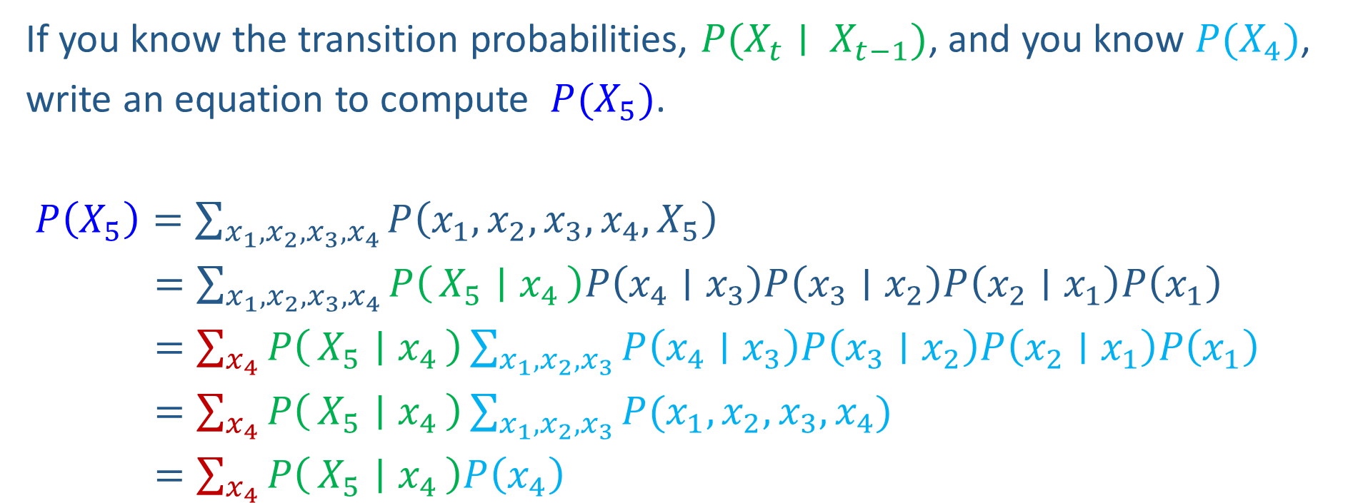

Markov chain warm-up
X₁
X₂
X₃
X₄
If you know the transition probabilities, $P(X_{t}∣ X_{t−1})$, and you know $P(X_{4})$,
write an equation to compute $P(X_{5})$.
$P\left(X_{5}\right)=\sum_{{x_{1},x_{2}, x_{3},x}_{4}}{P\left({x_{1},x_{2},x_{3},x}_{4},X_{5}\right)}$
$=\sum_{{x_{1},x_{2}, x_{3},x}_{4}}{P\left(X_{5} ∣ x_{4}\right)P\left(x_{4}∣x_{3}\right)P\left(x_{3}∣x_{2}\right)P\left(x_{2}∣x_{1}\right)P\left(x_{1}\right)}$
$=\sum_{x_{4}}{P\left(X_{5} ∣ x_{4}\right)}\sum_{x_{1},x_{2}, x_{3}}{P\left(x_{4}∣x_{3}\right)P\left(x_{3}∣x_{2}\right)P\left(x_{2}∣x_{1}\right)P\left(x_{1}\right)}$
$=\sum_{x_{4}}{P\left(X_{5} ∣ x_{4}\right)}\sum_{x_{1},x_{2}, x_{3}}{P(x_{1},x_{2},x_{3},x_{4})}$
$=\sum_{x_{4}}{P\left(X_{5} ∣ x_{4}\right)P\left(x_{4}\right)}$

Slide 7
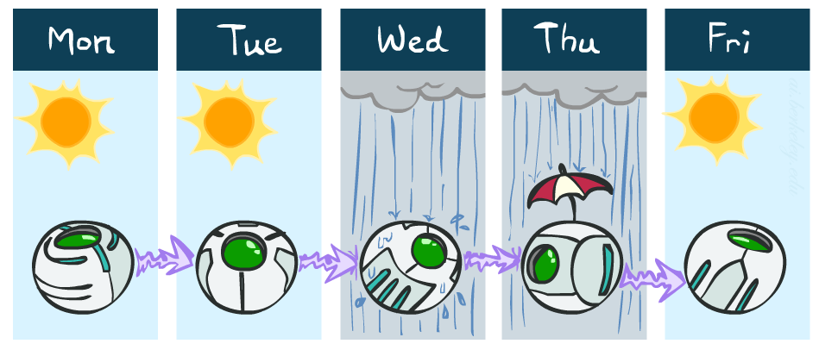
Weather prediction
States {rain, sun}
Initial distribution P(X₀)
  Transition model P(X_{t} | X_{t-1})
P(X₀)
sun | rain
0.5 | 0.5
Two new ways of representing the same CPT
0.9
0.3
0.9
X_{t-1} | P(X_{t}|X_{t-1})
 | sun | rain
sun | 0.9 | 0.1
rain | 0.3 | 0.7
rain
sun
sun
sun
0.1
0.3
rain
rain
0.7
0.7
0.1

Slide 8
Weather prediction
X_{t-1} | P(X_{t}|X_{t-1})
 | sun | rain
sun | 0.9 | 0.1
rain | 0.3 | 0.7
Time 0: P(X₀) =<0.5,0.5>
What is the weather like at time 1?
  P(X₁) =
∑_{x0} P(X₀=x_{0,} X₁)
  = ∑_{x0} P(X₁| X₀=x₀) P(X₀=x₀)
  = 0.5<0.9,0.1> + 0.5<0.3,0.7>
  = <0.6,0.4>
X₀
X₁

Slide 9
Weather prediction, contd.
X_{t-1} | P(X_{t}|X_{t-1})
 | sun | rain
sun | 0.9 | 0.1
rain | 0.3 | 0.7
Time 1: P(X₁) =<0.6,0.4>
What is the weather like at time 2?
  P(X₂) =
∑_{x1} P(X₁=x₁, X₂)
  = ∑_{x1} P(X₂| X₁=x₁) P(X₁=x₁)
  = 0.6<0.9,0.1> + 0.4<0.3,0.7>
  = <0.66,0.34>
X₀
X₁
X₂

Slide 10
Weather prediction, contd.
X_{t-1} | P(X_{t}|X_{t-1})
 | sun | rain
sun | 0.9 | 0.1
rain | 0.3 | 0.7
Time 2: P(X₂) =<0.66,0.34>
What is the weather like at time 3?
  P(X₃) =
∑_{x2} P(X₂=x₂, X₃)
  = ∑_{x2} P(X₃| X₂=x₂) P(X₂=x₂)
  = 0.66<0.9,0.1> + 0.34<0.3,0.7>
  = <0.696,0.304>
X₁
X₂
X₃

Slide 11
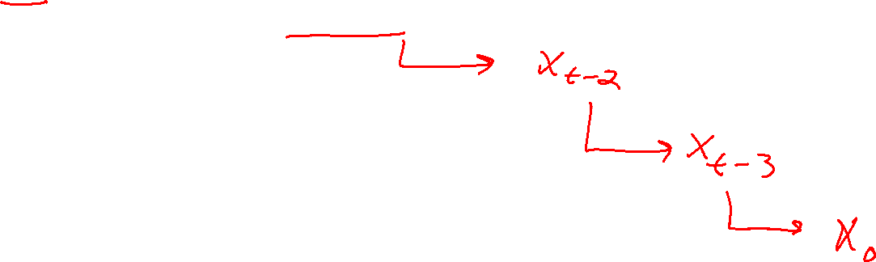
Forward algorithm (simple form)
Probability from previous iteration
What is the state at time t?
  P(X_{t}) = ∑_{xt-1} P(X_{t-1}=x_{t-1}, X_{t})
  = ∑_{xt-1} P(X_{t}| X_{t-1}=x_{t-1}) P(X_{t-1}=x_{t-1})
Iterate this update starting at t=0
Transition model

Slide 12

Hidden Markov Models

Slide 13
HMM as a Bayes Net Warm-up
For the following Bayes net, write the query P(X₂ | e_{1:4}) in terms of the conditional probability tables associated with the Bayes net.
P(X₂ | e₁,e₂,e₃,e₄) =
X₁
X₂
X₃
X₄
e₁
e₂
e₃
e₄

Slide 14
HMM as a Bayes Net Warm-up
For the following Bayes net, write the query P(X₄ | e_{1:4}) in terms of the conditional probability tables associated with the Bayes net.
P(X₄ | e₁,e₂,e₃,e₄) =
X₁
X₂
X₃
X₄
e₁
e₂
e₃
e₄

Slide 15
Hidden Markov Models
Usually the true state is not observed directly
Hidden Markov models (HMMs)
  Underlying Markov chain over states X
  You observe evidence E at each time step
  X_{t} is a single discrete variable; E_{t} may be continuous and may consist of several variables
X₀
X₁
X₂
X₃
X₅
E₁
E₂
E₃
E₅

Slide 16


Example: Weather HMM
An HMM is defined by:
  Initial distribution: P(X₀)
  Transition model: P(X_{t} | X_{t-1})
  Sensor model: P(E_{t} | X_{t})
W_{t-1} | P(W_{t}|W_{t-1})
 | sun | rain
sun | 0.9 | 0.1
rain | 0.3 | 0.7
Weather _{t-1}
Weather _{t}
Weather _{t+1}
W_{t} | P(U_{t}|W_{t})
 | true | false
sun | 0.2 | 0.8
rain | 0.9 | 0.1
Umbrella _{t-1}
Umbrella _{t}
Umbrella _{t+1}
Notes:
demo

Slide 17

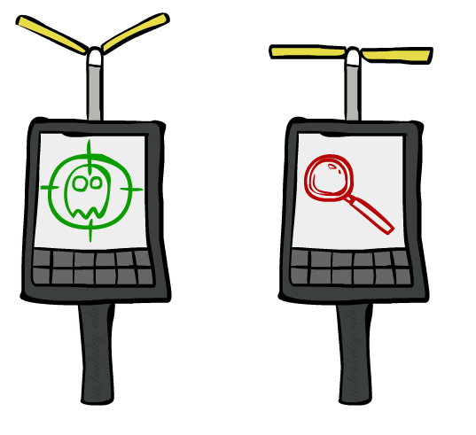
Example: Ghostbusters HMM
  State: location of moving ghost
  Observations: Color recorded by ghost sensor at clicked squares
  P(X₀) = uniform
  P(X_{t} | X_{t-1}) = usually move clockwise, but sometimes move randomly or stay in place
P(C_{tij} | X_{t}) = same sensor model as before:
red means close, green means far away.
1/6
1/6
1/2
0
1/6
0
0
0
0
1/9
1/9
1/9
1/9
1/9
1/9
P( X₂ | X₁=(2,3) )
1/9
1/9
1/9
P(X₁)
X₀
X₁
X₂
X₃
X₅
C_{1ij}
C_{2ij}
C_{3ij}
[Demo: Ghostbusters – Circular Dynamics – HMM (L14D2)]
Notes:
Dan has some demo for this.

Slide 18

HMM as Probability Model
  Joint distribution for Markov model:
  P(X₀,…, X_{T}) = P(X₀) ∏_{t=1:T} P(X_{t} | X_{t-1})
  Joint distribution for hidden Markov model:
  P(X₀, X₁,E₁, …, X_{T},E_{T}) = P(X₀) ∏_{t=1:T} P(X_{t} | X_{t-1}) P(E_{t} | X_{t})
  Future states are independent of the past given the present
  Current evidence is independent of everything else given the current state
  Are evidence variables independent of each other?
X₀
X₁
X₂
X₃
X₅
Useful notation: X_{a:b} = X_{a} , X_{a+1}, …, X_{b}
For example: P(X_{1:2} | e_{1:3}) = P(X₁, X₂, | e₁ , e₂, e₃)
E₁
E₂
E₃
E₅
Notes:
Add conditional independence consequences here

Slide 19
Other HMM Queries
Filtering: P(X_{t}|e_{1:t})
Prediction: P(X_{t+k}|e_{1:t})
X₁
X₂
X₃
X₄
X₁
X₂
X₃
X₄
X₅
e₁
e₂
e₃
e₄
e₁
e₂
e₃
Smoothing: P(X_{k}|e_{1:t}), k<t
Explanation: P(X_{1:t}|e_{1:t})
X₁
X₂
X₃
X₄
X₁
X₂
X₃
X₄
e₁
e₂
e₃
e₄
e₁
e₂
e₃
e₄

Slide 20
Inference Tasks
Filtering: P(X_{t}|e_{1:t})
  belief state—input to the decision process of a rational agent
Prediction: P(X_{t+k}|e_{1:t}) for k > 0
  evaluation of possible action sequences; like filtering without the evidence
Smoothing: P(X_{k}|e_{1:t}) for 0 ≤ k < t
  better estimate of past states, essential for learning
Most likely explanation: argmax_{x1:t} P(x_{1:t} | e_{1:t})
  speech recognition, decoding with a noisy channel

Slide 21
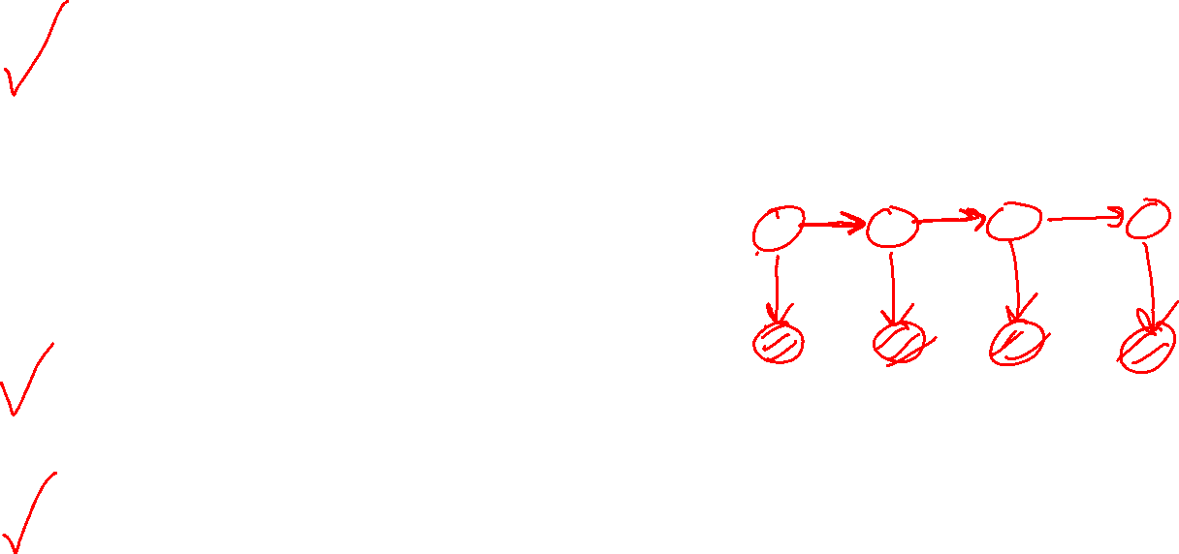
Real HMM Examples
Speech recognition HMMs:
  Observations are acoustic signals (continuous valued)
  States are specific positions in specific words (so, tens of thousands)
Machine translation HMMs:
  Observations are words (tens of thousands)
  States are translation options
Robot tracking:
  Observations are range readings (continuous)
  States are positions on a map (continuous)
Molecular biology:
  Observations are nucleotides ACGT
  States are coding/non-coding/start/stop/splice-site etc.

Slide 22


Danielle Belgrave, Microsoft Research
https://www.microsoft.com/en-us/research/people/dabelgra/
Developmental Profiles of Eczema, Wheeze, and Rhinitis:
Two Population-Based Birth Cohort Studies
Danielle Belgrave, et al. PLOS Medicine, 2014
https://journals.plos.org/plosmedicine/article?id=10.1371/journal.pmed.1001748

Slide 23
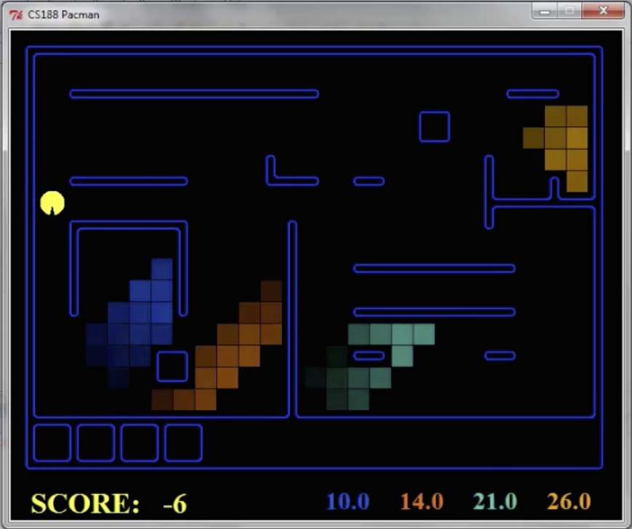
Pacman – Hunting Invisible Ghosts with Sonar
[Demo: Pacman – Sonar – No Beliefs(L14D1)]

Slide 24

Filtering Algorithm
P(X_{t+1}|e_{1:t+1}) = α P(e_{t+1}|X_{t+1}) ∑_{xt} P(X_{t+1}| x_{t}) P(x_{t} | e_{1:t})
f_{1:t+1} = Forward(f_{1:t} , e_{t+1})
Normalize
Update
Predict

Slide 25
Filtering Algorithm
Query: What is the current state, given all of the current and past evidence?
Marching forward through the HMM network
X₁
X₂
e₁
e₂

Slide 26
Filtering Algorithm
Query: What is the current state, given all of the current and past evidence?
Marching forward through the HMM network
X₁
X₂
X₃
e₁
e₂
e₃

Slide 27
Filtering Algorithm
Query: What is the current state, given all of the current and past evidence?
Marching forward through the HMM network
X₁
X₂
X₃
X₄
e₁
e₂
e₃
e₄

Slide 28
Filtering Algorithm
Query: What is the current state, given all of the current and past evidence?
Marching forward through the HMM network
X₁
X₂
X₃
X₄
e₁
e₂
e₃
e₄

Slide 29



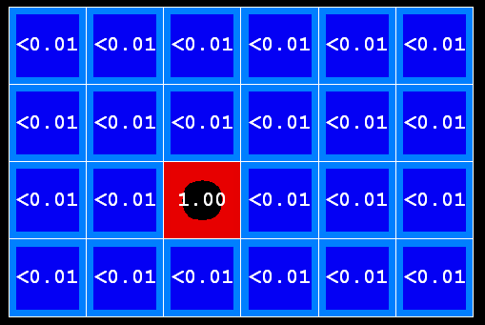
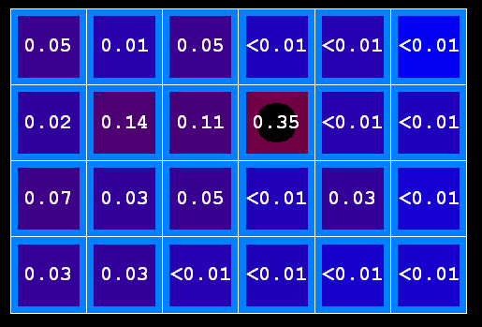
Example: Prediction step
As time passes, uncertainty “accumulates”
(Transition model: ghosts usually go clockwise)
T = 1
T = 2
T = 5

Slide 30


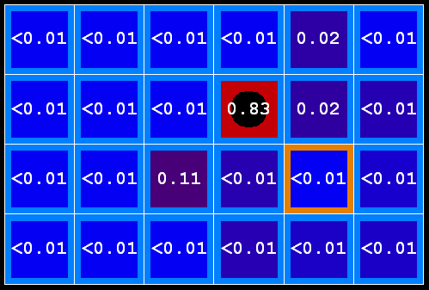
Example: Update step
As we get observations, beliefs get reweighted, uncertainty “decreases”
Before observation
After observation

Slide 31
Demo Ghostbusters – Circular Dynamics -- HMM

Slide 32
Filtering Algorithm
P(X_{t+1}|e_{1:t+1}) = α P(e_{t+1}|X_{t+1}) ∑_{xt} P(X_{t+1}| x_{t}) P(x_{t} | e_{1:t})
Normalize
Update
Predict

Slide 33
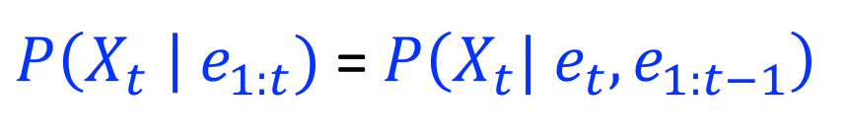
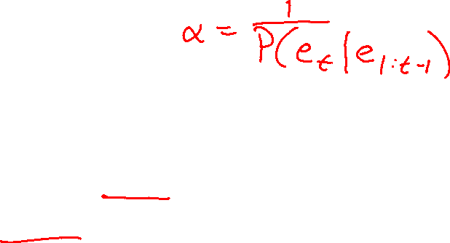


Filtering Algorithm
Query: What is the current state, given all of the current and past evidence?
Matching math with Bayes net
$P\left(X_{t} \right| e_{1:t})$ =$P\left(X_{t}{| e_{t}, e}_{1:t−1}\right)$
X₁
X₂
X₃
X₄
$$=α P\left(X_{t}, {e_{t}| e}_{1:t−1}\right)$$
e₁
e₂
e₃
e₄
Def. of cond. probability with $X_{t}$, $e_{t}$
Notes:
Explain propto

Slide 34
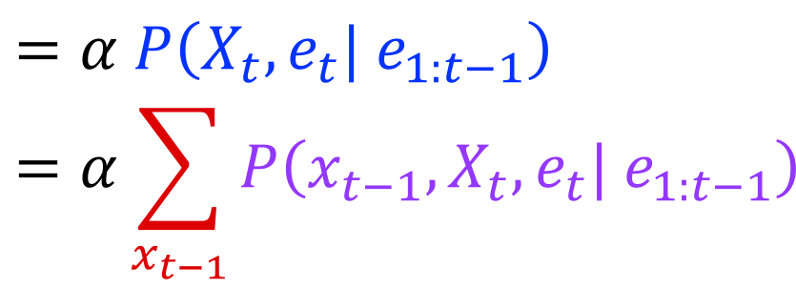

Filtering Algorithm
Query: What is the current state, given all of the current and past evidence?
Matching math with Bayes net
$P\left(X_{t} \right| e_{1:t})$ =$P\left(X_{t}{| e_{t}, e}_{1:t−1}\right)$
X₁
X₂
X₃
X₄
$$=α P\left(X_{t}, {e_{t}| e}_{1:t−1}\right)$$
$$=α\sum_{x_{t−1}}{P\left(x_{t−1},X_{t}, e_{t}| e_{1:t−1}\right)}$$
e₁
e₂
e₃
e₄
Summation over variable $X_{t−1}$

Slide 35
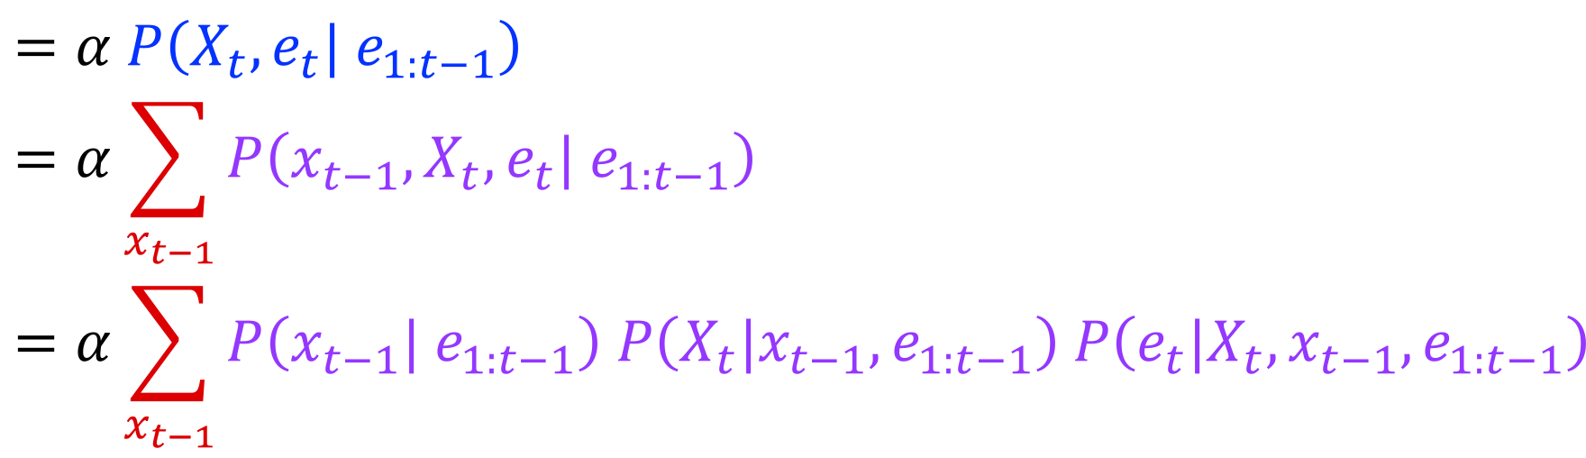

Filtering Algorithm
Query: What is the current state, given all of the current and past evidence?
Matching math with Bayes net
$P\left(X_{t} \right| e_{1:t})$ =$P\left(X_{t}{| e_{t}, e}_{1:t−1}\right)$
X₁
X₂
X₃
X₄
$$=α P\left(X_{t}, {e_{t}| e}_{1:t−1}\right)$$
$$=α\sum_{x_{t−1}}{P\left(x_{t−1},X_{t}, e_{t}| e_{1:t−1}\right)}$$
$$=α\sum_{x_{t−1}}{P\left(x_{t−1}| e_{1:t−1}\right) P\left(X_{t}|x_{t−1},e_{1:t−1}\right) P\left(e_{t}|X_{t},x_{t−1},e_{1:t−1}\right)}$$
e₁
e₂
e₃
e₄
Chain rule with $x_{t−1}$, $X_{t}$, and $e_{t}$

Slide 36
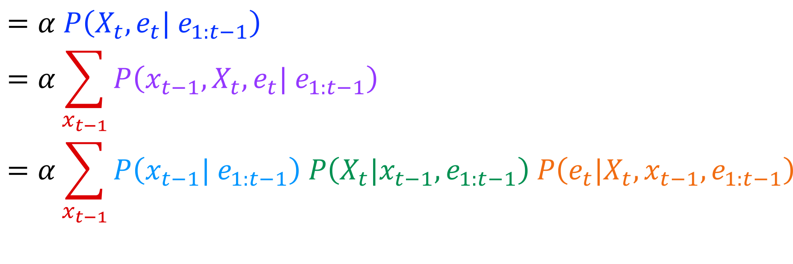
Filtering Algorithm
Query: What is the current state, given all of the current and past evidence?
Matching math with Bayes net
$P\left(X_{t} \right| e_{1:t})$ =$P\left(X_{t}{| e_{t}, e}_{1:t−1}\right)$
X₁
X₂
X₃
X₄
$$=α P\left(X_{t}, {e_{t}| e}_{1:t−1}\right)$$
$$=α\sum_{x_{t−1}}{P\left(x_{t−1},X_{t}, e_{t}| e_{1:t−1}\right)}$$
$$=α\sum_{x_{t−1}}{P\left(x_{t−1}| e_{1:t−1}\right) P\left(X_{t}|x_{t−1},e_{1:t−1}\right) P\left(e_{t}|X_{t},x_{t−1},e_{1:t−1}\right)}$$
e₁
e₂
e₃
e₄
Chain rule with $x_{t−1}$, $X_{t}$, and $e_{t}$

Slide 37
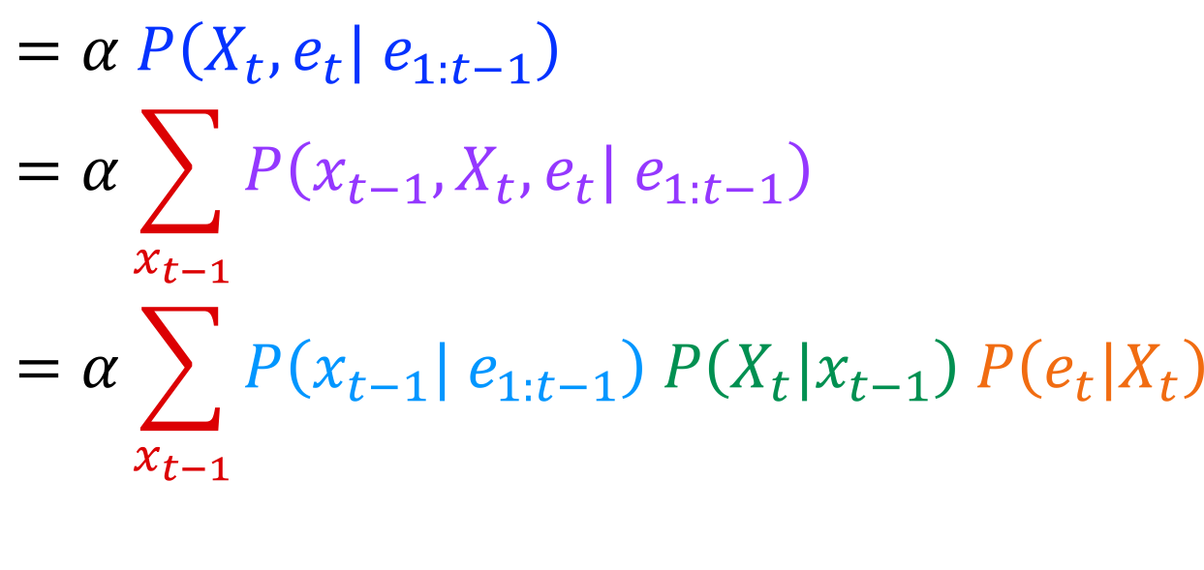
Filtering Algorithm
Query: What is the current state, given all of the current and past evidence?
Matching math with Bayes net
$P\left(X_{t} \right| e_{1:t})$ =$P\left(X_{t}{| e_{t}, e}_{1:t−1}\right)$
X₁
X₂
X₃
X₄
$$=α P\left(X_{t}, {e_{t}| e}_{1:t−1}\right)$$
$$=α\sum_{x_{t−1}}{P\left(x_{t−1},X_{t}, e_{t}| e_{1:t−1}\right)}$$
$$=α\sum_{x_{t−1}}{P\left(x_{t−1}| e_{1:t−1}\right) P\left(X_{t}|x_{t−1}\right) P\left(e_{t}|X_{t}\right)}$$
e₁
e₂
e₃
e₄
Bayes net conditional independence

Slide 38
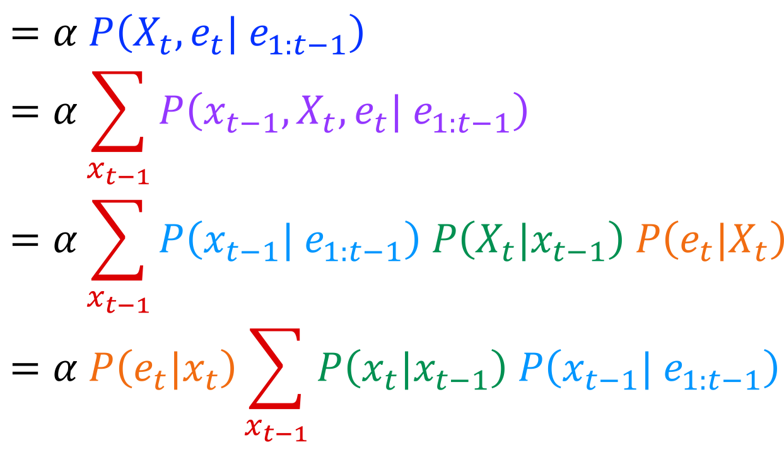

Filtering Algorithm
Query: What is the current state, given all of the current and past evidence?
Matching math with Bayes net
$P\left(X_{t} \right| e_{1:t})$ =$P\left(X_{t}{| e_{t}, e}_{1:t−1}\right)$
X₁
X₂
X₃
X₄
$$=α P\left(X_{t}, {e_{t}| e}_{1:t−1}\right)$$
$$=α\sum_{x_{t−1}}{P\left(x_{t−1},X_{t}, e_{t}| e_{1:t−1}\right)}$$
$$=α\sum_{x_{t−1}}{P\left(x_{t−1}| e_{1:t−1}\right) P\left(X_{t}|x_{t−1}\right) P\left(e_{t}|X_{t}\right)}$$
$$=α P\left(e_{t}|x_{t}\right)\sum_{x_{t−1}}{P\left(x_{t}|x_{t−1}\right) P\left(x_{t−1}| e_{1:t−1}\right) }$$
e₁
e₂
e₃
e₄
Pulling $P\left(e_{t}|X_{t}\right)$ out of the summation

Slide 39
Filtering Algorithm
Query: What is the current state, given all of the current and past evidence?
Matching math with Bayes net
$P\left(X_{t} \right| e_{1:t})$ =$P\left(X_{t}{| e_{t}, e}_{1:t−1}\right)$
X₁
X₂
X₃
X₄
$$=α P\left(X_{t}, {e_{t}| e}_{1:t−1}\right)$$
$$=α\sum_{x_{t−1}}{P\left(x_{t−1},X_{t}, e_{t}| e_{1:t−1}\right)}$$
$$=α\sum_{x_{t−1}}{P\left(x_{t−1}| e_{1:t−1}\right) P\left(X_{t}|x_{t−1}\right) P\left(e_{t}|X_{t}\right)}$$
$$=α P\left(e_{t}|x_{t}\right)\sum_{x_{t−1}}{P\left(x_{t}|x_{t−1}\right) P\left(x_{t−1}| e_{1:t−1}\right) }$$
e₁
e₂
e₃
e₄
Recursion!

Slide 40
Filtering Algorithm
Query: What is the current state, given all of the current and past evidence?
Matching math with Bayes net
$P\left(X_{t} \right| e_{1:t})$ =$P\left(X_{t}{| e_{t}, e}_{1:t−1}\right)$
X₁
X₂
X₃
X₄
$$=α P\left(X_{t}, {e_{t}| e}_{1:t−1}\right)$$
$$=α\sum_{x_{t−1}}{P\left(x_{t−1},X_{t}, e_{t}| e_{1:t−1}\right)}$$
$$=α\sum_{x_{t−1}}{P\left(x_{t−1}| e_{1:t−1}\right) P\left(X_{t}|x_{t−1}\right) P\left(e_{t}|X_{t}\right)}$$
$$=α P\left(e_{t}|x_{t}\right)\sum_{x_{t−1}}{P\left(x_{t}|x_{t−1}\right) P\left(x_{t−1}| e_{1:t−1}\right) }$$
e₁
e₂
e₃
e₄
Recursion!

Slide 41
Filtering Algorithm
P(X_{t+1}|e_{1:t+1}) = α P(e_{t+1}|X_{t+1}) ∑_{xt} P(X_{t+1}| x_{t}) P(x_{t} | e_{1:t})
f_{1:t+1} = Forward(f_{1:t} , e_{t+1})
Cost per time step: O(|X|²) where |X| is the number of states
Time and space costs are constant, independent of t
O(|X|²) is infeasible for models with many state variables
We get to invent really cool approximate filtering algorithms
Normalize
Update
Predict

Slide 42
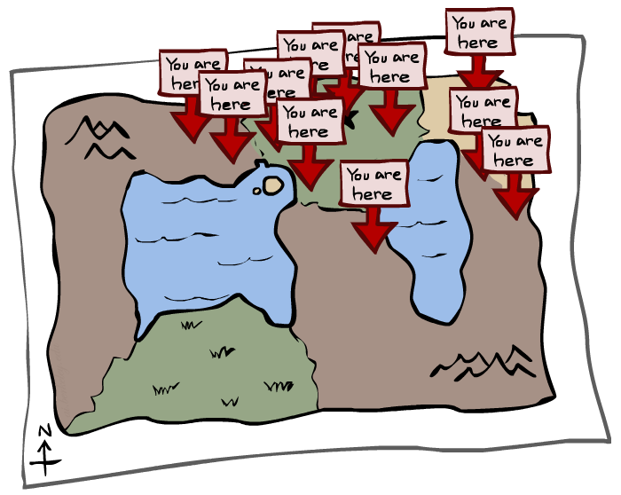
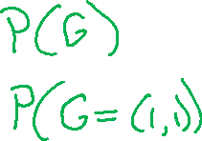
Particle Filtering

Slide 43
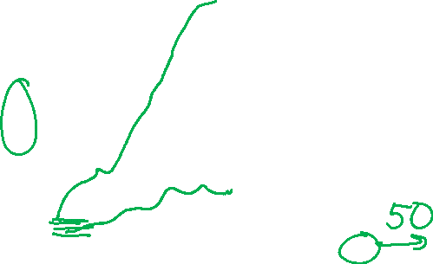
We need a new algorithm!
When |X| is more than 10⁶ or so (e.g., 3 ghosts in a 10x20 world), exact inference becomes infeasible
Likelihood weighting fails completely – number of samples needed grows exponentially with T
X₀
X₁
X₂
X₃
E₁
E₂
E₃

Slide 44
We need a new idea!
t=2
t=7
The problem: sample state trajectories go off into low-probability regions, ignoring the evidence; too few “reasonable” samples
Solution: kill the bad ones, make more of the good ones
This way the population of samples stays in the high-probability region
This is called resampling or survival of the fittest

Slide 45
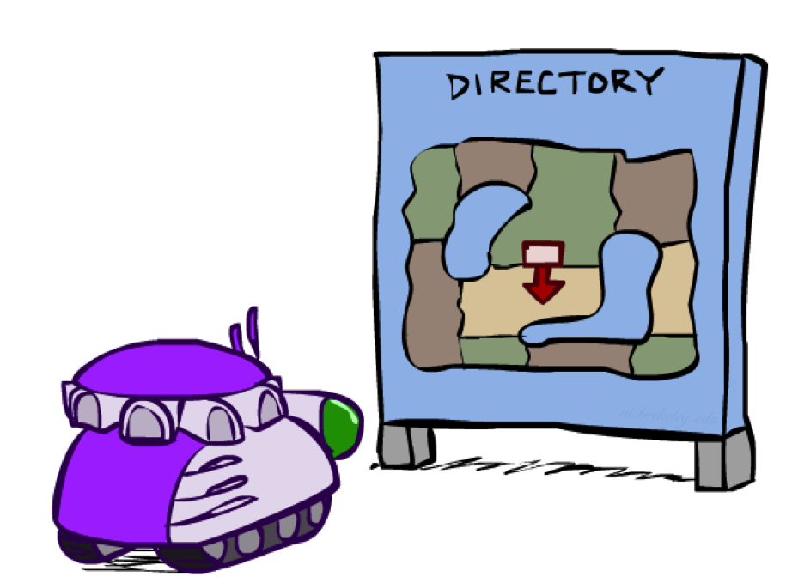
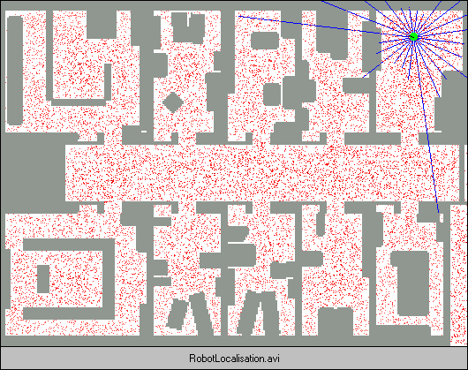
Robot Localization
In robot localization:
  We know the map, but not the robot’s position
  Observations may be vectors of range finder readings
  State space and readings are typically continuous (works basically like a very fine grid) and so we cannot store B(X)
  Particle filtering is a main technique

Slide 46

Particle Filter Localization (Sonar)
[Dieter Fox, et al.]
[Video: global-sonar-uw-annotated.avi]

Slide 47

Particle Filtering
Represent belief state by a set of samples
  Samples are called particles
  Time per step is linear in the number of samples
  But: number needed may be large
This is how robot localization works in practice
0.0
0.1
0.0
0.0
0.0
0.2
0.0
0.2
0.5

Slide 48
Representation: Particles
Our representation of P(X) is now a list of N particles (samples)
  Generally, N << |X|
  Storing map from X to counts would defeat the point
P(x) approximated by number of particles with value x
  So, many x may have P(x) = 0!
  More particles, more accuracy
  Usually we want a low-dimensional marginal
    E.g., “Where is ghost 1?” rather than “Are ghosts 1,2,3 in {2,6], [5,6], and [8,11]?”
For now, all particles have a weight of 1
Particles:
(3,3)
(2,3)
(3,3)
(3,2)
(3,3)
(3,2)
(1,2)
(3,3)
(3,3)
(2,3)

Slide 49
Particle Filtering: Propagate forward
A particle in state x_{t} is moved by sampling its next position directly from the transition model:
  x_{t+1} ~ P(X_{t+1} | x_{t})
  Here, most samples move clockwise, but some move in another direction or stay in place
This captures the passage of time
  If enough samples, close to exact values before and after (consistent)
Particles:
(3,3)
(2,3)
(3,3)
(3,2)
(3,3)
(3,2)
(1,2)
(3,3)
(3,3)
(2,3)
Particles:
(3,2)
(2,3)
(3,2)
(3,1)
(3,3)
(3,2)
(1,3)
(2,3)
(3,2)
(2,2)

Slide 50
Particle Filtering: Observe
Particles:
(3,2)
(2,3)
(3,2)
(3,1)
(3,3)
(3,2)
(1,3)
(2,3)
(3,2)
(2,2)
Slightly trickier:
  Don’t sample observation, fix it
  Similar to likelihood weighting, weight samples based on the evidence
    W = P(e_{t}| x_{t})
  Normalize the weights: particles that fit the data better get higher weights, others get lower weights
Particles:
(3,2) w=.9
(2,3) w=.2
(3,2) w=.9
(3,1) w=.4
(3,3) w=.4
(3,2) w=.9
(1,3) w=.1
(2,3) w=.2
(3,2) w=.9
(2,2) w=.4

Slide 51
Particle Filtering: Resample
Rather than tracking weighted samples, we resample
N times, we choose from our weighted sample distribution (i.e., draw with replacement)
Now the update is complete for this time step, continue with the next one
Particles:
(3,2) w=.9
(2,3) w=.2
(3,2) w=.9
(3,1) w=.4
(3,3) w=.4
(3,2) w=.9
(1,3) w=.1
(2,3) w=.2
(3,2) w=.9
(2,2) w=.4
(New) Particles:
(3,2)
(2,2)
(3,2)
(2,3)
(3,3)
(3,2)
(1,3)
(2,3)
(3,2)
(3,2)

Slide 52
Summary: Particle Filtering
Particles: track samples of states rather than an explicit distribution
Propagate forward
Weight
Resample
Particles:
(3,3)
(2,3)
(3,3)
(3,2)
(3,3)
(3,2)
(1,2)
(3,3)
(3,3)
(2,3)
Particles:
(3,2)
(2,3)
(3,2)
(3,1)
(3,3)
(3,2)
(1,3)
(2,3)
(3,2)
(2,2)
Particles:
(3,2) w=.9
(2,3) w=.2
(3,2) w=.9
(3,1) w=.4
(3,3) w=.4
(3,2) w=.9
(1,3) w=.1
(2,3) w=.2
(3,2) w=.9
(2,2) w=.4
(New) Particles:
(3,2)
(2,2)
(3,2)
(2,3)
(3,3)
(3,2)
(1,3)
(2,3)
(3,2)
(3,2)
Consistency: see proof in AIMA Ch. 15
[Demos: ghostbusters particle filtering (L15D3,4,5)]

Slide 53
Summary: Particle Filtering
Particles: track samples of states rather than an explicit distribution
Propagate forward
Weight
Resample
Particles:
(3,3)
(2,3)
(3,3)
(3,2)
(3,3)
(3,2)
(1,2)
(3,3)
(3,3)
(2,3)
Particles:
(3,2)
(2,3)
(3,2)
(3,1)
(3,3)
(3,2)
(1,3)
(2,3)
(3,2)
(2,2)
Particles:
(3,2) w=.9
(2,3) w=.2
(3,2) w=.9
(3,1) w=.4
(3,3) w=.4
(3,2) w=.9
(1,3) w=.1
(2,3) w=.2
(3,2) w=.9
(2,2) w=.4
(New) Particles:
(3,2)
(2,2)
(3,2)
(2,3)
(3,3)
(3,2)
(1,3)
(2,3)
(3,2)
(3,2)
Consistency: see proof in AIMA Ch. 15
[Demos: ghostbusters particle filtering (L15D3,4,5)]

Slide 54
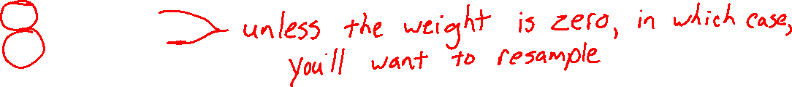
Piazza Poll 1
If we only have one particle which of these steps are unnecessary?
  Select all that are unnecessary.
  Propagate forward
  Weight
  Resample
  I don’t know
Propagate forward
Weight
Resample
[Demos: ghostbusters particle filtering (L15D3,4,5)]

Slide 55
Weighting and Resampling
How to compute the updated weight
Weight
Particles:
(3,2) w=.9
(2,3) w=.2
(3,2) w=.9
(3,1) w=.4
(3,3) w=.4
(3,2) w=.9
(1,3) w=.1
(2,3) w=.2
(3,2) w=.9
(2,2) w=.4

Slide 56
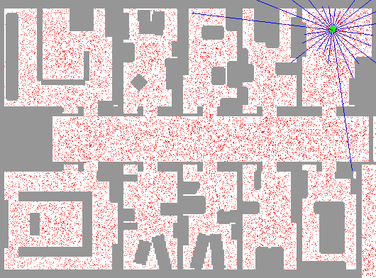
Particle Filter Localization (Laser)
[Dieter Fox, et al.]
[Video: global-floor.gif]

Slide 57

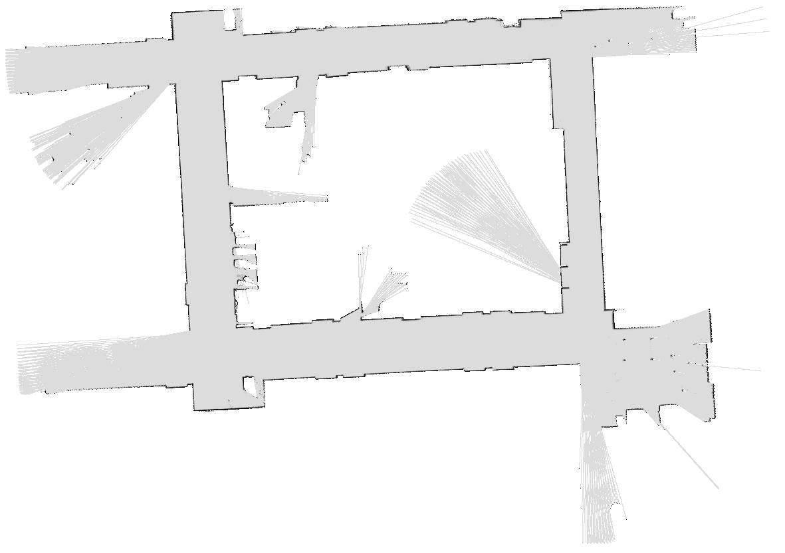
Robot Mapping
SLAM: Simultaneous Localization And Mapping
  We do not know the map or our location
  State consists of position AND map!
  Main techniques: Kalman filtering (Gaussian HMMs) and particle methods
DP-SLAM, Ron Parr
[Demo: PARTICLES-SLAM-mapping1-new.avi]

Slide 58

Particle Filter SLAM – Video 1
[Sebastian Thrun, et al.]
[Demo: PARTICLES-SLAM-mapping1-new.avi]

Slide 59

Particle Filter SLAM – Video 2
[Dirk Haehnel, et al.]
[Demo: PARTICLES-SLAM-fastslam.avi]

