Slide 1
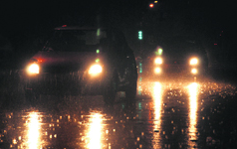
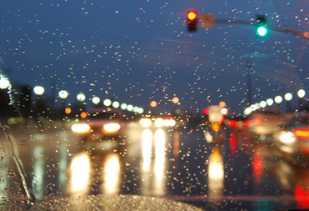
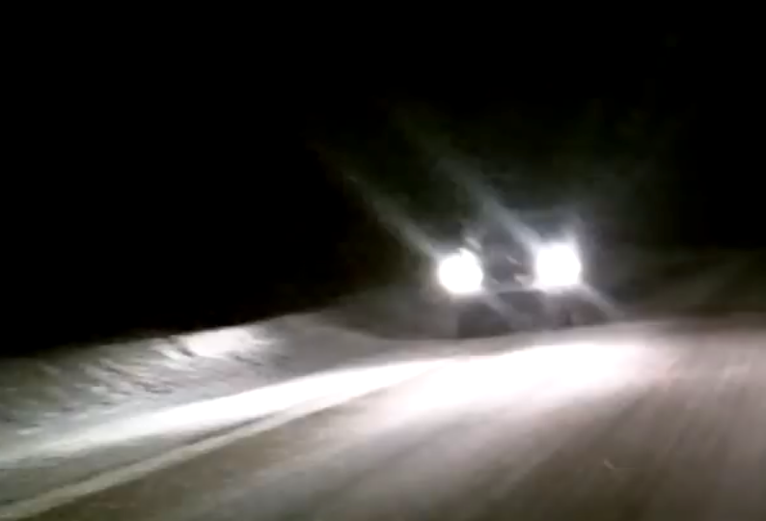
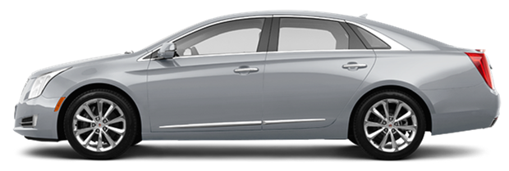
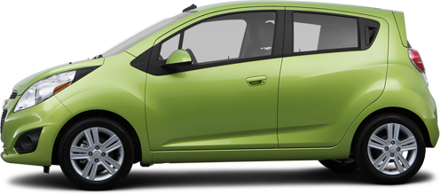
Reduced Road Glare
rain
rain
snow
Wet Road Surface

Slide 2
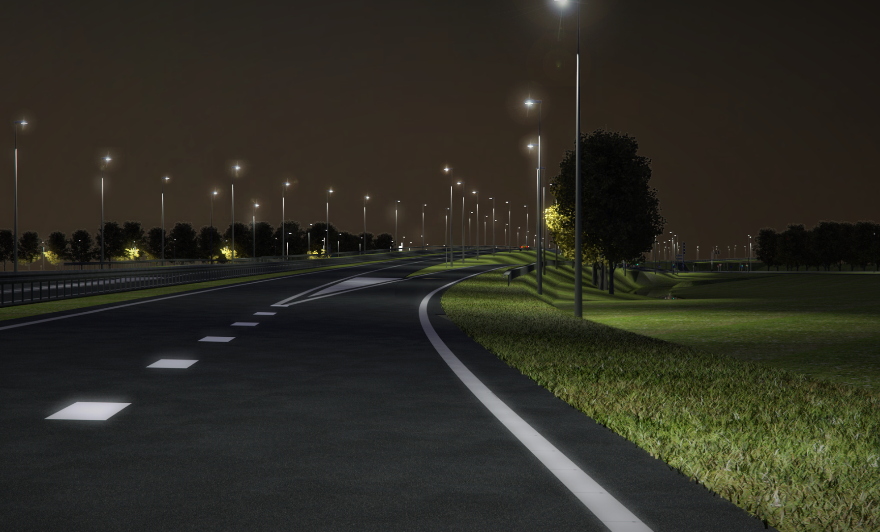
Distraction-Free Navigational Info
100 ft

Slide 3
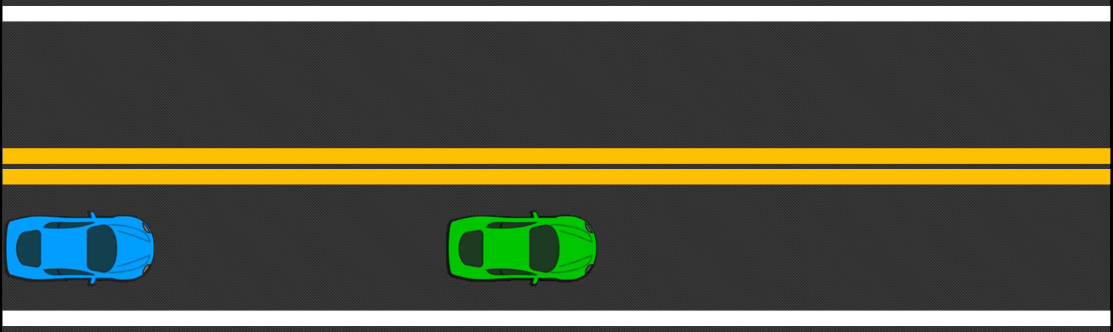
Adaptive Cruise Control
Typically, 25 - 50 meter gap at 50 mph
Notes:
1-2 seconds time gap, 50 mph, 25 – 50 m gap

Slide 4
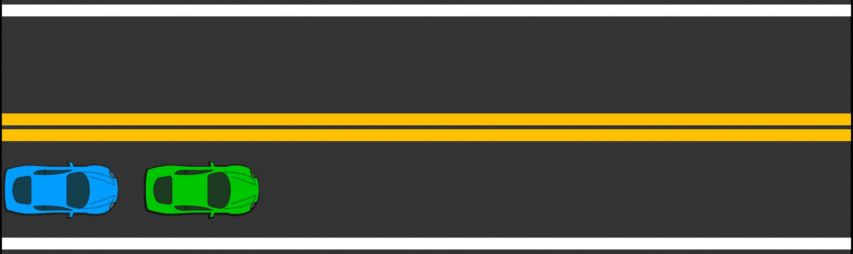
Bumper-to-Bumper at High Speeds
Gap can be reduced with our high-speed system (~1ms)

Slide 5
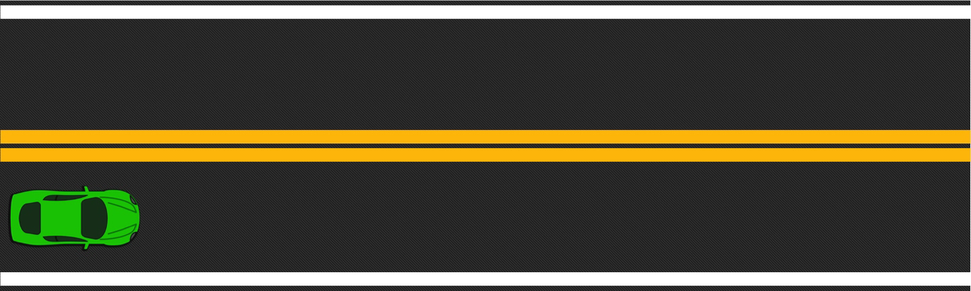
Bumper-to-Bumper Vehicle Platoon

Slide 6
Bumper-to-Bumper at High Speeds
Data Source | Typical Acquisition Rate | Typical Accuracy
Camera | 30 Hz (33 ms) | Algorithm dependent
RADAR | 20 Hz (50 ms) | 0.5 m, 0.12 m/s
LIDAR | 100 Hz (10 ms) | 60 mm
GPS | 50 Hz (20 ms) | 3 – 8 m
DSRC | 100 Hz (10 ms) | Distance dependent

Slide 7
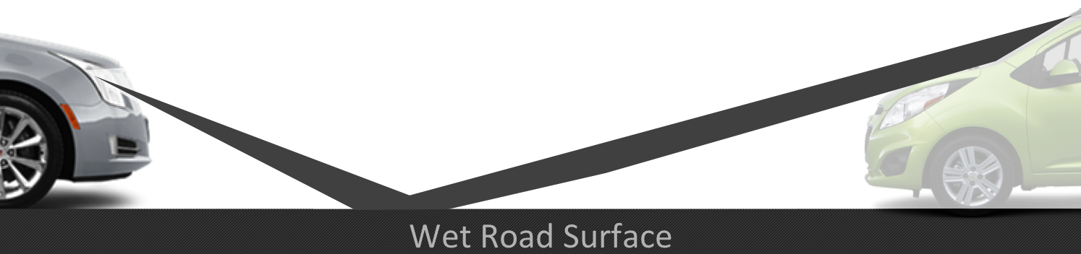
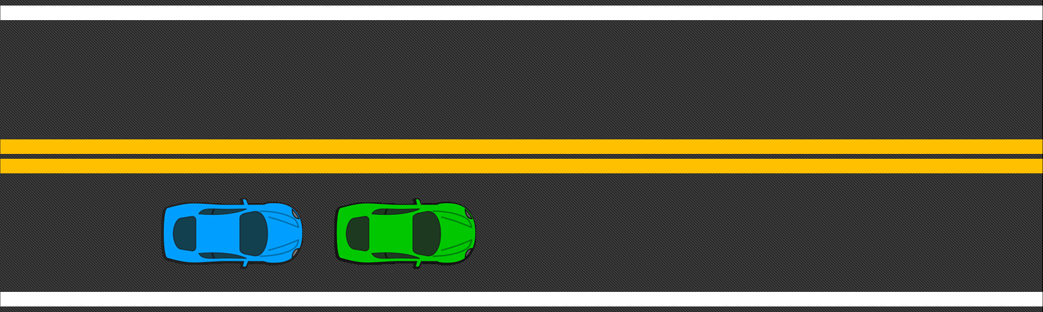
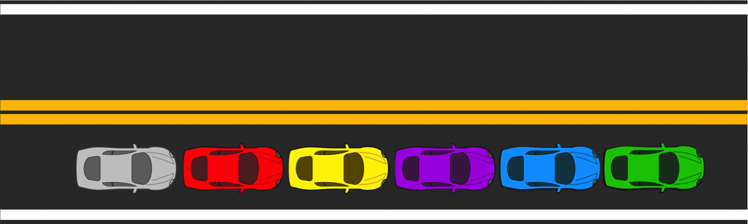
Programmable Headlight Versatility
Improved Visibility on Reflective Road Surfaces
100 ft
Distraction-Free Navigation
Improved Vehicle Awareness

