Slide 1

14-513
18-613

Slide 2
Machine-Level Programming I: Basics
18-213/18-613: Introduction to Computer Systems
4th Lecture, Spring 2026

Slide 3
Today: Machine Programming I: Basics
High level goals:
  Improve code performance, reliability, and code security (and think a bit about the flip side of that coin)
    Understand our toolchain, so we can maximize the benefit we get from it
    Empower the compiler to do more or us
    Optimize by hand, where, and only where appropriate
    Debug deeply rooted problems
    Protect the security and reliability of code
  Note: Writing assembly is not on this list!

Slide 4
Today: Machine Programming I: Basics
History of Intel processors and architectures CSAPP 3.1
Assembly Basics: Registers, operands, move CSAPP 3.3-3.4
Arithmetic & logical operations CSAPP 3.5
C, assembly, machine code CSAPP 3.2

Slide 5
Intel x86 Processors
Dominate laptop/desktop/server market
Evolutionary design
  Backwards compatible up until 8086, introduced in 1978
  Added more features as time goes on
x86 is a Complex Instruction Set Computer (CISC)
  Many different instructions with many different formats
    But, only small subset encountered with Linux programs
Compare: Reduced Instruction Set Computer (RISC)
  RISC: *very few* instructions, with *very few* modes for each
  RISC can be quite fast (but Intel still wins on speed!)
  Current RISC renaissance (e.g., ARM, RISCV), especially for low-power

Slide 6
Intel x86 Evolution: Milestones
Name Date Transistors MHz
8086 1978 29K 5-10
  First 16-bit Intel processor. Basis for IBM PC & DOS
  1MB address space
386 1985 275K 16-33
  First 32 bit Intel processor , referred to as IA32
  Added “flat addressing”, capable of running Unix
Pentium 4E 2004 125M 2800-3800
  First 64-bit Intel x86 processor, referred to as x86-64
Core 2 2006 291M 1060-3333
  First multi-core Intel processor
Core i7 2008 731M 1600-4400
  Four cores (our shark machines)

Slide 7
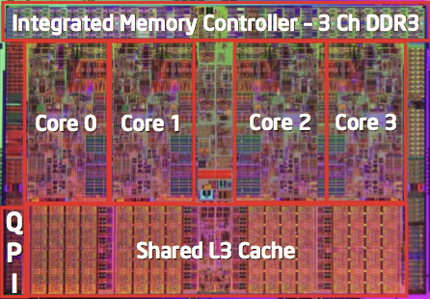
Intel x86 Processors, cont.
Machine Evolution
  386 1985 0.3M
  Pentium 1993 3.1M
  Pentium/MMX 1997 4.5M
  PentiumPro 1995 6.5M
  Pentium III 1999 8.2M
  Pentium 4 2000 42M
  Core 2 Duo 2006 291M
  Core i7 2008 731M
  Core i7 Skylake 2015 1.9B
Added Features
  Instructions to support multimedia operations
  Instructions to enable more efficient conditional operations
  Transition from 32 bits to 64 bits
  More cores

Slide 8
Intel x86 Processors, cont.
Past Generations
  1st Pentium Pro 1995 600 nm
  1st Pentium III 1999 250 nm
  1st Pentium 4 2000 180 nm
  1st Core 2 Duo 2006 65 nm
Recent & Upcoming Generations
  Nehalem 2008 45 nm
  Sandy Bridge 2011 32 nm
  Ivy Bridge 2012 22 nm
  Haswell 2013 22 nm
  Broadwell 2014 14 nm
  Skylake 2015 14 nm
  Kaby Lake 2016 14 nm
  Coffee Lake 2017 14 nm
  Cannon Lake 2018 10 nm
  Ice Lake 2019 10 nm
  Tiger Lake 2020 10 nm
  Alder Lake 2021 10 nm
  Raptor Lake 2022 10 nm .. “Intel 7 process”
  Meteor Lake 2023 7 nm … “Intel 4 process”
  Arrow Lake 2024 3 nm → TSMC
  Nova Lake. 2026?
Process technology
Process technology dimension
= width of narrowest wires
(10 nm ≈ 100 atoms wide)
Notes:
Raptor Lake is expected to be available second half of 2022

Slide 9
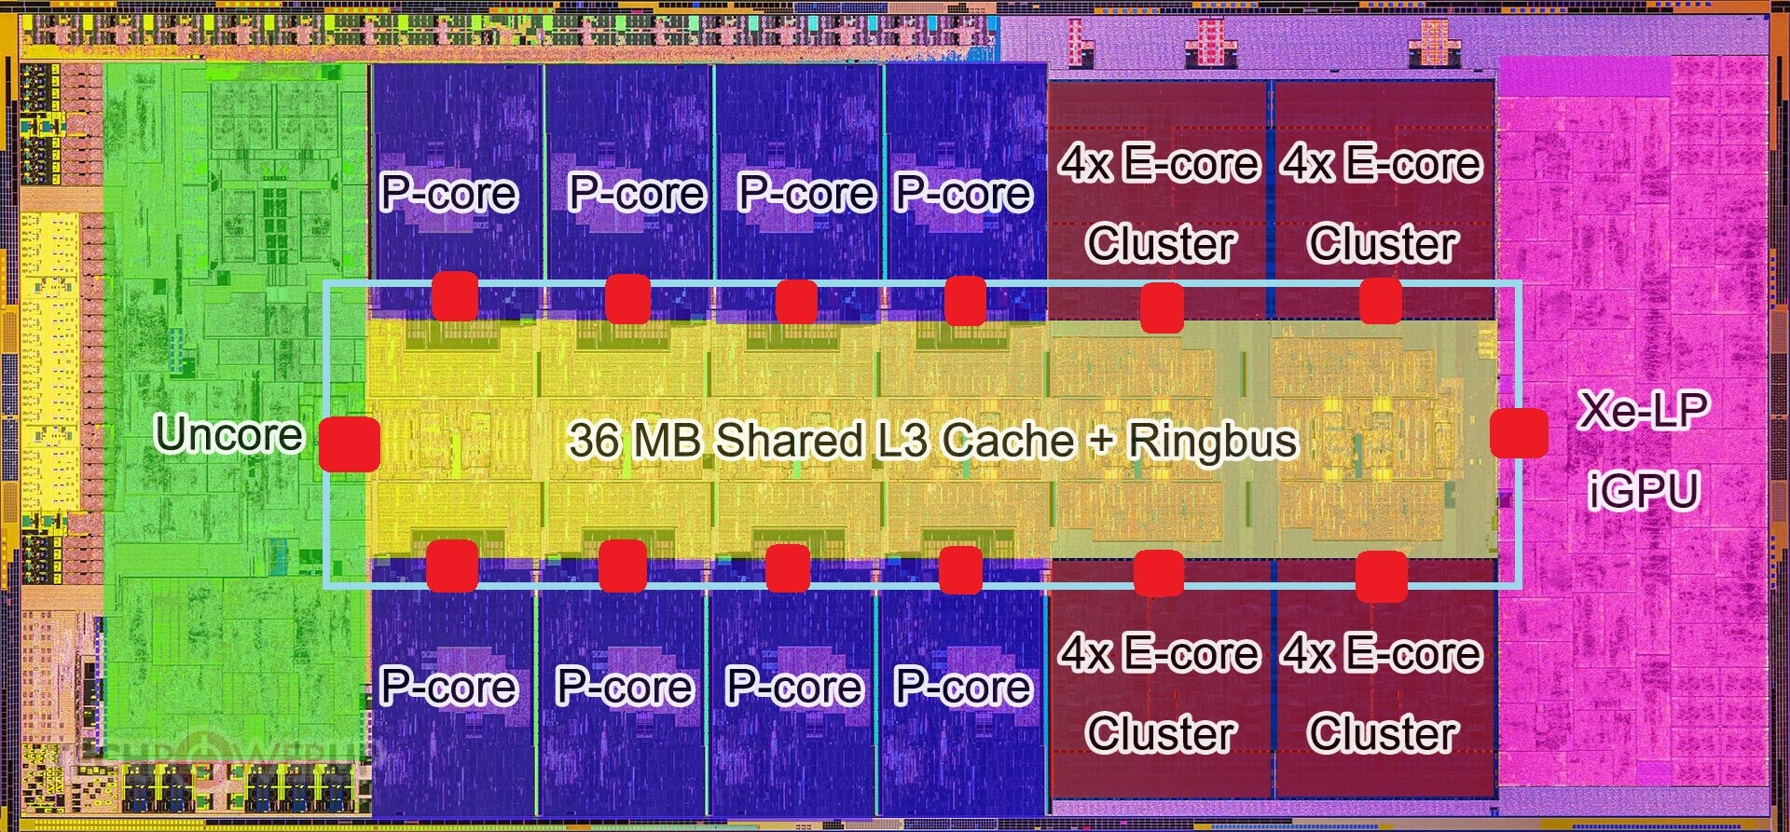
Intel’s Latest: Arrow Lake (2024)
In recent years, increasing die space devoted to the graphics/AI engine

Slide 10
x86 Clones: Advanced Micro Devices (AMD)
Historically
  AMD has followed just behind Intel
  A little bit slower, a lot cheaper
Then (mid 2000s)
  Recruited top circuit designers from Digital Equipment Corp. and other downward trending companies
  Built Opteron: tough competitor to Pentium 4
  Developed x86-64, their own extension to 64 bits
Since Then..
  Intel got its act together (until about 2019), but slipping more recently
  1995-2011: Lead semiconductor “fab” in world
    2018: #2 largest by $$ (#1 is Samsung)
    2019-2022: back-and-forth with Samsung for #1
    2023+: Moving to #4 or #5 (NVIDIA is #1); relying on TSMC for Arrow Lake
  AMD fell behind in the 2010s but has been gaining steam in the past 5 years
    Relies on external semiconductor manufacturer GlobalFoundaries
    ca. 2019 CPUs (e.g., Ryzen) are competitive again (with TSMC)
    Intel still ahead by revenue (~ 2:1) but the gap is closing (was ~5:1 in 2021)

Slide 11
Intel’s 64-Bit History
2001: Intel Attempts Radical Shift from IA32 to IA64
  Totally different architecture (Itanium, AKA “Itanic”)
  Executes IA32 code only as legacy
  Performance disappointing
2003: AMD Steps in with Evolutionary Solution
  x86-64 (now called “AMD64”)
Intel Felt Obligated to Focus on IA64
  Hard to admit mistake or that AMD is better
2004: Intel Announces EM64T extension to IA32
  Extended Memory 64-bit Technology
  Almost identical to x86-64!
Virtually all modern x86 processors support x86-64
  But, lots of code still runs in 32-bit mode

Slide 12
Our Coverage
IA32
  The traditional x86
  For 15/18-213: RIP, Summer 2015
x86-64
  The standard
  shark> gcc hello.c
  shark> gcc –m64 hello.c
Presentation
  Book covers x86-64
  Web aside on IA32
  We will only cover x86-64

Slide 13
Today: Machine Programming I: Basics
History of Intel processors and architectures
Assembly Basics: Registers, operands, move
Arithmetic & logical operations
C, assembly, machine code

Slide 14

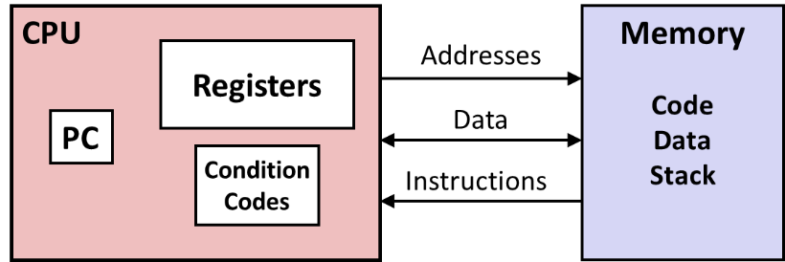
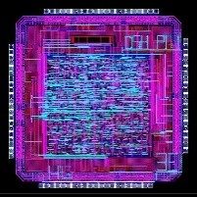
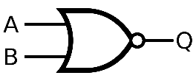
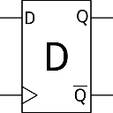
Levels of Abstraction
#include <stdio.h>
int main(){
int i, n = 10, t1 = 0, t2 = 1, nxt;
for (i = 1; i <= n; ++i){
printf("%d, ", t1);
nxt = t1 + t2;
t1 = t2;
t2 = nxt; }
return 0; }
C programmer
Seems like nice clean layers…
Assembly programmer
Computer Designer
Gates, clocks, circuit layout, …

Slide 15
Definitions
Architecture: (also ISA: instruction set architecture) The parts of a processor design that one needs to understand for writing correct machine/assembly code
  Examples: instruction set specification, registers
  Machine Code: The byte-level programs that a processor executes
  Assembly Code: A text representation of machine code
Microarchitecture: Implementation of the architecture
  Examples: cache sizes and core frequency
Example ISAs:
  Intel: x86, IA32, Itanium, x86-64
  ARM: Used in almost all mobile phones
  RISC V: Recent open-source ISA

Slide 16
Assembly/Machine Code View
CPU
Memory
Registers
Addresses
Data
Code
Data
Stack
PC
Condition
Codes
Instructions
Programmer-Visible State
  PC: Program counter
    Address of next instruction
    Called “RIP” (x86-64)
  Register file
    Heavily used program data
  Condition codes
    Store status information about most recent arithmetic or logical operation
    Used for conditional branching
  Memory
    Byte addressable array
    Code and user data
    Stack to support procedures

Slide 17
Assembly Characteristics: Data Types
“Integer” data of 1, 2, 4, or 8 bytes
  Data values
  Addresses (untyped pointers)
Floating point data of 4, 8, or 10 bytes
(SIMD vector data types of 8, 16, 32 or 64 bytes)
Code: Byte sequences encoding series of instructions
No aggregate types such as arrays or structures
  Just contiguously allocated bytes in memory

Slide 18
x86-64 Integer Registers
%rax
%r8
%eax
%r8d
%rbx
%r9
%ebx
%r9d
%rcx
%r10
%ecx
%r10d
%rdx
%r11
%edx
%r11d
%rsi
%r12
%esi
%r12d
%rdi
%r13
%edi
%r13d
%rsp
%r14
%esp
%r14d
%rbp
%r15
%ebp
%r15d
  Can reference low-order 4 bytes (also low-order 1 & 2 bytes)
  Not part of memory (or cache)

Slide 19
Some History: IA32 Registers
Origin
(mostly obsolete)
%eax
%ax
%ah
%al
accumulate
%ecx
%cx
%ch
%cl
counter
%edx
%dx
%dh
%dl
data
general purpose
%ebx
%bx
%bh
%bl
base
%esi
source
index
%si
%edi
destination
index
%di
%esp
stack
pointer
%sp
%ebp
base
pointer
%bp
16-bit virtual registers
(backwards compatibility)

Slide 20
Assembly Characteristics: Operations
Transfer data between memory and register
  Load data from memory into register
  Store register data into memory
Perform arithmetic function on register or memory data
Transfer control
  Unconditional jumps to/from procedures
  Conditional branches
  Indirect branches

Slide 21
Moving Data
%rax
%rcx
Moving Data
  movq Source, Dest
Operand Types
  Immediate: Constant integer data
    Example: $0x400, $-533
    Like C constant, but prefixed with ‘$’
    Encoded with 1, 2, or 4 bytes
  Register: One of 16 integer registers
    Example: %rax, %r13
    But %rsp reserved for special use
    Others have special uses for particular instructions
  Memory: 8 consecutive bytes of memory at address given by register
    Simplest example: (%rax)
    Various other “addressing modes”
%rdx
%rbx
%rsi
%rdi
%rsp
%rbp
%rN
Warning: Intel docs use
mov Dest, Source

Slide 22
movq Operand Combinations
Source
Dest
Src,Dest
C Analog
Reg
movq $0x4,%rax
temp = 0x4;
Imm
Mem
movq $-147,(%rax)
*p = -147;
Reg
movq %rax,%rdx
temp2 = temp1;
movq
Reg
Mem
movq %rax,(%rdx)
*p = temp;
Mem
Reg
movq (%rax),%rdx
temp = *p;
Cannot do memory-memory transfer with a single instruction

Slide 23
Simple Memory Addressing Modes
Normal (R) Mem[Reg[R]]
  Register R specifies memory address
  Aha! Pointer dereferencing in C
  movq (%rcx),%rax
Displacement D(R) Mem[Reg[R]+D]
  Register R specifies start of memory region
  Constant displacement D specifies offset
  movq 8(%rbp),%rdx

Slide 24
Example of Simple Addressing Modes
void
whatAmI(<type> a, <type> b)
{
????
}
whatAmI:
movq (%rdi), %rax
movq (%rsi), %rdx
movq %rdx, (%rdi)
movq %rax, (%rsi)
ret
%rsi
%rdi

Slide 25
Example of Simple Addressing Modes
void swap
(long *xp, long *yp)
{
long t0 = *xp;
long t1 = *yp;
*xp = t1;
*yp = t0;
}
swap:
movq (%rdi), %rax
movq (%rsi), %rdx
movq %rdx, (%rdi)
movq %rax, (%rsi)
ret

Slide 26
Understanding Swap()
Memory
void swap
(long *xp, long *yp)
{
long t0 = *xp;
long t1 = *yp;
*xp = t1;
*yp = t0;
}
Registers
%rdi
%rsi
%rax
%rdx
Register Value
%rdi xp
%rsi yp
%rax t0
%rdx t1
swap:
movq (%rdi), %rax # t0 = *xp
movq (%rsi), %rdx # t1 = *yp
movq %rdx, (%rdi) # *xp = t1
movq %rax, (%rsi) # *yp = t0
ret

Slide 27
Understanding Swap()
Memory
Registers
Address
123
0x120
%rdi
0x120
0x118
%rsi
0x100
0x110
%rax
0x108
%rdx
456
0x100
swap:
movq (%rdi), %rax # t0 = *xp
movq (%rsi), %rdx # t1 = *yp
movq %rdx, (%rdi) # *xp = t1
movq %rax, (%rsi) # *yp = t0
ret

Slide 28
Understanding Swap()
Memory
Registers
Address
123
0x120
%rdi
0x120
0x118
%rsi
0x100
0x110
%rax
123
0x108
%rdx
456
0x100
swap:
movq (%rdi), %rax # t0 = *xp
movq (%rsi), %rdx # t1 = *yp
movq %rdx, (%rdi) # *xp = t1
movq %rax, (%rsi) # *yp = t0
ret

Slide 29
Understanding Swap()
Memory
Registers
Address
123
0x120
%rdi
0x120
0x118
%rsi
0x100
0x110
%rax
123
0x108
%rdx
456
456
0x100
swap:
movq (%rdi), %rax # t0 = *xp
movq (%rsi), %rdx # t1 = *yp
movq %rdx, (%rdi) # *xp = t1
movq %rax, (%rsi) # *yp = t0
ret

Slide 30
Understanding Swap()
Memory
Registers
Address
456
0x120
%rdi
0x120
0x118
%rsi
0x100
0x110
%rax
123
0x108
%rdx
456
456
0x100
swap:
movq (%rdi), %rax # t0 = *xp
movq (%rsi), %rdx # t1 = *yp
movq %rdx, (%rdi) # *xp = t1
movq %rax, (%rsi) # *yp = t0
ret

Slide 31
Understanding Swap()
Memory
Registers
Address
456
0x120
%rdi
0x120
0x118
%rsi
0x100
0x110
%rax
123
0x108
%rdx
456
123
0x100
swap:
movq (%rdi), %rax # t0 = *xp
movq (%rsi), %rdx # t1 = *yp
movq %rdx, (%rdi) # *xp = t1
movq %rax, (%rsi) # *yp = t0
ret

Slide 32
Simple Memory Addressing Modes
Normal (R) Mem[Reg[R]]
  Register R specifies memory address
  Aha! Pointer dereferencing in C
  movq (%rcx),%rax
Displacement D(R) Mem[Reg[R]+D]
  Register R specifies start of memory region
  Constant displacement D specifies offset
  movq 8(%rbp),%rdx

Slide 33
Complete Memory Addressing Modes
Most General Form
D(Rb,Ri,S) Mem[Reg[Rb]+S*Reg[Ri]+ D]
  D: Constant “displacement” 1, 2, or 4 bytes
  Rb: Base register: Any of 16 integer registers
  Ri: Index register: Any, except for %rsp
  S: Scale: 1, 2, 4, or 8 (why these numbers?)
Special Cases
(Rb,Ri) Mem[Reg[Rb]+Reg[Ri]]
D(Rb,Ri) Mem[Reg[Rb]+Reg[Ri]+D]
(Rb,Ri,S) Mem[Reg[Rb]+S*Reg[Ri]]

Slide 34
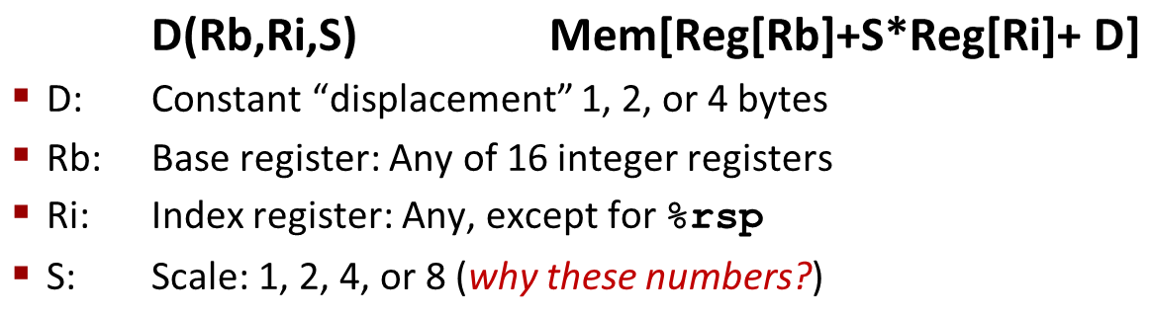
Address Computation Examples
%rdx | 0xf000
%rcx | 0x0100
Expression | Address Computation | Address
0x8(%rdx)
(%rdx,%rcx)
(%rdx,%rcx,4)
0x80(,%rdx,2)
Expression | Address Computation | Address
0x8(%rdx) | 0xf000 + 0x8 | 0xf008
(%rdx,%rcx) | 0xf000 + 0x100 | 0xf100
(%rdx,%rcx,4) | 0xf000 + 4*0x100 | 0xf400
0x80(,%rdx,2) | 2*0xf000 + 0x80 | 0x1e080
Notes:
0xf000 + 0x8 = 0xf008
0xf000 + 0x0100 = 0xf100
0xf000 + 4*0x0100 = 0xf400
2*0xf000 + 0x80 = 0x1d080

Slide 35
Address Computation Examples
%rdx | 0xf000
%rcx | 0x0100
Expression | Address Computation | Address
0x8(%rdx)
(%rdx,%rcx)
(%rdx,%rcx,4)
0x80(,%rdx,2)
Expression | Address Computation | Address
0x8(%rdx) | 0xf000 + 0x8 | 0xf008
(%rdx,%rcx) | 0xf000 + 0x100 | 0xf100
(%rdx,%rcx,4) | 0xf000 + 4*0x100 | 0xf400
0x80(,%rdx,2) | 2*0xf000 + 0x80 | 0x1e080
Notes:
0xf000 + 0x8 = 0xf008
0xf000 + 0x0100 = 0xf100
0xf000 + 4*0x0100 = 0xf400
2*0xf000 + 0x80 = 0x1d080

Slide 36
Today: Machine Programming I: Basics
History of Intel processors and architectures
Assembly Basics: Registers, operands, move
Arithmetic & logical operations
C, assembly, machine code

Slide 37
Address Computation Instruction
leaq Src, Dst
  Src is address mode expression
  Set Dst to address denoted by expression
Uses
  Computing addresses without a memory reference
    E.g., translation of p = &x[i];
  Computing arithmetic expressions of the form x + k*y
    k = 1, 2, 4, or 8
Example
long m12(long x)
{
return x*12;
}
Converted to ASM by compiler:
leaq (%rdi,%rdi,2), %rax # t = x+2*x
salq $2, %rax # return t<<2

Slide 38
Some Arithmetic Operations
Two Operand Instructions:
  Format Computation
    addq Src,Dest Dest = Dest + Src
    subq Src,Dest Dest = Dest − Src
    imulq Src,Dest Dest = Dest * Src
    shlq Src,Dest Dest = Dest << Src Synonym: salq
    sarq Src,Dest Dest = Dest >> Src Arithmetic
    shrq Src,Dest Dest = Dest >> Src Logical
    xorq Src,Dest Dest = Dest ^ Src
    andq Src,Dest Dest = Dest & Src
    orq Src,Dest Dest = Dest | Src
Watch out for argument order! Src,Dest
(Warning: Intel docs use “op Dest,Src”)
No distinction between signed and unsigned int (why?)

Slide 39
Quiz Time!

Slide 40
Some Arithmetic Operations
One Operand Instructions
    incq Dest Dest = Dest + 1
    decq Dest Dest = Dest − 1
    negq Dest Dest = − Dest
    notq Dest Dest = ~Dest
See book for more instructions
  Depending how you count, there are 2,034 total x86 instructions
  (If you count all addr modes, op widths, flags, it’s actually 3,683)

Slide 41
Arithmetic Expression Example
arith:
leaq (%rdi,%rsi), %rax
addq %rdx, %rax
leaq (%rsi,%rsi,2), %rdx
salq $4, %rdx
leaq 4(%rdi,%rdx), %rcx
imulq %rcx, %rax
ret
long arith
(long x, long y, long z)
{
long t1 = x+y;
long t2 = z+t1;
long t3 = x+4;
long t4 = y * 48;
long t5 = t3 + t4;
long rval = t2 * t5;
return rval;
}
Interesting Instructions
  leaq: address computation
  salq: shift
  imulq: multiplication
    Curious: only used once…
Notes:
(rsi,rsi,2) = 3y; 3y << 4 == 3y * 16 = 48y

Slide 42
Understanding Arithmetic Expression Example
arith:
leaq (%rdi,%rsi), %rax # t1
addq %rdx, %rax # t2
leaq (%rsi,%rsi,2), %rdx
salq $4, %rdx # t4
leaq 4(%rdi,%rdx), %rcx # t5
imulq %rcx, %rax # rval
ret
long arith
(long x, long y, long z)
{
long t1 = x+y;
long t2 = z+t1;
long t3 = x+4;
long t4 = y * 48;
long t5 = t3 + t4;
long rval = t2 * t5;
return rval;
}
Register | Use(s)
%rdi | Argument x
%rsi | Argument y
%rdx | Argument z, t4
%rax | t1, t2, rval
%rcx | t5

Slide 43
Today: Machine Programming I: Basics
History of Intel processors and architectures
Assembly Basics: Registers, operands, move
Arithmetic & logical operations
C, assembly, machine code

Slide 44
Turning C into Object Code
  Code in files p1.c p2.c
  Compile with command: gcc –Og p1.c p2.c -o p
    Use basic optimizations (-Og) [New to recent versions of GCC]
    Put resulting binary in file p
text
C program (p1.c p2.c)
Compiler (gcc –Og -S)
text
Asm program (p1.s p2.s)
Assembler (gcc or as)
binary
Object program (p1.o p2.o)
Static libraries (.a)
Linker (gcc or ld)
binary
Executable program (p)

Slide 45
Compiling Into Assembly
C Code (sum.c)
Generated x86-64 Assembly
long plus(long x, long y);
void sumstore(long x, long y,
long *dest)
{
long t = plus(x, y);
*dest = t;
}
sumstore:
pushq %rbx
movq %rdx, %rbx
call plus
movq %rax, (%rbx)
popq %rbx
ret
Obtain (on shark machine) with command
  gcc –Og –S sum.c
Produces file sum.s
Warning: Will get very different results on non-Shark machines (Andrew Linux, Mac OS-X, …) due to different versions of gcc and different compiler settings.

Slide 46
What it really looks like
.globl sumstore
.type sumstore, @function
sumstore:
.LFB35:
.cfi_startproc
pushq %rbx
.cfi_def_cfa_offset 16
.cfi_offset 3, -16
movq %rdx, %rbx
call plus
movq %rax, (%rbx)
popq %rbx
.cfi_def_cfa_offset 8
ret
.cfi_endproc
.LFE35:
.size sumstore, .-sumstore

Slide 47
What it really looks like
Things that look weird and are preceded by a ‘.’ are generally directives.
.globl sumstore
.type sumstore, @function
sumstore:
.LFB35:
.cfi_startproc
pushq %rbx
.cfi_def_cfa_offset 16
.cfi_offset 3, -16
movq %rdx, %rbx
call plus
movq %rax, (%rbx)
popq %rbx
.cfi_def_cfa_offset 8
ret
.cfi_endproc
.LFE35:
.size sumstore, .-sumstore
sumstore:
pushq %rbx
movq %rdx, %rbx
call plus
movq %rax, (%rbx)
popq %rbx
ret

Slide 48
Assembly Characteristics: Data Types
“Integer” data of 1, 2, 4, or 8 bytes
  Data values
  Addresses (untyped pointers)
Floating point data of 4, 8, or 10 bytes
(SIMD vector data types of 8, 16, 32 or 64 bytes)
Code: Byte sequences encoding series of instructions
No aggregate types such as arrays or structures
  Just contiguously allocated bytes in memory

Slide 49
Assembly Characteristics: Operations
Transfer data between memory and register
  Load data from memory into register
  Store register data into memory
Perform arithmetic function on register or memory data
Transfer control
  Unconditional jumps to/from procedures
  Conditional branches

Slide 50
Object Code
Code for sumstore
Assembler
  Translates .s into .o
  Binary encoding of each instruction
  Nearly-complete image of executable code
  Missing linkages between code in different files
Linker
  Resolves references between files
  Combines with static run-time libraries
    E.g., code for malloc, printf
  Some libraries are dynamically linked
    Linking occurs when program begins execution
0x0400595:
0x53
0x48
0x89
0xd3
0xe8
0xf2
0xff
0xff
0xff
0x48
0x89
0x03
0x5b
0xc3
  Total of 14 bytes
  Each instruction 1, 3, or 5 bytes
  Starts at address 0x0400595

Slide 51
Machine Instruction Example
C Code
  Store value t where designated by dest
Assembly
  Move 8-byte value to memory
    Quad words in x86-64 parlance
  Operands:
    t: Register %rax
    dest: Register %rbx
    *dest: Memory M[%rbx]
Object Code
  3-byte instruction
  Stored at address 0x40059e
*dest = t;
movq %rax, (%rbx)
0x40059e: 48 89 03

Slide 52
Disassembling Object Code
Disassembled
0000000000400595 <sumstore>:
400595: 53 push %rbx
400596: 48 89 d3 mov %rdx,%rbx
400599: e8 f2 ff ff ff callq 400590 <plus>
40059e: 48 89 03 mov %rax,(%rbx)
4005a1: 5b pop %rbx
4005a2: c3 retq
Disassembler
  objdump –d sum
  Useful tool for examining object code
  Analyzes bit pattern of series of instructions
  Produces approximate rendition of assembly code
  Can be run on either a.out (complete executable) or .o file

Slide 53
Alternate Disassembly
Disassembled
Dump of assembler code for function sumstore:
0x0000000000400595 <+0>: push %rbx
0x0000000000400596 <+1>: mov %rdx,%rbx
0x0000000000400599 <+4>: callq 0x400590 <plus>
0x000000000040059e <+9>: mov %rax,(%rbx)
0x00000000004005a1 <+12>:pop %rbx
0x00000000004005a2 <+13>:retq
Within gdb Debugger
  Disassemble procedure
  gdb sum
  disassemble sumstore

Slide 54
Alternate Disassembly
Disassembled
Object
Code
Dump of assembler code for function sumstore:
0x0000000000400595 <+0>: push %rbx
0x0000000000400596 <+1>: mov %rdx,%rbx
0x0000000000400599 <+4>: callq 0x400590 <plus>
0x000000000040059e <+9>: mov %rax,(%rbx)
0x00000000004005a1 <+12>:pop %rbx
0x00000000004005a2 <+13>:retq
0x0400595:
0x53
0x48
0x89
0xd3
0xe8
0xf2
0xff
0xff
0xff
0x48
0x89
0x03
0x5b
0xc3
Within gdb Debugger
  Disassemble procedure
  gdb sum
  disassemble sumstore
  Examine the 14 bytes starting at sumstore
  x/14xb sumstore

Slide 55
What Can be Disassembled?
% objdump -d WINWORD.EXE
WINWORD.EXE: file format pei-i386
No symbols in "WINWORD.EXE".
Disassembly of section .text:
30001000 <.text>:
30001000: 55 push %ebp
30001001: 8b ec mov %esp,%ebp
30001003: 6a ff push $0xffffffff
30001005: 68 90 10 00 30 push $0x30001090
3000100a: 68 91 dc 4c 30 push $0x304cdc91
Reverse engineering forbidden by
Microsoft End User License Agreement
Anything that can be interpreted as executable code
Disassembler examines bytes and reconstructs assembly source

Slide 56
Machine Programming I: Summary
History of Intel processors and architectures
  Evolutionary design leads to many quirks and artifacts
C, assembly, machine code
  New forms of visible state: program counter, registers, ...
  Compiler must transform statements, expressions, procedures into low-level instruction sequences
Assembly Basics: Registers, operands, move
  The x86-64 move instructions cover wide range of data movement forms
Arithmetic
  C compiler will figure out different instruction combinations to carry out computation

