Slide 1

1 = TWR 8:00am-9:30am 18-537 2 = TWR 9:30am-11:00am 18x13 3 = TWR 11:00am-12:30pm Office_Hours 4 = T 8:00pm-9:00pm TA_Meeting 5 = W 8:00pm-10:00pm TA_Meeting
14-513
18-613

Slide 2
Floating Point
18-213/18-613: Introduction to Computer Systems
3rd Lecture, Spring 2026

Slide 3
Today: Floating Point
Background: Fractional binary numbers
IEEE floating point standard: Definition
Example and properties
Rounding, addition, multiplication
Floating point in C
Summary

Slide 4
Fractional binary numbers
What is 00101.110₂?

Slide 5
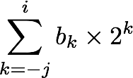
Fractional Binary Numbers
2^{i}
2^{i-1}
4
2
1
• • •
bi | bi-1 | ••• | b2 | b1 | b0 | b-1 | b-2 | b-3 | ••• | b-j
1/2
1/4
1/8
2^{-j}
• • •
Representation
  Bits to right of “binary point” represent fractional powers of 2
  Represents rational number:
Notes:
Latex source for equation: \sum_{k=-j}^i b_k \times 2^k

Slide 6
Fractional Binary Numbers: Examples
Value Representation
23 10111.000₂ = 16 + 4 + 2 + 1
11 1/2 = 23/2 01011.100₂ = 8 + 2 + 1 + 1/2
5 3/4 = 23/4 00101.1102 = 4 + 1 + 1/2 + 1/4
2 7/8 = 23/8 00010.1112 = 2 + 1/2 + 1/4 + 1/8
Observations
  Divide by 2 by shifting right (unsigned)
  Multiply by 2 by shifting left
  Numbers of form 0.111111…2 are just below 1.0
    1/2 + 1/4 + 1/8 + … + 1/2^{i} + … ➙ 1.0
    Use notation 1.0 – ε

Slide 7
Representable Numbers
Limitation #1
  Can only exactly represent numbers of the form x/2^{k}
    Other rational numbers have repeating bit representations
  Value Representation
    1/3 0.0101010101[01]…2
    1/5 0.001100110011[0011]…2
    1/10 0.0001100110011[0011]…2
Limitation #2
  Just one setting of binary point within the w bits
    Limited range of numbers (very small values? very large?)

Slide 8
(Binary) Scientific Notation
What are the parts of a number in scientific notation?
What value does the significand always begin with in scientific notation?
1.1101101101101₂ x 2¹³
Exponent
Significand

Slide 9
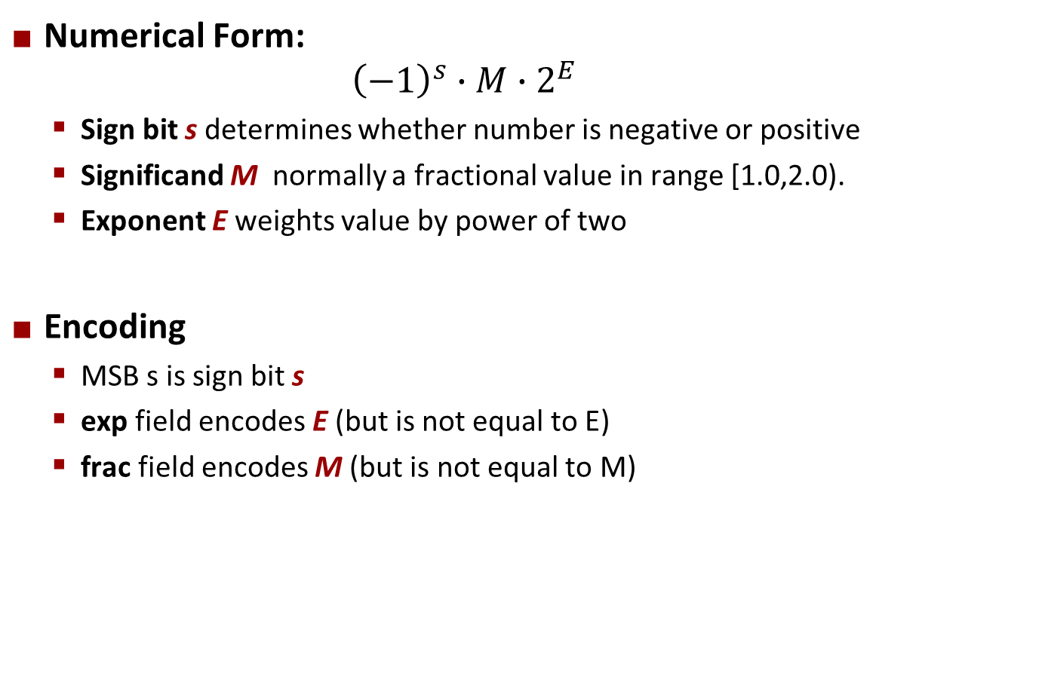
Floating Point Representation
  Example:
  15213₁₀ = (-1)⁰ x 1.1101101101101₂ x 2¹³
Numerical Form:
${\left(−1\right)}^{s}∙M∙2^{E}$
  Sign bit s determines whether number is negative or positive
  Significand M normally a fractional value in range [1.0,2.0).
  Exponent E weights value by power of two
Encoding
  MSB s is sign bit s
  exp field encodes E (but is not equal to E)
  frac field encodes M (but is not equal to M)
s | exp | frac

Slide 10
Floats can’t represent all real numbers!
Ariane 5 explodes on maiden voyage: $500 MILLION dollars lost
  64-bit floating point number assigned to 16-bit integer (1996)
  Legacy code from Ariane 4 with a lower top speed
  Causes rocket to get incorrect value of horizontal velocity and crash
Patriot Missile defense system misses scud – 28 people die
  System tracks time in tenths of second
  Converted from integer to floating point number.
  Accumulated rounding error causes drift. 20% drift over 8 hours.
  Eventually (on 2/25/1991 system was on for 100 hours) causes range mis-estimation sufficiently large to miss incoming missiles.
Notes:
To save time, fast forward video to 1:20 and watch only until 1:50.

Slide 11
Today: Floating Point
Background: Fractional binary numbers
IEEE floating point standard: Definition
Example and properties
Rounding, addition, multiplication
Floating point in C
Summary

Slide 12
IEEE Floating Point
IEEE Standard 754
  Established in 1985 as uniform standard for floating point arithmetic
    Before that, many idiosyncratic formats
  Supported by all major CPUs
    Some specialized CPUs don’t implement IEEE 754 in full
Driven by numerical concerns
  Nice standards for rounding, overflow, underflow
  Hard to make fast in hardware
    Numerical analysts predominated over hardware designers
    in defining standard

Slide 13
IEEE 754 Floating Point: Goal
6-bit IEEE-like format
  e = 3 exponent bits
  f = 2 fraction bits
  Bias is 2³⁻¹-1 = 3
Notice how the distribution gets denser toward zero.
s | exp | frac
1 | 3-bits | 2-bits
8 values
Wide range and precision where it is needed most

Slide 14
Distribution of Values (close-up view)
6-bit IEEE-like format
  e = 3 exponent bits
  f = 2 fraction bits
  Bias is 3
s | exp | frac
1 | 3-bits | 2-bits
Increasingly bigger steps for large numbers
Dense packing for small numbers

Slide 15
Precision options
Single precision: 32 bits
≈ 7 decimal digits, 10^{±38}
Double precision: 64 bits
≈ 16 decimal digits, 10^{±308}
Other formats: half precision, quad precision
s | exp | frac
1 | 8-bits | 23-bits
s | exp | frac
1 | 11-bits | 52-bits

Slide 16
Three “kinds” of floating point numbers
s | exp | frac
1 | e-bits | f-bits
00…00
exp ≠ 0 and exp ≠ 11…11
11…11
denormalized
normalized
special

Slide 17
“Normalized” Values
v = (–1)^{s} M 2E
When: exp ≠ 000…0 and exp ≠ 111…1
Exponent coded as a biased value: E = exp – Bias
  exp: unsigned value of exp field
  Bias = 2^{k-1} - 1, where k is number of exponent bits
    Single precision: 127 (exp: 1…254, E: -126…127)
    Double precision: 1023 (exp: 1…2046, E: -1022…1023)
Significand coded with implied leading 1: M = 1.xxx…x2
  xxx…x: bits of frac field
  Minimum when frac=000…0 (M = 1.0)
  Maximum when frac=111…1 (M = 2.0 – ε)
  Get extra leading bit for “free”

Slide 18
Normalized Encoding Example
v = (–1)^{s} M 2E
E = exp – Bias
Value: float F = 15213.0;
  15213₁₀ = 11101101101101₂
  = 1.1101101101101₂ x 2¹³
Significand
  M = 1.1101101101101₂
  frac = 11011011011010000000000₂
Exponent
  E = 13
  Bias = 127
  exp = 140 = 10001100₂
Result:
0 10001100 11011011011010000000000
s
exp
frac

Slide 19
Denormalized Values
v = (–1)^{s} M 2E
E = 1 – Bias
Condition: exp = 000…0
Exponent value: E = 1 – Bias (instead of exp – Bias) (why?)
Significand coded with implied leading 0: M = 0.xxx…x2
  xxx…x: bits of frac
Cases
  exp = 000…0, frac = 000…0
    Represents zero value
    Note distinct values: +0 and –0 (why?)
  exp = 000…0, frac ≠ 000…0
    Numbers closest to 0.0
    Equispaced

Slide 20
Special Values
Condition: exp = 111…1
Case: exp = 111…1, frac = 000…0
  Represents value ∞ (infinity)
  Operation that overflows
  Both positive and negative
  E.g., 1.0/0.0 = −1.0/−0.0 = +∞, 1.0/−0.0 = −∞
Case: exp = 111…1, frac ≠ 000…0
  Not-a-Number (NaN)
  Represents case when no numeric value can be determined
  E.g., sqrt(–1), ∞ − ∞, ∞ × 0

Slide 21
Quiz
Day 3 – Floating Point (Canvas)

Slide 22
Today: Floating Point
Background: Fractional binary numbers
IEEE floating point standard: Definition
Example and properties
Rounding, addition, multiplication
Floating point in C
Summary

Slide 23
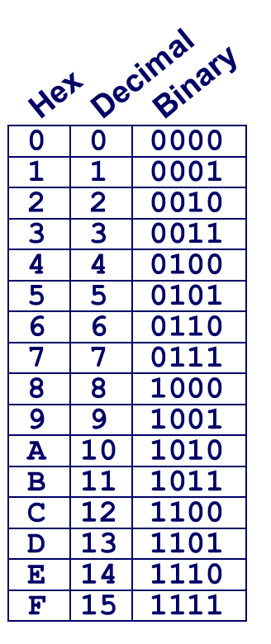
C float Decoding Example #1
v = (–1)^{s} M 2E
E = exp – Bias
float: 0xC0A00000
binary: 1100 0000 1010 0000 0000 0000 0000 0000
1 | 1000 0001 | 010 0000 0000 0000 0000 0000
1 | 8-bits | 23-bits
E = 129
S = 1 -> negative number
M = 1.010 0000 0000 0000 0000 0000
M = 1 + 1/4 = 1.25
v = (–1)^{s} M 2E =

Slide 24
C float Decoding Example #1
v = (–1)^{s} M 2E
E = exp – Bias
float: 0xC0A00000
  Bias = 2^{k-1} – 1 = 127
binary: 1100 0000 1010 0000 0000 0000 0000 0000
1 | 1000 0001 | 010 0000 0000 0000 0000 0000
1 | 8-bits | 23-bits
E = exp – Bias = 129 – 127 = 2 (decimal)
S = 1 -> negative number
M = 1.010 0000 0000 0000 0000 0000
M = 1 + 1/4 = 1.25
v = (–1)^{s} M 2E = (-1)¹ * 1.25 * 2² = -5

Slide 25
C float Decoding Example #2
v = (–1)^{s} M 2E
E = 1 – Bias
float: 0x001C0000
binary: 0000 0000 0001 1100 0000 0000 0000 0000
0 | 0000 0000 | 001 1100 0000 0000 0000 0000
1 | 8-bits | 23-bits
E = 129
S = 1 -> negative number
M = 0.010 0000 0000 0000 0000 0000
M = 1 + 1/4 = 1.25
v = (–1)^{s} M 2E =

Slide 26
C float Decoding Example #2
v = (–1)^{s} M 2E
E = 1 – Bias
float: 0x001C0000
  Bias = 2^{k-1} – 1 = 127
binary: 0000 0000 0001 1100 0000 0000 0000 0000
0 | 0000 0000 | 001 1100 0000 0000 0000 0000
1 | 8-bits | 23-bits
E = 1 – Bias = 1 – 127 = –126 (decimal)
S = 0 -> positive number
M = 0.001 1100 0000 0000 0000 0000
M = 1/8 + 1/16 + 1/32 = 7/32 = 7*2^{–5}
v = (–1)^{s} M 2E = (-1)⁰ * 7*2^{–5} * 2^{–126} = 7*2^{–131}
v ≈ 2.571393892 X 10^{–39}

Slide 27
Visualization: Floating Point Encodings
−∞
+∞
−Normalized
−Denorm
+Denorm
+Normalized
NaN
NaN
−0
+0

Slide 28
Special Properties of the IEEE Encoding
FP Zero Same as Integer Zero
  All bits = 0
Can (Almost) Use Unsigned Integer Comparison
  Must first compare sign bits
  Must consider −0 = 0
  NaNs problematic
    Will be greater than any other values
    What should comparison yield? The answer is complicated.
  Otherwise OK
    Denorm vs. normalized
    Normalized vs. infinity

Slide 29
Interesting Numbers
{single,double}
Description exp frac Numeric Value
Zero 00…00 00…00 0.0
Smallest Pos. Denorm. 00…00 00…01 2^{– {23,52}} x 2^{– {126,1022}}
  Single ≈ 1.4 x 10^{–45}
  Double ≈ 4.9 x 10^{–324}
Largest Denormalized 00…00 11…11 (1.0 – ε) x 2^{– {126,1022}}
  Single ≈ 1.18 x 10^{–38}
  Double ≈ 2.2 x 10^{–308}
Smallest Pos. Normalized 00…01 00…00 1.0 x 2^{– {126,1022}}
  Just larger than largest denormalized
One 01…11 00…00 1.0
Largest Normalized 11…10 11…11 (2.0 – ε) x 2^{{127,1023}}
  Single ≈ 3.4 x 10³⁸
  Double ≈ 1.8 x 10³⁰⁸

Slide 30
Dynamic Range (s=0 only)
v = (–1)^{s} M 2E
norm: E = exp – Bias
denorm: E = 1 – Bias
s exp frac E Value
0 0000 000 -6 0
0 0000 001 -6 1/8*1/64 = 1/512
0 0000 010 -6 2/8*1/64 = 2/512
…
0 0000 110 -6 6/8*1/64 = 6/512
0 0000 111 -6 7/8*1/64 = 7/512
0 0001 000 -6 8/8*1/64 = 8/512
0 0001 001 -6 9/8*1/64 = 9/512
…
0 0110 110 -1 14/8*1/2 = 14/16
0 0110 111 -1 15/8*1/2 = 15/16
0 0111 000 0 8/8*1 = 1
0 0111 001 0 9/8*1 = 9/8
0 0111 010 0 10/8*1 = 10/8
…
0 1110 110 7 14/8*128 = 224
0 1110 111 7 15/8*128 = 240
0 1111 000 n/a inf
closest to zero
Denormalized
numbers
(-1)⁰(0+1/4)*2⁻⁶
largest denorm
smallest norm
(-1)⁰(1+1/8)*2⁻⁶
closest to 1 below
Normalized
numbers
closest to 1 above
largest norm

Slide 31
Today: Floating Point
Background: Fractional binary numbers
IEEE floating point standard: Definition
Example and properties
Rounding, addition, multiplication
Floating point in C
Summary

Slide 32
Floating Point Operations: Basic Idea
x +f y = Round(x + y)
x ×f y = Round(x × y)
Basic idea
  First compute exact result
  Make it fit into desired precision
    Possibly overflow if exponent too large
    Possibly round to fit into frac

Slide 33
Rounding
Rounding Modes (illustrate with $ rounding)
$1.40 $1.60 $1.50 $2.50 –$1.50
  Towards zero $1 $1 $1 $2 –$1
  Round down (−∞) $1 $1 $1 $2 –$2
  Round up (+∞) $2 $2 $2 $3 –$1
  Nearest Even* (default) $1 $2 $2 $2 –$2
*Round to nearest, but if half-way in-between then round to nearest even

Slide 34
Closer Look at Round-To-Even
Default Rounding Mode
  Hard to get any other kind without dropping into assembly
    C99 has support for rounding mode management
  All others are statistically biased
    Sum of set of positive numbers will consistently be over- or under- estimated
Applying to Other Decimal Places / Bit Positions
  When exactly halfway between two possible values
    Round so that least significant digit is even
  E.g., round to nearest hundredth
    7.8949999 7.89 (Less than half way)
    7.8950001 7.90 (Greater than half way)
    7.8950000 7.90 (Half way—round up)
    7.8850000 7.88 (Half way—round down)

Slide 35
Rounding Binary Numbers
Binary Fractional Numbers
  “Even” when least significant bit is 0
  “Half way” when bits to right of rounding position = 100…2
Examples
  Round to nearest 1/4 (2 bits right of binary point)
  Value Binary Rounded Action Rounded Value
  2 3/32 10.000112 10.002 (<1/2—down) 2
  2 3/16 10.001102 10.012 (>1/2—up) 2 1/4
  2 7/8 10.111002 11.002 ( 1/2—up) 3
  2 5/8 10.101002 10.102 ( 1/2—down) 2 1/2

Slide 36
Rounding
1.BBGRXXX
Guard bit: LSB of result
Sticky bit: OR of remaining bits
Round bit: 1st bit removed
Round up conditions
  Round = 1, Sticky = 1 ➙ > 0.5
  Guard = 1, Round = 1, Sticky = 0 ➙ Round to even
  Fraction GRS Incr? Rounded
  1.0000000 000 N 1.000
  1.1010000 100 N 1.101
  1.0001000 010 N 1.000
  1.0011000 110 Y 1.010
  1.0001010 011 Y 1.001
  1.1111100 111 Y 10.000

Slide 37
FP Multiplication
(–1)^{s1} M1 2^{E1} x (–1)^{s2} M2 2^{E2}
Exact Result: (–1)^{s} M 2E
  Sign s: s1 ^ s2
  Significand M: M1 x M2
  Exponent E: E1 + E2
Fixing
  If M ≥ 2, shift M right, increment E
  If E out of range, overflow
  Round M to fit frac precision
Implementation
  Biggest chore is multiplying significands
4 bit significand: 1.010*2² x 1.110*2³ = 10.0011*2⁵
= 1.00011*2⁶ = 1.001*2⁶

Slide 38
Floating Point Addition
(–1)^{s1} M1 2^{E1} + (-1)^{s2} M2 2^{E2}
  Assume E1 > E2
Exact Result: (–1)^{s} M 2E
  Sign s, significand M:
    Result of signed align & add
  Exponent E: E1
Fixing
  If M ≥ 2, shift M right, increment E
  if M < 1, shift M left k positions, decrement E by k
  Overflow if E out of range
  Round M to fit frac precision
Get binary points lined up
E1–E2
(–1)^{s1} M1
+
(–1)^{s2} M2
(–1)^{s} M
1.010*2² + 1.110*2³ = (0.1010 + 1.1100)*2³
= 10.0110 * 2³ = 1.00110 * 2⁴ = 1.010 * 2⁴

Slide 39
Mathematical Properties of FP Add
Compare to those of Abelian Group
  Closed under addition?
    But may generate infinity or NaN
  Commutative?
  Associative?
    Overflow and inexactness of rounding
    (3.14+1e10)-1e10 = 0, 3.14+(1e10-1e10) = 3.14
  0 is additive identity?
  Every element has additive inverse?
    Yes, except for infinities & NaNs
Monotonicity
  a ≥ b ⇒ a+c ≥ b+c?
    Except for infinities & NaNs
Yes
Yes
No
Yes
Almost
Almost

Slide 40
Mathematical Properties of FP Mult
Compare to Commutative Ring
  Closed under multiplication?
    But may generate infinity or NaN
  Multiplication Commutative?
  Multiplication is Associative?
    Possibility of overflow, inexactness of rounding
    Ex: (1e20*1e20)*1e-20= inf, 1e20*(1e20*1e-20)= 1e20
  1 is multiplicative identity?
  Multiplication distributes over addition?
    Possibility of overflow, inexactness of rounding
    1e20*(1e20-1e20)= 0.0, 1e20*1e20 – 1e20*1e20 = NaN
Monotonicity
  a ≥ b & c ≥ 0 ⇒ a * c ≥ b *c?
    Except for infinities & NaNs
Yes
Yes
No
Yes
No
Almost

Slide 41
Today: Floating Point
Background: Fractional binary numbers
IEEE floating point standard: Definition
Example and properties
Rounding, addition, multiplication
Floating point in C
Summary

Slide 42
Floating Point in C
C Guarantees Two Levels
  float single precision
  double double precision
Conversions/Casting
  Casting between int, float, and double changes bit representation
  double/float → int
    Truncates fractional part
    Like rounding toward zero
    Not defined when out of range or NaN: Generally sets to TMin
  int → double
    Exact conversion, as long as int has ≤ 53 bit word size
  int → float
    Will round according to rounding mode

Slide 43


Floating Point Puzzles
For each of the following C expressions, either:
  Argue that it is true for all argument values
  Explain why not true
x == (int)(float) x
x == (int)(double) x
f == (float)(double) f
d == (double)(float) d
f == -(-f);
2/3 == 2/3.0
d < 0.0 ⇒ ((d*2) < 0.0)
d > f ⇒ -f > -d
d * d >= 0.0
(d+f)-d == f
int x = …;
float f = …;
double d = …;
Assume neither
d nor f is NaN

Slide 44
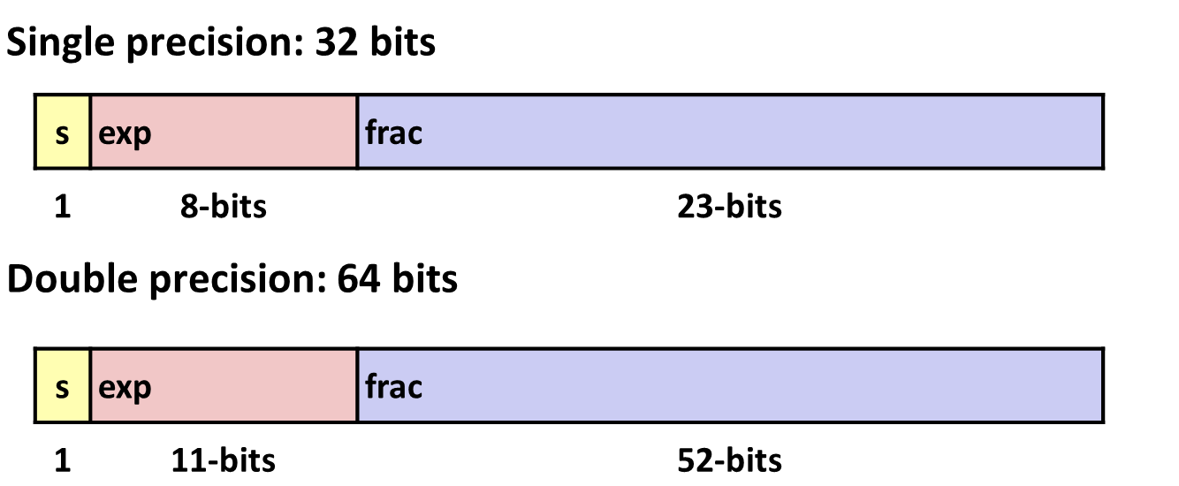
Summary
IEEE Floating Point has clear mathematical properties
Represents numbers of form M x 2E
One can reason about operations independent of implementation
  As if computed with perfect precision and then rounded
Not the same as real arithmetic
  Violates associativity/distributivity
  Makes life difficult for compilers & serious numerical applications programmers

Slide 45
Additional Slides

Slide 46
Creating Floating Point Number
Steps
  Normalize to have leading 1
  Round to fit within fraction
  Postnormalize to deal with effects of rounding
Case Study
  Convert 8-bit unsigned numbers to tiny floating point format
  Example Numbers
  128 10000000
  15 00001101
  33 00010001
  35 00010011
  138 10001010
  63 00111111
s | exp | frac
1 | 4-bits | 3-bits

Slide 47
Normalize
s | exp | frac
1 | 4-bits | 3-bits
Requirement
  Set binary point so that numbers of form 1.xxxxx
  Adjust all to have leading one
    Decrement exponent as shift left
  Value Binary Fraction Exponent
  128 10000000 1.0000000 7
  15 00001101 1.1010000 3
  17 00010001 1.0001000 4
  19 00010011 1.0011000 4
  138 10001010 1.0001010 7
  63 00111111 1.1111100 5

Slide 48
Postnormalize
Issue
  Rounding may have caused overflow
  Handle by shifting right once & incrementing exponent
  Value Rounded Exp Adjusted Numeric Result
  128 1.000 7 128
  15 1.101 3 15
  17 1.000 4 16
  19 1.010 4 20
  138 1.001 7 134
  63 10.000 5 1.000/6 64

Slide 49
Tiny Floating Point Example
s | exp | frac
1 | 4-bits | 3-bits
8-bit Floating Point Representation
  the sign bit is in the most significant bit
  the next four bits are the exp, with a bias of 7
  the last three bits are the frac
Same general form as IEEE Format
  normalized, denormalized
  representation of 0, NaN, infinity

