Slide 1

14-513
18-613

Slide 2
OpenMP: An Introduction 18-213/18-613: Introduction to Computer Systems 26th Lecture, April 21th, 2022
Very lightly adapted from Prof. Scott Baden’s Lecture 8, CS-160, Winter 2016 @ CSE, UCSD

Slide 3
Announcements
Lab 7 (proxylab) checkpoint due today!
Happy hacking!
Final submission due Thursday, April 28th
Homework is on the usual schedule
Also due Thursday, April 28th.
We have an early final exam: Monday, May 2nd @ 5:30pm ET
See Fall 2021 practice exams on Web site
Format and content will be similar
Counts BIG: 25% of final grade
Each 4 points = 1 point on final grade
Small Groups next week will help prepare
You’ll need to review: It is comprehensive to “Day One”
Please let us know how we can help

Slide 4
Today
OpenMP Overview

Slide 5
OpenMP
A higher level interface for thread programming:
http://www.openmp.org
Parallelization via source code annotations
All major compilers support it, including gnu
https://gcc.gnu.org/wiki/openmp
Compare with explicit threads programing
#pragma omp parallel private(i) shared(n)
{
#pragma omp for
for(i=0; i < n; i++)
work(i);
}
int i0 = (n*TID)/NTHREADS;
int i1 = i0 + n/NTHREADS;
for (i=i0; i< i1; i++)
work(i);
8

Slide 6
OpenMP’s Fork-Join Model
A program begins life as a single thread
Enter a parallel region, spawning a team of threads
The lexically enclosed program statements execute in parallel by all team members
When we reach the end of the scope…
The team of threads synchronize at a barrier and are disbanded; they enter a wait state
Only the initial thread continues
Thread teams can be created and disbanded many times during program execution, but this can be costly
A clever compiler can avoid many thread creations and joins

Slide 7
Fork join model with loops
cout << “Serial\n”;
N = 1000;
#pragma omp parallel{
#pragma omp for
for (i=0; i<N; i++)
A[i] = B[i] + C[i];
#pragma omp single
M = A[N/2];
#pragma omp for
for (j=0; j<M; j++)
p[j] = q[j] – r[j];
}
cout << “Finish\n”;
Seung-Jai Min
Serial
Parallel
Serial
Parallel
Serial

Slide 8
Loop parallelization
The translator automatically generates appropriate local loop bounds
Also inserts any needed barriers
We use private/shared clauses to distinguish thread private from global data
Handles irregular problems
Decomposition can be static or dynamic
#pragma omp parallel for shared(Keys) private(i) reduction(&:done) for i = OE; i to N-2 by 2
if (Keys[i] > Keys[i+1]) swap Keys[i] ↔ Keys[i+1]; done *= false; } end do
return done;

Slide 9
Another way of annotating loops
These are equivalent
#pragma omp parallel
{
#pragma omp for
for (int i=1; i< N-1; i++) a[i] = (b[i+1] – b[i-1])/2h
}
#pragma omp parallel for for (int i=1; i< N-1; i++)
a[i] = (b[i+1] – b[i-1])/2h

Slide 10
Variable scoping
Any variables declared outside a parallel region are shared by all threads
Variables declared inside the region are private
Shared & private declarations override defaults, also usefule as documentation
int main (int argc, char *argv[]) {
double a[N], b[N], c[N]; int i;
#pragma omp parallel for shared(a,b,c,N) private(i)
for (i=0; i < N; i++)
a[i] = b[i] = (double) i;
#pragma omp parallel for shared(a,b,c,N) private(i)
for (i=0; i<N; i++)
c[i] = a[i] + sqrt(b[i]);

Slide 11
Dealing with loop carried dependences
OpenMP will dutifully parallelize a loop when you tell it to, even if doing so “breaks” the correctness of the code
int* fib = new int[N]; fib[0] = fib[1] = 1;
#pragma omp parallel for num_threads(2) for (i=2; i<N; i++)
fib[i] = fib[i-1]+ fib[i-2];
Sometimes we can restructure an algorithm, as we saw in odd/even sorting
OpenMP may warn you when it is doing something unsafe, but not always

Slide 12

Why dependencies prevent parallelization
Consider the following loops
#pragma omp parallel
{
#pragma omp for nowait
for (int i=1; i< N-1; i++)
a[i] = (b[i+1] – b[i-1])/2h
#pragma omp for
for (int i=N-2; i>0; i--)
b[i] = (a[i+1] – a[i-1])/2h
}
Why aren’t the results correct?

Slide 13


Why dependencies prevent parallelization
Consider the following loops
#pragma omp parallel
{
#pragma omp for nowait
for (int i=1; i< N-1; i++)
a[i] = (b[i+1] – b[i-1])/2h
#pragma omp for
for (int N-2; i>0; i--)
b[i] = (a[i+1] – a[i-1])/2h
}
Results will be incorrect because the array a[ ], in
loop #2, depends on the outcome of loop #1 (a true dependence)
We don’t know when the threads finish
OpenMP doesn’t define the order that the loop iterations wil be incorrect

Slide 14
Barrier Synchronization in OpenMP
To deal with true- and anti-dependences, OpenMP inserts a barrier (by default) between loops:
for (int i=0; i< N-1; i++)
a[i] = (b[i+1] – b[i-1])/2h
BARRIER
for (int i=N-1; i>=0; i--)
b[i] = (a[i+1] –a[i-1])/2h
No thread may pass the barrier until all have arrived hence loop 2 may not write into b until loop 1 has finished reading the old values
Do we need the barrier in this case? Yes
for (int i=0; i< N-1; i++)
a[i] = (b[i+1] – b[i-1])/2h
BARRIER?
for (int i=N-1; i>=0; i--)
c[i] = a[i]/2;

Slide 15
Which loops can OpenMP parallellize, assuming there is a barrier before the start of the loop?
A. 1 & 2
B. 1 & 3
C. 3 & 4
D. 2 & 4
All the loops
1. for i = 1 to N-1
A[i] = A[i] + B[i-1];
4. for i = 0 to N-2{
A[i] = B[i];
C[i] = A[i] + B[i];
E[i] = C[i+1];
}
2. for i = 0 to N-2 A[i+1] = A[i] + 1;
3. for i = 0 to N-1 step 2
A[i] = A[i-1] + A[i];
All arrays have at least N elements

Slide 16
Which loops can OpenMP parallellize, assuming there is a barrier before the start of the loop?
A. 1 & 2
B. 1 & 3
C. 3 & 4
D. 2 & 4
All the loops
1. for i = 1 to N-1
A[i] = A[i] + B[i-1];
4. for i = 0 to N-2{
A[i] = B[i];
C[i] = A[i] + B[i];
E[i] = C[i+1];
}
2. for i = 0 to N-2 A[i+1] = A[i] + 1;
3. for i = 0 to N-1 step 2
A[i] = A[i-1] + A[i];
All arrays have at least N elements

Slide 17
How would you parallelize loop 2 by hand?
for i = 1 to N-1
A[i] = A[i] + B[i-1];
for i = 0 to N-2 A[i+1] = A[i] + 1;

Slide 18
How would you parallelize loop 2 by hand?
for i = 0 to N-2 A[i+1] = A[i] + 1;
for i = 0 to N-2 A[i+1] = A[0] + i;

Slide 19
To ensure correctness, where must we remove the nowait clause?
Between loops 1 and 2
Between loops 2 and 3
Between both loops
D. None
#pragma omp parallel for shared(a,b,c) private(i)
for (i=0; i<N; i++)
c[i] = (double) i
#pragma omp parallel for shared(c) private(i) nowait
for (i=1; i<N; i+=2)
c[i] = c[i] + c[i-1]
#pragma omp parallel for shared(c) private(i) nowait
for (i=2; i<N; i+=2)
c[i] = c[i] + c[i-1]

Slide 20
To ensure correctness, where must we remove the nowait clause?
Between loops 1 and 2
Between loops 2 and 3
Between both loops
D. None
#pragma omp parallel for shared(a,b,c) private(i)
for (i=0; i<N; i++)
c[i] = (double) i
#pragma omp parallel for shared(c) private(i) nowait
for (i=1; i<N; i+=2)
c[i] = c[i] + c[i-1]
#pragma omp parallel for shared(c) private(i) nowait
for (i=2; i<N; i+=2)
c[i] = c[i] + c[i-1]

Slide 21
Exercise: Removing data dependencies
How can we split this loop into 2 loops so that each loop parallelizes, and the result it correct?
 B initially:
 B on 1 thread:
0 1 2 3 4 5 6 7
7 7 7 7 11 12 13 14
#pragma omp parallel for shared (N,B)
for i = 0 to N-1
B[i] += B[N-1-i];
B[0] += B[7], | B[1] += B[6], | B[2] += B[5]
B[3] += B[4], | B[4] += B[3], | B[5] += B[2]
B[6] += B[1], | B[7] += B[0]

Slide 22
Splitting a loop
For iterations i=N/2+1 to N, B[N-i] references newly computed data
All others reference “old” data
B initially:
Correct result:
0 1 2 3 4 5 6 7
7 7 7 7 11 12 13 14
#pragma omp parallel for nowait
for i = 0 to N/2-1
B[i] += B[N-1-i];
for i = N/2+1 to N-1
B[i] += B[N-1-i];
for i = 0 to N-1
B[i] += B[N-i];

Slide 23
Reductions in OpenMP
In some applications, we reduce a collection of values down to a single global value
Taking the sum of a list of numbers
Decoding when Odd/Even sort has finished
OpenMP avoids the need for an explicit serial section
int Sweep(int *Keys, int N, int OE, ) {
bool done = true;
#pragma omp parallel for reduction(&:done)
for (int i = OE; i < N-1; i+=2) {
if (Keys[i] > Keys[i+1]) {
Keys[i] ↔ Keys[i+1];
done &= false;
}
} //All threads ‘and’ their done flag into a local variable
// and store the accumulated value into the global
return done;
}

Slide 24
Reductions in OpenMP
In some applications, we reduce a collection of values down to a single value
Taking the sum of a list of numbers
Decoding when Odd/Even sort has finished
OpenMP avoids the need for an explicit serial section
int Sweep(int *Keys, int N, int OE) {
bool done = true;
#pragma omp parallel for reduction(&:done)
for (int i = OE; i < N-1; i+=2) {
if (Keys[i] > Keys[i+1]) {
Keys[i] ↔ Keys[i+1];
done &= false;
}
} //All threads ‘and’ their done flag into the local variable
return done;
}

Slide 25
Which functions may we use in a reduction?
Add
Subtract
Logical And
A and B
A,B and C
a₀ + a₁ + …. + a_{n-1}
a₀ - a₁ - …. - a_{n-1}
a₀ ⋀ a₁ ⋀ …. ⋀ a_{n-1}

Slide 26
Which functions may we use in a reduction?
Add
Subtract
Logical And
A and B
A,B and C
a₀ + a₁ + …. + a_{n-1}
a₀ - a₁ - …. - a_{n-1}
a₀ ⋀ a₁ ⋀ …. ⋀ a_{n-1}

Slide 27
Odd-Even sort in OpenMP
for s = 1 to MaxIter do
done = Sweep(Keys, N, 0);
done &= Sweep(Keys, N, 1);
if (done) break;
end do
int Sweep(int *Keys, int N, int OE){
bool done=true;
#pragma omp parallel for shared(Keys) private(i) reduction(&:done)
for (i = OE; i < N-1; i+=2) {
if (Keys[i] > Keys[i+1]) {
int tmp = Keys[i];
Keys[i] = Keys[i+1];
Keys[i+1] = tmp;
done *= false;
}
return done;
}
ªi-1
a_{i}
ªi+1
-n 8Mi, -i 200, -f 50
P=1 | P=2 | P=4 | P=8
6.09s | 3.51s | 2.78s | 2.78s
g++ -fopenmp, on Bang

Slide 28
Why isn’t a barrier needed between the calls to sweep( )?
The calls to sweep occur outside parallel sections
OpenMP inserts barriers after the calls to Sweep
OpenMP places a barrier after the “for i" loop inside Sweep()
A & C
B & C
for (s = 1; s<= to MaxIter; s++) {
done = Sweep(Keys, N, 0);
done &= Sweep(Keys, N, 1);
if (done) break;
}
int Sweep(int *Keys, int N, int OE) {
bool done=true;
#pragma omp parallel for shared(Keys) private(i) reduction(&:done)
for (i = OE; i<= (N-2); i-=2) {
if (Keys[i] > Keys[i+1]) {
swap (&Keys[i], &Keys[i+1]);
done &= false;
}
}
return done;
}

Slide 29
Why isn’t a barrier needed between the calls to sweep( )?
The calls to sweep occur outside parallel sections
OpenMP inserts barriers after the calls to Sweep
OpenMP places a barrier after the “for i" loop inside Sweep()
A & C
B & C
for (s = 1; s<= to MaxIter; s++) {
done = Sweep(Keys, N, 0);
done &= Sweep(Keys, N, 1);
if (done) break;
}
int Sweep(int *Keys, int N, int OE) {
bool done=true;
#pragma omp parallel for shared(Keys) private(i) reduction(&:done)
for (i = OE; i<= (N-2); i-=2) {
if (Keys[i] > Keys[i+1]) {
swap (&Keys[i], &Keys[i+1]);
done &= false;
}
}
return done;
}

Slide 30
Another way of annotating loops + Sharing
These examples are equivalent
Why don’t we need to declare private(i)?
#pragma omp parallel shared(a,b) {
#pragma omp for schedule(static)
for (int i=1; i< N-1; i++)
a[i] = (b[i+1] – b[i-1])/2h
}
#pragma omp parallel for shared(a,b) schedule(static)
for (int i=1; i< N-1; i++)
a[i] = (b[i+1] – b[i-1])/2h
OpenMP has rules about what is shared vs private by default
Shared by default
Declared outside a private area
Global, static, or dynamically allocated
Private by default
Loop control variables
Local/Automatic variables declared within parallel area

Slide 31
The No Wait clause
Removes the barrier after an omp for loop
Why are the results incorrect?
We don’t know when the threads finish
OpenMP doesn’t define the order that the loop iterations will be incorrect
#pragma omp parallel
{
#pragma omp for nowait
for (int i=1; i< N-1; i++) a[i] = (b[i+1] – b[i-1])/2h
#pragma omp for
for (int i=N-2; i>0; i--)
b[i] = (a[i+1] – a[i-1])/2h
}

Slide 32
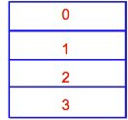
Parallelizing a nested loop with OpenMP
Not all implementations can parallelize inner loops
We parallelize the outer loop index
#pragma omp parallel private(i) shared(n)
#pragma omp for
for(i=0; i < n; i++) {
for(j=0; j < n; j++) {
V[i,j] = (u[i-1,j] + u[i+1,j]+ u[i,j-1]+ u[i, j+1] - h2f[i,j])/4
}
}
Generated code
mymin = 1 + ($TID * n/NT),
for(i=mymin; i < mymax; i++) {
for(j=0; j < n; j++) {
V[i,j] = (u[i-1,j] + u[i+1,j]+ u[i,j-1]+ u[i, j+1] - h²f[i,j])/4
}
}
Barrier();

Slide 33
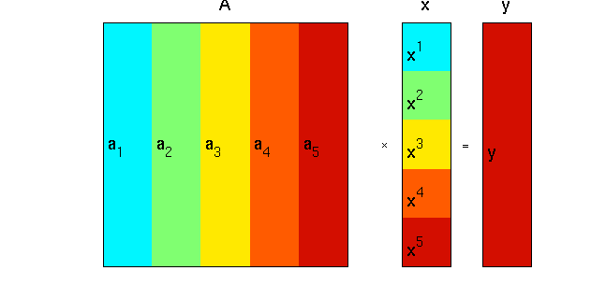
An application: Matrix Vector Multiplication

Slide 34
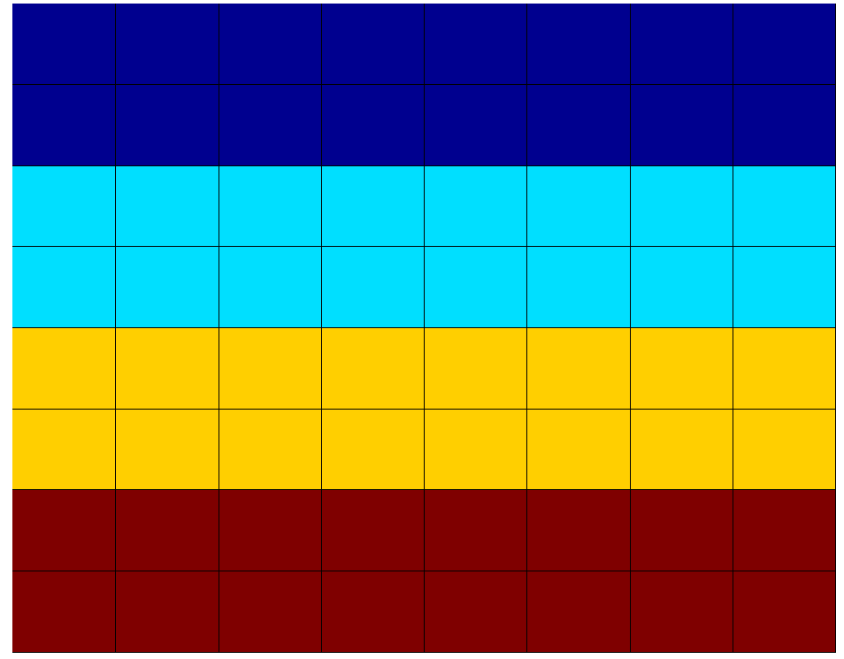
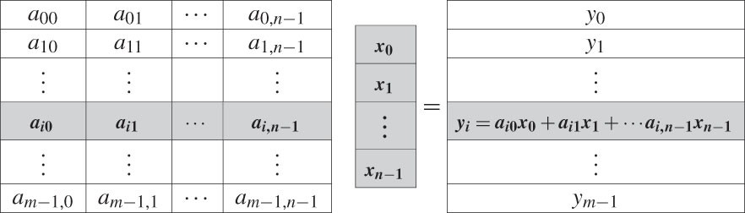
Application: Matrix Vector Multiplication
double **A, *x, *y;
#pragma omp parallel shared(A,x,N)
#pragma omp for
for (i=0; i<N; i++){ y[i] = 0.0;
for (j=0; j<N; j++) y[i] += A[i][j] * x[j];
}
// GLOBAL

Slide 35
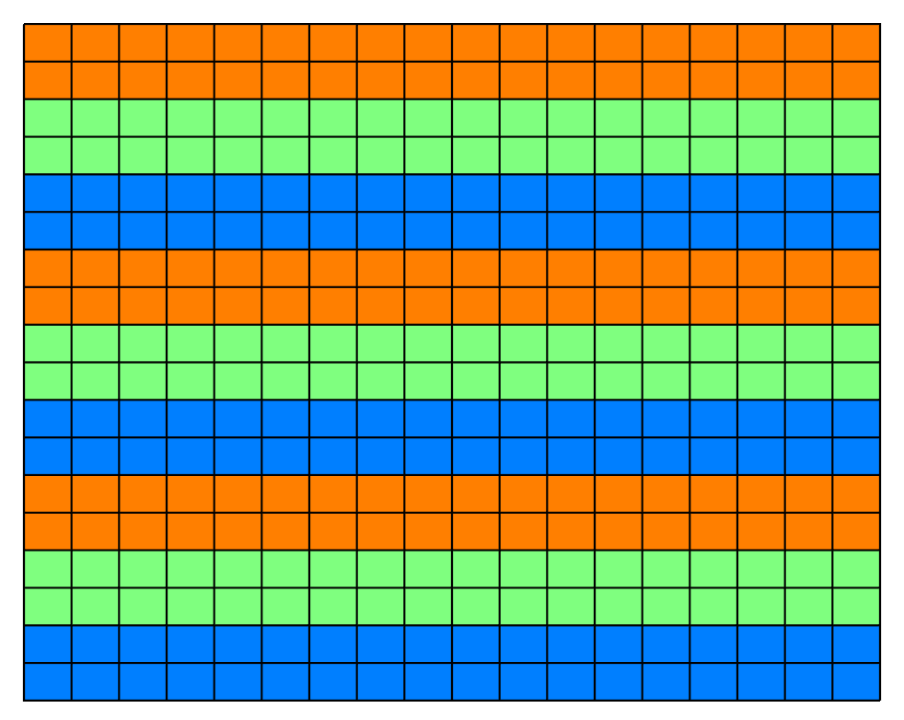

Support for load balancing in OpenMP
OpenMP supports Block Cyclic decompositions with chunk size
#pragma omp parallel for schedule(static, 2)
for ( int i = 0; i < n; i++ ) {
for (int j = 0; j < n; j++ ){ do
z = z² + c
while (|z| < 2 );
}
}

Slide 36
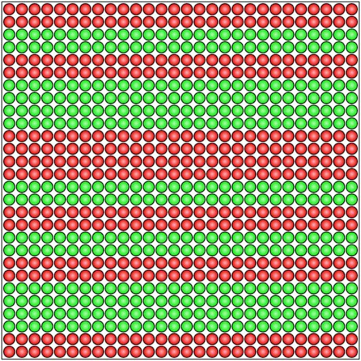
OpenMP supports self scheduling
Adjust task granularity with a chunksize
#pragma omp parallel for schedule(dynamic, 2)
for( int i = 0; i < n; i++ ) {
for (int j = 0; j < n; j++ ){
do
z = z² + c
while (|z| < 2 )
}
}

Slide 37
Iteration to thread mapping in OpenMP
#pragma omp parallel shared(N,iters) private(i)
#pragma omp for
for (i = 0; i < N; i++)
iters[i] = omp_get_thread_num();
# of openMP threads = 3 (no schedule)
N = 9: 0 0 0 1 1 1 2 2 2
# of openMP threads = 4, schedule(static,2):
N = 16: 0 0 1 1 2 2 3 3 0 0 1 1 2 2 3 3
# of openMP threads = 4, schedule(static,2)
N=9: 0 0 1 1 2 2 0 0 1

Slide 38
Initializing Data in OpenMP
Allocate heap storage (shared) outside a parallel region
Initialize it inside a parallel region
May allow it to be done in parallel.
double **A;
A =(double**) malloc(sizeof(double*)*N + sizeof(double)*N*N);
assert(A);
#pragma omp parallel private(j) shared(A,N)
for(j=0;j<N;j++)
A[j] = (double *)(A+N) + j*N;
#pragma omp parallel private(i,j) shared(A,N)
for ( j=0; j<N; j++ )
for ( i=0; i<N; ci++ )
A[i][j] = 1.0 / (double) (i+j-1);

Slide 39
OpenMP is also an API
But we don’t use this lower level interface unless necessary
Parallel for is much easier to use
#ifdef _OPENMP
#include <omp.h>
#endif
int tid=0, nthrds,1;
#pragma omp parallel
{
#ifdef _OPENMP
tid = omp_get_thread_num();
nthrds = omp_get_num_threads();
#endif
int i0=(n/nthrds)*tid, i1=i0+n/nthrds;
for(i=i0; i < i1; i++)
work(i);
}

Slide 40
Summary: what does OpenMP accomplish for us?
Higher level interface simplifies the programmer’s model
Spawn and join threads, “Outlining” code into a thread function
Handles synchronization and partitioning
If it does all this, why do you think we need to have a lower level threading interface?

