Slide 1
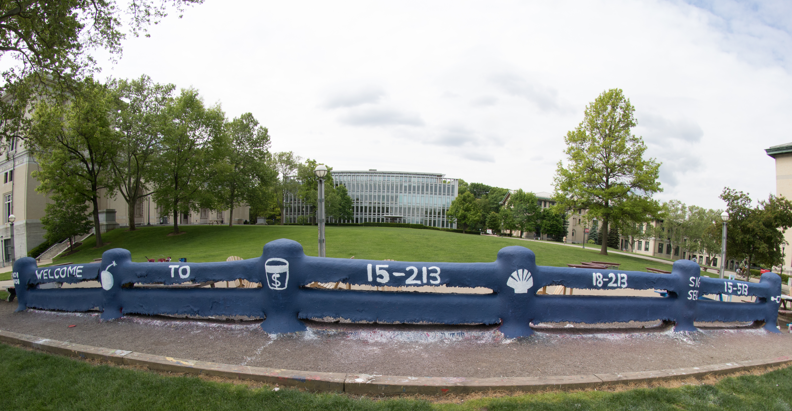
14-513
18-613

Slide 2
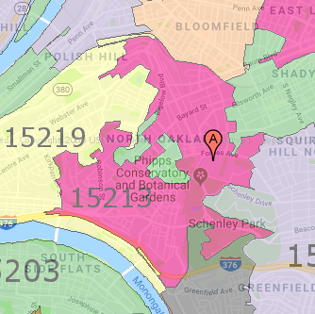
Course Overview
18-213/18-613: Computer Systems
An 15-213/18-213/15-513/14-513/18-613 Ecosystem Course
1st Lecture, May 13th, 2025
Instructors:
Gregory Kesden

Slide 3
18-213/18-613
In A Nutshell

Slide 4
Why Are We Here?
“This course provides a programmers view of how computer systems execute programs, store information, and communicate.”
“It enables students to become more effective programmers, especially in dealing with issues of performance, portability and robustness.”
“It also serves as a foundation for courses on compilers, networks, operating systems, and computer architecture, where a deeper understanding of systems-level issues is required.”
  From the official course description, emphasis added.

Slide 5
Why Are We Here?
Topics covered include:
  machine-level code and its generation by optimizing compilers,
  performance evaluation and optimization,
  computer arithmetic,
  memory organization and management,
  networking technology and protocols, and
  supporting concurrent computation.
Also from the official course description

Slide 6
Who Are You?
(And, Who Is Everyone Else?)

Slide 7
Who Are You?
18-213
  ECE Undergrads
18-613
  MS in Electrical and Computer Engineering (Pittsburgh and Silicon Valley)
  MS in Software Engineering (Silicon Valley)
  MS in Artificial Intelligence Engineering
Interlopers ☺
  Others who happened to want the flexibility of a remote class this summer, since the other related offerings are Pittsburgh-centric.
    You are most welcome and invited!

Slide 8
Where Is Everyone Else? Sibling Offering
15-213
  Undergrads in CS (Majors, 2nd majors, minors)
14-513/15-513
  Other Masters Students (Outside of the College of Engineering)

Slide 9
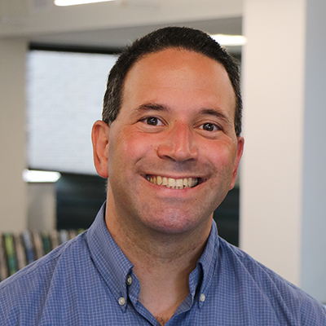
Who Am I?
I’m Here To Help!

Slide 10
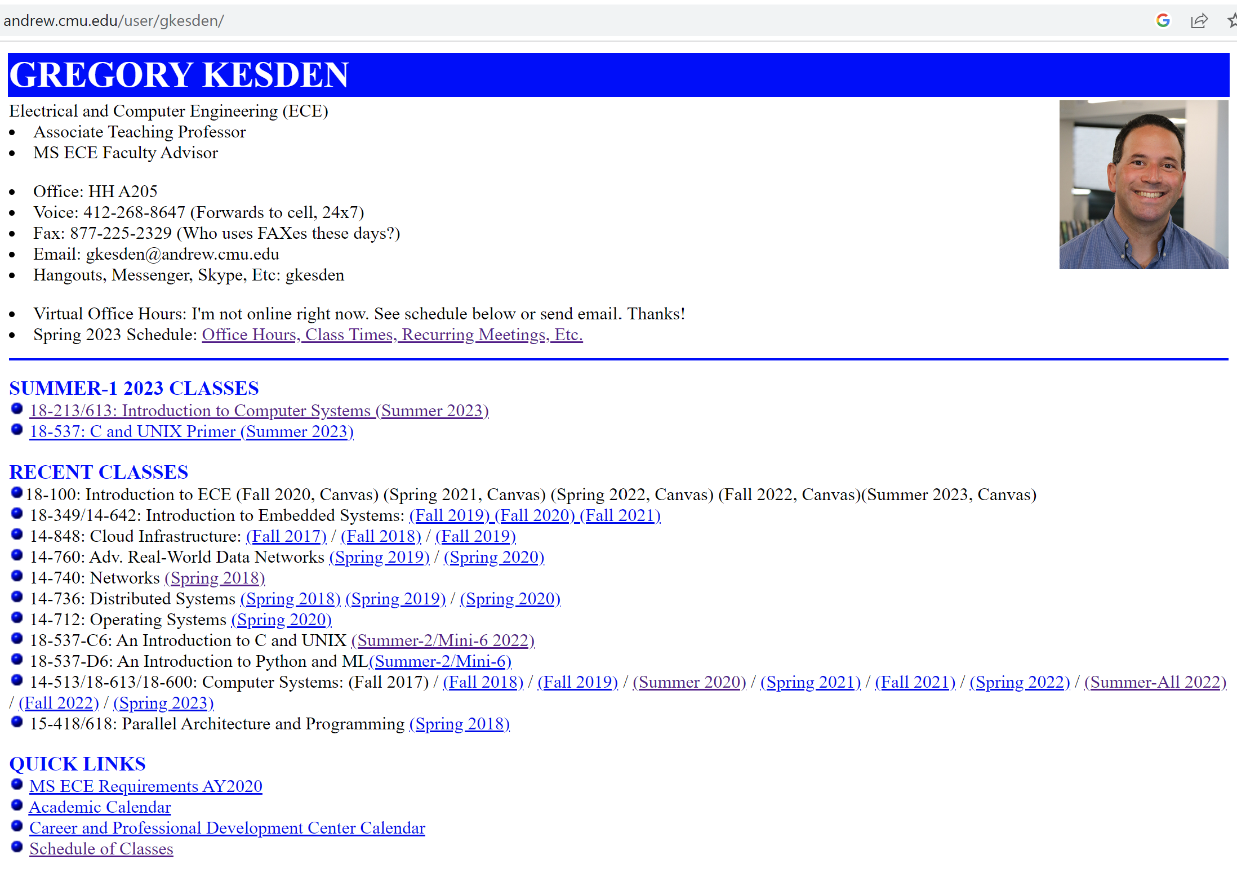
Who Am I? Gregory Kesden

Slide 11

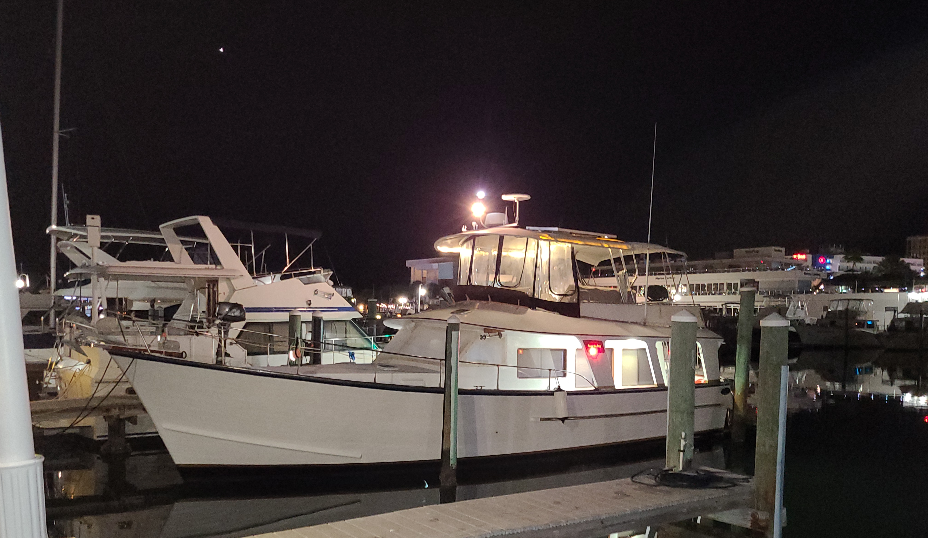
Where Am I? Working Remote (Sometimes)

Slide 12
About Me
I’m Here To Help!

Slide 13
About The Course
Topical Coverage In Detail

Slide 14
Programs and Data
Topics
  Bit operations, arithmetic, assembly language programs
  Representation of C control and data structures
  Includes aspects of architecture and compilers
Assignments
  L0 (C programming Lab): Test/refresh your C programming abilities
  L1 (datalab): Manipulating bits
  L2 (bomblab): Defusing a binary bomb
  L3 (attacklab): The basics of code injection attacks

Slide 15
The Memory Hierarchy
Topics
  Memory technology, memory hierarchy, caches, disks, locality
  Includes aspects of architecture and OS
Assignments
  L4 (cachelab): Building a cache simulator and optimizing for locality.
    Learn how to exploit locality in your programs.

Slide 16
Virtual Memory
Topics
  Virtual memory, address translation, dynamic storage allocation
  Includes aspects of architecture and OS
Assignments
  L5 (malloclab): Writing your own malloc package
    Get a real feel for systems-level programming

Slide 17
Exceptional Control Flow
Topics
  Hardware exceptions, processes, process control, Unix signals, nonlocal jumps
  Includes aspects of compilers, OS, and architecture
Assignments
  L6 (tshlab): Writing your own Unix shell.
    A first introduction to concurrency

Slide 18
Networking, and Concurrency
Topics
  High level and low-level I/O, network programming
  Internet services, Web servers
  concurrency, concurrent server design, threads
  I/O multiplexing with select
  Includes aspects of networking, OS, and architecture
Assignments
  L7 (proxylab): Writing your own Web proxy
    Learn network programming and more about concurrency and synchronization.

Slide 19
What Makes This Course Different?
Course Perspective and Overarching Theme

Slide 20
Course Perspective
Most Systems Courses are Builder-Centric
  Computer Architecture
    Design pipelined processor in Verilog
  Operating Systems
    Implement sample portions of operating system
  Compilers
    Write compiler for simple language
  Networking
    Implement and simulate network protocols

Slide 21
Course Perspective (Cont.)
Our Course is Programmer-Centric
  By knowing more about the underlying system, you can be more effective as a programmer
  Enable you to
    Write programs that are more reliable and efficient
    Incorporate features that require hooks into OS
      E.g., concurrency, signal handlers
  Cover material in this course that you won’t see elsewhere
  Not just a course for dedicated hackers
    We bring out the hidden hacker in everyone!

Slide 22
Course Theme:
(Systems) Knowledge is Power!
Systems Knowledge
  How hardware (processors, memories, disk drives, network infrastructure) plus software (operating systems, compilers, libraries, network protocols) combine to support the execution of application programs
  How you as a programmer can best use these resources
Useful outcomes
  Become more effective programmers
    Able to find and eliminate bugs efficiently
    Able to understand and tune for program performance
  Prepare for later “systems” classes in CS, ECE, INI, ...
    Compilers, Operating Systems, Networks, Computer Architecture, Embedded Systems, Storage Systems, Computer Security, etc.

Slide 23
It’s Important to Understand How Things Work
Why do I need to know this stuff?
  Abstraction is good, but don’t forget reality
Most CS courses emphasize abstraction
  (CE courses less so)
  Abstract data types
  Asymptotic analysis
These abstractions have limits
  Especially in the presence of bugs
  Need to understand details of underlying implementations
  Sometimes the abstract interfaces don’t provide the level of control or performance you need

Slide 24
About The Course
How We Get There

Slide 25
Course Components
Lectures
  Higher level concepts
Labs (8)
  The heart of the course
  1-2+ weeks each
  Provide in-depth understanding of an aspect of systems
  Programming and measurement
Exams (midterm + final)
  Test your understanding of concepts & mathematical principles

Slide 26
Lab Rationale
Each lab has a well-defined goal such as solving a puzzle or winning a contest
Doing the lab should result in new skills and concepts
We try to use competition in a fun and healthy way
  Set a reasonable threshold for full credit
  Post intermediate results (anonymized) on Autolab scoreboard for glory!

Slide 27
Course Resources

Slide 28
Textbooks
Randal E. Bryant and David R. O’Hallaron,
  Computer Systems: A Programmer’s Perspective, Third Edition (CS:APP3e), Pearson, 2016
  http://csapp.cs.cmu.edu
  This book really matters for the course!
    How to solve labs
    Practice problems typical of exam problems
  Electronic editions available (Don’t get paperback version!)
  On reserve in Sorrells Library
Brian Kernighan and Dennis Ritchie,
  The C Programming Language, Second Edition, Prentice Hall, 1988
  Still the best book about C, from the originators
  Even though it does not cover more recent extensions of C
  On reserve in Sorrells Library

Slide 29
Online Resources
Web site: https://www.cs.cmu.edu/~18213
  Contains the schedule, deadlines, course policies, and many other resources.
Autolab: https://beta.autolabproject.com/
  Used to distribute labs, let you test your solutions, compete against each other, and for final grading

Slide 30
Online Resources
https://piazza.com/cmu/summer2025/18213and18613/home
https://piazza.com/cmu/summer2025/18213and18613/home
https://piazza.com/cmu/summer2025/18213and18613/home
Piazza: https://piazza.com/cmu/summer2025/18213and18613/home
  Q&A among your peers and privately with course staff
  Can be anonymous with peers.
Canvas: https://www.canvas.cmu.edu
  Video links are automatically uploaded here after processing
    Look for “Panopto”
  Access is automatically managed by the University, updating each night to sync with the official course roster.

Slide 31
Getting Help
Carnegie Mellon
Email, Call, or Zoom the Instructor
  See web site for coordinates. Cell phone is 412-818-7813
Piazza
  https://piazza.com/cmu/summer2025/18213and18613/home
Drop in office hours via Zoom
  TBA
Small Group Sessions
  We’ll organize those this week
Appointments
  By request

Slide 32
Facilities
Labs will use the Intel Computer Systems Cluster
  The “shark machines”
  linux> ssh shark.ics.cs.cmu.edu
  21 servers donated by Intel for 213/513/613
    10 student machines (for student logins)
    1 head node (for instructor logins)
    10 grading machines (for autograding)
  Each server: Intel Core i7: 8 Nehalem cores, 32 GB DRAM, RHEL 6.1
  Rack-mounted in Gates machine room
  Login using your Andrew ID and password

Slide 33
Course Policies

Slide 34
Policies: Grading
Final grades based on a straight scale (90/80/70/60)
Labs (50%):
  weighted according to effort
Final Exam (25%):
  Comprehensive, proctored, at the end.
  No note sheet, we’ll provide a reference sheet.
Homework (20%)
  Weekly Problem sets, mostly former exam questions
Small Group/Participation (5% or coefficient)
  Small groups are mandatory.
  If you can’t attend you’ll be dropped, less than 60% attendance it’ll count as a coefficient for your average, otherwise 5%
  Via Zoom (Camera on). Weekly for ~1hr.

Slide 35
Timeliness
Grace days
  5 grace days for the semester
  Limit of 0, 1, or 2 grace days per lab used automatically
  Covers scheduling crunch, out-of-town trips, illnesses, minor setbacks
Lateness penalties
  Once grace day(s) used up, get penalized 15% per day
  No handins later than 3 days after due date
Catastrophic events
  Major illness, death in family, …
  Formulate a plan (with your academic advisor) to get back on track
Advice
  Once you start running late, it’s really hard to catch up
  Try to save your grace days until the last few labs

Slide 36
A Personal Touch
You’ll soon be organized into groups of 5 students and a TA facilitator
  Each TA facilitator only has 2 groups.
  The goal is to give you personal attention and to help you enjoy getting to know and working with some of your wonderful colleagues.
If you need anything, your TA should be your first stop
  They focus on only 10 students. Their goal is to know you well.
  They have time allocated each week for 1:1 meetings with students in their group – if you need help, don’t let it go to waste, just ask
They are very empowered.
  If you need anything, e.g. schedule adjustments, just ask. They’ll work with you in a personal way to adjust deadlines to your needs.
  But they aren’t allowed to “kick the can”. They need to make adjustments that lead to getting caught up. They are asked to consider the whole schedule and ensure a good path to success.

Slide 37
Academic Integrity, and Violations Thereof
Doing one’s own work and giving credit where credit is due for the ideas and work of others are very important in the academic culture at CMU and across the United States, among many other places
Even what may seem to some to be small failures to do one’s own work or credit others are taken very seriously here
  Course penalties ranging from -100% on the assignment to an R in the class
  Program penalties ranging from probation to dismissal
  Other consequences, such as loss of eligibility for scholarships, fellowships, awards, etc
Please carefully read the policy w.r.t. AI Tools such as ChatGPT, Co-Pilot, etc.

Slide 38
Consider “Speeding” on the Highway
The posted sign says, “65 MPH”
  In some places this means, “Go 60 MPH to be safe, because if you cross 65 MPH, you’ll likely be pulled over, fined, and your insurance will cost a lot more. And, be careless too often and you’ll lose your license.”
    The speed limit is set to protect lives. It makes no sense to risk killing a person, widowing someone, orphaning someone, or disabling someone for life just to get somewhere a few minutes faster.
  In some places this means, “Don’t go less than 65 MPH or over 79 MPH”
    Cars are pretty safe, speed limits are set very conservatively, I’m an especially good driver, and if I go slower, I’ll slow down everyone behind me and they’ll be annoyed, people will honk at me, and my friends won’t let me drive.”
Conditions – and culture – define one’s view.
  It varies drastically from place to place.

Slide 39
Our Culture
Credit must be given for other people’s intellectual contributions (.)
  Ideas
  Work product
Using other people’s intellectual property when it isn’t allowed is like trespassing – but worse.
  It isn’t allowed (.)
Using other people’s intellectual property without proper citation isn’t allowed.
  It is like stealing a rental car.

Slide 40
Know the Policies
Look at the syllabus, course web site, University Web site, and any departmental or program information:
  Read the policies
  Ask questions
  Follow the policies
Work that isn’t yours can’t influence your project work
  Things you google, or find on git, or your seniors tell you, or your friends tell you.
You can’t give unauthorized assistance
  Even after you leave the class.
The policy is retroactive
  You can be punished in accordance with the policy – even after graduation.

Slide 41
How to Avoid AIVs
Start early
Don’t rely on marathon programming sessions
  Your brain works better in small bursts of activity
  Ideas / solutions will come to mind while you’re doing other things
Plan for stumbling blocks
  Assignment is harder than you expected
  Code doesn’t work
  Bugs hard to track down
  Life gets in the way
    Minor health issues
    Unanticipated events

Slide 42
Diving In:
Great Realities

Slide 43
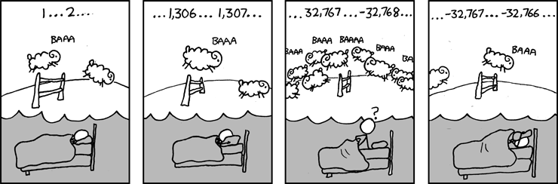
Great Reality #1:
Ints are not Integers, Floats are not Reals
Example 1: Is x² ≥ 0?
  Float’s: Yes!
  Int’s:
    40000 * 40000 --> 1600000000
    50000 * 50000 --> ?
Example 2: Is (x + y) + z = x + (y + z)?
  Unsigned & Signed Int’s: Yes!
  Float’s:
    (1e20 + -1e20) + 3.14 --> 3.14
    1e20 + (-1e20 + 3.14) --> ??
Source: xkcd.com/571

Slide 44
Computer Arithmetic
Does not generate random values
  Arithmetic operations have important mathematical properties
Cannot assume all “usual” mathematical properties
  Due to finiteness of representations
  Integer operations satisfy “ring” properties
    Commutativity, associativity, distributivity
  Floating point operations satisfy “ordering” properties
    Monotonicity, values of signs
Observation
  Need to understand which abstractions apply in which contexts
  Important issues for compiler writers and serious application programmers

Slide 45
Great Reality #2:
You’ve Got to Know Assembly
Chances are, you’ll never write programs in assembly
  Compilers are much better & more patient than you are
But: Understanding assembly is key to machine-level execution model
  Behavior of programs in presence of bugs
    High-level language models break down
  Tuning program performance
    Understand optimizations done / not done by the compiler
    Understanding sources of program inefficiency
  Implementing system software
    Compiler has machine code as target
    Operating systems must manage process state
  Creating / fighting malware
    x86 assembly is the language of choice!

Slide 46
Great Reality #3: Memory Matters
Random Access Memory Is an Unphysical Abstraction
Memory is not unbounded
  It must be allocated and managed
  Many applications are memory dominated
Memory referencing bugs especially pernicious
  Effects are distant in both time and space
Memory performance is not uniform
  Cache and virtual memory effects can greatly affect program performance
  Adapting program to characteristics of memory system can lead to major speed improvements

Slide 47
Great Reality #4: There’s more to performance than asymptotic complexity
Constant factors matter too!
And even exact op count does not predict performance
  Easily see 10:1 performance range depending on how code written
  Must optimize at multiple levels: algorithm, data representations, procedures, and loops
Must understand system to optimize performance
  How programs compiled and executed
  How to measure program performance and identify bottlenecks
  How to improve performance without destroying code modularity and generality

Slide 48

Why The Performance Differs
copyij
copyji

Slide 49
Great Reality #5:
Computers do more than execute programs
They need to get data in and out
  I/O system critical to program reliability and performance
They communicate with each other over networks
  Many system-level issues arise in presence of network
    Concurrent operations by autonomous processes
    Coping with unreliable media
    Cross platform compatibility
    Complex performance issues

Slide 50
Coming Up
Next class: From Signals to Bits to Integer Arithmetic
Soon: Autolab will come online for testing
Soon: Group sign-up
Soon: Office Hours posting.
Always: How can we be of service? Please reach out!

Slide 51
Welcome and Enjoy!

