Slide 1

14-513
18-613

Slide 2
Network Programming: Part I 18-213/18-613: Introduction to Computer Systems 20th Lecture,

Slide 3
Announcements
tshlab due Friday
Proxy lab out Friday
Homework out today
On usual schedule
Due a week from Thursday (Next lecture) , as usual

Slide 4
Network Reference Model
Application – Establish an idiom for communicating with a particular application
Transport – Establish endpoints useful to a programmer
Network – Given multiple inter-connected LANs, achieve cross-connectivity,
Link – Manage the channel to enable actual communication, i.e. establish a LAN
Physical – Establish a channel with connectivity and signaling

Slide 5
Network Reference Model
Application – Establish an idiom for communicating with a particular application
Transport – Establish endpoints useful to a programmer
Network – Given multiple inter-connected LANs, achieve cross-connectivity,
Link – Manage the channel to enable actual communication, i.e. establish a LAN
Physical – Establish a channel with connectivity and signaling

Slide 6
Physical Layer: Establishes the Channel
Medium? Light? Radio frequency? Electrical signals?
What color(s) of light? How bright?
What RF frequencies? How powerful?
What signals represent what values?
What shape are the connectors?
How far can cables run?
Etc.
We have a functioning physical layer once we have the ability to send and receive signals

Slide 7
Physical Layer: Bandwidth vs Latency
Bandwidth = bits/second.
Improved with parallelism or faster clock rate
Latency = Function of signal propagation speed
Limited by speed of light
Major paradigm shift would be needed to make traffic to India or China less latent
Latency tends to be limiting at a global scale
Speed of light over long distances
Bandwidth tends to be limited at local scale, e.g data center
How to divide up and recombine messages to utilize parallelism?
How to clock faster without losing signal to noise.

Slide 8
Network Reference Model
Application – Establish an idiom for communicating with a particular application
Transport – Establish endpoints useful to a programmer
Network – Given multiple inter-connected LANs, achieve cross-connectivity,
Link – Manage the channel to enable actual communication, i.e. establish a LAN
Physical – Establish a channel with connectivity and signaling

Slide 9
Link Layer: Manages the Channel
When do we start transmitting? When do we stop?
When do we start receiving? When do we stop?
Who is sending? Who is receiving?
How do we know if it is correct?
What happens if there is contention for, or collision in, a shared channel?
Key contributions: Framing, among others
We have a functioning link layer once we can build a functioning LAN of at least two stations.

Slide 10
Link layer: Quick evolution of lans: Simple LANs
Two or more hosts share a common physical medium, e.g. ethernet
Physical protocols define hardware
Link-layer protocols manage it
Point-to-point, e.g. fiberoptic
Broadcast, e.g. ethernet

Slide 11
Link Layer: Quick evolution of lans: wired Limits
Consider ethernet: Multiple stations share a common wire
What happens if more than one transmits at the same time?
Collision, e.g. corruption
Link layer manages collision, e.g. exponential back-off, jamming signals, etc.
Wire can only get so long
Attenuation, power to drive it, noise, etc.
Mess of actually getting the wire through the building, etc.
Can only have a certain number of stations
Too little network time per each, otherwise
Aside: Wireless has similar limits, too.

Slide 12
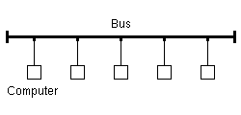
Link Layer: Quick evolution of lans: BUS Topology
https://upload.wikimedia.org/wikipedia/commons/9/9e/Bustopologie.png
Imagine having to snake one wire around the building!

Slide 13
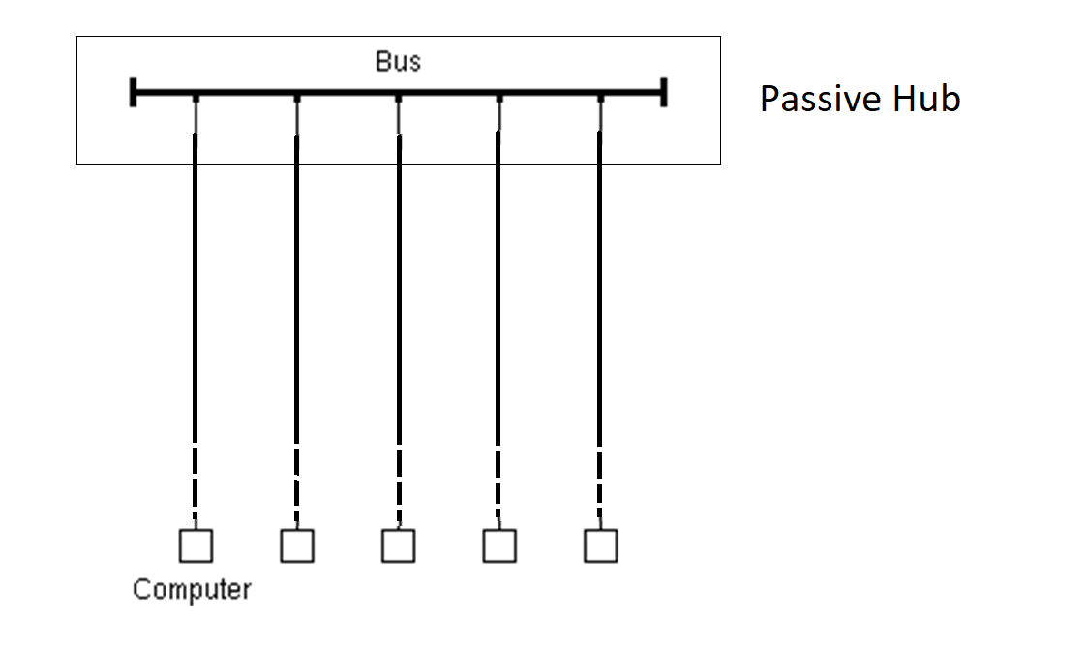
Link Layer: Quick Evolution of lans: hub Topology
The bus remains an equivalent collision/contention domain, but the wiring gets easier, physically.
“home runs” to wiring
closet, etc.
Adapted from: https://upload.wikimedia.org/wikipedia/commons/9/9e/Bustopologie.png

Slide 14
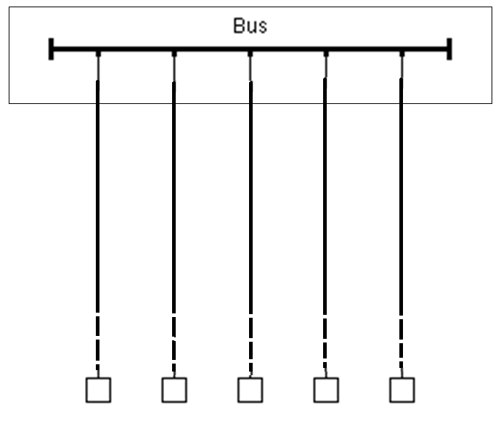
Link Layer: Quick Evolution of LANS: HUB HIERARCHY
Hierarchies can be built, e.g. one hub per
Hallway connected to one hub for the floor. But, all buses form a single collision/contention domain.

Slide 15
Link Layer: Quick Evolution of LANS: Network Switches
Enable connection of input and output port pairs without sharing a single common channel
Crossbar switch: Mess of switched connections
Input and output buffering with shared memory and control
Etc
Learning
Pay attention when host sends to learn which port it is on, then direct messages to that host only to that port
Flood all ports only when destination unknown.
Enables larger networks

Slide 16
Link Layer: Quick Evolution of LANS: Limits
Even with switching, there is a limit to the size of a LAN
In the worst case, a host which is not known, the entire LAN is still a single contention/collision domain
If a host hasn’t yet sent, or hasn’t sent recently enough to be cached, flooding will be needed
The flooding can, in the worst case, flood every port on every switch
There obviously is no way to know the location of every host on the Internet
And, of course, networks use different technologies, are managed by different domains, etc.

Slide 17
Network Reference Model
Application – Establish an idiom for communicating with a particular application
Transport – Establish endpoints useful to a programmer
Network – Given multiple inter-connected LANs, achieve cross-connectivity,
Link – Manage the channel to enable actual communication, i.e. establish a LAN
Physical – Establish a channel with connectivity and signaling

Slide 18
Network layer: Scaling up
Passing messages among multiple networks
For scale
Of different types (wired, wireless, fiber, infrared, etc)
Managed by different domains, etc.
Globally meaningful addressing
Ability to choose paths among multiple options
We have a functioning network layer once we can connect multiple networks, identify hosts among them, and messages can find their way across networks from source to destination.

Slide 19
NetWork Layer: Addressing
Hierarchical addressing
Traditional IPv4 addresses: 32-bits: Network# + Host Number
IPv6 addresses: 128-bits and more structured
Host number translated to LAN station ID, e.g by ARP between IPv4 and 802.11
Routing selects path to take from one network to another, often on a hop-by-hop basis
Does this packet belong on one of my LANs? If so ARP and deliver
If not, send upstream (or to a peer, or…)
This provides for an order of magnitude more hosts

Slide 20
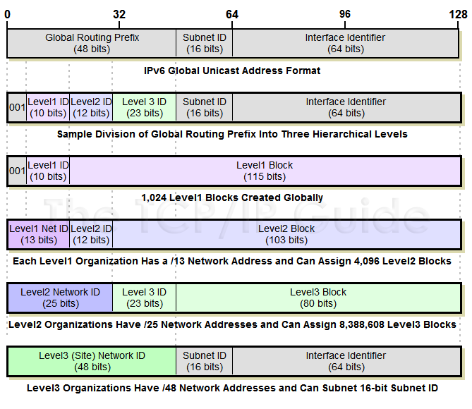
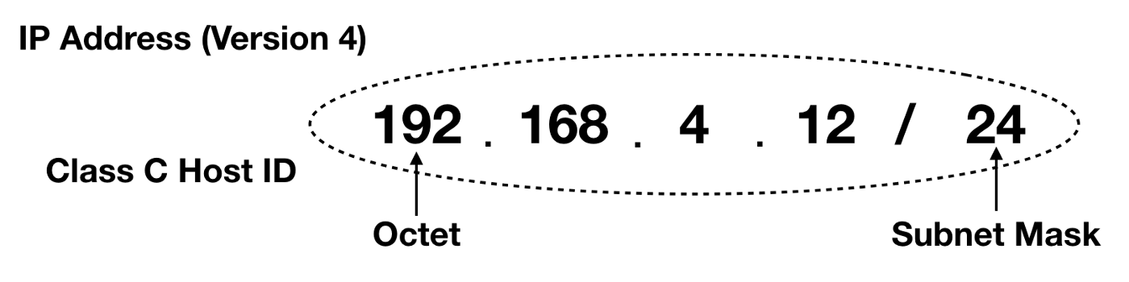
Network Layer: Addressing
https://medium.com/hd-pro/cidr-addressing-and-subnet-masking-on-ip-networks-part-i-3054e3fbb0a1
http://www.tcpipguide.com/free/t_IPv6GlobalUnicastAddressFormat-4.htm

Slide 21
The Network Layer: IP Address Assignment
Old school: Go to system administrator and trade MAC address for IP address
Today: DHCP server automates this. Broadcast of request with MAC is answered with assigned IP
Assigned IP is leased and needs to be renewed
Assigned IP can be from dynamic pool
Assigned IP can also be according to a pre-configured rule, such as to give a server a well-known address
DHCP can also communicate other configuration information

Slide 22
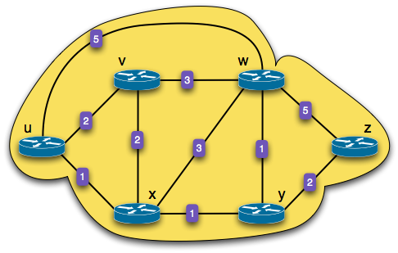
The Network Layer: Routing
What is the least-cost path between u and z?
There are 17 different paths
Routing Algorithm: find the least-cost path between any pairs of nodes
When u forwards a packet bound for z :
Choose exit link with least-cost path

Slide 23
What is the least-cost path between u and z?
There are 17 different paths
Routing Algorithm: find the least-cost path between any pairs of nodes
When u forwards a packet bound for z :
Choose exit link with least-cost path
Notes:
17 different paths exist from u to z - enumerated by making a tree from U, branches ending at Z.

Slide 24
Network Reference Model
Application – Establish an idiom for communicating with a particular application
Transport – Establish endpoints useful to a programmer
Network – Given multiple inter-connected LANs, achieve cross-connectivity,
Link – Manage the channel to enable actual communication, i.e. establish a LAN
Physical – Establish a channel with connectivity and signaling

Slide 25
Transport Layer: Meaningful endpoints
Hosts don’t communication – various aspects of software systems do
Consider how many different sessions your Web browser has with servers. Now add for your IM sessions, upgrades-in-progress, music streaming, etc.
Endpoints enable the establishment of sessions
Classic model is <<IP:port>:<IP:port>>
Client: Ephemeral port
Host: Well-known port

Slide 26
Transport Layer:Meaningful endpoints, cont.
Character of communication
Reliable/session-oriented, e.g. TCP
Unreliable/datagram, e.g. UDP
Etc.
The transport layer exists once we have the ability to establish communication from end-point to end-point with well-understood properties

Slide 27
Transport Layer: User Datagram Protocol (UDP)
Reminder: Port numbers in addition to IP addresses
Best effort = Unreliable
Messages can be lost or reordered
Message corruption is assumed to be detected at the link layer
Message oriented. Max message size
Simple
Used for timely updates, e.g. send audio or video for teleconferencing

Slide 28
Transport Layer: Reliable Protocols
Keeps trying to send data until it succeeds or times out
Used acknowledgements to determine that it does not need to resent
Buffers to ensure in-order delivery, which allows head-of-line blocking
Messages are assumed to be correct or undelivered via checksums at link layer
“Byzantine Failures” are possible, occur commonly at Internet scale, but infrequent enough to be (mostly) ignored. Maybe.
Can’t guarantee delivery.
At best can trade timeliness for delivery

Slide 29
Network Reference Model
Application – Establish an idiom for communicating with a particular application
Transport – Establish endpoints useful to a programmer
Network – Given multiple inter-connected LANs, achieve cross-connectivity,
Link – Manage the channel to enable actual communication, i.e. establish a LAN
Physical – Establish a channel with connectivity and signaling

Slide 30
Transport layer: Stop-And-Wait PROTOCOLS
Send a message. Wait one fully network latency for it to get to the recipient. Wait for the recipient to process it. Wait another full network latency to send back the acknowledgement
In one round-trip time (RTT), only one message is sent.
RTT sec * bits/sec = total bits we can send in that time.
Size of message is what we actually sent. Rest of time is wasted waiting.

Slide 31
Transport layer: Sliding Window
Buffer enough data on sender to keep sending for the entire RTT.
Treat sending buffer as circular: As ACKs come back, “slide window” to buffer new data, releasing old data and keep sending.
If ACK doesn’t come back in time, resend data.
Head-of-line blocking is possible
Keep buffer an receiver in sync with sender to buffer, releasing segments up the stack in order.
Requires segments, segment numbers

Slide 32
Transport layer: Sliding Window
Acknowledged packets
Packets not acknowledged yet
LAR
LFS
seq. numbers
LAR (last ACK received)
LFS (last frame sent)

Slide 33
Transport layer: Sliding Window, Cont.
Sender
Receiver
Max ACK received
Next seqnum
Next expected
Max acceptable
…
…
…
…
Sender window
Receiver window
Credit:
Hui Zhang
Sent & Acked
Sent Not Acked
Received & Acked
Acceptable Packet
OK to Send
Not Usable
Not Usable

Slide 34
Transport Layer: Transmission Control Protocol (TCP)
Reminder: Port numbers in addition to IP addresses
Used for transmissions that need to be correct, but not timely
Streaming audio or video, e.g. recorded movies
Bulk data transfer, e.g. uploads or downloads
Requires overhead of establishing a session to maintain shared state between sender and receiver to coordinate.
Different schemes for ACKs
Delayed ACKs, Cumulative ACKs, Selective ACKs

Slide 35
Transport Layer: Transmission Control Protocol (TCP)
Congestion Control
Packet loss can be due to many types of failure, including congestion
If congestion, desire is to slow down.
Slowing down can be achieved by shrinking window, which leaves network time unused
TCP has different strategies it can use to determine when to slow down and how to speed back up.
3-Way Handshake: SYN, SYN-ACK, ACK-SYN
Establishes session, negotiates window sizes and other options, e.g. SACK, window sizes, etc.

Slide 36
Application Layer: Purposeful Communication
Defined by the messaging we, as programs, bake into our applications, shaped by our applications,
e.g. client-server interactions, peer-to-peer interactions, etc.
E.g. HTTP: PUT, GET, POST, etc
E.g DNS: queries, responses, updates, etc.
MIME, VOIP protocols, etc.
Application protocols exist when applications can communicate

Slide 37
Application layer Domain NamE System (DNS)
Old school
Let “The Keeper of All Things” know about a hostname:IP assignment in your organization
The Keeper updates a “hosts” text file with the information
Periodically download this file to keep your system up to date
Obvious scalability problems, but /etc/hosts still exists vestigially and for special cases
Today
Domain Name System (DNS) is a distributed data base that delegates assignments for information to the responsible domains and can direct queries to the servers associated with those domains.
Uses caching for efficiency.
We’ll talk about it later in detail
Protocol specifies message format for queries and replies, etc.

Slide 38
Properties of DNS Mappings
Can explore properties of DNS mappings using nslookup
(In our examples, the output is edited for brevity)
Each host has a locally defined domain name localhost which always maps to the loopback address 127.0.0.1
Use hostname to determine real domain name of local host:
linux> nslookup localhost
Address: 127.0.0.1
linux> hostname
whaleshark.ics.cs.cmu.edu

Slide 39
Properties of DNS Mappings (cont)
Simple case: one-to-one mapping between domain name and IP address:
Multiple domain names mapped to the same IP address:
linux> nslookup whaleshark.ics.cs.cmu.edu
Address: 128.2.210.175
linux> nslookup cs.mit.edu
Address: 18.62.1.6
linux> nslookup eecs.mit.edu
Address: 18.62.1.6

Slide 40
Properties of DNS Mappings (cont)
Multiple domain names mapped to multiple IP addresses:
Some valid domain names don’t map to any IP address:
linux> nslookup www.twitter.com
Address: 104.244.42.65
Address: 104.244.42.129
Address: 104.244.42.193
Address: 104.244.42.1
linux> nslookup twitter.com
Address: 104.244.42.129
Address: 104.244.42.65
Address: 104.244.42.193
Address: 104.244.42.1
linux> nslookup ics.cs.cmu.edu
(No Address given)

