Slide 1
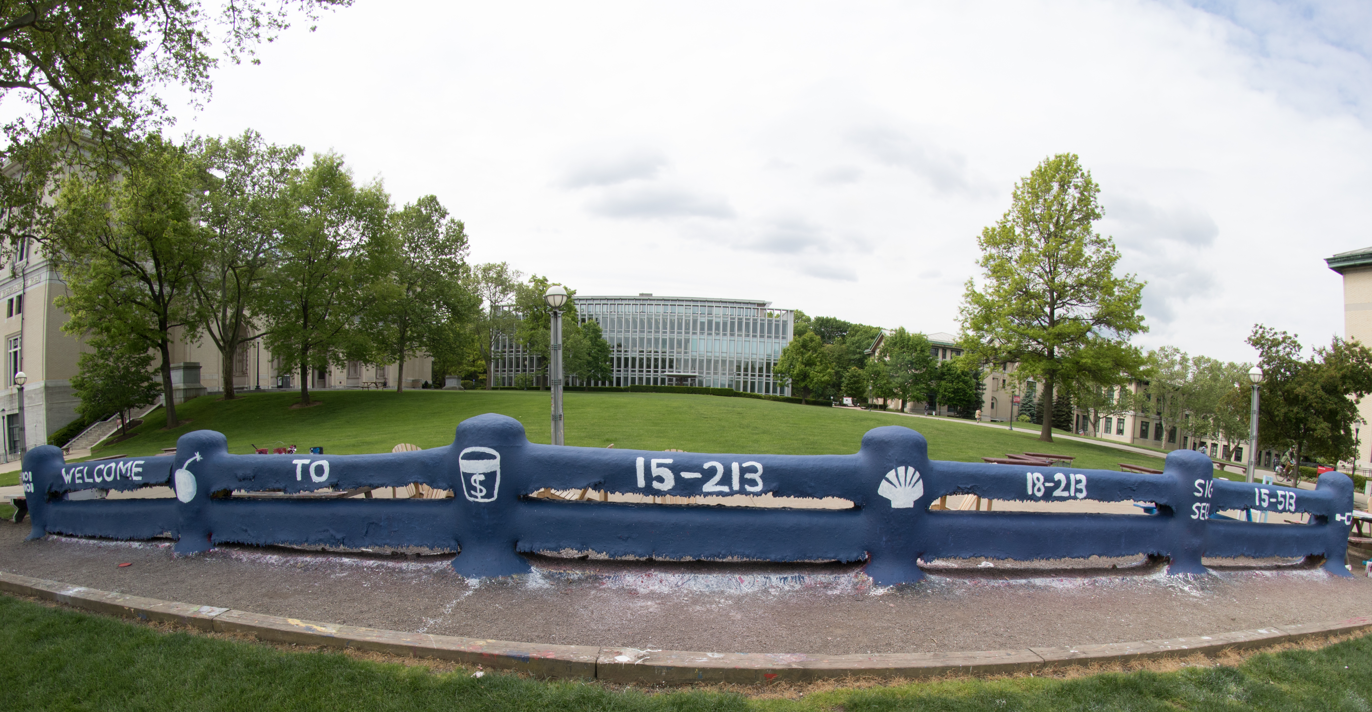
14-513
18-613

Slide 2
From Bits through Integers 18-213/18-613 Introduction to Computer Systems
2nd Lecture, August 31st, 2023

Slide 3
Bits, Bytes, and Integers
Representing information as bits CSAPP 2.1
Bit-level manipulations
Integers CSAPP 2.2
Representation: unsigned and signed
Conversion, casting
Expanding, truncating
Addition, negation, multiplication, shifting CSAPP 2.3
Byte Ordering CSAPP 2.1.3

Slide 4
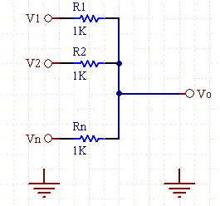
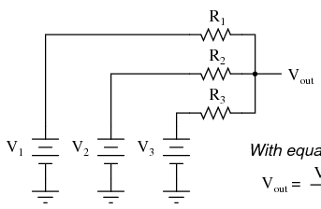
Analog Computers
Before digital computers there were analog computers.
Consider a couple of simple analog computers:
A simple circuit can allow one to adjust voltages using variable resistors and measure the output using a volt meter:
A simple network of adjustable parallel resistors can allow one to find the average of the inputs.
https://www.daycounter.com/Calculators/Voltage-Summer/Voltage-Summer-Calculator.phtml
https://www.quora.com/What-is-the-most-basic-voltage-adder-circuit-without-a-transistor-op-amp-and-any-external-supply

Slide 5
Needing Less Accuracy, Precision is Better
We don’t try to measure exactly
We just ask, is it high enough to be “On”, or
Is it low enough to be “Off”.
We have two states, so we have a binary, or 2-ary, system.
We represent these states as 0 and 1
Now we can easily interpret, communicate, and duplicate signals well enough to know what they mean.
0
1
0
1.1V
0.9V
0.2V
0.0V

Slide 6
Binary Representation
Binary representation leads to a simple binary, i.e. base-2, numbering system
0 represents 0
1 represents 1
Each “place” represents a power of two, exactly as each place in our usual “base 10”, 10-ary numbering system represents a power of 10
By encoding/interpreting sets of bits in various ways, we can represent different things:
Operations to be executed by the processor, numbers, enumerable things, such as text characters
As long as we can assign it to a discrete number, we can represent it in binary

Slide 7
Binary Representation: Simple Numbers
For example, we can count in binary, a base-2 numbering system
000, 001, 010, 011, 100, 101, 110, 111, …
000 = 0*2² + 0*2¹ ⁺ 0*2⁰ = 0 (in decimal)
001 = 0*2² + 0*2¹ ⁺ 1*2⁰ = 1 (in decimal)
010 = 0*2² + 1*2¹ ⁺ 0*2⁰ = 2 (in decimal)
011 = 0*2² + 1*2¹ ⁺ 1*2⁰ = 3 (in decimal)
Etc.
For reference, consider some base-10 examples:
000 = 0*10² + 0*10¹ ⁺ 0*10⁰
001 = 0*10² + 0*10¹ ⁺ 1*10⁰
357 = 3*10² + 5*10¹ ⁺ 7*10⁰

Slide 8
Hexadecimal and Octal
Writing out numbers in binary takes too many digits
We want a way to represent numbers more densely such that fewer digits are required
But also such that it is easy to get at the bits that we want
Any power-of-two base provides this property
Octal, e.g. base-8, and hexadecimal, e.g. base-16 are the closest to our familiar base-10.
Each has been used by “computer people” over time
Hexadecimal is often preferred because it is denser.

Slide 9
Hexadecimal
Decimal
Hex
Binary
Hexadecimal 0016 to FF16
Base 16 number representation
Use characters ‘0’ to ‘9’ and ‘A’ to ‘F’
Consider 1A2B in Hexadecimal:
1*16³ + A*16² + 2*16¹ + B*16⁰
1*16³ + 10*16² + 2*16¹ + 11*16⁰ = 6699 (decimal)
The C Language prefixes hexadecimal numbers with “0x” so they aren’t confused with decimal numbers
Write FA1D37B16 in C as
0xFA1D37B
0xfa1d37b
0
0
0000
1
1
0001
2
2
0010
3
3
0011
4
4
0100
5
5
0101
6
6
0110
7
7
0111
8
8
1000
9
9
1001
A
10
1010
B
11
1011
C
12
1100
D
13
1101
E
14
1110
F
15
1111
18213: 0100 0111 0010 0101
4
7
2
5

Slide 10
Today: Bits, Bytes, and Integers
Representing information as bits
Bit-level manipulations
Integers
Representation: unsigned and signed
Conversion, casting
Expanding, truncating
Addition, negation, multiplication, shifting
Byte Ordering

Slide 11
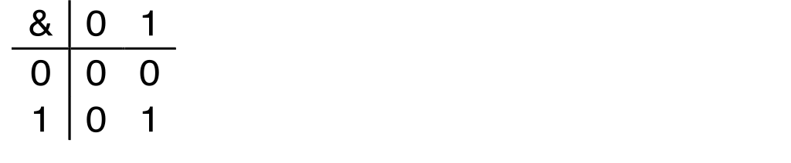
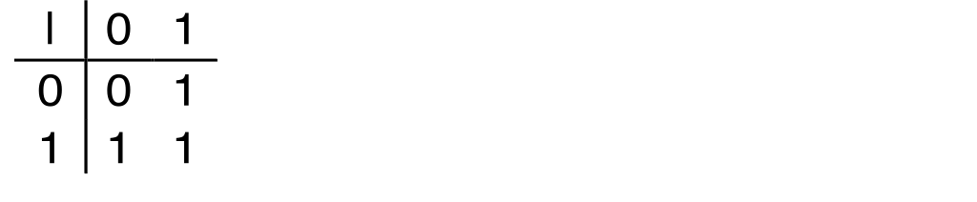
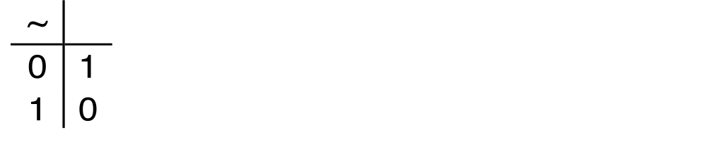
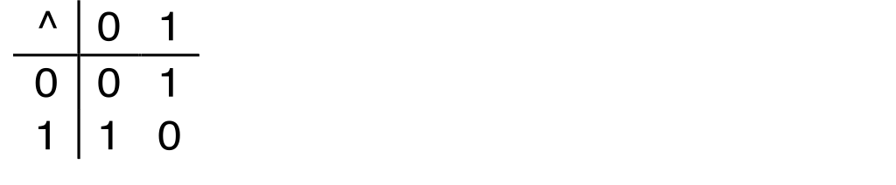
Boolean Algebra
Developed by George Boole in 19th Century
Algebraic representation of logic
Encode “True” as 1 and “False” as 0
And
A&B = 1 when both A=1 and B=1
Or
A|B = 1 when either A=1 or B=1
Not
~A = 1 when A=0
Exclusive-Or (Xor)
A^B = 1 when either A=1 or B=1, but not both

Slide 12
General Boolean Algebras
Operate on Bit Vectors
Operations applied bitwise
All of the Properties of Boolean Algebra Apply
01101001
& 01010101
01000001
01101001
| 01010101
01111101
01101001
^ 01010101
00111100
~ 01010101
10101010
01000001
01111101
00111100
10101010

Slide 13
Example: Representing & Manipulating Sets
Representation
Width w bit vector represents subsets of {0, …, w–1}
a_{j} = 1 if j ∈ A
01101001 { 0, 3, 5, 6 }
76543210
01010101 { 0, 2, 4, 6 }
76543210
Operations
& Intersection 01000001 { 0, 6 }
| Union 01111101 { 0, 2, 3, 4, 5, 6 }
^ Symmetric difference 00111100 { 2, 3, 4, 5 }
~ Complement 10101010 { 1, 3, 5, 7 }

Slide 14
Bit-Level Operations in C
Decimal
Hex
Binary
Operations &, |, ~, ^ Available in C
Apply to any “integral” data type
long, int, short, char, unsigned
View arguments as bit vectors
Arguments applied bit-wise
Examples (Char data type)
~0x41 → 0xBE
~010000012 → 101111102
~0x00 → 0xFF
~000000002 → 111111112
0x69 & 0x55 → 0x41
011010012 & 010101012 → 010000012
0x69 | 0x55 → 0x7D
011010012 | 010101012 → 011111012
0
0
0000
1
1
0001
2
2
0010
3
3
0011
4
4
0100
5
5
0101
6
6
0110
7
7
0111
8
8
1000
9
9
1001
A
10
1010
B
11
1011
C
12
1100
D
13
1101
E
14
1110
F
15
1111

Slide 15
Bit-Level Operations in C
Decimal
Hex
Binary
Operations &, |, ~, ^ Available in C
Apply to any “integral” data type
long, int, short, char, unsigned
View arguments as bit vectors
Arguments applied bit-wise
Examples (Char data type)
~0x41 → 1011 11100xBE~010000012 → 101111102
~0x00 → 1111 11110xF~000000002 → 1111112
0x69 & 0x55: 0x69 | 0x55:
0110 1001 0110 1001
& 0101 0101 | 0101 0101
----------------- -----------------
0100 0001011010 0111 1101011010012 012 & 010101012 → 010000012
0x7D
011010012 | 010101012 → 011111012
0
0
0000
1
1
0001
2
2
0010
3
3
0011
4
4
0100
5
5
0101
6
6
0110
7
7
0111
8
8
1000
9
9
1001
A
10
1010
B
11
1011
C
12
1100
D
13
1101
E
14
1110
F
15
1111

Slide 16
Contrast: Logic Operations in C
Contrast to Bit-Level Operators
Logic Operations: &&, ||, !
View 0 as “False”
Anything nonzero as “True”
Always return 0 or 1
Early termination
Examples (char data type)
!0x41 → 0x00
!0x00 → 0x01
!!0x41→ 0x01
0x69 && 0x55 → 0x01
0x69 || 0x55 → 0x01
p && *p (avoids null pointer access)
Watch out for && vs. & (and || vs. |)…
Super common C programming pitfall!

Slide 17
Shift Operations
Left Shift: x << y
Shift bit-vector x left y positions
Throw away extra bits on left
Fill with 0’s on right
Right Shift: x >> y
Shift bit-vector x right y positions
Throw away extra bits on right
Logical shift
Fill with 0’s on left
Arithmetic shift
Replicate most significant bit on left
Undefined Behavior
Shift amount < 0 or ≥ word size
Argument x
01100010
<< 3
00010000
00010000
00010000
Log. >> 2
00011000
00011000
00011000
Arith. >> 2
00011000
00011000
00011000
Argument x
10100010
<< 3
00010000
00010000
00010000
Log. >> 2
00101000
00101000
00101000
Arith. >> 2
11101000
11101000
11101000

Slide 18
Today: Bits, Bytes, and Integers
Representing information as bits
Bit-level manipulations
Integers
Representation: unsigned and signed
Conversion, casting
Expanding, truncating
Addition, negation, multiplication, shifting

Slide 19
Binary Number Lines
In binary, the number of bits in the data type size determines the number of points on the number line.
We can assign the points any meaning we’d like
Consider the following examples:
1 bit number line
0 1
2 bit number line
00 01 10 11
3 bit number line
000 001 010 011 100 101 110 111

Slide 20
Some Purely Imaginary Examples
3 bit number line
-1/16 -1/8 -1/4 0 1/16 1/8 1/4 1/2
0 1 2 3 4 5 6 7
-4 -3 -2 -1 0 1 2 3
A B C D E F G H

Slide 21
Overflow
Let’s consider a simple 3 digit number line:
0 1 2 3 4 5 6 7
000 001 010 011 100 101 110 111
What happens if we add 1 to 7?
In other words, what happens if we add 1 to 111?
111+ 001 = 1 000
But, we only get 3 bits – so we lose the leading-1.
This is called overflow
The result is 000

Slide 22
Modulus Arithmetic
Let’s explore this idea of overflow some more
111 + 001 = 1 000 = 000
111 + 010 = 1 001 = 001
111 + 011 = 1 010 = 010
111 + 100 = 1 011 = 011
…
111 + 110 = 1 101 = 101
111 + 111 = 1 110 = 110
So, arithmetic “wraps around” when it gets “too positive”

Slide 23
Unsigned and Non-Negative Integers
We’ll use the term “ints” to mean the finite set of integer numbers that we can represent on a number line enumerated by some fixed number of bits, i.e. bit width.
We normally represent unsigned and non-negative int using simple binary as we have already discussed
An “unsigned” int is any int on a number line, e.g. of a data type, that doesn’t contain any negative numbers
A non-negative number is a number greater than or equal to (>=) 0 on a number line, e.g. of a data type, that does contain negative numbers

Slide 24
How represent negative Numbers?
We could use the leading bit as a sign bit:
0 means non-negative
1 means negative
000 001 010 011 100 101 110 111
0 1 2 3 -0 -1 -2 -3
This has some benefits
It lets us represent negative and non-negative numbers
0 represents 0
It also has some drawbacks
There is a -0, which is the same as 0, except that it is different
How to add such numbers 1 + -1 should equal 0
But, by simple math, 001 + 101 = 110, which is -2?

Slide 25
A Magic Trick!
Let’s just start with three ideas:
1 should be represented as 1
-1 + 1 = 0
We want addition to work in the familiar way, with simple rules.
We want a situation where “-1” + 1 = 0
Consider a 3 bit number:
001 + “-1” = 0
001 + 111 = 0
Remember 001 + 111 = 1 000, and the leading one is lost to overflow.
“-1” = 111
Yep!

Slide 26
Negative Numbers
Well, if 111 is -1, what is -2?
-1 - 1
111 – 001 = 110
Does that really work?
If it does -2 + 2 = 0
110 + 010 = 1 000 = 000
-2 + 5 should be 3, right?
110 + 101 = 1 011 = 011

Slide 27
Finding –x the easy way
Given a non-negative number in binary, e.g. 5, represented with a fixed bit width, e.g. 4
0101
We can find its negative by flipping each bit and adding 1
0101 This is 5
1010 This is the “ones complement of 5”, e.g. 5 with bits flipped
1011 This is the “twos complement of 5”, e.g. 5 with the bits flipped and 1 added
0101 + 1011 = 1 0000 = 0000
-x = ~x+1
Because of the fixed width, the “two’s complement” of a number can be used as its negative.

Slide 28
Why Does This Work?
Consider any number and its (ones) complement:
0101
1010
They are called complements because complementary bits are set. As a result, if they are added, all bits are necessarily set:
0101 + 1010 = 1111
Adding 1 to the sum of a number and its complement necessarily results in a 0 due to overflow
(0101 + 1010) + 1 = 1111 + 1 = 1 0000 = 0000
And if x + y = 0, y must equal –x

Slide 29
Why Does This Work? Cont.
If x + y = 0
y must equal –x
So if x + (Complement(x) + 1) = 0
Complement(x) + 1 must equal –x
Another way of looking at it:
if x + (Complement(x) + 1) = 0
x + Complement(x) = -1
x = -1 - Complement(x)
-x = 1 + Complement(x)

Slide 30
Visualizing Two’s Complement
Numbers “wrap around” with -1 at the very end
000 001 010 011 100 101 110 111
0 1 2 3 -4 -3 -2 -1
A few things to note:
All negative numbers start with a ”1”
E.g. 100 is “-4”
You can view the leading “1” as introducing a “-4”
E.g. 101 = 1*-4+0*2+1*1= -3
But 010 = 0*-4+1*2+0*1 = 2
-4 is missing a positive partner

Slide 31
Complement & Increment Examples
x = 0
x = Tmin (The most negative two’s complement number)
Canonical counter example

Slide 32
Encoding Integers: Dense Form
Unsigned
Two’s Complement
short int x = 15213;
short int y = -15213;
Sign Bit
C does not mandate using two’s complement
But, most machines do, and we will assume so
C short (2 bytes long)
Sign Bit
For 2’s complement, most significant bit indicates sign
0 for nonnegative, 1 for negative

Slide 33
Numeric Ranges
Unsigned Values
UMin = 0
000…0
UMax = 2^{w} – 1
111…1
Two’s Complement Values
TMin = –2^{w–1}
100…0
TMax = 2^{w–1} – 1
011…1
Minus 1
111…1
Values for W = 16

Slide 34
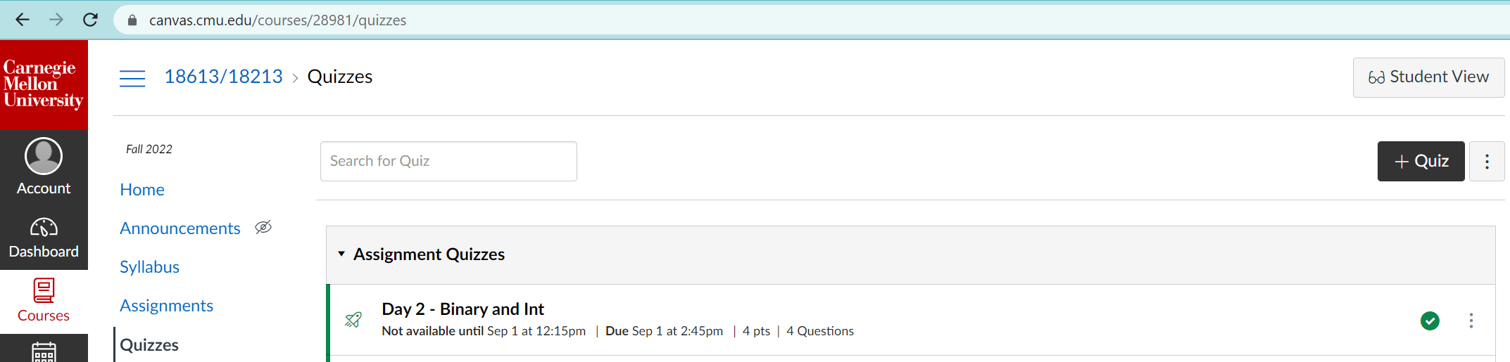
Quiz Time!

Slide 35
Today: Bits, Bytes, and Integers
Representing information as bits
Bit-level manipulations
Integers
Representation: unsigned and signed
Conversion, casting
Expanding, truncating
Addition, negation, multiplication, shifting
Byte Ordering

Slide 36
Mapping Signed ↔ Unsigned
Bits
0000
0001
0010
0011
0100
0101
0110
0111
1000
1001
1010
1011
1100
1101
1110
1111
Signed
0
1
2
3
4
5
6
7
-8
-7
-6
-5
-4
-3
-2
-1
Unsigned
0
1
2
3
4
5
6
7
8
9
10
11
12
13
14
15
=
+/- 16

Slide 37
Relation between Signed & Unsigned
Two’s Complement
Unsigned
T2U
x
T2B
B2U
ux
X
Maintain Same Bit Pattern
w–1
0
ux
+
+
+
• • •
+
+
+
x
-
+
+
• • •
+
+
+
Large negative weight
becomes
Large positive weight

Slide 38
Conversion Visualized
2’s Comp. → Unsigned
Ordering Inversion
Negative → Big Positive
UMax
UMax – 1
TMax + 1
Unsigned
Range
TMax
TMax
2’s Complement Range
0
0
–1
–2
TMin

Slide 39
Signed vs. Unsigned in C
Constants
By default are considered to be signed integers
Unsigned if have “U” as suffix
0U, 4294967259U
Casting
Explicit casting between signed & unsigned same as U2T and T2U
int tx, ty;
unsigned ux, uy;
tx = (int) ux;
uy = (unsigned) ty;
Implicit casting also occurs via assignments and procedure calls
tx = ux; int fun(unsigned u);
uy = ty; uy = fun(tx);

Slide 40
Casting Surprises
Expression Evaluation
If there is a mix of unsigned and signed in single expression, signed values implicitly cast to unsigned
Including comparison operations <, >, ==, <=, >=
Examples for W = 32: TMIN = -2,147,483,648 , TMAX = 2,147,483,647
Constant₁ Constant₂ Relation Evaluation
0 0U
-1 0
-1 0U
2147483647 -2147483647-1
2147483647U -2147483647-1
-1 -2
(unsigned)-1 -2
2147483647 2147483648U
2147483647 (int) 2147483648U
0 0U == unsigned
-1 0 < signed
-1 0U > unsigned
2147483647 -2147483648 > signed
2147483647U -2147483648 < unsigned
-1 -2 > signed
(unsigned) -1 -2 > unsigned
2147483647 2147483648U < unsigned
2147483647 (int) 2147483648U > signed

Slide 41
Summary Casting Signed ↔ Unsigned: Basic Rules
Bit pattern is maintained
But reinterpreted
Can have unexpected effects: adding or subtracting 2^{w}
Expression containing signed and unsigned int
int is cast to unsigned!!

Slide 42
Today: Bits, Bytes, and Integers
Representing information as bits
Bit-level manipulations
Integers
Representation: unsigned and signed
Conversion, casting
Expanding, truncating
Addition, negation, multiplication, shifting
Byte Ordering

Slide 43
Sign Extension
Task:
Given w-bit signed integer x
Convert it to w+k-bit integer with same value
Rule:
Make k copies of sign bit:
X’ = x_{w–1} ,…, x_{w–1} , x_{w–1} , x_{w–2} ,…, x₀
k copies of MSB
w
X
• • •
• • •
X’
• • •
• • •
k
w

Slide 44
Sign Extension: Simple Example
Positive number
Negative number
-16 | 8 | 4 | 2 | 1
0 | 1 | 0 | 1 | 0
-16 | 8 | 4 | 2 | 1
1 | 0 | 1 | 1 | 0
10 =
-10 =
-32 | 16 | 8 | 4 | 2 | 1
0 | 0 | 1 | 0 | 1 | 0
-32 | 16 | 8 | 4 | 2 | 1
1 | 1 | 0 | 1 | 1 | 0
10 =
-10 =

Slide 45
Truncation
Task:
Given k+w-bit signed or unsigned integer X
Convert it to w-bit integer X’ with same value for “small enough” X
Rule:
Drop top k bits:
X’ = x_{w–1} , x_{w–2} ,…, x₀
k
w
X
• • •
• • •
• • •
X’
• • •
w

Slide 46
Truncation: Simple Example
No sign change
Sign change
-16 | 8 | 4 | 2 | 1
0 | 0 | 0 | 1 | 0
-16 | 8 | 4 | 2 | 1
0 | 1 | 0 | 1 | 0
2 =
10 =
 | -8 | 4 | 2 | 1
 | 0 | 0 | 1 | 0
 | -8 | 4 | 2 | 1
 | 1 | 0 | 1 | 0
2 =
-6 =
2 mod 16 = 2
10 mod 16 = 10U mod 16 = 10U = -6
-16 | 8 | 4 | 2 | 1
1 | 1 | 0 | 1 | 0
-16 | 8 | 4 | 2 | 1
1 | 0 | 1 | 1 | 0
-6 =
-10 =
 | -8 | 4 | 2 | 1
 | 1 | 0 | 1 | 0
 | -8 | 4 | 2 | 1
 | 0 | 1 | 1 | 0
-6 =
6 =
-6 mod 16 = 26U mod 16 = 10U = -6
-10 mod 16 = 22U mod 16 = 6U = 6

Slide 47
Summary: Expanding, Truncating: Basic Rules
Expanding (e.g., short int to int)
Unsigned: zeros added
Signed: sign extension
Both yield expected result
Truncating (e.g., unsigned to unsigned short)
Unsigned/signed: bits are truncated
Result reinterpreted
Unsigned: mod operation
Signed: similar to mod
For small (in magnitude) numbers yields expected behavior

Slide 48
Today: Bits, Bytes, and Integers
Representing information as bits
Bit-level manipulations
Integers
Representation: unsigned and signed
Conversion, casting
Expanding, truncating
Addition, negation, multiplication, shifting
Byte Ordering

Slide 49
Unsigned Addition
u
Operands: w bits
• • •
+
v
• • •
True Sum: w+1 bits
u + v
• • •
Discard Carry: w bits
UAdd_{w}(u , v)
• • •
Decimal
Hex
Binary
Standard Addition Function
Ignores carry output
Implements Modular Arithmetic
s = UAdd_{w}(u , v) = u + v mod 2^{w}
0
0
0000
1
1
0001
2
2
0010
3
3
0011
4
4
0100
5
5
0101
6
6
0110
7
7
0111
unsigned char
1110 1001
+ 1101 0101
E9
+ D5
223
+ 213
8
8
1000
9
9
1001
A
10
1010
1 1011 1110
1BE
446
B
11
1011
C
12
1100
1011 1110
BE
190
D
13
1101
E
14
1110
F
15
1111

Slide 50
Two’s Complement Addition
Operands: w bits
u
• • •
+
v
• • •
True Sum: w+1 bits
u + v
• • •
Discard Carry: w bits
TAdd_{w}(u , v)
• • •
TAdd and UAdd have Identical Bit-Level Behavior
Signed vs. unsigned addition in C:
int s, t, u, v;
s = (int) ((unsigned) u + (unsigned) v);
t = u + v
Will give s == t
1110 1001
+ 1101 0101
E9
+ D5
-23
+ -43
1 1011 1110
1BE
-66
1011 1110
BE
-66

Slide 51
Visualizing “True Sum” Integer Addition
Integer Addition
4-bit integers u, v
Compute true sum Add₄(u , v)
Values increase linearly with u and v
Forms planar surface
Add₄(u , v)
v
u

Slide 52
Visualizing Unsigned Addition
Wraps Around
If true sum ≥ 2^{w}
At most once
Overflow
UAdd₄(u , v)
True Sum
2^{w+1}
Overflow
2^{w}
v
0
Modular Sum
u

Slide 53
Visualizing 2’s Complement Addition
NegOver
Values
4-bit two’s comp.
Range from -8 to +7
Wraps Around
If sum ≥ 2^{w–1}
Becomes negative
At most once
If sum < –2^{w–1}
Becomes positive
At most once
TAdd₄(u , v)
v
u
PosOver

Slide 54
Multiplication
Goal: Computing Product of w-bit numbers x, y
Either signed or unsigned
Result: Same as computing ideal, exact result x*y and keeping w lower bits.
Ideal,exact results can be bigger than w bits
Worst case is up to 2w bits
Unsigned, because all bits are magnitude
Signed, but only for Tmin*Tmin, because anything added to Tmin reduces its magnitude and Tmax is less than Tmin.
So, maintaining exact results…
would need to keep expanding word size with each product computed
Impossible in hardware (at least without limits), as all resources are finite
In practice, is done in software, if needed
e.g., by “arbitrary precision” arithmetic packages

Slide 55
Power-of-2 Multiply with Shift
Operation
u << k gives u * 2^{k}
Both signed and unsigned
Examples
u << 3 == u * 8
(u << 5) – (u << 3) == u * 24
Most machines shift and add faster than multiply
Compiler generates this code automatically
k
u
• • •
Operands: w bits
*
2^{k}
0
•••
0
1
0
•••
0
0
True Product: w+k bits
u · 2^{k}
• • •
0
•••
0
0
Discard k bits: w bits
UMult_{w}(u , 2^{k})
•••
0
•••
0
0
TMult_{w}(u , 2^{k})

Slide 56
Unsigned Power-of-2 Divide with Shift
Quotient of Unsigned by Power of 2
u >> k gives ⎣ u / 2^{k} ⎦
Uses logical shift
k
u
•••
•••
Binary Point
Operands:
/
2^{k}
0
•••
0
1
0
•••
0
0
Division:
u / 2^{k}
0
.
0
•••
0
0
•••
•••
Result:
⎣ u / 2^{k} ⎦
0
0
•••
0
0
•••

Slide 57
Signed Power-of-2 Divide with Shift
Quotient of Signed by Power of 2
x >> k gives ⎣ x / 2^{k} ⎦
Uses arithmetic shift
Rounds to the left, not towards zero (Unlikely to be what is expected, introduces a bias).
k
x
•••
•••
Binary Point
Operands:
/
2^{k}
0
•••
0
1
0
•••
0
0
Division:
x / 2^{k}
0
•••
•••
.
•••
Result:
RoundDown(x / 2^{k})
0
•••
•••

Slide 58
Round-toward-0 Divide
Quotient of Negative Number by Power of 2
Want ⎡ x / 2^{k} ⎤ (Round Toward 0)
Compute as ⎣ (x+(2^{k}-1))/ 2^{k} ⎦
In C: (x + (1<<k)-1) >> k
Biases dividend toward 0
Case 1: No rounding
k
Dividend:
u
1
•••
0
•••
0
0
+2^{k} –1
0
•••
0
0
1
•••
1
1
Binary Point
1
•••
1
•••
1
1
Divisor:
/
2^{k}
0
•••
0
1
0
•••
0
0
⎡ u / 2^{k} ⎤
0
.
1
•••
1
1
1
•••
1
•••
1
1
Biasing has no effect

Slide 59
Correct Power-of-2 Divide (Cont.)
Case 2: Rounding
k
Dividend:
x
1
•••
•••
+2^{k} –1
0
•••
0
0
1
•••
1
1
1
•••
•••
Incremented by 1
Binary Point
Divisor:
/
2^{k}
0
•••
0
1
0
•••
0
0
⎡ x / 2^{k} ⎤
.
0
1
•••
1
1
1
•••
•••
Incremented by 1
Biasing adds 1 to final result

Slide 60
Today: Bits, Bytes, and Integers
Representing information as bits
Bit-level manipulations
Integers
Representation: unsigned and signed
Conversion, casting
Expanding, truncating
Addition, negation, multiplication, shifting
Byte Ordering

Slide 61
Byte Ordering
So, how are the bytes within a multi-byte word ordered in memory?
Conventions
Big Endian: Sun (Oracle SPARC), PPC Mac, Internet
Least significant byte has highest address
Little Endian: x86, ARM processors running Android, iOS, and Linux
Least significant byte has lowest address
Becomes a concern when data is communicated
Over a network, via files, etc.
Important notes
Bits are not reversed, as the low order bit is the reference point.
Doesn’t affect chars, or strings (arrays of chars), as chars are only one byte

Slide 62
Byte Ordering Example
Example
Variable x has 4-byte value of 0x01234567
Address given by &x is 0x100
Big Endian
0x100
0x101
0x102
0x103
01
01
23
23
45
45
67
67
Little Endian
0x100
0x101
0x102
0x103
67
67
45
45
23
23
01
01

Slide 63
Reading Byte-Reversed Listings
Disassembly
Text representation of binary machine code
Generated by program that reads the machine code
Example Fragment
Deciphering Numbers
Value: 0x12ab
Pad to 32 bits: 0x000012ab
Split into bytes: 00 00 12 ab
Reverse: ab 12 00 00
Address Instruction Code Assembly Rendition
8048365: 5b pop %ebx
8048366: 81 c3 ab 12 00 00 add $0x12ab,%ebx
804836c: 83 bb 28 00 00 00 00 cmpl $0x0,0x28(%ebx)

Slide 64
Today: Bits, Bytes, and Integers
Representing information as bits CSAPP 2.1
Bit-level manipulations
Integers CSAPP 2.2
Representation: unsigned and signed
Conversion, casting
Expanding, truncating
Addition, negation, multiplication, shifting CSAPP 2.3
Byte Ordering CSAPP 2.1.3
Questions?

