Slide 1
Refractive and Specular Light-Path Triangulation
Chia-Yin Tsai and Vishwanath Saragadam

Slide 2
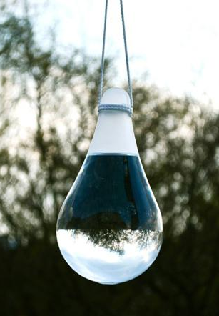
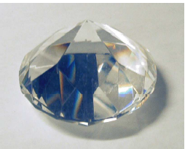
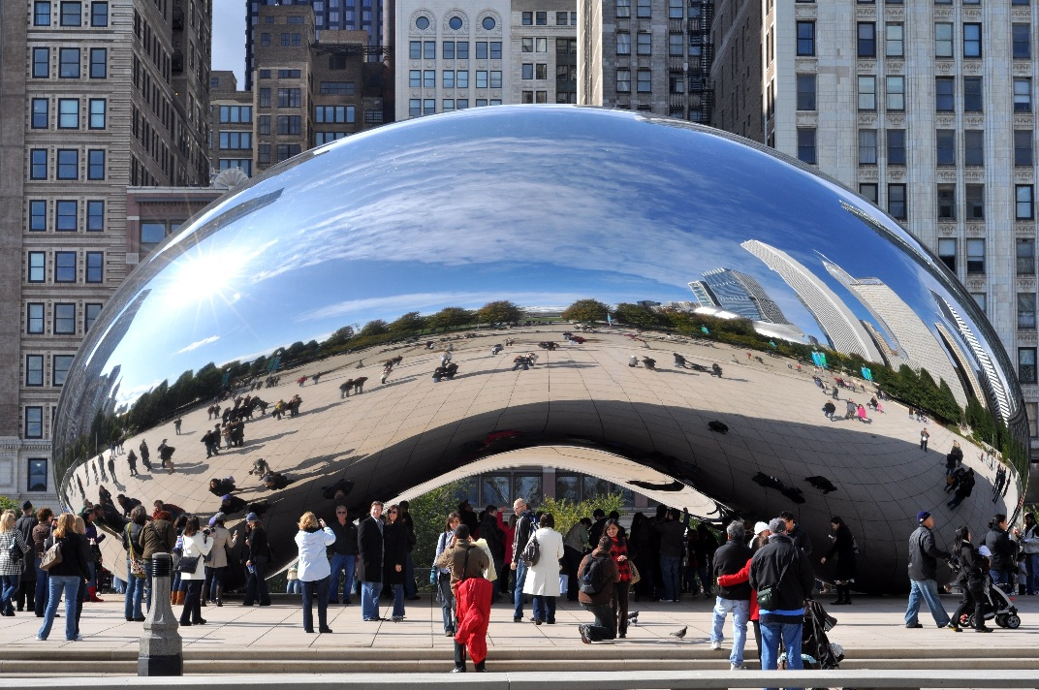
Objective
How to reconstruct an object
that does not has its own
appearance
Notes:
We as the broad question, how do we reconstruct specular and refractive objects?
Put it another way, how do we reconstruct objects which don’t have an appearance of their own but simply show a distorted version of its environment.

Slide 3
Failure of stereo matching
Notes:
As you can see in the two images, the correspondences don’t work for highly specular objects.
The same reflection point corresponds to two different points on the object.
So stereo is out of question. But knowing that we are dealing with refractive and reflective objects, can we come up with some models?

Slide 4
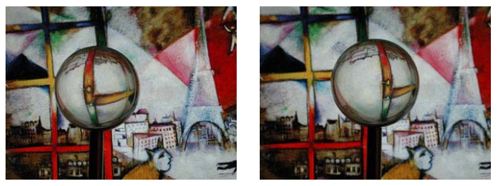
Shape recovery with models
Limited to very simple objects.
Ben Ezra and Nayar, “What does motion reveal about transparency?”
Notes:
One of the early methods involved reconstruction of very simple objects like ellipsoids using distortion with known motion.
Though one image may not say much about a transparent object, two images, with known motion between the two can reveal some information.
While effective for parametrized and simple models, not much can be done for very generic scenes.

Slide 5
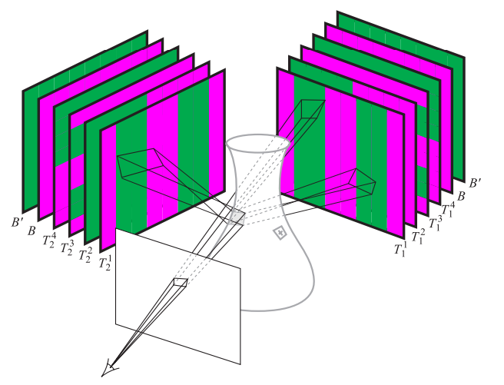
Environmental matting
Arrangement of cameras, mirrors and lenses and unknown. Estimate the mapping from environment to image.
Zonker et al., “Environment matting and compositing.”
Notes:
Of more interest and along the lines of this paper is environmental matting, where the function that maps from a known projection to the image helps recover the effect of the transparent object on any background.
This assumes that the imaging system, like the camera, lenses and mirrors is not known.

Slide 6
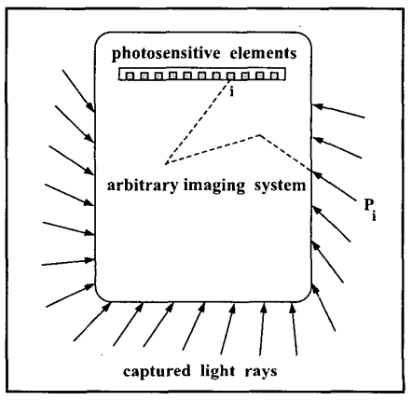
Generalized imaging models
Non-perspective mapping of rays. Assumes correspondence between rays and sensor elements.
Grossberg and Nayar, “A general imaging model and a method to find its parameters.”
Notes:
Another idea which can be considered a primer is the idea of generalized imaging models, which deals with non-perspective projection of scene geometry, with known mapping between rays and sensor elements.
Good, but again no assumptions on the imaging systems.

Slide 7
In short ...
All previous methods use simple models or structured light.
Black box assumption of scene settings.
No single image reconstruction algorithms.
Notes:
Slide self explanatory

Slide 8
A Theory of Refractive and Specular 3D Shape by Light-Path Triangulation
Provides a general framework for analyzing refraction and reflection.
Characterize the light path.
Provide reconstruction algorithms for some cases.
Notes:
This paper thus ….

Slide 9
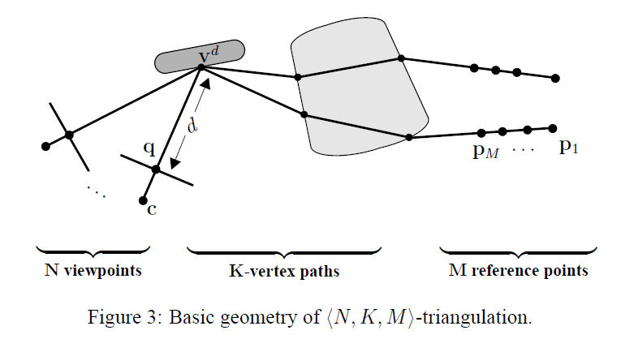
Light-Path Triangulation
Notes:
A light path is the curve that a ray would trace when going from a scene point p to a known viewpoint c and a known image plane.
As can be seen, a light path is necessarily a piecewise linear curve.
In the image, assuming a light path exists, q is called the indirect projection of p.
The question the paper asks is very simple. Under what <N, M, K> can we recover the scene geometry and what is the reconstruction algorithm?

Slide 10
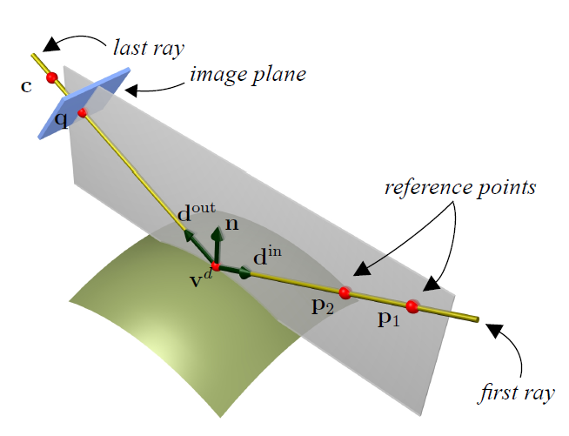
Three light path properties.
are coplanar.

Slide 11
Three light path properties.
are coplanar.
With known refractive index and any two of
, the third can be determined.

Slide 12
Three light path properties.
3. Reference point corresponding to same image point will be on the same first ray.
Notes:
The nice thing about all the three properties is that they hold for reflective and refractive objects.

Slide 13
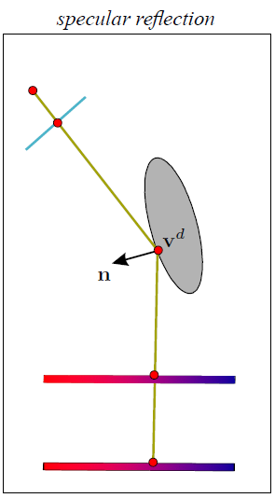
(1,1,2)-triangulation
Notes:
Now that we have the three properties with us, we can look at some of the theoretical results.
The simplest one to start with is the 1, 1, 2 triangulation, which means, 1 image point, 1 vertex on the object and two reference points
A geometric object with such a setting would be a specular object like the one shown in the right image.

Slide 14
(1,1,2)-reconstruction
Law of sine
Notes:
The location of vd, the last vertex that the light ray visits is given by the formula, and this depth is unique.

Slide 15
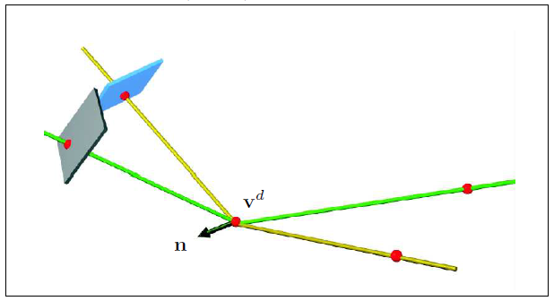
(2,1,1)-triangulation
Notes:
<2, 1, 1> triangulation, which is two image points, one vertex point and one reference point is discussed in dynamic refraction paper, but the main takeaway is that this problem is tractable and has a close form expression.

Slide 16
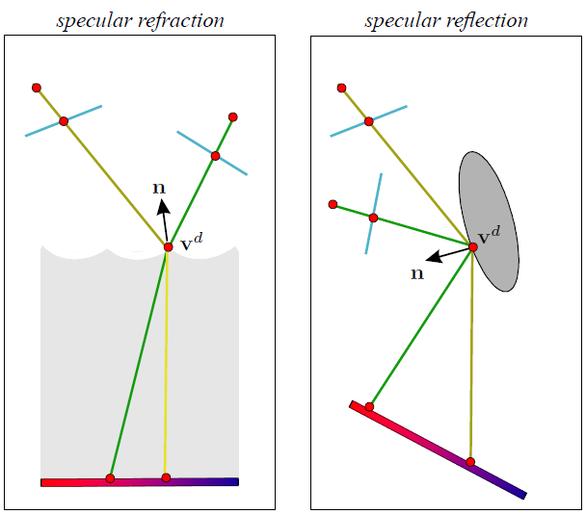
Notes:
<2, 1, 1> can be part of two settings.
Image on the left shows a refractive geometry and image on the right shows a reflective geometry.

Slide 17
(2,1,1)-triangulation
d is used for reconstruction
Notes:
Now Chia-Yin will discuss the rest of the paper.

Slide 18
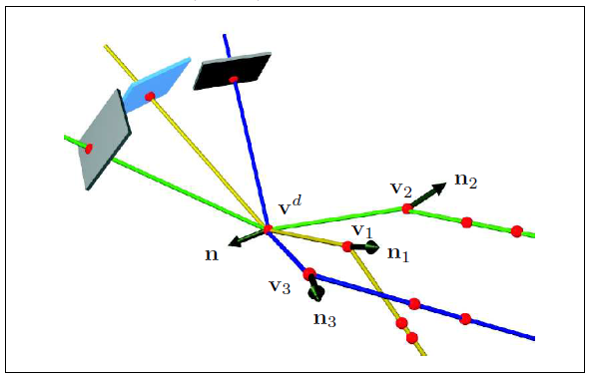
(3,2,2)-triangulation

Slide 19
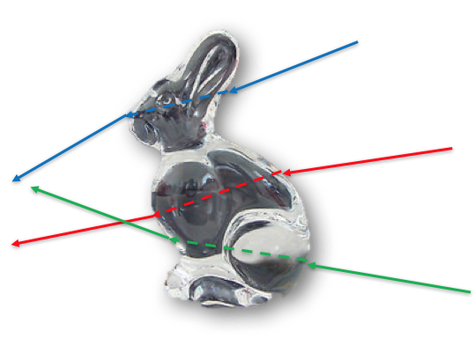
(3,2,2)-triangulation

Slide 20
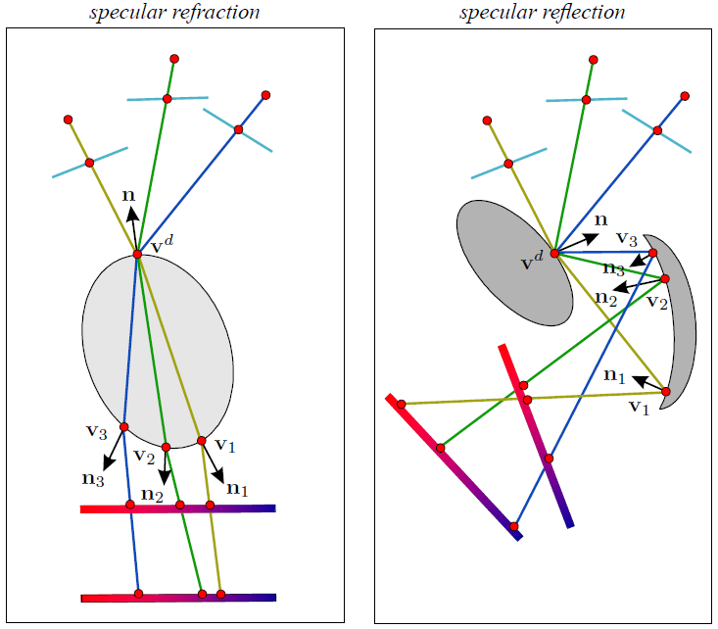

Slide 21
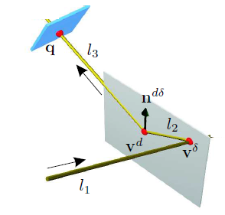
(3,2,2)-reconstruction
Use d and δ for analyzing the light path, and assume a refractive index
Searching through (d, δ) plane to find discrete set of solution.

Slide 22
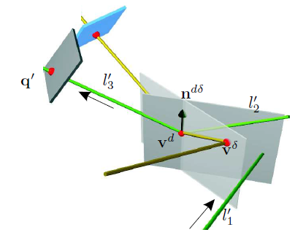
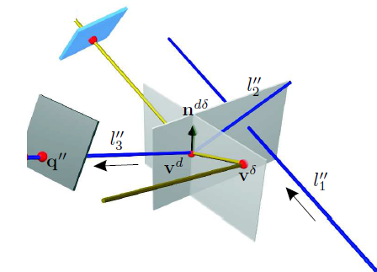
(3,2,2)-reconstruction

Slide 23
Ambiguity
There exist a discrete set of (d, δ) for each refractive index.
(3,2,2)-triangulation is tractable only when the refractive index is known

Slide 24
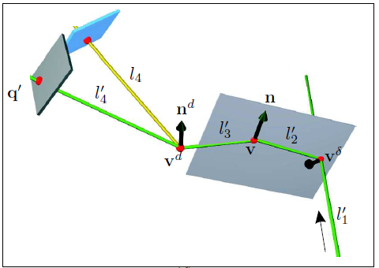
(N,3,2)-triangulation
Intractable, because of infinite combination of d and δ.

Slide 25
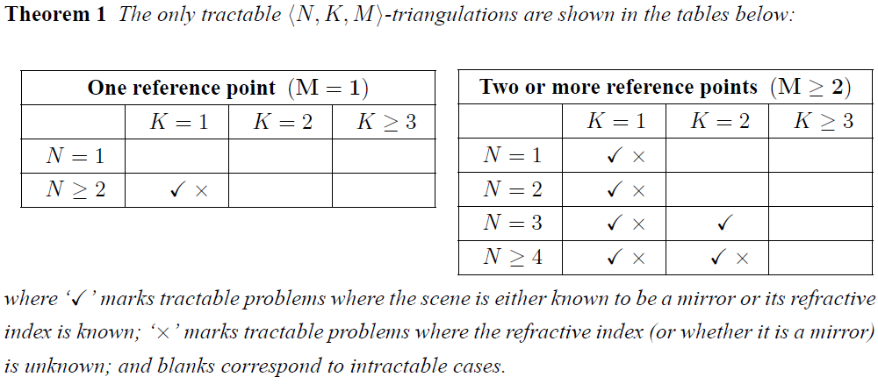
Tractable cases

Slide 26
possible ways to deal with K>=3 case
If every scene point is intersected by at least 3(K-1) light paths of length <=K, and if the first and the last ray of the path are known, the location of the scene point is constrained to a 0-dimensional solution manifold.
A Theory of Refractive and Specular 3D Shape by Light-Path Triangulation. K. Kutulakos and E. Steger

Slide 27
possible ways to deal with K>=3 case
Intuition K surface, K-1 connecting rays

Slide 28
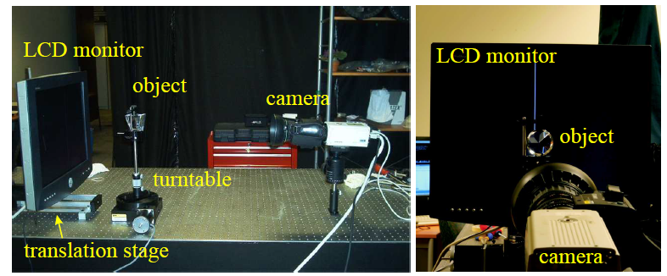
Experiment setup
Calibrated camera and scene
A Theory of Refractive and Specular 3D Shape by Light-Path Triangulation. K. Kutulakos and E. Steger

Slide 29
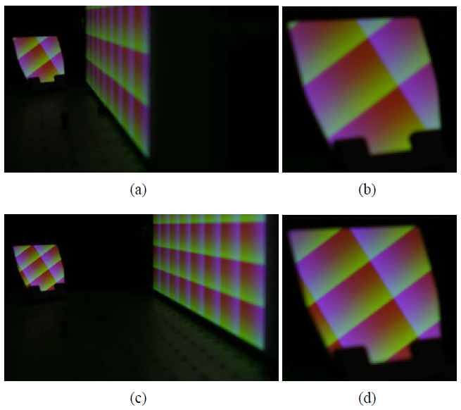
A Theory of Refractive and Specular 3D Shape by Light-Path Triangulation. K. Kutulakos and E. Steger

Slide 30
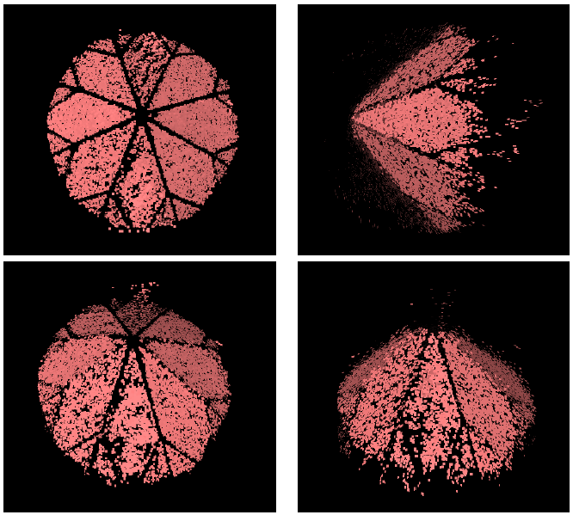
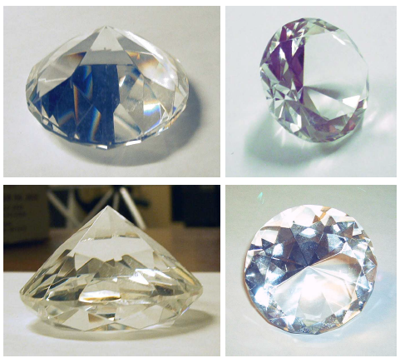
Results
Point-wise reconstruction

Slide 31
score
Score: 1.5
Pros
A systematic framework to analyze specular and refractive object reconstruction.
Well written paper.
Cons
Very cumbersome data collection procedure.
Only two objects

