Slide 1
(De) Focusing on Global Illumination for Active Scene Recovery
Mohit Gupta¹
Srinivasa Narasimhan¹
Yuandong Tian¹
Li Zhang²
¹Carnegie Mellon University
²University of Wisconsin-Madison
Presented by Rick and Chia-Yin
Notes:
Hello everybody. The title of my talk is Defocusing on global illumination for active scene recovery.
In this work, we have studied the inter-relationship between defocused illumination and global illumination.
This is joint work with Yuandong Tian and Srinivasa Narasimhan at the Carnegie Mellon University, and Li Jhang at the University of Wisconsin Madison.
Let’s begin by understanding what is defocused illumination and global illumination.
<<Correct Broken Fonts – use Palatino Linotype – or remove animations>>

Slide 2
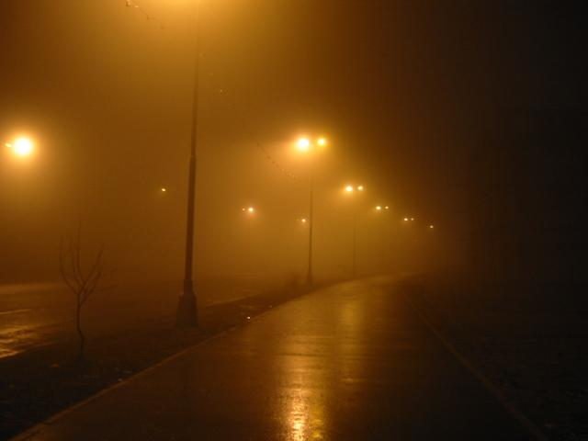
Global Illumination is Everywhere
Volumetric Scattering
Inter-reflections
Direct Illumination
Sub-surface scattering
Light Source
Scene
Notes:
Here is a scene and a light source. In the simplest case, light travels in a straight line from the source to the viewer. This is direct illumination.
However, light can get reflected from other parts of the scene – this is called inter-reflections. If the surface is translucent, light will permeate *BENEATH* the surface – this is called sub-surface scattering. Finally, in the presence of media such as dust, smoke and water, light will get scattered – this is called volumetric scattering.
All these complex and interesting effects are collectively called global illumination or global light transport.

Slide 3
Separate Direct and Global Illumination
Volumetric Scattering
Inter-reflections
Direct Illumination
Sub-surface scattering
Light Source
Scene
Projector
Notes:
Here is a scene and a light source. In the simplest case, light travels in a straight line from the source to the viewer. This is direct illumination.
However, light can get reflected from other parts of the scene – this is called inter-reflections. If the surface is translucent, light will permeate *BENEATH* the surface – this is called sub-surface scattering. Finally, in the presence of media such as dust, smoke and water, light will get scattered – this is called volumetric scattering.
All these complex and interesting effects are collectively called global illumination or global light transport.

Slide 4
Separate Direct and Global Illumination
Volumetric Scattering
Inter-reflections
Direct Illumination
Sub-surface scattering
Light Source
Scene
Focal Plane
Image Plane
Defocus
Projector
Lens
Scene
Notes:
Here is a scene and a light source. In the simplest case, light travels in a straight line from the source to the viewer. This is direct illumination.
However, light can get reflected from other parts of the scene – this is called inter-reflections. If the surface is translucent, light will permeate *BENEATH* the surface – this is called sub-surface scattering. Finally, in the presence of media such as dust, smoke and water, light will get scattered – this is called volumetric scattering.
All these complex and interesting effects are collectively called global illumination or global light transport.

Slide 5
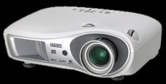
Defocused Illumination
Focal Plane
Image Plane
Defocus
Projector
Lens
Scene
Slide adapted from Zhang et al
Notes:
Now, let’s take the same scene and illuminate it with a limited depth of field device, such as a projector. For example this projector here. Projectors are designed to project a focused image on a single flat screen. However, if the projector focal plane is not on the scene, the image will be blurred or defocused. This is called defocused illumination.
Now these are two completely different physical effects – global illumination is an intrinsic property of the scene, and depends on material properties and scene geometry. On the other hand, defocused illumination is a property of the illumination device. So, one is a property of the scene, the other a property of illumination. Then why is it that we are interested in studying them together?

Slide 6
Defocused Illumination: Low Pass Filter
With Defocus
No Defocus
Global Illumination: Low Pass Filter
No Global Illumination
With Global Illumination
Notes:
The first key observation that we make is that *BOTH* these effects manifest themselves as low pass filters on the incident illumination.
We saw that defocus results in blurring of the projected image.
Interestingly, global illumination has a similar effect as well. For example, we notice a glow around street lights in foggy conditions, which is like a blur.
So – both these effects **essentially ** result ** in ** blurring ** of ** the incident illumination!
Now, this is something interesting – let’s investigate this a bit further. Let’s consider a scenario where both these effects occur together.

Slide 7
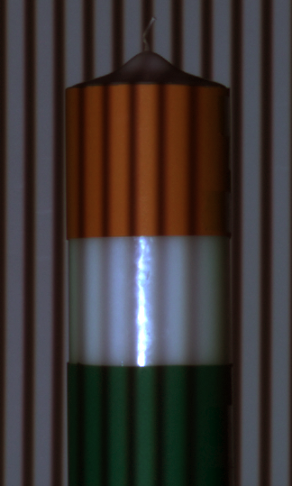
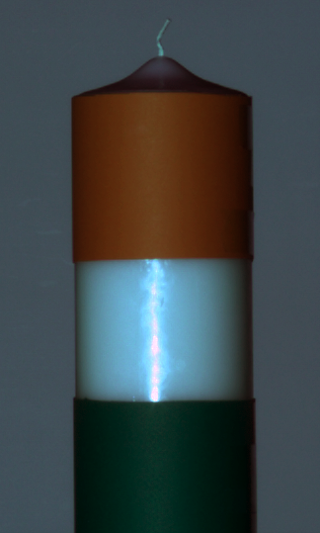
Defocused Illumination + Global Illumination
Notes:
Here is a toy scene consisting of a wax candle. We covered the top and bottom parts of the candle with diffuse paper – so that only the middle portion is translucent.
Now, let’s project a stripes pattern on this candle with a projector. This is illustrated with this ray-diagram here. Since the projector is focused on the background wall –the candle receives defocused illumination. Additionally, **ONLY** the middle portion of the candle receives global illumination in the form of sub-surface scattering.
By shifting the illumination pattern one pixel at a time – we record the temporal brightness profiles at the scene points A and B.
Clearly, Profile at A is more blurred than Profile at B due to the effect of global illumination. We can state this fact as a convolution with a global illumination blur kernel. The profile at B is a convolution of the input pattern with the defocus blur kernel.
7

Slide 8
Defocused Illumination (Direct component)
Direct component:
focal plane
location
time
i
radiance
Notes:
Here is a toy scene consisting of a wax candle. We covered the top and bottom parts of the candle with diffuse paper – so that only the middle portion is translucent.
Now, let’s project a stripes pattern on this candle with a projector. This is illustrated with this ray-diagram here. Since the projector is focused on the background wall –the candle receives defocused illumination. Additionally, **ONLY** the middle portion of the candle receives global illumination in the form of sub-surface scattering.
By shifting the illumination pattern one pixel at a time – we record the temporal brightness profiles at the scene points A and B.
Clearly, Profile at A is more blurred than Profile at B due to the effect of global illumination. We can state this fact as a convolution with a global illumination blur kernel. The profile at B is a convolution of the input pattern with the defocus blur kernel.
8

Slide 9
Defocused Illumination + Global Illumination
Direct component:
focal plane
location
time
i
radiance
BRDF,
orientation,
intensity fall-off
Notes:
Here is a toy scene consisting of a wax candle. We covered the top and bottom parts of the candle with diffuse paper – so that only the middle portion is translucent.
Now, let’s project a stripes pattern on this candle with a projector. This is illustrated with this ray-diagram here. Since the projector is focused on the background wall –the candle receives defocused illumination. Additionally, **ONLY** the middle portion of the candle receives global illumination in the form of sub-surface scattering.
By shifting the illumination pattern one pixel at a time – we record the temporal brightness profiles at the scene points A and B.
Clearly, Profile at A is more blurred than Profile at B due to the effect of global illumination. We can state this fact as a convolution with a global illumination blur kernel. The profile at B is a convolution of the input pattern with the defocus blur kernel.
9

Slide 10
Defocused Illumination + Global Illumination
Direct component:
focal plane
location
illumination pattern
time
i
radiance
BRDF,
orientation,
intensity fall-off
Notes:
Here is a toy scene consisting of a wax candle. We covered the top and bottom parts of the candle with diffuse paper – so that only the middle portion is translucent.
Now, let’s project a stripes pattern on this candle with a projector. This is illustrated with this ray-diagram here. Since the projector is focused on the background wall –the candle receives defocused illumination. Additionally, **ONLY** the middle portion of the candle receives global illumination in the form of sub-surface scattering.
By shifting the illumination pattern one pixel at a time – we record the temporal brightness profiles at the scene points A and B.
Clearly, Profile at A is more blurred than Profile at B due to the effect of global illumination. We can state this fact as a convolution with a global illumination blur kernel. The profile at B is a convolution of the input pattern with the defocus blur kernel.
10

Slide 11
Defocused Illumination + Global Illumination
Direct component:
focal plane
location
illumination pattern
time
i
radiance
BRDF,
orientation,
intensity fall-off
defocus blur kernel
Notes:
Here is a toy scene consisting of a wax candle. We covered the top and bottom parts of the candle with diffuse paper – so that only the middle portion is translucent.
Now, let’s project a stripes pattern on this candle with a projector. This is illustrated with this ray-diagram here. Since the projector is focused on the background wall –the candle receives defocused illumination. Additionally, **ONLY** the middle portion of the candle receives global illumination in the form of sub-surface scattering.
By shifting the illumination pattern one pixel at a time – we record the temporal brightness profiles at the scene points A and B.
Clearly, Profile at A is more blurred than Profile at B due to the effect of global illumination. We can state this fact as a convolution with a global illumination blur kernel. The profile at B is a convolution of the input pattern with the defocus blur kernel.
11

Slide 12
Defocused Illumination + Global Illumination
Direct and Global component:
i
fraction of
direct component from j to i
Notes:
Here is a toy scene consisting of a wax candle. We covered the top and bottom parts of the candle with diffuse paper – so that only the middle portion is translucent.
Now, let’s project a stripes pattern on this candle with a projector. This is illustrated with this ray-diagram here. Since the projector is focused on the background wall –the candle receives defocused illumination. Additionally, **ONLY** the middle portion of the candle receives global illumination in the form of sub-surface scattering.
By shifting the illumination pattern one pixel at a time – we record the temporal brightness profiles at the scene points A and B.
Clearly, Profile at A is more blurred than Profile at B due to the effect of global illumination. We can state this fact as a convolution with a global illumination blur kernel. The profile at B is a convolution of the input pattern with the defocus blur kernel.
12

Slide 13
Defocused Illumination + Global Illumination
Direct and Global component:
i
Fourier transform
Notes:
Here is a toy scene consisting of a wax candle. We covered the top and bottom parts of the candle with diffuse paper – so that only the middle portion is translucent.
Now, let’s project a stripes pattern on this candle with a projector. This is illustrated with this ray-diagram here. Since the projector is focused on the background wall –the candle receives defocused illumination. Additionally, **ONLY** the middle portion of the candle receives global illumination in the form of sub-surface scattering.
By shifting the illumination pattern one pixel at a time – we record the temporal brightness profiles at the scene points A and B.
Clearly, Profile at A is more blurred than Profile at B due to the effect of global illumination. We can state this fact as a convolution with a global illumination blur kernel. The profile at B is a convolution of the input pattern with the defocus blur kernel.
13

Slide 14
Defocused Illumination + Global Illumination
Since periodic pattern shifting
i
Notes:
Here is a toy scene consisting of a wax candle. We covered the top and bottom parts of the candle with diffuse paper – so that only the middle portion is translucent.
Now, let’s project a stripes pattern on this candle with a projector. This is illustrated with this ray-diagram here. Since the projector is focused on the background wall –the candle receives defocused illumination. Additionally, **ONLY** the middle portion of the candle receives global illumination in the form of sub-surface scattering.
By shifting the illumination pattern one pixel at a time – we record the temporal brightness profiles at the scene points A and B.
Clearly, Profile at A is more blurred than Profile at B due to the effect of global illumination. We can state this fact as a convolution with a global illumination blur kernel. The profile at B is a convolution of the input pattern with the defocus blur kernel.
14

Slide 15
Defocused Illumination + Global Illumination
Since periodic pattern shifting
i
defocus
blur kernel
global illumination blur kernel
Notes:
Here is a toy scene consisting of a wax candle. We covered the top and bottom parts of the candle with diffuse paper – so that only the middle portion is translucent.
Now, let’s project a stripes pattern on this candle with a projector. This is illustrated with this ray-diagram here. Since the projector is focused on the background wall –the candle receives defocused illumination. Additionally, **ONLY** the middle portion of the candle receives global illumination in the form of sub-surface scattering.
By shifting the illumination pattern one pixel at a time – we record the temporal brightness profiles at the scene points A and B.
Clearly, Profile at A is more blurred than Profile at B due to the effect of global illumination. We can state this fact as a convolution with a global illumination blur kernel. The profile at B is a convolution of the input pattern with the defocus blur kernel.
15

Slide 16
Defocused Illumination + Global Illumination
Since periodic pattern shifting
i
defocus
blur kernel
global illumination blur kernel
( Nearly independent to focal location f ! )
Notes:
Here is a toy scene consisting of a wax candle. We covered the top and bottom parts of the candle with diffuse paper – so that only the middle portion is translucent.
Now, let’s project a stripes pattern on this candle with a projector. This is illustrated with this ray-diagram here. Since the projector is focused on the background wall –the candle receives defocused illumination. Additionally, **ONLY** the middle portion of the candle receives global illumination in the form of sub-surface scattering.
By shifting the illumination pattern one pixel at a time – we record the temporal brightness profiles at the scene points A and B.
Clearly, Profile at A is more blurred than Profile at B due to the effect of global illumination. We can state this fact as a convolution with a global illumination blur kernel. The profile at B is a convolution of the input pattern with the defocus blur kernel.
16

Slide 17
Global Illumination is Nearly Indep. to f
j
i
rapidly
j
j₁
i
j₂
∑ ~ 0
~ 1
Notes:
Here is a toy scene consisting of a wax candle. We covered the top and bottom parts of the candle with diffuse paper – so that only the middle portion is translucent.
Now, let’s project a stripes pattern on this candle with a projector. This is illustrated with this ray-diagram here. Since the projector is focused on the background wall –the candle receives defocused illumination. Additionally, **ONLY** the middle portion of the candle receives global illumination in the form of sub-surface scattering.
By shifting the illumination pattern one pixel at a time – we record the temporal brightness profiles at the scene points A and B.
Clearly, Profile at A is more blurred than Profile at B due to the effect of global illumination. We can state this fact as a convolution with a global illumination blur kernel. The profile at B is a convolution of the input pattern with the defocus blur kernel.
17

Slide 18
Global Illumination is Nearly Indep. to f
j
Nearly independent to focal location f !
i
rapidly
j
j₁
i
j₂
∑ ~ 0
~ 1
Notes:
Here is a toy scene consisting of a wax candle. We covered the top and bottom parts of the candle with diffuse paper – so that only the middle portion is translucent.
Now, let’s project a stripes pattern on this candle with a projector. This is illustrated with this ray-diagram here. Since the projector is focused on the background wall –the candle receives defocused illumination. Additionally, **ONLY** the middle portion of the candle receives global illumination in the form of sub-surface scattering.
By shifting the illumination pattern one pixel at a time – we record the temporal brightness profiles at the scene points A and B.
Clearly, Profile at A is more blurred than Profile at B due to the effect of global illumination. We can state this fact as a convolution with a global illumination blur kernel. The profile at B is a convolution of the input pattern with the defocus blur kernel.
18

Slide 19
Defocused Illumination + Global Illumination
Focal Plane
A
Projector
B
Combined Blur Kernel
Temporal Radiance Profile at A
Input Pattern
Defocus Blur Kernel
Global Illumination Blur Kernel
=
*
*
Time
Time
Notes:
Now , this is nice - By expressing both these effects as blur kernels, we now no longer have to worry about explicitly modeling them – especially global illumination, which can be extremely hard. We can straightaway borrow tools from signal processing literature and analyze them.
For example, we might want to analyze these two effects separately. What we observe though is a combined blur – the convolution of both these kernels – so, we need to separate them. Fortunately, we can modulate the defocus by changing the projector focus setting. What about the global illumination blur? How does that depend on focus setting?
19

Slide 20
Defocused Illumination + Global Illumination
Focal Plane
A
Projector
B
Combined Blur Kernel
Temporal Radiance Profile at A
Input Pattern
Defocus Blur Kernel
Global Illumination Blur Kernel
=
*
*
Time
Time
indep. of focus
Notes:
Now , this is nice - By expressing both these effects as blur kernels, we now no longer have to worry about explicitly modeling them – especially global illumination, which can be extremely hard. We can straightaway borrow tools from signal processing literature and analyze them.
For example, we might want to analyze these two effects separately. What we observe though is a combined blur – the convolution of both these kernels – so, we need to separate them. Fortunately, we can modulate the defocus by changing the projector focus setting. What about the global illumination blur? How does that depend on focus setting?
20

Slide 21
Depth Recovery in the presence of Global Illumination
Notes:
Let’s see how can we get the correct depths. Basically, we have two unknowns: global illumination and defocus. So, intuitively, with two focal plane positions, we should be able to separate the two.

Slide 22
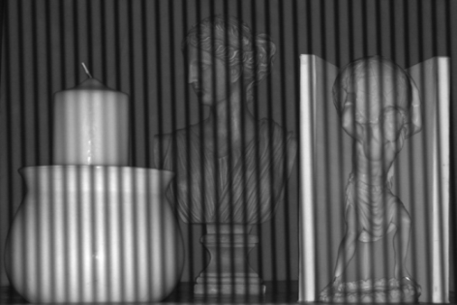
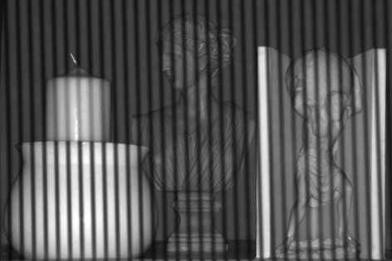
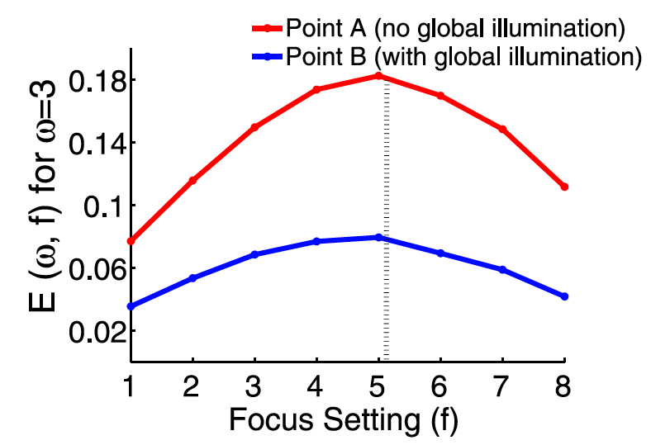
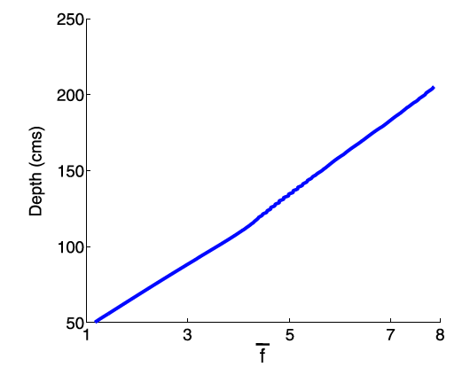
Depth using Multiple Focal Plane Positions
Input
A
A
A
…
Focal Plane Position 1
Focal Plane Position 2
Focal Plane Position 3
Notes:
Here are two example sequences – in the first, the projector is focus behind the scene and in the second, it is focused in front of the scene.
Consider the radiance profiles at scene point A for the two focus settings. The profiles are a convolution of the input pattern, the defocus blur kernel and the global illumination blur kernel. We now use the fact that the global illumination kernel is the same across different focus settings.

Slide 23
Depth using Two Focal Plane Positions
Input
A
=
*
*
Focal Plane Position 1
A
=
*
*
Intensity Profile
Input Pattern
Defocus Kernel
Global illumination blur Kernel
Focal Plane Position 2
Notes:
Here are two example sequences – in the first, the projector is focus behind the scene and in the second, it is focused in front of the scene.
Consider the radiance profiles at scene point A for the two focus settings. The profiles are a convolution of the input pattern, the defocus blur kernel and the global illumination blur kernel. We now use the fact that the global illumination kernel is the same across different focus settings.

Slide 24
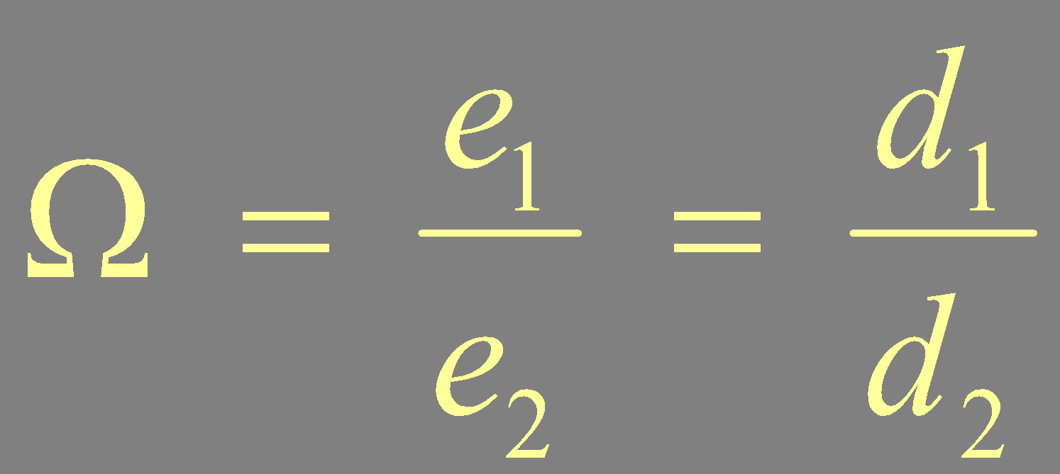
Depth using Two Focal Plane Positions
Input
A
Focal Plane Position 1
Ratio of DFT Coefficients:
A
Ω is invariant to Global Illumination
Focal Plane Position 2
Notes:
So, we take the discrete fourier transform of the two profiles and take their ratio to cancel the g-term. The ratio omega is a depth measure which is invariant to global illumination!
To get real depths --- we do a one time calibration step.
Since the defocus blur kernel is dependent on the depth.

Slide 25
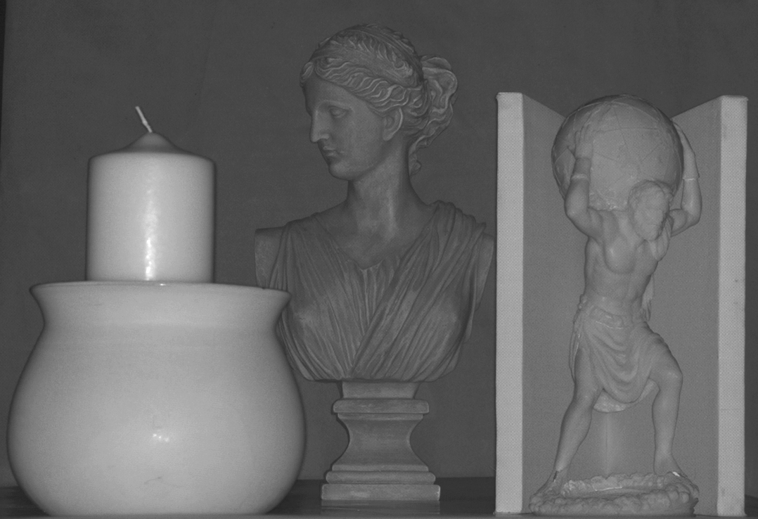
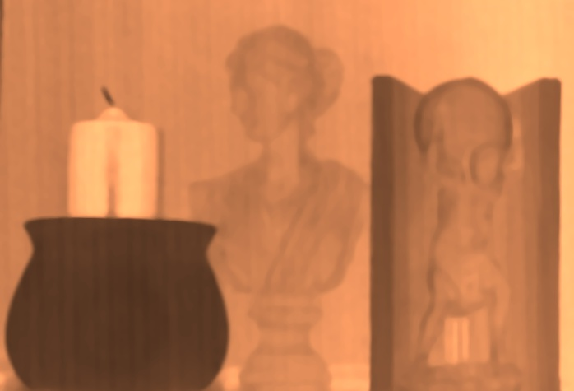
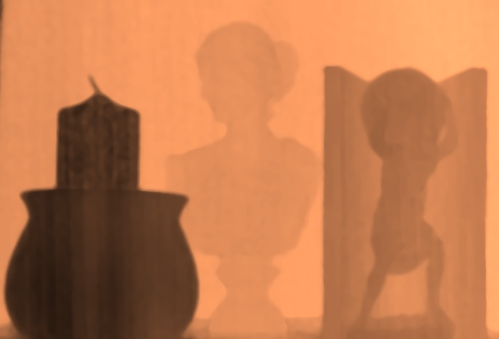
Comparison
Scene
One Focal Plane [Zhang et al]
Two Focal Planes [This Paper]
Multiple Focal Planes [This Paper]
Notes:
Here is a comparison. Top right is the previous technique – the bottom row is our results – with two and multiple focal planes. Looking at this comparison, it becomes clear that one has to account for global illumination for accurate depth recovery – and we have shown that this can be done by modeling both defocus and global illumination as blur kernels and then separating them.
Let’s look at some more results.

Slide 26
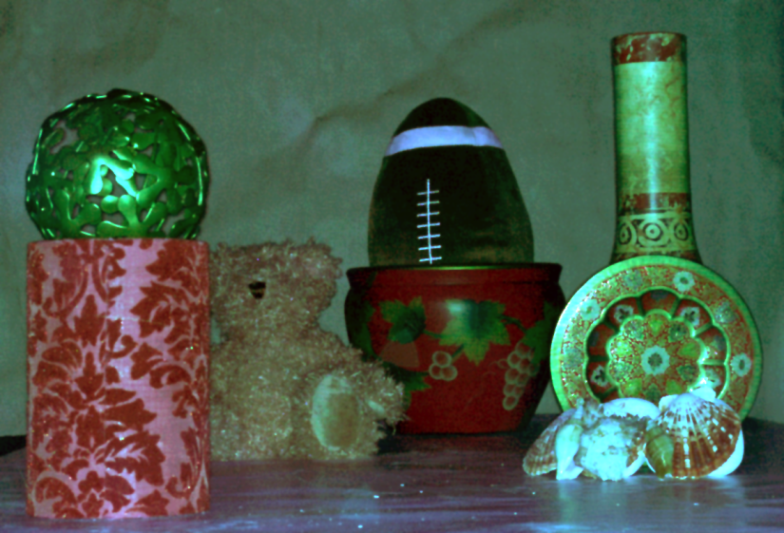
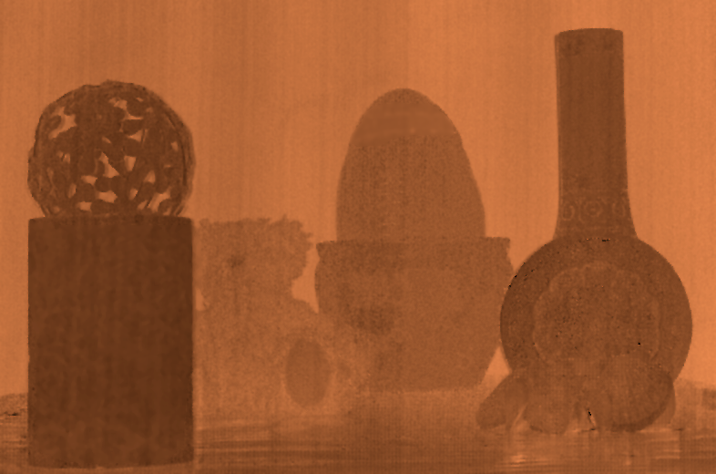
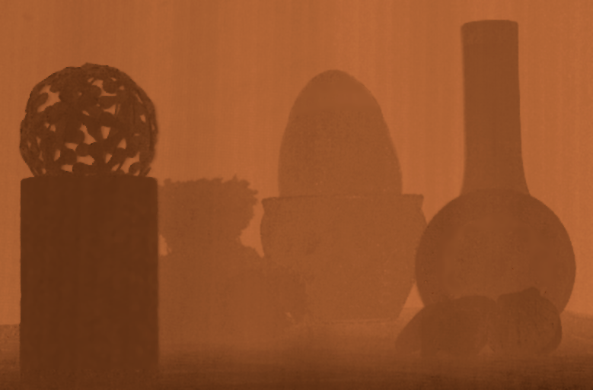
Depth Recovery
Scene
One Focal Plane [Zhang et al]
Two Focal Planes [This Paper]
Multiple Focal Planes [This Paper]
Notes:
Look at the base of the objects – because of inter-reflections, the previous technique produces incorrect results. In the correct depth map, there should be a smooooooth transition in depths – which is the case with our results. <Pause>

Slide 27
Direct-Global Separation in the presence of Projector Defocus
Notes:
To get the correct separation in the presence of defocus – let’s think about the source of error – defocus. Defocus is a depth dependent effect. So, in principle, if we have a depth map of the scene – we can remove the defocus effects. The depth map can be computed from any of the techniques discussed earlier.

Slide 28
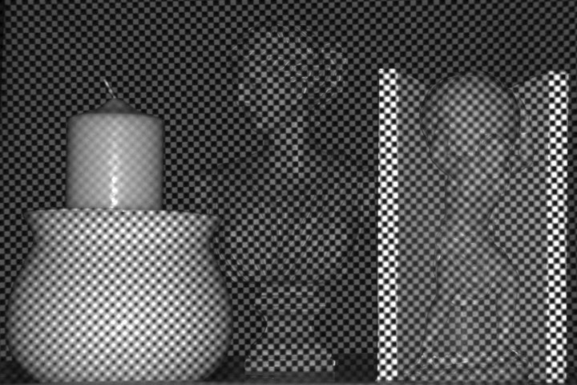
Separation of Direct and Global Components
[Nayar et al’ 06]
S
S
S
Checker-board pattern projected on the scene
Notes:
Recently Nayar et al proposed a technique for separating the direct and global components of light transport using high-frequency illumination. For example, we can use a checker-board pattern with half the pixels on and the other half off.
Consider the scene point S. If it is getting directly lit, it is receiving the direct component and HALF the global component – since only half the pixels are on. We call this emax. If it is not getting directly lit, it receives only half the global component. This is emin.
By shifting the pattern – we can compute the pixel wise emax and emin. From these, we can solve for the direct and global components.
This technique, however, does not account for defocus. Let’s see how does defocus affects separation.

Slide 29
How does Defocus affect Direct-Global Separation?
Defocus Blur
S
S
Projector
Focal Plane Position (f)
Checker-board pattern projected on the scene
Defocus blur considered.
Notes:
Consider this scene point. The pattern is blurred here due to defocus. The separation equations have to be modified in this manner to account for defocus. This point receives only a fraction of the direct component. This fraction depends on the focal plane position – when the point is in focus, it is 1. Since global illumination is a low frequency effect, we assume that S still receives half the global component. Similarly, for the emin image, the scene point receives a fraction of the direct component. This fraction is zero when it is in focus.

Slide 30
How does Defocus affect Direct-Global Separation?
Direct Component
Global Component
Focal plane moving from the front to the back
Notes:
If we do not account for defocus, we will get different separations for different focal plane positions – which is not right, because direct and global components are inherent to the scene – they should not be changing with the focus setting of the projector.

Slide 31
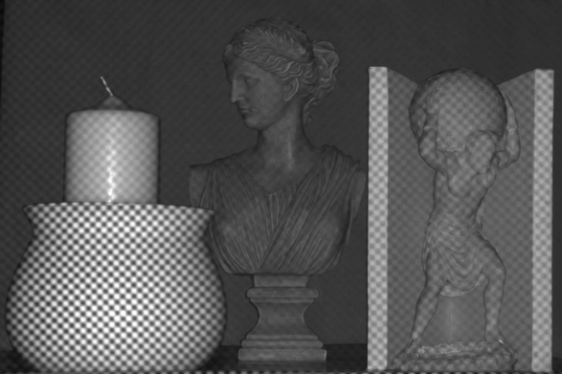
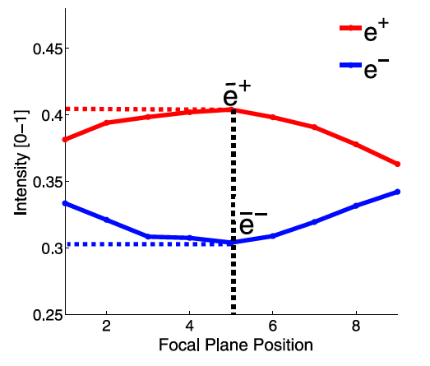
Separation using Multiple Focal Plane
Input
Max Intensity:
Min Intensity:
S
Notes:
Let’s see how we do this.
Once again, let’s consider the scene point S – and compute emax and emin: the maximum and the minimum intensity.
Now here are two equations and 4 unknowns: eglobal, edirect, alpha-max and alpha-min. But, alpha-max and alpha-min depend ONLY on the defocus, and can be computed given the depth map of the scene.
So, we can take the difference of these two equations to eliminate the global component, and compute the direct component. Alpha-max and Alpha-min are computed from the depth map.
The global component is then computed simply by subtracting the direct image from the total image.
Here are the resulting direct and global components.

Slide 32
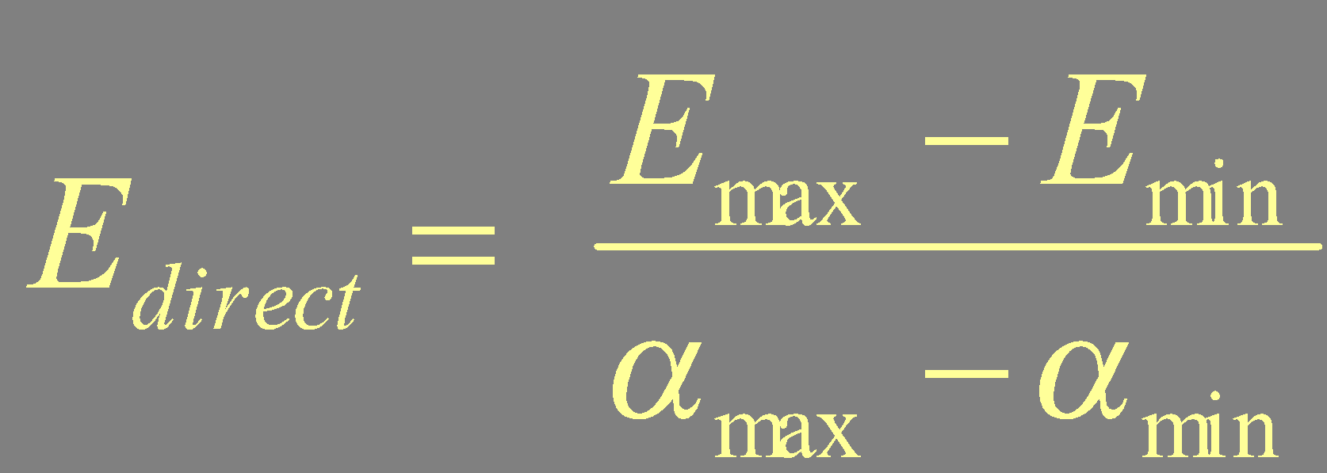
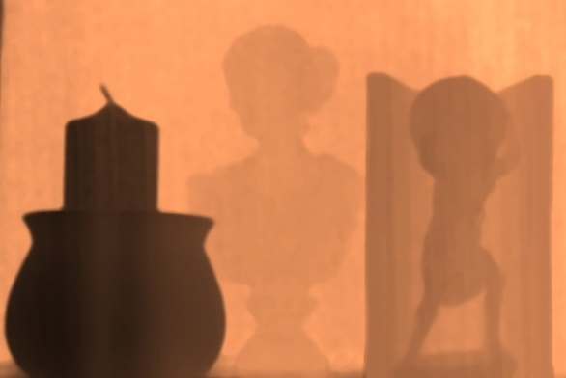
Separation using One Focal Plane + Depth map
Input
Max Intensity:
Min Intensity:
S
Direct Component:
Global Component:
Depth Map
Notes:
Let’s see how we do this.
Once again, let’s consider the scene point S – and compute emax and emin: the maximum and the minimum intensity.
Now here are two equations and 4 unknowns: eglobal, edirect, alpha-max and alpha-min. But, alpha-max and alpha-min depend ONLY on the defocus, and can be computed given the depth map of the scene.
So, we can take the difference of these two equations to eliminate the global component, and compute the direct component. Alpha-max and Alpha-min are computed from the depth map.
The global component is then computed simply by subtracting the direct image from the total image.
Here are the resulting direct and global components.

Slide 33
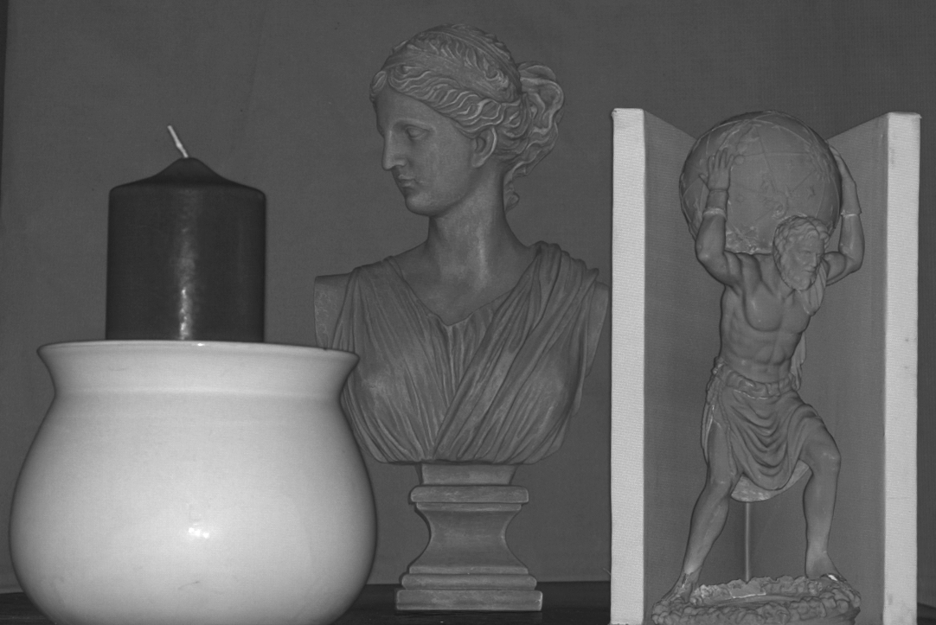
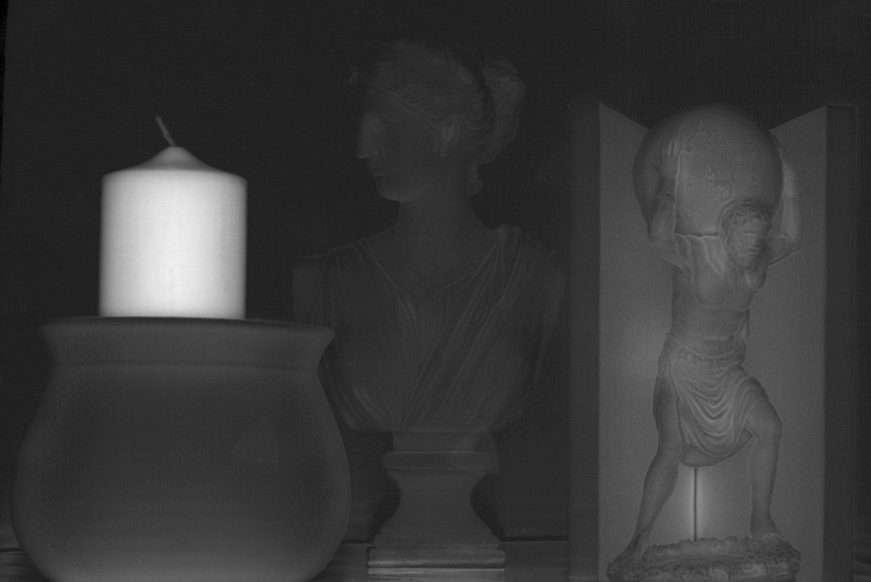
Separation using a Single Focal Plane + Depth Map
Direct Component
Global Component
Notes:
Notice the high global component due to sub-surface scattering on the candle, in the concavity and on the marble statue. The background wall and the clay pot have low amounts of global component.
It’s interesting to note the duality between the two applications: Earlier we were removing global illumination to get the correct depths – now we are removing defocus to get the correct global illumination.
Let’s look at some more results.

Slide 34
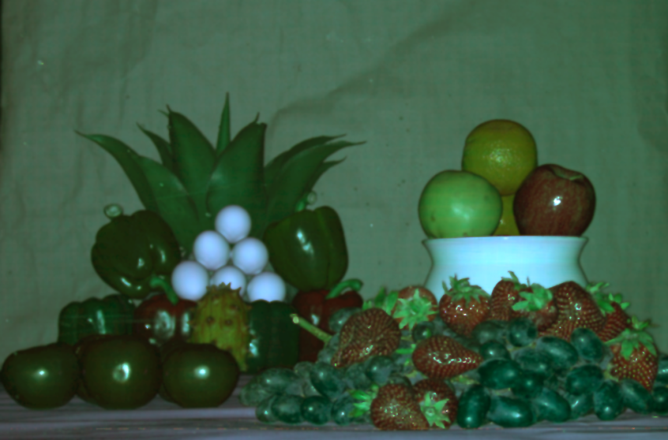
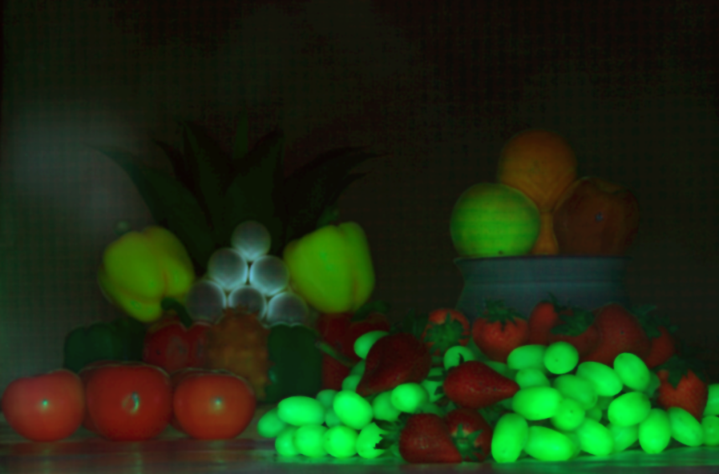
Separation using a Single Focal Plane + Depth Map
Direct Component
Global Component
Notes:
This is the separation using our multiple focal plane algorithms. The color of the pepper is mostly due to sub-surface scattering, and the translucency in the flower.

Slide 35
Illumination Defocus using an area light source
Scene
Area Light Source
Mask
Aperture
Focal Plane
Sun for Outdoor Scene Recovery
Notes:
Now, so far, we have associated projectors with illumination defocus – when it is really a more general effect. We have observed that we can simulate defocus using an area light source and a mask –the mask acts as the focal plane and the area source acts as the aperture. We can change the focus setting by either moving the mask or changing the size of the source. One big criticism we get is that all these techniques are good for table-top objects. With this analysis, we can use sun for recovering scene properties even for outdoor scenes.

Slide 36
Thoughts
Score: 1.5
Good:
Solve the practical defocus issue
Propose practical algorithms for scene depth estimation and global/direct light separation.
Bad:
Does not discuss how to select the width of the illumination (freq too high it will be blurred, too low violates its assumption and increases acquisition time)
Notes:
For example, recently projector defocus analysis was used to compute scene depths – however, this technique does not account for global illumination. On the other hand, the recent technique to separate the direct and global methods does not account for defocus.
Because of this interplay, because these two effects co-exist –we should really study them together. It might be hard – because physically, these are two different effects. But let’s see how different they really are?

