Slide 1
Fast Separation of Direct and Global Images Using High Frequency Illumination
Shree K. Nayar, Gurunandan Krishnan, Michael D. Grossberg, Ramesh Raskar
Presented by: Yiying Li and Harrison Billmers

Slide 2
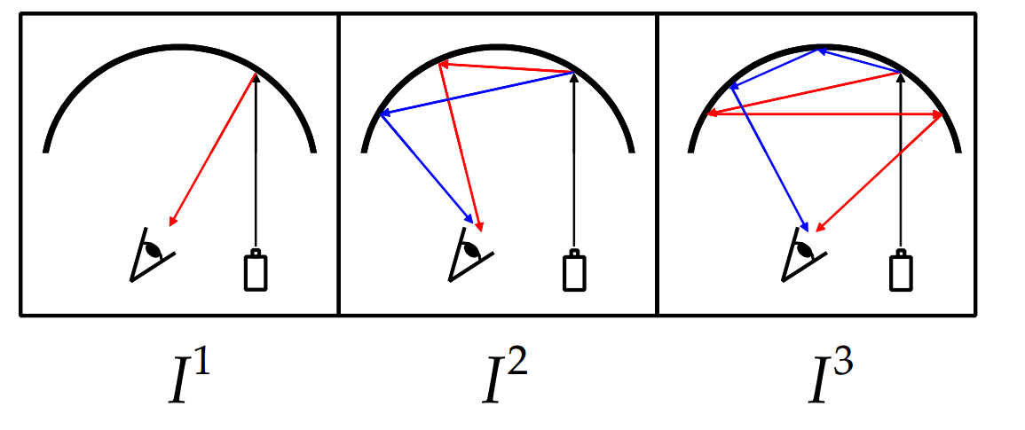
Related Works
Inverse Light Transport (Seitz et. al. ICCV 05)
  Estimates interreflections contribution given the number of reflections
  Based on Lambertian assumption and large amounts of data need
Dual Photography (Sen et. al. Siggraph 05)
  Estimates the transport matrix between camera and projector
  Still requires a lot of images
  Don’t need full transport matrix

Slide 3
Direct and Global Components
Direct Components
  The radiance of a scene point due to illumination from the source directly
Global Components
  Radiance of a scene point due to illumination from other points in the scene
  Interreflections
  Subsurface scattering
  Volumetric scattering
  Translucency

Slide 4
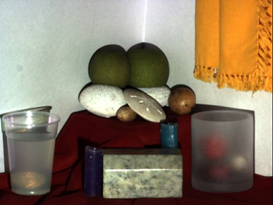
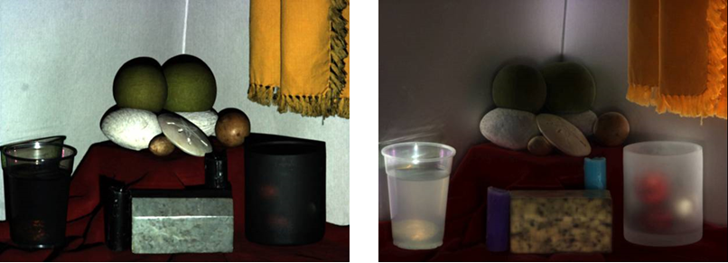
Scene
Direct
Global

Slide 5
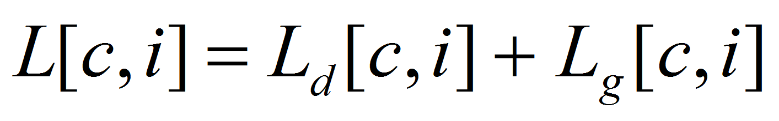
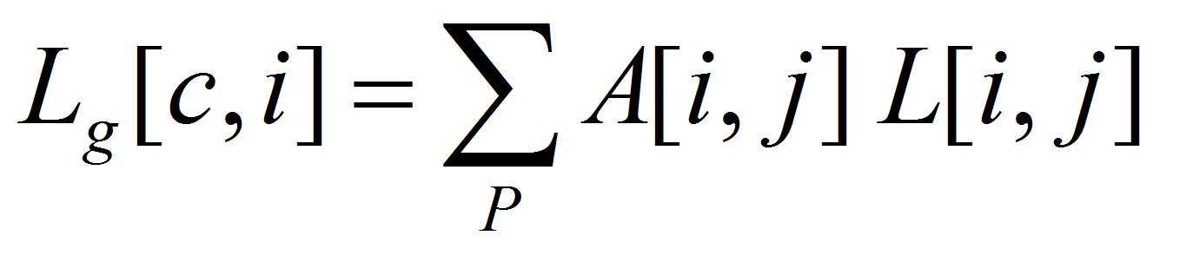


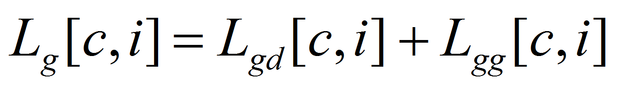
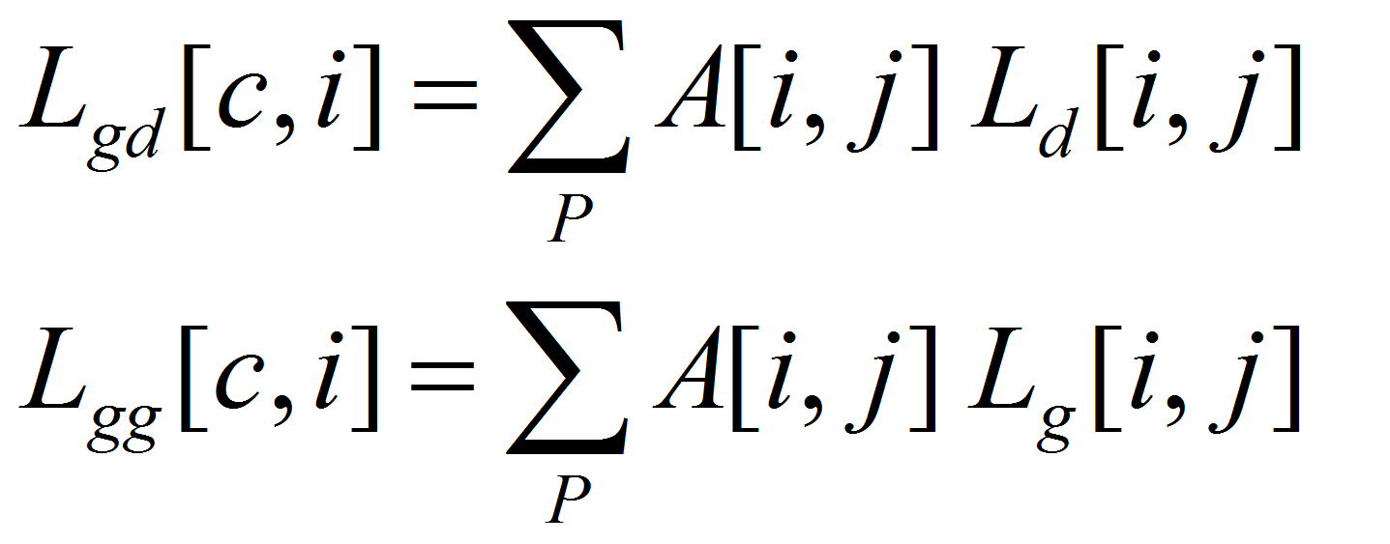
Direct and Global Components
Radiance = Direct Component +
Global Component
The sum of all interreflections from all patches
BRDF and Geometry
Radiance of patch j in the direction of patch i
2nd order of the form as above

Slide 6
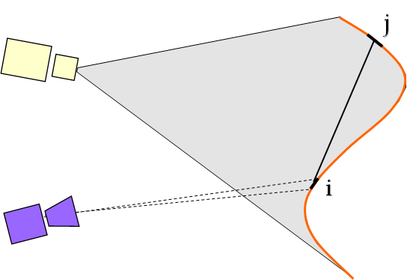
Interreflections
Source
Surface
Camera

Slide 7
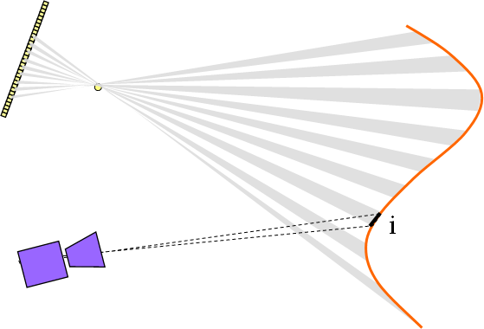

High Frequency Illumination Pattern
Source
Surface
Camera

Slide 8
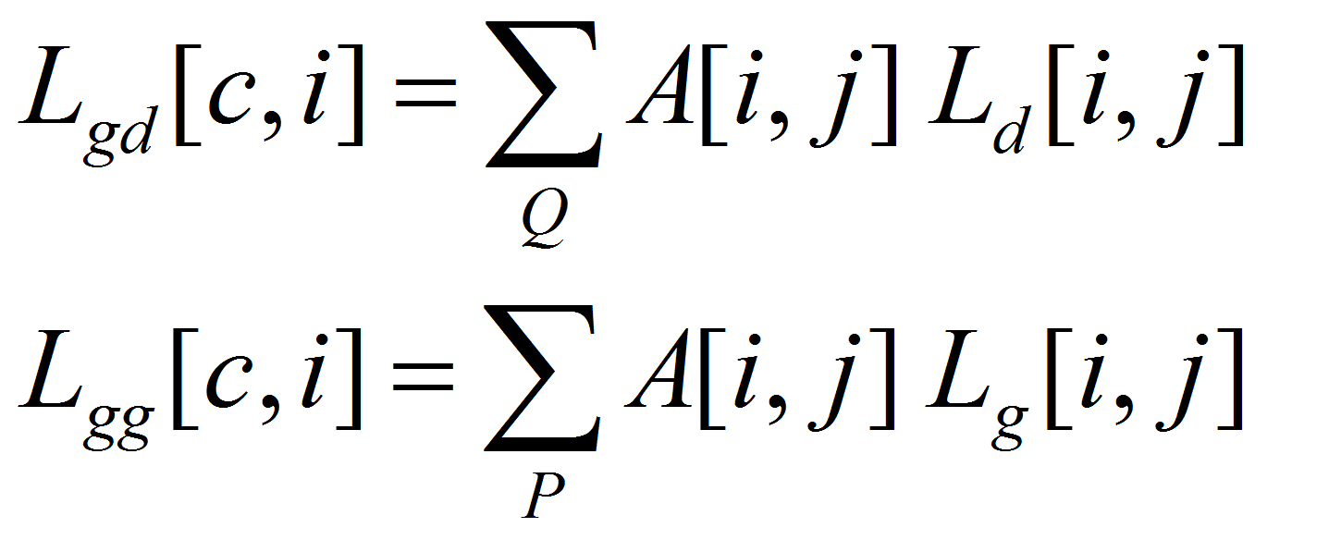
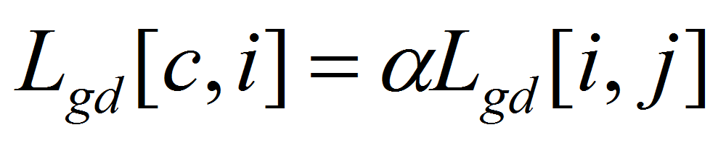

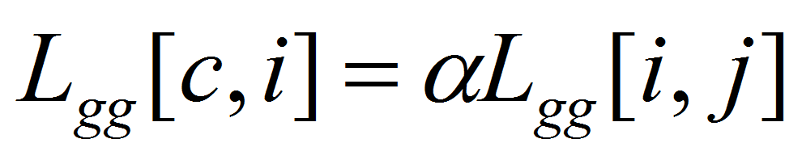
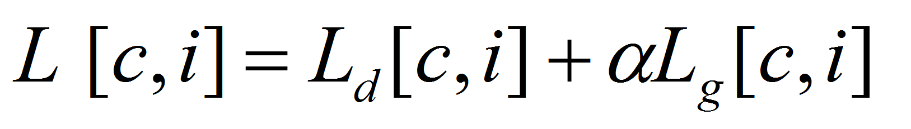
Direct and Global Components
+
-
If A is smoothing and we sample at high enough frequency
+
Fraction of the patches lit
+
+

Slide 9
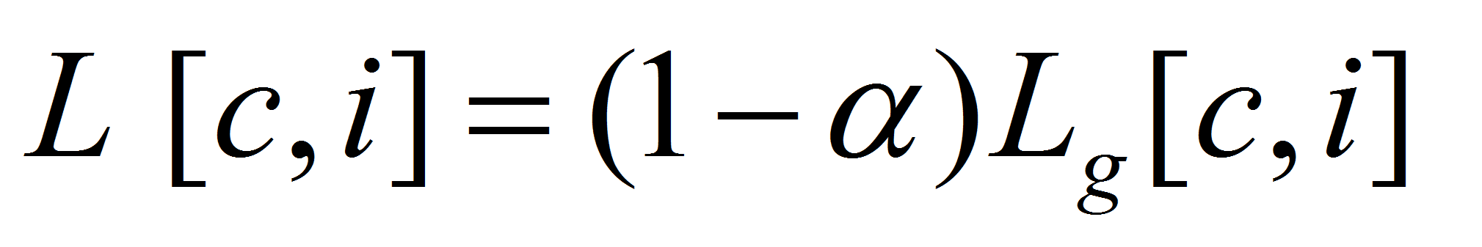
High Frequency Illumination Pattern
Source
Surface
Camera
+
-
+
-

Slide 10
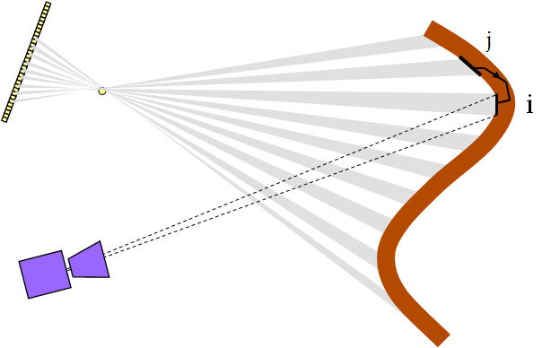
Subsurface Scattering
Source
Translucent
Surface
Camera

Slide 11
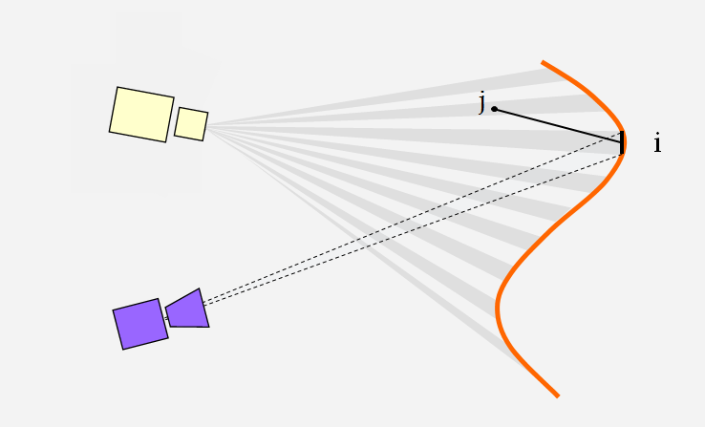
Volumetric Scattering
Source
Translucent
Surface
Camera

Slide 12
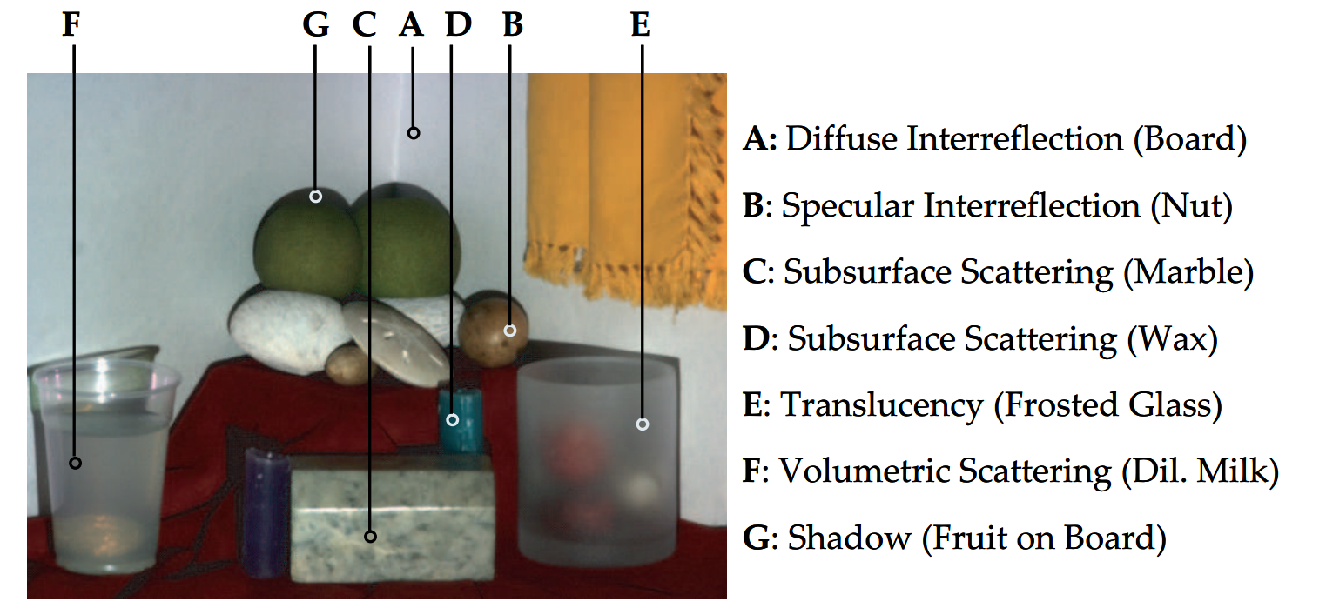
Experiment System
Using a scene with variety of physical phenomena
Scene is lit with a 1024x768 Projector
Images were captured with a same size (1024x768) camera
  Due to the Bayer filter and the noise it incurs
  32 takes of the same scene was averaged per image

Slide 13
Experiments
Experiment 1
  Vary the size of the illumination patch used to construct the high frequency pattern
  From 3 to 11
Experiment 2
  Lit the scene with 100 different illumination patterns
  Kept points of interests unlit @ 6x6 patch
Experiment 3
  Vary alpha
Experiment 4
  Vary the frequency of the checkerboard patterns

Slide 14
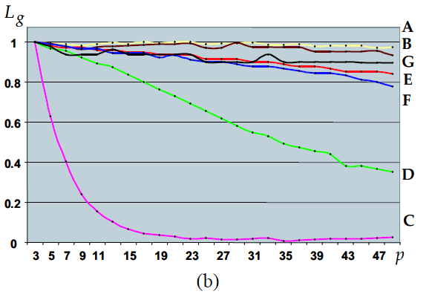
Experiment 1:
Unlit Surrounding
Patch

Slide 15
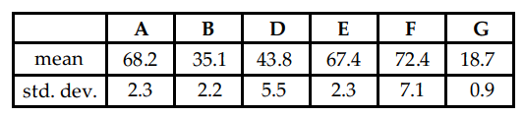
Experiment 2:
Randomized Lighting

Slide 16
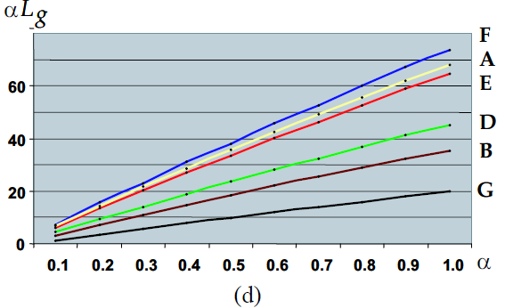
Experiment 3:
Alpha Variation

Slide 17
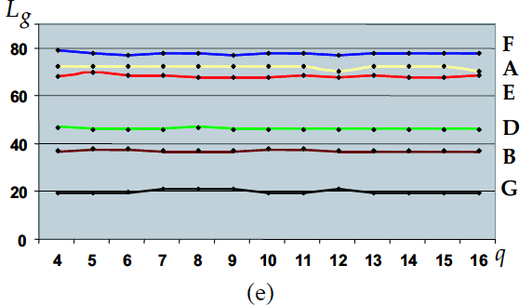
Experiment 4:
Vary Checkerboard
Frequency

Slide 18
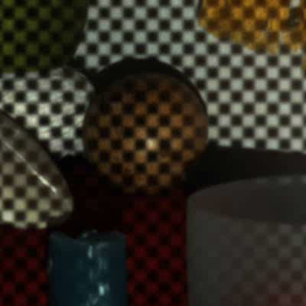
Checkboard Illumination Shifts
Due to some light-leakage and defocusing from
the projector, more than two images were taken
to minimize error.
A 8x8 pixel checkboard pattern (alpha = 0.5) was
advanced by 3 pixels 5 times in each direction,
for a total of 25 images. The min and max
(L_{min}, L_{max}) were found per pixel, in turned used for
computing direct and global illumination (L_{d}, L_{g})

Slide 19
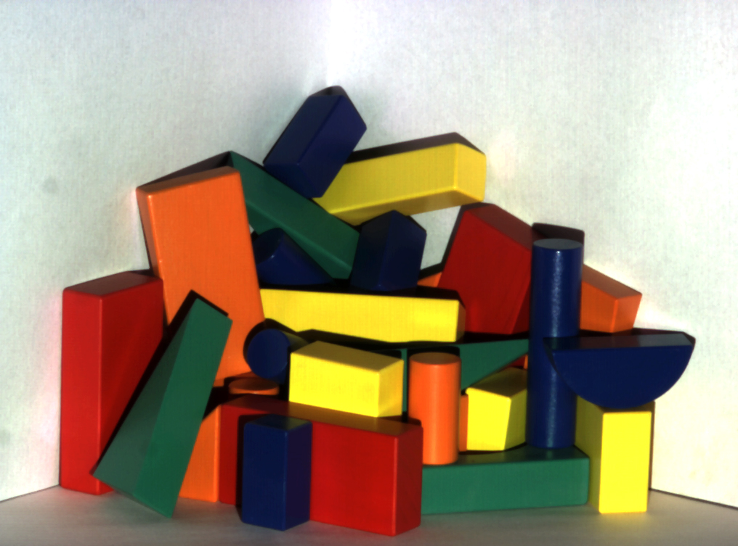
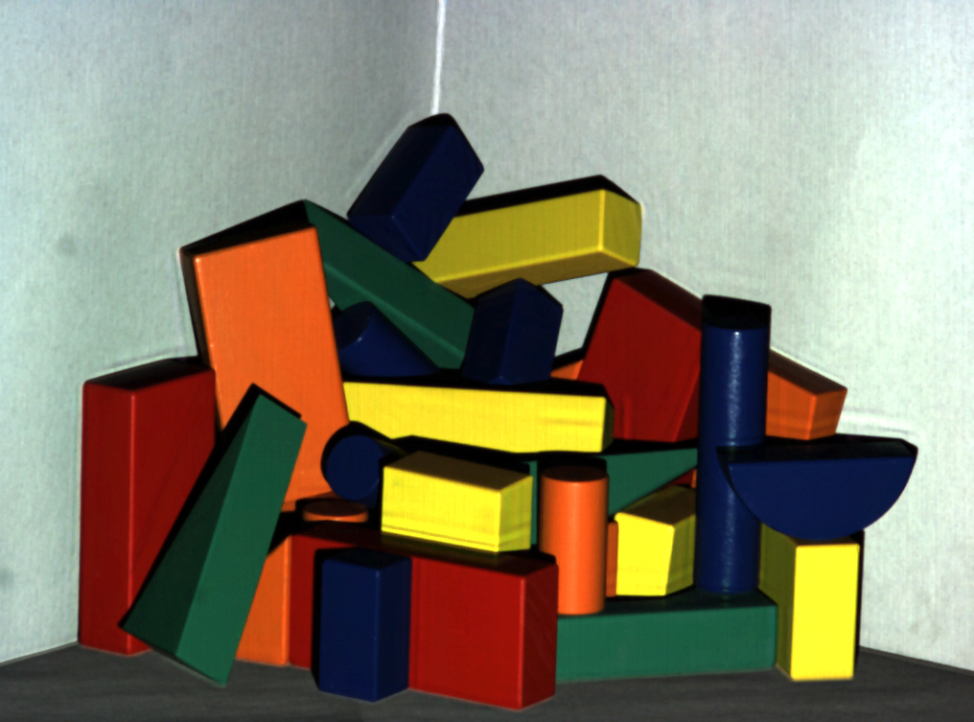
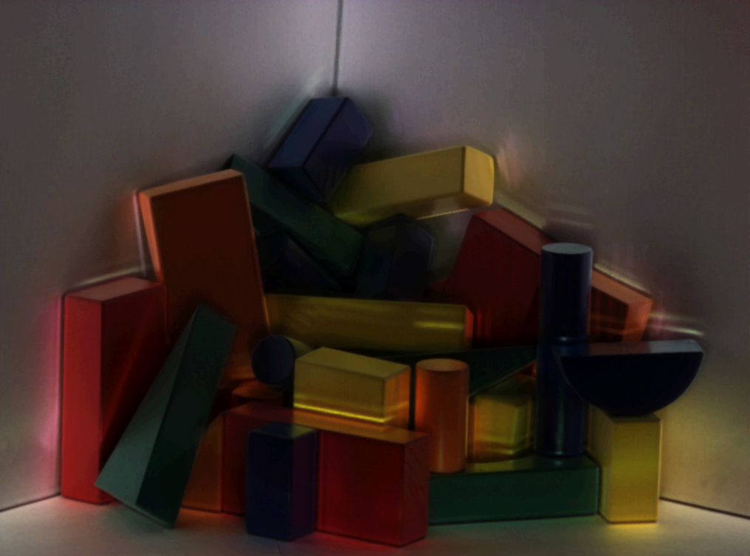
Results
Scene
Direct
Global

Slide 20
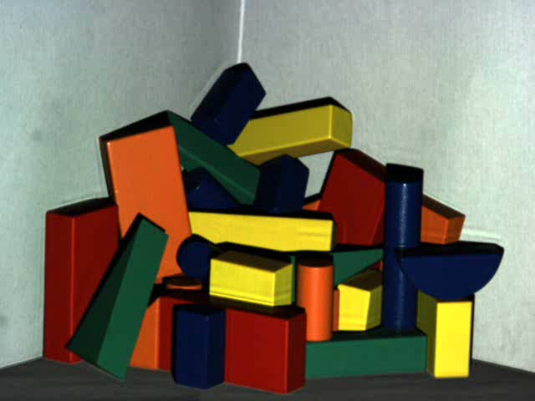

Slide 21
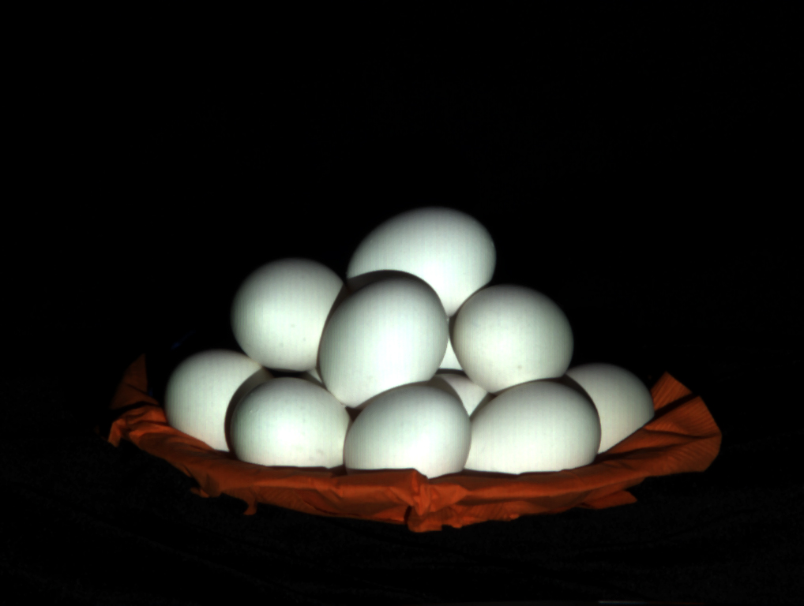
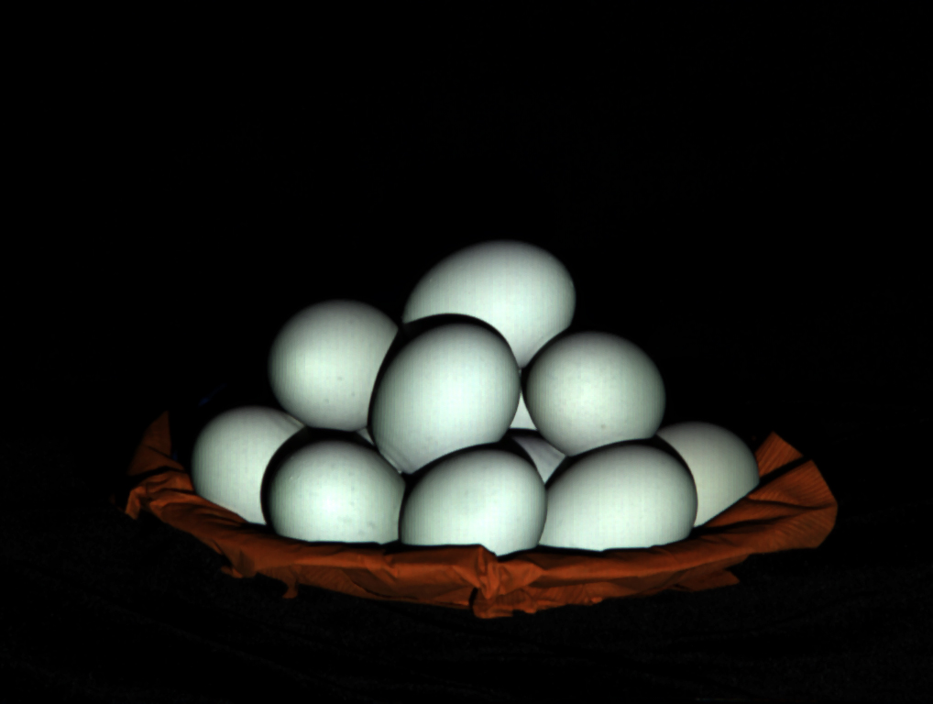
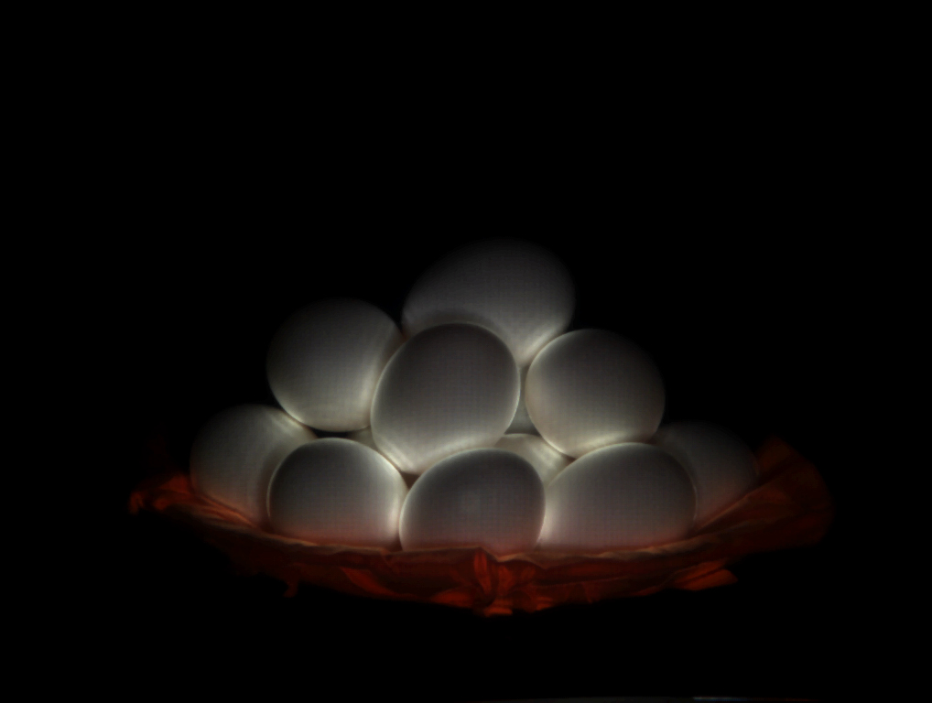
Results
Scene
Direct
Global

Slide 22
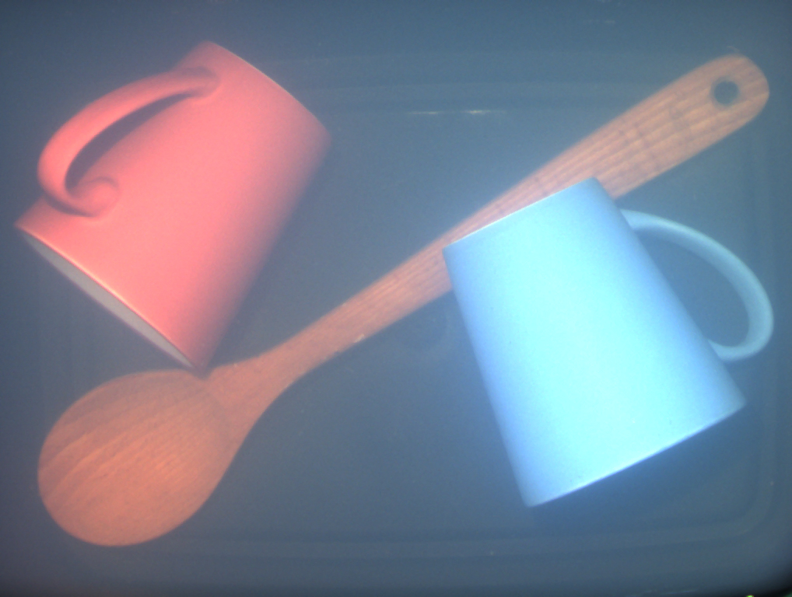
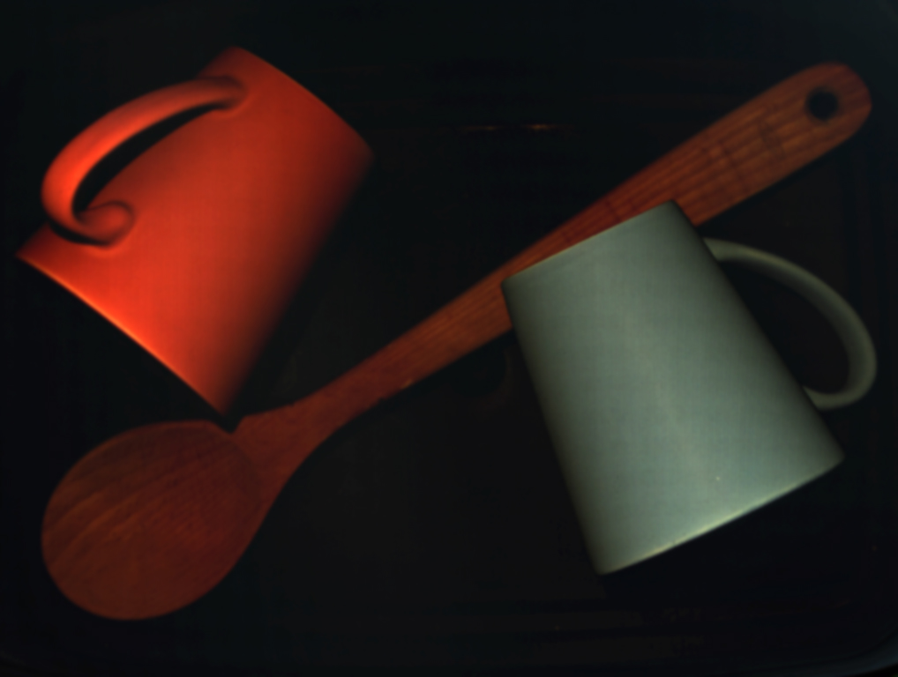
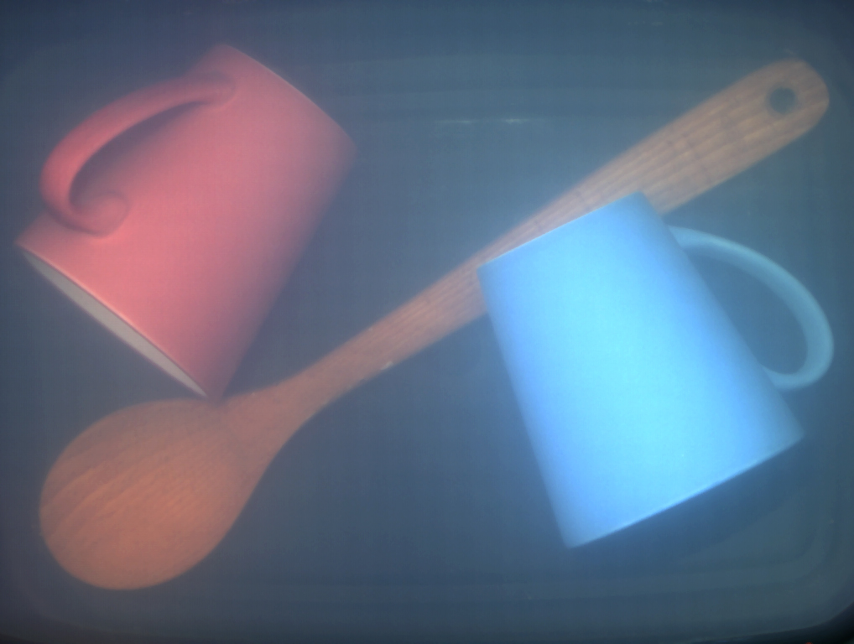
Results
Scene
Direct
Global

Slide 23
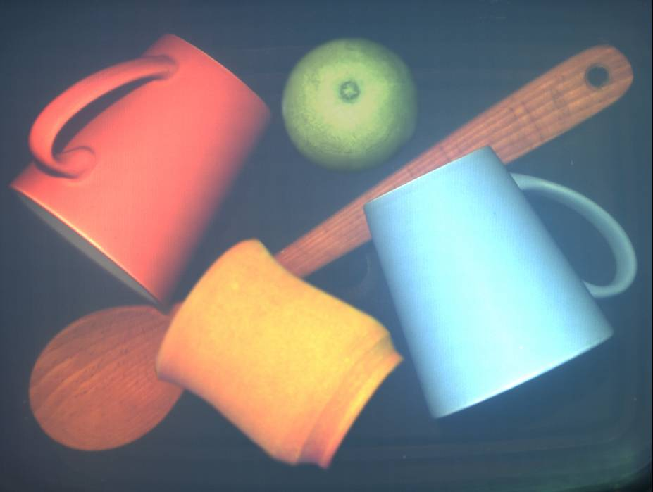
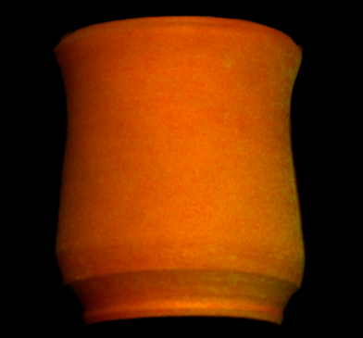
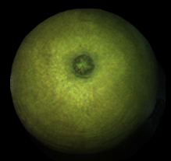
Novel Image

Slide 24
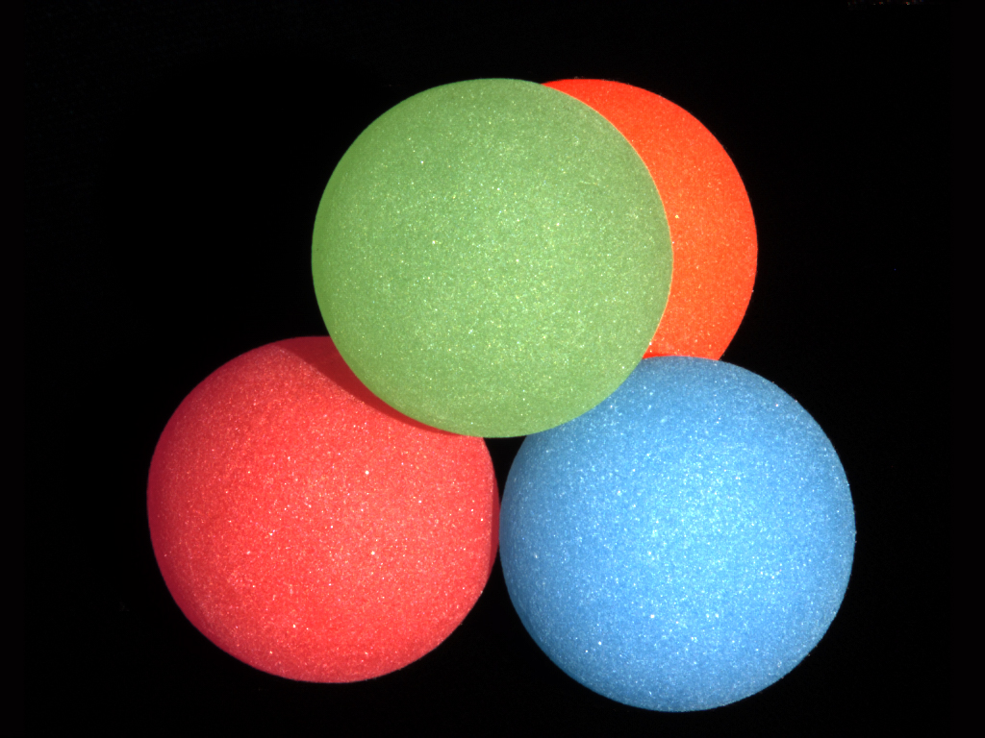
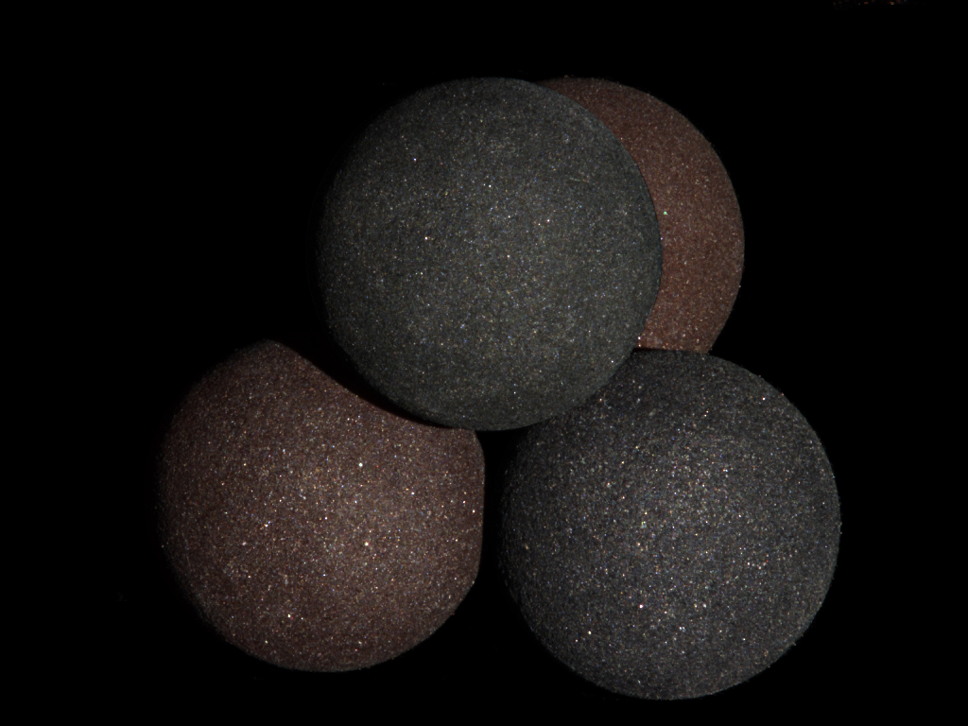
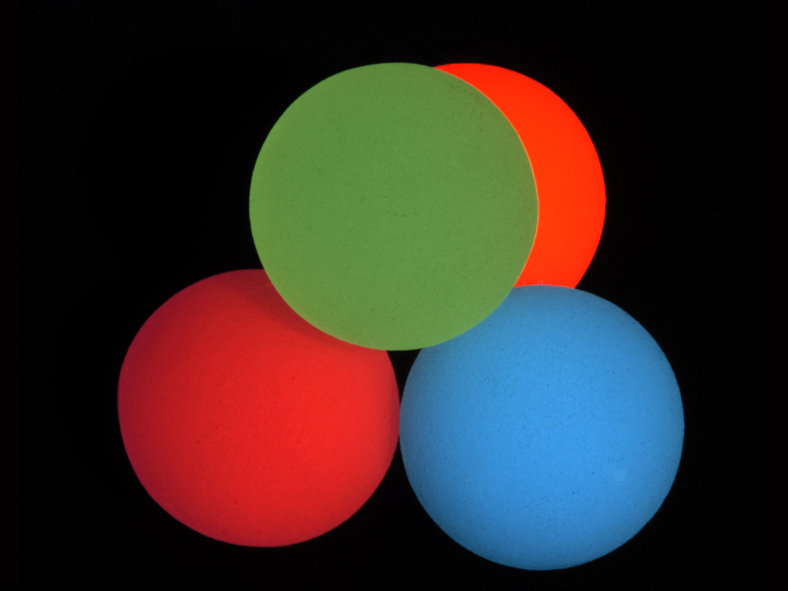
Results
Scene
Direct
Global

Slide 25
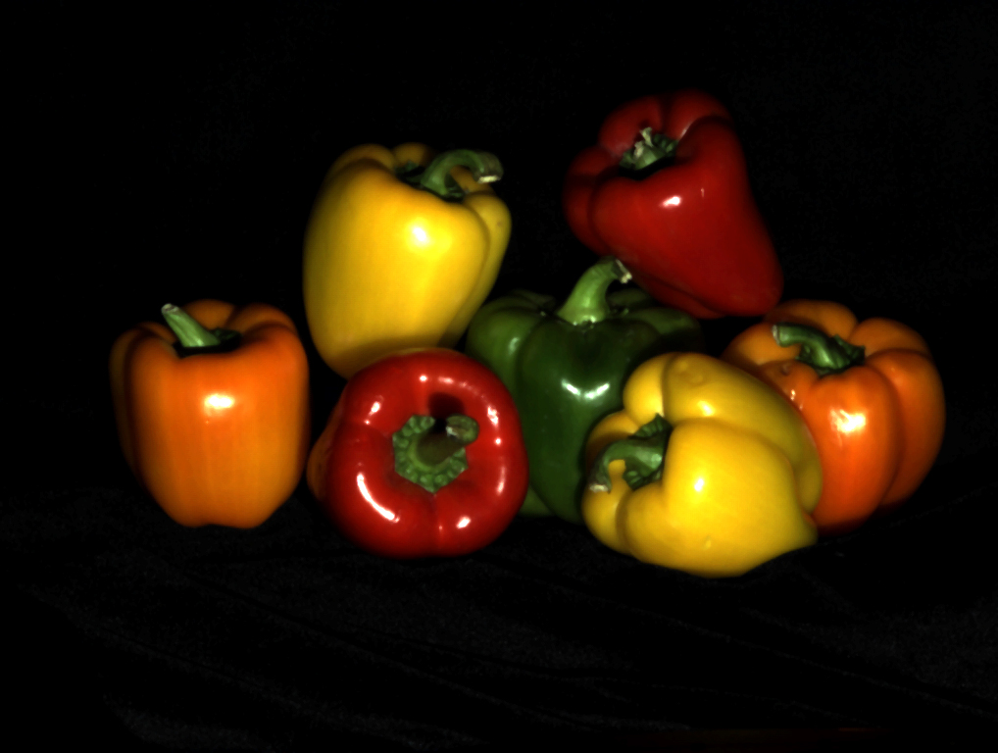
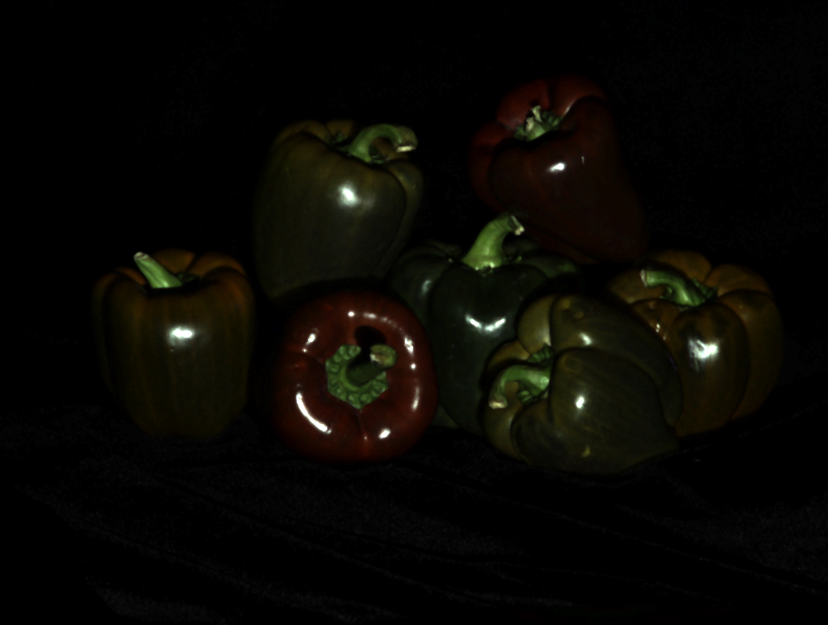
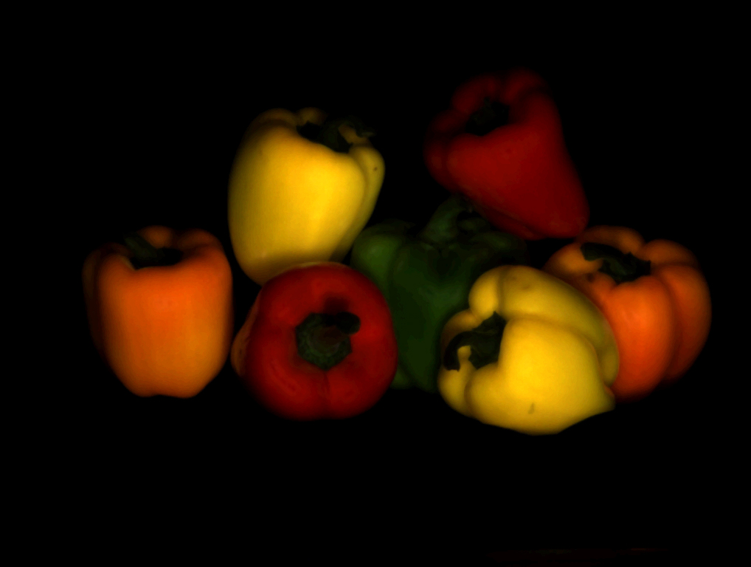
Results
Scene
Direct
Global

Slide 26


Slide 27



Variants of Separation Method
Coded Structured Light
Shifted Sinusoids
Rather than using a projector, utilize a natural light source and occlude.
Shadow of Line Occluder
Shadow of Mesh Occluders

Slide 28
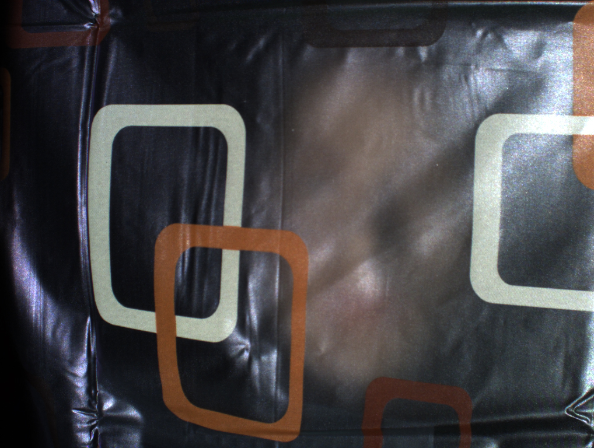

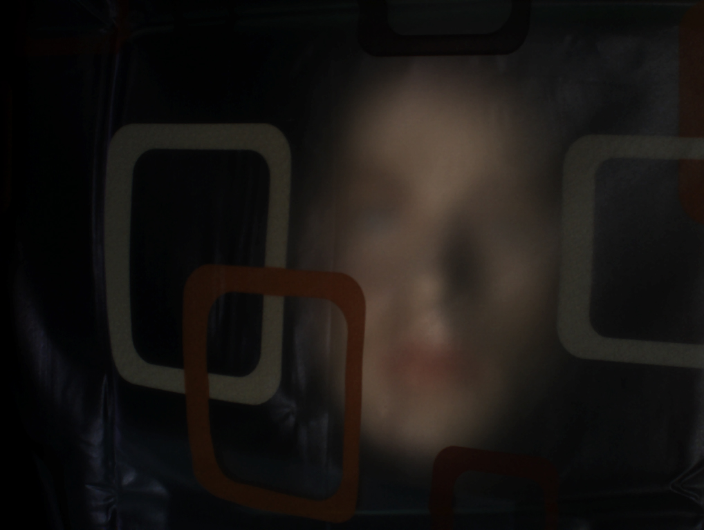
Results
Scene
Direct
Global

Slide 29
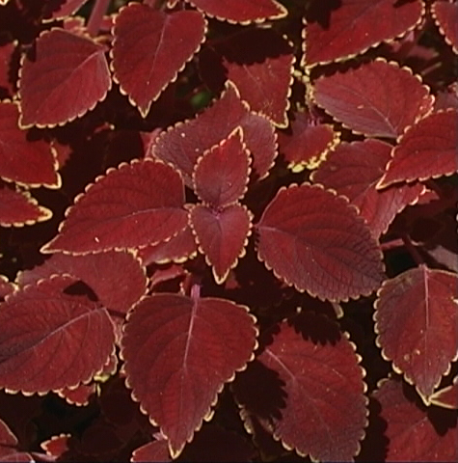
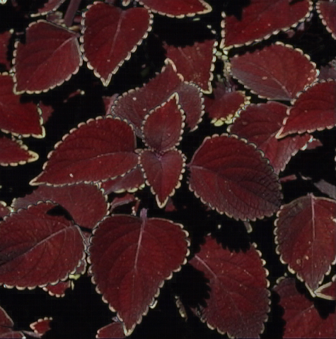
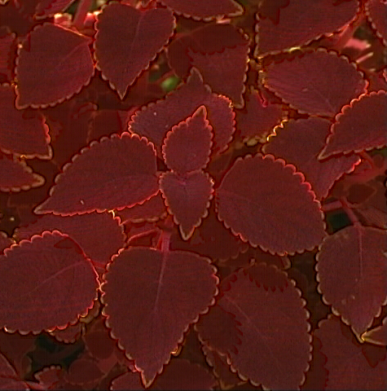
Results
Scene
Direct
Global

Slide 30
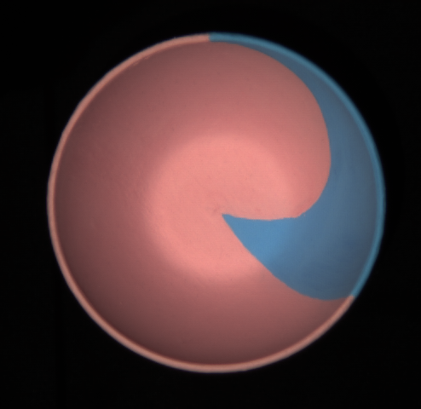
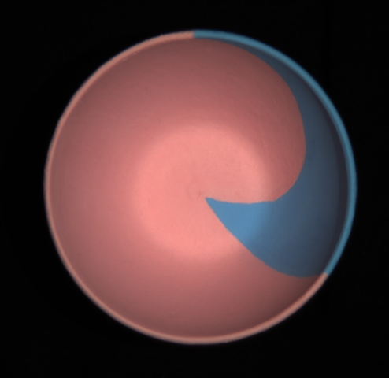
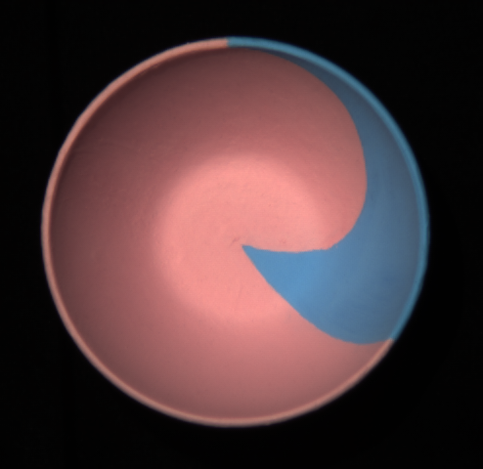
Photometric Stereo using Direct Images
Source 1
Source 2
Source 3
Bowl
Shape
Global
Direct
Nayar et al., 1991

Slide 31
Single Image Separation
Utilize an n by m window around pixels.
Save the value if it is the min or max in it’s window.
Interpolate to generate full resolution image.
Reduce resolution by a factor of k through averaging.

Slide 32
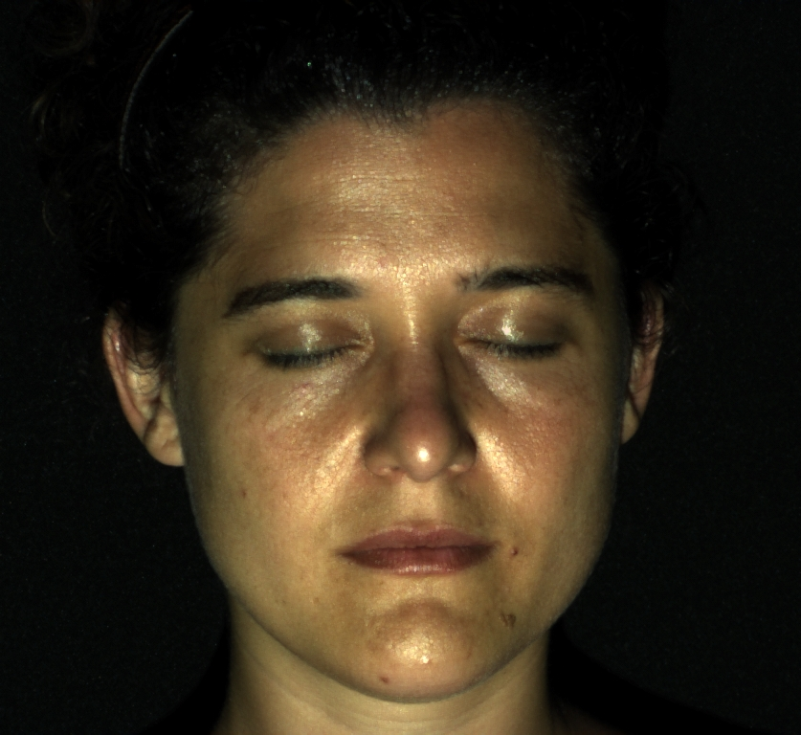





Face: Without and With Makeup
Without Makeup
Direct
Global
With Makeup
Direct
Global

Slide 33



Failure Case
Scene
Direct
Global

Slide 34
Score: 2 (accept)
Pros:
Simple Concept
Lots of results
Photometric Stereo confirmation
Cons:
Mainly qualitative approach for proving effectiveness
Appendix could be clarified
No details on how source occluders were removed from images

Slide 35
Additional Results

Slide 36



Results
Scene
Direct
Global

Slide 37



Results
Scene
Direct
Global

