Slide 1
Synchronization
15-740 Spring’18
Nathan BeckmanN

Slide 2
Types of Synchronization
Mutual Exclusion
  Locks
Event Synchronization
  Global or group-based (barriers)
  Point-to-point (producer-consumer)

Slide 3
Simple Producer-Consumer Example
st xdata, (xdatap)
ld xflag, 1
st xflag, (xflagp)
Producer
Consumer
flag
data
Initially flag=0
spin: ld xflag, (xflagp)
beqz xflag, spin
ld xdata, (xdatap)
Is this correct?
Can consumer read flag=1 before data written by producer?

Slide 4
Sequential Consistency
A Memory Model
P
P
P
P
P
P
M
“ A system is sequentially consistent if the result of any execution is the same as if the operations of all the processors were executed in some sequential order, and the operations of each individual processor appear in the order specified by the program”
Leslie Lamport
Sequential Consistency = arbitrary order-preserving interleaving of memory references of sequential programs

Slide 5
Simple Producer-Consumer Example
sd xdata, (xdatap)
li xflag, 1
sd xflag, (xflagp)
Producer
Consumer
flag
data
Initially flag =0
spin: ld xflag, (xflagp)
beqz xflag, spin
ld xdata, (xdatap)
Dependencies from sequential ISA
Dependencies added by sequentially consistent memory model

Slide 6
Implementing SC in hardware
Only a few commercial systems implemented SC
  Neither x86 nor ARM are SC
Requires either severe performance penalty
  Wait for stores to complete before issuing new store
Or, complex hardware (MIPS R10K)
  Issue loads speculatively
  Detect inconsistency with later store
  Squash speculative load

Slide 7
Software reorders too!
Compiler can reorder/remove memory operations unless made aware of memory model
  Instruction scheduling, move loads before stores if to different address
  Register allocation, cache load value in register, don’t check memory
Prohibiting these optimizations would result in very poor performance
//Producer code
*datap = x/y;
*flagp = 1;
//Consumer code
while (!*flagp)
;
d = *datap;

Slide 8
Relaxed memory models
Not all dependencies assumed by SC are supported, and software has to explicitly insert additional dependencies were needed
Which dependencies are dropped depends on the particular memory model
  IBM370, TSO, PSO, WO, PC, Alpha, RMO, …
How to introduce needed dependencies varies by system
  Explicit FENCE instructions (sometimes called sync or memory barrier instructions)
  Implicit effects of atomic memory instructions
Programmers supposed to work with this????

Slide 9
Fences in producer-consumer
Producer
Consumer
flag
data
Initially flag =0
sd xdata, (xdatap)
li xflag, 1
fence.w.w // Write-Write
// fence
sd xflag, (xflagp)
spin: ld xflag, (xflagp)
beqz xflag, spin
fence.r.r // Read-Read
// fence
ld xdata, (xdatap)

Slide 10
Simple mutual-exclusion example
Thread 1
Memory
Thread 2
data
xdatap
xdatap
// Both threads execute:
ld xdata, (xdatap)
add xdata, 1
st xdata, (xdatap)
Is this correct?

Slide 11
MutEx with LD/ST in SC
A protocol based on two shared variables c1 and c2.
Initially, both c1 and c2 are 0 (not busy)
Process 1
  ...
  c1=1;
L: if c2=1 then go to L
  < critical section>
  c1=0;
Process 2
  ...
  c2=1;
L: if c1=1 then go to L
  < critical section>
  c2=0;
What is wrong?
Deadlock!

Slide 12
MutEx with LD/ST in SC (2nd attempt)
To avoid deadlock, let a process give up the reservation
(i.e. Process 1 sets c1 to 0) while waiting.
1. Deadlock impossible, but livelock may occur (low probability)
2. Unlucky processes never get lock (starvation)
Process 1
  ...
L: c1=1;
  if c2=1 then
{ c1=0; go to L}
  < critical section>
  c1=0
Process 2
  ...
L: c2=1;
  if c1=1 then
{ c2=0; go to L}
  < critical section>
  c2=0

Slide 13

A Protocol for Mutual Exclusion (+ SC)
T. Dekker, 1966
A protocol based on 3 shared variables c1, c2 and turn.
Initially, both c1 and c2 are 0 (not busy)
turn = $i$ ensures that only process $i$ can wait
Variables c1 and c2 ensure mutual exclusion
Solution for n processes was given by Dijkstra and is quite tricky!
Process 1
  ...
  c1=1;
  turn = 1;
L: if c2=1 & turn=1
    then go to L
  < critical section>
  c1=0;
Process 2
  ...
  c2=1;
  turn = 2;
L: if c1=1 & turn=2
then go to L
  < critical section>
  c2=0;

Slide 14
Components of Mutual Exclusion
Acquire
  How to get into critical section
Wait algorithm
  What to do if acquire fails
Release algorithm
  How to let next thread into critical section
Can be implemented using LD/ST, but…
  Need fences in weaker models
  Doesn’t scale + complex

Slide 15
Busy Waiting vs. Blocking
Threads spin in above algorithm if acquire fails
Busy-waiting is preferable when:
  Scheduling overhead is larger than expected wait time
  Schedule-based blocking is inappropriate (eg, OS)
Blocking is preferable when:
  Long wait time & other useful work to be done
  Especially if core is needed to release the lock!
Hybrid spin-then-block often used

Slide 16
Need atomic primitive!
Many choices…
Test&Set – set to 1 and return old value
Swap – atomic swap of register + memory location
Fetch&Op
  E.g., Fetch&Increment, Fetch&Add, …
Compare&Swap – “if *mem == A then *mem == B”
Load-linked/Store-Conditional (LL/SC)

Slide 17
Mutual Exclusion with Atomic Swap
Thread 1
Memory
Thread 2
xlockp
xlockp
lock
data
xdatap
xdatap
li xone, 1
spin: amoswap xlock, xone, (xlockp)
bnez xlock, spin
ld xdata, (xdatap)
add xdata, 1
st xdata, (xdatap)
st x0, (xlockp)
Assumes SC memory model
Acquire Lock
Critical Section
Release Lock

Slide 18
Mutual Exclusion with Relaxed Consistency
Thread 1
Memory
Thread 2
xlockp
xlockp
lock
data
xdatap
xdatap
li xone, 1
spin: amoswap xlock, xone, (xlockp)
bnez xlock, spin
fence.r.r
ld xdata, (xdatap)
add xdata, 1
sd xdata, (xdatap)
fence.w.w
sd x0, (xlockp)
Acquire Lock
Critical Section
Release Lock

Slide 19
Mutual Exclusion with Atomic Swap
Atomic swap: amoswap x, y, (z)
  Semantics:
  x = Mem[z]
  Mem[z] = y
lock: li r1, #1
spin: amoswap r2, r1, (lockaddr)
bnez r2, spin
ret
unlock: st (lockaddr), #0
ret
Much simpler than LD/ST with SC!

Slide 20
Mutual Exclusion with Test & Set
Test & set: t&s y, (x)
  Semantics:
  y = Mem[x]
  If y == 0 then Mem[x] = 1
lock: t&s r1, (lockaddr)
bnez r1, lock
ret
unlock: st (lockaddr), #0
ret

Slide 21
Load-linked / store-conditional
Load-linked/Store-Conditional (LL/SC)
  LL y, (x):
  y = Mem[x]
  SC y, z, (x):
  if (x is unchanged since LL) then
  Mem[x] = y
  z = 1
  else
  z = 0
  endif
Useful to efficiently implement many atomic primitives
Fits nicely in 2-source reg, 1-destination reg instruction formats
Typically implemented as weak LL/SC: intervening loads/stores result in SC failure

Slide 22
Mutual Exclusion with LL/SC
lock: ll r1, (lockaddr)
bnez r1, lock
add r1, r1, #1
sc r1, r2, (lockaddr)
beqz r2, lock
ret
unlock: st (lockaddr), #0
ret

Slide 23
Implementing fetch&op with LL/SC
f&op: ll r1, (location)
op r2, r1, value
sc r2, r3, (location)
beqz r3, f&op
ret

Slide 24
Implementing Atomics
Lock cache line or entire cache:
Get exclusive permissions
Don’t respond to invalidates
Perform operation (e.g., add in fetch&add)
Resume normal operation

Slide 25
Implementing LL/SC
Invalidation-based directory protocol
  SC requests exclusive permissions
  If requestor is still sharer, success
  Otherwise, fail and don’t get permissions (invalidation in flight)
Add link register to store address of LL
  Invalidated upon coherence / eviction
  Only safe to use register-register instructions between LL/SC

Slide 26
How to Evaluate?
Scalability
Network load
Single-processor latency
Space Requirements
Fairness
Required atomic operations
Sensitivity to co-scheduling

Slide 27

T&S Lock Performance
Code: for (i=0;i<N;i++) { lock; delay(c); unlock; }
Same total no. of lock calls as $P$ increases; measure time per transfer
20
s
s
18
16
s
s
s
14
s
s
s)
12
s
s
μ
s
s
ime (
10
s
T
s
8
6
4
s
2
s
n
s
u
0
l
3
5
7
9
11
13
15
Number of processors

Slide 28
Evaluation of Test&Set based lock
lock: t&s reg, (loc)
bnz lock
ret
unlock: st location, #0
ret
Scalability poor
Network load large
Single-processor latency good
Space Requirements good
Fairness poor
Required atomic operations T&S
Sensitivity to co-scheduling good?

Slide 29

Test and Test&Set
A: while (lock != 0);
if (test&set(lock) == 0) {
/* critical section */;
lock = 0;
} else {
goto A;
}
$+$ Spinning happens in cache
$−$ Bursts of traffic when lock released

Slide 30
Test&Set with Backoff
Upon failure, delay for a while before retrying
  either constant delay or exponential backoff
Tradeoffs:
  (+) much less network traffic
  (-) exponential backoff can cause starvation for high-contention locks
    new requestors back off for shorter times
But exponential found to work best in practice

Slide 31
T&S Lock Performance
Code: for (i=0;i<N;i++) { lock; delay(c); unlock; }
Same total no. of lock calls as $P$ increases; measure time per transfer
20
T
est&set,
l
s
c
= 0
s
T
est&set, exponential backof
18
l
f,
c
= 3.64
s
T
est&set, exponential backof
n
f,
c
= 0
n
16
u
Ideal
s
s
s
l
14
s
l
n
s
l
s)
12
s
s
n
μ
s
s
l
n
ime (
10
s
l
l
T
s
l
n
8
n
n
l
n
6
n
l
4
n
l
s
l
l
n
2
s
l
n
U U u u u u u u u u u u u u u
l
n
n
n
n
s
u
0
l
3
5
7
9
11
13
15
Number of processors

Slide 32
Test&Set with Update
Test&Set sends updates to processors that cache the lock
Tradeoffs:
  (+) good for bus-based machines
  (-) still lots of traffic on distributed networks
Main problem with test&set-based schemes:
  a lock release causes all waiters to try to get the lock, using a test&set to try to get it.

Slide 33
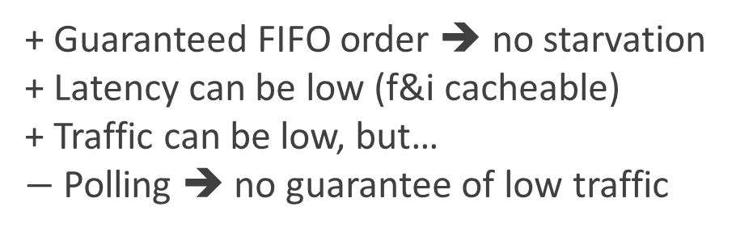
Ticket Lock (fetch&incr based)
Two counters:
  next_ticket (number of requests)
  now_serving (number of releases that have happened)
Algorithm:
Acquire Lock
  ticket = fetch&increment(next_ticket)
  while (ticket != now_serving) delay(x)
  /* mutex */
  now_serving++
Critical Section
Release Lock
+ Guaranteed FIFO order ➔ no starvation
+ Latency can be low (f&i cacheable)
+ Traffic can be low, but…
$−$ Polling ➔ no guarantee of low traffic
What delay to use?
Not exponential! Why?
Instead: ticket – now_serving

Slide 34
Array-Based Queueing Locks
Every process spins on a unique location, rather than on a single now_serving counter
next-slot
Lock
Wait
Wait
Wait
Wait
Acquire Lock
my-slot = F&I(next-slot)
my-slot = my-slot % num_procs
while (slots[my-slot] == Wait);
slots[my-slot] = Wait;
// mutex
slots[(my-slot+1)%num_procs] = Lock;
Critical Section
Release Lock

Slide 35
List-Base Queueing Locks (MCS)
All other good things + O(1) traffic even without coherent caches (spin locally)
Uses compare&swap to build linked lists in software
Locally-allocated flag per list node to spin on
Can work with fetch&store, but loses FIFO guarantee
Tradeoffs:
  (+) less storage than array-based locks
  (+) O(1) traffic even without coherent caches
  (-) compare&swap not easy to implement (three read-register operands)

Slide 36
Barriers

Slide 37
Barrier
Single operation: wait until P threads all reach synchronization point
Barrier
Barrier

Slide 38
Barriers
We will discuss five barriers:
  centralized
  software combining tree
  dissemination barrier
  tournament barrier
  MCS tree-based barrier

Slide 39
Barrier Criteria
  Length of critical path
  Determines performance on scalable network
  Total network communication
  Determines performance on non-scalable network (e.g., bus)
  Storage requirements
  Implementation requirements (e.g., atomic ops)

Slide 40
Critical Path Length
Analysis assumes independent parallel network paths available
May not apply in some systems
  Eg, communication serializes on bus
  In this case, total communication dominates critical path
More generally, network contention can lengthen critical path

Slide 41
Centralized Barrier
Basic idea:
  Notify a single shared counter when you arrive
  Poll that shared location until all have arrived
  Implemented using atomic fetch & op on counter

Slide 42
Centralized Barrier – 1st attempt
int counter = 1;
void barrier(P) {
if (fetch_and_increment(&counter) == P) {
counter = 1;
} else {
while (counter != 1) { /* spin */ }
}
}
Is this implementation correct?

Slide 43
Centralized Barrier
Basic idea:
  Notify a single shared counter when you arrive
  Poll that shared location until all have arrived
  Implemented using atomic fetch & decrement on counter
Simple solution requires polling/spinning twice:
  First to ensure that all procs have left previous barrier
  Second to ensure that all procs have arrived at current barrier

Slide 44
Centralized Barrier – 2nd attempt
int enter = 1; // allocate on diff cache lines
int exit = 1;
void barrier(P) {
if (fetch_and_increment(&enter) == P) { // enter barrier
enter = 1;
} else {
while (enter != 1) { /* spin */ }
}
if (fetch_and_increment(&exit) == P) { // exit barrier
exit = 1;
} else {
while (exit != 1) { /* spin */ }
}
}
Do we need to count to P twice?

Slide 45
Centralized Barrier
Basic idea:
  Notify a single shared counter when you arrive
  Poll that shared location until all have arrived
  Implemented using atomic fetch & decrement on counter
Simple solution requires polling/spinning twice:
  First to ensure that all procs have left previous barrier
  Second to ensure that all procs have arrived at current barrier
Avoid spinning with sense reversal

Slide 46
Centralized Barrier – Final version
int counter = 1;
bool sense = false;
void barrier(P) {
bool local_sense = ! sense;
if (fetch_and_increment(&counter) == P) {
counter = 1;
sense = local_sense;
} else {
while (sense != local_sense) { /* spin */ }
}
}

Slide 47
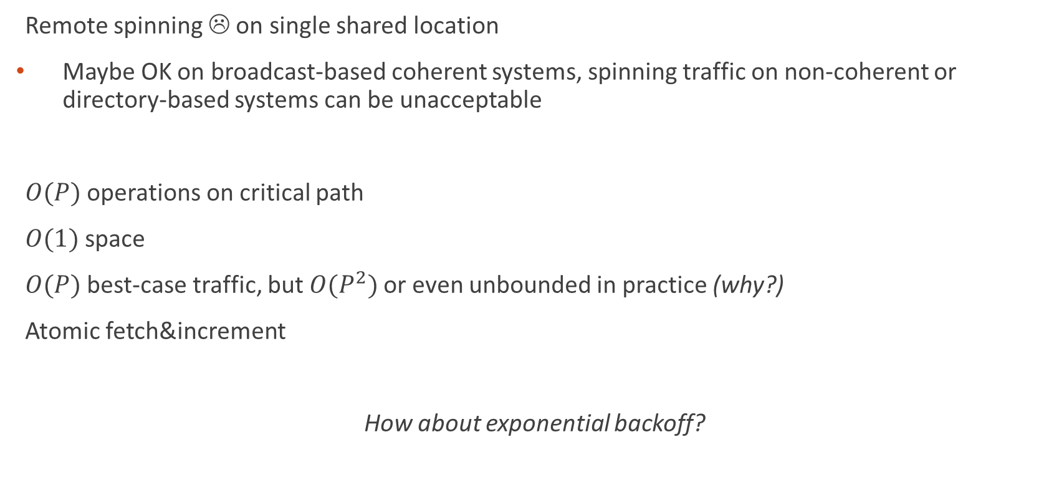
Centralized Barrier Analysis
Remote spinning ☹ on single shared location
Maybe OK on broadcast-based coherent systems, spinning traffic on non-coherent or directory-based systems can be unacceptable
$O(P)$ operations on critical path
$O(1)$ space
$O(P)$ best-case traffic, but $O(P^{2})$or even unbounded in practice (why?)
Atomic fetch&increment
How about exponential backoff?

Slide 48
Software Combining-Tree Barrier
Writes into one tree for barrier arrival
Reads from another tree to allow procs to continue
Sense reversal to distinguish consecutive barriers

Slide 49
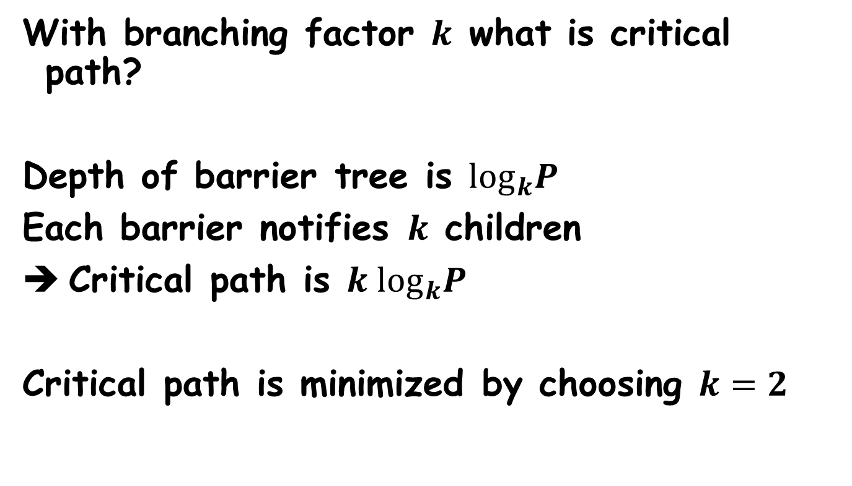
Combining Barrier – Why binary?
With branching factor $k$ what is critical path?
Depth of barrier tree is $\log_{k}P$
Each barrier notifies $k$ children
Critical path is $k \log_{k}P$
Critical path is minimized by choosing $k=2$

Slide 50

Software Combining-Tree Analysis
Remote spinning ☹
$O(log⁡P)$ critical path
$O(P)$ space
$O(P)$ total network communication
  Unbounded without coherence
Needs atomic fetch & increment

Slide 51
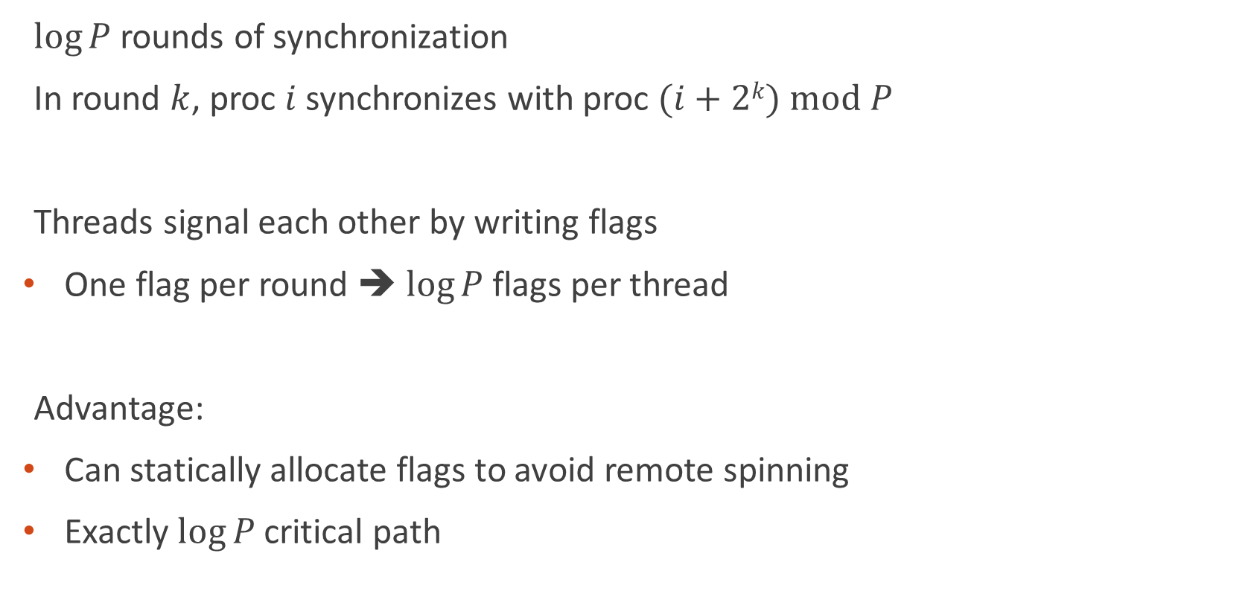
Dissemination Barrier
$log⁡P$rounds of synchronization
In round $k$, proc $i$ synchronizes with proc $(i+2k) mod P$
Threads signal each other by writing flags
One flag per round ➔ $log⁡P$flags per thread
Advantage:
Can statically allocate flags to avoid remote spinning
Exactly $log⁡P$critical path

Slide 52
Dissemination Barrier with P=5
???
Barrier

Slide 53

Dissemination Barrier with P=5
$3=\log_{2}P$ rounds
Barrier

Slide 54

Dissemination Barrier with P=5
$3=\log_{2}P$ rounds
Round 1: offset $2^{0}=1$
Barrier

Slide 55

Dissemination Barrier with P=5
$3=\log_{2}P$ rounds
Round 1: offset $2^{0}=1$
Barrier
Round 2: offset $2^{1}=2$

Slide 56

Dissemination Barrier with P=5
$3=\log_{2}P$ rounds
Round 1: offset $2^{0}=1$
Barrier
Round 2: offset $2^{1}=2$
Round 3: offset $2^{2}=4$

Slide 57
Dissemination Barrier with P=5
$3=\log_{2}P$ rounds
Round 1: offset $2^{0}=1$
Barrier
Round 2: offset $2^{1}=2$
Round 3: offset $2^{2}=4$

Slide 58
Dissemination Barrier with P=5
Threads can progress unevenly through barrier
But none will exit until all arrive

Slide 59
Why Dissemination Barriers Work
Prove that:
Any thread leaves barrier
➔
All threads entered barrier
???
Thread leaving

Slide 60
Why Dissemination Barriers Work
Prove that:
Any thread exits barrier
➔
All threads entered barrier
Forward propagation proves:
All threads exit barrier
Just follow dependence graph backwards!
Each exiting thread is the root of a binary tree with all entering threads as leaves (requires log P rounds)
Proof is symmetric (mod P) for all threads

Slide 61
Dissemination Implementation #1
const int rounds = log(P);
bool flags[P][rounds]; // allocated in local storage per thread
void barrier() {
for (round = 0 to rounds – 1) {
partner = (tid + 2^round) mod P;
flags[partner][round] = 1;
while (flags[tid][round] == 0) { /* spin */ }
flags[tid][round] = 0;
}
}
What’d we forget?

Slide 62
Dissemination Implementation #2
const int rounds = log(P);
bool flags[P][rounds]; // allocated in local storage per thread
local bool sense = false;
void barrier() {
for (round = 0 to rounds – 1) {
partner = (tid + 2^round) mod P;
flags[partner][round] = !sense;
while (flags[tid][round] == sense) { /* spin */ }
}
sense = !sense;
}
Good?

Slide 63
Sense Reversal in Dissemination
Thread 2 isn’t scheduled for a while…
Thread 2 blocks waiting on old sense
But this is the same barrier!
Sense reversed!

Slide 64
Dissemination Implementation #3
const int rounds = log(P);
bool flags[P][2][rounds]; // allocated in local storage per thread
local bool sense = false;
local int parity = 0;
void barrier() {
for (round = 0 to rounds – 1) {
partner = (tid + 2^round) mod P;
flags[partner][parity][round] = !sense;
while (flags[tid][parity][round] == sense)
{ /* spin */ }
}
if (parity == 1) {
sense = !sense;
}
parity = 1 – parity;
}
Allocate 2 barriers, alternate between them via ‘parity’.
Reverse sense every other barrier.

Slide 65

Dissemination Barrier Analysis
Local spinning only
$O(log⁡P)$ messages on critical path
$O(P log⁡P)$ space – $log⁡P$ variables per processor
$O(P log⁡P)$ total messages on network
Only uses loads & stores

Slide 66
Minimum Barrier Traffic
What is the minimum number of messages needed to implement a barrier with N processors?
P-1 to notify everyone arrives
P-1 to wakeup
➔ 2P – 2 total messages minimum
…
P1
P2
P3
P4
PN

Slide 67
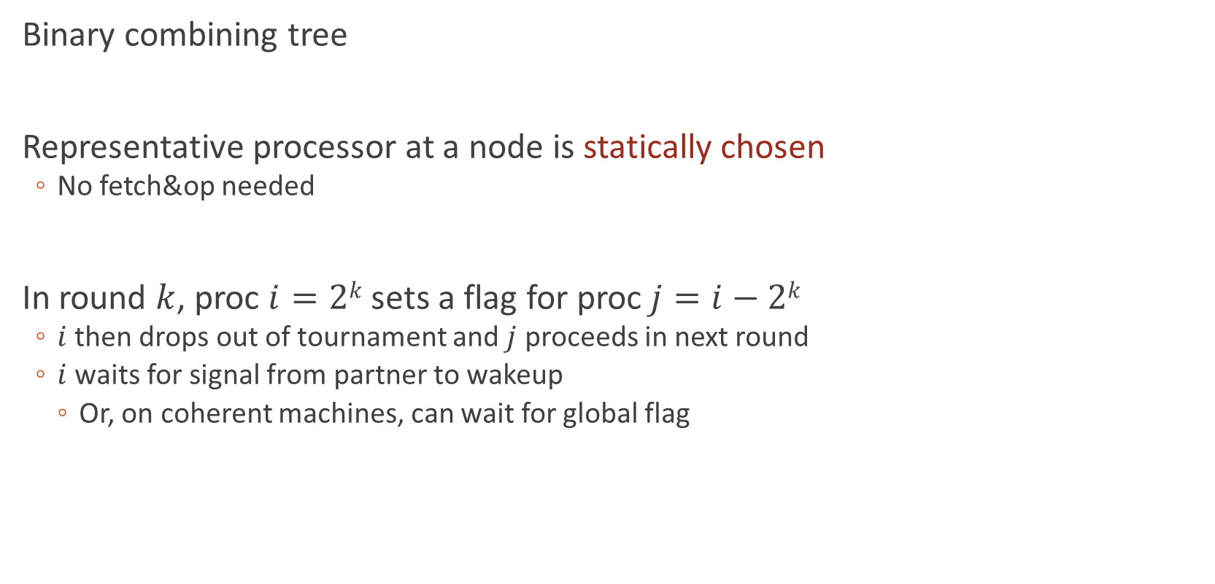
Tournament Barrier
Binary combining tree
Representative processor at a node is statically chosen
  No fetch&op needed
In round $k$, proc $i=2k$ sets a flag for proc$j=i−2k$
  $i$ then drops out of tournament and $j$ proceeds in next round
  $i$ waits for signal from partner to wakeup
    Or, on coherent machines, can wait for global flag

Slide 68
Tournament Barrier with P=8

Slide 69
Tournament Barrier with P=8

Slide 70
Tournament Barrier with P=8

Slide 71
Tournament Barrier with P=8

Slide 72
Tournament Barrier with P=8

Slide 73
Tournament Barrier with P=8

Slide 74
Tournament Barrier with P=8

Slide 75
Tournament Barrier with P=8

Slide 76
Tournament Barrier with P=8

Slide 77
Tournament Barrier with P=8

Slide 78
Why Tournament Barrier Works
As before, threads can progress at different rates through tree
Easy to show correctness:
  Tournament root must unblock for any thread to exit barrier
  Root depends on all threads (leaves of tree)
Implemented by two loops, up & down tree
Depth encoded by first 1 in thread id bits

Slide 79
Depth == First 1 in Thread ID
000
001
010
011
100
101
110
111

Slide 80
Tournament Barrier Implementation
// for simplicity, assume P power of 2
void barrier(int tid) {
int round;
for (round = 0; // wait for children (depth == first 1)
((P | tid) & (1 << round)) == 0; round++) {
while (flags[tid][round] != sense) { /* spin */ }
}
if (round < logP) { // signal + wait for parent (all but root)
int parent = tid & ~((1 << (round+1)) - 1);
flags[parent][round] = sense;
while (flags[tid][round] != sense) { /* spin */ }
}
while (round-- > 0) { // wake children
int child = tid | (1 << round);
flags[child][round] = sense;
}
sense = !sense;
}

Slide 81

Tournament Barrier Analysis
Local spinning only
$O(log⁡P)$ messages on critical path (but > dissemination)
$O(P)$ space
$O(P)$ total messages on network
Only uses loads & stores

Slide 82
MCS Software Barrier
Modifies tournament barrier to allow static allocation in wakeup tree, and to use sense reversal
Every thread is a node in two P-node trees:
  has pointers to its parent building a fan-in-4 arrival tree
    fan-in = flags / word for parallel checks
  has pointers to its children to build a fan-out-2 wakeup tree

Slide 83
MCS Barrier with P=7

Slide 84
MCS Barrier with P=7

Slide 85
MCS Barrier with P=7

Slide 86
MCS Barrier with P=7

Slide 87
MCS Barrier with P=7

Slide 88
MCS Barrier with P=7

Slide 89
MCS Barrier with P=7

Slide 90
MCS Barrier with P=7

Slide 91
MCS Barrier with P=7

Slide 92

MCS Software Barrier Analysis
Local spinning only
$O(log⁡P)$ messages on critical path
$O(P)$ space for P processors
Achieves theoretical minimum communication of $(2P – 2)$ total messages
Only needs loads & stores

Slide 93

Review: Critical path
All critical paths $O(log⁡P)$, except centralized $O(P)$
But beware network contention!
➔ Linear factors dominate bus

Slide 94

Review: Network transactions
Centralized, combining tree:
  $O(P)$ if broadcast and coherent caches;
  unbounded otherwise
Dissemination:
  $O(P log⁡P)$
Tournament, MCS:
  $O(P)$

Slide 95

Review: Storage requirements
Centralized:
  $O(1)$
MCS, combining tree:
  $O(P)$
Dissemination, Tournament:
  $O(P log⁡P)$

Slide 96
Review: Primitives Needed
Centralized and software combining tree:
  atomic increment / atomic decrement
Others (dissemination, tournament, MCS):
  atomic read
  atomic write

Slide 97
Barrier recommendations
Without broadcast on distributed memory:
  Dissemination
  MCS is good, only critical path length is about 1.5X longer (for wakeup tree)
  MCS has somewhat better network load and space requirements
Cache coherence with broadcast (e.g., a bus):
  MCS with flag wakeup
  But centralized is best for modest numbers of processors
Big advantage of centralized barrier:
  Adapts to changing number of processors across barrier calls

Slide 98
Synchronization Summary
Required for concurrent programs
  mutual exclusion
  producer-consumer
  barrier
Hardware support
  ISA
  Cache
  Memory
Complex interactions
  Scalability, Efficiency, Indirect effects
  What about message passing?

