Slide 1
Domain-Specific Programming Systems
Lecture 22:
Slide acknowledgments:
Pat Hanrahan, Zach Devito (Stanford University)
Jonathan Ragan-Kelley (MIT, Berkeley)

Slide 2
Course themes:
Designing computer systems that scale
(running faster given more resources)
Designing computer systems that are efficient
(running faster under constraints on resources)
Techniques discussed:
      Exploiting parallelism in applications
      Exploiting locality in applications
      Leveraging hardware specialization (earlier lecture)
Notes:
performance, two ways to things about it
using parallelism is the most efficient way to scale PEAK CAPABILITY/resource
parallelism introduces overheads

Slide 3
Claim: most software uses modern hardware resources inefficiently
Consider a piece of sequential C code
  Call the performance of this code our “baseline performance”
Well-written sequential C code: ~ 5-10x faster
Assembly language program: maybe another small constant factor faster
Java, Python, PHP, etc. ??
Credit: Pat Hanrahan

Slide 4
Code performance: relative to C (single core)
GCC -O3 (no manual vector optimizations)
51
40/57/53
47 44/114x
= NBody
= Mandlebrot
= Tree Alloc/Delloc
= Power method (compute eigenvalue)
no data
no data
Java
Scala
C# (Mono)
Haskell
Go
Javascript(V8)
Lua
PHP
Python 3
Ruby
(JRuby)
Data from: The Computer Language Benchmarks Game: http://shootout.alioth.debian.org

Slide 5
Even good C code is inefficient
Recall Assignment 1’s Mandelbrot program
Consider execution on a high-end laptop: quad-core, Intel Core i7, AVX instructions...
Single core, with AVX vector instructions: 5.8x speedup over C implementation
Multi-core + hyper-threading + AVX instructions: 21.7x speedup
Conclusion: basic C implementation compiled with -O3 leaves a lot of performance on the table
Notes:
automatic tools definitely could have figured it out

Slide 6
Making efficient use of modern machines is challenging
(proof by assignments 2, 3, and 4)
In our assignments, you only programmed homogeneous parallel computers.
…And parallelism even in that context was not easy.
Assignment 2: GPU cores only
Assignments 3 & 4: shared memory / message passing
Notes:
I doubt automatic tools could have figured those problems out

Slide 7
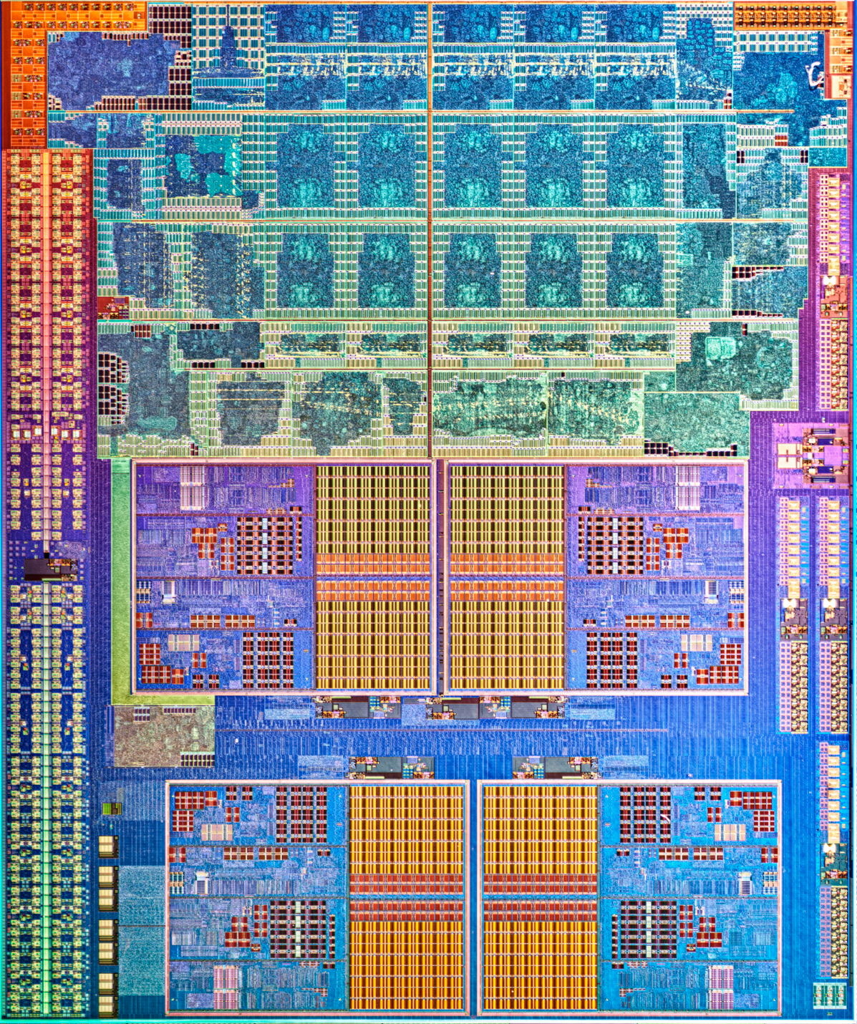
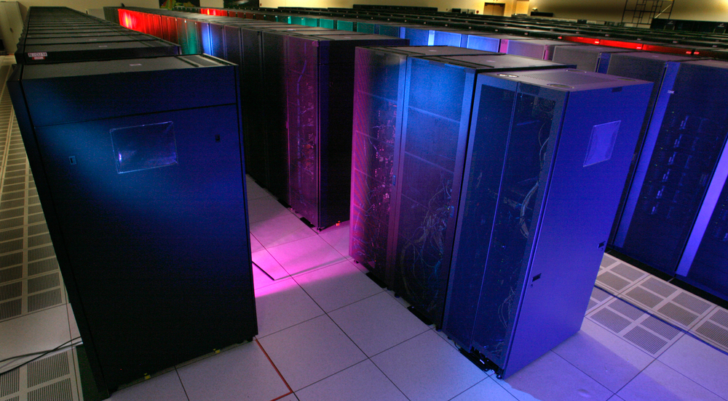
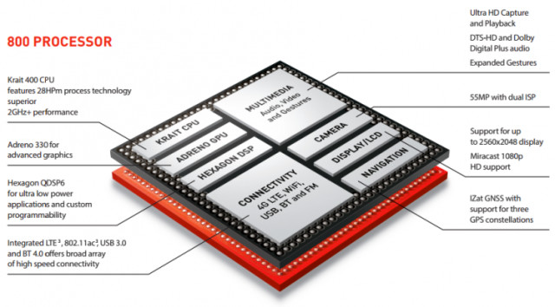
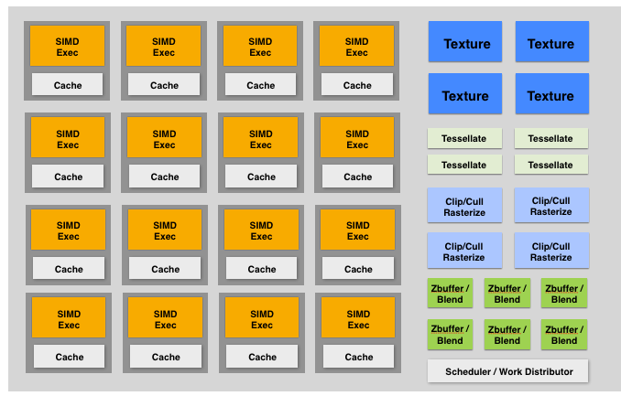
Recall: need for efficiency leading to heterogeneous parallel platforms
CPU+data-parallel accelerator
Integrated
CPU + GPU
GPU:
throughput cores + fixed-function
Qualcomm Snapdragon SoC
Mobile system-on-a-chip:
CPU+GPU+media processing

Slide 8
Hardware trend: specialization of execution
Multiple forms of parallelism
  SIMD/vector processing
  Multi-threading
  Multi-core
  Multiple node
  Multiple server
Heterogeneous execution capability
  Programmable, latency-centric (e.g., “CPU-like” cores)
  Programmable, throughput-optimized (e.g., “GPU-like” cores)
  Fixed-function, application-specific (e.g., image/video/audio processing)
Fine-granularity parallelism: perform same logic on different data
Mitigate inefficiencies (stalls) caused by unpredictable data access
Varying scales of coarse-granularity parallelism
Motivation for parallelism and specialization: maximize compute capability given constraints on chip area, chip energy consumption.
Result: amazingly high compute capability in a wide range of devices!

Slide 9
Hardware diversity is a huge challenge
Machines with very different performance characteristics
Even worse: different technologies and performance characteristics within the same machine at different scales
    Within a core: SIMD, multi-threading: fine-granularity sync and communication
    Across cores: coherent shared memory via fast on-chip network
    Hybrid CPU+GPU multi-core: incoherent (potentially) shared memory
    Across racks: distributed memory, multi-stage network
Notes:
I tried to design a language that used the same strategy for all levels
didn’t quite work

Slide 10
Variety of programming models to abstract HW
Machines with very different performance characteristics
Worse: different technologies and performance characteristics within the same machine at different scales
    Within a core: SIMD, multi-threading: fine grained sync and comm
      Abstractions: SPMD programming (ISPC, Cuda, OpenCL, Metal, Renderscript)
    Across cores: coherent shared memory via fast on-chip network
      Abstractions: OpenMP pragma, Cilk, TBB
    Hybrid CPU+GPU multi-core: incoherent (potentially) shared memory
      Abstractions: OpenCL
    Across racks: distributed memory, multi-stage network
      Abstractions: message passing (MPI, Go, Spark, Legion, Charm++)
Credit: Pat Hanrahan

Slide 11
This is a huge challenge
Machines with very different performance characteristics
Worse: different performance characteristics within the same machine at different scales
To be efficient, software must be optimized for HW characteristics
  Difficult even in the case of one level of one machine
  Combinatorial complexity of optimizations when considering a complex machine, or different machines
  Loss of software portability
Credit: Pat Hanrahan

Slide 12
Open computer science question:
How do we enable programmers to productively write software that efficiently uses current and future heterogeneous, parallel machines?

Slide 13
The [magical] ideal parallel programming language
High Performance
(software is scalable and efficient)
??
Productivity
(ease of development)
Completeness
(applicable to most problems we want to write a program for)
Credit: Pat Hanrahan
Notes:
speculate it doesn’t exist

Slide 14
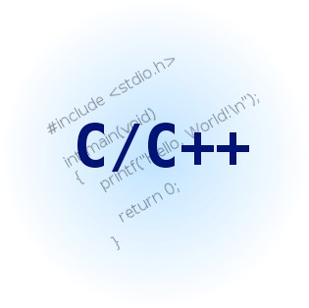


Successful programming languages
(Success = widely used)
High Performance
(software is scalable and efficient)
??
Productivity
(ease of development)
Completeness
(applicable to most problems we want to write a program for)
Credit: Pat Hanrahan
Notes:
speculate it doesn’t exist

Slide 15
Growing interest in domain-specific programming systems
To realize high performance and productivity: willing to sacrifice completeness
High Performance
(software is scalable and efficient)
Domain-specific languages (DSL) and programming frameworks
??
Productivity
(ease of development)
Completeness
(applicable to most problems we want to write a program for)
Credit: Pat Hanrahan
Notes:
speculate it doesn’t exist

Slide 16
Domain-specific programming systems
Main idea: raise level of abstraction for expressing programs
Introduce high-level programming primitives specific to an application domain
  Productive: intuitive to use, portable across machines, primitives correspond to behaviors frequently used to solve problems in targeted domain
  Performant: system uses domain knowledge to provide efficient, optimized implementation(s)
    Given a machine: system knows what algorithms to use, parallelization strategies to employ for this domain
    Optimization goes beyond efficient mapping of software to hardware! The hardware platform itself can be optimized to the abstractions as well
Cost: loss of generality/completeness
Notes:
imagine you are an expert

Slide 17
Two domain-specific programming examples
Liszt: for scientific computing on meshes
Halide: for image processing
What are other domain specific languages?
(SQL is another good example)
Notes:
what those abstractions are, and what they enable

Slide 18
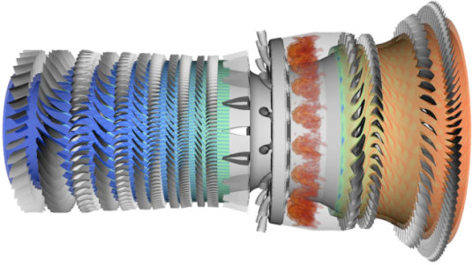
Example 1:
Lizst: a language for solving PDE’s on meshes
[DeVito et al. Supercomputing 11, SciDac ’11]
Slide credit for this section of lecture:
Pat Hanrahan and Zach Devito (Stanford)
http://liszt.stanford.edu/
Notes:
notice how I explain these systems, useful in projects

Slide 19
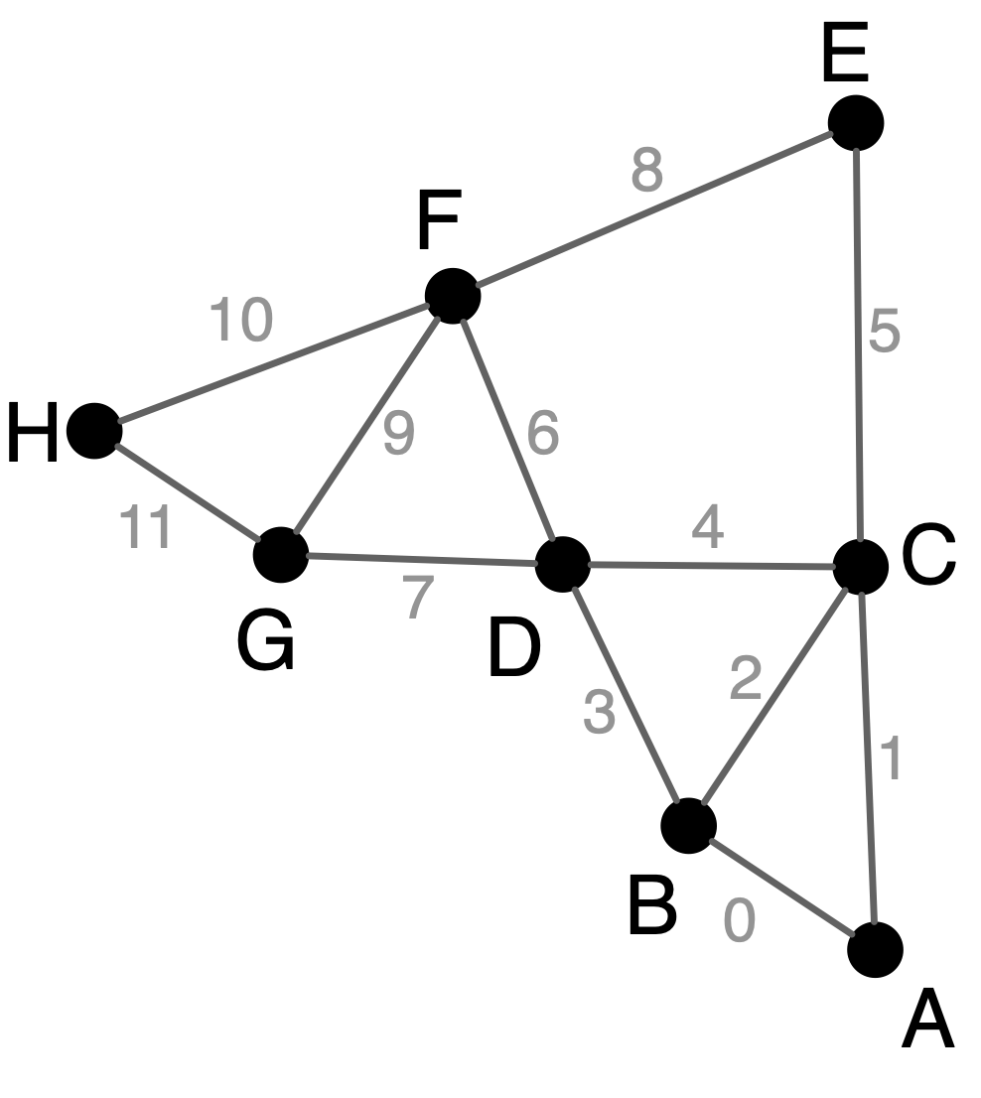
What a Liszt program does
A Liszt program is run on a mesh
A Liszt program defines, and compute the value of, fields defined on the mesh
Position is a field defined at each mesh vertex.
The field’s value is represented by a 3-vector.
val Position = FieldWithConst[Vertex,Float3](0.f, 0.f, 0.f)
val Temperature = FieldWithConst[Vertex,Float](0.f)
val Flux = FieldWithConst[Vertex,Float](0.f)
val JacobiStep = FieldWithConst[Vertex,Float](0.f)
Color key:
Fields
Mesh entity
Notes:
Fields are a higher-kinded type
(special function that maps a type to a new type)
Notes:
variable declarations
POSITION: function from a vertex to a float3

Slide 20
Liszt program: heat conduction on mesh
Program computes the value of fields defined on meshes
Set flux for all vertices to 0.f;
var i = 0;
while ( i < 1000 ) {
Flux(vertices(mesh)) = 0.f;
JacobiStep(vertices(mesh)) = 0.f;
for (e <- edges(mesh)) {
val v1 = head(e)
val v2 = tail(e)
val dP = Position(v1) - Position(v2)
val dT = Temperature(v1) - Temperature(v2)
val step = 1.0f/(length(dP))
Flux(v1) += dT*step
Flux(v2) -= dT*step
JacobiStep(v1) += step
JacobiStep(v2) += step
}
i += 1
}
Color key:
Fields
Mesh
Topology functions
Iteration over set
Independently, for each
edge in the mesh
Given edge, loop body accesses/modifies field values at adjacent mesh vertices
Access value of field
at mesh vertex v2
Notes:
vertices(mesh) is a set of vertices
first line sets flux to 0
For (e <- edges(mesh)) defines data-parallel operator with stencil neighboring vertices for each edge, and synchronization at end of it.

Slide 21
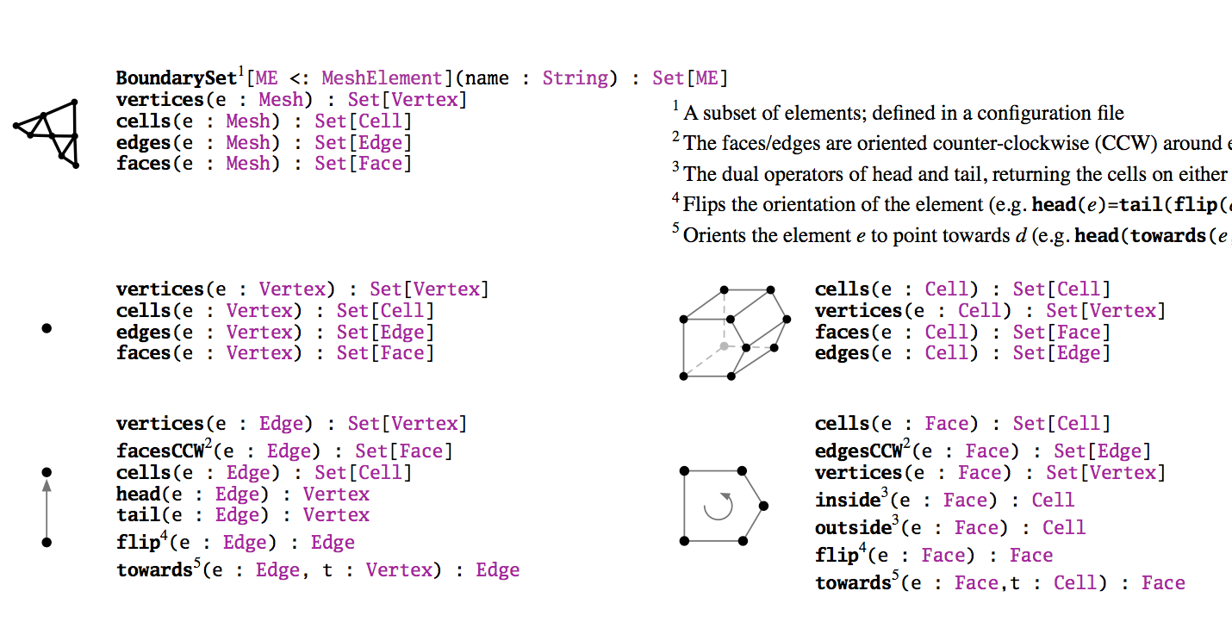
Liszt’s topological operators
Used to access mesh elements relative to some input vertex, edge, face, etc.
Topological operators are the only way to access mesh data in a Liszt program
Notice how many operators return sets (e.g., “all edges of this face”)

Slide 22
Liszt programming
A Liszt program describes operations on fields of an abstract mesh representation
Application specifies type of mesh (regular, irregular) and its topology
Mesh representation is chosen by Liszt (not by the programmer)
  Based on mesh type, program behavior, and target machine
Well, that’s interesting. I write a program, and the compiler decides what data structure it should use based on what operations my code performs.
Notes:
let’s stop here

Slide 23
Compiling to parallel computers
Recall challenges you have faced in your assignments
Identify parallelism
Identify data locality
Reason about required synchronization
Now consider how to automate this process in the Liszt compiler.

Slide 24
Key: determining program dependencies
Identify parallelism:
Absence of dependencies implies code can be executed in parallel
Identify data locality:
Partition data based on dependencies (localize dependent computations for faster synchronization)
Reason about required synchronization:
Synchronization is needed to respect dependencies (must wait until the values a computation depends on are known)
In general programs, compilers are unable to infer dependencies at global scale: a[f(i)] += b[i] (must execute f(i) to know if dependency exists across loop iterations i)

Slide 25
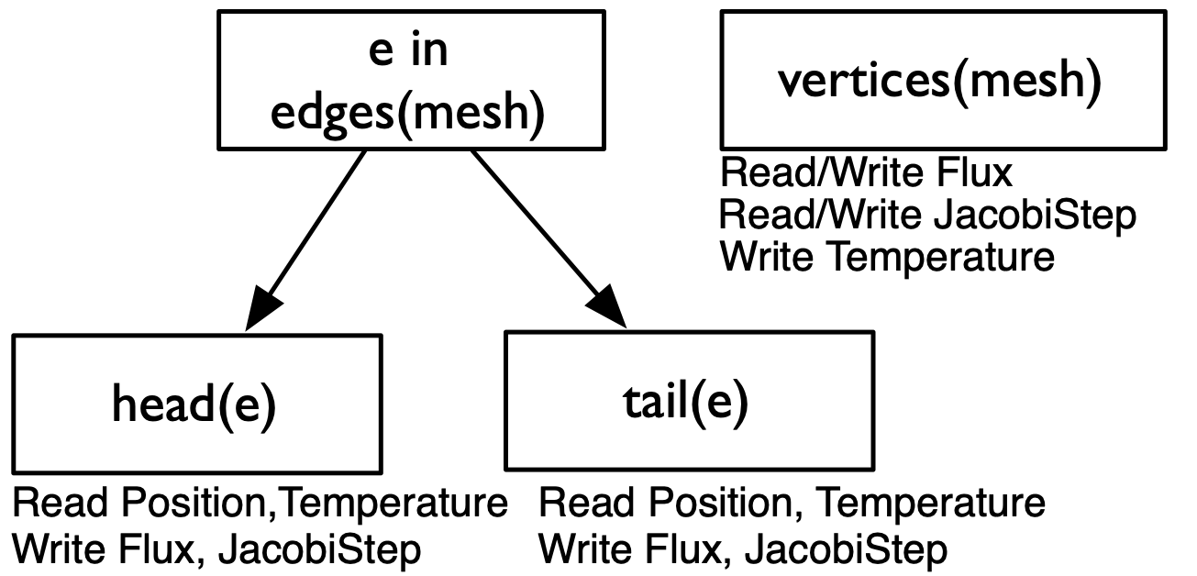
Liszt is constrained to allow dependency analysis
Lizst infers “stencils”:
“stencil” = mesh elements accessed in an iteration of loop
= dependencies for the iteration
Statically analyze code to find stencil of each top-level for loop
  Extract nested mesh element reads
  Extract field operations
Edge 6’s read stencil is D and F
for (e <- edges(mesh)) {
val v1 = head(e)
val v2 = tail(e)
val dP = Position(v1) - Position(v2)
val dT = Temperature(v1) - Temperature(v2)
val step = 1.0f/(length(dP))
Flux(v1) += dT*step
Flux(v2) -= dT*step
JacobiStep(v1) += step
JacobiStep(v2) += step
}
…
Notes:
dependencies are necessary BUT NOT SUFFICIENT
also need domain knowledge to know what TO DO with dependencies

Slide 26
Restrict language for dependency analysis
Language restrictions:
  Mesh elements are only accessed through built-in topological functions:
  cells(mesh), …
  Single static assignment:
  val v1 = head(e)
  Data in fields can only be accessed using mesh elements:
  Pressure(v)
  No recursive functions
Restrictions allow compiler to automatically infer stencil for a loop iteration.

Slide 27

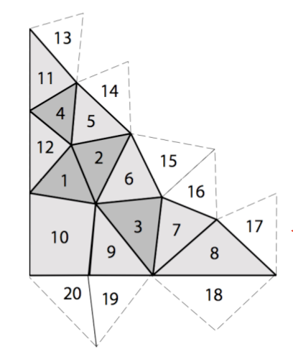
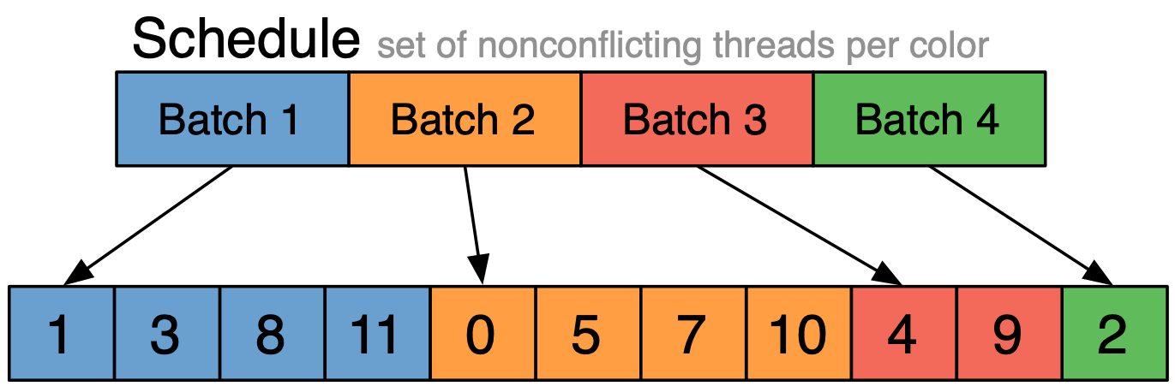
Portable parallelism: use dependencies to implement different parallel execution strategies
I’ll discuss two strategies…
Strategy 1: mesh partitioning
Strategy 2: mesh coloring
Ghost Cell
Owned Cell
Notes:
two strategies for parallelization, I’m going to describe both

Slide 28
Imagine compiling a Lizst program to the
(entire) Latedays cluster
(multiple nodes, distributed address space)
How might Liszt distribute a graph across these nodes?

Slide 29
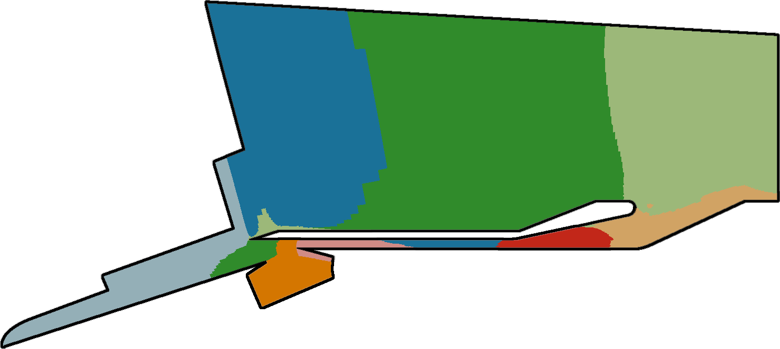
Distributed memory implementation of Liszt
Mesh + Stencil → Graph → Partition
for(f <- faces(mesh)) {
rhoOutside(f) =
calc_flux(f, rho(outside(f))) +
calc_flux(f, rho(inside(f)))
}
Initial Partition (by ParMETIS)
Consider distributed memory implementation
Store region of mesh on each node in a cluster
(Note: ParMETIS is a tool for partitioning meshes)
Notes:
Divide mesh across a bunch of processors
Per-face computation. Need density from the adjacent faces

Slide 30
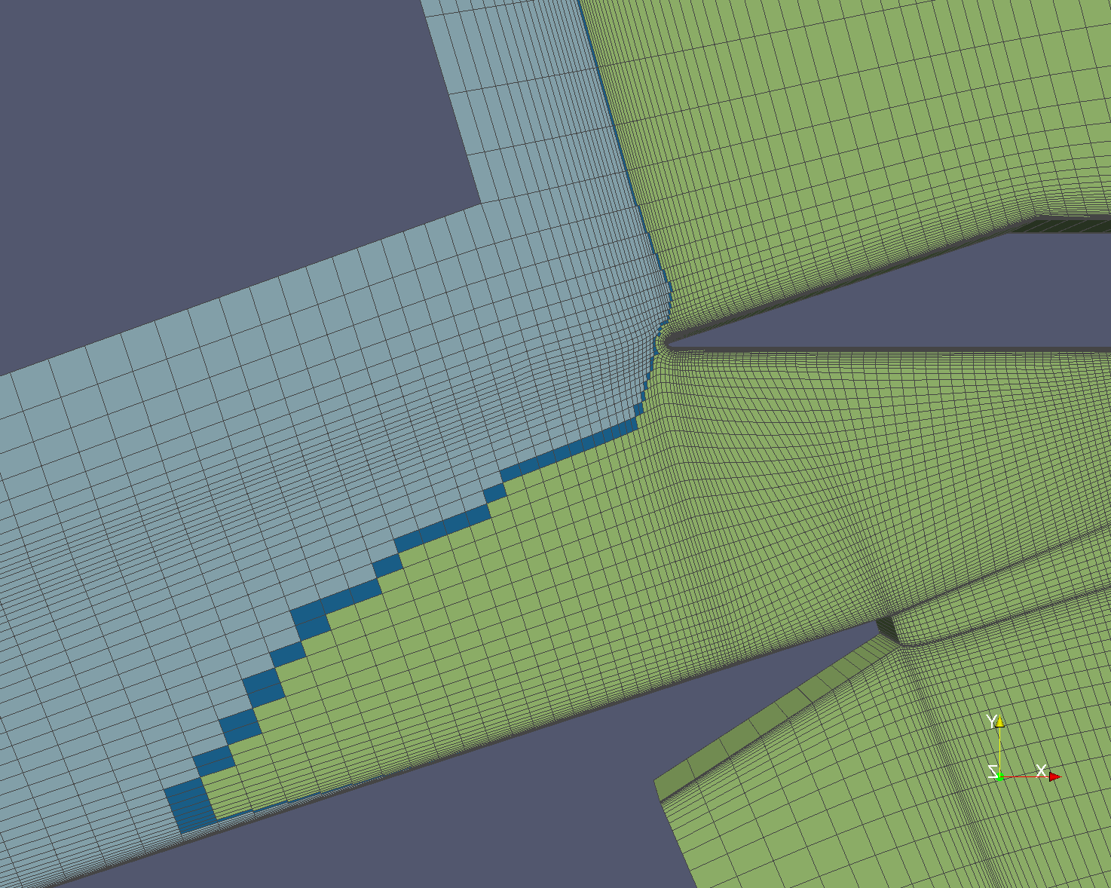
Ghost Cells
Each processor also needs data for neighboring cells to perform computation (“ghost cells”)
Listz allocates ghost region storage and emits required communication to implement topological operators.
Notes:
each processor needs a bit more data
this is like the solver, exchange with neighbors

Slide 31
Imagine compiling a Lizst program to a GPU
(single address space, many tiny threads)

Slide 32
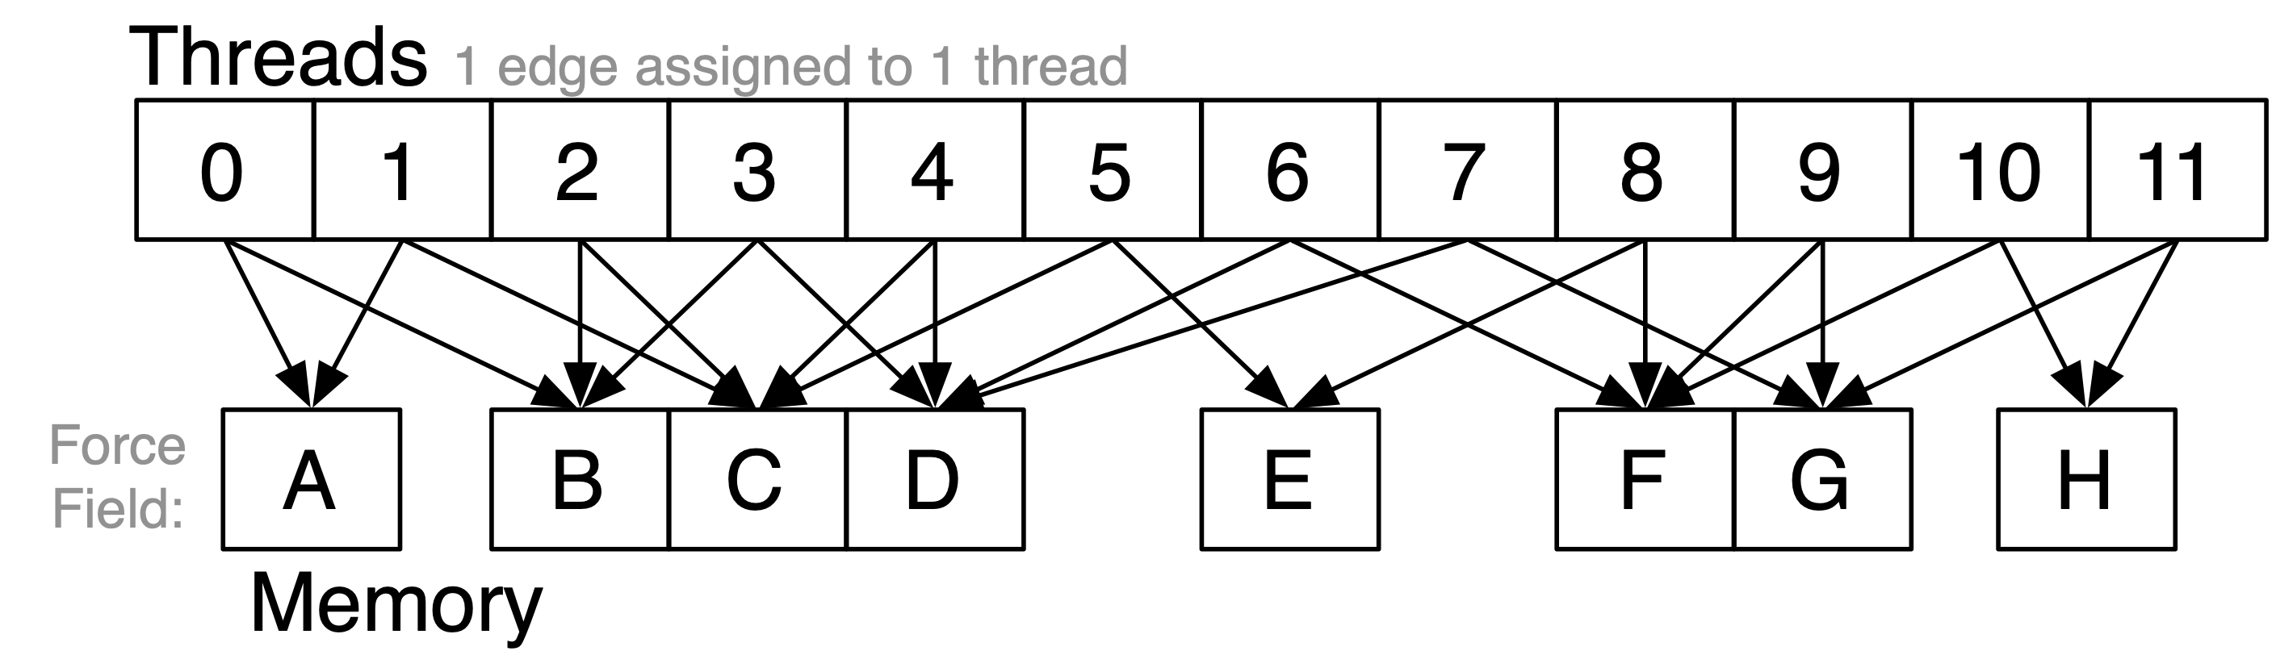
GPU implementation: parallel reductions
In previous example, one region of mesh assigned per processor (or node in MPI cluster)
On GPU, natural parallelization is one edge per CUDA thread
Threads (each edge assigned to 1 CUDA thread)
Flux field values (per vertex)
for (e <- edges(mesh)) {
…
Flux(v1) += dT*step
Flux(v2) -= dT*step
…
}
Different edges share a vertex: requires atomic update of per-vertex field data
Notes:
different edges must write to same vertex
say you wanted to avoid fine-grained synchronization for atomicAdd

Slide 33
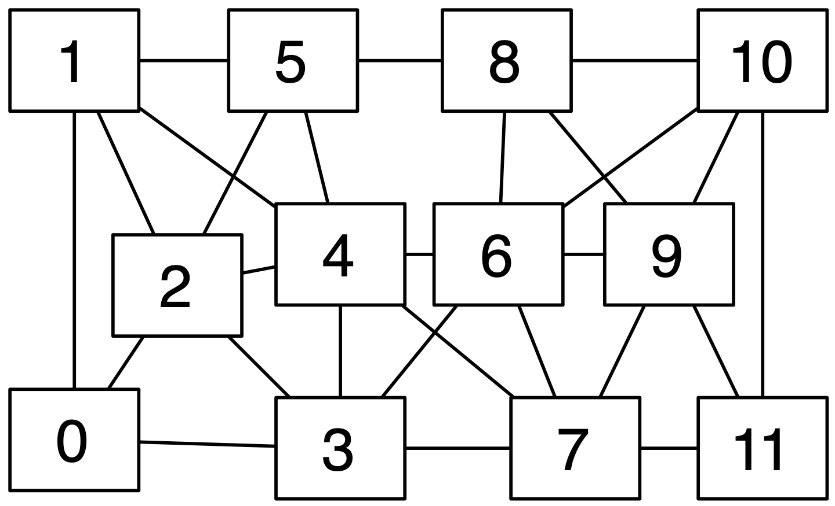
GPU implementation: conflict graph
Threads (each edge assigned to 1 CUDA thread)
Flux field values (per vertex)
Identify mesh edges with colliding writes
(lines in graph indicate presence of collision)
Can simply run program once to get this information.
(results valid for subsequent executions provided mesh does not change)
Notes:
0 and 1 write to A (so there’s an edge in the conflict graph)
0 and 2 write to B

Slide 34
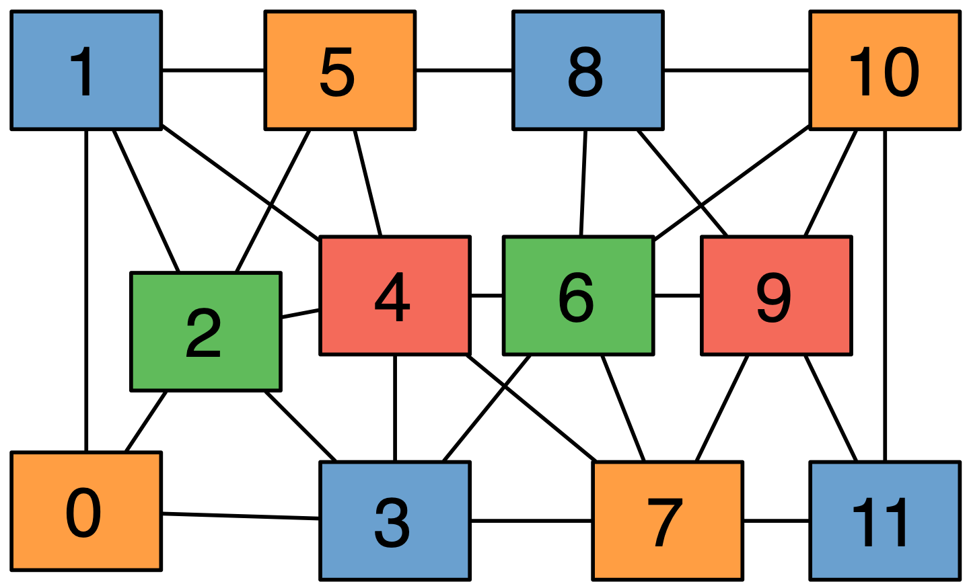
GPU implementation: conflict graph
Threads (each edge assigned to 1 CUDA thread)
Flux field values (per vertex)
“Color” nodes in graph such that no connected nodes have the same color
Can execute on GPU in parallel, without atomic operations, by running all nodes with the same color in a single CUDA launch.

Slide 35
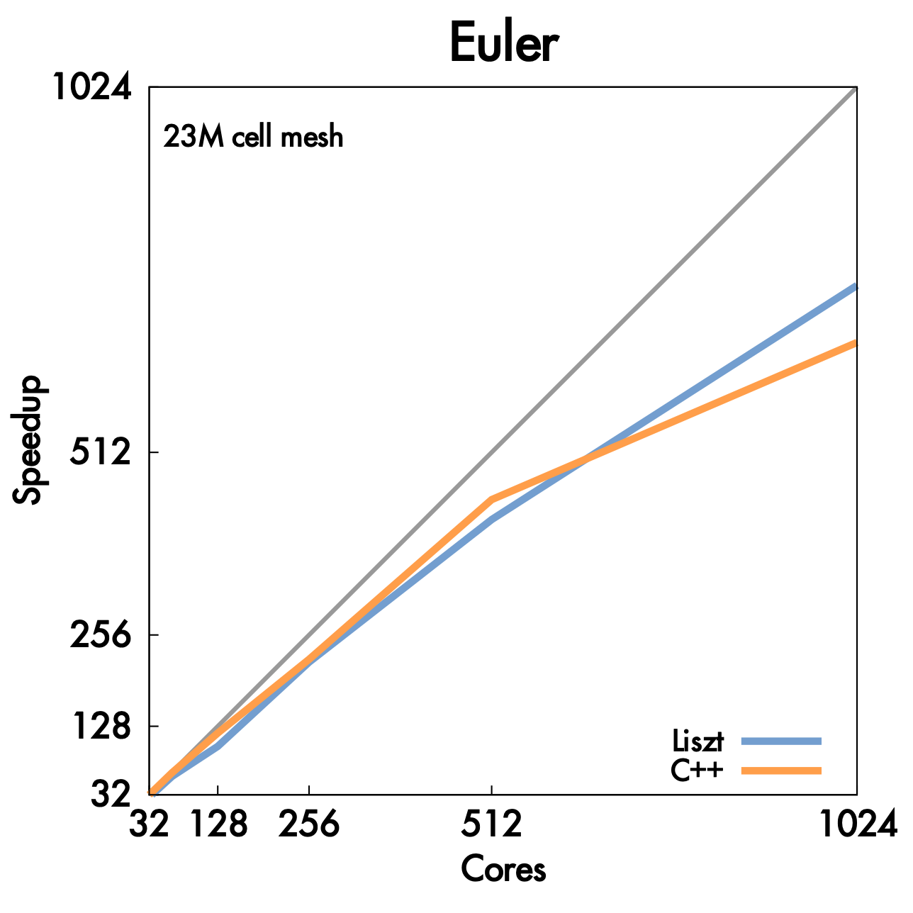
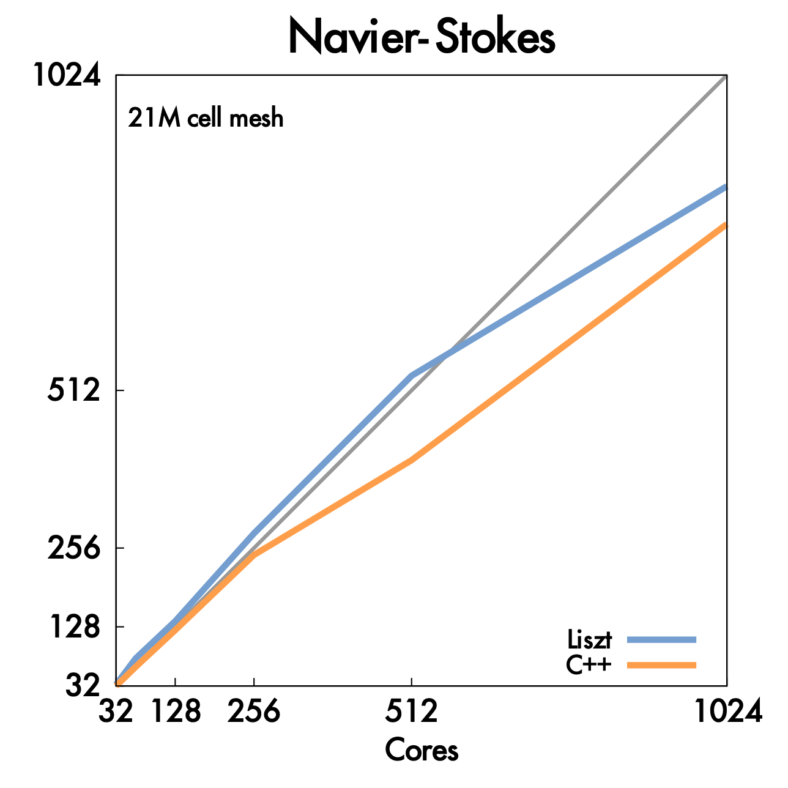
Cluster performance of Lizst program
256 nodes, 8 cores per node (message-passing implemented using MPI)
Important: performance portability!
Same Liszt program also runs with high efficiency on GPU (results not shown here).
But uses a different algorithm when compiled to GPU! (graph coloring)

Slide 36
Liszt summary
Productivity:
  Abstract representation of mesh: vertices, edges, faces, fields (concepts that a scientist thinks about already!)
  Intuitive topological operators
Portability
  Same code runs on large cluster of CPUs (MPI) and GPUs (and combinations thereof!)
High-performance
    Language is constrained to allow compiler to track dependencies
    Used for locality-aware partitioning in distributed memory implementation
    Used for graph coloring in GPU implementation
    Compiler knows how to chooses different parallelization strategies for different platforms
    Underlying mesh representation can be customized by system based on usage and platform (e.g, don’t store edge pointers if code doesn’t need it, choose struct of arrays vs. array of structs for per-vertex fields)

Slide 37
Example 2:
Halide: a domain-specific language for image processing
Jonathan Ragan-Kelley, Andrew Adams et al.
[SIGGRAPH 2012, PLDI 13]

Slide 38

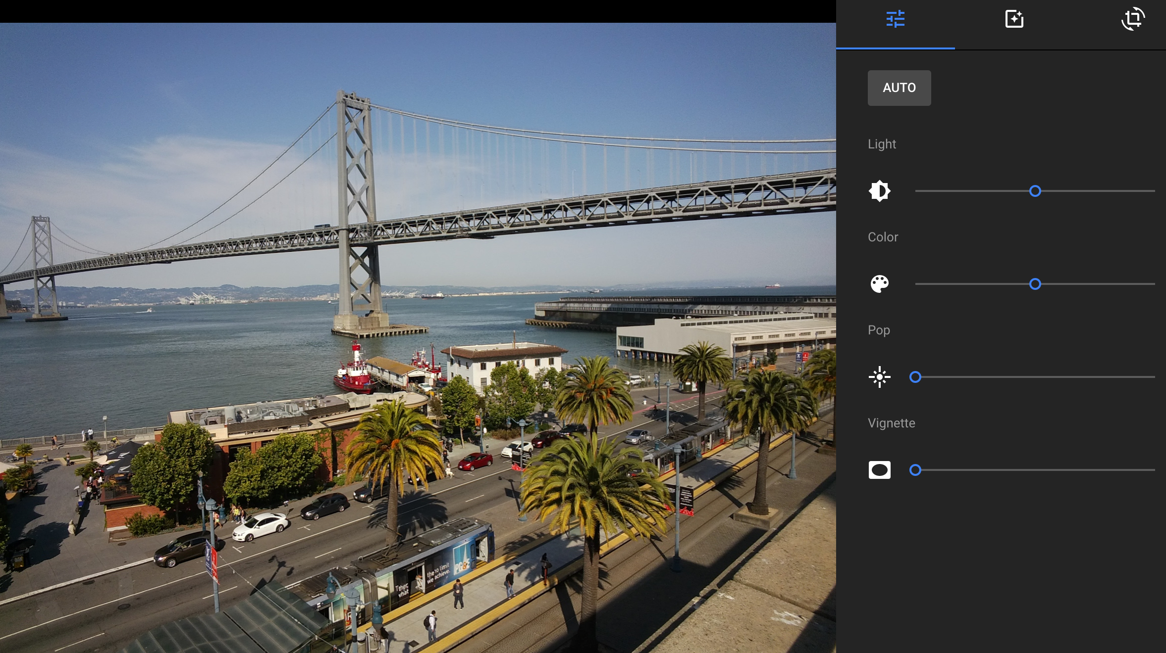
Halide used in practice
Halide used to implement Android HDR+ app
Halide code used to process all images uploaded to Google Photos

Slide 39
A quick tutorial on high-performance image processing

Slide 40
What does this C code do?
int WIDTH = 1024;
int HEIGHT = 1024;
float input[(WIDTH+2) * (HEIGHT+2)];
float output[WIDTH * HEIGHT];
float weights[] = {1.0/9, 1.0/9, 1.0/9,
1.0/9, 1.0/9, 1.0/9,
1.0/9, 1.0/9, 1.0/9};
for (int j=0; j<HEIGHT; j++) {
for (int i=0; i<WIDTH; i++) {
float tmp = 0.f;
for (int jj=0; jj<3; jj++)
for (int ii=0; ii<3; ii++)
tmp += input[(j+jj)*(WIDTH+2) + (i+ii)] * weights[jj*3 + ii];
output[j*WIDTH + i] = tmp;
}
}

Slide 41




3x3 box blur
(Zoom view)

Slide 42
3x3 image blur
int WIDTH = 1024;
int HEIGHT = 1024;
float input[(WIDTH+2) * (HEIGHT+2)];
float output[WIDTH * HEIGHT];
float weights[] = {1.0/9, 1.0/9, 1.0/9,
1.0/9, 1.0/9, 1.0/9,
1.0/9, 1.0/9, 1.0/9};
for (int j=0; j<HEIGHT; j++) {
for (int i=0; i<WIDTH; i++) {
float tmp = 0.f;
for (int jj=0; jj<3; jj++)
for (int ii=0; ii<3; ii++)
tmp += input[(j+jj)*(WIDTH+2) + (i+ii)] * weights[jj*3 + ii];
output[j*WIDTH + i] = tmp;
}
}
Total work per image = 9 x WIDTH x HEIGHT
For NxN filter: N² x WIDTH x HEIGHT
Notes:
What is the work complexity?
Arithmetic intensity

Slide 43
Two-pass 3x3 blur
int WIDTH = 1024;
int HEIGHT = 1024;
float input[(WIDTH+2) * (HEIGHT+2)];
float tmp_buf[WIDTH * (HEIGHT+2)];
float output[WIDTH * HEIGHT];
float weights[] = {1.0/3, 1.0/3, 1.0/3};
for (int j=0; j<(HEIGHT+2); j++)
for (int i=0; i<WIDTH; i++) {
float tmp = 0.f;
for (int ii=0; ii<3; ii++)
tmp += input[j*(WIDTH+2) + i+ii] * weights[ii];
tmp_buf[j*WIDTH + i] = tmp;
}
for (int j=0; j<HEIGHT; j++) {
for (int i=0; i<WIDTH; i++) {
float tmp = 0.f;
for (int jj=0; jj<3; jj++)
tmp += tmp_buf[(j+jj)*WIDTH + i] * weights[jj];
output[j*WIDTH + i] = tmp;
}
}
Total work per image = 6 x WIDTH x HEIGHT
For NxN filter: 2N x WIDTH x HEIGHT
WIDTH x HEIGHT extra storage
3X lower arithmetic intensity than 3D blur
input
(W+2)x(H+2)
1D horizontal blur
tmp_buf
W x (H+2)
1D vertical blur
output
W x H
Notes:
blur horizontally
then blur vertically
big difference in total work when N is large

Slide 44
Two-pass image blur: locality
Intrinsic bandwidth requirements of algorithm:
Application must read each element of input image and must write each element of output image.
int WIDTH = 1024;
int HEIGHT = 1024;
float input[(WIDTH+2) * (HEIGHT+2)];
float tmp_buf[WIDTH * (HEIGHT+2)];
float output[WIDTH * HEIGHT];
float weights[] = {1.0/3, 1.0/3, 1.0/3};
for (int j=0; j<(HEIGHT+2); j++)
for (int i=0; i<WIDTH; i++) {
float tmp = 0.f;
for (int ii=0; ii<3; ii++)
tmp += input[j*(WIDTH+2) + i+ii] * weights[ii];
tmp_buf[j*WIDTH + i] = tmp;
}
for (int j=0; j<HEIGHT; j++) {
for (int i=0; i<WIDTH; i++) {
float tmp = 0.f;
for (int jj=0; jj<3; jj++)
tmp += tmp_buf[(j+jj)*WIDTH + i] * weights[jj];
output[j*WIDTH + i] = tmp;
}
}
Data from input reused three times. (immediately reused in next two i-loop iterations after first load, never loaded again.)
Perfect cache behavior: never load required data more than once
Perfect use of cache lines (don’t load unnecessary data into cache)
Two pass: loads/stores to tmp_buf are overhead (this memory traffic is an artifact of the two-pass implementation: it is not intrinsic to computation being performed)
Data from tmp_buf reused three times (but three rows of image data are accessed in between)
Never load required data more than once… if cache has capacity for three rows of image
Perfect use of cache lines (don’t load unnecessary data into cache)
Notes:
pipeline of convolutions
NEED THREE ROWS OF IMAGE TO FIT IN CACHE TO GET PHASE 2 REUSE (PROBLEM FOR WIDER CONVOLUTIONS)

Slide 45
Two-pass image blur, “chunked” (version 1)
int WIDTH = 1024;
int HEIGHT = 1024;
float input[(WIDTH+2) * (HEIGHT+2)];
float tmp_buf[WIDTH * 3];
float output[WIDTH * HEIGHT];
float weights[] = {1.0/3, 1.0/3, 1.0/3};
for (int j=0; j<HEIGHT; j++) {
for (int j2=0; j2<3; j2++)
for (int i=0; i<WIDTH; i++) {
float tmp = 0.f;
for (int ii=0; ii<3; ii++)
tmp += input[(j+j2)*(WIDTH+2) + i+ii] * weights[ii];
tmp_buf[j2*WIDTH + i] = tmp;
for (int i=0; i<WIDTH; i++) {
float tmp = 0.f;
for (int jj=0; jj<3; jj++)
tmp += tmp_buf[jj*WIDTH + i] * weights[jj];
output[j*WIDTH + i] = tmp;
}
}
input
(W+2)x(H+2)
Only 3 rows of intermediate buffer need to be allocated
tmp_buf
(Wx3)
Produce 3 rows of tmp_buf
(only what’s needed for one row of output)
output
W x H
Combine them together to get one row of output
Total work per row of output:
  step 1: 3 x 3 x WIDTH work
  step 2: 3 x WIDTH work
Total work per image = 12 x WIDTH x HEIGHT ????
Loads from tmp_buffer are cached (assuming tmp_buffer fits in cache)
Notes:
Main idea:
precompute inputs for one row of output
produce row of output
GOOD: NO LONGER 2X BANDWIDTH BECAUSE TMP_BUF FITS IN CACHE (JUST 3 ROWS)
PROBLEM: RECOMPUTING A BUNCH OF STUFF. 12WH math now instead of 9WH math
Q. WHY DID WE PICK THREE ROWS ONLY? WHAT IF WE PICKED MORE?

Slide 46
Two-pass image blur, “chunked” (version 2)
int WIDTH = 1024;
int HEIGHT = 1024;
float input[(WIDTH+2) * (HEIGHT+2)];
float tmp_buf[WIDTH * (CHUNK_SIZE+2)];
float output[WIDTH * HEIGHT];
float weights[] = {1.0/3, 1.0/3, 1.0/3};
for (int j=0; j<HEIGHT; j+CHUNK_SIZE) {
for (int j2=0; j2<CHUNK_SIZE+2; j2++)
for (int i=0; i<WIDTH; i++) {
float tmp = 0.f;
for (int ii=0; ii<3; ii++)
tmp += input[(j+j2)*(WIDTH+2) + i+ii] * weights[ii];
tmp_buf[j2*WIDTH + i] = tmp;
for (int j2=0; j2<CHUNK_SIZE; j2++)
for (int i=0; i<WIDTH; i++) {
float tmp = 0.f;
for (int jj=0; jj<3; jj++)
tmp += tmp_buf[(j2+jj)*WIDTH + i] * weights[jj];
output[(j+j2)*WIDTH + i] = tmp;
}
}
Sized to fit in cache
(capture all producer-consumer locality)
input
(W+2)x(H+2)
Produce enough rows of tmp_buf to produce a CHUNK_SIZE number of rows of output
tmp_buf
W x (CHUNK_SIZE+2)
output
W x H
Produce CHUNK_SIZE rows of output
Total work per chunck of output:
(assume CHUNK_SIZE = 16)
  Step 1: 18 x 3 x WIDTH work
  Step 2: 16 x 3 x WIDTH work
Total work per image: (34/16) x 3 x WIDTH x HEIGHT
= 6.4 x WIDTH x HEIGHT
Trends to ideal 6 x WIDTH x HEIGHT as CHUNK_SIZE is increased!
Notes:
TMP_BUF IS SIZED TO FIT IN THE CACHE
just a bit more work than basic separable implementation
much better bandwidth characteristics
where are the cache misses? (cold misses on input + reuse of 2 rows of input... probably fits in cache)
is it worth it?

Slide 47
Conflicting goals (once again...)
Want to be work efficient (perform fewer operations)
Want to take advantage of locality when present
  Otherwise work-efficient code will be bandwidth bound
  Ideally: bandwidth cost of implementation is very close to intrinsic cost of algorithm: data is loaded from memory once and reused as much as needed prior to being discarded from processor’s cache
Want to execute in parallel (multi-core, SIMD within core)
Notes:
parallel hasn’t been brought up yet

Slide 48
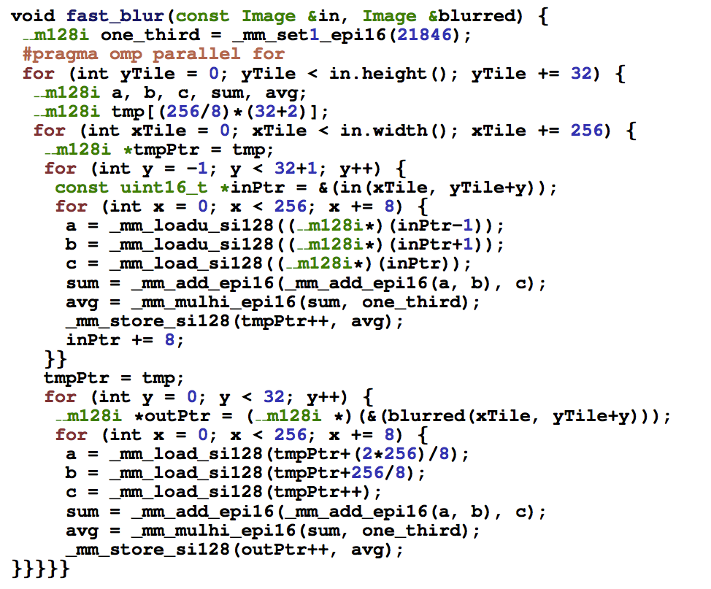
Optimized C++ code: 3x3 image blur
Good: 10x faster: on a quad-core CPU than original two-pass code
Bad: specific to SSE (not AVX2), CPU-code only, hard to tell what is going on at all!
Multi-core execution (partition image vertically)
Modified iteration order: 256x32 block-major iteration (to maximize cache hit rate)
use of SIMD vector intrinsics
two passes fused into one: tmp data read from cache
Notes:
Q. how many of you can tell its a convolution
specific to SSE, cache size
imagine what you might do if I asked you to port your code to GPU, or to ARM CPU
why only 10x faster

Slide 49
Halide blur (algorithm description)
// Halide 3x3 blur program definition
Func halide_blur(Func in) {
Func blurx, out;
Var x, y;
blurx(x,y) = (in(x-1, y) + in(x,y) + in(x+1,y)) / 3.0f;
out(x,y) = (blurx(x,y-1) + blurx(x,y) + blurx(x,y+1)) / 3.0f;
return out;
}
Images are pure functions
Functions map integer coordinates (in up to a 4D domain) to values (e.g., colors of corresponding pixels)
(in, blurx and out are functions)
Algorithms are a series of functions (think: pipeline stages)
Value of blurx at coordinate (x,y) is given by expression accessing three values of in
// top-level calling code
Image<uint8_t> input = load_image(“myimage.png”); // define input image
Func my_program = halide_blur(input); // define pipeline
Image<uint8_t> output = my_program.realize(input.width(), input.height(),
input.channels()); // execute pipeline
output.save(“myblurredimage.png”);
NOTE: execution order and storage are unspecified by the abstraction. The implementation can evaluate, reevaluate, cache individual points as desired!
Notes:
THIS IS C++ METAPROGRAMMING
the algorithm is defined as a series of functions from pixel coordinates to expressions giving the values at those coordinates.

Slide 50
Think of a Halide program as a pipeline
// Halide 3x3 blur program definition
Func halide_blur(Func in) {
Func blurx, out;
Var x, y;
blurx(x,y) = (in(x-1, y) + in(x,y) + in(x+1,y)) / 3.0f;
out(x,y) = (blurx(x,y-1) + blurx(x,y) + blurx(x,y+1)) / 3.0f;
return out;
}
in
blurx
out

Slide 51
Halide schedule describes how to execute a pipeline
// Halide program definition
Func halide_blur(Func in) {
Func blurx, out;
Var x, y, xi, yi
// the “algorithm description” (what to do)
blurx(x,y) = (in(x-1, y) + in(x,y) + in(x+1,y)) / 3.0f;
out(x,y) = (blurx(x,y-1) + blurx(x,y) + blurx(x,y+1)) / 3.0f;
// “the schedule” (how to do it)
out.tile(x, y, xi, yi, 256, 32).vectorize(xi,8).parallel(y);
blurx.chunk(x).vectorize(x, 8);
return out;
}
When evaluating out, use 2D tiling order (loops named by x, y, xi, yi).
Use tile size 256 x 32.
Vectorize the xi loop (8-wide)
Use threads to parallelize the y loop
Produce only chunks of blurx at a time. Vectorize the x (innermost) loop

Slide 52
Halide schedule describes how to execute a pipeline
// Halide program definition
Func halide_blur(Func in) {
Func blurx, out;
Var x, y, xi, yi
// the “algorithm description” (what to do)
blurx(x,y) = (in(x-1, y) + in(x,y) + in(x+1,y)) / 3.0f;
out(x,y) = (blurx(x,y-1) + blurx(x,y) + blurx(x,y+1)) / 3.0f;
// “the schedule” (how to do it)
out.tile(x, y, xi, yi, 256, 32).vectorize(xi,8).parallel(y);
blurx.chunk(x).vectorize(x, 8);
return out;
}
void halide_blur(uint8_t* in, uint8_t* out) {
#pragma omp parallel for
for (int y=0; y<HEIGHT; y+=32) { // tile loop
for (int x=0; y<WIDTH; x+=256) { // tile loop
// buffer
uint8_t* blurx[34 * 256];
// produce intermediate buffer
for (int yi=0; yi<34; yi++) {
// SIMD vectorize this loop (not shown)
for (int xi=0; xi<256; xi++) {
blurx[yi*256+xi] =
(in[(y+yi-1)*WIDTH+x+xi-1] +
in[(y+yi-1)*WIDTH+x+xi] +
in[(y+yi-1)*WIDTH+x+xi+1]) / 3.0;
}
}
// consume intermediate buffer
for (int yi=0; yi<32; yi++) {
// SIMD vectorize this loop (not shown)
for (int xi=0; xi<256; xi++) {
out[(y+yi)*256+(x+xi)] =
(blurx[yi*256+xi] +
blurx[(yi+1)*256+xi] +
blurx[(yi+2)*256+xi]) / 3.0;
}
}
} // loop over tiles
} // loop over tiles
}
Given a schedule, Halide carries out mechanical process of implementing the specified schedule

Slide 53
Halide: two domain-specific co-languages
Functional language for describing image processing operations
Domain-specific language for describing schedules
Design principle: separate “algorithm specification” from its schedule
  Programmer’s responsibility: provide a high-performance schedule
  Compiler’s responsibility: carry out mechanical process of generating threads, SIMD instructions, managing buffers, etc.
  Result: enable programmer to rapidly explore space of schedules
    (e.g., “tile these loops”, “vectorize this loop”, “parallelize this loop across cores”)
Domain scope:
  All computation on regular N-D coordinate spaces
  Only feed-forward pipelines (includes special support for reductions and fixed recursion depth)
  All dependencies inferable by compiler

Slide 54
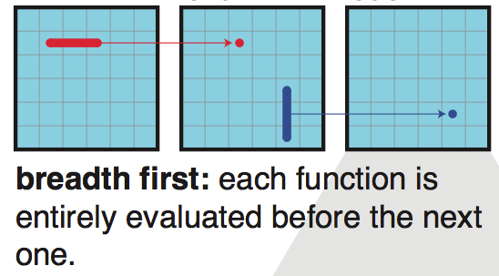
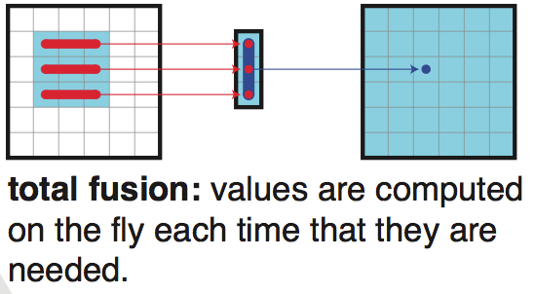
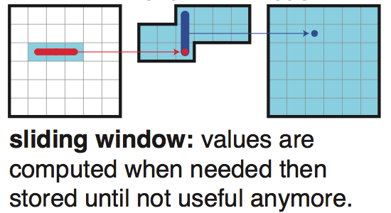
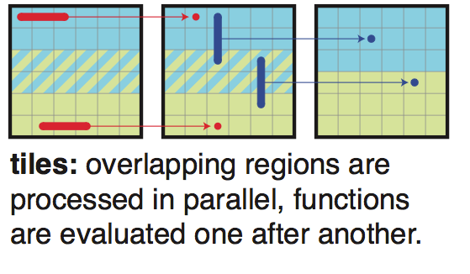
Producer/consumer scheduling primitives
Four basic scheduling primitives shown below
in
tmp
blurred
in
tmp
blurred
“Root”
“Inline”
in
tmp
blurred
in
tmp
blurred
“Sliding Window”
“Chunked”
Notes:
inline: complexity: 9HW instead of 6, but no dump of tmp

Slide 55
Producer/consumer scheduling primitives
// Halide program definition
Func halide_blur(Func in) {
Func blurx, out;
Var x, y, xi, yi
// the “algorithm description” (what to do)
blurx(x,y) = (in(x-1, y) + in(x,y) + in(x+1,y)) / 3.0f;
out(x,y) = (blurx(x,y-1) + blurx(x,y) + blurx(x,y+1)) / 3.0f;
// “the schedule” (how to do it)
blurx.compute_at(ROOT);
return out;
}
“Root”:
compute all points of the producer, then run consumer (minimal locality)
void halide_blur(uint8_t* in, uint8_t* out) {
uint8_t blurx[WIDTH * HEIGHT];
for (int y=0; y<HEIGHT; y++) {
for (int x=0; y<WIDTH; x++) {
blurx[] = ...
for (int y=0; y<HEIGHT; y++) {
for (int x=0; y<WIDTH; x++) {
out[] = ...
}
“Inline”:
revaluate producer at every use site in consumer (maximal locality)
// Halide program definition
Func halide_blur(Func in) {
Func blurx, out;
Var x, y, xi, yi
// the “algorithm description” (what to do)
blurx(x,y) = (in(x-1, y) + in(x,y) + in(x+1,y)) / 3.0f;
out(x,y) = (blurx(x,y-1) + blurx(x,y) + blurx(x,y+1)) / 3.0f;
// “the schedule” (how to do it)
blurx.inline();
return out;
}
void halide_blur(uint8_t* in, uint8_t* out) {
for (int y=0; y<HEIGHT; y++) {
for (int x=0; y<WIDTH; x++) {
out[] = (((in[(y-1)*WIDTH+x-1] +
in[(y-1)*WIDTH+x] +
in[(y-1)*WIDTH+x+1]) / 3) +
((in[y*WIDTH+x-1] +
in[y*WIDTH+x] +
in[y*WIDTH+x+1]) / 3) +
((in[(y+1)*WIDTH+x-1] +
in[(y+1)*WIDTH+x] +
in[(y+1)*WIDTH+x+1]) / 3));
}

Slide 56
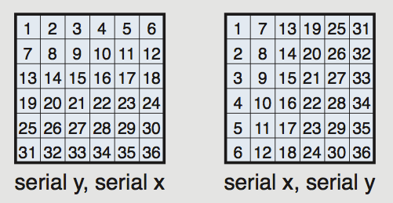
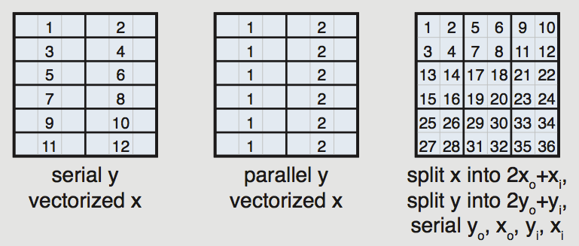
Domain iteration primitives
Specify both order and how to parallelize
(multi-thread, SIMD vector)
2D blocked iteration order
Notes:
numbers show order of operations in a thread

Slide 57
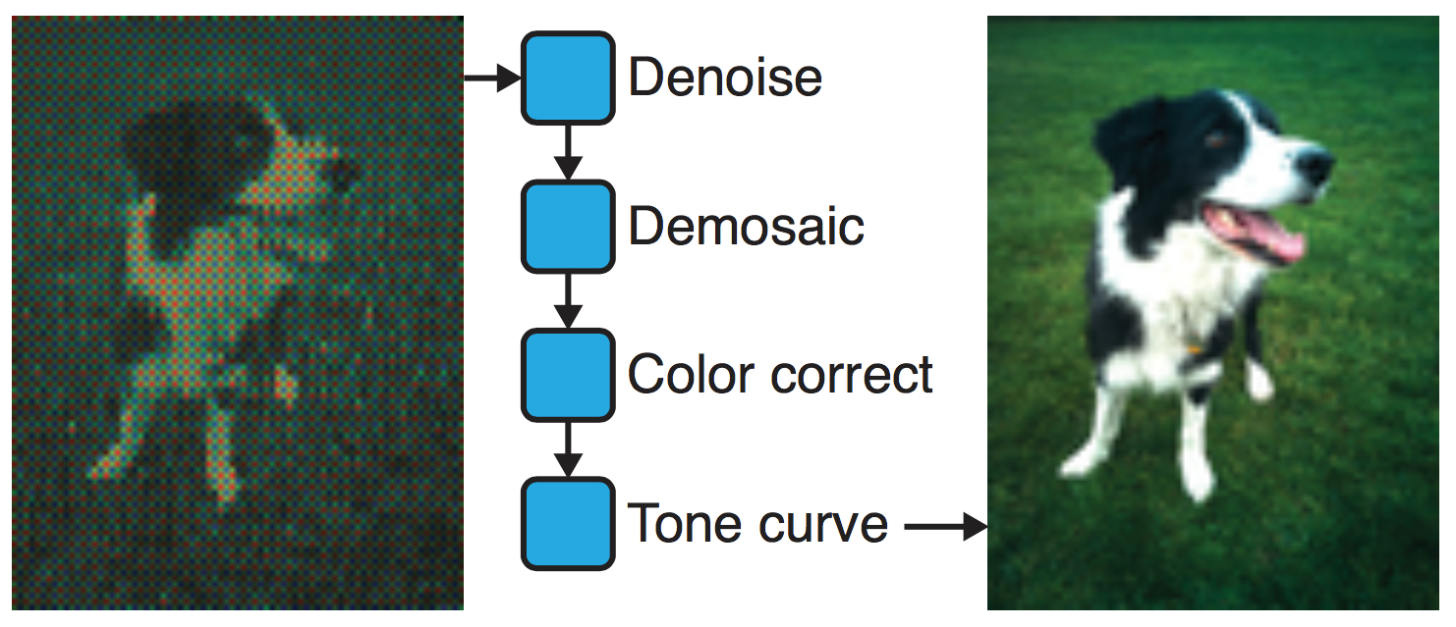
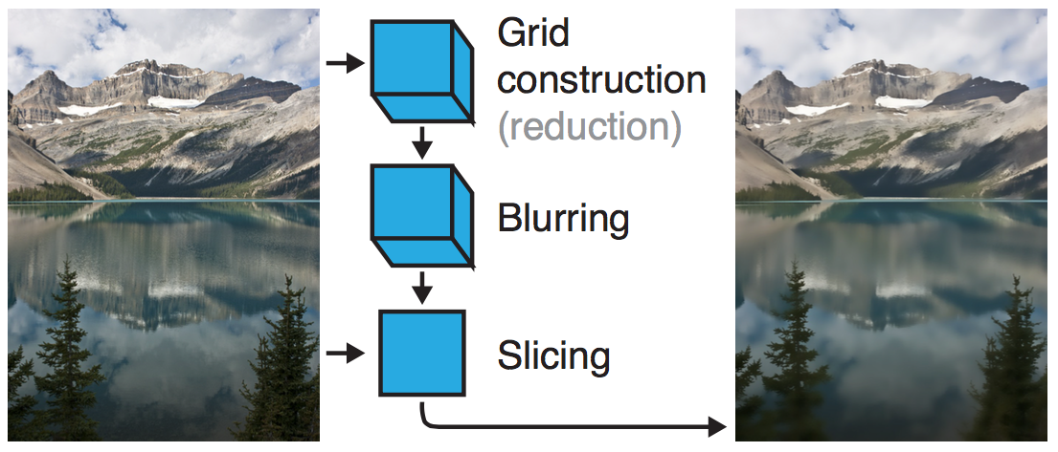
Example Halide results
Camera RAW processing pipeline
(Convert RAW sensor data to RGB image)
  Original: 463 lines of hand-tuned ARM NEON assembly
  Halide: 2.75x less code, 5% faster
Bilateral filter
(Common image filtering operation used in many applications)
  Original 122 lines of C++
  Halide: 34 lines algorithm + 6 lines schedule
      CPU implementation: 5.9x faster
      GPU implementation: 2x faster than hand-written CUDA

Slide 58
Stepping back: what is Halide?
Halide is a DSL for helping good developers optimize image processing code more rapidly
  Halide doesn’t decide how to optimize a program for a novice programmer
  Halide provides primitives for a programmer (that has strong knowledge of code optimization, such as a 418 student) to rapidly express what optimizations the system should apply
  Halide carries out the nitty-gritty of mapping that strategy to a machine

Slide 59
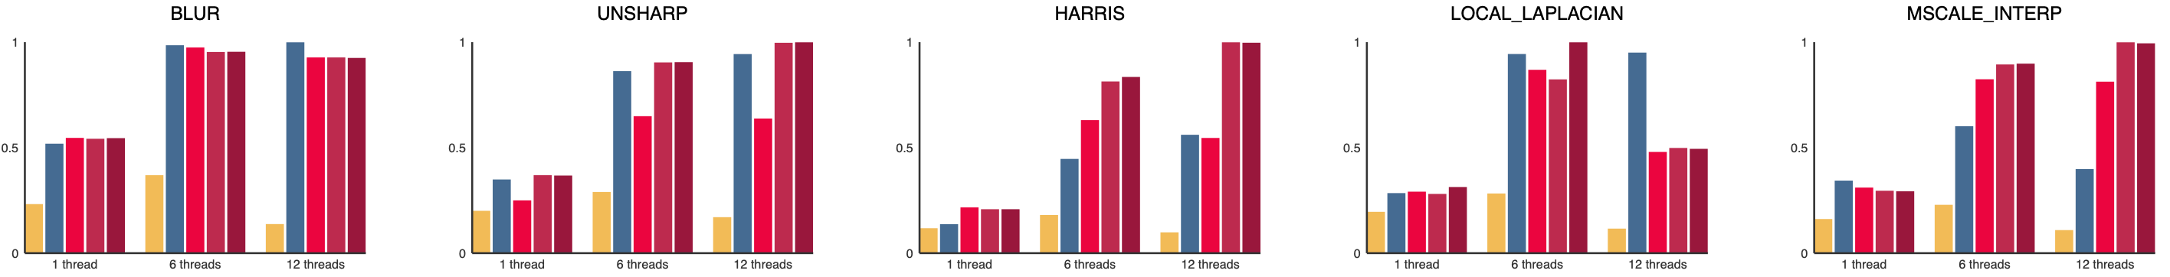
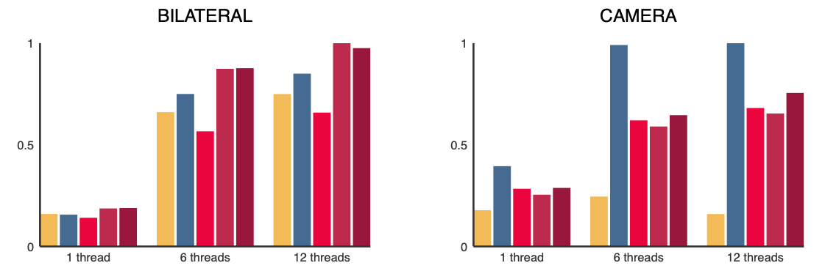
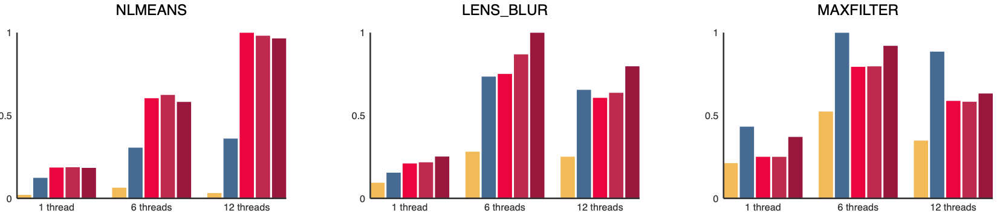
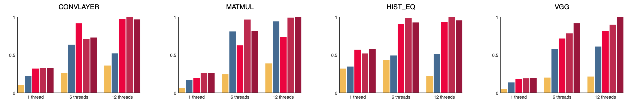
Automatically generating Halide schedules
[Mullapudi, CMU 2016]
Extend Halide compiler to automatically generate schedule for programmer
Compiler input: Halide program + size of expected input/output images
= Naive schedule
= Automatically generated schedule (no autotuning, ~ seconds)
= Expert manual schedule
(best human-created schedule)
= Automatically generated, with auto-tuning (~ 10 minutes)
= Automatically generated, auto-tuning over 3 days

Slide 60
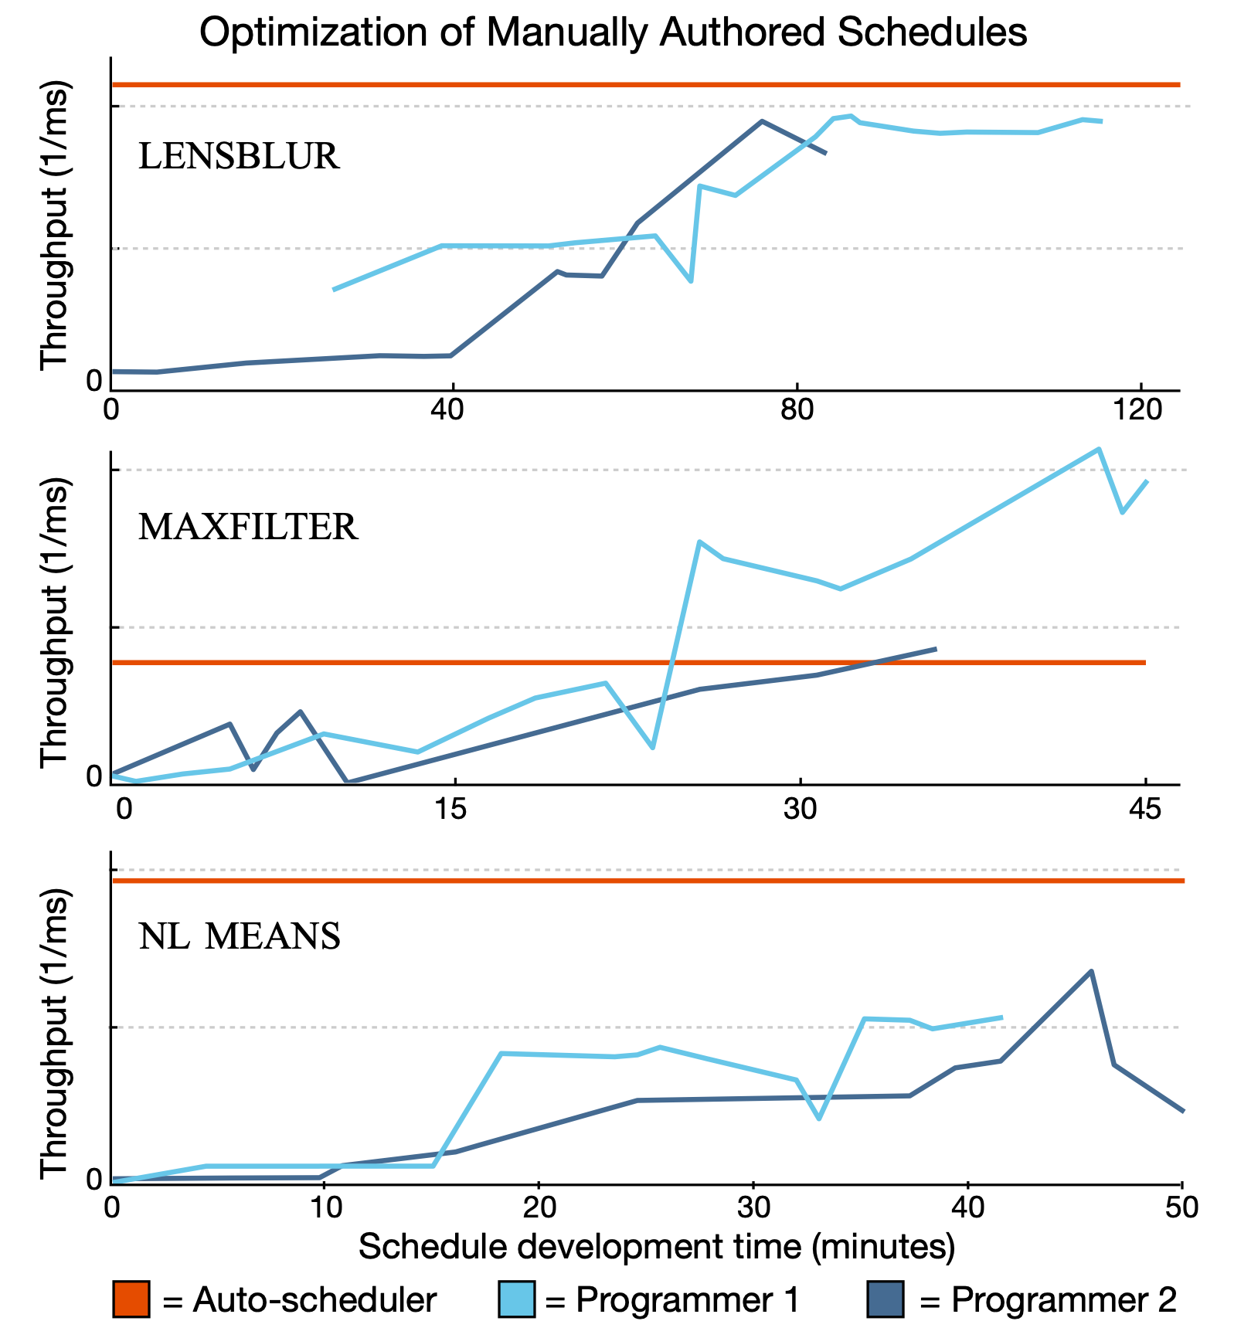
“Racing” top Halide programmers
Halide auto-scheduler produced schedules that were better than those of expert Google Halide programmers in two of three cases (it got beat in one!)

Slide 61
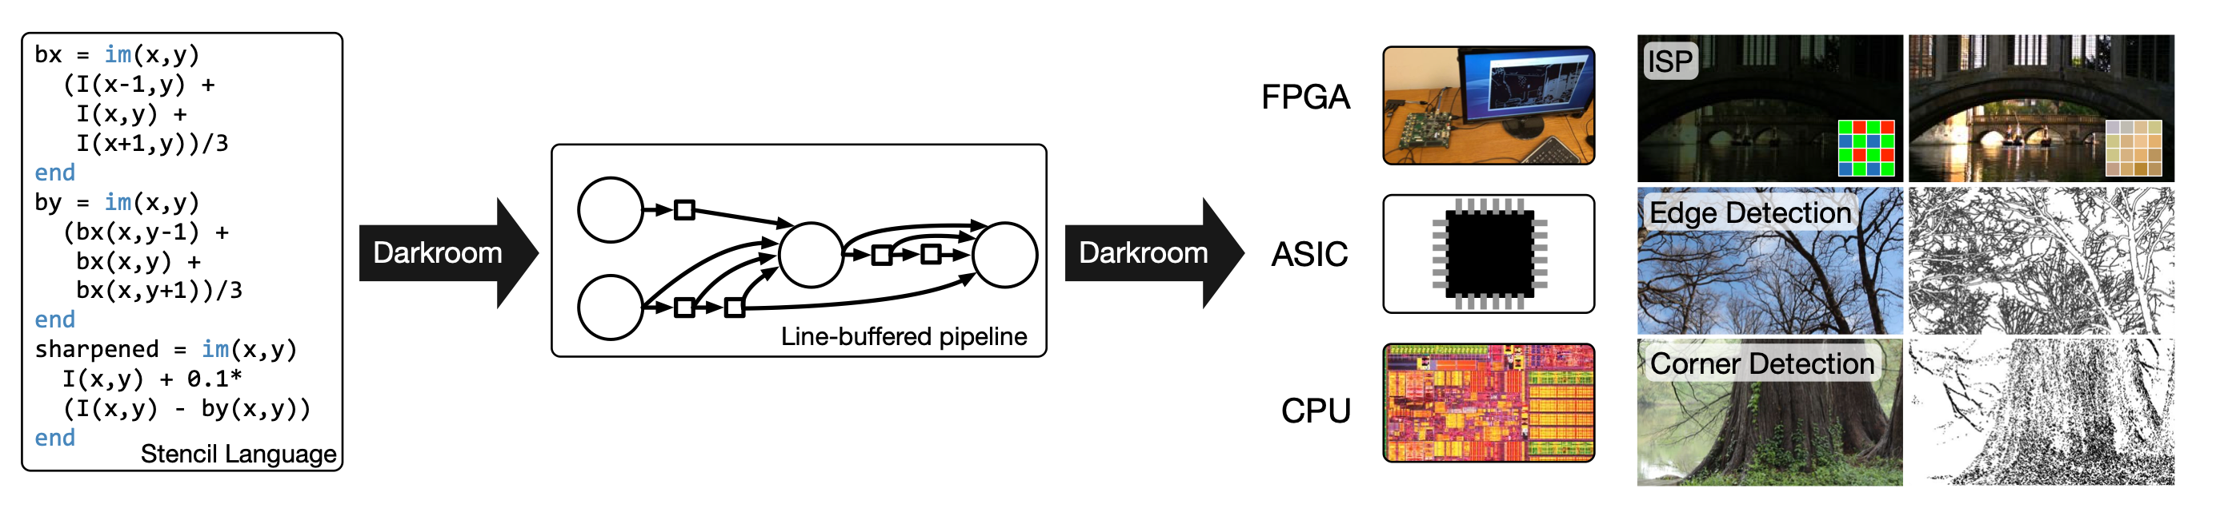
Darkroom/Rigel
[Hegarty 2014, Hegarty 2016]
Directly synthesize FGPA implementation of image processing pipeline from a high-level description (a constrained “Halide-like” language)
Goal: ultra high efficiency image processing

Slide 62


Many other recent domain-specific programming systems
Less domain specific than examples given today, but still designed specifically for:
data-parallel computations on big data for distributed systems (“Map-Reduce”)
DSL for graph-based machine learning computations
Also see Green-Marl, Ligra
(DSLs for describing operations on graphs)
Model-view-controller paradigm for web-applications
Ongoing efforts in many domains...
Simit: a language for physical simulation [MIT]

Slide 63
Domain-specific programming system development
Can develop DSL as a stand-alone language
  Graphics shading languages
  MATLAB, SQL
“Embed” DSL in an existing generic language
  e.g., C++ library (GraphLab, OpenGL host-side API, Map-Reduce)
  Lizst syntax above was all valid Scala code
Active research idea:
  Design generic languages that have facilities that assist rapid embedding of new domain-specific languages
  “What is a good language for rapidly making new DSLs?”

Slide 64
Summary
Modern machines: parallel and heterogeneous
  Only way to increase compute capability in energy-constrained world
Most software uses small fraction of peak capability of machine
  Very challenging to tune programs to these machines
  Tuning efforts are not portable across machines
Domain-specific programming environments trade-off generality to achieve productivity, performance, and portability
  Case studies today: Liszt, Halide
  Common trait: languages provide abstractions that make dependencies known
  Understanding dependencies is necessary but not sufficient: need domain restrictions and domain knowledge for system to synthesize efficient implementations

