Slide 1
Under the Hood, Part 1: Implementing Message Passing
Lecture 20a:

Slide 2

Today’s Theme

Slide 3
Message passing model (abstraction)
Threads operate within their own private address spaces
Threads communicate by sending/receiving messages
  send: specifies recipient, buffer to be transmitted, and optional message identifier (“tag”)
  receive: sender, specifies buffer to store data, and optional message identifier
  Sending messages is the only way to exchange data between threads 1 and 2
Thread 1 address space
Thread 2 address space
x
send(X, 2, my_msg_id)
semantics: send contexts of local variable X as message to thread 2 and tag message with the id “my_msg_id”
Variable X
recv(Y, 1, my_msg_id)
semantics: receive message with id “my_msg_id” from thread 1 and store contents in local variable Y
Y
Variable Y
Illustration adopted from Culler, Singh, Gupta
Notes:
not by manipulating shared variables
telephone call metaphor, rather than bulletin board metaphor
HOW TO THINK ABOUT IT

Slide 4
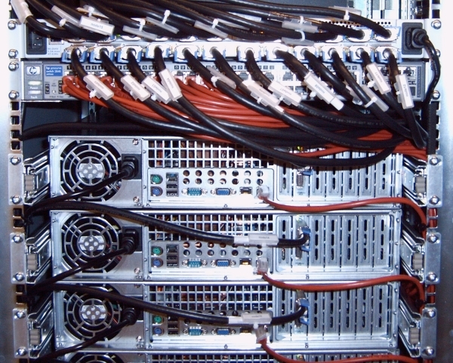
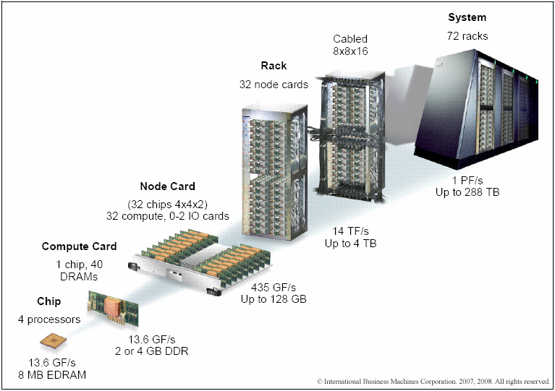
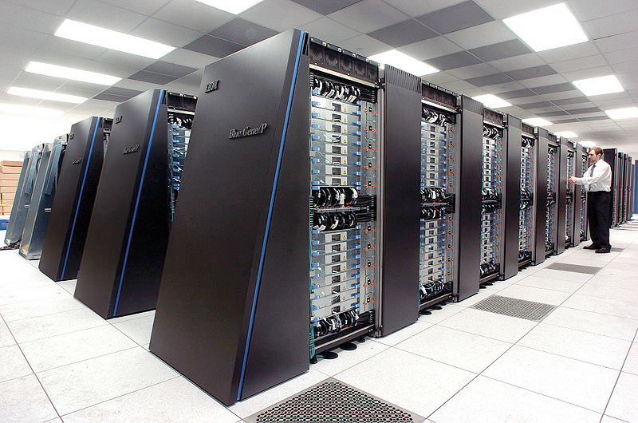
Message passing systems
Popular software library: MPI (message passing interface)
Hardware need not implement system-wide loads and stores to execute message passing programs (need only be able to communicate messages)
  Can connect commodity systems together to form large parallel machine
  (message passing is a programming model for clusters)
Cluster of workstations
(Infiniband network)
IBM Blue Gene/P Supercomputer
Image credit: IBM

Slide 5
Network Transaction
Interconnection Network
Serialized Message
Output Buffer
Input Buffer
Source Node
Destination Node
One-way transfer of information from a source output buffer to a destination input buffer
  causes some action at the destination
    e.g., deposit data, state change, reply
  occurrence is not directly visible at source

Slide 6
Bus Transactions vs.
Network Transactions
Issues: Bus Network
protection check V->P ??
format wires flexible
output buffering reg, FIFO ??
media arbitration global local
destination naming and routing
input buffering limited many source
action
completion detection

Slide 7
Shared Address Space Abstraction
Source
Destination
(1) Initiate memory access
(2) Address translation
(3) Local/remote check
(4) Request transaction
(5) Remote memory access
(6) Reply transaction
(7) Complete memory access
Load r1 <— Address
Read request
Read request
Wait
Memory access
Read response
Read response
Time
Fundamentally a two-way request/response protocol
  writes have an acknowledgement

Slide 8
Key Properties of SAS Abstraction
Source and destination addresses are specified by source of the request
  a degree of logical coupling and trust
No storage logically “outside the application address space(s)”
  may employ temporary buffers for transport
Operations are fundamentally request-response
Remote operation can be performed on remote memory
  logically does not require intervention of the remote processor

Slide 9
Message Passing Implementation Options
Synchronous:
  Send completes after matching receive and source data sent
  Receive completes after data transfer complete from matching send
Asynchronous:
  Send completes after send buffer may be reused

Slide 10
Synchronous Message Passing
Source
Destination
(1) Initiate send
(2) Address translation
(3) Local/remote check
(4) Send-ready request
(5) Remote check for posted receive (assume success)
(6) Reply transaction
(7) Bulk data transfer
Source VA —> Dest VA
Send(Pdest, local VA, len)
Receive(Psrc, local VA, len)
Send-ready request
Wait
Tag check
Receive-ready reply
Data-transfer request
Time
Data is not transferred until target address is known
  Limits contention and buffering at the destination
Performance?

Slide 11
Asynchronous Message Passing: Optimistic
Source
Destination
(1) Initiate send
(2) Address translation
(3) Local/remote check
(4) Send data
(5) Remote check for posted receive; on fail, allocate data buffer
Send(Pdest, local VA, len)
Data-transfer request
Tag Match
Allocate Buffer
Time
Receive(Psrc, local VA, len)
Good news:
  source does not stall waiting for the destination to receive
Bad news:
  storage is required within the message layer (?)

Slide 12
Asynchronous Message Passing: Conservative
Source
Destination
(1) Initiate send
(2) Address translation
(3) Local/remote check
(4) Send-ready request
(5) Remote check for posted receive (assume fail); record send-ready
(6) Receive-ready request
(7) Bulk data reply
Source VA —> Dest VA
Send(Pdest, local VA, len)
Send-ready request
Resume computing
Tag match
Receive(Psrc, local VA, len)
Receive-ready request
Time
Data-transfer reply
Where is the buffering?
Contention control? Receiver-initiated protocol?
What about short messages?

Slide 13
Key Features of Message Passing Abstraction
Source knows send address, destination knows receive address
  after handshake they both know both
Arbitrary storage “outside the local address spaces”
  may post many sends before any receives
Fundamentally a 3-phase transaction
  includes a request / response
  can use optimistic 1-phase in limited “safe” cases
    credit scheme

Slide 14
Challenge: Avoiding Input Buffer Overflow
This requires flow-control on the sources
Approaches:
  Reserve space per source (credit)
    when is it available for reuse? (utilize ack messages?)
  Refuse input when full
    what does this do to the interconnect?
      backpressure in a reliable network
      tree saturation? deadlock?
      what happens to traffic not bound for congested destination?
  Drop packets (?)
  ???

Slide 15
The Fetch Deadlock Problem
Even if a node cannot issue a request, it must sink network transactions
Incoming transaction may be a request
  which will generate a response
Closed system (finite buffering)

Slide 16
Challenge: Avoiding Fetch Deadlock
Must continue accepting messages, even when cannot source msgs
  what if incoming transaction is a request?
    each may generate a response, which cannot be sent!
    what happens when internal buffering is full?
Approaches:
Logically independent request/reply networks
  physical networks
  virtual channels with separate input/output queues
Bound requests and reserve input buffer space
  K(P-1) requests + K responses per node
  service discipline to avoid fetch deadlock?
NACK on input buffer full
  NACK delivery?

Slide 17
Implementation Challenges: Big Picture
One-way transfer of information
No global knowledge, nor global control
  barriers, scans, reduce, global-OR give fuzzy global state
Very large number of concurrent transactions
Management of input buffer resources
  many sources can issue a request and over-commit destination before any see the effect
Latency is large enough that you are tempted to “take risks”
  e.g., optimistic protocols; large transfers; dynamic allocation

Slide 18
Implementing Parallel Runtimes, Part 2
Lecture 20b:

Slide 19
Objectives
What are the costs of using parallelism APIs?
How do the runtimes operate?

Slide 20
Basis of Lecture
This lecture is based on runtime and source code analysis of Intel’s open source parallel runtimes
  OpenMP – https://www.openmprtl.org/
  Cilk – https://bitbucket.org/intelcilkruntime/intel-cilk-runtime
And using the LLVM compiler
  OpenMP – part of LLVM as of 3.8
  CilkPlus: http://cilkplus.github.io/ ➔ OpenCilk: http://cilk.mit.edu

Slide 21
OpenMP and Cilk
What do these have in common?
  pthreads
What benefit does abstraction versus implementation provide?

Slide 22
Simple OpenMP Loop Compiled
What is this code doing?
What do the OpenMP semantics specify?
How might you accomplish this?
extern float foo( void );
int main (int argc, char** argv) {
int i;
float r = 0.0;
#pragma omp parallel for schedule(dynamic) reduction(+:r)
for ( i = 0; i < 10; i ++ ) {
r += foo();
}
return 0;
}
Under the hood:
Scheduling
Work (in parallel)
Reduction
Barrier
Example from OpenMP runtime documentation

Slide 23
Simple OpenMP Loop Compiled
extern float foo( void );
int main (int argc, char** argv) {
  static int zero = 0;
  auto int gtid;
  auto float r = 0.0;
  __kmpc_begin( & loc3, 0 );
  gtid = __kmpc_global thread num( & loc3 );
  __kmpc_fork call( &loc7, 1, main_7_parallel_3, &r );
  __kmpc_end( & loc0 );
  return 0;
}
Call a (new) function in parallel with the argument(s)
Example from OpenMP runtime documentation

Slide 24
Simple OpenMP Loop Compiled
OpenMP “microtask”
  Each thread runs the task
Initializes local iteration bounds and local reduction
Each iteration receives a chunk and operates locally
After finishing all chunks, combine into global reduction
struct main_10_reduction_t_5 { float r_10_rpr; };
void main_7_parallel_3( int *gtid, int *btid, float *r_7_shp ) {
  auto int i_7_pr;
  auto int lower, upper, liter, incr;
  auto struct main_10_reduction_t_5 reduce;
  reduce.r_10_rpr = 0.F;
  liter = 0;
  __kmpc_dispatch_init_4( & loc7,*gtid, 35, 0, 9, 1, 1 );
  while ( __kmpc_dispatch_next_4( & loc7, *gtid, &liter,
  &lower, &upper, &incr) ) {
    for( i_7_pr = lower; upper >= i_7_pr; i_7_pr ++ )
      reduce.r_10_rpr += foo();
  }
  switch( __kmpc_reduce_nowait( & loc10, *gtid, 1, 4,
  &reduce, main_10_reduce_5, &lck ) ) {
  case 1:
    *r_7_shp += reduce.r_10_rpr;
    __kmpc_end_reduce_nowait( & loc10, *gtid, &lck);
  break;
  case 2:
    __kmpc_atomic_float4_add( & loc10, *gtid,
    r_7_shp, reduce.r_10_rpr );
  break;
  default:;
  }
}
Example from OpenMP runtime documentation

Slide 25
Simple OpenMP Loop Compiled
All code combined
extern float foo( void );
int main (int argc, char** argv) {
  static int zero = 0;
  auto int gtid;
  auto float r = 0.0;
  __kmpc_begin( & loc3, 0 );
  gtid = __kmpc_global thread num( & loc3 );
  __kmpc_fork call( &loc7, 1, main_7_parallel_3, &r );
  __kmpc_end( & loc0 );
  return 0;
}
struct main_10_reduction_t_5 { float r_10_rpr; };
static kmp_critical_name lck = { 0 };
static ident_t loc10;
void main_10_reduce_5( struct main_10_reduction_t_5 *reduce_lhs, struct main_10_reduction_t_5 *reduce_rhs )
{
  reduce_lhs->r_10_rpr += reduce_rhs->r_10_rpr;
}
void main_7_parallel_3( int *gtid, int *btid, float *r_7_shp ) {
  auto int i_7_pr;
  auto int lower, upper, liter, incr;
  auto struct main_10_reduction_t_5 reduce;
  reduce.r_10_rpr = 0.F;
  liter = 0;
  __kmpc_dispatch_init_4( & loc7,*gtid, 35, 0, 9, 1, 1 );
  while ( __kmpc_dispatch_next_4( & loc7, *gtid, &liter,
  &lower, &upper, &incr) ) {
    for( i_7_pr = lower; upper >= i_7_pr; i_7_pr ++ )
      reduce.r_10_rpr += foo();
  }
  switch( __kmpc_reduce_nowait( & loc10, *gtid, 1, 4,
  &reduce, main_10_reduce_5, &lck ) ) {
  case 1:
    *r_7_shp += reduce.r_10_rpr;
    __kmpc_end_reduce_nowait( & loc10, *gtid, &lck);
  break;
  case 2:
    __kmpc_atomic_float4_add( & loc10, *gtid, r_7_shp,
    reduce.r_10_rpr );
  break;
  default:;
  }
}
Example from OpenMP runtime documentation

Slide 26
Fork Call
“Forks” execution and calls a specified routine (microtask)
Determine how many threads to allocate to the parallel region
Setup task structures
Release allocated threads from their idle loop
Notes:
__kmp_internal_fork calls __kmp_fork_barrier on which the workers are waiting (See __kmp_launch_thread)
Assigned threads then - rc = (*pteam)->t.t_invoke( gtid );
And finally __kmp_join_barrier

Slide 27
Iteration Mechanisms
Static, compile time iterations
  __kmp_for_static_init
  Compute one set of iteration bounds
Everything else
  __kmp_dispatch_next
  Compute the next set of iteration bounds

Slide 28
OMP Barriers
Two phase -> gather and release
  Gather non-master threads pass, master waits
  Release is opposite
Barrier can be:
  Linear (Centralized)
  Tree
  Hypercube
  Hierarchical
Notes:
Kmp_barrier.cpp – switch(barrier type)
Linear barrier -> flag.release() -> kmp_barrier_release?

Slide 29
OMP Atomic
Can the compiler do this in a read-modify-write (RMW) op?
Otherwise, create a compare-and-swap loop
T* val;
T update;
#pragma omp atomic
*val += update;
If T is int, this is “lock add …”.
If T is float, this is “lock cmpxchg …”
Why?

Slide 30
OMP Tasks
#pragma omp task depend (inout:x) …
Create microtasks for each task
  Track dependencies by a list of address / length tuples
  Ordered, dataflow scheduling of tasks on memory locations
Allows dynamic creation of task graph for computations with irregular structure

Slide 31
Cilk
Covered in Lecture 6
We discussed the what and why, now the how

Slide 32
Simple Cilk Program Compiled
What is this code doing?
What do the Cilk semantics specify?
Which is the child? Which is the continuation?
int fib(int n) {
if (n < 2)
return n;
int a = cilk_spawn fib(n-1);
int b = fib(n-2);
cilk_sync;
return a + b;
}
Notes:
Recall that cilk_spawn is actually the “straightline” path, which the next line is the parallel continuation.

Slide 33
How to create a continuation?
Continuation needs all of the state to continue
  Register values, stack, etc.
What function allows code to jump to a prior point of execution?
Setjmp(jmp_buf env)
  Save stack context
  Return via longjmp(env, val)
  Setjmp returns 0 if saving, val if returning via longjmp

Slide 34
Basic Block
Unit of Code Analysis
Sequence of instructions
  Execution can only enter at the first instruction
    Cannot jump into the middle
  Execution can only exit at the last instruction
    Branch or Function Call
    Or the start of another basic block (fall through)

Slide 35
Simple Cilk Program Revisited
entry
setjmp
!0
fib(n-2)
0
maybe
fib(n-1)
Save Continuation
parallel
serial
setjmp
Is sync?
0
!0
fib1 + fib2
fib1 + fib2
cilkrts_sync
ret
Leave frame
Notes:
Save Continuation
Fib(n-1) may never return
Cilkrts_sync save a completion continuation, then find more work

Slide 36
Cilk Workers
While there may be work
  Try to get the next item from our queue
  Else try to get work from a random queue
  If there is no work found, wait on semaphore
If work item is found
  Resume with the continuation’s stack

Slide 37
Thread Local Storage
Linux supports thread local storage
  New: C11 - _Thread_local keyword
    one global instance of the variable per thread
  Compiler places values into .tbss
  OS provides each thread with this space
Since Cilk and OpenMP are using pthreads
  These values are in the layer below them

