Slide 1
Interconnection Networks
Lecture 15:
Credit: some slides created by Michael Papamichael, others based on slides from Onur Mutlu’s 18-742

Slide 2
Basic system design from previous lectures
Processor
Processor
Cache
Cache
Interconnect (shared bus)
Bus
Arbitrator
Bus clients (interconnect nodes)
Memory
Bus interconnect:
All nodes connected by a shared set of wires
Request bus:
cmd + address
e.g., 40 bits
Response bus:
data
e.g., 256 bits
Response tag
3 bits

Slide 3

Today: modern interconnect designs
Processor
Processor
Cache
Cache
Interconnection Network
Interconnect nodes
Memory
Today’s topics: the basic ideas of building a high-performance interconnection network in a parallel processor.
(think: “a network-on-a-chip”)

Slide 4
What are interconnection networks used for?
To connect:
Processor cores with other cores
Processors and memories
Processor cores and caches
Caches and caches
I/O devices

Slide 5
Why is the design of the interconnection network important?
System scalability
How large of a system can be built?
How easy is it to add more nodes (e.g., cores)
System performance and energy efficiency
How fast can cores, caches, memory communicate
How long is latency to memory?
How much energy is spent on communication?

Slide 6
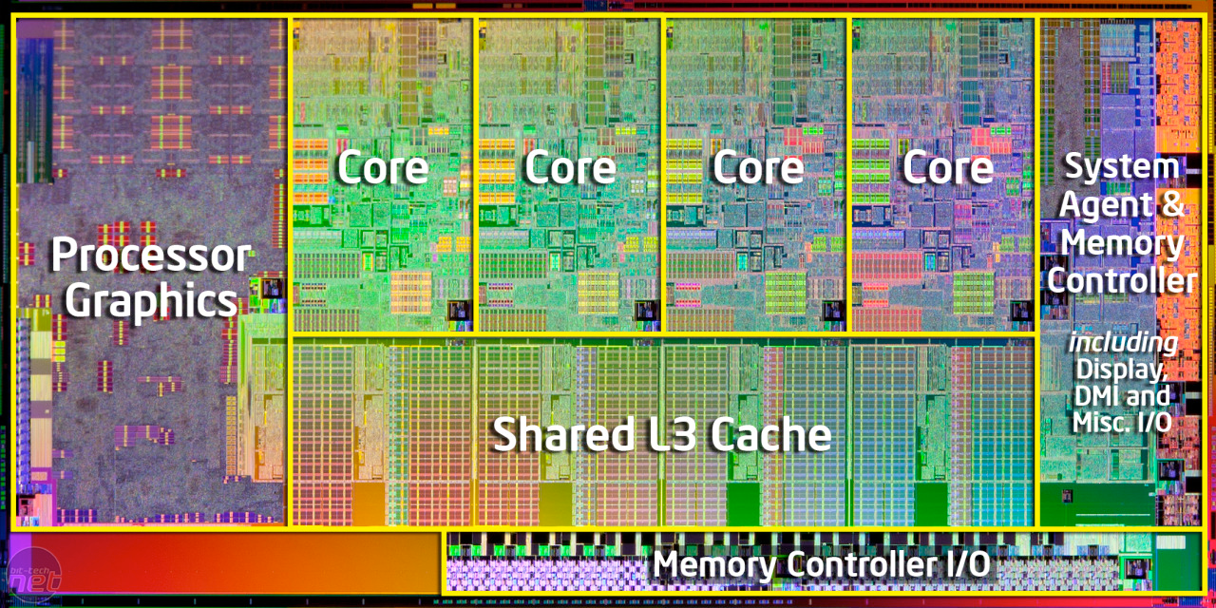
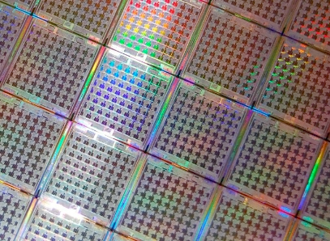
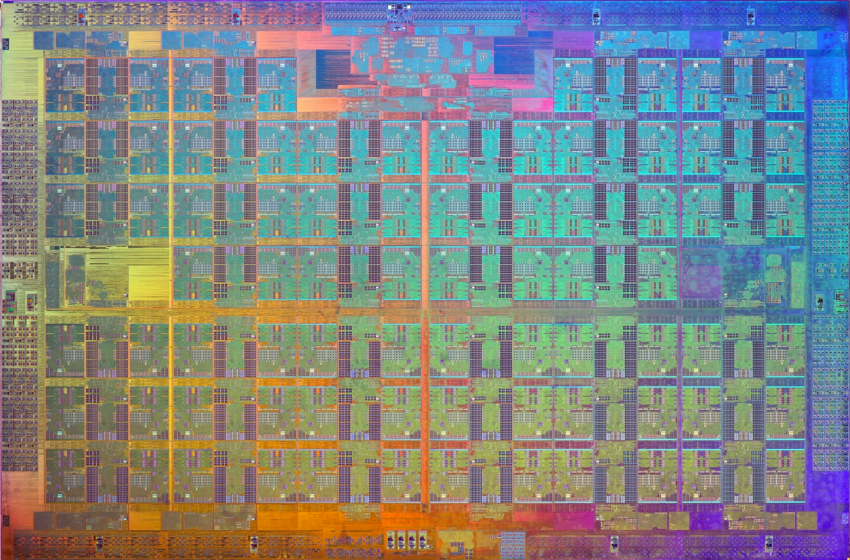
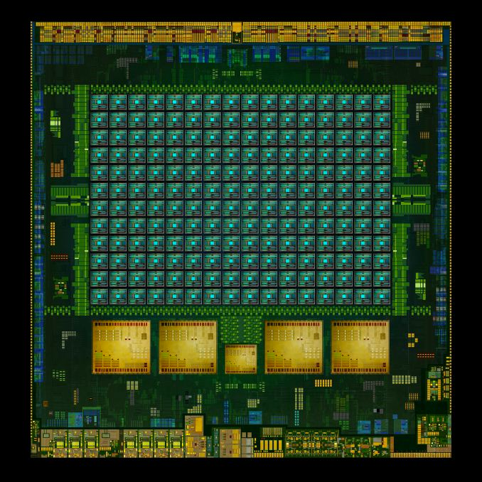
With increasing core counts…
Scalability of on-chip interconnection network becomes increasingly important
Intel core i7 (4-CPU cores, + GPU)
Tilera GX 64-core chip
Intel Xeon Phi (72-core x86)
Tegra K1: 4 + 1 ARM cores + GPU cores

Slide 7
Interconnect terminology

Slide 8
Terminology
Network node: a network endpoint connected to a router/switch
Examples: processor caches, the memory controller
Network interface:
Connects nodes to the network
Switch/router:
Connects a fixed number of input links to a fixed number of output links
Link:
A bundle of wires carrying a signal
Network interface
Node
0
Switch
1
Link
2
3
Notes:
describe iconography

Slide 9
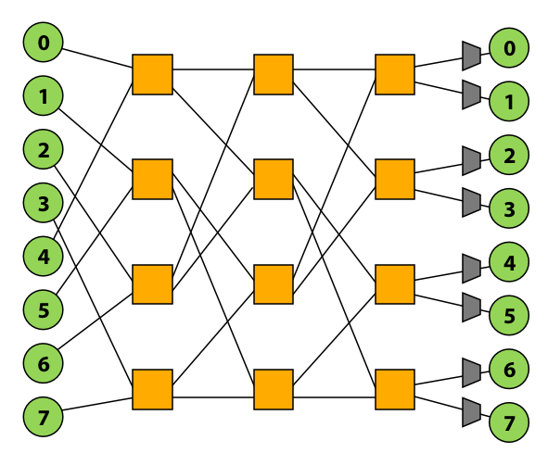
Design issues
Topology: how switches are connected via links - Affects routing, throughput, latency, complexity/cost of implementation
Routing: how a message gets from its source to its destination in the network
- Can be static (messages take a predetermined path) or adaptive based on load
Buffering and flow control
What data are stored in the network? packets, partial packets? etc.
How does the network manage buffer space?

Slide 10
Properties of interconnect topology
Routing distance
Number of links (“hops”) along a route between two nodes
Diameter: the maximum routing distance
Average distance: average routing distance over all valid routes
Example:
diameter = 6

Slide 11
Properties of interconnect topology
Direct vs. indirect networks
Direct network: endpoints sit “inside” the network
e.g., mesh is direct network: every node is both an endpoint and a switch
Direct network
Indirect network

Slide 12
Properties of an interconnect topology
Bisection bandwidth:
Common metric of performance for recursive topologies
Cut network in half, sum bandwidth of all severed links
Warning: can be misleading as it does not account for switch and routing efficiencies
Blocking vs. non-blocking:
If connecting any pairing of nodes is possible, network is non-blocking (otherwise, it’s blocking)
Notes:
The bisection bandwidth is the bandwidth across the minimum cut which divides the network into two equal partitions.

Slide 13
Example: blocking vs. non-blocking
Is this network blocking or non-blocking?
Consider simultaneous messages from 0-to-1 and 3-to-7.
0
0
1
1
2
2
3
3
4
4
5
5
6
6
7
7
Note: in this network illustration, each node is drawn twice for clarity (at left and at right)

Slide 14
Example: blocking vs. non-blocking
Is this network blocking or non-blocking?
Consider simultaneous messages from 0-to-1 and 3-to-7.
Consider simultaneous messages from 1-to-6 and 3-to-7. Blocking!!!
0
0
1
1
2
2
3
3
4
4
5
5
6
6
7
7
Note: in this network illustration, each node is drawn twice for clarity (at left and at right)
Conflict

Slide 15
Load-latency behavior of network
General rule: latency increases with load (throughput)
Saturation throughput
(given by flow control)
Zero load or idle latency
(topology+routing+flow control)
Throughput given by routing
Latency
Throughput given by topology
Min latency given by routing algorithm
Min latency given by topology
Load - Offered Traffic (bits/sec)

Slide 16
Interconnect topologies

Slide 17
Many possible network topologies
Bus
Crossbar
Ring
Tree
Omega
Hypercube
Mesh
Torus
Butterfly
…

Slide 18
Bus interconnect
Good:
Simple design
Cost effective for a small number of nodes
Easy to implement coherence (via snooping)
Bad:
Contention: all nodes contend for shared bus
Limited bandwidth: all nodes communicate over same wires (one communication at a time)
High electrical load = low frequency, high power
Logical Structure
Physical Structure
1
0
2
0
1
2
3
4
3
4

Slide 19
Crossbar interconnect
Every node is connected to every other node (non-blocking, indirect)
Switch i,j provides direct connection from node i to node j
Good:
O(1) latency and high bandwidth
Bad:
Not scalable: O(N²) switches
High cost
Difficult to arbitrate at scale
0
1
2
3
4
5
6
7
0
1
2
3
4
5
6
Crossbar scheduling algorithms / efficient hardware implementations are still active research areas.
7
8-node crossbar network (N=8)
Note: in this network illustration, each node is drawn twice for clarity (at left and at top)
Notes:
non-buffering switches

Slide 20
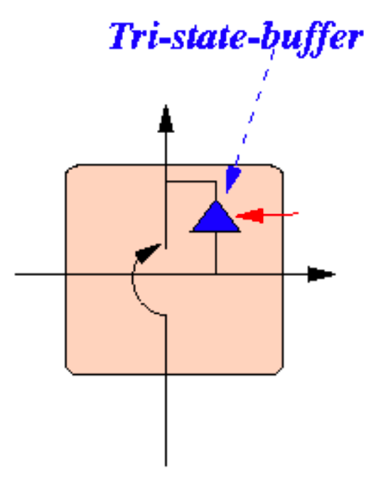
Crossbar interconnect
(Here is a more verbose illustration than that on previous slide)
0
1
2
3
4
5
6
7
0
1
2
Horizontal/Vertical lines
Continuous wires
Circles
Optionally connect horizontal wire to vertical
3
4
5
6
7

Slide 21
Crossbar Logical Structure
0
7
1
6
2
5
3
4
For each possible sender:
Can connect to any set of receivers simultaneously
Very general, but very expensive

Slide 22
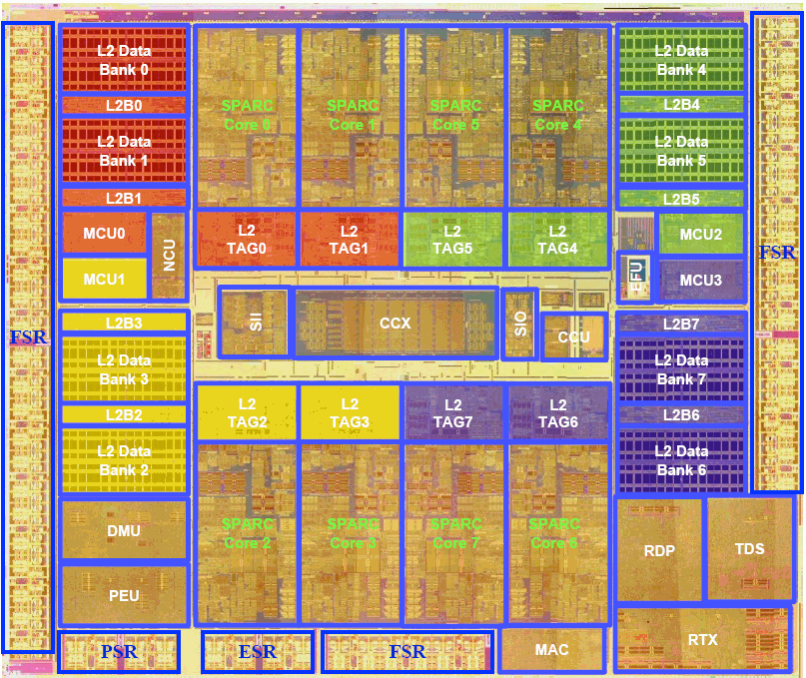
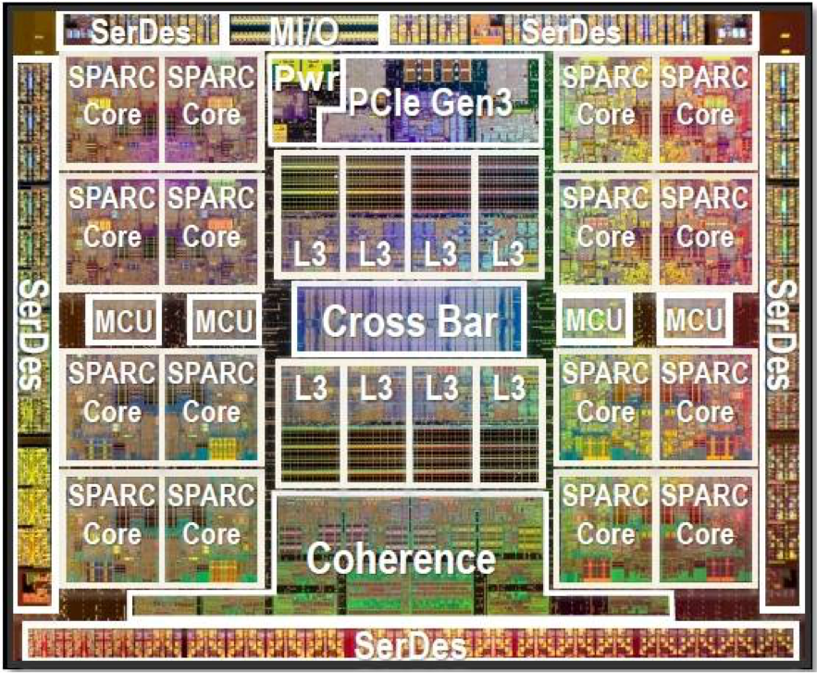
Crossbars were used in recent multi-core processing from Oracle (previously Sun)
Sun SPARC T2 (8 cores, 8 L2 cache banks)
Oracle SPARC T5 (16 cores, 8 L3 cache banks)
Note that crossbar (CCX) occupies about the same chip area as a core
Notes:
point out area of chip dedicated to crossbar

Slide 23
Ring
Good:
Simple
Cheap: O(N) cost
Bad:
High latency: O(N)
Bisection bandwidth remains constant as nodes are added (scalability issue)
Used in recent Intel architectures
Core i7
Also used in IBM CELL Broadband Engine (9 cores)
0
1
2
3

Slide 24
Intel’s ring interconnect
Introduced in Sandy Bridge microarchitecture
System Agent
Four rings
request
snoop
Ack
data (32 bytes)
Six interconnect nodes: four “slices” of L3 cache + system agent + graphics
Each bank of L3 connected to ring bus twice
Theoretical peak BW from cores to L3 at 3.4 GHz is approx. 435 GB/sec
When each core is accessing its local slice
L3 cache slice
(2 MB)
Core
L3 cache slice
(2 MB)
Core
L3 cache slice
(2 MB)
Core
L3 cache slice
(2 MB)
Core
Graphics
Notes:
unidirectional ring, but connected twice

Slide 25
Mesh
Direct network
Echoes locality in grid-based applications
O(N) cost
Average latency: O(sqrt(N))
Easy to lay out on chip: fixed-length links
Path diversity: many ways for message to travel from one node to another
Used by:
Tilera processors
Prototype Intel chips
2D Mesh
Notes:
Q. what’s a potential problem with a mesh network?
A. average node-to-node latency highly variable depending on where node is on grid
say you were processor, and you had to choose a position on a grid to minimize communication latency
near a corner there’s trouble. Middle is better.

Slide 26
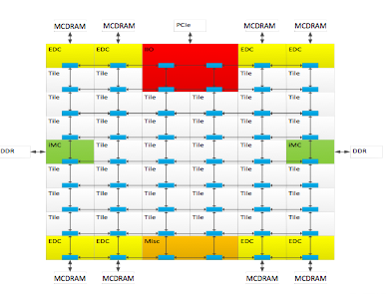
Xeon Phi (Knights Landing)
72 cores, arranged as 6 x 6 mesh of tiles (2 cores/tile)
YX routing of messages:
Move in Y
“Turn”
Move in X
Notes:
72 cores, paired up, so 36 caches / nodes, 6x6

Slide 27
Torus
Characteristics of mesh topology are different based on whether node is near edge or middle of network (torus topology introduces new links to avoid this problem)
Still O(N) cost, but higher cost than 2D grid
Higher path diversity and bisection BW than mesh
Higher complexity
Difficult to layout on chip
Unequal link lengths
2D Torus

Slide 28
Folded Torus
Interleaving rows & columns eliminates need for long connections
All connections doubled in length
16
16
Torus
Folded Torus
00
10
20
30
00
10
30
20
01
11
21
31
01
11
31
21
02
12
22
32
03
13
33
23
03
13
23
33
02
12
32
22

Slide 29
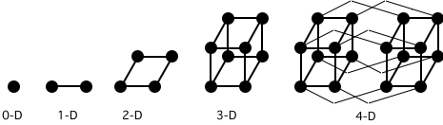
Hypercube
Low latency: O(lg N)
Radix: O(lg N)
Number of links O(N lg N)
6D hypercube used in 64-core Cosmic Cube computer developed at Caltech in the 80s
SGI Origin used a hypercube
1101
1111
1100
0101
0111
1110
0100
1001
1011
0110
1000
1010
0001
0011
0000
0010
Notes:
bisection is N/2

Slide 30
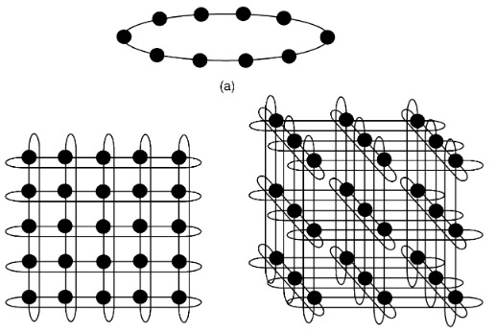
Generalizing Torii and Hypercubes
k-ary n-cube
Rings of k nodes
Connected in n dimensions
(10,1)
(5,2)
(3,3)
(2,0)
(2,1)
(2,2)
(2,3)
(2,4)

Slide 31
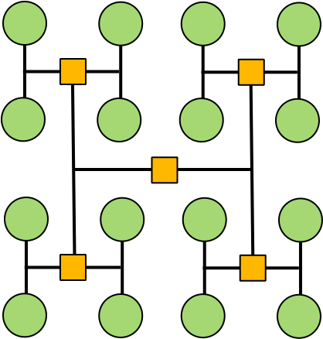
Trees
Planar, hierarchical topology
Like mesh/torus, good when traffic has locality
Latency: O(lg N)
Use “fat trees” to alleviate root bandwidth problem (higher bandwidth links near root)
0
2
8
10
1
3
9
11
4
6
12
14
5
7
13
15
0
1
2
3
4
5
6
7
H-Tree
Fat Tree
Notes:
Q. What’s the latency
Q. What’s the problem with a tree (think: bisection BW)
Solution: fat trees
The Fat Tree network was invented by MIT Prof. Charles Leiserson and was used as the interconnection network in the Thinking Machines CM-5 supercomputer developed in the 90s. A CM-5 was featured in the movie Jurassic Park.

Slide 32
Tree Routing
Getting from 1 to 2:
1 = 001₂
2 = 010₂
Getting from 3 to 6:
3 = 011₂
6 = 110₂
Upward:
Until have common ancestor
Downward:
0 → left, 1 → right
0
1
2
3
4
5
6
7

Slide 33
Fat Tree
Charles Leiserson, 1985
Increase bandwidth between nodes as move upward
O(N) bisection bandwidth
Routing:
Like tree routing, but randomly choose when multiple links possible
0
1
2
3
4
5
6
7

Slide 34
Constant-Width Fat Tree
Sometimes called “Folded Clos Network”
All nodes fixed degree
Simpler hardware design
Used in Infiniband networks
0
1
2
3
4
5
6
7

Slide 35
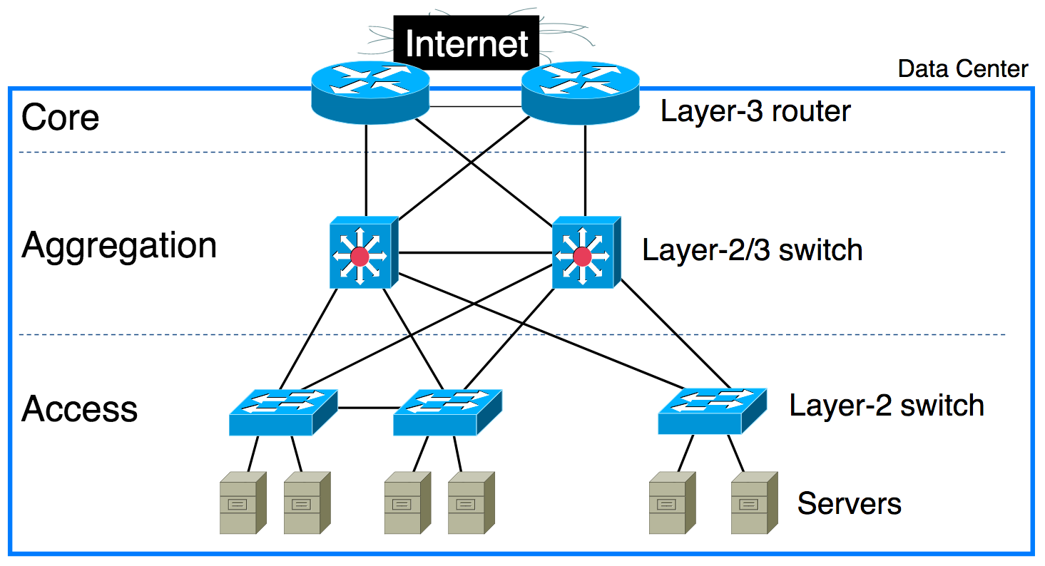
Data Center Networks
Requirements
Provide connectivity between 1K–10K nodes in data center
High bisection bandwidth
Low cost
Traditional Design: Hierarchy of Ethernet Switches

Slide 36
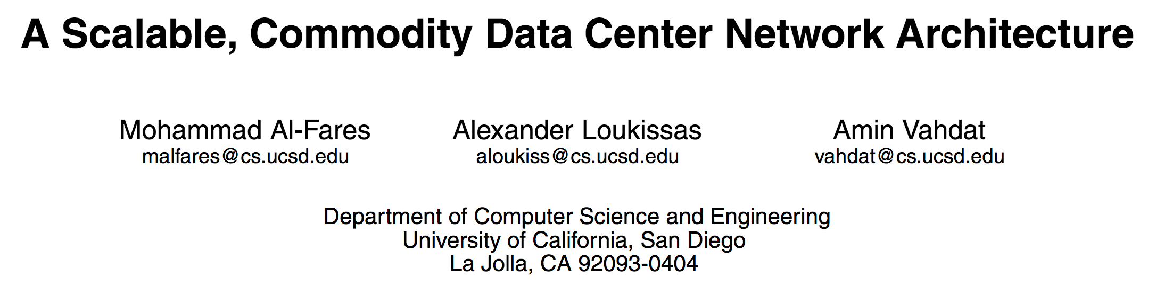
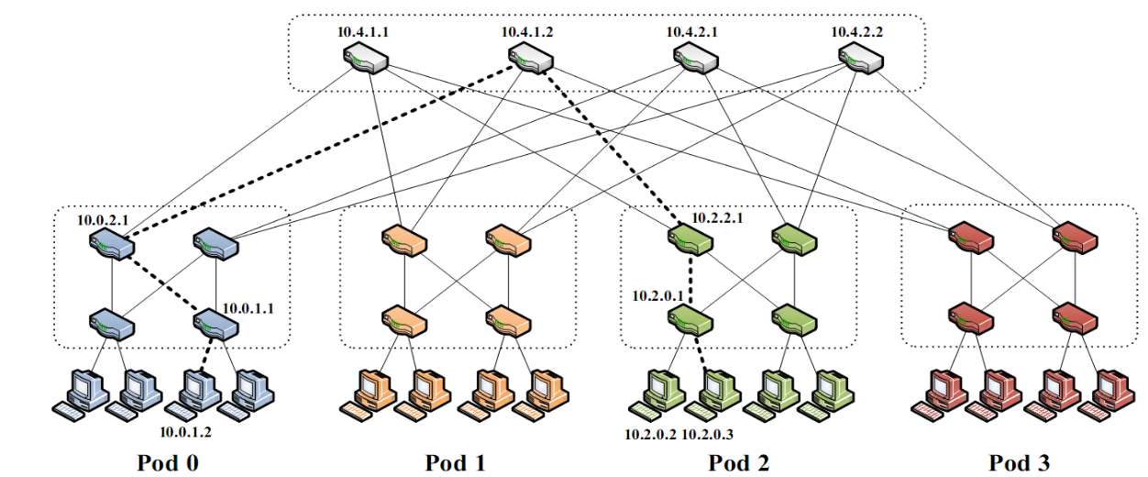
Clos/Fat-Tree Networks for Data Centers
Many copies of identical switches
More tolerant of failures
Can implement with IP-based protocols

Slide 37
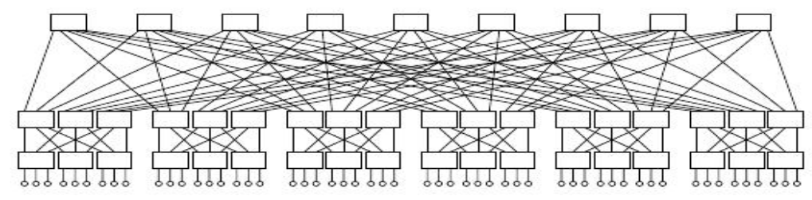
Generalizing Clos Network
k-ary fat tree
Basic unit is k-ported switch
E.g., k = 6:
Connect k³/4 hosts with 5k²/4 switches
Bisection bandwidth = k³/4

Slide 38
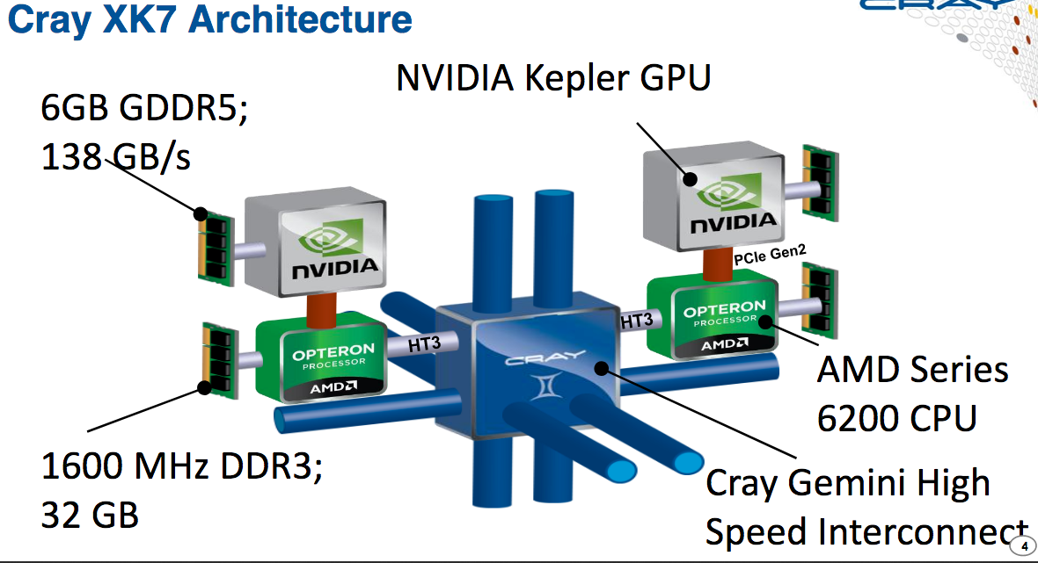
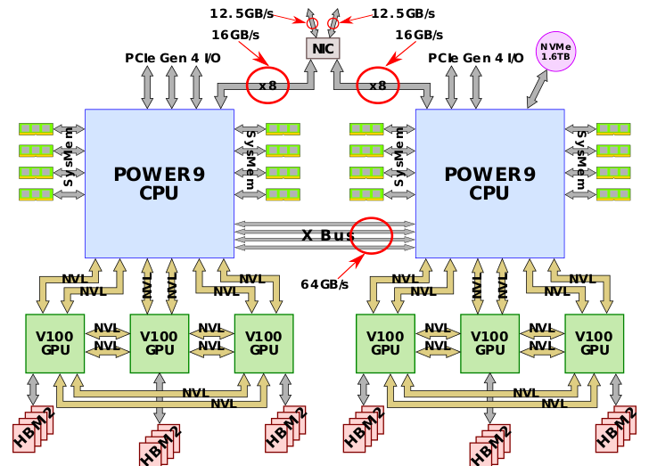
Supercomputer Networks
Oak Ridge Titan
Fastest Computer in 2013
3D Torus Network
18,688 nodes
~ 26 x 26 x 28
Oak Ridge Summit
Fastest in 2018
3-level fat tree
4,608 nodes
~ k = 28

Slide 39
Multi-stage logarithmic
Indirect network with multiple switches between terminals
Cost: O(N lg N)
Latency: O(lg N)
Many variations: Omega, butterfly, etc…
000
001
010
011
100
101
110
111
0
0
000
001
010
011
100
101
110
111
1
1
2
2
3
3
4
4
5
5
6
6
7
7
Omega Network
Notes:
log n steps
cost is n lg n because lg n steps * n/2 each step
how do you route to …
bit pattern tells you how to route (each stage, look at corresponding bit in destination)

Slide 40
Multi-stage logarithmic Routing
Route from 1 to 6
6 = 110₂
1 → down, 0 → up
000
001
010
011
100
101
110
111
0
0
000
001
010
011
100
101
110
111
1
1
2
2
3
3
4
4
5
5
6
6
7
7
Omega Network
Notes:
log n steps
cost is n lg n because lg n steps * n/2 each step
how do you route to …
bit pattern tells you how to route (each stage, look at corresponding bit in destination)

Slide 41
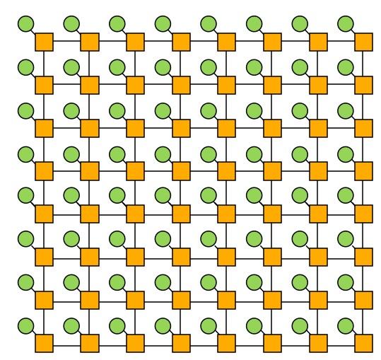
Review: network topologies
Topology
Direct/Indirect
Blocking/ Non-blocking
Cost
Latency
Crossbar Indirect Non-blocking O(N²)
O(1)
Multi-stage log. Indirect Blocking (one discussed in class is, others are not)
O(N lg N) O(lg N)
Mesh Direct Blocking
O(N) O(sqrt(N)) (average)
Notes:
bisection: mesh (sqrt(N)), torus 2 x mesh

Slide 42
Buffering and flow control

Slide 43
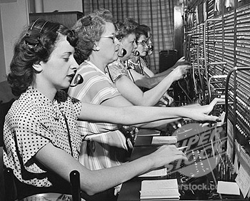

Circuit switching vs. packet switching
Circuit switching sets up a full path (acquires all resources) between sender and receiver prior to sending a message
Establish route (reserve links) then send all data for message
Higher bandwidth transmission (no per-packet link mgmt overhead)
Does incur overhead to set up/tear down path
Reserving links can result in low utilization
Packet switching makes routing decisions per packet
Route each packet individually (possibly over different network links)
Opportunity to use link for a packet whenever link is idle
Overhead due to dynamic switching logic during transmission
No setup/tear down overhead
Notes:
how many of you have taken a networking class
once again, infringement on other topics

Slide 44
Granularity of communication
Message
Unit of transfer between network clients (e.g., cores, memory)
Can be transmitted using many packets
Packet
Unit of transfer for network
Can be transmitted using multiple flits (will discuss later)
Flit (flow control unit)
Packets broken into smaller units called “flits”
Flit: (“flow control unit”) a unit of flow control in the network
Flits become minimum granularity of routing/buffering

Slide 45
Packet format
A packet consists of:
Header:
Contains routing and control information
At start of packet to router can start forwarding early
Payload/body: containing the data to be sent
Tail
Contains control information, e.g., checksum code for error detection
Generally located at end of packet so it can be generated “on the way out”
(sender computes checksum, appends it to end of packet)
Packet
Header
Payload/body
Tail

Slide 46
Handling contention
Scenario: two packets need to be routed onto the same outbound link at the same time
Options:
Buffer one packet, send it over link later
Drop one packet
Reroute one packet (deflection)
In this lecture: we only consider buffering *
Packet 1
Packet 2
* But recent research has looked at using bufferless networks with deflection routing
as a power-efficient interconnect for chip multiprocessors.
Notes:
Q. what can we do?
Q. what happens if we drop one and try again?
Q. why doesn’t this happen in a circuit switched network

Slide 47
Circuit-switched routing
High-granularity resource allocation
Main idea: pre-allocate all resources (links across multiple switches) along entire network path for a message (“setup a flow”)
Costs
Needs setup phase (“probe”) to set up the path (and to tear it down and release the resources when message complete)
Lower link utilization. Transmission of two messages cannot share same link (even if some resources on a preallocated path are no longer utilized during a transmission)
Benefits
No contention during transmission due to preallocation, so no need for buffering
Arbitrary message sizes (once path is set up, send data until done)
Source
Dest
Reserved
Link
Reserved
Link
Reserved
Link
Notes:
costs are setup and tear down
but once you’re ready, you’re ready

Slide 48
Store-and-forward (packet-based routing)
Packet copied entirely into network switch before moving to next node
Flow control unit is an entire packet
Different packets from the same message can take different routes, but all data in a packet is transmitted over the same route
Requires buffering for entire packet in each router
High per-packet latency (latency = packet transmission time on link x network distance)
Source
Busy Link
Busy Link
One packet
Packet Buffer
Packet Buffer
Packet Buffer
Busy Link
Packet Buffer
Packet Buffer
Packet Buffer
Destination
Note to students: in lecture this slide was animated and the final build shown here is not illustrative of store-and-forward routing concept (please refer to lecture video)
Notes:
Q. problem: latency
Q. Can we do better on latency?

Slide 49
Cut-through flow control (also packet-based)
Switch starts forwarding data on next link as soon as packet header is received (header determines how much link bandwidth packet requires + where to route)
Result: reduced transmission latency
Cut-through routing reduces to store-and-forward under high contention. Why?
Source
One Packet
Busy Link
Busy Link
Packet Buffer
Packet Buffer
Packet Buffer
Busy Link
Packet Buffer
Packet Buffer
Packet Buffer
Destination
Store and forward solution from previous slide: 3 hops x 4 units of time to transmit packet over a single link = 12 units of time
Cut-through solution: 3 steps of latency for head of packet to get to destination + 3 units of time for rest of packet = 6 units of time
Note to students: in lecture this slide was animated and the final build shown here is not illustrative of the cut-through routing concept (please refer to lecture video or Powerpoint version)
Notes:
Go back through steps (store and forward= 12 steps (3 hops * 4)
Here: 8 steps. (5 latency + 3 rest of packet)
Q. What if link not available?
NOTE: ALL THIS DONE AT PACKET GRANULARITY. THE OPERATION IS JUST SEND PACKET

Slide 50
Cut-through flow control
If output link is blocked (cannot transmit head), transmission of tail can continue
Worst case: entire message is absorbed into a buffer in a switch (cut-through flow control degenerates to store-and-forward in this case)
Requires switches to have buffering for entire packet, just like store-and-forward

Slide 51
Wormhole flow control
Flit (flow control unit)
Packets broken into smaller units called “flits”
Flit: (“flow control unit”) a unit of flow control in the network
Flits become minimum granularity of routing/buffering
Recall: up until now, packets were the granularity of transfer AND flow control and buffering (store-and-forward, cut-through routing)
Message
Packet
Packet
Head
Flit
Flit
Flit
Flit
Flit
Flit
Flit
Tail
Flit
Head
Flit
Flit
Flit
Flit
Flit
Flit
Flit
Tail
Flit

Slide 52
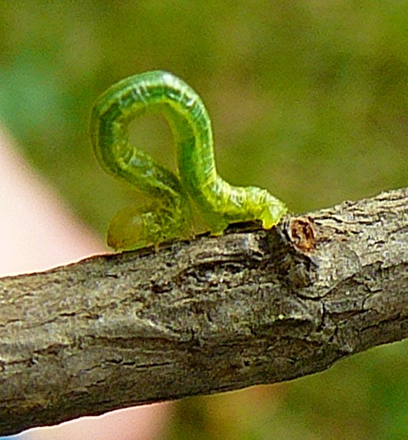
Wormhole flow control
Routing information only in head flit
Body flits follows head, tail flit flows body
If head flit blocks, rest of packet stops
Completely pipelined transmission
For long messages, latency is almost entirely independent of network distance. Why?
Body flits (2 in this example)
Source
Tail flit
T
B1
B0
Busy Link
Busy Link
Flit Buffer
Flit Buffer
Flit Buffer
Example:
Four-flit packet sent using wormhole flow control
Busy Link
B0
Head flit
T
H
B1
H
Flit Buffer
Flit Buffer
Flit Buffer
Destination
Notes:
wait for head

Slide 53
Problem: head-of-line blocking
Flit Buffer
Flit Buffer
Flit Buffer
Head flit for blue packet:(route is free, but blocked behind gray packet in buffer)
Idle link
(reserved)
Idle link
(reserved)
Flit Buffer
Flit Buffer
Flit Buffer
Idle link
(reserved)
Blue flits to be routed this way to their dest (this link is free)
Flit Buffer
Flit Buffer
Flit Buffer
Head flit for gray packet:
(blocked waiting for this busy link)
Notes:
two flows here
first describe gray

Slide 54
Virtual channel flow control
Multiplex multiple operations over single physical channel
Divide switch’s input buffer into multiple buffers sharing a single physical channel
Reduces head-of-line blocking
Packet in flow 0: transmitting
Buf 0
Buf 1
Buf 0
Buf 1
Packet in flow 1: Blocked waiting for this link
See “Virtual Channel Flow Control,” [Dally ISCA 1990]

Slide 55
Other uses of virtual channels
Deadlock avoidance
Can be used to break cyclic dependency of resources
Prevent cycles by ensuring requests and responses use different virtual channels
“Escape” VCs: retain at least one virtual channel that uses deadlock-free routing
Prioritization of traffic classes
Provide quality-of-service guarantees
Some virtual channels have higher priority than others

Slide 56
Current research topics
Energy efficiency of interconnections
Interconnect can be energy intensive (~35% of total chip power in MIT RAW research processor)
Bufferless networks
Other techniques: turn on/off regions of network, use fast and slow networks
Prioritization and quality-of-service guarantees
Prioritize packets to improve multi-processor performance (e.g., some applications may be more sensitive to network performance than others)
Throttle endpoints (e.g., cores) based on network feedback
New/emerging technologies
Die stacking (3D chips)
Photonic networks-on-chip (use optical waveguides instead of wires)
Reconfigurable devices (FPGAs): create custom interconnects tailored to application (see CMU projects: CONNECT, CoRAM, Shrinkwrap)

Slide 57
Summary
The performance of the interconnection network in a modern multi-processor is critical to overall system performance
Buses do not scale to many nodes
Historically interconnect was off-chip network connecting sockets, boards, racks
Today, all these issues apply to the design of on-chip networks
Network topologies differ in performance, cost, complexity tradeoffs
e.g., crossbar, ring, mesh, torus, multi-stage network, fat tree, hypercube
Challenge: efficiently routing data through network
Interconnect is a precious resource (communication is expensive!)
Flit-based flow control: fine-grained flow control to make good use of available link bandwidth
If interested, much more to learn about (not discussed in this class): ensuring quality-of-service, prioritization, reliability, deadlock, livelock, etc.
Notes:
now think about last time when we went through many steps to issue a load instruction. We didn’t even talk about the network

