Slide 1
Why Parallelism?
Why Efficiency?
Lecture 1:

Slide 2

Hi!
Plus . . .
An evolving collection of teaching assistants
Randy Bryant
Nathan Beckmann
Notes:
introduce staff
Address the wait list
Q. Why are you here.
One reason: you want to make your programs faster.

Slide 3
Getting into the Class
Status (Mon Jan. 13, 09:30)
157 students enrolled
103 on wait list
175 max. enrollment
~20 slots
If you are registered
Do Assignment 1
Due Jan. 29
If find too challenging, then please drop by Jan. 27
Clearing Wait List
Complete Assignment 1 by Jan. 22, 23:00
No Autolab account required
We will enroll top-performing students
It’s that simple!
You will know by Jan. 27

Slide 4
What will you be doing in this course?

Slide 5
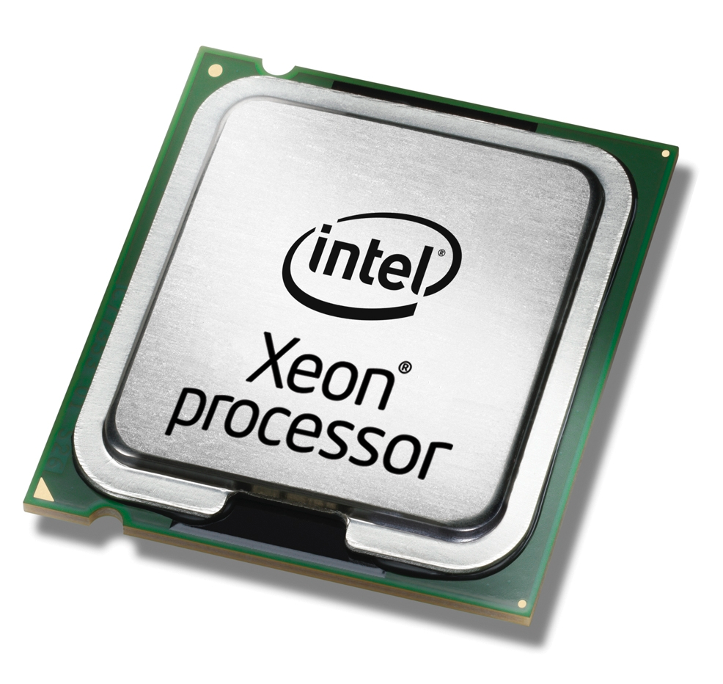
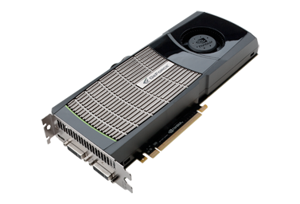
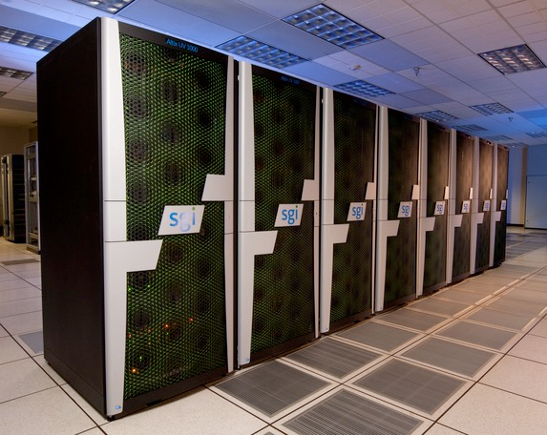
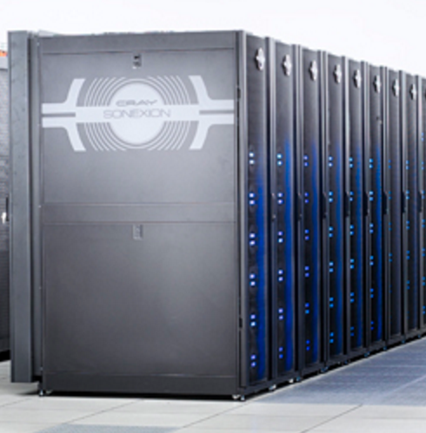
Assignments
Four programming assignments
First assignment is done individually, the rest will be done in pairs
Each uses a different parallel programming environment
Each also involves measurement, analysis, and tuning
Assignment 1: SIMD and multi-core parallelism
Assignment 2: CUDA programming on NVIDIA GPUs
Assignment 3: Parallel Programming via a Shared-Address Space Model
Assignment 4: Parallel Programming via a Message Passing Model

Slide 6
Final project
6-week self-selected final project
Performed in groups (by default, 2 people per group)
Keep thinking about your project ideas starting TODAY!
Poster session at end of term
Check out previous projects:
http://15418.courses.cs.cmu.edu/spring2016/competition
http://15418.courses.cs.cmu.edu/fall2017/article/10
http://www.cs.cmu.edu/afs/cs.cmu.edu/academic/class/15418-s18/www/15418-s18-projects.pdf
http://www.cs.cmu.edu/afs/cs.cmu.edu/academic/class/15418-s19/www/15418-s19-projects.pdf

Slide 7
Exercises
Five homework exercises
Scheduled throughout term
Designed to prepare you for the exams
We will grade your work only in terms of participation
Did you make a serious attempt?
Only a participation grade will go into the gradebook

Slide 8
Grades
40% Programming assignments (4)
30% Exams (2)
25% Final project
5% Exercises
Each student gets up to five late days on programming assignments (see syllabus for details)

Slide 9
Getting started
Visit course home page
http://www.cs.cmu.edu/~418/
Sign up for the course on Piazza
http://piazza.com/cmu/spring2020/1541815618
Textbook
There is no course textbook, but please see web site for suggested references
Find a Partner
Assignments 2–4, final project

Slide 10
Regarding the class meeting times
Class MWF 3:00–4:20
Lectures (mostly)
Some designated “Recitations”
Targeted toward things you need to know for an upcoming assignment
No classes last part of the term
Let you focus on projects

Slide 11
Collaboration (Acceptable & Unacceptable)
Do
Become familiar with course policy
Talk with instructors, TAs, partner
Brainstorm with others
Use general information on WWW
Don’t
Copy or provide code to anyone
Use information specific to 15-418/618 on WWW
Leave your code in accessible place
Now or in the future
http://www.cs.cmu.edu/~418/academicintegrity.html

Slide 12
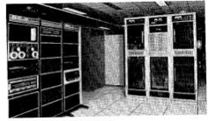


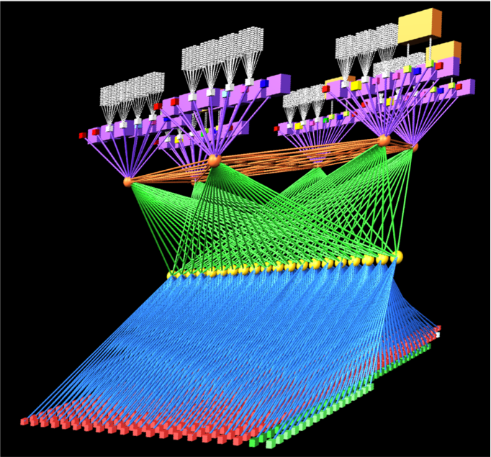
A Brief History of Parallel Computing
Initial Focus (starting in 1970s): “Supercomputers” for Scientific Computing
C.mmp at CMU (1971)
16 PDP-11 processors
Cray XMP (circa 1984)
4 vector processors
Thinking Machines CM-2 (circa 1987)
65,536 1-bit processors +
2048 floating-point co-processors
Bridges at the Pittsburgh
Supercomputer Center
800+ compute nodes
Heterogenous Structure

Slide 13


A Brief History of Parallel Computing
Initial Focus (starting in 1970s): “Supercomputers” for Scientific Computing
Another Driving Application (starting in early ‘90s): Databases
Especially, handling millions of transactions per second for web services
Sun Enterprise 10000 (circa 1997)
16 UltraSPARC-II processors
Oracle Supercluster M7 (today)
4 X 32-core SPARC M2 processors
RIP 2019. Killed by cloud computing

Slide 14
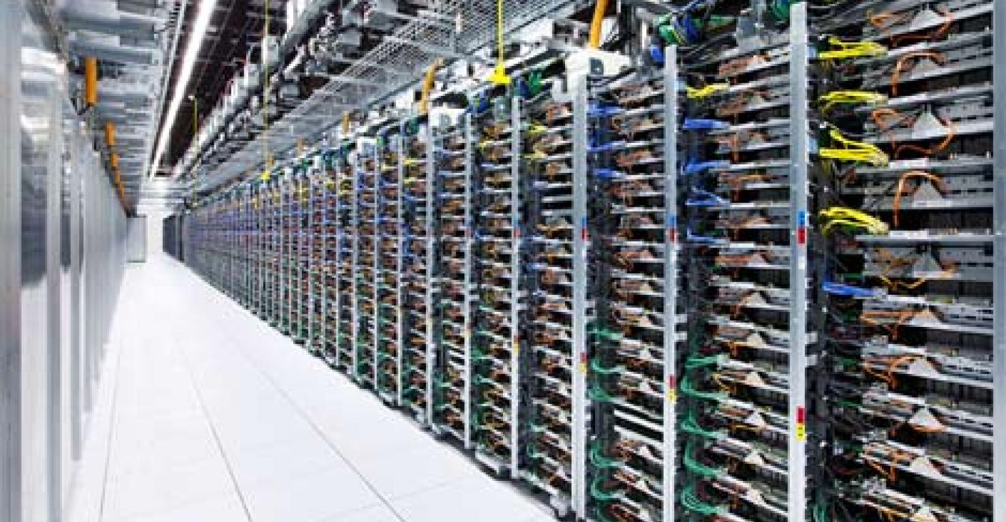
A Brief History of Parallel Computing
Cloud computing (2000–present)
Build out massive centers with many, simple processors
Connected via LAN technology
Program using distributed-system models
Not really the subject of this course (take 15-440)

Slide 15
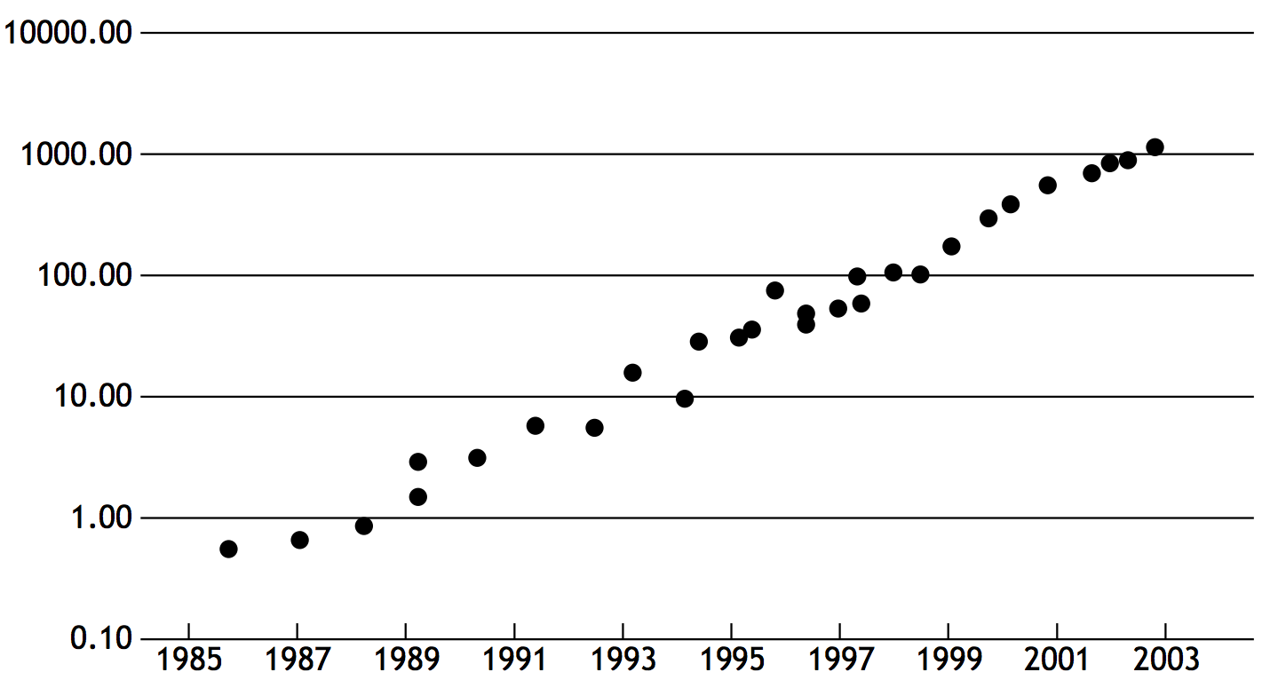
Setting Some Context
Before we continue our multiprocessor story, let’s pause to consider:
Q: what had been happening with single-processor performance?
A: since forever, they had been getting exponentially faster
Why?
Image credit: Olukutun and Hammond, ACM Queue 2005

Slide 16
A Brief History of Processor Performance
Wider data paths
4 bit → 8 bit → 16 bit → 32 bit → 64 bit
More efficient pipelining
e.g., 3.5 Cycles Per Instruction (CPI) → 1.1 CPI
Exploiting instruction-level parallelism (ILP)
“Superscalar” processing: e.g., issue up to 4 instructions/cycle
“Out-of-order” processing: extract parallelism from instruction stream
Faster clock rates
e.g., 10 MHz → 200 MHz → 3 GHz
During the 80s and 90s: large exponential performance gains
and then…

Slide 17
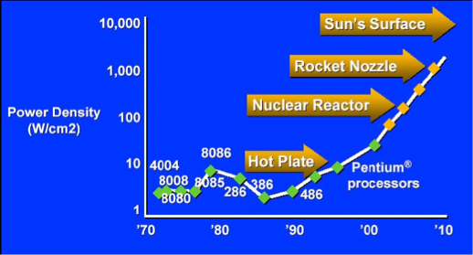
A Brief History of Parallel Computing
Initial Focus (starting in 1970s): “Supercomputers” for Scientific Computing
Another Driving Application (starting in early ‘90s): Databases
Inflection point in 2004: Intel hits the Power Density Wall
Pat Gelsinger, ISSCC 2001

Slide 18
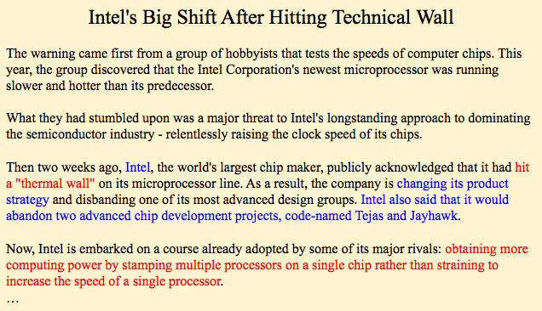
From the New York Times
John Markoff, New York Times, May 17, 2004

Slide 19
ILP tapped out + end of frequency scaling
Processor clock rate stops increasing
No further benefit from ILP
= Transistor density
= Clock frequency
= Power
= Instruction-level parallelism (ILP)
Image credit: “The free Lunch is Over” by Herb Sutter, Dr. Dobbs 2005
Notes:
first point out end of ILP
then point out lack of clock scaling
why? because of the light blue line
comment on Moore’s law (transistor count)

Slide 20
Programmer’s Perspective on Performance
Question: How do you make your program run faster?
Answer before 2004:
Just wait 6 months, and buy a new machine!
(Or if you’re really obsessed, you can learn about parallelism.)
Answer after 2004:
You need to write parallel software.

Slide 21




Parallel Machines Today
Examples from Apple’s product line:
Mac Pro
28 Intel Xeon W cores
iPhone XS
6 CPU cores
(2 fast +
4 low power)
6 GPU cores
iMac Pro
18 Intel Xeon W cores
MacBook Pro Retina 15”
8 Intel Core i9 cores
(images from apple.com)

Slide 22
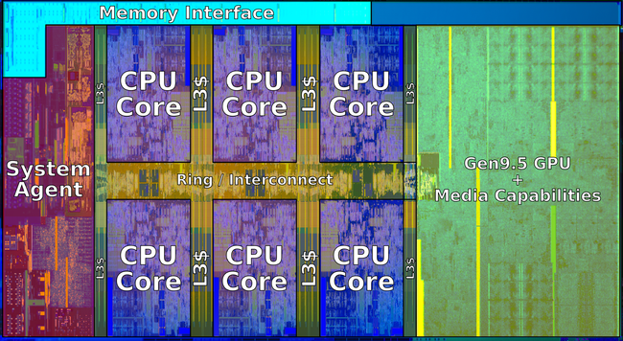
Intel Coffee Lake Core i9 (2019)
6-core CPU + multi-core GPU integrated on one chip

Slide 23
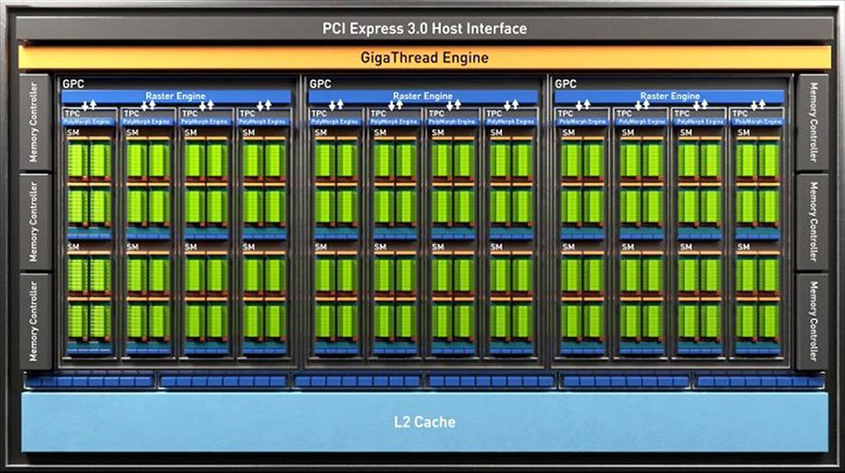
NVIDIA GeForce GTX 1660 Ti GPU (2019)
24 major processing blocks
(but much, much more parallelism available... details coming soon)
Notes:
2048 cores / 16 SM = 128 lanes per sm = 32 * 4

Slide 24
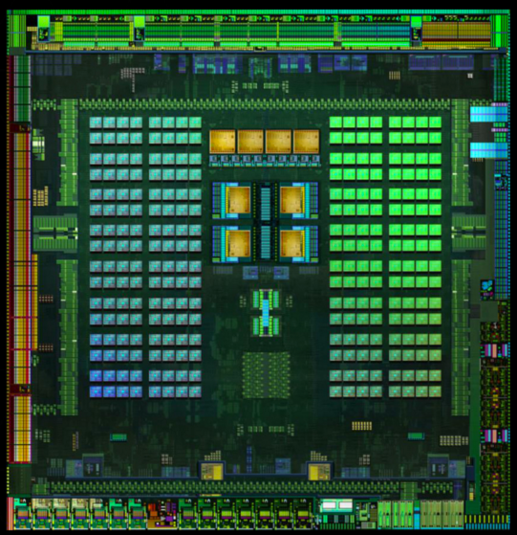
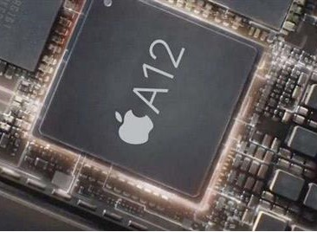
Mobile parallel processing
Power constraints heavily influence design of mobile systems
Apple A12: (in iPhone XR)
4 CPU cores
4 GPU cores
Neural net engine
+ much more
NVIDIA Tegra K1:
Quad-core ARM A57 CPU + 4 ARM A53 CPUs +
NVIDIA GPU + image processor...

Slide 25

Supercomputing
Today: clusters of multi-core CPUs + GPUs
Oak Ridge National Laboratory: Summit (#1 supercomputer in world)
4,608 nodes
Each with two 22-core CPUs + 6 GPUs
Notes:
299,008 total CPU cores

Slide 26
Supercomputers vs. Cloud Systems
Supercomputers
Data Center Clusters
Target Applications
Few, big tasks
Customized
Optimized for reliability
Low latency interconnect
Minimal
Static scheduling
Low-level, processor-centric model
Programmer manages resources
Many small tasks
Consumer grade
Optimized for low cost
Throughput-optimized interconnect
Provides reliability
Dynamic allocation
High level, data-centric model
Let run-time system manage resources
Hardware
Run-Time System
Application Programming

Slide 27
Supercomputer / Data Center Overlap
Supercomputer features in data centers
Data center computers sometimes used to solve problem
E.g., learn neural network for language translation
Data center computers sometimes equipped with GPUs
Data center features in supercomputers
Also used to process many small–medium jobs

Slide 28
What is a parallel computer?
Notes:
STEP 1: Time one student (16 numbers ~ 25 seconds -- 115)
There’s fundamental limit to how fast he/she is going to be able to do this
Q. HOW CAN WE MAKE IT FASTER (practice to get faster?)
STEP 2: Bring in a second student, but don’t let them talk (have to walk over) (8 numbers each -- 117)
Q. WHAT WAS THE TIME?
STEP 3: Let them shout.

Slide 29
One common definition
A parallel computer is a collection of processing elements that cooperate to solve problems quickly
We care about performance *
We care about efficiency
We’re going to use multiple processors to get it
* Note: different motivation from “concurrent programming” using pthreads in 15-213
Notes:
fast = performance
multiple processing elements
so I’ve got a problem

Slide 30
DEMO 1
(This semester’s first parallel program)
Notes:
STEP 1: Time one student (16 numbers ~ 25 seconds -- 115)
There’s fundamental limit to how fast he/she is going to be able to do this
Q. HOW CAN WE MAKE IT FASTER (practice to get faster?)
STEP 2: Bring in a second student, but don’t let them talk (have to walk over) (8 numbers each -- 117)
Q. WHAT WAS THE TIME?
STEP 3: Let them shout.

Slide 31
Speedup
One major motivation of using parallel processing: achieve a speedup
For a given problem:
speedup( using P processors ) =
execution time (using 1 processor)
execution time (using P processors)
Notes:
I’d like to define speedup
Q. Did we achieve a speedup?
Q. What was the best speedup we could possibly achieve?

Slide 32
Class observations from demo 1
Communication limited the maximum speedup achieved
In the demo, the communication was telling each other the partial sums
Minimizing the cost of communication improves speedup
Moving students (“processors”) closer together (or let them shout)

Slide 33
DEMO 2
(scaling up to four “processors”)
Notes:
main point: uneven distribution of work (16 total ,— 118) SECOND GROUP = 118
How to improve:
— work stealing
— or putting one big pile on the table (dynamic assignment)

Slide 34
Class observations from demo 2
Imbalance in work assignment limited speedup
Some students (“processors”) ran out work to do (went idle), while others were still working on their assigned task
Improving the distribution of work improved speedup

Slide 35
DEMO 3
(massively parallel execution)
Notes:
total age of everyone in the class
maximum number of units taken (can only communicate with your neighbor)

Slide 36
Class observations from demo 3
The problem I just gave you has a significant amount of communication compared to computation
Communication costs can dominate a parallel computation, severely limiting speedup
Notes:
what if I gave you 1 million numbers?

Slide 37
Course theme 1:
Designing and writing parallel programs ... that scale!
Parallel thinking
Decomposing work into pieces that can safely be performed in parallel
Assigning work to processors
Managing communication/synchronization between the processors so that it does not limit speedup
Abstractions/mechanisms for performing the above tasks
Writing code in popular parallel programming languages
Notes:
so what is this course about? (why are we here)

Slide 38
Course theme 2:
Parallel computer hardware implementation: how parallel computers work
Mechanisms used to implement abstractions efficiently
Performance characteristics of implementations
Design trade-offs: performance vs. convenience vs. cost
Why do I need to know about hardware?
Because the characteristics of the machine really matter
(recall speed of communication issues in earlier demos)
Because you care about efficiency and performance
(you are writing parallel programs after all!)
Notes:
Hardware!
do things differently depending on characteristics of machine
just saw the example

Slide 39
Course theme 3:
Thinking about efficiency
FAST != EFFICIENT
Just because your program runs faster on a parallel computer, it does not mean it is using the hardware efficiently
Is 2x speedup on computer with 10 processors a good result?
Programmer’s perspective: make use of provided machine capabilities
HW designer’s perspective: choosing the right capabilities to put in system (performance/cost, cost = silicon area?, power?, etc.)
Notes:
Q. is it a good result? Generally no. But if you care about getting something done, maybe yes!
Game example
Computational finance example
Weather forecasting, fraud detection example
Depends on needs

Slide 40
Fundamental Shift in CPU Design Philosophy
Before 2004:
within the chip area budget, maximize performance
increasingly aggressive speculative execution for ILP
After 2004:
area within the chip matters (limits # of cores/chip):
maximize performance per area
power consumption is critical (battery life, data centers)
maximize performance per Watt
upshot: major focus on efficiency of cores

Slide 41
Summary
Today, single-thread performance is improving very slowly
To run programs significantly faster, programs must utilize multiple processing elements
Which means you need to know how to write parallel code
Writing parallel programs can be challenging
Requires problem partitioning, communication, synchronization
Knowledge of machine characteristics is important
I suspect you will find that modern computers have tremendously more processing power than you might realize, if you just use it!
Welcome to 15-418!
Notes:
remember to sign up on the web site and on Piazza.

