Slide 1
Identifying Performance Limiters
Paulius Micikevicius| NVIDIA
August 23, 2011
“Re-presented” by Gregory Kesden, 15-418, Spring 2018

Slide 2
Performance Optimization Process
Use appropriate performance metric for each kernel
For example, Gflops/s don’t make sense for a bandwidth-bound kernel
Determine what limits kernel performance
Memory throughput
Instruction throughput
Latency
Combination of the above
Address the limiters in the order of importance
Determine how close to the HW limits the resource is being used
Analyze for possible inefficiencies
Apply optimizations
Often these will just fall out from how HW operates
2

Slide 3
3 Ways to Assess Performance Limiters
Algorithmic
Based on algorithm’s memory and arithmetic requirements
Least accurate: undercounts instructions and potentially memory accesses
Profiler
Based on profiler-collected memory and instruction counters
More accurate, but doesn’t account well for overlapped memory and arithmetic
Code modification
Based on source modified to measure memory-only and arithmetic-only times
Most accurate, however cannot be applied to all codes
3

Slide 4
Things to Know About Your GPU
Theoretical memory throughput
For example, Tesla M2090 theory is 177 GB/s
Theoretical instruction throughput
Varies by instruction type
refer to the CUDA Programming Guide (Section 5.4.1) for details
Tesla M2090 theory is 665 GInstr/s for fp32 instructions
Half that for fp64
I’m counting instructions per thread
Rough “balanced” instruction:byte ratio
For example, 3.76:1 from above (fp32 instr : bytes)
Higher than this will usually mean instruction-bound code
Lower than this will usually mean memory-bound code
4

Slide 5
Algorithmic Analysis
Approach:
Compute the ratio of arithmetic operations to bytes accessed in the algorithm (for example, per output element)
Compare to the balanced ratio for your GPU
Better than nothing, but not very accurate:
Undercounts instructions: control flow, address calculation, etc.
May undercount memory accesses: ignores cache line sizes
Example: vector add
Read two 4-byte words, add, write one 4-byte word
1 instr : 12 bytes
Much lower than 3.76:1, thus memory bound
5

Slide 6
Analysis with the Profiler
Relevant profiler counters:
instructions_issued
Incremented by 1 per warp, counter is for one SM
dram_reads, dram_writes
Incremented by 1 per 32B access to DRAM
Note that the VisualProfiler converts each of the above to 2 counters
These simply get added together, refer to the Visual Profiler User Guide for details
You’ll need to do this yourself if you’re using command-line profiling
If your code hits in L2 cache a lot, you may want to look at L2 counters instead (accesses to L2 are still expensive compared to arithmetic)
Compute instruction:byte ratio and compare to the balanced one:
(number of SMs) * 32 * instructions_issued : 32B * (dram_reads + dram_writes)
Example: vector add
1.49:1, lower than 3.76 so memory-bound
6
© NVIDIA 2011

Slide 7
Another Way to Use the Profiler
VisualProfiler will report instruction and memory throughputs
IPC (instructions per clock) for instructions
GB/s achieved for memory (and L2)
Compare those with the theory for the HW
Profiler will also report the theoretical best
Though for IPC it assumes fp32 instructions, it DOES NOT take instruction mix into consideration
If one of the metrics is close to the hw peak, you’re likely limited by it
If neither metric is close to the peak, then unhidden latency is likely an issue
“close” is approximate, I’d say 70% of theory or better
Example: vector add
IPC: 0.55 out of 2.0
Memory throughput: 130 GB/s out of 177 GB/s
Conclusion: memory bound
7
© NVIDIA 2011

Slide 8
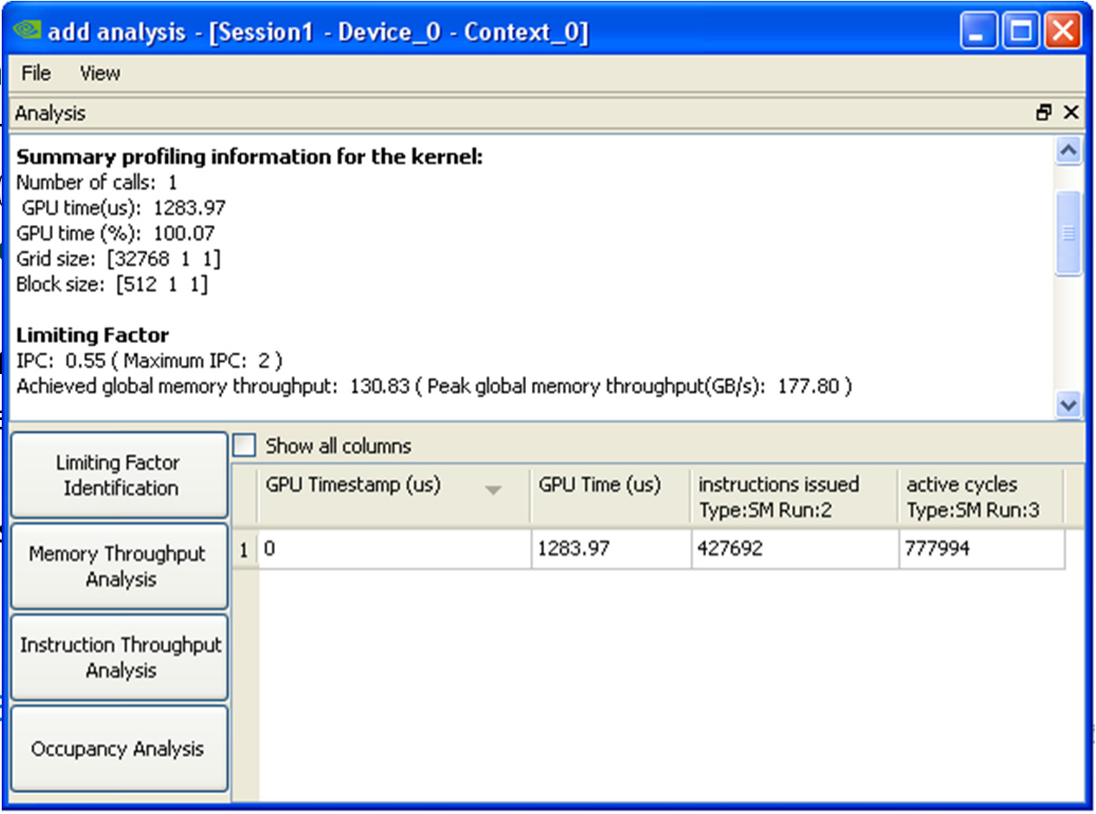
Another Way to Use the Profiler
VisualProfiler will report in
IPC (instructions per clock) f
GB/s achieved for memory (
Compare those with the th
Profiler will also report the
Though for IPC it assumes f
If one of the metrics is close
If neither metric is close to
“close” is approximate, I’d s
Example: vector add
IPC: 0.55 out of 2.0
Memory throughput: 130 G
Conclusion: memory bound
struction and memory throughputs
or instructions and L2)
eory for the HW
theoretical best
p32 instructions, it DOES NOT take instruction mix into consideration
to the hw peak, you’re likely limited by it
the peak, then unhidden latency is likely an issue ay 70% of theory or better
B/s out of 177 GB/s
8
© NVIDIA 2011

Slide 9
Notes on Instruction Counts
Undercount by algorithmic analysis
Algorithmic analysis assumed 1 instruction (add)
Actual code contains 17 instructions
You can actually check the machine-language assembly instructions
Compile into a .cubin file
Use cuobjdump tool (comes with CUDA toolkit) to get assembly from .cubin
Useful for checking instruction counts
Actual instruction counts could also be used to somewhat refine the theoretical IPC for the specific code
For example, if all instructions were fp64, the theoretical IPC is 1.0, not 2.0
9
© NVIDIA 2011

Slide 10
Notes on the Profiler
Most counters are reported per Streaming Multiprocessor (SM)
Not entire GPU
Exceptions: L2 and DRAM counters
A single run can collect a few counters
Multiple runs are needed when profiling more counters
Done automatically by the Visual Profiler
Have to be done manually using command-line profiler
Counter values may not be exactly the same for repeated runs
Threadblocks and warps are scheduled at run-time
So, “two counters being equal” usually means “two counters within a small delta”
Refer to the profiler documentation for more information

Slide 11
Analysis with Modified Source Code
Time memory-only and math-only versions of the kernel
Easier for codes that don’t have data-dependent control-flow or addressing
Gives you good estimates for:
Time spent accessing memory
Time spent in executing instructions
Comparing the times for modified kernels
Helps decide whether the kernel is mem or math bound
Shows how well memory operations are overlapped with arithmetic
Compare the sum of mem-only and math-only times to full-kernel time

Slide 12
Some Example Scenarios
time
mem math full
Memory-bound Good mem-math
overlap: latency not a problem
(assuming memory throughput is not low compared to HW theory)
12

Slide 13
Some Example Scenarios
time
mem math full
mem math full
Memory-bound
Math-bound
Good mem-math overlap: latency not a problem
(assuming memory throughput is not low compared to HW theory)
Good mem-math overlap: latency not a problem
(assuming instruction throughput is not low compared to HW theory)

Slide 14
Some Example Scenarios
time
mem math full
mem math full
mem math
full
Memory-bound
Math-bound
Balanced
Good mem-math overlap: latency not a problem
(assuming memory throughput is not low compared to HW theory)
Good mem-math overlap: latency not a problem
(assuming instruction throughput is not low compared to HW theory)
Good mem-math overlap: latency not a problem
(assuming memory/instr throughput is not low compared to HW theory)
14

Slide 15
Some Example Scenarios
time
mem math full
mem math full
mem math
full
mem math full
Memory-bound
Math-bound
Balanced
Memory and latency bound
Good mem-math overlap: latency not a problem
(assuming memory throughput is not low compared to HW theory)
Good mem-math overlap: latency not a problem
(assuming instruction throughput is not low compared to HW theory)
Good mem-math overlap: latency not a problem
(assuming memory/instr throughput is not low compared to HW theory)
Poor mem-math overlap: latency is a problem

Slide 16
Source Modification
Memory-only:
Remove as much arithmetic as possible
Without changing access pattern
Use the profiler to verify that load/store count is the same
Store-only:
Also remove the loads
Math-only:
Remove global memory accesses
Need to trick the compiler:
Compiler throws away all code that it detects as not contributing to stores
Put stores inside conditionals that always evaluate to false
Condition should depend on the value about to be stored (prevents other optimizations)
Condition outcome should not be known to the compiler

Slide 17
Source Modification for Read-only
global void add( float *output, float *A, float *B, int flag)
{
...
value = A[idx] + B[idx];
if( 1 == value * flag )
output[idx] = value;
If you compare only the flag, the compiler may move the computation into the conditional as well
}

Slide 18
Source Modification and Occupancy
Removing pieces of code is likely to affect register count
This could increase occupancy, skewing the results
Make sure to keep the same occupancy
Check the occupancy with profiler before modifications
After modifications, if necessary add shared memory to match the unmodified kernel’s occupancy
kernel<<< grid, block, smem, ...>>>(...)

Slide 19
Another Case Study
Analysis:
Time (ms):
– Full-kernel: 25.82
Instr:byte ratio = ~3.21
Good overlap between math and mem:
2.29 ms of math-only time (18%) is not overlapped with mem
App memory throughput: 72 GB/s
Mem-only:
Math-only:
23.53
12.52
Instructions issued:
– Full-kernel: 20,388,591
HW throughput is 125 GB/s
HW theory is 177 GB/s, so memory is not used efficiently
Mem-only:
Math-only:
10,034,799
14,683,776
Conclusion:
Code is more memory- than instruction-limited
IPC is 1.2 (60% of theory)
Memory throughput is 70%
Optimizations should focus on memory throughput first
Total DRAM requests
– Full-kernel: 101,328,372
– Mem-only: 101,328,372
– Math-only:
Memory is a larger portion of total time
Also note that application and hw throughputs are different
– More on this in upcoming webinar
0

Slide 20
Summary
Rough algorithmic analysis:
How many bytes needed, how many instructions
Profiler analysis:
Instruction count, memory access count
Check how close instruction and memory throughputs are to hw theory
Analysis with source modification:
Full version of the kernel
Memory-only version of the kernel
Math-only version of the kernel
Examine how these times relate and overlap
More details on memory- and instruction-optimizations
Upcoming webinars

Slide 21
Local Memory and Register Spilling
Paulius Micikevicius| NVIDIA

Slide 22
Local Memory
Name refers to memory where registers and other thread-
data is spilled
Usually when one runs out of SM resources
“Local” because each thread has its own private area
Details:
Not really a “memory” – bytes are stored in global memory
Differences from global memory:
Addressing is resolved by the compiler
Stores are cached in L1

Slide 23
LMEM Access Operation
A store writes a line to L1
If evicted, that line is written to L2
The line could also be evicted from L2, in which case it’s written to DRAM
A load requests the line from L1
If a hit, operation is complete
If a miss, then requests the line from L2
If a miss, then requests the line from DRAM
A store always happens before a load
Only GPU threads can access LMEM addresses

Slide 24
Fermi Memory Hierarchy
SM-0
SM-1
SM-N
Registers
Registers
Registers
L1
SMEM
L1
SMEM
L1
SMEM
L2
Global Memory (DRAM)

Slide 25
When is Local Memory Used?
Register spilling
Fermi hardware limit is 63 registers per thread
Programmer can specify lower registers/thread limits:
To increase occupancy (number of concurrently running threads)
-maxrregcount option to nvcc, launch_bounds () qualifier in the code
LMEM is used if the source code exceeds register limit
Arrays declared inside kernels, if compiler can’t resolve indexing
Registers aren’t indexable, so have to be placed in LMEM

Slide 26
How Does LMEM Affect Performance?
It could hurt performance in two ways:
Increased memory traffic
Increased instruction count
Spilling/LMEM usage isn’t always bad
LMEM bytes can get contained within L1
Avoids memory traffic increase
Additional instructions don’t matter much if code is not instruction-throughput limited

Slide 27
General Analysis/Optimization Steps
Check for LMEM usage
Compiler output
nvcc option: –Xptxas –v,–abi=no
Will print the number of lmem bytes for each kernel (only if kernel uses LMEM)
Profiler
Check the impact of LMEM on performance
Bandwidth-limited code:
Check how much of L2 or DRAM traffic is due to LMEM
Arithmetic-limited code:
Check what fraction of instructions issued is due to LMEM
Optimize:
Try: increasing register count, increasing L1 size, using non-caching loads

Slide 28
Register Spilling: Analysis
Profiler counters:
l1_local_load_hit, l1_local_load_miss, l1_local_store_hit, l1_local_store_miss
Counted for a single SM, incremented by 1 for each 128-byte transaction
Impact on memory
Any memory traffic that leaves SMs (goes to L2) is expensive
L2 counters of interest: read and write sector queries
Actual names are longer, check the profiler documentation
Incremented by 1 for each 32-byte transaction
Compare:
Estimated L2 transactions due to LMEM misses in all the SMs
2*(number of SMs)*4*l1_local_load_miss
2: load miss implies a store happened first
Number of SMs: l1_local_load_miss counter is for a single SM
4: local memory transaction is 128-bytes = 4 L2-transactions
Sum of L2 read and write queries (not misses)
Impact on instructions
Compare the sum of all LMEM instructions to total instructions issued

Slide 29
Optimizations When Register Spilling is Problematic
Try increasing the limit of registers per thread
Use a higher limit in –maxrregcount, or lower thread count for launch_bounds
Likely reduces occupancy, potentially reducing execution efficiency
may still be an overall win – fewer total bytes being accessed
Try using non-caching loads for global memory
nvcc option: -Xptxas –dlcm=cg
Potentially fewer contentions with spilled registers in L1
Increase L1 size to 48KB
Default is 16KB L1, larger L1 increases the chances for LMEM hits
Can be done per kernel or per device:
cudaFuncSetCacheConfig(), cudaDeviceSetCacheConfig()

Slide 30
Case Study
Time Domain Finite Difference of the 3D Wave Equation
Simulates seismic wave propagation through Earth subsurface
Largely memory bandwidth-bound
Running more threads concurrently helps saturate memory bandwidth
Thus, to run 1024 threads per Fermi SM we specify 32 register maximum per thread
Check for LMEM Use
Spills 44 bytes per thread when compiled down to 32 registers per thread
$ nvcc -arch=sm_20 -Xptxas -v,-abi=no,-dlcm=cg fwd_o8.cu -maxrregcount=32
ptxas info : Compiling entry function '_Z15fwd_3D_orderX2bILi4ELi9EEvPfS0_S0_iiiii' for 'sm_20‘ ptxas info : Used 32 registers, 44+0 bytes lmem, 6912+0 bytes smem, 76 bytes cmem[0], …

Slide 31
Case Study: Analyze the Impact on Memory
Using profiler counters:
SM counters:
l1_local_load_miss:
l1_local_load_hit:
l1_local_store_miss:
l1_local_store_hit:
inst_issued: 20,412,251
L2 query counts:
Read:
Write:
Total:
This was on a 16-SM GPU
564,332
91,520
269,215
13,477
To get the counters use any of:
Visual Profiler
Command-line profiler
NSight
99,435,608
33,385,908
132,821,516

Slide 32

Case Study: Analyze the Impact on Memory
Using profiler counters:
SM counters:
l1_local_load_miss:
l1_local_load_hit:
l1_local_store_miss:
l1_local_store_hit:
inst_issued: 20,412,251
L2 query counts:
Read:
Write:
Total:
This was on a 16-SM GPU
564,332
91,520
269,215
13,477
Load L1 hit rate: 13.95%
Estimated L2 queries per SM due to LMEM:
2*4*564,332 = 4,514,656
99,435,608
33,385,908
132,821,516
Estimated L2 queries due to LMEM of all 16 SMs: 16*4,514,656 = 72,234,496
Percentage of all L2 queries due to LMEM: 72,234,496 / 132,821,516 = 53.38%

Slide 33
Case Study: Analyze the Impact on Memory
Using profiler counters:
SM counters:
l1_local_load_miss:
l1_local_load_hit:
l1_local_store_miss:
l1_local_store_hit:
inst_issued: 20,412,251
L2 query counts:
Read:
Write:
Total:
This was on a 16-SM GPU
564,332
91,520
269,215
13,477
Load L1 hit rate: 13.95%
Estimated L2 queries per SM due to LMEM:
2*4*564,332 = 4,514,656
99,435,608
33,385,908
132,821,516
Estimated L2 queries due to LMEM of all 16 SMs: 16*4,514,656 = 72,234,496
Percentage of all L2 queries due to LMEM: 72,234,496 / 132,821,516 = 53.38%

Slide 34

Case Study: Analyze the Impact on Instructions
Using profiler counters:
SM counters:
l1_local_load_miss:
l1_local_load_hit:
l1_local_store_miss:
l1_local_store_hit:
inst_issued: 20,412,251
L2 query counts:
Read:
Write:
Total:
This was on a 16-SM GPU
564,332
91,520
269,215
13,477
Total instructions due to LMEM: 938,944
Percentage of instructions due to LMEM:
938,944 / 20,412,251 = 4.60%
99,435,608
33,385,908
132,821,516

Slide 35
Case Study: Analyze the Impact on Instructions
Using profiler counters:
SM counters:
l1_local_load_miss:
l1_local_load_hit:
l1_local_store_miss:
l1_local_store_hit:
inst_issued: 20,412,251
L2 query counts:
Read:
Write:
Total:
This was on a 16-SM GPU
564,332
91,520
269,215
13,477
Total instructions due to LMEM: 938,944
Percentage of instructions due to LMEM:
938,944 / 20,412,251 = 4.60%
99,435,608
33,385,908
132,821,516

Slide 36
Case Study: Optimizations
Try increasing register count
Remove the –maxrregcount=32 compiler option
46 registers per thread, no spilling
Performance improved by 1.22x
Increase L1 cache size
Keeping the 32 register maximum and spilling 44 bytes
Add cudaDeviceSetCacheConfig( cudaFuncCachePreferL1 ); call
L1 LMEM load hit rate improved to 98.32%
Estimated 1.63% of all requests to L2 were due to LMEM
way too small to worry about
1.63 was computed as on slide 12 (not by 100% - 98.32%)
performance improved by 1.45x
Application was already using non-caching loads for other reasons

Slide 37
Register Spilling: Summary
Doesn’t always decrease performance, but when it does it’s because of:
Increased pressure on the memory bus
Increased instruction count
Use the profiler to determine:
Bandwidth-limited codes: LMEM L1 miss impact on memory bus (to L2) for
Arithmetic-limited codes: LMEM instruction count as percentage of all instructions
Optimize by
Increasing register count per thread
Incresing L1 size
Using non-caching GMEM loads

