Slide 1
Design and Debugging
15-213/14-513/15-513: Introduction to Computer Systems
8th Lecture

Slide 2
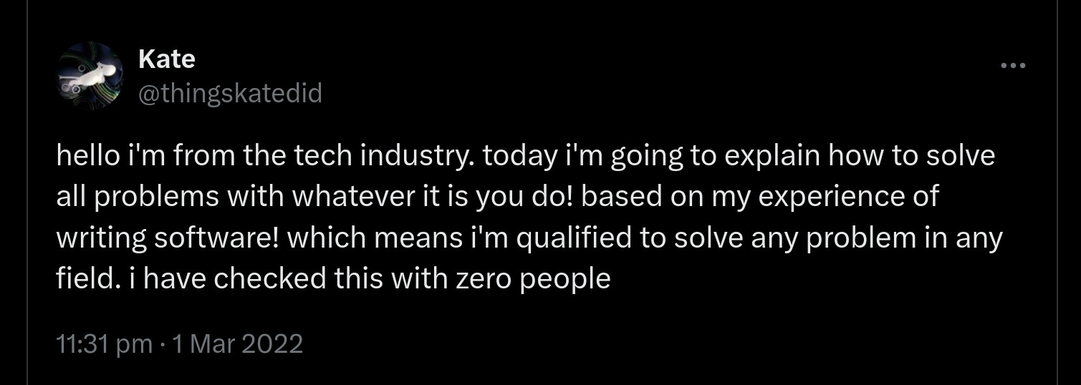

Slide 3
While in undergrad, I avoided “humanities” classes like the plague in order to focus on my primary workloads, something I consider to be one of the greatest missed opportunities of my life now
My education at CMU was extremely enabling, but [ … ] it took a moment of personal hardship for me to even identify and then focus on my values.

Slide 4


Slide 6
After this lecture, you will be able to
Describe the steps to debug complex code failures
Identify ways to manage the complexity when programming
State guidelines for communicating the intention of the code

Slide 7
Outline
Debugging
  Defects and Failures
  Scientific Debugging
  Tools
Design
  Managing complexity
  Communication
  Naming
  Comments

Slide 8

Complex Systems, Complex Failures
Atlas-Centaur

Slide 9
Atlas-Centaur second stage failed after entering an uncontrolled spin
  Investigation - turbopumps relied on gas expansion and clogged from plastic remnants of scouring pads
  Proposed Solution - Bake off plastic
Next launch – second stage failed after entering an …
  Further investigation – a valve had been leaking for years (a defect)
    Increased need for engine efficiency pushed this leak into failure range
    Was likely the actual cause of the previous launch
https://www.thespacereview.com/article/1321/1
https://llis.nasa.gov/lesson/467

Slide 10
Defects, Errors, & Failures
1. The programmer creates a defect (or a fault)
2. The defect (maybe) causes an error
wrong results in data values or control signals
3. The error propagates
4. The error causes a failure
a component or system does not produce the intended result at an interface
Why does a defect not necessarily cause an error?
Why is an error not necessarily a failure?
Notes:
Because the conditions necessary to trigger the defect may not be met – e.g., bugs in error handling, some memory errors
Because errors can be masked or detected. Example: ECC memory.

Slide 11
Curse of Debugging
Not every defect causes a failure!
  A defect can be latent or active
  A defect in code that doesn’t get executed most of the time…
Testing can only show the presence of [defects] – not their absence. (Dijkstra 1972)

Slide 12
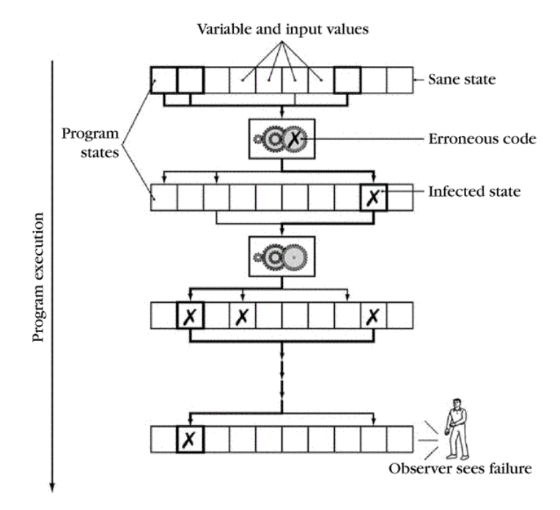
Defects to Failures
Code with defects will introduce erroneous state or control
  Correct code may
  propagate this state
  Eventually an erroneous
  state is observed
Some executions will not
trigger the defect
  Others will not propagate
  erroneous state
Debugging sifts through
the code to find the defect
valid state
Error in state

Slide 13


Slide 14
Explicit Debugging
Stating the problem
  Describe the problem aloud or in writing
    A.k.a. “Rubber duck” or “teddy bear” method
  Often a comprehensive problem description is sufficient to solve the failure
  Mental model != actual code
  Sometimes it’s just a matter of getting a fresh perspective.

Slide 15
Scientific Debugging
Before debugging
  Describe the problem!
  Propose a possible defect; why it explains the failure condition
  No idea? What experiments would give you useful info?
Occam’s Razor – given several hypotheses, pick the simplest / closest to current work
Hypothesis
Problem Description
Code
Failing Runs
Other Runs

Slide 16
Scientific Debugging
Make predictions based on your hypothesis
  What do you expect to happen under new conditions
  What data could confirm or refute your hypothesis
How can I collect that data?
  What experiments?
  What collection mechanism?
Does the data refute the hypothesis?
  Refine the hypothesis based on the new inputs
Prediction
Observation & Conclusion
Hypothesis
Experiment

Slide 17
Scientific Debugging
A set of experiments has confirmed the hypothesis
  This is the diagnosis of the defect
Develop a fix for the defect
Run experiments to confirm the fix
  Otherwise, how do you know that it is fixed?
  In the real world, you often add a test here
Diagnosis
Fix
Confirm

Slide 18
Code with a Bug
int fib(int n)
{
int f, f0 = 1, f1 = 1;
while (n > 1) {
n = n - 1;
f = f0 + f1;
f0 = f1;
f1 = f;
}
return f;
}
int main(..) {
..
for (i = 9; i > 0; i--)
printf(“fib(%d)=%d\n”,
i, fib(i));
$ gcc -o fib fib.c fib(9)=55
fib(8)=34
...
fib(2)=2 fib(1)=134513905
A defect has caused a failure.
How do we know it’s a failure?
It violates the spec.
First, know what SHOULD happen.
Notes:
Simple example to illustrate techniques.
Students do not need to know the code or find the bug.
To fix the bug we need to know what fib(1) should produce, of course, and that depends slightly on how we’re spec’ing our fib function.

Slide 19
Constructing a Hypothesis
Specification defined the first Fibonacci number as 1
  We have observed working runs (e.g., fib(2))
  We have observed a failing run
  We then read the code
fib(1) failed // Hypothesis
Code | Hypothesis
for (i = 9; …) | Result depends on order of calls
while (n > 1) { | Loop check is incorrect
int f; | F is uninitialized
Notes:
What is the input to the hypothesis?
Propose three possible hypotheses from the code.

Slide 20
Brute Force Approach
First, compilation flags
  MUST include “-Wall”
  Should include “-Werror”
Prompt> gcc -Wall -Werror -O3 -o badfib badfib.c
badfib.c: In function ‘fib’:
badfib.c:12:5: error: ‘f’ may be used uninitialized in this function [-Werror=maybe-uninitialized]
return f;
^
cc1: all warnings being treated as errors

Slide 21
Brute Force Approach
prompt>gcc -O3 -o badfib badfib.c
prompt>./badfib
...
fib(2)=2
fib(1)=0
fib(0)=0
prompt>gcc -O2 -o badfib badfib.c
prompt>./badfib
...
fib(2)=2
fib(1)=0
fib(0)=0
prompt>gcc -O1 -o badfib badfib.c
prompt>./badfib
...
fib(2)=2
fib(1)=9
fib(0)=9
prompt>gcc -O0 -o badfib badfib.c
prompt>./badfib
...
fib(2)=2
fib(1)=2
fib(0)=2
First, compilation flags: “-Wall –Werror”
  MUST include “-Wall”
  Should include “-Werror”
Second, other optimization levels
  Try at least –O3 and –O0

Slide 22
Brute Force Approach
First, compilation flags: “-Wall –Werror”
  MUST include “-Wall”
  Should include “-Werror”
Second, other optimization levels
  Try at least –O3 and –O0
Valgrind (even if your program appears to be working!)
  Run on both –O3 and –O0
  Only run after all warnings are gone!

Slide 23
prompt> gcc -g -O3 -o badfib badfib.c
prompt> valgrind badfib
==1462== Memcheck, a memory error detector
==1462== Copyright (C) 2002-2017, and GNU GPL'd, by Julian Seward et al.
==1462== Using Valgrind-3.13.0 and LibVEX; rerun with -h for copyright info
==1462== Command: badfib
==1462==
fib(9)=55
fib(8)=34
fib(7)=21
fib(6)=13
fib(5)=8
fib(4)=5
fib(3)=3
fib(2)=2
fib(1)=0
fib(0)=0
==1462==
==1462== HEAP SUMMARY:
==1462== in use at exit: 0 bytes in 0 blocks
==1462== total heap usage: 1 allocs, 1 frees, 1,024 bytes allocated
==1462==
==1462== All heap blocks were freed -- no leaks are possible
==1462==
==1462== For counts of detected and suppressed errors, rerun with: -v
==1462== ERROR SUMMARY: 0 errors from 0 contexts (suppressed: 0 from 0)
Valgrind is not perfect. On –O3 it finds no errors!

Slide 24
prompt> gcc -g -O0 -o badfib badfib.c
prompt> valgrind badfib
==1561== Memcheck, a memory error detector
==1561== Copyright (C) 2002-2017, and GNU GPL'd, by Julian Seward et al.
==1561== Using Valgrind-3.13.0 and LibVEX; rerun with -h for copyright info
==1561== Command: badfib
==1561==
fib(9)=55
fib(8)=34
fib(7)=21
fib(6)=13
fib(5)=8
fib(4)=5
fib(3)=3
fib(2)=2
==1561== Conditional jump or move depends on uninitialised value(s)
==1561== at 0x4E988DA: vfprintf (vfprintf.c:1642)
==1561== by 0x4EA0F25: printf (printf.c:33)
==1561== by 0x400581: main (badfib.c:24)
==1561==
==1561== Use of uninitialised value of size 8
==1561== at 0x4E9486B: _itoa_word (_itoa.c:179)
==1561== by 0x4E97F0D: vfprintf (vfprintf.c:1642)
==1561== by 0x4EA0F25: printf (printf.c:33)
==1561== by 0x400581: main (badfib.c:24)
==1561==
==1561== Conditional jump or move depends on uninitialised value(s)
==1561== at 0x4E94875: _itoa_word (_itoa.c:179)
==1561== by 0x4E97F0D: vfprintf (vfprintf.c:1642)
==1561== by 0x4EA0F25: printf (printf.c:33)
==1561== by 0x400581: main (badfib.c:24)
==1561==
==1561== Conditional jump or move depends on uninitialised value(s)
==1561== at 0x4E98014: vfprintf (vfprintf.c:1642)
==1561== by 0x4EA0F25: printf (printf.c:33)
==1561== by 0x400581: main (badfib.c:24)
==1561==
==1561== Conditional jump or move depends on uninitialised value(s)
==1561== at 0x4E98B4C: vfprintf (vfprintf.c:1642)
==1561== by 0x4EA0F25: printf (printf.c:33)
==1561== by 0x400581: main (badfib.c:24)
==1561==
fib(1)=2
fib(0)=2
==1561==
==1561== HEAP SUMMARY:
==1561== in use at exit: 0 bytes in 0 blocks
==1561== total heap usage: 1 allocs, 1 frees, 1,024 bytes allocated
==1561==
==1561== All heap blocks were freed -- no leaks are possible
==1561==
==1561== For counts of detected and suppressed errors, rerun with: -v
==1561== Use --track-origins=yes to see where uninitialised values come from
==1561== ERROR SUMMARY: 10 errors from 5 contexts (suppressed: 0 from 0)
Valgrind is not perfect, but pretty darn good.

Slide 25
Constructing a Hypothesis
Specification defined the first Fibonacci number as 1
  We have observed working runs (e.g., fib(2))
  We have observed a failing run
  We then read the code
fib(1) failed // Hypothesis
Code | Hypothesis
for (i = 9; …) | Result depends on order of calls
while (n > 1) { | Loop check is incorrect
int f; | F is uninitialized
Notes:
What is the input to the hypothesis?
Propose three possible hypotheses from the code.

Slide 26
Prediction
Propose a new condition or conditions
  What will logically happen if your hypothesis is correct?
  What data can be
fib(1) failed // Hypothesis
  // Result depends on order of calls
    If fib(1) is called first, it will return correctly.
  // Loop check is incorrect
    Change to n >= 1 and run again.
  // f is uninitialized
    Change to int f = 1;

Slide 27
Experiment
Identical to the conditions of a prior run
  Except with one condition changed
Conditions
  Program input, using a debugger, altering the code
fib(1) failed // Hypothesis
  If fib(1) is called first, it will return correctly.
    Fails.
  Change to n >= 1
    fib(1)=2
    fib(0)=...
  Change to int f = 1;
    Works. Sometimes a prediction can be a fix.

Slide 28
Observation
What is the observed result?
  Factual observation, such as “Calling fib(1) will return 1.”
  The conclusion will interpret the observation(s)
Don’t interfere – or back out interference.
  printf() can interfere for some kinds of bugs!
  Like quantum physics, sometimes observations are part of the experiment
Proceed systematically.
  Update the conditions incrementally so each observation relates to a specific change
Do NOT ever proceed past first bug.

Slide 29

Debugging Tools
Observing program state can require a variety of tools
  Debugger (e.g., gdb)
    What state is in local / global variables (if known)
    What path through the program was taken
  Valgrind
    Does execution depend on uninitialized variables
    Are memory accesses ever out-of-bounds
Notes:
Image: https://thumbs.dreamstime.com/m/sherlock-holmes-cartoon-vector-14725610.jpg (from a search for pubic domain images)

Slide 30
Diagnosis
A scientific hypothesis that explains current observations and makes future predictions becomes a theory
  We’ll call this a diagnosis
Use the diagnosis to develop a fix for the defect
  Avoid post hoc, ergo propter hoc fallacy
  Or correlation does not imply causation
Understand why the defect and fix relate
Notes:
Fallacy commonly seen in malloc lab. If I add a printf to this code, then it works at –O3. Actual problem is that there is undefined behavior and the printf function call reduced the optimization space.
Story: “Once there was a program that only worked on Wednesday. The spec had declared that days are at most 8 characters long. Wednesday is 9 (+ NULL). The NULL was initializing another field so the program would only then operate correctly.”

Slide 31
Fix and Confirm
Confirm that the fix resolves the failure
If you fix multiple perceived defects, which fix was for the failure?
  Be systematic

Slide 32
Learn
Common failures and insights
  Why did the code fail?
  What are my common defects?
Assertions and invariants
  Add checks for expected behavior
    N.b., Assertions must not have side effects
  Extend checks to detect the fixed failure
Testing
  Every successful set of conditions is added to the test suite
Notes:
- Prof Railing says, “I don’t use certain C syntax in my code as I know I am prone to errors if I do.”
- Are there internal conditions to check for (invariants)? External (tests)?

Slide 33
Quick and Dirty
Not every problem needs scientific debugging
  Set a time limit: (for example)
    0 minutes – -Wall, valgrind
    1 – 10 minutes – Informal Debugging
    10 – 60 minutes – Scientific Debugging
    > 60 minutes – Take a break / Ask for help

Slide 34
Code Smells
Use of uninitialized variables
Unused values
Unreachable code
Memory leaks
Interface misuse
Null pointers
Notes:
Common bugs, many of which can be detected by compilers or existing tools.

Slide 35
Quiz
https://canvas.cmu.edu/courses/39547/quizzes/118139

Slide 36
Outline
Debugging
  Defects and Failures
  Scientific Debugging
  Tools
Design
  Managing complexity
  Communication
  Naming
  Comments

Slide 37
Design
A good design needs to achieve many things:
  Performance
  Availability
  Modifiability, portability
  Scalability
  Security
  Testability
  Usability
  Cost to build, cost to operate
Notes:
From these many objectives, we will summarize into two points.

Slide 38
Design
A good design needs to achieve many things:
  Performance
  Availability
  Modifiability, portability
  Scalability
  Security
  Testability
  Usability
  Cost to build, cost to operate
But above all else: it must be readable
Notes:
From these many objectives, we will summarize into two points.

Slide 39
Good Design
Complexity Management
&
Communication
Notes:
IF a design does these things and solves the problem, then it can also achieve (or be extended to achieve) the other objectives

Slide 40
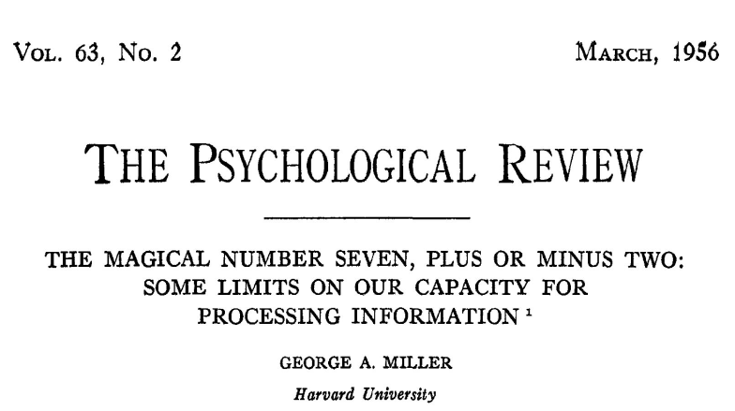
There are well known limits to how much complexity a human can manage easily.

Slide 41
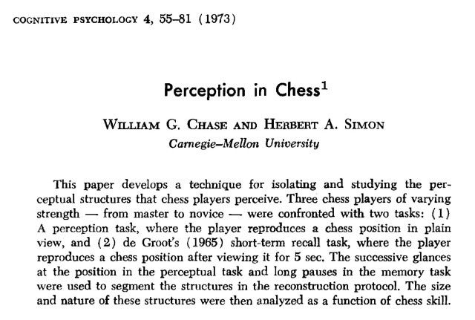
But patterns can be very helpful…

Slide 42
Complexity Management
Many techniques have been developed to help manage complexity:
Separation of concerns
Modularity
Reusability
Extensibility
DRY
Abstraction
Information Hiding
...
Notes:
This is a lot and the list is beyond the scope of the course. Next slide is the 200-level suggestion(s)

Slide 43
Managing Complexity
Design code to be testable
Try to reuse testable chunks
Notes:
To start managing complexity, split

Slide 44
Complexity Example
Split a cache access into three+ testable components
  State all of the steps that a cache access requires
  Convert address into tag, set index, block offset
  Look up the set using the set index
  Check if the tag matches any line in the set
  If so, hit
  If not a match, miss, then
  Find the LRU block
  Evict the LRU block
  Read in the new line from memory
  Update LRU
  Update dirty if the access was a store
  Which steps depend on the operation being a load or a store?
Notes:
I would have students talk to their neighbors for a few minutes about these steps

Slide 45
Complexity Example
Split a datalab problem into testable components:
  State all of the steps: (I use comments)
  Generate the mask 0b101010…10
  Generate the mask 0b010101…01
  Coalesce …
  Generate the mask 0b11001100… and its complement
  Coalesce…
  Do final logic
  Mask generation, e.g., is a simple place to test, has known output, etc.
Notes:
I would have students talk to their neighbors for a few minutes about these steps
Convert address can also be multiple steps
This is just one example sequence

Slide 46
Designs need to be testable
Testable design
  Testing versus Contracts
  These are complementary techniques
Testing and Contracts are
  Acts of design more than verification
  Acts of documentation

Slide 47
Designs need to be testable
Testable design
  Testing versus Contracts
  These are complementary techniques
Testing and Contracts are
  Acts of design more than verification
  Acts of documentation: executable documentation!

Slide 48
Testing Example – cachelab preview
In cachelab, we give you our tests, but they’re a little more complicated.
For your cache simulator, you can write your own traces
  Write a trace to test for a cache hit
  L 50, 1
  L 50, 1
  Write a trace to test dirty bytes in cache
  S 100, 1
Adding tiny tests as you go makes it much easier to verify things are working.
Before that – test your parsing by outputting our logging format.

Slide 49
Testable design is modular
Modular code has: separation of concerns, encapsulation, abstraction
  Leads to: reusability, extensibility, readability, testability
Separation of concerns
  Create helper functions so each function does “one thing”
  Functions should neither do too much nor too little
  Avoid duplicated code
Encapsulation, abstraction, and respecting the interface
  Each module is responsible for its own internals
  No outside code “intrudes” on the inner workings of another module

Slide 50
Trust the Compiler!
Use plenty of temporary variables
Use plenty of functions
Let compiler do the math

Slide 51
Communication
When writing code, the author is communicating with:
The machine
Other developers of the system
Code reviewers
Their future self
Notes:
We communicate with different audiences.

Slide 52
Communication
There are many techniques that have been developed around code communication:
Tests
Naming
Comments
Commit Messages
Code Review
Design Patterns
...
Notes:
We communicate through many means

Slide 53
Naming

Slide 54
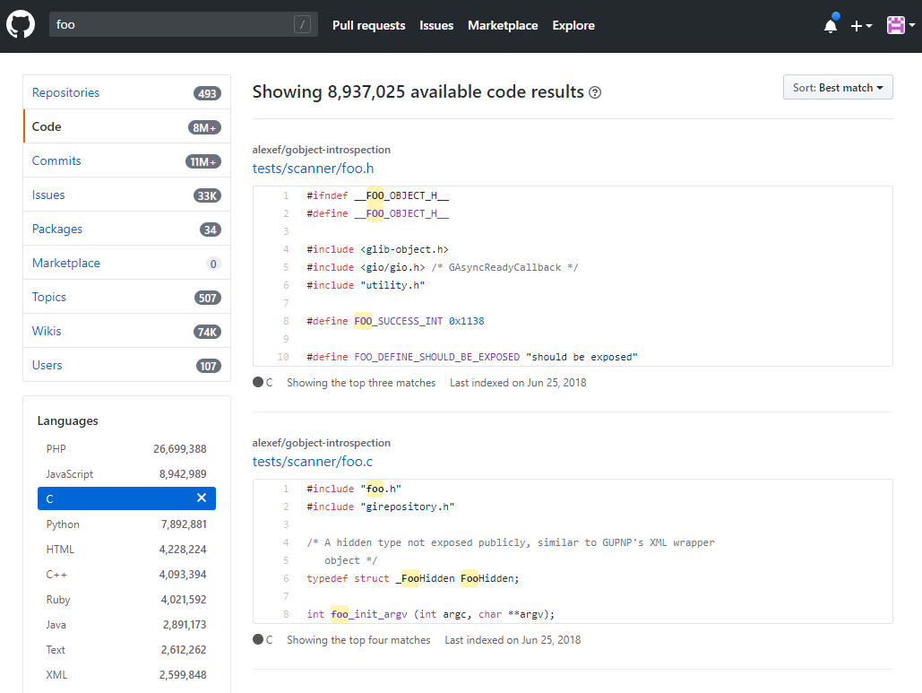
Avoid deliberately meaningless names:

Slide 55
Naming is understanding
“If you don’t know what a thing should be called, you cannot know what it is.
If you don’t know what it is, you cannot sit down and write the code.” - Sam Gardiner

Slide 56
Better naming practices
Start with meaning and intention
Use words with precise meanings (avoid “data”, “info”, “perform”)
Prefer fewer words in names
Avoid abbreviations in names
Use code review to improve names
Be consistent about your naming scheme
Read the code out loud to check that it sounds okay
Actually rename things
  Modern editors make this easier
Notes:
Yes, the 213 course-staff is guilty of transgressing many of these suggestions

Slide 57
Naming guidelines – Use dictionary words
Only use dictionary words and abbreviations that appear in a dictionary.
  For example: FileCpy -> FileCopy
  Avoid vague abbreviations such as acc, mod, auth, etc..

Slide 58
Avoid using single-letter names
Single letters are unsearchable
  Give no hints as to the variable’s usage
Exceptions are loop counters
  Especially if you know why i, j, etc. were originally used
  C/unix systems have a few other common conventions, such as ‘fd’ for “file descriptor” and “str” for a string argument to a function. Following existing style is fine & good.
Notes:
See https://en.wikibooks.org/wiki/Fortran/Fortran_variables

Slide 59
Limit name character length
“Good naming limits individual name length, and reduces the need for specialized vocabulary” – Philip Relf

Slide 60
Limit name word count
Keep names to a four word maximum
Limit names to the number of words that people can read at a glance.
Which of each pair do you prefer?
a1) arraysOfSetsOfLinesOfBlocks
a2) cache
b1) evictedData
b2) evictedDataBytes
Notes:
Bpr: “My friend wrote the following line in C++. This data structure tracked the coherence state in a simulator. I still wonder if he could have done better
map<uint, map<ContextId, map<ContextId, map<uint, uint> > > > theDataStructureWhichShallNotBeNamed;”

Slide 61
Describe Meaning
Use descriptive names.
Avoid names with no meaning: a, foo, blah, tmp, etc
There are reasonable exceptions:
void swap(int* a, int* b) {
int tmp = *a;
*a = *b;
*b = tmp;
}
Notes:
Tmp is fine when it really is short-lived and temporary.

Slide 62
Use a large vocabulary
Be more specific when possible:
  Person -> Employee
What is size in this binaryTree?
struct binaryTree {
int size;
…
};
height
numChildren
subTreeNumNodes
keyLength
Notes:
Discuss size. Could be height of tree, number of nodes, memory usage, etc.

Slide 63
Use problem domain terms
Use the correct term in the problem domain’s language.
  Hint: as a student, consider the terms in the assignment
In cachelab, consider the following:
line
element

Slide 64
Use opposites precisely
Consistently use opposites in standard pairs
  first/end -> first/last

Slide 65
Comments

Slide 66
Don’t Comments
Don’t say what the code does
  because the code already says that
Don’t explain awkward logic
  improve the code to make it clear
Don’t add too many comments
  it’s messy, and they get out of date

Slide 67
Awkward Code
Imagine someone (TA, employer, etc) has to read your code
  Would you rather rewrite or comment the following?
  How about?
  Both lines update program state in the same way.
(*(void **)((*(void **)(bp)) + DSIZE)) = (*(void **)(bp + DSIZE));
bp->prev->next = bp->next;
Notes:
Old malloc example, published in SIGCSE by Railing and Bryant.

Slide 68
Do Comments
Answer the question: why the code exists
When should I use this code?
When shouldn’t I use it?
What are the alternatives to this code?

Slide 69
Why does this exist?
Explain why a magic number is what it is.
When should this code be used? Is there an alternative?
// Each address is 64-bit, which is 16 + 1 hex characters
const int MAX_ADDRESS_LENGTH = 17;
unsigned power2(unsigned base, unsigned expo){
unsigned i;
unsigned result = 1;
for(i=0;i<expo;i++){
result+=result;
}
return result;
}
Notes:
The power2 code is from a student’s submission.

Slide 70
How to write good comments
Code by commenting!
Write short comment
  Helps you think about design & overcome blank-page problem
  Single line comments
  Example: Write four one-line comments for quick sort
// Initialize locals
// Pick a pivot value
// Reorder array around the pivot
// Recurse
Notes:
Students are notorious for writing comments last, so emphasize that brief comments of the design comes before implementation.

Slide 71
How to write good comments
Write short comments of what the code will do.
  Single line comments
  Example: Write four one-line comments for quick sort
Write that code.
Revise comments / code
  If the code or comments are awkward or complex
  Join / Split comments as needed
Maintain code and revised comments

Slide 72
How to write good comments
Try to write good code first
Try to write a one-sentence comment
Refactor the code until the comment is easy to write
Now write a good comment
Maintain your code AND your comments
Notes:
Original good comment strategy

Slide 73
Commit Messages
Committing code to a source repository is a vital part of development
  Protects against system failures and typos:
    cat foo.c versus cat > foo.c
  The commit messages are your record of your work
    Communicating to your future self
    Describe in one line what you did
  “Parses command line arguments”
  “fix bug in unique tests, race condition not solved”
  “seg list finished, performance is …”
Use branches
Notes:
The cat example will silently truncate the file to be empty.

Slide 74
Summary
Programs have defects
  Be systematic about finding them
Programs are more complex than humans can manage
  Write code to be manageable
Programming is not solitary, even if you are communicating with a grader or a future self
  Be understandable in your communication

Slide 75
Acknowledgements
Some debugging content derived from:
  http://www.whyprogramsfail.com/slides.php
  And Saltzer & Kaashoek, “Principles of Computer System Design”
Some code examples for design are based on:
  “The Art of Readable Code”. Boswell and Foucher. 2011.
Lecture originally written by
  Michael Hilton and Brian Railing

