Slide 1



Linux Boot Camp
Jack Biggs
Sol Boucher
17 Jan 2016

Slide 2
Connecting
SSH
Windows users: PuTTY (or SSH Tectia)
Mac & Linux users: Terminal (Just type ssh!)
andrewid@shark.ics.cs.cmu.edu
Files
Windows, Mac, Linux users: Filezilla
andrewid@unix.andrew.cmu.edu
Discouraged for use with text editing - more on that later

Slide 3
Welcome!
$ ls
$ cd private
$ mkdir 15-213
$ cd 15-213
$ mv ~/Downloads/datalab-handout.tar .
$ tar xvf datalab-handout.tar
$ cd datalab

Slide 4
Terminal Shortcuts
~ is an alias to your home directory.
  Ex: cp foo.txt ~
. is an alias to your present directory.
  Ex: cp ~/foo.txt .
.. is an alias to the parent directory.
  Ex: cp ~/foo.txt ..
* will match as many characters as it can.
  Ex: cp ~/*.txt .
  Ex: objdump -d *
  Ex: rm *.c (be very very very careful!!)
    There is no trash with rm. It is gone.

Slide 5
More Terminal Shortcuts
Pressing tab will autocomplete filenames.
Use the up+down arrow keys to scroll through your previous commands.
Control+R lets you search your command history.
Control+A jumps to the beginning of the line.
Control+E jumps to the end of the line.
Control+U clears everything to the left of the cursor.
Control+C kills your current program.
Control+D (on a blank line) exits the terminal.
Control+L clears your screen.

Slide 6
Fancy Terminal Shortcuts
Bash automatically splits things up in brackets!
  Ex: cp foo{1,2}.txt = cp foo1.txt foo2.txt
  Ex: cp foo.txt{,.bak} = cp foo.txt foo.txt.bak
  For when typing the same filename gets annoying
Bash has for loops!
  Ex: Append “15-213” to every file ending in .c
for file in *.c; do echo “15-213” >> $file; done
Have fun, but don’t break things or lose track of time

Slide 7
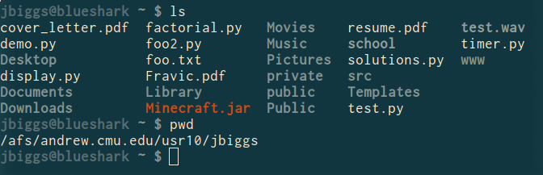
ls <dir>
Lists the files in the present working directory, or, if specified, dir.
  -l lists ownership and permissions.
  -a shows hidden files (“dotfiles”).
pwd tells you your present working directory.

Slide 8
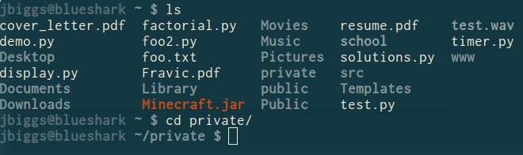
cd <directory>
Try running cd - to return to the previous directory.
Try running cd .. to return to the parent directory.
Changes your present working directory.

Slide 9
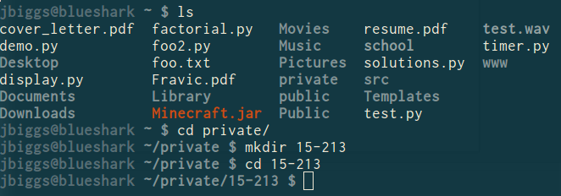
mkdir <dirname>
Makes a directory dirname in your present working directory.
Directories and folders are the same thing!

Slide 10
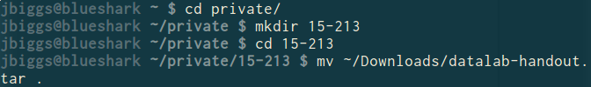
mv <src> <dest>
cp works in exactly the same way, but copies instead
  for copying folders, use cp -r
dest can be into an existing folder (preserves name), or a file/folder of a different name
src can be either a file or a folder

Slide 11
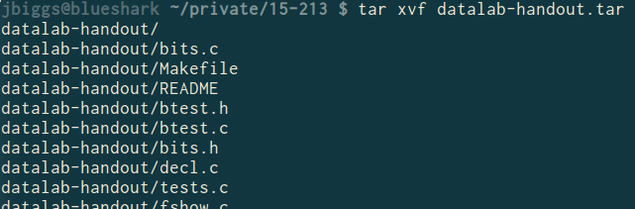
tar <options> <filename>
For full list of options, see man tar
tar stands for tape archive. Was used on tapes!
x - extract, v - verbose, f - file input
All of our handouts will be in tar format.

Slide 12
Also, rm <file1> <file2> … <filen>
To remove an (empty) directory, use rmdir
  To remove a folder and its contents, use rm -rf
    Please be careful, don’t delete your project.
    There is no “Trash” here. It’s gone.
    Contact ugradlabs@cs.cmu.edu to restore.
    Latest restore is up to a day old!

Slide 13

What’s in a file? (using grep)
grep <pattern> <file> will output any lines of file that have pattern as a substring
  grep -v will output lines without pattern as substring
  grep -n prints line numbers
  grep -R will search recursively
Try it: grep ‘phase’ bomb.c
  grep -v -n ‘printf’ src.c
  grep -R ‘unsigned’ .

Slide 14
pipes and redirects
A pipe redirects output from one program as input to another program.
  Ex: objdump -d bomb | grep “mov”
  Ex: ls *.c | grep malloc
  Ex: ls -l | grep jbiggs | wc -l
Can redirect output to a file.
  Ex: cmd arg1 … argn > file.txt will write the output of cmd over file.txt.
  Ex: cmd arg1 … argn >> file.txt will append the output of cmd to file.txt.

Slide 15
Looking for something? grep -A -B
grep -B <x>: include x lines Before match.
grep -A <y>: include y lines After match.
Ex: objdump -d | grep -A 25 explode_bomb
Ex: grep -B 20 return *.c

Slide 16

What’s in a file? (using cat)
cat <file1> <file2> … <filen> lets you display the contents of a file in the terminal window.
  Use cat -n to add line numbers!
You can combine multiple files into one!
  cat <file1> … <filen> >> file.txt
Good for seeing what’s in small files.
Try cat -n bomb.c. Too big, right?

Slide 17
What’s in a file? (using less)
less <file> will give you a scrollable interface for viewing large files without editing them.
  To find something, use /
    To view the next occurrence, press n
    To view previous occurrence, press N
  To quit, use q
Try it: Type “/phase”

Slide 18
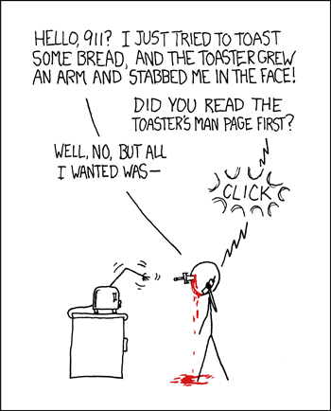
man <thing>
What is that command? What is this C standard library function? What does this library do?
Pages viewed with less
Try it!
  man grep
  man tar
  man strlen
  man 3 printf
  man stdio.h
  man man

Slide 19
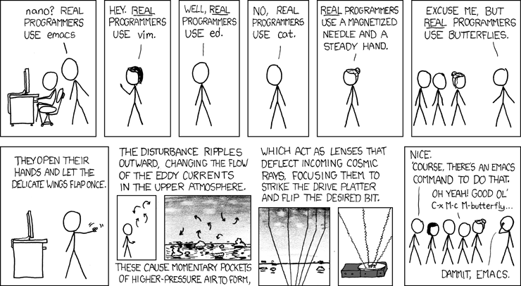
Editors (a touchy subject)

Slide 20
Editors (a touchy subject)
vim is nice, made for very powerful text editing
  Try running vimtutor to get started learning
emacs is nice, made to be more versatile
  Definitely do the emacs tutorial in emacs, “ctrl-h t”
gedit has a GUI, but requires X Forwarding setup. Too platform-dependent to show here, sadly.
I strongly recommend editing on the terminal.
Gist: Use an editor with auto-indent and line numbers

Slide 21
screen
Run simultaneous programs in different “tabs”
<Control-a>, then press c: create new tab
<Control-a>, then press k: kill current tab
  Consider exiting bash rather than killing window (bad)
<Control-a>, then press n: go to next tab
<Control-a>, then press p: go to previous tab
<Control-a>, then press <number>: go to tab <number>
<Control-a>, then press a: send “Control-a” to window
<Control-a>, then press ?: help
All other shortcuts stay, screen only binds to <Control-a>

Slide 22
Editors (if you really really just want a GUI)
Simple answer: Go to a Linux cluster on-campus, open a terminal, and run:
  ssh -Y andrewid@shark.ics.cs.cmu.edu
Now you can run gedit <filename> &
& forks your process into the background so you can use the prompt without waiting for gedit to finish

Slide 23
Editors (if you really, really just want a GUI)
Not-so-simple answer: Google “How to install X Forwarding on <platform>”
  Mac: You need XQuartz
  Windows: You need XMing and PuTTY
This allows you to execute GUI applications on the shark machines, but have the GUI appear on your computer.

Slide 24
A word about editing locally and using (S)FTP
We heavily discourage this.
It is a pain.
You will waste time.
  Edit the file
  Save the file
  Upload the file
  FTP: “Do you want to replace this file?”
  Every single time! (╯°□°）╯︵ ┻━┻)
You will likely have to have a console on the shark machines open for gdb and compilation anyway.
  Use screen!

Slide 25
Commands related to 15-213
gdb, the GNU Debugger, will be used for bomb lab.
objdump displays the symbols in an executable.
gcc is the GNU C Compiler.
make is a configurable build system often used for compiling programs.
We will provide other tools in the handouts as well

Slide 26
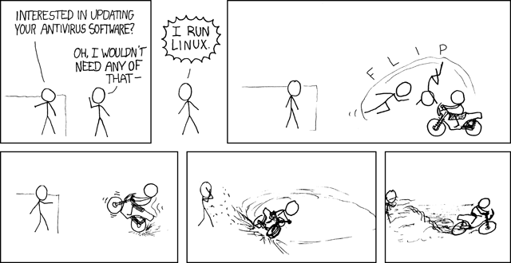

Slide 27
Vim Tutorial
Basics (Quick vimtutor walkthrough)
Splits & Tabs
  Splitting the same file
Specific, useful shortcuts (gd, %, null register, indent)
Visual mode
Find
  Basic Regular Expressions
Find-and-Replace
Macros (super awesome!)
Materials: http://cs.cmu.edu/~213/recitations/bootcamp.zip

Slide 28
Git Tutorial
GitLab hosting: https://git.ece.cmu.edu/
git clone git@git.ece.cmu.edu:<andrewid>/<repo>
git status
git add
git commit -a
git push
git log
git rm
git diff
git pull
Visit a TA if you need help or want to do something advanced.

Slide 29
Resources
Quick references: cs.cmu.edu/~213/resources.html
CMU Computer Club
  www.contrib.andrew.cmu.edu/~sbaugh/emacs.html
  club.cc.cmu.edu/talks/fall15/power-vim.html
  club.cc.cmu.edu/talks/fall15/power-git.html
Great Practical Ideas
  www.cs.cmu.edu/~15131/f15/topics/bash/
  www.cs.cmu.edu/~15131/f15/topics/git/
Official manuals
info bash / info emacs
  :help in Vim
git help

