Slide 1

14-513
18-613

Slide 2
File Systems and Network Programming
15-213/15-513/14-513: Introduction to Computer Systems
19th Lecture, Nov 11, 2025

Slide 3
Today
File Systems
Network types and structures
Locating a host
Setting up a connection

Slide 4
File System
Manages disk blocks to provide a file abstraction
Surface* organized into tracks
Tracks divided into sectors
B₀
B₁
• • •
B_{k-1}
B_{k}
B_{k+1}
• • •
Current file position = k
*Durable storage has many architectures, but ultimately they expose “blocks”

Slide 5
Making a File System
File systems start by formatting raw disk blocks
  Designate one (or more) blocks as “super”
  Record the rest of the blocks as free

Slide 6
Managing a File System
“Super” block is the master block with information
  Type information
  Size
  Root directory
  Free blocks
SFS has a flat directory structure, so the root directory is part of the superblock

Slide 7
Finding a File
A directory is a special file
  Maps strings to files
  Those files could also be directories
Index in directory
Max files in directory
Allocated?
for (fileEntry = 0; (unsigned long)fileEntry < FILE_COUNT_LIMIT;
fileEntry++) {
if (superBlock->files[fileEntry].first_block != 0 &&
strcmp(superBlock->files[fileEntry].name, fileName) == 0) {
return addOpenFileEntry(fileEntry);
Check name

Slide 8
Opening a File
Find the file
Create the three table entries
  Find an available file descriptor
  Allocate an open file table entry
    Pos, permissions, etc
  Load file info into memory
    *SFS is always in-memory, so this is implicit

Slide 9
Reading a File
The file system will map file pos to disk blocks
Lots of ways to map
  Contiguous
  Linked / FAT
  Indexed
SFS

Slide 10
Writing a File
Like reading, but the file could grow
  SFS preallocates space
  Interesting synchronization

Slide 11
Deleting a File
Like free(), but …
  Can open files be deleted?
Two steps:
  Removing the mapping
  Putting the blocks into the free list

Slide 12
SFS Specific Notes
“Shark” File System
  Uses mmap to bring the entire “disk” file into memory
  Treats the disk as an array of 512-byte blocks
  Block 0 is the superblock, other references to 0 are NULLs
  Flat directory structure

Slide 13
Further Notes
https://tcpp.cs.gsu.edu/curriculum/sites/default/files/Edupar115.pdf
Scope of assignment:
  Average of 200 lines of additional code
  13 hours to complete (9 days of assigned work)
The tricky part is identifying critical sections
  Critical sections are defined by the shared variable / resource
  That can be two (or more) threads calling the same or different functions

Slide 14
Part of sfs_open
sfs_filesystem_t *superBlock = accessSuperBlock();
int fileEntry;
int emptyEntry = -1;
for (fileEntry = 0; (unsigned long)fileEntry < FILE_COUNT_LIMIT;
fileEntry++)
{
if (superBlock->files[fileEntry].first_block != 0 &&
strcmp(superBlock->files[fileEntry].name, fileName) == 0)
{
return addOpenFileEntry(fileEntry);
}
else if (emptyEntry == -1 &&
superBlock->files[fileEntry].first_block == 0)
{
emptyEntry = fileEntry;
}
}

Slide 15
Today
File Systems
Network types and structures
Locating a host
Setting up a connection

Slide 16
Computer Networks
A network is a hierarchical system of boxes and wires organized by geographical proximity
  LAN (Local Area Network) spans a building or campus
    Ethernet is most prominent example
  WAN (Wide Area Network) spans country or world
    Typically high-speed point-to-point (mostly optical) links
  Also: SAN (Storage area network), MAN (Metropolitan), etc., etc.
An internetwork (internet) is an interconnected set of networks
  The Global IP Internet (uppercase “I”) is the most famous example of an internet (lowercase “i”)
Let’s see how an internet is built from the ground up

Slide 17
Hardware Organization of a Network Host
CPU chip
register file
ALU
system bus
memory bus
main
memory
MI
I/O
bridge
Expansion slots
I/O bus
USB
controller
graphics
adapter
disk
controller
network
adapter
mouse
keyboard
monitor
disk
network

Slide 18
Example Lowest Level: Ethernet
host
host
host
100 Mb/s
100 Mb/s
hub
port
Ethernet segment consists of a collection of hosts connected by wires (twisted pairs) to a hub
Spans room or floor in a building
Operation
  Each Ethernet adapter has a unique 48-bit address (MAC address)
    E.g., 00:16:ea:e3:54:e6

Slide 19
Next Level: Bridged Ethernet Segment
A
B
host
host
host
host
host
X
hub
100 Mb/s
bridge
100 Mb/s
hub
1 Gb/s
host
host
hub
100 Mb/s
bridge
100 Mb/s
hub
Y
host
host
host
host
host
C
Spans building or campus
Bridges cleverly learn which hosts are reachable from which ports and then selectively copy frames from port to port

Slide 20
Conceptual View of LANs
For simplicity, hubs, bridges, and wires are often shown as a collection of hosts attached to a single wire:
host
host
...
host

Slide 21
Next Level: internets
Multiple incompatible LANs can be physically connected by specialized computers called routers
The connected networks are called an internet (lower case)
host
host
...
host
host
host
...
host
LAN 1
LAN 2
router
router
router
WAN
WAN
LAN 1 and LAN 2 might be completely different, totally incompatible
(e.g., Ethernet, Fibre Channel, 802.11*, T1-links, DSL, …)

Slide 22
Logical Structure of an internet
host
host
router
router
router
router
router
router
Ad hoc interconnection of networks
  No particular topology
  Vastly different router & link capacities
Send packets from source to destination by hopping through networks
  Router forms bridge from one network to another
  Different packets may take different routes

Slide 23
The Notion of an internet Protocol
How is it possible to send bits across incompatible LANs and WANs?
Solution: protocol software running on each host and router
  Protocol is a set of rules that governs how hosts and routers should cooperate when they transfer data from network to network.
  Smooths out the differences between the different networks

Slide 24
What Does an internet Protocol Do?
Provides a naming scheme
  An internet protocol defines a uniform format for host addresses
  Each host (and router) is assigned at least one of these internet addresses that uniquely identifies it
Provides a delivery mechanism
  An internet protocol defines a standard transfer unit (packet)
  Packet consists of header and payload
    Header: contains info such as packet size, source and destination addresses
    Payload: contains data bits sent from source host

Slide 25
Transferring internet Data Via Encapsulation
LAN1
Host A
Host B
LAN2
client
server
(1)
data
(8)
data
protocol
software
protocol
software
internet packet
(2)
data
PH
FH1
(7)
data
PH
FH2
LAN1 frame
LAN1
adapter
LAN2
adapter
Router
(3)
data
PH
FH1
(6)
data
PH
FH2
LAN1
adapter
LAN2
adapter
LAN2 frame
(4)
data
PH
FH1
data
PH
FH2
(5)
PH: internet packet header
FH: LAN frame header
protocol
software

Slide 26
Other Issues
We are glossing over a number of important questions:
  What if different networks have different maximum frame sizes? (segmentation)
  How do routers know where to forward frames?
  How are routers informed when the network topology changes?
  What if packets get lost?
These (and other) questions are addressed by the area of systems known as computer networking

Slide 27
Global IP Internet (upper case)
Most famous example of an internet
Based on the TCP/IP protocol family
  IP (Internet Protocol)
    Provides basic naming scheme and unreliable delivery capability
    of packets (datagrams) from host-to-host
  UDP (User Datagram Protocol)
    Uses IP to provide unreliable datagram delivery from
    process-to-process
  TCP (Transmission Control Protocol)
    Uses IP to provide reliable byte streams from process-to-process over connections
Accessed via a mix of Unix file I/O and functions from the sockets interface
Notes:
IP: host2host
UDP/TCP: proc2proc

Slide 28
Hardware and Software Organization of an Internet Application
Internet client host
Internet server host
Client
User code
Server
Sockets interface
(system calls)
TCP/IP
Kernel code
TCP/IP
Hardware interface
(interrupts)
Network
adapter
Hardware
and firmware
Network
adapter
Global IP Internet

Slide 29
A Programmer’s View of the Internet
1. Hosts are mapped to a set of 32-bit IP addresses
  128.2.203.179
  127.0.0.1 (always localhost)
2. As a convenience for humans, the Domain Name System maps a set of identifiers called Internet domain names to IP addresses:
  www.cs.cmu.edu “resolves to” 128.2.217.3
3. A process on one Internet host can communicate with a process on another Internet host over a connection

Slide 30
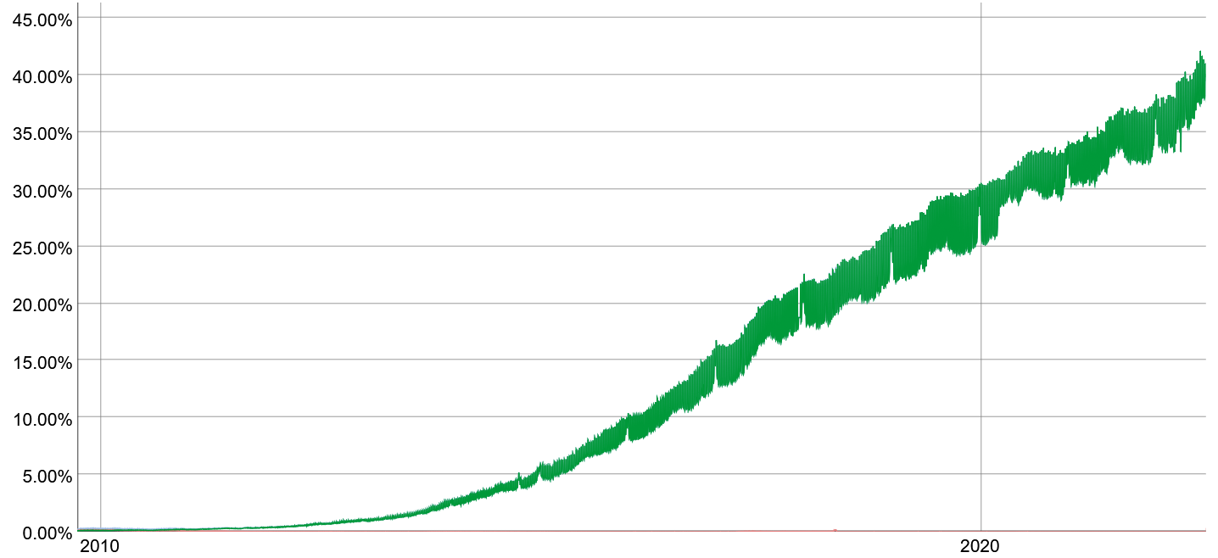
Aside: IPv4 and IPv6
IPv4 (Internet Protocol version 4) specified 1981
  32-bit host addresses (192.0.2.43)
  Known to not be enough for everyone since ~1990
IPv6 (Internet Protocol version 6) specified 1996
  128-bit addresses (2001:0db8:0:0:0:0:cafe:la7e)
  Intended to replace IPv4
  Very slow adoption due to need to replace routers
  (CMU’s network doesn’t support IPv6 at all!)
Application programmers mostly don’t have to care
  Sockets API makes it easy to write code that seamlessly uses either, as necessary
IPv6 traffic to Google
https://www.google.com/intl/en/ipv6/statistics.html

Slide 31
(1) IP Addresses
32-bit IP addresses are stored in an IP address struct
  IP addresses are always stored in memory in network byte order
  (big-endian byte order)
  True in general for any integer transferred in a packet header from one machine to another.
    E.g., the port number used to identify an Internet connection.
/* Internet address structure */
struct in_addr {
uint32_t s_addr; /* network byte order (big-endian) */
};

Slide 32
Dotted Decimal Notation
By convention, each byte in a 32-bit IP address is represented by its decimal value and separated by a period
    IP address: 0x8002C2F2 = 128.2.194.242
Use getaddrinfo and getnameinfo functions (described later) to convert between IP addresses and dotted decimal format.

Slide 33
Today
File Systems
Network types and structures
Locating a host
Setting up a connection

Slide 34
(2) Internet Domain Names
unnamed root
.net
.edu
.gov
.com
First-level domain names
mit
cmu
berkeley
amazon
Second-level domain names
cs
ece
www
54.230.48.28
Third-level domain names
ics
pdl
whaleshark
128.2.210.175
www
128.2.131.66

Slide 35
Domain Naming System (DNS)
The Internet maintains a mapping between IP addresses and domain names in a worldwide distributed database called DNS
Conceptually, programmers can view the DNS database as a collection of millions of host entries.
  Each host entry defines the mapping between a set of domain names and IP addresses.
  In a mathematical sense, a host entry is an equivalence class of domain names and IP addresses.

Slide 36
Properties of DNS Mappings
Can explore properties of DNS mappings using nslookup
  (Output edited for brevity)
Each host has a locally defined domain name localhost which always maps to the loopback address 127.0.0.1
Use hostname to determine real domain name of local host:
linux> nslookup localhost
Address: 127.0.0.1
linux> hostname
whaleshark.ics.cs.cmu.edu

Slide 37
Properties of DNS Mappings (cont)
Simple case: one-to-one mapping between domain name and IP address:
Multiple domain names mapped to the same IP address:
And backwards:
linux> nslookup whaleshark.ics.cs.cmu.edu
Address: 128.2.210.175
linux> nslookup cs.mit.edu
Address: 18.25.0.23
linux> nslookup eecs.mit.edu
Address: 18.25.0.23
linux> nslookup 18.25.0.23
23.0.25.18.in-addr.arpa name = eecs.mit.edu.

Slide 38
Properties of DNS Mappings (cont)
Multiple domain names mapped to multiple IP addresses:
Some valid domain names don’t map to any IP address:
linux> nslookup www.twitter.com
Address: 104.244.42.65
Address: 104.244.42.129
Address: 104.244.42.193
Address: 104.244.42.1
linux> nslookup www.twitter.com
Address: 104.244.42.129
Address: 104.244.42.65
Address: 104.244.42.193
Address: 104.244.42.1
linux> nslookup ics.cs.cmu.edu
(No Address given)

Slide 39
Today
File Systems
Network types and structures
Locating a host
Setting up a connection

Slide 40
A Client-Server Transaction
Most network applications are based on the client-server model:
  A server process and one or more client processes
  Server manages some resource
  Server provides service by manipulating resource for clients
  Server activated by request from client (vending machine analogy)
1. Client sends request
Client
process
Server
process
Resource
4. Client
handles
response
3. Server sends response
2. Server
handles
request
Note: clients and servers are processes running on hosts
(can be the same or different hosts)

Slide 41
(3) Internet Connections
Clients and servers most often communicate by sending streams of bytes over TCP connections. Each connection is:
  Point-to-point: connects a pair of processes.
  Full-duplex: data can flow in both directions at the same time,
  Reliable: stream of bytes sent by the source is eventually received by the destination in the same order it was sent.
A socket is an endpoint of a connection
  Socket address is an IPaddress:port pair
A port is a 16-bit integer that identifies a process:
  Ephemeral port: Assigned automatically by client kernel when client makes a connection request.
  Well-known port: Associated with some service provided by a server (e.g., port 80 is associated with Web servers)

Slide 42
Well-known Service Names and Ports
Popular services have permanently assigned well-known ports and corresponding well-known service names:
  echo servers: echo 7
  ftp servers: ftp 21
  ssh servers: ssh 22
  email servers: smtp 25
  Unencrypted Web servers: http 80
  SSL/TLS encrypted Web: https 443
Mappings between well-known ports and service names is contained in the file /etc/services on each Linux machine.

Slide 43
Anatomy of a Connection
A connection is uniquely identified by the socket addresses of its endpoints (socket pair)
  (cliaddr:cliport, servaddr:servport)
Client socket address
128.2.194.242:51213
Server socket address
208.216.181.15:80
Client
Server
(port 80)
Connection socket pair
(128.2.194.242:51213, 208.216.181.15:80)
Client host address
128.2.194.242
Server host address
208.216.181.15
51213 is an ephemeral port
allocated by the kernel
80 is a well-known port
associated with Web servers

Slide 44
Using Ports to Identify Services
Server host 128.2.194.242
Client host
Service request for
128.2.194.242:80
(i.e., the Web server)
Web server
(port 80)
Client
Kernel
Echo server
(port 7)
Service request for
128.2.194.242:7
(i.e., the echo server)
Web server
(port 80)
Client
Kernel
Echo server
(port 7)

Slide 45
Quiz
https://canvas.cmu.edu/courses/49105/quizzes/150047

Slide 46
Sockets Interface
Set of system-level functions used in conjunction with Unix I/O to build network applications.
Created in the early 80’s as part of the original Berkeley distribution of Unix that contained an early version of the Internet protocols.
Available on all modern systems
  Unix variants, Windows, OS X, IOS, Android, ARM

Slide 47
Sockets
What is a socket?
  To the kernel, a socket is an endpoint of communication
  To an application, a socket is a file descriptor that lets the application read/write from/to the network
  Using the FD abstraction lets you reuse code & interfaces
Clients and servers communicate with each other by reading from and writing to socket descriptors
The main distinction between regular file I/O and socket I/O is how the application “opens” the socket descriptors
Client
Server
clientfd
serverfd

Slide 48
Socket Programming Example
Echo server and client
Server
  Accepts connection request
  Repeats back lines as they are typed
Client
  Requests connection to server
  Repeatedly:
    Read line from terminal
    Send to server
    Read reply from server
    Print line to terminal
Notes:
Students brainstorm about what steps are required for each component

Slide 49
Echo Server/Client Session Example
Client
bambooshark: ./echoclient whaleshark.ics.cs.cmu.edu 6616 (A)
This line is being echoed (B)
This line is being echoed
This one is, too (C)
This one is, too
^D
bambooshark: ./echoclient whaleshark.ics.cs.cmu.edu 6616 (D)
This one is a new connection (E)
This one is a new connection
^D
Server
whaleshark: ./echoserveri 6616
Connected to (BAMBOOSHARK.ICS.CS.CMU.EDU, 33707) (A)
server received 26 bytes (B)
server received 17 bytes (C)
Connected to (BAMBOOSHARK.ICS.CS.CMU.EDU, 33708) (D)
server received 29 bytes (E)

Slide 50
Echo
Server
+ Client
Structure
2. Start client
1. Start server
Client
Server
open_clientfd
open_listenfd
Connection
request
Await connection
request from client
accept
3. Exchange
data
Client / Server
Session
terminal read
socket write
socket read
socket read
terminal write
socket write
4. Disconnect client
EOF
5. Drop client
close
socket read
close

Slide 51
Echo
Server
+ Client
Structure
2. Start client
1. Start server
Client
Server
open_clientfd
open_listenfd
Connection
request
Await connection
request from client
accept
3. Exchange
data
Client / Server
Session
fgets
rio_writen
rio_readlineb
rio_readlineb
fputs
rio_writen
4. Disconnect client
EOF
5. Drop client
close
rio_readlineb
close

Slide 52
Recall: Unbuffered RIO Input/Output
Same interface as Unix read and write
Especially useful for transferring data on network sockets
  rio_readn returns short count only if it encounters EOF
    Only use it when you know how many bytes to read
  rio_writen never returns a short count
  Calls to rio_readn and rio_writen can be interleaved arbitrarily on the same descriptor
#include "csapp.h"
ssize_t rio_readn(int fd, void *usrbuf, size_t n);
ssize_t rio_writen(int fd, void *usrbuf, size_t n);
Return: num. bytes transferred if OK, 0 on EOF (rio_readn only), -1 on error

Slide 53
Recall: Buffered RIO Input Functions
Efficiently read text lines and binary data from a file partially cached in an internal memory buffer
  rio_readlineb reads a text line of up to maxlen bytes from file fd and stores the line in usrbuf
    Especially useful for reading text lines from network sockets
  Stopping conditions
    maxlen bytes read
    EOF encountered
    Newline (‘\n’) encountered
#include "csapp.h"
void rio_readinitb(rio_t *rp, int fd);
ssize_t rio_readlineb(rio_t *rp, void *usrbuf, size_t maxlen);
ssize_t rio_readnb(rio_t *rp, void *usrbuf, size_t n);
Return: num. bytes read if OK, 0 on EOF, -1 on error

Slide 54
Echo Client: Main Routine
#include "csapp.h"
int main(int argc, char **argv)
{
int clientfd;
char *host, *port, buf[MAXLINE];
rio_t rio;
host = argv[1];
port = argv[2];
clientfd = Open_clientfd(host, port);
Rio_readinitb(&rio, clientfd);
while (Fgets(buf, MAXLINE, stdin) != NULL) {
Rio_writen(clientfd, buf, strlen(buf));
Rio_readlineb(&rio, buf, MAXLINE);
Fputs(buf, stdout);
}
Close(clientfd);
exit(0);
}
echoclient.c
Notes:
Why is strlen(buf) ok here?

Slide 55
Echo
Server
+ Client
Structure
2. Start client
1. Start server
Client
Server
open_clientfd
open_listenfd
Connection
request
Await connection
request from client
accept
3. Exchange
data
Client / Server
Session
fgets
rio_writen
rio_readlineb
rio_readlineb
fputs
rio_writen
4. Disconnect client
EOF
5. Drop client
close
rio_readlineb
close

Slide 56
Iterative Echo Server: Main Routine
#include "csapp.h”
void echo(int connfd);
int main(int argc, char **argv)
{
int listenfd, connfd;
socklen_t clientlen;
struct sockaddr_storage clientaddr; /* Enough room for any addr */
char client_hostname[MAXLINE], client_port[MAXLINE];
listenfd = Open_listenfd(argv[1]);
while (1) {
clientlen = sizeof(struct sockaddr_storage); /* Important! */
connfd = Accept(listenfd, (SA *)&clientaddr, &clientlen);
Getnameinfo((SA *) &clientaddr, clientlen,
client_hostname, MAXLINE, client_port, MAXLINE, 0);
printf("Connected to (%s, %s)\n", client_hostname, client_port);
echo(connfd);
Close(connfd);
}
exit(0);
}
echoserveri.c

Slide 57
Echo Server: echo function
The server uses RIO to read and echo text lines until EOF (end-of-file) condition is encountered.
  EOF condition caused by client calling close(clientfd)
void echo(int connfd)
{
size_t n;
char buf[MAXLINE];
rio_t rio;
Rio_readinitb(&rio, connfd);
while((n = Rio_readlineb(&rio, buf, MAXLINE)) != 0) {
printf("server received %d bytes\n", (int)n);
Rio_writen(connfd, buf, n);
}
}
echo.c
Notes:
Why does this not use strlen?

Slide 58
Digging Deeper
Start server
Start server
open_listenfd
getaddrinfo
socket
open_listenfd
bind
listen

Slide 59
Host and Service Conversion: getaddrinfo
getaddrinfo is the modern way to convert string representations of hostnames, host addresses, ports, and service names to socket address structures.
  Replaces obsolete gethostbyname and getservbyname funcs.
Advantages:
  Reentrant (can be safely used by threaded programs).
  Allows us to write portable protocol-independent code
    Works with both IPv4 and IPv6
Disadvantages
  Somewhat complex
  Fortunately, a small number of usage patterns suffice in most cases.

Slide 60
Host and Service Conversion: getaddrinfo
Given host and service, getaddrinfo returns result that points to a linked list of addrinfo structs, each of which points to a corresponding socket address struct, and which contains arguments for the sockets interface functions.
Helper functions:
  freeadderinfo frees the entire linked list.
  gai_strerror converts error code to an error message.
int getaddrinfo(const char *host, /* Hostname or address */
const char *service, /* Port or service name */
const struct addrinfo *hints,/* Input parameters */
struct addrinfo **result); /* Output linked list */
void freeaddrinfo(struct addrinfo *result); /* Free linked list */
const char *gai_strerror(int errcode); /* Return error msg */

Slide 61
Linked List Returned by getaddrinfo
addrinfo structs
result
Socket address structs
ai_canonname
ai_addr
ai_next
NULL
ai_addr
ai_next
NULL
ai_addr
NULL
Notes:
Each entry includes the appropriate information for connect, bind, etc

Slide 62
Running hostinfo
whaleshark> ./hostinfo localhost
127.0.0.1
whaleshark> ./hostinfo whaleshark.ics.cs.cmu.edu
128.2.210.175
whaleshark> ./hostinfo twitter.com
199.16.156.230
199.16.156.38
199.16.156.102
199.16.156.198
whaleshark> ./hostinfo google.com
172.217.15.110
2607:f8b0:4004:802::200e
Notes:
Code not shown that walks the returns from getaddrinfo

Slide 63
Sockets Interface: socket
Clients and servers use the socket function to create a socket descriptor:
Example:
Example:
int socket(int domain, int type, int protocol)
int clientfd = socket(AF_INET, SOCK_STREAM, 0);
Protocol specific!
Indicates that we are using 32-bit IPV4 addresses
Indicates that the socket will be the end point of a reliable (TCP) connection
int clientfd = socket(ai->ai_family, ai->ai_socktype,
ai->ai_protocol);
Use getaddrinfo and you don’t have to know or care which protocol!
Notes:
Protocol is usually 0. Says what number protocol in the family to use and most have only 1.

Slide 64
Sockets Interface
Start server
Client
Server
getaddrinfo
getaddrinfo
SA list
SA list
socket
socket
clientfd
listenfd
open_listenfd
open_clientfd
bind
listen
Connection
request
connect
accept
Client / Server
Session
rio_writen
rio_readlineb
Await connection
request from
next client
rio_readlineb
rio_writen
close
EOF
rio_readlineb
close

Slide 65
Sockets Interface: bind
A server uses bind to ask the kernel to associate the server’s socket address with a socket descriptor:
Our convention: typedef struct sockaddr SA;
Process can read bytes that arrive on the connection whose endpoint is addr by reading from descriptor sockfd
Similarly, writes to sockfd are transferred along connection whose endpoint is addr
Best practice is to use getaddrinfo to supply the arguments addr and addrlen.
int bind(int sockfd, SA *addr, socklen_t addrlen);
Notes:
Bind attaches the protocol socket to a specific address on the machine

Slide 66
Sockets Interface
Client
Server
getaddrinfo
getaddrinfo
SA list
SA list
socket
socket
clientfd
listenfd
open_listenfd
open_clientfd
bind
listenfd <-> SA
listen
Connection
request
connect
accept
Client / Server
Session
rio_writen
rio_readlineb
Await connection
request from
next client
rio_readlineb
rio_writen
close
EOF
rio_readlineb
close

Slide 67
Sockets Interface: listen
Kernel assumes that descriptor from socket function is an active socket that will be on the client end
A server calls the listen function to tell the kernel that a descriptor will be used by a server rather than a client:
Converts sockfd from an active socket to a listening socket that can accept connection requests from clients.
backlog is a hint about the number of outstanding connection requests that the kernel should queue up before starting to refuse requests (128-ish by default)
int listen(int sockfd, int backlog);

Slide 68
Sockets Interface
Client
Server
getaddrinfo
getaddrinfo
SA list
SA list
socket
socket
clientfd
listenfd
open_listenfd
open_clientfd
bind
listenfd <-> SA
listen
Connection
request
listening listenfd
connect
accept
Client / Server
Session
rio_writen
rio_readlineb
Await connection
request from
next client
rio_readlineb
rio_writen
close
EOF
rio_readlineb
close

Slide 69
Sockets Interface: accept
Servers wait for connection requests from clients by calling accept:
Waits for connection request to arrive on the connection bound to listenfd, then fills in client’s socket address in addr and size of the socket address in addrlen.
Returns a connected descriptor connfd that can be used to communicate with the client via Unix I/O routines.
int accept(int listenfd, SA *addr, int *addrlen);

Slide 70
Sockets Interface
Client
Server
getaddrinfo
getaddrinfo
SA list
SA list
socket
socket
clientfd
listenfd
open_listenfd
open_clientfd
bind
listenfd <-> SA
listen
Connection
request
listening listenfd
connect
accept
rio_writen
rio_readlineb
Client / Server
Session
Await connection
request from
next client
rio_readlineb
rio_writen
close
EOF
rio_readlineb
close

Slide 71
Sockets Interface: connect
A client establishes a connection with a server by calling connect:
Attempts to establish a connection with server at socket address addr
  If successful, then clientfd is now ready for reading and writing.
  Resulting connection is characterized by socket pair
  (x:y, addr.sin_addr:addr.sin_port)
    x is client address
    y is ephemeral port that uniquely identifies client process on client host
Best practice is to use getaddrinfo to supply the arguments addr and addrlen.
int connect(int clientfd, SA *addr, socklen_t addrlen);

Slide 72
connect/accept Illustrated
listenfd
Client
Server
1. Server blocks in accept, waiting for connection request on listening descriptor listenfd
clientfd
Connection
request
listenfd
Client
Server
2. Client makes connection request by calling and blocking in connect
clientfd
listenfd
3. Server returns connfd from accept. Client returns from connect. Connection is now established between clientfd and connfd
Client
Server
clientfd
connfd

Slide 73
Connected vs. Listening Descriptors
Listening descriptor
  End point for client connection requests
  Created once and exists for lifetime of the server
Connected descriptor
  End point of the connection between client and server
  A new descriptor is created each time the server accepts a connection request from a client
  Exists only as long as it takes to service client
Why the distinction?
  Allows for concurrent servers that can communicate over many client connections simultaneously
    E.g., Each time we receive a new request, we fork a child to handle the request

Slide 74
Client
Server
getaddrinfo
getaddrinfo
SA list
SA list
socket
socket
clientfd
listenfd
open_listenfd
open_clientfd
bind
listenfd <-> SA
listen
Connection
request
listening listenfd
connect
accept
connected (to SA) clientfd
connected connfd
rio_writen
rio_readlineb
Client / Server
Session
Await connection
request from
next client
rio_readlineb
rio_writen
close
EOF
rio_readlineb
close

Slide 75
Outline
Network types and structures
Locating a host
Setting up a connection
HTTP Example

Slide 76
Today
File Systems
Network types and structures
Locating a host
Setting up a connection
HTTP Example

Slide 77
Web Server Basics
Clients and servers communicate using the HyperText Transfer Protocol (HTTP)
  Client and server establish TCP connection
  Client requests content
  Server responds with requested content
  Client and server close connection (eventually)
Current version is HTTP/2.0
but HTTP/1.1 widely used still
  RFC 2616, June, 1999.
Web
client
(browser)
HTTP request
Web
server
HTTP response
(content)
HTTP
Web content
TCP
Streams
IP
Datagrams
http://www.w3.org/Protocols/rfc2616/rfc2616.html

Slide 78
Web Content
Web servers return content to clients
  content: a sequence of bytes with an associated MIME (Multipurpose Internet Mail Extensions) type
Example MIME types
  text/html HTML document
  text/plain Unformatted text
  image/gif Binary image encoded in GIF format
  image/png Binary image encoded in PNG format
  image/jpeg Binary image encoded in JPEG format
You can find the complete list of MIME types at:
http://www.iana.org/assignments/media-types/media-types.xhtml

Slide 79
Static and Dynamic Content
The content returned in HTTP responses can be either static or dynamic
  Static content: content stored in files and retrieved in response to an HTTP request
    Examples: HTML files, images, audio clips, Javascript programs
    Request identifies which content file
  Dynamic content: content produced on-the-fly in response to an HTTP request
    Example: content produced by a program executed by the server on behalf of the client
    Request identifies file containing executable code
Web content associated with a file that is managed by the server

Slide 80
URLs and how clients and servers use them
Unique name for a file: URL (Universal Resource Locator)
Example URL: http://www.cmu.edu:80/index.html
Clients use prefix (http://www.cmu.edu:80) to infer:
  What kind (protocol) of server to contact (HTTP)
  Where the server is (www.cmu.edu)
  What port it is listening on (80)
Servers use suffix (/index.html) to:
  Determine if request is for static or dynamic content.
    No hard and fast rules for this
    One convention: executables reside in cgi-bin directory
  Find file on file system
    Initial “/” in suffix denotes home directory for requested content.
    Minimal suffix is “/”, which server expands to configured default filename (usually, index.html)

Slide 81
HTTP Request Example
GET / HTTP/1.1 Client: request line
Host: www.cmu.edu Client: required HTTP/1.1 header
Client: blank line terminates headers
HTTP standard requires that each text line end with “\r\n”
Blank line (“\r\n”) terminates request and response headers
Notes:
openssl s_client -connect www.somesite:443

Slide 82
HTTP Requests
HTTP request is a request line, followed by zero or more request headers
Request line: <method> <uri> <version>
  <method> is one of GET, POST, OPTIONS, HEAD, PUT, DELETE, or TRACE
  <uri> is typically URL for proxies, URL suffix for servers
    A URL is a type of URI (Uniform Resource Identifier)
    See http://www.ietf.org/rfc/rfc2396.txt
  <version> is HTTP version of request (HTTP/1.0 or HTTP/1.1)
Request headers: <header name>: <header data>
  Provide additional information to the server
Notes:
Request header examples: brand name of the browser, domain name of the origin server

Slide 83
HTTP Responses
HTTP response is a response line followed by zero or more response headers, possibly followed by content, with blank line (“\r\n”) separating headers from content.
Response line:
<version> <status code> <status msg>
  <version> is HTTP version of the response
  <status code> is numeric status
  <status msg> is corresponding English text
    200 OK Request was handled without error
    301 Moved Provide alternate URL
    404 Not found Server couldn’t find the file
Response headers: <header name>: <header data>
  Provide additional information about response
  Content-Type: MIME type of content in response body
  Content-Length: Length of content in response body

Slide 84
Example HTTP Transaction
whaleshark> telnet www.cmu.edu 80 Client: open connection to server
Trying 128.2.42.52... Telnet prints 3 lines to terminal
Connected to WWW-CMU-PROD-VIP.ANDREW.cmu.edu.
Escape character is '^]'.
GET / HTTP/1.1 Client: request line
Host: www.cmu.edu Client: required HTTP/1.1 header
Client: blank line terminates headers
HTTP/1.1 301 Moved Permanently Server: response line
Date: Wed, 05 Nov 2014 17:05:11 GMT Server: followed by 5 response headers
Server: Apache/1.3.42 (Unix) Server: this is an Apache server
Location: http://www.cmu.edu/index.shtml Server: page has moved here
Transfer-Encoding: chunked Server: response body will be chunked
Content-Type: text/html; charset=... Server: expect HTML in response body
Server: empty line terminates headers
15c Server: first line in response body
<HTML><HEAD> Server: start of HTML content
…
</BODY></HTML> Server: end of HTML content
0 Server: last line in response body
Connection closed by foreign host. Server: closes connection
HTTP standard requires that each text line end with “\r\n”
Blank line (“\r\n”) terminates request and response headers
Notes:
openssl s_client -connect www.somesite:443

Slide 85
Example HTTP Transaction, Take 2
whaleshark> telnet www.cmu.edu 80 Client: open connection to server
Trying 128.2.42.52... Telnet prints 3 lines to terminal
Connected to WWW-CMU-PROD-VIP.ANDREW.cmu.edu.
Escape character is '^]'.
GET /index.shtml HTTP/1.1 Client: request line
Host: www.cmu.edu Client: required HTTP/1.1 header
Client: blank line terminates headers
HTTP/1.1 200 OK Server: response line
Date: Wed, 05 Nov 2014 17:37:26 GMT Server: followed by 4 response headers
Server: Apache/1.3.42 (Unix)
Transfer-Encoding: chunked
Content-Type: text/html; charset=...
Server: empty line terminates headers
1000 Server: begin response body
<html ..> Server: first line of HTML content
…
</html>
0 Server: end response body
Connection closed by foreign host. Server: close connection

Slide 86
Example HTTP(S) Transaction, Take 3
whaleshark> openssl s_client www.cs.cmu.edu:443
CONNECTED(00000005)
…
Certificate chain
…
- Server certificate
-----BEGIN CERTIFICATE-----
MIIGDjCCBPagAwIBAgIRAMiF7LBPDoySilnNoU+mp+gwDQYJKoZIhvcNAQELBQAw
djELMAkGA1UEBhMCVVMxCzAJBgNVBAgTAk1JMRIwEAYDVQQHEwlBbm4gQXJib3Ix
EjAQBgNVBAoTCUludGVybmV0MjERMA8GA1UECxMISW5Db21tb24xHzAdBgNVBAMT
wkWkvDVBBCwKXrShVxQNsj6J
…
-----END CERTIFICATE-----
subject=/C=US/postalCode=15213/ST=PA/L=Pittsburgh/street=5000 Forbes Ave/O=Carnegie Mellon University/OU=School of Computer Science/CN=www.cs.cmu.edu issuer=/C=US/ST=MI/L=Ann Arbor/O=Internet2/OU=InCommon/CN=InCommon RSA Server CA
SSL handshake has read 6274 bytes and written 483 bytes
…
>GET / HTTP/1.0
HTTP/1.1 200 OK
Date: Tue, 12 Nov 2019 04:22:15 GMT
Server: Apache/2.4.10 (Ubuntu)
Set-Cookie: SHIBLOCATION=scsweb; path=/; domain=.cs.cmu.edu
... HTML Content Continues Below ...

Slide 87
Appendix

Slide 88
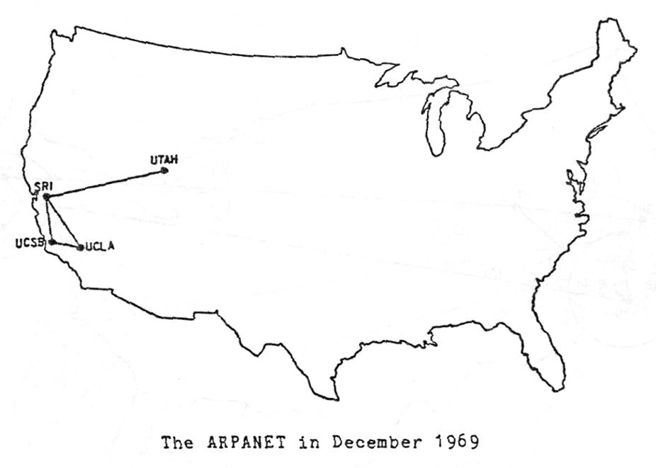

Slide 89
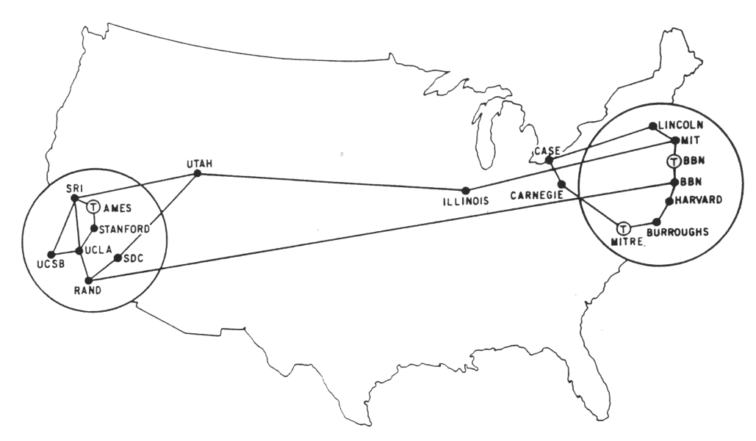
The ARPANET in December 1970

Slide 90
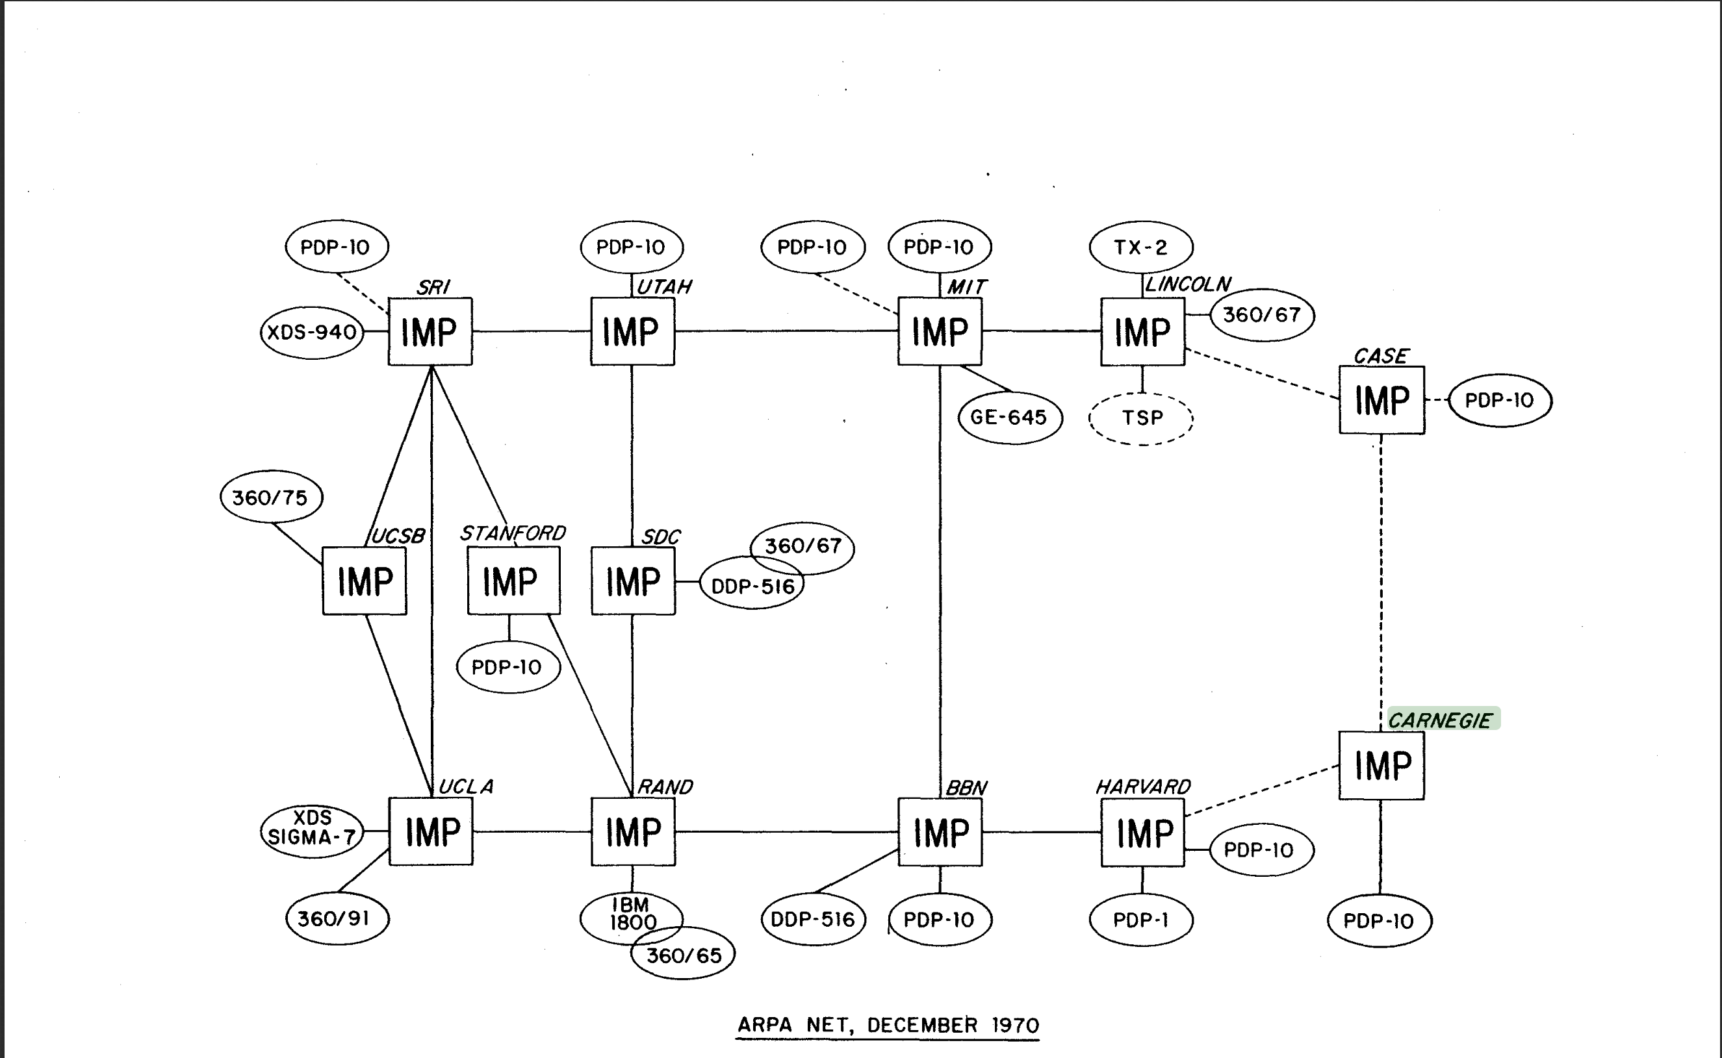

Slide 91
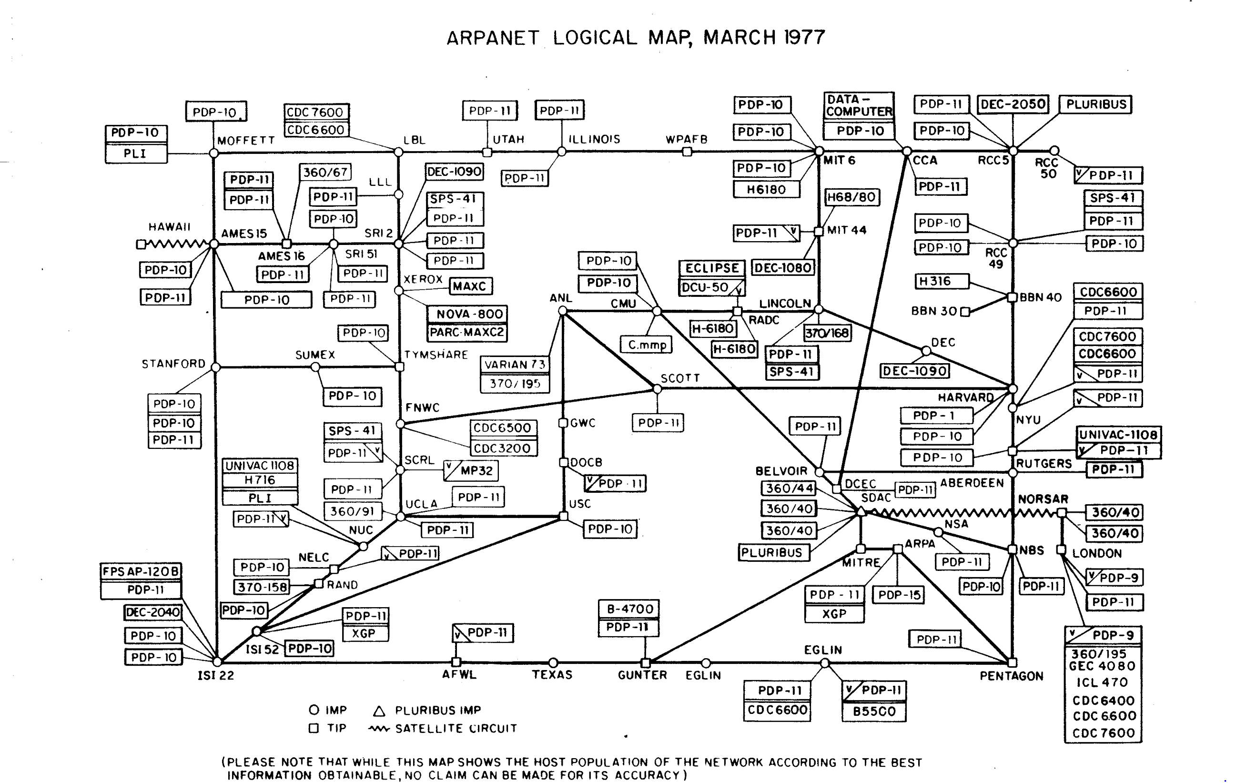

Slide 92


Slide 93

A Map of 460 Billion Device Connections to the Internet collected by the Carna Botnet

Slide 94
Basic Internet Components
Internet backbone:
  collection of routers (nationwide or worldwide) connected by high-speed point-to-point networks
Internet Exchange Points (IXP):
  router that connects multiple backbones (often referred to as peers)
  Also called Network Access Points (NAP)
Regional networks:
  smaller backbones that cover smaller geographical areas
  (e.g., cities or states)
Point of presence (POP):
  machine that is connected to the Internet
Internet Service Providers (ISPs):
  provide dial-up or direct access to POPs

Slide 95
Internet Connection Hierarchy
Private
“peering”
agreements
between
two backbone
companies
often bypass
IXP
IXP
IXP
IXP
Colocation
sites
Backbone
Backbone
Backbone
Backbone
POP
POP
POP
POP
POP
POP
POP
T3
Regional net
ISP
Big Business
POP
POP
POP
POP
POP
POP
POP
Cable
modem
DSL
T1
T1
ISP (for individuals)
Small Business
Pgh employee
DC employee

