Slide 1

14-513
18-613

Slide 2
Dynamic Memory Allocation:
Basic Concepts
15-213/15-513/14-513: Introduction to Computer Systems
13th Lecture, Oct 7, 2025

Slide 3
Today
Basic concepts
Implicit free lists

Slide 4
Dynamic Memory Allocation
Memory
invisible to
user code
Application
Kernel virtual memory
Dynamic Memory Allocator
User stack
(created at runtime)
Heap
%rsp
(stack
pointer)
Programmers use dynamic memory allocators (such as malloc) to acquire virtual memory (VM) at runtime
  For data structures whose size is only known at runtime
Dynamic memory allocators manage an area of process VM known as the heap
Memory-mapped region for
shared libraries
“The break”
Run-time heap
(created by malloc)
Read/write segment
(.data, .bss)
Loaded
from
the
executable
file
Read-only segment
(.init, .text, .rodata)
0x400000
Unused
0

Slide 5
Dynamic Memory Allocation
Allocator maintains heap as collection of variable sized blocks, which are either allocated or free
Types of allocators
  Explicit allocator: application allocates and frees space
    e.g., malloc and free in C
  Implicit allocator: application allocates, but does not free space
    e.g., new and garbage collection in Java
Will discuss simple explicit memory allocation today

Slide 6
The malloc Package
#include <stdlib.h>
void *malloc(size_t size)
  Successful:
    Returns a pointer to a memory block of at least size bytes
    aligned to a 16-byte boundary (on x86-64)
    If size == 0, returns NULL
  Unsuccessful: returns NULL (0) and sets errno
void free(void *p)
  Returns the block pointed at by p to pool of available memory
  p must come from a previous call to malloc, calloc, or realloc
Other functions
  calloc: Version of malloc that initializes allocated block to zero
  realloc: Changes the size of a previously allocated block
  sbrk: Used internally by allocators to grow or shrink the heap

Slide 7
malloc Example
#include <stdio.h>
#include <stdlib.h>
void foo(long n) {
long i, *p;
/* Allocate a block of n longs */
p = (long *) malloc(n * sizeof(long));
if (p == NULL) {
perror("malloc");
exit(0);
}
/* Initialize allocated block */
for (i=0; i<n; i++)
p[i] = i;
/* Do something with p */
. . .
/* Return allocated block to the heap */
free(p);
}

Slide 8
Heap Visualization Convention
1 square = 1 “word” = 8 bytes
Highest address
within heap
(“the break”, adjustable by sbrk system call)
Lowest address within heap
Allocated block
(4 words)
Free block
(2 words)
Free word
Allocated word

Slide 9
Allocation Example
(Conceptual)
p1 = malloc(32)
p2 = malloc(40)
Gap for alignment
p3 = malloc(48)
free(p2)
p4 = malloc(16)

Slide 10
Constraints
Applications
  Can issue arbitrary sequence of malloc and free requests
  free request must be to a malloc’d block
Explicit Allocators
  Can’t control number or size of allocated blocks
  Must respond immediately to malloc requests
    i.e., can’t reorder or buffer requests
  Must allocate blocks from free memory
    i.e., can only place allocated blocks in free memory
  Must align blocks so they satisfy all alignment requirements
    16-byte (x86-64) alignment on 64-bit systems
  Can manipulate and modify only free memory
  Can’t move the allocated blocks once they are malloc’d
    i.e., compaction is not allowed. Why not?

Slide 11
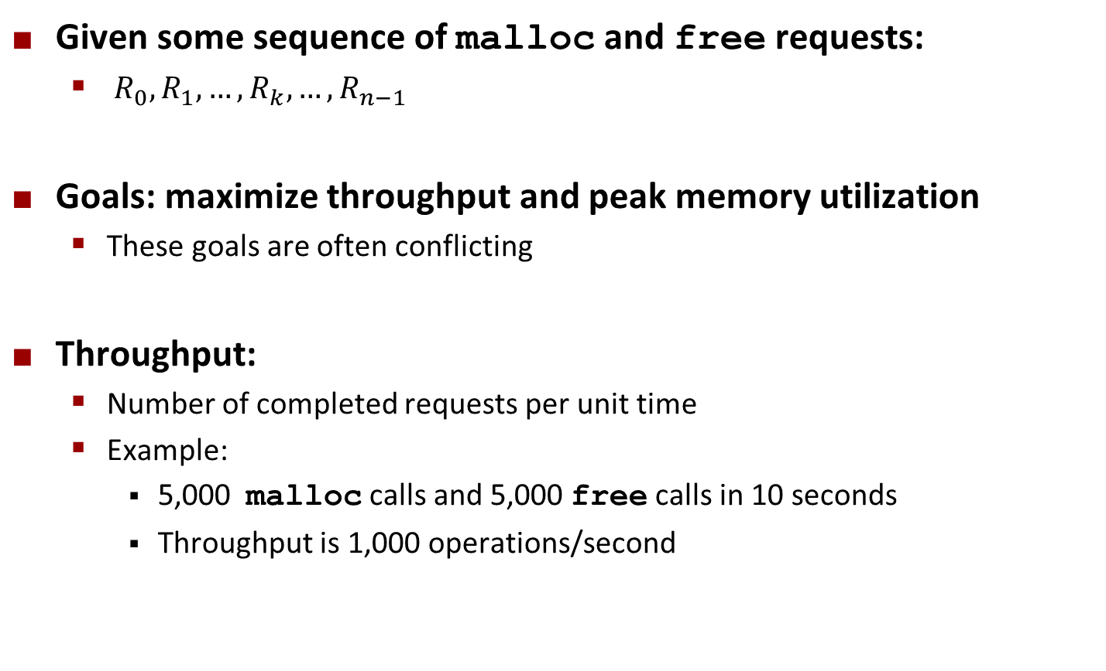
Performance Goal: Throughput
Given some sequence of malloc and free requests:
  $R_{0}, R_{1},…, R_{k},…,R_{n−1}$
Goals: maximize throughput and peak memory utilization
  These goals are often conflicting
Throughput:
  Number of completed requests per unit time
  Example:
    5,000 malloc calls and 5,000 free calls in 10 seconds
    Throughput is 1,000 operations/second

Slide 12
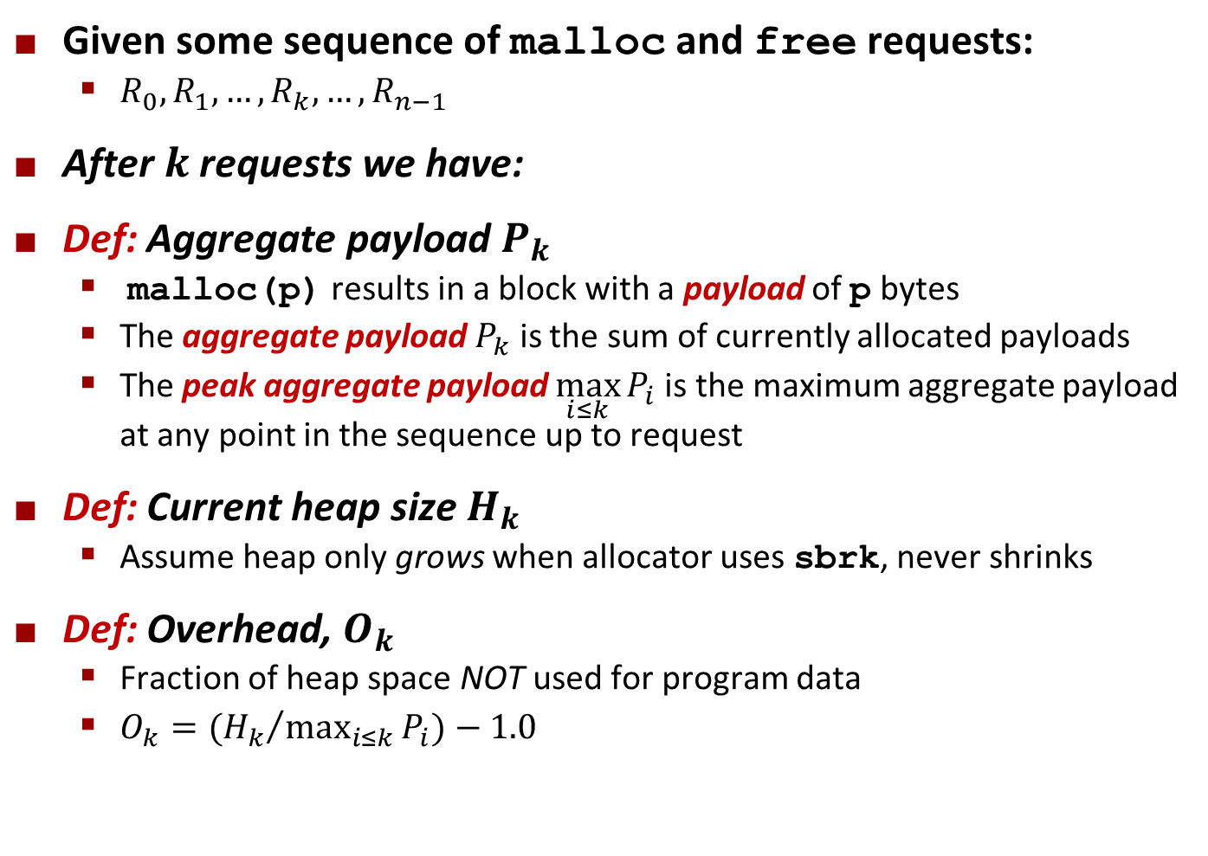
Performance Goal: Minimize Overhead
Given some sequence of malloc and free requests:
  $R_{0}, R_{1},…, R_{k},…,R_{n−1}$
After $k$ requests we have:
Def: Aggregate payload $P_{k}$
  malloc(p) results in a block with a payload of p bytes
  The aggregate payload $P_{k}$ is the sum of currently allocated payloads
  The peak aggregate payload $\max_{i≤k}{P_{i}}$is the maximum aggregate payload at any point in the sequence up to request
Def: Current heap size $H_{k}$
  Assume heap only grows when allocator uses sbrk, never shrinks
Def: Overhead, $O_{k}$
  Fraction of heap space NOT used for program data
  $O_{k}=({H_{k}}/{\max_{i≤k}{P_{i}}})−1.0$

Slide 13
Benchmark Example
Step | Command | Delta | Allocated | Peak
1 | a 0 9904 | 9904 | 9904 | 9904
2 | a 1 50084 | 50084 | 59988 | 59988
3 | a 2 20 | 20 | 60008 | 60008
4 | a 3 16784 | 16784 | 76792 | 76792
5 | f 3 | -16784 | 60008 | 76792
6 | a 4 840 | 840 | 60848 | 76792
7 | a 5 3244 | 3244 | 64092 | 76792
8 | f 0 | -9904 | 54188 | 76792
9 | a 6 2012 | 2012 | 56200 | 76792
10 | f 2 | -20 | 56180 | 76792
11 | a 7 33856 | 33856 | 90036 | 90036
12 | f 1 | -50084 | 39952 | 90036
13 | a 8 136 | 136 | 40088 | 90036
14 | f 7 | -33856 | 6232 | 90036
15 | f 6 | -2012 | 4220 | 90036
16 | a 9 20 | 20 | 4240 | 90036
17 | f 4 | -840 | 3400 | 90036
18 | f 8 | -136 | 3264 | 90036
19 | f 5 | -3244 | 20 | 90036
20 | f 9 | -20 | 0 | 90036
Benchmark
syn-array-short
  Trace provided with malloc lab
  Allocate & free 10 blocks
  a = allocate
  f = free
  Bias toward allocate at beginning & free at end
  Blocks number 1–10
  Allocated: Sum of all allocated amounts
  Peak: Max so far of Allocated

Slide 14
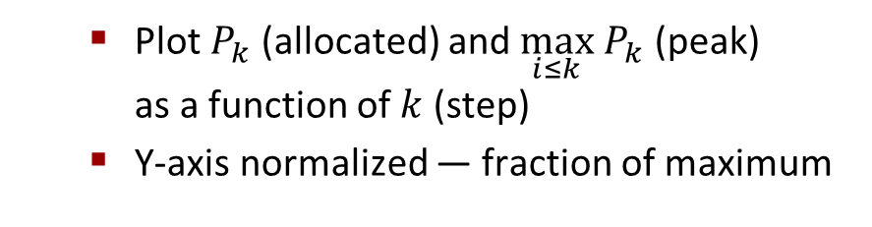
Benchmark Visualization
Step | Command | Delta | Allocated | Peak
1 | a 0 9904 | 9904 | 9904 | 9904
2 | a 1 50084 | 50084 | 59988 | 59988
3 | a 2 20 | 20 | 60008 | 60008
4 | a 3 16784 | 16784 | 76792 | 76792
5 | f 3 | -16784 | 60008 | 76792
6 | a 4 840 | 840 | 60848 | 76792
7 | a 5 3244 | 3244 | 64092 | 76792
8 | f 0 | -9904 | 54188 | 76792
9 | a 6 2012 | 2012 | 56200 | 76792
10 | f 2 | -20 | 56180 | 76792
11 | a 7 33856 | 33856 | 90036 | 90036
12 | f 1 | -50084 | 39952 | 90036
13 | a 8 136 | 136 | 40088 | 90036
14 | f 7 | -33856 | 6232 | 90036
15 | f 6 | -2012 | 4220 | 90036
16 | a 9 20 | 20 | 4240 | 90036
17 | f 4 | -840 | 3400 | 90036
18 | f 8 | -136 | 3264 | 90036
19 | f 5 | -3244 | 20 | 90036
20 | f 9 | -20 | 0 | 90036
  Plot $P_{k}$ (allocated) and $\max_{i≤k} P_{k}$ (peak)
  as a function of $k$ (step)
  Y-axis normalized — fraction of maximum

Slide 15
Typical Benchmark Behavior
Peak
Allocated
Longer sequence of mallocs & frees (40,000 blocks)
  Starts with all mallocs, and shifts toward all frees
Allocator must manage space efficiently the whole time
Production allocators can shrink the heap

Slide 16
Fragmentation
Poor memory utilization caused by fragmentation
  Internal fragmentation
  External fragmentation

Slide 17
Internal Fragmentation
For a given block, internal fragmentation occurs if payload is smaller than block size
Caused by
  Overhead of maintaining heap data structures
  Padding for alignment purposes
  Explicit policy decisions
  (e.g., to return a big block to satisfy a small request)
Depends only on the pattern of previous requests
  Thus, easy to measure
Block
Internal
fragmentation
Payload
Internal
fragmentation

Slide 18
Internal Fragmentation Effect
Peak + Internal Frag
Peak
Allocated
Purple line: additional heap size due to
allocator’s data + padding for alignment
  For this benchmark, 1.5% overhead
  Cannot achieve in practice
  Especially since cannot move allocated blocks

Slide 19
External Fragmentation
Occurs when there is enough aggregate heap memory, but no single free block is large enough
Depends on the pattern of future requests
  Thus, difficult to measure
p1 = malloc(32)
p2 = malloc(40)
p3 = malloc(48)
free(p2)
p4 = malloc(64)
Yikes! (what would happen now?)

Slide 20
External Fragmentation Effect
Peak + All Frag (Best Fit)
Peak + Internal Frag
Peak
Allocated
Green line: additional heap size due to external fragmentation
Best Fit: One allocation strategy
  (To be discussed later)
  Total overhead = 8.3% on this benchmark

Slide 21
Implementation Issues
How do we know how much memory to free given just a pointer?
How do we keep track of the free blocks?
What do we do with the extra space when allocating a structure that is smaller than the free block it is placed in?
How do we pick a block to use for allocation -- many might fit?
How do we reuse a block that has been freed?

Slide 22
Knowing How Much to Free
Standard method
  Keep the length (in bytes) of a block in the word preceding the block.
    Including the header
    This word is often called the header field or header
  Requires an extra word for every allocated block
p0
p0 = malloc(32)
48
block size
Payload
(aligned)
Padding
(for alignment)
free(p0)

Slide 23
Keeping Track of Free Blocks
Method 1: Implicit list using length—links all blocks
Method 2: Explicit list among the free blocks using pointers
Method 3: Segregated free list
  Different free lists for different size classes
Method 4: Blocks sorted by size
  Can use a balanced tree (e.g., Red-Black tree) with pointers within each free block, and the length used as a key
Need to tag
each block as
allocated/free
Unused
32
48
32
16
Need space
for pointers
32
48
32
16

Slide 24
Today
Basic concepts
Implicit free lists

Slide 25
Method 1: Implicit Free List
For each block we need both size and allocation status
  Could store this information in two words: wasteful!
Standard trick
  When blocks are aligned, some low-order address bits are always 0
  Instead of storing an always-0 bit, use it as an allocated/free flag
  When reading the Size word, must mask out this bit
1 word
Size
a
a = 1: Allocated block
a = 0: Free block
Size: total block size
Payload: application data
(allocated blocks only)
Format of
allocated and
free blocks
Payload
Optional
padding

Slide 26
Detailed Implicit Free List Example
End
Block
Start
of
heap
Unused
16/0
32/1
64/0
32/1
8/1
heap_start
heap_end
Double-word
aligned
Allocated blocks: shaded
Free blocks: unshaded
Headers: labeled with “size in words/allocated bit”
Headers are at non-aligned positions
➔ Payloads are aligned

Slide 27
Implicit List: Data Structures
header
payload
Block declaration
Getting payload from block pointer
Getting header from payload
typedef uint64_t word_t;
typedef struct block
{
word_t header;
unsigned char payload[0];
} block_t;
// Zero length array
// block_t *block
return (void *) (block->payload);
// bp points to a payload
return (block_t *) ((unsigned char *) bp
- offsetof(block_t, payload));
C function offsetof(struct, member) returns offset of member within struct

Slide 28
Implicit List: Header access
Size
a
Getting allocated bit from header
Getting size from header
Initializing header
return header & 0x1;
return header & ~0xfL;
// block_t *block
block->header = size | alloc;

Slide 29
Implicit List: Traversing list
header
payload
unused
header
payload
block size
Find next block
static block_t *find_next(block_t *block)
{
return (block_t *) ((unsigned char *) block
+ get_size(block));
}
End
Block
Unused
16/0
32/1
64/0
32/1
8/1

Slide 30
Implicit List: Finding a Free Block
First fit:
  Search list from beginning, choose first free block that fits:
  Finding space for asize bytes (including header):
static block_t *find_fit(size_t asize)
{
block_t *block;
for (block = heap_start; block != heap_end;
block = find_next(block)) {
{
if (!(get_alloc(block))
&& (asize <= get_size(block)))
return block;
}
return NULL; // No fit found
}
heap_start
heap_end
16/0
32/1
64/0
32/1
8/1

Slide 31
Implicit List: Finding a Free Block
First fit:
  Search list from beginning, choose first free block that fits:
  Can take linear time in total number of blocks (allocated and free)
  In practice it can cause “splinters” at beginning of list
Next fit:
  Like first fit, but search list starting where previous search finished
  Should often be faster than first fit: avoids re-scanning unhelpful blocks
  Some research suggests that fragmentation is worse
Best fit:
  Search the list, choose the best free block: fits, with fewest bytes left over
  Keeps fragments small—usually improves memory utilization
  Will typically run slower than first fit
  Still a greedy algorithm. No guarantee of optimality

Slide 32
Comparing Strategies
Total Overheads (for this benchmark)
  Perfect Fit: 1.6%
  Best Fit: 8.3%
  First Fit: 11.9%
  Next Fit: 21.6%

Slide 33
Implicit List: Allocating in Free Block
Allocating in a free block: splitting
  Since allocated space might be smaller than free space, we might want to split the block
32
32
48
16
8
p
split_block(p, 32)
32
32
32
16
16
8

Slide 34
Implicit List: Splitting Free Block
split_block(p, 32)
64
16
32
32
16
p
// Warning: This code is incomplete
static void split_block(block_t *block, size_t asize){
size_t block_size = get_size(block);
if ((block_size - asize) >= min_block_size) {
write_header(block, asize, true);
block_t *block_next = find_next(block);
write_header(block_next, block_size - asize, false);
}

Slide 35
Implicit List: Freeing a Block
Simplest implementation:
  Need only clear the “allocated” flag
  But can lead to “false fragmentation”
32
32
32
16
16
8
free(p)
p
32
32
32
16
16
8
malloc(5*SIZ)
Yikes!
  There is enough contiguous
  free space, but the allocator
  won’t be able to find it

Slide 36
Implicit List: Coalescing
Join (coalesce) with next/previous blocks, if they are free
  Coalescing with next block
32
32
32
16
16
8
logically
gone
free(p)
p
32
32
48
16
16
1

Slide 37
Implicit List: Coalescing
Join (coalesce) with next block, if it is free
  Coalescing with next block
  How do we coalesce with previous block?
    How do we know where it starts?
    How can we determine whether its allocated?
64
32
16
16
8
logically
gone
free(p)
p
64
48
16
16
8

Slide 38
Implicit List: Bidirectional Coalescing
Boundary tags [Knuth73]
  Replicate size/allocated word at “bottom” (end) of free blocks
  Allows us to traverse the “list” backwards, but requires extra space
  Important and general technique!
8
32
32
32
32
48
48
32
32
8
Header
Size
a
a = 1: Allocated block
a = 0: Free block
Size: Total block size
Payload: Application data
(allocated blocks only)
Format of
allocated and
free blocks
Payload and
padding
Boundary tag
(footer)
Size
a

Slide 39
Quiz
https://canvas.cmu.edu/courses/49105/quizzes/150029/

Slide 40
Implementation with Footers
header
payload
unused
footer
header
payload
Locating footer of current block
asize
asize
dsize
const size_t dsize = 2*sizeof(word_t);
static word_t *header_to_footer(block_t *block)
{
size_t asize = get_size(block);
return (word_t *) (block->payload + asize - dsize);
}

Slide 41
Implementation with Footers
header
payload
unused
footer
header
payload
Locating footer of previous block
1 word
static word_t *find_prev_footer(block_t *block)
{
return &(block->header) - 1;
}

Slide 42
Splitting Free Block: Full Version
split_block(p, 32)
64
64
16
32
32
32
32
16
p
static void split_block(block_t *block, size_t asize){
size_t block_size = get_size(block);
if ((block_size - asize) >= min_block_size) {
write_header(block, asize, true);
write_footer(block, asize, true);
block_t *block_next = find_next(block);
write_header(block_next, block_size - asize, false);
write_footer(block_next, block_size - asize, false);
}

Slide 43
Constant Time Coalescing
Case 1
Case 2
Case 3
Case 4
Allocated
Allocated
Free
Free
Block being
freed
Allocated
Free
Allocated
Free

Slide 44
Constant Time Coalescing (Case 1)
m1
1
m1
1
m1
1
m1
1
n
1
n
0
n
1
n
0
m2
1
m2
1
m2
1
m2
1

Slide 45
Constant Time Coalescing (Case 2)
m1
1
m1
1
m1
1
m1
1
n
1
n+m2
0
n
1
m2
0
m2
0
n+m2
0

Slide 46
Constant Time Coalescing (Case 3)
m1
0
n+m1
0
m1
0
n
1
n
1
n+m1
0
m2
1
m2
1
m2
1
m2
1

Slide 47
Constant Time Coalescing (Case 4)
m1
0
n+m1+m2
0
m1
0
n
1
n
1
m2
0
m2
0
n+m1+m2
0

Slide 48
Heap Structure
Dummy
Footer
Dummy
Header
Start
of
heap
8/1
16/0
32/1
64/0
32/1
8/1
heap_start
heap_end
Dummy footer before first header
  Marked as allocated
  Prevents accidental coalescing when freeing first block
Dummy header after last footer
  Prevents accidental coalescing when freeing final block

Slide 49
Top-Level Malloc Code
const size_t dsize = 2*sizeof(word_t);
void *mm_malloc(size_t size)
{
size_t asize = round_up(size + dsize, dsize);
block_t *block = find_fit(asize);
if (block == NULL)
return NULL;
size_t block_size = get_size(block);
write_header(block, block_size, true);
write_footer(block, block_size, true);
split_block(block, asize);
return header_to_payload(block);
}
round_up(n, m)
=
m *((n+m-1)/m)

Slide 50
Top-Level Free Code
void mm_free(void *bp)
{
block_t *block = payload_to_header(bp);
size_t size = get_size(block);
write_header(block, size, false);
write_footer(block, size, false);
coalesce_block(block);
}

Slide 51
Disadvantages of Boundary Tags
Internal fragmentation
Can it be optimized?
  Which blocks need the footer tag?
  What does that mean?
Size
a
Payload and
padding
Size
a

Slide 52
No Boundary Tag for Allocated Blocks
Boundary tag needed only for free blocks
When sizes are multiples of 16, have 4 spare bits
1 word
1 word
Size
b1
a = 1: Allocated block
a = 0: Free block
b = 1: Previous block is allocated
b = 0: Previous block is free
Size: block size
Payload: application data
Size
b0
Payload
Unallocated
Optional
padding
Size
b0
Allocated
Block
Free
Block

Slide 53
No Boundary Tag for Allocated Blocks
(Case 1)
m1
?1
m1
?1
previous
block
block
being
freed
n
11
n
10
n
10
m2
11
m2
01
next
block
Header: Use 2 bits (address bits always zero due to alignment):
(previous block allocated)<<1 | (current block allocated)

Slide 54
No Boundary Tag for Allocated Blocks (Case 2)
previous
block
m1
?1
m1
?1
block
being
freed
n
11
n+m2
10
m2
10
next
block
m2
10
n+m2
10
Header: Use 2 bits (address bits always zero due to alignment):
(previous block allocated)<<1 | (current block allocated)

Slide 55
No Boundary Tag for Allocated Blocks (Case 3)
m1
?0
n+m1
?0
previous
block
m1
?0
block
being
freed
n
01
n+m1
?0
m2
11
m2
01
next
block
Header: Use 2 bits (address bits always zero due to alignment):
(previous block allocated)<<1 | (current block allocated)

Slide 56
No Boundary Tag for Allocated Blocks (Case 4)
previous
block
m1
?0
n+m1+m2
?0
m1
?0
block
being
freed
n
01
m2
10
next
block
m2
10
n+m1+m2
?0
Header: Use 2 bits (address bits always zero due to alignment):
(previous block allocated)<<1 | (current block allocated)

Slide 57
Summary of Key Allocator Policies
Placement policy:
  First-fit, next-fit, best-fit, etc.
  Trades off lower throughput for less fragmentation
  Interesting observation: segregated free lists (next lecture) approximate a best fit placement policy without having to search entire free list
Splitting policy:
  When do we go ahead and split free blocks?
  How much internal fragmentation are we willing to tolerate?
Coalescing policy:
  Immediate coalescing: coalesce each time free is called
  Deferred coalescing: try to improve performance of free by deferring coalescing until needed.

Slide 58
Implicit Lists: Summary
Implementation: very simple
Allocate cost:
  linear time worst case
Free cost:
  constant time worst case
  even with coalescing
Memory Overhead
  will depend on placement policy
  First-fit, next-fit or best-fit
Not used in practice for malloc/free because of linear-time allocation
  used in many special purpose applications
However, the concepts of splitting and boundary tag coalescing are general to all allocators

