Slide 1
Introduction to GDB and Debugging
15-213/18-213/15-513/14-513/18-613: Introduction to Computer Systems

Slide 2
Big Questions
How can code be debugged?
  What is code tracing?
  What is valgrind?
  What is GDB?
How do you use GDB?
Notes:
This bootcamp is mainly to show you the tools you have been provided to troubleshoot current and future labs. In particular, Neel will be showing off how to use GDB, which makes bomblab slightly less painful to deal with.

Slide 3
Tools for Debugging
Code Tracing
Valgrind
GDB
printf()
malloc/free bug
Everything else
Notes:
We will only cover these three tools during this presentation, but don’t see them as a hierarchy. Different problems require unique solutions, sometimes printf will take you less time than gdb. Just keep that in mind

Slide 4
Debugging Basics: Code Tracing

Slide 5
Code Tracing
Use print statements to determine variable values at different points in code
  Insert print statements after sections of code
    Keep track of values
  Can also print out several values at a time to see how values change
  Think through the actual vs expected outputs
Why use code tracing?
When to Use | When Not to Use
Easy and relatively simple code Tracing conditional paths in an if statement | Messy and complicated programs Typically prints out variable values regardless of if the value has changed “Tidal wave of output”
Notes:
We’ve all done it, this is a fantastic debugging technique, and should be one of your first gotos where available. Unfortunately, there are going to be labs where a call to printf may not be possible or could interfere with the functionality of your code. For that, we have more sophisticated tools.

Slide 6
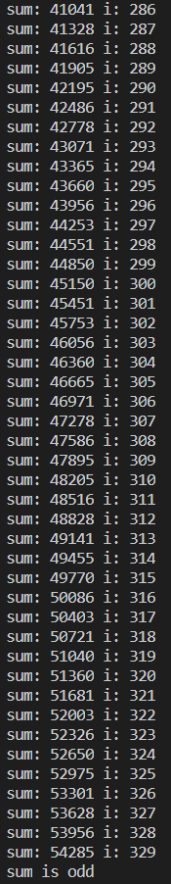
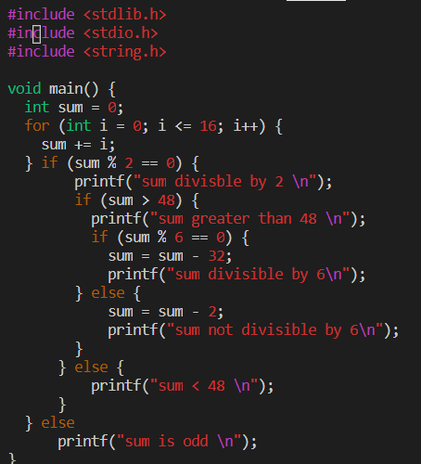
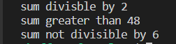
Code Tracing Example
BAD
Prints out series of unhelpful information
GOOD
Not super complicated code
Trace through if/else chain
RISK: bug in trace code!

Slide 7
Debugging Memory: Valgrind

Slide 8
Valgrind
Why use Valgrind?
When to Use | When Not to Use
Dealing with memory (especially dynamic memory allocation) Whenever bugs occur. Get instant feedback about what the bug is, where it occurred, and why. | Program contains no invalid reads and writes and no leaked memory If the test case is inherently slow, then this is not a good choice
Tool for debugging, memory leak detection, and profiling
Valgrind flags errors that don’t appear without valgrind
Using valgrind (Make sure Valgrind is installed):
$ valgrind ./a.out
...
HEAP SUMMARY:
==41495== in use at exit: 0 bytes in 0 blocks
==41495== total heap usage: 1 allocs, 1 frees, 8 bytes allocated
==41495==
==41495== All heap blocks were freed --- no leaks are possible
...
Notes:
Valgrind will be available for labs where you are likely to encounter memory issues.

Slide 9
Running Valgrind
Recommended Valgrind Options:
$ valgrind -–leak-resolution=high –-leak-check=full –-show-reachable=yes –-track-fds=yes ./myProgram arg1 arg2
Feel free to look through $ man valgrind and play around with options
Notes:
leak-resolution=high: each instance of memory leakage is reported with nonunique backtraces merged
leak-check=full: gives individual leak details
show-reachable=yes: covered later
track-fds=yes: print a list of open file descriptors and exit

Slide 10
Invalid Reads and Writes
Reading freed variables
Reading uninitialized variables
Writing to uninitialized memory
  Caused by writing too much data to allocated memory
int foo( int y) {
int *bar = malloc(sizeof(int));
*bar = y;
free(bar);
printf(“bar: %d \n”, *bar);
return y;
}
Notes:
You all probably dealt with this during c programming lab.

Slide 11
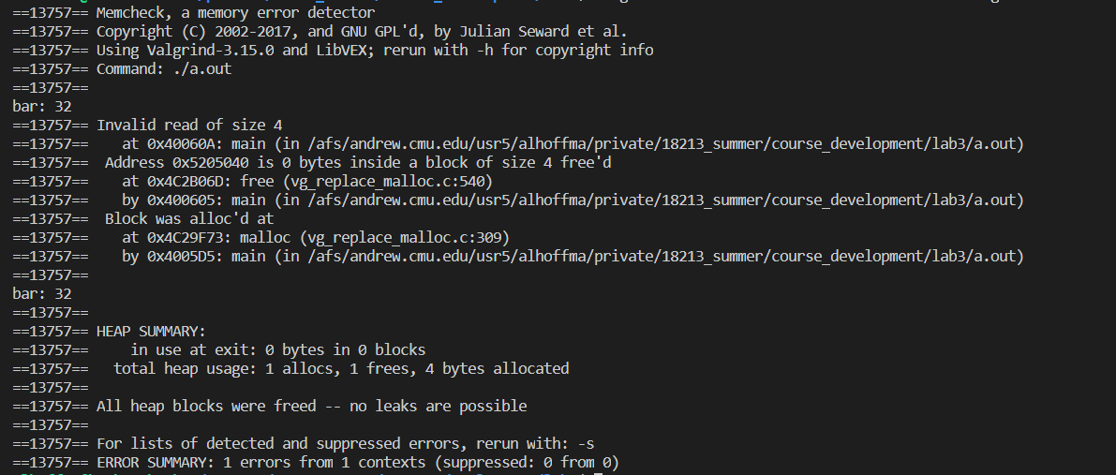
Invalid Reads and Writes Sample Output
Notes:
need to say that “size 4” means an int, which has 4 bytes. Need to say “heap” means “malloc’d memory”.

Slide 12
Memory Leaks
Forgetting to free memory after using it
  Sometimes, there is overhead memory that is never freed
    Memory that is allocated by a programmer should always be freed
int foo( int y) {
int *bar = malloc(sizeof(int));
*bar = y;
printf(“bar: %d \n”, *bar);
return y;
}
Notes:
Any time you allocate memory on the heap, you should free it directly. Unfreed memory is known as a memory leak

Slide 13
Types of Memory Leaks
Still Reachable
Block is still pointed at, programmer could go back and free it before exiting
Definitely Lost
No pointer to the block can be found
Indirectly Lost
Block is “lost” because the blocks that point to it are themselves lost
Possibly Lost
Pointer exists but it points to an internal part of the memory block
Notes:
These are shown when you specify still-reachable=yes

Slide 14
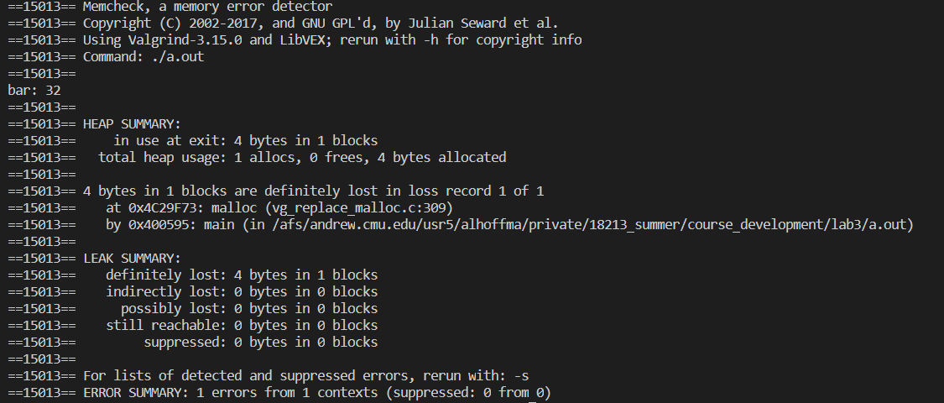
Memory Leaks Sample Output

Slide 15
Debugging Everything: GDB
Notes:
Ali starts here

Slide 16
What is GDB?
GNU Debugger
Powerful debugger that lets you inspect your program as it’s executing
Allows you to see what is going on ‘inside’ another program
Breaks abstraction between program and machine
Why use GDB?
When to Use | When Not to Use
Complicated code that you need to step through Need to find values at specific points Valgrind was not helpful To inspect machine state | NOTE: This is intentionally left blank (Often Super Useful!)
Notes:
GDB is an outside program that solely acts as a debugger. If you’ve ever used an IDE with a “debug” mode, these features will be familiar to you.

Slide 17
GDB Takeaways
GDB is a powerful debugger that has the capabilities to
  Set breakpoints stop at line of code
  Set watchpoints stop when variable changes
  Print values
  Step through execution
  Backtrace see previous function calls
These capabilities will be useful for debugging general code in 213
  GDB has many functionalities beyond these slides, check out this link for more features
    https://sourceware.org/gdb/current/onlinedocs/gdb/
Notes:
ali

Slide 18
Starting GDB
Helpful Resource:
https://sourceware.org/gdb/current/onlinedocs/gdb/
You can open gdb by typing into the shell:
  $ gdb
  (gdb) run 15213 // run program
Type gdb and then a binary to specify which program to run
  $ gdb <binary> ($ gdb ./a.out)
You can optionally have gdb pass any arguments after the executable file using --args
  $ gdb --args gcc -O2 -c foo.c
Quitting GDB:
  (gdb) quit [expression]
  (gdb) q
  or type an end-of-file character (usually Ctrl-d)
More GDB options and help:
  $ gdb -help OR $ gdb -h
Notes:
For this next portion, it’s a good idea to get a feel for the commands available to you, but don’t start writing frantically, you can come reference these slides later

Slide 19
GDB Commands

Slide 20
Controlled Program Execution
(gdb) CTRL + c: stops execution
(gdb) next (n): run next line of program and does NOT step into functions
  (gdb) next X (n X): run next X lines of function
  (gdb) nexti: run next line of assembly code and does NOT step into functions
(gdb) step (s): run next line of program AND step into functions
  (gdb) step X (s X): step through next X lines of function
  (gdb) stepi: step through next line of assembly code
(gdb) continue (c): continue running code until next breakpoint or error
(gdb) finish (f):run code until current function is finished
Notes:
Note the difference between next and step, they could save you some tears during bomblab

Slide 21
Connecting Execution with Code
(gdb) disassemble (disas): disassemble source code into assembly code
  NOT dis: dis == disable breakpoints
(gdb) list (l): list 10 lines of source code from current line
  (gdb) list X (l X): list 10 lines of source code from line number X
  (gdb) list fnName (l fnName): list 10 lines of source code from fnName function
Notes:
Important note here, disas is shorthand for disassemble and will save you time. Dis disables your breakpoints and will lose you points

Slide 22
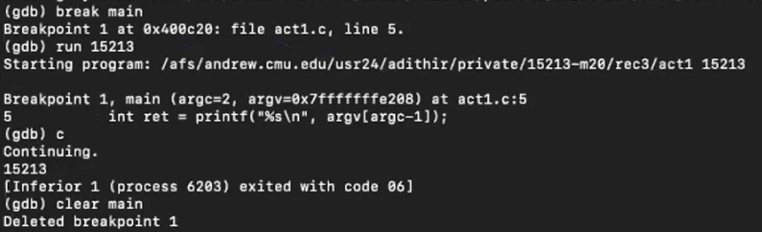
Breakpoints
A breakpoint makes your program stop whenever a certain point in the program is reached
(gdb)break function_name: breaks once you call a specific function. (break abbreviated b)
(gdb)break *0x…: breaks when you execute instruction at a certain address
(gdb)info b: displays information about all breakpoints currently set
(gdb)disable #: disables breakpoint with ID equal to # ($disa is short form not $disas!!!)
(gdb)clear [location]: delete breakpoints according to where they are in your program.
Setting breakpoint
Breakpoint hit
Breakpoint deleted
Notes:
<break file_path:line number>

Slide 23
Watchpoints
A special breakpoint that stops your program when the value of an expression changes
  The expression may be a value of a variable, or involve values combined by operators
Enable, disable, and delete both breakpoints and watchpoints
(gdb)delete [watchpoint]:delete individual breakpoints/ watchpoints by specifying breakpoint numbers
  If no argument is specified, delete all breakpoints , (gdb)d
Examples:
(gdb)watch foo: watch the value of a single variable
(gdb)watch *(int *)0x600850: watch for a change in a numerically entered address
Watchpoint 1: *(int *)6293584
(output)
Notes:
Watchpoints are like breakpoints but for variable changes. Where a breakpoint stops before executing the line it breaks at, a watchpoint stops execution after the value it’s “watching” changes

Slide 24
Printing Values & Inspecting Memory
Printing Values
Inspecting Memory
(gdb) print (p) [any valid expression]
  Print local variables or memory locations
  Be sure to cast to the right data type
    (e.g. p *(long*)ptr)
  (gdb) print (p) *pntr: prints value of pointer
  (gdb) print (p) *(struct_t*) tmp: casts tmp to struct_t* and prints internal values
(gdb) print (p) expr: prints value of data type
(gdb) x/nfu [memory address]: equivalent to (gdb) print *(addr)
  n: inspect next n units of memory
  f (format): can be represented as:
    d (decimal), x (hexadecimal), s (string)
  u (unit): can be represented as:
    b (bytes), w (words/ 4 bytes)
These are just some common ways to inspect memory and print values, check the resources links for more uses
Notes:
The syntax for printing values can be wildly different depending on how you want to access that memory, check the docs for specifics.

Slide 25
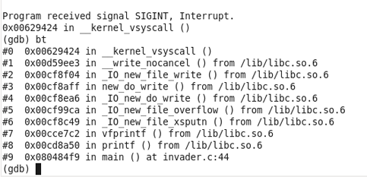
Backtrace
(gdb) backtrace (bt): prints a summary of how program got where it is
  Print sequence of function calls that led to this point
  Helpful to use when programs crash
(gdb) up N (u N): go up N function calls
(gdb) down N (d N): go down N function calls
Previous “frames”
Notes:
Top level (#0) is the most recent module

Slide 26
Calling Functions & Changing Values
Calling your program’s functions
Examples:
(gdb) call expr: Evaluate the expression expr without displaying void returned values.
Changing values:
(gdb) set [variable] expression: change the value associated with a variable, memory address, or expression
  Evaluates the specified expression. If the expression includes the assignment operator ("="), that operator will be evaluated and the assignment will be done.
The only difference between the set variable and the print commands is printing the value
→ Will be useful later...

Slide 27
Lab Time!
https://tinyurl.com/y6ca8kea

Slide 28
Feedback:
https://tinyurl.com/213bootcamp3

Slide 29
Resources
https://www.tutorialspoint.com/gnu_debugger/index.htm
https://sourceware.org/gdb/current/onlinedocs/gdb/ [scroll down for more information]
Notes:
a

