Slide 1
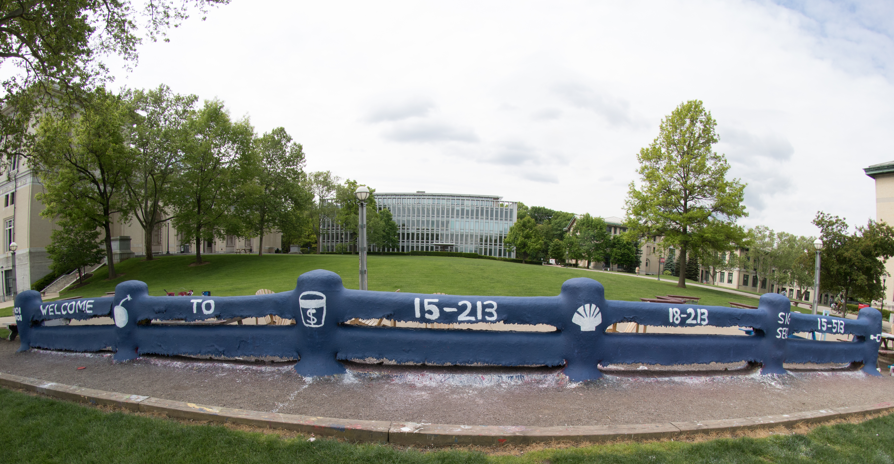
14-513
18-613

Slide 2
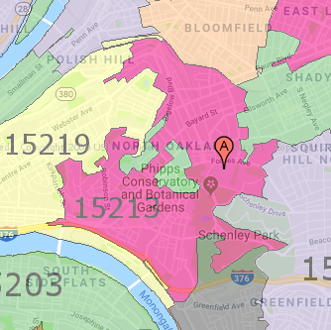
Course Overview
15-213/14-513/15-513:
Introduction to Computer Systems
1st Lecture, Aug. 31, 2021
Instructors:
Seth Goldstein (15-213)
Brian Railing (15-513)
David Varodayan (14-513)
Zack Weinberg (15-213)
The course that gives CMU its “Zip”!

Slide 3
Overview
Introductions
Big Picture
  Course theme
  Five realities
  How the course fits into the CS/ECE/INI curriculum
Academic integrity
Logistics and Policies

Slide 4


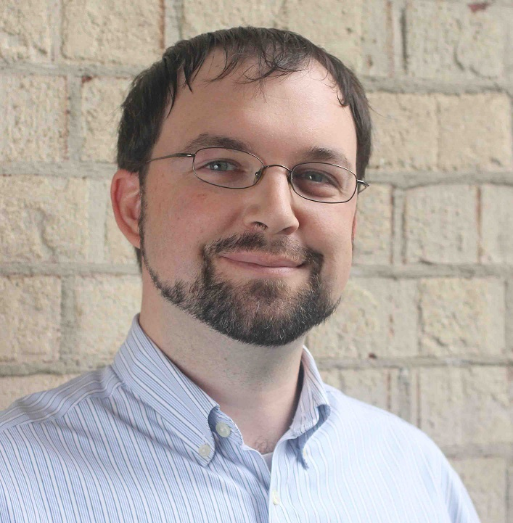
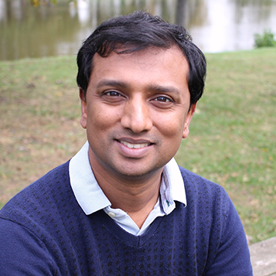
Instructors
Carnegie Mellon
Seth Goldstein
Zack Weinberg
15-213
Brian Railing
David Varodayan
15-513
14-513

Slide 5
The Big Picture

Slide 6
Course Theme:
(Systems) Knowledge is Power!
Systems Knowledge
  How hardware (processors, memories, disk drives, network infrastructure) plus software (operating systems, compilers, libraries, network protocols) combine to support the execution of application programs
  How you as a programmer can best use these resources
Useful outcomes from taking 213/513
  Become more effective programmers
    Able to find and eliminate bugs efficiently
    Able to understand and tune for program performance
  Prepare for later “systems” classes in CS & ECE
    Compilers, Operating Systems, Networks, Computer Architecture, Embedded Systems, Storage Systems, etc.

Slide 7
It’s Important to Understand How Things Work
Why do I need to know this stuff?
  Abstraction is good, but don’t forget reality
Most CS and CE courses emphasize abstraction
  Abstract data types
  Asymptotic analysis
These abstractions have limits
  Especially in the presence of bugs
  Need to understand details of underlying implementations
  Sometimes the abstract interfaces don’t provide the level of control or performance you need

Slide 8
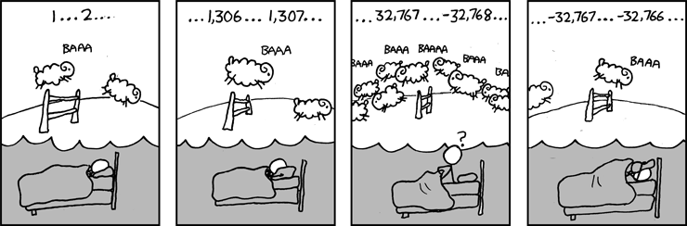
Great Reality #1:
Ints are not Integers, Floats are not Reals
Example 1: Is x² ≥ 0?
  Float’s: Yes!
  Int’s:
    40000 * 40000 --> 1600000000
    50000 * 50000 --> ?
Example 2: Is (x + y) + z = x + (y + z)?
  Unsigned & Signed Int’s: Yes!
  Float’s:
    (1e20 + -1e20) + 3.14 --> 3.14
    1e20 + (-1e20 + 3.14) --> ??
Source: xkcd.com/571

Slide 9
Computer Arithmetic
Does not generate random values
  Arithmetic operations have important mathematical properties
Cannot assume all “usual” mathematical properties
  Due to finiteness of representations
  Integer operations satisfy “ring” properties
    Commutativity, associativity, distributivity
  Floating point operations satisfy “ordering” properties
    Monotonicity, values of signs
Observation
  Need to understand which abstractions apply in which contexts
  Important issues for compiler writers and serious application programmers

Slide 10
Great Reality #2:
You’ve Got to Know Assembly
Chances are, you’ll never write programs in assembly
  Compilers are much better & more patient than you are
But: Understanding assembly is key to machine-level execution model
  Behavior of programs in presence of bugs
    High-level language models break down
  Tuning program performance
    Understand optimizations done / not done by the compiler
    Understanding sources of program inefficiency
  Implementing system software
    Compiler has machine code as target
    Operating systems must manage process state
  Creating / fighting malware
    x86 assembly is the language of choice!

Slide 11
Great Reality #3: Memory Matters
Random Access Memory Is an Unphysical Abstraction
Memory is not unbounded
  It must be allocated and managed
  Many applications are memory dominated
Memory referencing bugs especially pernicious
  Effects are distant in both time and space
Memory performance is not uniform
  Cache and virtual memory effects can greatly affect program performance
  Adapting program to characteristics of memory system can lead to major speed improvements

Slide 12
Memory Referencing Bug Example
typedef struct {
int a[2];
double d;
} struct_t;
double fun(int i) {
volatile struct_t s;
s.d = 3.14;
s.a[i] = 1073741824; /* Possibly out of bounds */
return s.d;
}
fun(0) --> 3.14
fun(1) --> 3.14
fun(2) --> 3.1399998664856
fun(3) --> 2.00000061035156
fun(4) --> 3.14
fun(6) --> Segmentation fault
  Result is system specific

Slide 13
Memory Referencing Bug Example
typedef struct {
int a[2];
double d;
} struct_t;
fun(0) --> 3.14
fun(1) --> 3.14
fun(2) --> 3.1399998664856
fun(3) --> 2.00000061035156
fun(4) --> 3.14
fun(6) --> Segmentation fault
Explanation:
Critical State | 6
? | 5
? | 4
d7 ... d4 | 3
d3 ... d0 | 2
a[1] | 1
a[0] | 0
Location accessed by fun(i)
struct_t

Slide 14
Memory Referencing Errors
C and C++ do not provide any memory protection
  Out of bounds array references
  Invalid pointer values
  Abuses of malloc/free
Can lead to nasty bugs
  Whether or not bug has any effect depends on system and compiler
  Action at a distance
    Corrupted object logically unrelated to one being accessed
    Effect of bug may be first observed long after it is generated
How can I deal with this?
  Program in Java, Ruby, Python, ML, …
  Understand what possible interactions may occur
  Use or develop tools to detect referencing errors (e.g. Valgrind)

Slide 15
Great Reality #4: There’s more to performance than asymptotic complexity
Constant factors matter too!
And even exact op count does not predict performance
  Easily see 10:1 performance range depending on how code written
  Must optimize at multiple levels: algorithm, data representations, procedures, and loops
Must understand system to optimize performance
  How programs compiled and executed
  How to measure program performance and identify bottlenecks
  How to improve performance without destroying code modularity and generality

Slide 16
Memory System Performance Example
void copyij(int src[2048][2048],
int dst[2048][2048])
{
int i,j;
for (i = 0; i < 2048; i++)
for (j = 0; j < 2048; j++)
dst[i][j] = src[i][j];
}
void copyji(int src[2048][2048],
int dst[2048][2048])
{
int i,j;
for (j = 0; j < 2048; j++)
for (i = 0; i < 2048; i++)
dst[i][j] = src[i][j];
}
4.3ms
81.8ms
2.0 GHz Intel Core i7 Haswell
Hierarchical memory organization
Performance depends on access patterns
  Including how step through multi-dimensional array

Slide 17
Why The Performance Differs
copyij
copyji

Slide 18
Great Reality #5:
Computers do more than execute programs
They need to get data in and out
  I/O system critical to program reliability and performance
They communicate with each other over networks
  Many system-level issues arise in presence of network
    Concurrent operations by autonomous processes
    Coping with unreliable media
    Cross platform compatibility
    Complex performance issues

Slide 19
Course Perspective
Most Systems Courses are Builder-Centric
  Computer Architecture
    Design pipelined processor in Verilog
  Operating Systems
    Implement sample portions of operating system
  Compilers
    Write compiler for simple language
  Networking
    Implement and simulate network protocols

Slide 20
Course Perspective (Cont.)
Our Course is Programmer-Centric
  By knowing more about the underlying system, you can be more effective as a programmer
  Enable you to
    Write programs that are more reliable and efficient
    Incorporate features that require hooks into OS
      E.g., concurrency, signal handlers
  Cover material in this course that you won’t see elsewhere
  Not just a course for dedicated hackers
    We bring out the hidden hacker in everyone!

Slide 21
Role within CS/ECE Curriculum
CS 122
Imperative
Programming
Foundation of Computer Systems
Underlying principles for hardware,
software, and networking
213/513
ECE Systems
18-330 Computer Security
18-349 Intro to Embedded Systems
18-441 Computer Networks
18-447 Computer Architecture
18-452 Wireless Networking
18-451 Cyberphysical Systems
CS Systems
15-319 Cloud Computing
15-330 Computer Security
15-410 Operating Systems
15-411 Compiler Design
15-415 Database Applications
15-418 Parallel Computing
15-440 Distributed Systems
15-441 Computer Networks
15-445 Database Systems
CS Graphics
15-462 Computer Graphics
15-463 Comp. Photography
Notes:
And take ~5 to get a systems concentration

Slide 22
Systems Concentration
For CS undergrads (currently)
Take ~5 systems courses
Chance to learn about wide range of systems and systems issues

Slide 23
Academic Integrity
Please pay close attention, especially if this is your first semester at CMU

Slide 24
Cheating/Plagiarism: Description
Unauthorized use of information
  Borrowing code: by copying, retyping, looking at a file
  Describing: verbal description of code from one person to another
    Even if you just describe/discuss how to put together CS:APP code snippets to solve the problem
  Searching the Web for solutions, discussions, tutorials, blogs, other universities’ 213 instances,… in English or any other language
  Copying code from a previous course or online solution
  Reusing your code from a previous semester (here or elsewhere)
    If you take the course this semester, all work has to be done this semester (unless you have special permission from the instructors)

Slide 25
Cheating/Plagiarism: Description (cont.)
Unauthorized supplying of information
  Providing copy: Giving a copy of a file to someone
  Providing access:
    Putting material in unprotected directory
    Putting material in unprotected code repository (e.g., Github)
      Or, letting protections expire
  Applies to this term and the future
    There is no statute of limitations for academic integrity violations
Collaborations beyond high-level, strategic advice
  Anything more than block diagram or a few words
  Code / pseudo-code is NOT high level
  Coaching, arranging blocks of allowed code is NOT high level
  Code-level debugging is NOT high level

Slide 26
Cheating/Plagiarism: Description
Attribution Requirements
  Starter code: No
  Other allowed code (course, CS:APP): Yes
  Indicate source, beginning, and end
See the course syllabus for details.
  Ignorance is not an excuse

Slide 27
Cheating/Plagiarism: Description
What is NOT cheating?
  Explaining how to use systems or tools
  Helping others with high-level design issues
  High means VERY high
  Using code supplied by us
  Using code from the CS:APP web site
  Using books from the library, Unix manpages, other published material
    Except the “Solutions Manual for CS:APP”
  Using general online references
    OK: The GNU C Library Manual, Beej’s Guide to C, cplusplus.com
    Not OK: searching for “213 malloc solution”

Slide 28
Cheating: Consequences
Penalty for cheating:
  Best case: -100% for assignment
    You would be better off to turn in nothing
  Worst case: Removal from course with failing grade
    This is the default
  Permanent mark on your record
  Loss of respect by you, the instructors and your colleagues
  If you do cheat – come clean asap!
Detection of cheating:
  We have sophisticated tools for detecting code plagiarism
  In Fall 2015, 20 students were caught cheating and failed the course.
    Some were expelled from the University
  In January 2016, 11 students were penalized for cheating violations that occurred as far back as Spring 2014.
  In May 2019, we gave an AIV to a student who took the course in Fall 2018 for unauthorized coaching of a Spring 2019 student. His grade was changed retroactively.
Don’t do it!
  Manage your time carefully
  Ask the staff for help when you get stuck

Slide 29
Cheating Notes
We have written over 100 letters for cheating cases
  Don’t add to this total
  Some have been for years earlier
Your work is sophisticated enough that there are many different solutions
  Things that look the same are very suspicious
  If you do your own work and commit regularly, your work is unique
We use PhD-level research to detect similarities
  Inputs include: multiple tools, online searches, past semester submissions

Slide 30
Some Concrete Examples:
This is Cheating:
  Searching the internet with the phrase 15-213, 15213, 213, 18213, 513, malloclab, etc.
    That’s right, just entering it in a search engine
  Looking at someone’s code on the computer next to yours
  Giving your code to someone else, now or in the future
  Posting your code in a publicly accessible place on the Internet, now or in the future
  Hacking the course infrastructure
This is OK (and encouraged):
  Googling a man page for fputs
  Asking a friend for help with gdb
  Asking a TA or course instructor for help, showing them your code, …
  Looking in the textbook for a code example
  Talking about a (high-level) approach to the lab with a classmate

Slide 31
How it Feels: Student and Instructor
Fred is desperate. He can’t get his code to work and the deadline is drawing near. In panic and frustration, he searches the web and finds a solution posted by a student at U. Oklahoma on Github. He carefully strips out the comments and inserts his own. He changes the names of the variables and functions. Phew! Got it done!
The course staff run checking tools that compare all submitted solutions to the solutions from this and other semesters, along with ones that are on the Web.
  Remember: We are as good at web searching as you are
Meanwhile, Fred has had an uneasy feeling: Will I get away with it? Why does my conscience bother me?
Fred gets email from an instructor: “Please see me tomorrow at 9:30 am.”
  Fred does not sleep well that night

Slide 32
How it Feels: Student and Instructor
The instructor feels frustrated. His job is to help students learn, not to be police. Every hour he spends looking at code for cheating is time that he cannot spend providing help to students. But, these cases can’t be overlooked
At the meeting:
  Instructor: “Explain why your code looks so much like the code on Github.”
  Fred: “Gee, I don’t know. I guess all solutions look pretty much alike.”
  Instructor: “I don’t believe you. I am going to file an academic integrity violation.”
    Fred will have the right to appeal, but the instructor does not need him to admit his guilt in order to penalize him.
Consequences
  Fred may (most likely) will be given a failing grade for the course
  Fred will be reported to the university
  A second AIV will lead to a disciplinary hearing
  Fred will go through the rest of his life carrying a burden of shame
  The instructor will experience a combination of betrayal and distress

Slide 33
Why It’s a Big Deal
This material is best learned by doing
  Even though that can, at times, be difficult and frustrating
  Starting with a copy of a program and then tweaking it is very different from writing from scratch
    Planning, designing, organizing a program are important skills
We are the gateway to other system courses
  Want to make sure everyone completing the course has mastered the material
Industry appreciates the value of this course
  We want to make sure anyone claiming to have taken the course is prepared for the real world
Working in teams and collaboration is an important skill
  But only if team members have solid foundations
  This course is about foundations, not teamwork

Slide 34
A Scenario: Cheating or Not?
Alice is working on malloc lab and is just plain stuck. Her code is seg faulting and she doesn't know why. It is only 2 days until malloc lab is due and she has 3 other assignments due this same week. She is in the cluster.
Bob is sitting next to her. He is pretty much done.
Sitting next to Bob is Charlie. He is also stuck.
1. Charlie gets up for a break and Bob makes a printout of his own code and leaves it on Charlie’s chair.
  Who cheated: Charlie? Bob?
2. Charlie finds the copy of Bob’s malloc code, looks it over, and then copies one function, but changes the names of all the variables.
  Who cheated: Charlie? Bob?

Slide 35
Another Scenario
Alice is working on malloc lab and is just plain stuck. Her code is seg faulting and she doesn't know why. It is only 2 days until malloc lab is due and she has 3 other assignments due this same week. She is in the cluster.
Bob is sitting next to her. He is pretty much done.
Sitting next to Bob is Charlie. He is also stuck.
1. Bob offers to help Alice and they go over her code together.
  Who cheated: Bob? Alice?
2. Bob gets up to go to the bathroom and Charlie looks over at his screen to see how Bob implemented his free list.
  Who cheated: Charlie? Bob?

Slide 36
Another Scenario (cont.)
3. Alice is having trouble with GDB. She asks Bob how to set a breakpoint, and he shows her.
  Who cheated: Bob? Alice?
4. Charlie goes to a TA and asks for help
  Who cheated: Charlie?
If you are uncertain which of these constitutes cheating, and which do not, please read the syllabus carefully. If you’re still uncertain, ask one of the staff

Slide 37
Version Control: Your Good Friend
Most labs will be distributed via GitHub Classroom
Must be used by all students
Students must commit early and often
If a student is accused of cheating (plagiarism), we will consult
the GIT server and look for a reasonable commit history
Missing GIT history will count against you
Please make sure you have one!

Slide 38
How to Avoid AIVs
Start early
Don’t rely on marathon programming sessions
  Your brain works better in small bursts of activity
  Ideas / solutions will come to mind while you’re doing other things
Plan for stumbling blocks
  Assignment is harder than you expected
  Code doesn’t work
  Bugs hard to track down
  Life gets in the way
    Minor health issues
    Unanticipated events

Slide 39
Logistics

Slide 40
15-213, 14-513, 15-513, 18-213, 18-613
Carnegie Mellon
15-213
  CS Undergraduates and other Undergraduates
  In-class lectures in CUC McConomy (with in-class quizzes)
14-513
  INI Masters students
  In-class lectures in CIC 1201 / B23 118 (with in-class quizzes)
15-513
  CS Masters and other Masters students
  Watch recorded lectures (no in-class quizzes)
18-213
  ECE Undergraduates
  In-class lectures in DH A302 (with in-class quizzes)
18-613
  ECE Masters students
  In-class lectures in BH A51 / B23 109 (with in-class quizzes)
Same material & labs for all the courses
15-cohort (for TAs, office hours, etc)
18-cohort (for TAs, office hours, etc)

Slide 41
Primary Textbook
Randal E. Bryant and David R. O’Hallaron,
  Computer Systems: A Programmer’s Perspective, Third Edition (CS:APP3e), Pearson, 2016
  https://csapp.cs.cmu.edu
  This book really matters for the course!
    How to solve labs
    Practice problems typical of exam problems
  Electronic editions available (Don’t get paperback version!)
  On reserve in Sorrells Library
Note: All textbooks have errors
  Don’t panic if you see something that seems wrong
  Come talk to us about it if you can’t make it make sense

Slide 42
Recommended reading
Brian Kernighan and Dennis Ritchie,
  The C Programming Language, Second Edition, Prentice Hall, 1988
  Everyone calls this book “K&R”
  Guide to C by the designers of the language
  Well-written, concise
  A little dated
    Doesn’t cover additions to C since 1988 (that’s thirty years ago…)
    Casual about issues we consider serious problems now
  On reserve in Sorrells Library

Slide 43
If you want more books about C
C for Programmers with an introduction to C11
  Paul and Harvey Deitel
  Opposite of K&R: modern, verbose
  Lots of worked-out examples
  Ugly code style (compare readability to K&R)
21st Century C
  Ben Klemens
  Supplement to full C textbooks: goes into the corners of the language
  Opinionated
  First half is about how to build C programs in the Unix environment
    So, if you want to understand the Makefiles we give you…
Learn C the Hard Way
  Zed A. Shaw
  Extremely opinionated
  Also has lots of worked-out examples
  Only book I can find that takes “undefined behavior” seriously enough
These books are not on reserve
  The library may still have them, or you can borrow a copy from Weinberg

Slide 44
Course Components
Lectures
  Higher level concepts
  In-class quizzes (except 15-513) could tilt you to a higher grade if borderline
Labs (8)
  1-2+ weeks each
  Provide in-depth understanding of an aspect of systems
  Programming and measurement
Written Assignments (best 10 of 12)
  Reinforce concepts
  You earn 1/3 of score by grading your peers’ work according to our rubric
  Due Wednesdays at 11:59pm ET with peer grades due the next Wednesday
Final Exam
  Test your understanding of concepts & mathematical principles
  Covers content from the whole semester

Slide 45
Programs and Data
Topics
  Bit operations, arithmetic, assembly language programs
  Representation of C control and data structures
  Includes aspects of architecture and compilers
Assignments
  L0 (C programming Lab): Test/refresh your C programming abilities
  L1 (datalab): Manipulating bits
  L2 (bomblab): Defusing a binary bomb
  L3 (attacklab): The basics of code injection attacks

Slide 46
The Memory Hierarchy
Topics
  Memory technology, memory hierarchy, caches, disks, locality
  Includes aspects of architecture and OS
Assignments
  L4 (cachelab): Building a cache simulator and optimizing for locality.
    Learn how to exploit locality in your programs.

Slide 47
Virtual Memory
Topics
  Virtual memory, address translation, dynamic storage allocation
  Includes aspects of architecture and OS
Assignments
  L5 (malloclab): Writing your own malloc package
    Get a real feel for systems-level programming

Slide 48
Exceptional Control Flow
Topics
  Hardware exceptions, processes, process control, Unix signals, nonlocal jumps
  Includes aspects of compilers, OS, and architecture
Assignments
  L6 (tshlab): Writing your own Unix shell.
    A first introduction to concurrency

Slide 49
Networking, and Concurrency
Topics
  High level and low-level I/O, network programming
  Internet services, Web servers
  concurrency, concurrent server design, threads
  I/O multiplexing with select
  Includes aspects of networking, OS, and architecture
Assignments
  L7 (proxylab): Writing your own Web proxy
    Learn network programming and more about concurrency and synchronization.

Slide 50
Lab Rationale
Each lab has a well-defined goal such as solving a puzzle or winning a contest
Doing the lab should result in new skills and concepts
We try to use competition in a fun and healthy way
  Set a reasonable threshold for full credit
  Post intermediate results (anonymized) on Autolab scoreboard for glory!

Slide 51
Lab0: C Programming
You can start now: see 213 schedule page
It should all be review:
  Basic C control flow, syntax, etc.
  Explicit memory management, as required in C.
  Creating and manipulating pointer-based data structures.
  Implementing robust code that operates correctly with invalid arguments, including NULL pointers.
  Creating rules in a Makefile
If this lab takes you more than 10 hours, please think hard about taking the course.

Slide 52
Policies: Lab
Work groups
  You must work alone on all lab assignments
Handins
  Labs due at 11:59pm ET
  Electronic handins using Autolab (no exceptions!)

Slide 53
Timeliness
Grace days
  5 grace days for the semester
  Limit of 0, 1, or 2 grace days per lab used automatically
  Covers scheduling crunch, out-of-town trips, illnesses, minor setbacks
Lateness penalties
  Once grace day(s) used up, get penalized 15% per day
  No handins later than 3 days after due date
Catastrophic events
  Major illness, death in family, …
  Formulate a plan (with your academic advisor) to get back on track
Advice
  Once you start running late, it’s really hard to catch up
  Try to save your grace days until the last few labs
Really, Really Hard!

Slide 54
Facilities
Labs will use the Intel Computer Systems Cluster
  The “shark machines”
  linux> ssh shark.ics.cs.cmu.edu
  21 servers donated by Intel for 213/513
    10 student machines (for student logins)
    1 head node (for instructor logins)
    10 grading machines (for autograding)
  Each server: Intel Core i7: 8 Nehalem cores, 32 GB DRAM, RHEL 6.1
  Login using your Andrew ID and password
  Storage shared with general-purpose Andrew clusters (AFS)
  Please don’t use the general-purpose Andrew clusters for 213 work
    They get overloaded
  You can try to do the labs on your local machine
    But it’s not guaranteed to work
    You may get very strange errors

Slide 55
Autolab (https://autolab.andrew.cmu.edu)
Labs are provided by the CMU Autolab system
  Project page: http://autolab.andrew.cmu.edu
  Developed by CMU faculty and students
  Key ideas: Autograding and Scoreboards
    Autograding: Providing you with instant feedback.
    Scoreboards: Real-time, rank-ordered, and anonymous summary.
  Used by over 3,000 students each semester
With Autolab you can use your Web browser to:
  Download the lab materials
  Handin your code for autograding by the Autolab server
  View the class scoreboard
  View the complete history of your code handins, autograded results, instructor’s evaluations, and gradebook.
  View the TA annotations of your code for Style points.

Slide 56
Autolab accounts
Students enrolled on Monday, August 30 have Autolab accounts
You must be enrolled to get an account
  Autolab is not tied into the Hub’s rosters
  If you add in, sign up with Google form (check on Piazza)
  We will update the autolab accounts once a day, so check back in 24 hours.
For those who are waiting to add in, the first lab (C Programming Lab) is available on the Schedule page of the course Web site.

Slide 57
Getting Help
Carnegie Mellon
Class Web page:
  http://www.cs.cmu.edu/~213 for 15-213/14-513/15-513
  Complete schedule of lectures, exams, and assignments
  Copies of lectures, assignments, exams, solutions
  FAQ
Piazza
  Best place for questions about assignments
  We will fill the FAQ and Piazza with answers to common questions
  Be careful about public posts: Remember the AIV policy
Canvas
  Zoom links / recorded lectures
  In-class quizzes
  Written assignments

Slide 58
Getting Help
Carnegie Mellon
Email
  Send email to individual instructors or TAs only to schedule appointments
Office hours
  TAs: See separate slide for 15-cohort vs. 18-cohort
  Instructors: See course home page
Walk-in Tutoring
  Details TBA. Will put information on class webpage.
1:1 Appointments
  You can schedule 1:1 appointments with any of the teaching staff

Slide 59
Recitations
Begins Monday 9/13
You must go to the recitation the registrar put you in.

Slide 60
Office Hours **needs updating**

Slide 61
Policies: Grading
Final Exam (30%)
Labs (50%): weighted according to effort
Written Assignments (20%): drop lowest 2 out of 12
  1/3 points for making a credible submission
  1/3 points from average of the three scores assigned by the peer graders
  1/3 points for completing the peer reviews with constructive feedback
Final grades based on a straight scale (90/80/70/60) with a small amount of curving
  Only upward

Slide 62
Bootcamps
Bootcamp #1
  Linux, the Command Line and Git
  Sunday, 9/5 6-8pm, Rashid
Bootcamp #2
  Debugging Fundamentals & GDB
  See schedule page on the web
Bootcamp #3
  GCC & Build Automation (makefiles)
  See schedule page on the web
More bootcamps to be announced for specific labs later

Slide 63
Waitlist questions
15-213: Mary Widom (marwidom@cs.cmu.edu)
15-513: Mary Widom (marwidom@cs.cmu.edu)
14-513: INI Enrollment (ini-academic@andrew.cmu.edu)
Please don’t contact the instructors with waitlist questions.

Slide 64
Managing this course
Time management is key
  Start early.
  Office hours are basically empty the first few days an assignment is out.
  If you feel pressured, do appropriate risk analysis
Read the Textbook!
Come to lecture
Go to recitation
(Finally, remember linux bootcamp this Sunday at 6pm)

Slide 65
Welcome and Enjoy!

Slide 66
Appendix: GitHub Classroom Example

Slide 67
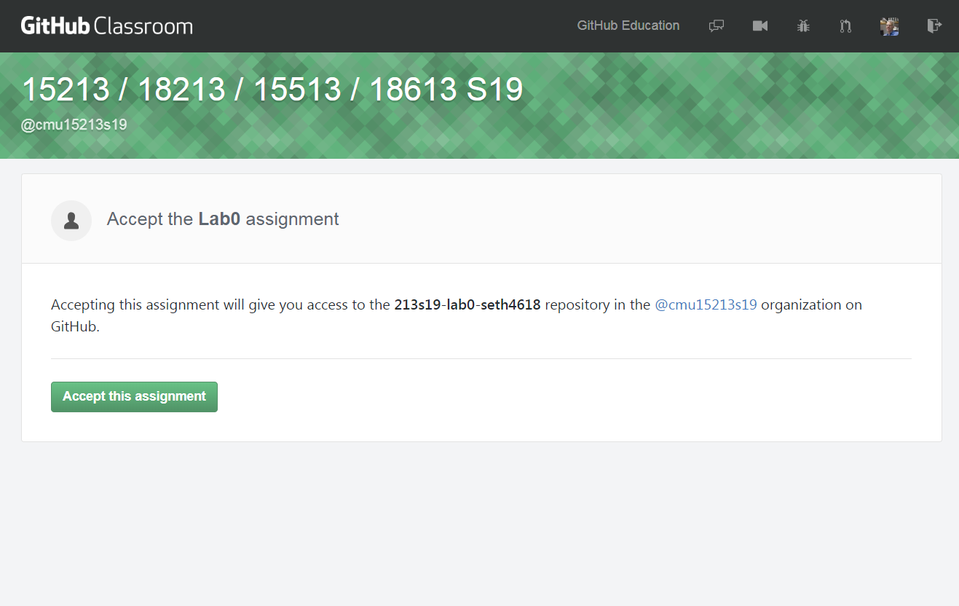
Git basics – create a project for your lab
Follow link from writeup in TPZ
Use link to create a repo
Clone to your local machine
Commit often!

Slide 68
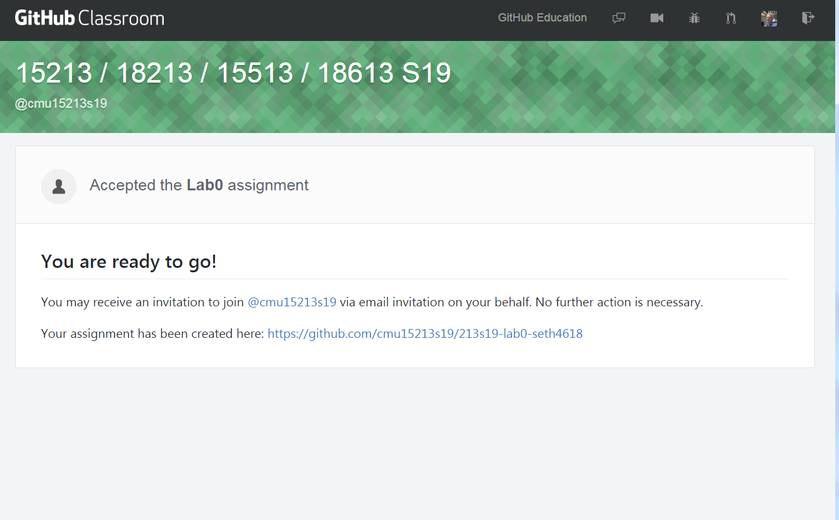
Git basics – create a project for your lab
Follow link from writeup in TPZ
Use link to create a repo
Clone to your local machine
Commit often!

Slide 69
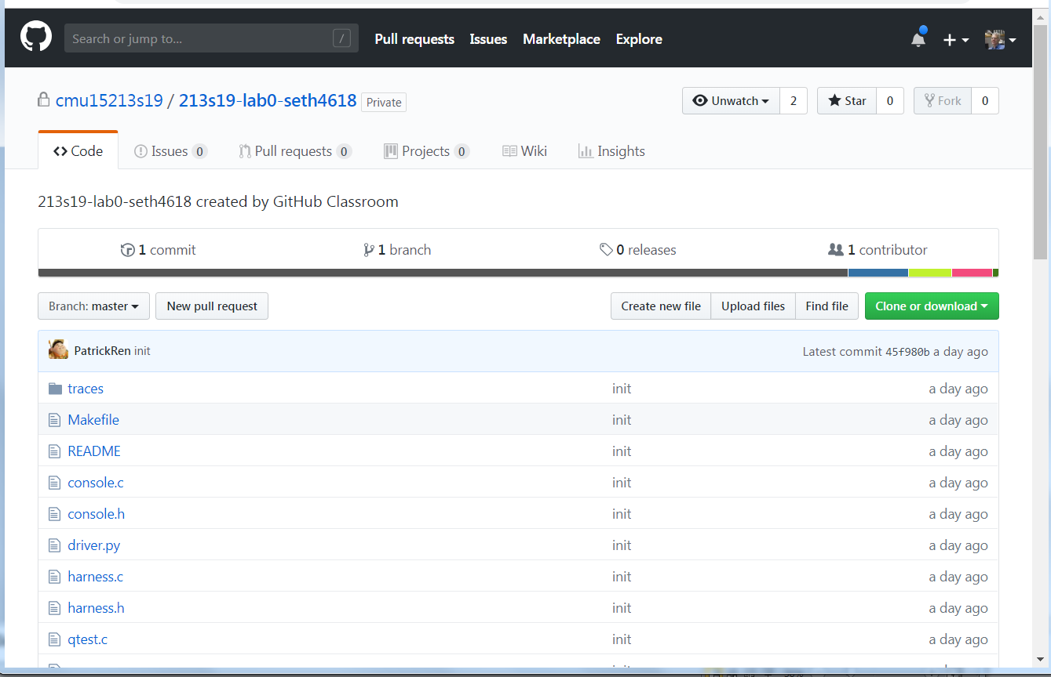
Git basics – create a project for your lab
Follow link from writeup in TPZ
Use link to create a repo
Clone to your local machine
Commit often!

Slide 70
Git basics – create a project for your lab
Follow link from writeup in TPZ
Use link to create a repo
Clone to your local machine
Commit often!

Slide 71
Git basics – clone it to a working directory
Clone into a directory with the proper permissions
git clone git@github.com:cmu15213s19/213s19-lab0-seth4618.git
cd 213s19-lab0-seth4618

