Slide 1
15-213 Recitation: C Review
TA’s
30 Sept 2019

Slide 2
Agenda
Logistics
Attack Lab Conclusion
C Assessment
C Programming Style
C Exercise
Cache Lab Overview
Appendix:
Valgrind
Clang / LLVM
Cache Structure

Slide 3
Logistics
Attack Lab is due tomorrow!
Come to office hours for help
Phase 5 is only worth 5 points
0.2% of your grade ≈ 0% of your grade
Cache Lab will be released shortly after!

Slide 4
Attack Lab Conclusion
Don’t use functions vulnerable to buffer overflow (like gets)
Use functions that allow you to specify buffer lengths:
fgets instead of gets
strncpy instead of strcpy
strncat instead of strcat
snprintf instead of sprint
Use sscanf and fscanf with input lengths (%213s)
Stack protection makes buffer overflow very hard…
But very hard ≠ impossible!

Slide 5
C Assessment
3.5 Basic C Programming Questions
Take some time to write down your answer for each question

Slide 6
C Assessment: Question 1
Consider the following code snippet which allocates an array and sets the values. Which lines have a problem and how can you fix it?
1 int main(int argc, char** argv) {
2 int *a = (int*) malloc(213 * sizeof(int));
3 for (int i=0; i<213; i++) {
4 if (a[i] == 0) a[i]=i;
5 else a[i]=-i;
6 }
7 return 0;
8 }

Slide 7
C Assessment: Question 1
malloc can fail!
1 int main(int argc, char** argv) {
2 int *a = (int*) malloc(213 * sizeof(int));
if (a == NULL) return 0;
3 for (int i=0; i<213; i++) {
4 if (a[i] == 0) a[i]=i;
5 else a[i]=-i;
6 }
7 return 0;
8 }

Slide 8
C Assessment: Question 1
Allocated memory is not initialized!
1 int main(int argc, char** argv) {
2 int *a = (int*) calloc(213, sizeof(int));
if (a == NULL) return 0;
3 for (int i=0; i<213; i++) {
4 if (a[i] == 0) a[i]=i;
5 else a[i]=-i;
6 }
7 return 0;
8 }

Slide 9
C Assessment: Question 1
Declaring variables inside a for loop requires -std=c99
1 int main(int argc, char** argv) {
2 int *a = (int*) calloc(213, sizeof(int));
if (a == NULL) return 0;
3 for (int i=0; i<213; i++) {
4 if (a[i] == 0) a[i]=i;
5 else a[i]=-i;
6 }
7 return 0;
8 }

Slide 10
C Assessment: Question 1
All allocated memory must be freed!
1 int main(int argc, char** argv) {
2 int *a = (int*) calloc(213, sizeof(int));
if (a == NULL) return 0;
3 for (int i=0; i<213; i++) {
4 if (a[i] == 0) a[i]=i;
5 else a[i]=-i;
6 }
free(a);
7 return 0;
8 }

Slide 11
C Assessment: Question 2
What are the values of A and B?
#define SUM(x, y) x + y
int sum(int x, int y) {
return x + y;
}
int A = SUM(2, 1) * 3;
int B = sum(2, 1) * 3;

Slide 12
C Assessment: Question 2
What is wrong with our macro SUM?
#define SUM(x, y) x + y
int sum(int x, int y) {
return x + y;
}
int A = SUM(2, 1) * 3; // A = 2 + 1 * 3 = 5!?
int B = sum(2, 1) * 3; // B = 9

Slide 13
C Assessment: Question 2
Use parentheses around result!
#define SUM(x, y) (x + y)
int sum(int x, int y) {
return x + y;
}
int A = SUM(2, 1) * 3; // A = 9
int B = sum(2, 1) * 3; // B = 9

Slide 14
C Assessment: Question 2 Part B
What are the values of A and B?
#define MULT(x, y) (x * y)
int mult(int x, int y) {
return x * y;
}
int A = MULT(2, 0 + 1) * 3;
int B = mult(2, 0 + 1) * 3;

Slide 15
C Assessment: Question 2 Part B
What is wrong with our macro MULT?
#define MULT(x, y) (x * y)
int mult(int x, int y) {
return x * y;
}
int A = MULT(2, 0 + 1) * 3; // A = (2 * 0 + 1) * 3 = 3?!
int B = mult(2, 0 + 1) * 3; // B = 6

Slide 16
C Assessment: Question 2 Part B
Use parentheses around macro arguments (and result)!
#define MULT(x, y) ((x) * (y))
int mult(int x, int y) {
return x * y;
}
int A = MULT(2, 0 + 1) * 3; // A = ((2) * (0 + 1)) * 3 = 6
int B = mult(2, 0 + 1) * 3; // B = 6

Slide 17
C Assessment: Question 2
Macros are good for compile-time decisions
Assert, requires, etc
dbg_print
Macros are not functions and should not be used interchangeably

Slide 18
C Assessment: Question 3
What lines make safe_int_malloc not so safe?
1 int *safe_int_malloc(int *pointer) {
2 pointer = malloc(sizeof(int));
3 if (pointer == NULL) exit(-1);
4 return &pointer;
5 }

Slide 19
C Assessment: Question 3
pointer is a local copy of the pointer! Modifying *pointer only changes the value within the scope of this function not outside
Passing in an int** let’s us change the value of int* pointer
1 int *safe_int_malloc(int **pointer) {
2 *pointer = malloc(sizeof(int));
3 if (pointer == NULL) exit(-1);
4 return &pointer;
5 }

Slide 20
C Assessment: Question 3
&pointer is a location on the stack in safe_int_malloc’s frame!
The address of something on the stack will be invalid after the function’s execution
1 int **safe_int_malloc(int **pointer) {
2 *pointer = malloc(sizeof(int));
3 if (pointer == NULL) exit(-1);
4 return pointer;
5 }

Slide 21
C Concepts: Pointers
Pointer: stores address of some value in memory
Example:
Let us have a pointer a where int* a = 0x100
*a = accesses value stored at location 0x100
a + i = 0x100 + sizeof(*a) * i
Dereferencing a NULL pointer causes segfault

Slide 22
C Concepts: Valgrind
Tool used for debugging memory use
Find corrupted memory and unexpected program behavior
Find many potential memory leaks and double frees
Shows heap usage over time
Detects invalid memory reads and writes
To learn more… man valgrind
Finding memory leaks
$ valgrind –leak-resolution=high –leak-check=full –show-reachable=yes –track-fds=yes ./myProgram arg1 arg2

Slide 23
C Concepts: Structs + Unions
Struct: groups list of variables under one block in memory
Union: store different data types in same region of memory
Many ways to refer to same memory location
struct temp { union temp {
int i; int i;
char c; char c;
}; };
i (4 bytes)
c (1)
i / c

Slide 24
C Assessment Conclusion
Did you answer every question correctly and know each concept? If not…
Refer to the C Bootcamp slides
Were the test and concepts so easy you were bored? If not…
Refer to the C Bootcamp slides
When in doubt…
Refer to the C Bootcamp slides
This will be very important for the rest of this class, so make sure you are comfortable with the material covered or come to the C Bootcamp!

Slide 25
C Programming Style
Write comments and then implement functionality
Communicate meaning through naming choices
Code should be testable. Modularity supports this
Use consistent formatting
Common bugs: memory and file descriptor leaks, check errors and failure conditions
Warning: Dr. Evil has returned to grade style on Cache Lab! ☺
Refer to full 213 Style Guide: http://cs.cmu.edu/~213/codeStyle.html

Slide 26
C Exercise: $ man 3 getopt
int getopt(int argc, char * const argv[], const char *optstring);
getopt returns -1 when done parsing
optstring is string with command line arguments
Characters followed by colon require arguments
Find argument text in char *optarg
getopt can’t find argument or finds illegal argument sets optarg to “?”
Example: “abc:d:”
a and b are boolean arguments (not followed by text)
c and d are followed by text (found in char *optarg)

Slide 27
while ((opt = getopt(argc, argv, "vn:")) != -1) {
switch (opt) {
case 'v':
verbose = 1;
break;
case 'n':
n = atoi(optarg);
break;
default:
fprintf(stderr, "usage: …");
exit(1);
}
}
Returns -1 when done parsing
Parses value to store in n b/c colon

Slide 28
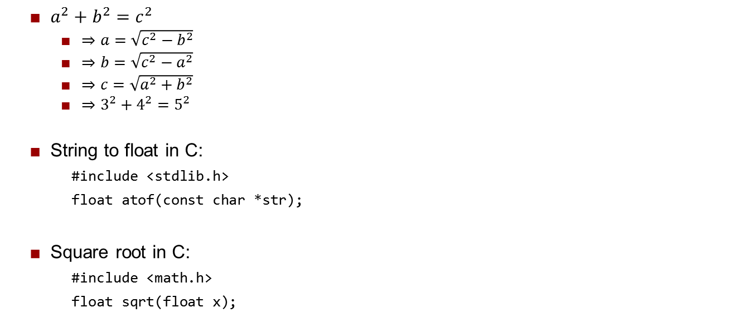
C Exercise: C Hints and Math Reminders
Goal: determine whether triangle is Pythagorean triple
Parse input side lengths a, b, c and optional help flag (1 or 0)

Slide 29
C Exercise
Learn to use getopt
Extremely useful for Cache Lab
Processes command line arguments
Let’s write a Pythagorean Triples Solver!
Pair up!
Login to a shark machine
$ wget http://cs.cmu.edu/~213/recitations/rec6.tar
$ tar xvf rec6.tar
$ cd rec6
Test Cases
3, 4, 5
5, 12, 13
7, 24, 25

Slide 30
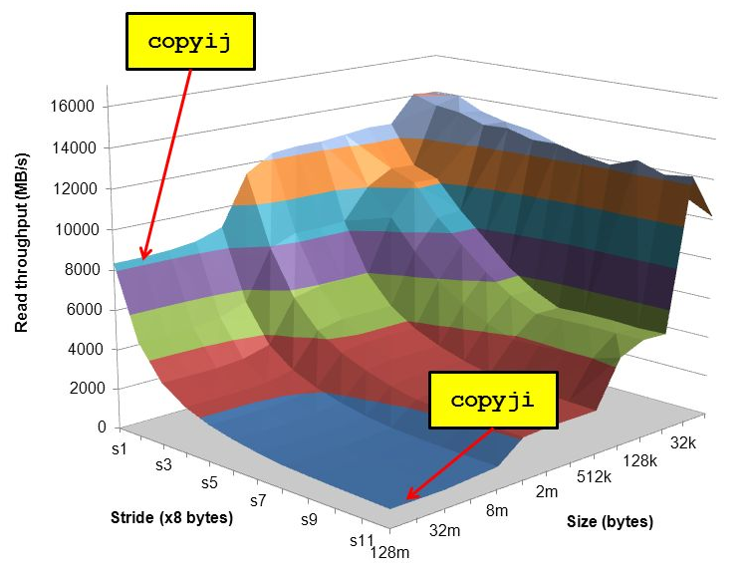
Cache Lab Overview
Programs exhibiting locality run a lot faster!
Temporal Locality – same item referenced again
Spatial Locality – nearby items referenced again
Cache Lab’s Goal:
Understand how L1, L2, … etc. caches work
Optimize memory dependent code to minimize cache misses and evictions
Noticeable increase in speed
The use of git is required
Commit regularly with meaningful commit messages

Slide 31
If you get stuck…
Reread the writeup
Look at CS:APP Chapter 6
Review lecture notes (http://cs.cmu.edu/~213)
Come to Office Hours (Sunday to Friday, 5:30-9:30pm GHC-5207)
Post private question on Piazza
man malloc, man valgrind, man gdb

Slide 32
Cache Lab Tips!
Review cache and memory lectures
Ask if you don’t understand something
Start early, this can be a challenging lab!
Don’t get discouraged!
If you try something that doesn't work, take a well deserved break, and then try again
Finally, Good luck on Cache Lab!

Slide 33
Appendix
Valgrind
Clang / LLVM
Cache Structure

Slide 34
Appendix: Clang / LLVM
Clang is a (gcc equivalent) C compiler
Support for code analyses and transformation
Compiler will check you variable usage and declarations
Compiler will create code recording all memory accesses to a file
Useful for Cache Lab Part B (Matrix Transpose)

Slide 35
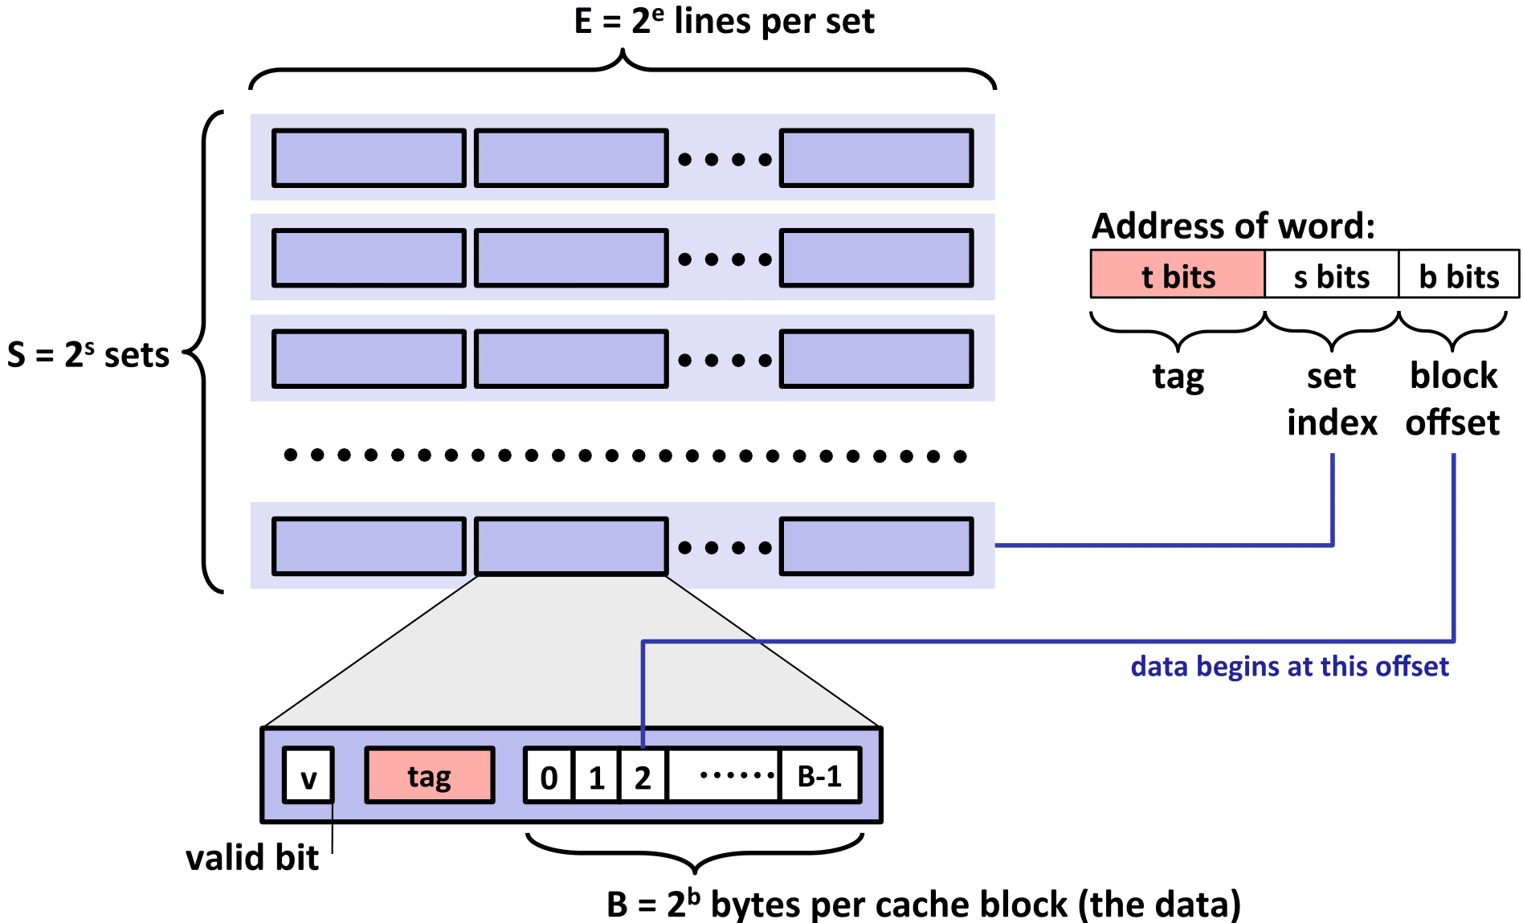
Appendix: Cache Structure

