Slide 1
15-213 Recitation: Attack Lab
Your TAs
September 23rd, 2019

Slide 2
Agenda
Reminders
Stacks
Attack Lab Activities

Slide 3
Reminders
Bomb Lab is due tomorrow!
Attack Lab is due Oct 1st, 2019!
  “But if you wait until the last minute, it only takes a minute!” – NOT!
  Don’t waste your grace days on this assignment!

Slide 4
Attack Lab
We’re letting you hijack programs by running buffer overflow attacks on them.
  Is that not justification enough?
Helps you understand stack discipline and stack frames
  Most difficult part of the midterm exam
Also let you defeat relatively secure programs with return oriented programming

Slide 5
Stack Overview
Let’s say you have the following stack diagram. What happens when you call a function?
What information always goes on the stack?
rsp
ret addr
rsp

Slide 6
Attack Lab Activities
Don’t be afraid if these concepts are unfamiliar! You will be learning them this week in lecture.

Slide 7
Attack Lab Activities
Three activities
  Each relies on a specially crafted assembly sequence to purposefully overwrite the stack
Activity 1 – Overwrites the return addresses
Activity 2 – Writes an assembly sequence onto the stack
Activity 3 – Uses byte sequences in libc as the instructions

Slide 8
Attack Lab Activities
One student needs a laptop
Login to a shark machine
$ wget http://www.cs.cmu.edu/~213/activities/attacklab_activity.tar
$ tar xvf attacklab_activity.tar
$ cd attacklab_activity
$ make
$ gdb act1

Slide 9
Activity 1
(gdb) break clobber
(gdb) run
(gdb) x $rsp
(gdb) backtrace
Q. Does the value at the top of the stack match any frame?

Slide 10
Activity 1 Continued
(gdb) x /2gx $rdi // Here are the two key values
(gdb) stepi // Keep doing this until
              (gdb)
              clobber () at support.s:16
              16 ret
(gdb) x/gx $rsp
Q. Has the return address changed?
(gdb) finish // Should exit and print out “Hi!”

Slide 11
Activity 1 Post
Clobber overwrites part of the stack with memory at $rdi, including the all-important return address
In act1 it writes two new return addresses:
  0x401040: address of printHi()
  0x400c63: address in main
Call clobber()
Clobber executes
In printHi()
In main()
ret
ret
0x7fffffffdd78
0x000000400c63
0x000000401040
0x000000400c63
0x000000401040

Slide 12
Activity 2
$gdb act2
(gdb) break clobber
(gdb) run
(gdb) x $rsp
Q. What is the address of the stack and the return address?
(gdb) x /4gx $rdi
Q. What will the new return address be?
(i.e., what is the first value?)

Slide 13
Activity 2 Continued
(gdb) x/5i $rdi + 8 // Display as instructions
Q. Why rdi + 8?
Q. What are the three addresses?
(gdb) break puts
(gdb) break exit
Q. Do these addresses look familiar?

Slide 14
Activity 2 Post
Normally programs cannot execute instructions on the stack
  Main used mprotect to disable the memory protection for this activity
Clobber wrote an address that’s on the stack as a return address
  Followed by a sequence of instructions
  Three addresses show up in the exploit:
    0x49b259 → “Hi\n” string
    0x4023b0 → puts() function
    0x401fe0 → exit() function

Slide 15
Activity 3
$gdb act3
(gdb) break clobber
(gdb) run
(gdb) x /5gx $rdi
Q. Which value will be first on the stack?
Q. At the end of clobber, where will the function return to?

Slide 16
Activity 3 Continued
(gdb) x /2i <return address>
Q. What does this sequence do?
Q. Do the same for the other addresses. Note that some are return addresses and some are for data. When you continue, what will the code now do?

Slide 17
Activity 3 Post
It’s harder to stop programs from running existing pieces of code in the executable.
Clobber wrote multiple return addresses (aka gadgets) that each performed a small task, along with data that will get popped off the stack while running the gadgets.
  0x401a6e: pop %rdi; retq
  0x4941f0: Pointer to the string “Hi\n”
  0x476397: pop %rax; retq
  0x401060: Address of a printing function
  0x44ad15: callq *%rax

Slide 18
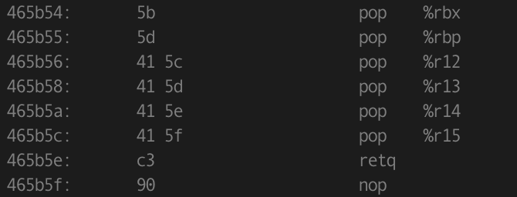

Activity 3 Post
Note that some of the return addresses actually cut off bytes from existing instructions
0x465b5c …0c …0d
-----------------------------------------
pop %r15 retq
41 5f c3
pop %rdi retq
5f c3

Slide 19
Attack Lab Tools
gcc –c test.s; objdump –d test.o > test.asm
  Compiles the assembly code in test.s and shows the actual bytes for the instructions
./hex2raw < exploit.txt > converted.txt
Convert hex codes in exploit.txt into raw ASCII strings to pass to targets
See the writeup for more details on how to use this
(gdb) display /12gx $rsp (gdb) display /2i $rip
Displays 12 elements on the stack and the next 2 instructions to run
GDB is also useful to for tracing to see if an exploit is working

Slide 20
If you get stuck
Please read the writeup. Please read the writeup. Please read the writeup. Please read the writeup!
CS:APP Chapter 3
View lecture notes and course FAQ at http://www.cs.cmu.edu/~213
Office hours Sunday through Friday 5:30-9:30pm in GHC 5207
Post a private question on Piazza
man gdb, gdb's help command

