Slide 1
15-213: Final Exam Review
Minji, Harsha, and Ishita

Slide 2

Threads and Synchronization

Slide 3
Threads and Synchronization
Problem Statement:
15-213 TAs now want to begin a new procedure for daily office hours:
When a student enters the room, he/she will see a table inside the room with several pens and several notebooks on it (if the pens and notebooks haven't been claimed by other students). TAs are inside the room waiting to help them.

Slide 4
Threads and Synchronization
Procedure for students:
Wait until you get called, claim a pen and a notebook.
Use the pen to write your questions on the notebook.
After you are done with question writing, release the pen.
Hold the notebook and wait until a TA is free to help you.
After you are done with talking to a TA about the question, go back to claim a pen and write the solutions on the notebook.
Release the pen and the notebook and go home.

Slide 5
Threads and Synchronization
Typical Code to launch threads and wait for them to finish:
void launch_threads()
{
for(int i = 0; i < S; i++)
{
students[s] =
pthread_create(students+i,
NULL, student_fn, NULL);
}
}
void reap_threads()
{
for(int i = 0; i < S; i++)
{
pthread_join(students[i]);
}
}
sem_t pen;
sem_t notebook;
sem_t ta;
int main(int argc, char** argv)
{
int P = 5, N = 5, T = 3, S = 50;
sem_init(&pen, 0, P);
sem_init(&notebook, 0, N);
sem_init(&ta, 0, T);
int* students = malloc(S * sizeof(int));
launch_threads();
reap_threads();
}

Slide 6
Threads and Synchronization
A student writes the following worker thread to simulate the given procedure
void* student_fn(void* varp)
{
P(&pen);
P(&notebook);
sleep(genrand() % 60); // Time for you to write questions
V(&pen);
P(&ta);
sleep(genrand() % 900); // Time for you to ask TA
V(&ta);
P(&pen);
sleep(genrand() % 60); // Time for you to write solutions
V(&notebook);
V(&pen);
return 0;
}
However, the code sometimes gets stuck by a deadlock. Which of the following is correct?
A: The deadlock is caused by the pen and the notebook.
B: The deadlock is caused by the notebook and the TA.
C: The deadlock is caused by the TA and the pen.

Slide 7
Threads and Synchronization
A student writes the following program to simulate the given procedures
void* student_fn(void* varp)
{
P(&pen);
P(&notebook);
sleep(genrand() % 60); // Time for you to write questions
V(&pen);
P(&ta);
sleep(genrand() % 900); // Time for you to ask TA
V(&ta);
P(&pen);
sleep(genrand() % 60); // Time for you to write solutions
V(&notebook);
V(&pen);
return 0;
}
Let us consider a simple example:
Pens: 5
Notebooks: 5
TAs:
Students: 50

Slide 8
Threads and Synchronization
Case C: TAs and Pens
There is no overlap
There can’t be a case where a student who is talking to a TA is waiting on a pen.
There can’t be a case where a student who is holding a pen is waiting on a TA
Let’s analyse the semaphores
void* student_fn(void* varp)
{
P(&pen);
P(&notebook);
sleep(genrand() % 60); // Time for you to write questions
V(&pen);
P(&ta);
sleep(genrand() % 900); // Time for you to ask TA
V(&ta);
P(&pen);
sleep(genrand() % 60); // Time for you to write solutions
V(&notebook);
V(&pen);
return 0;
}
S: Signal
W: Wait
W:Get a pen
W:Get a Notebook
S: Give up pen
W:Get a TA
S:Give up TA
W:Get a pen
S:Give up Notebook
S: Give up pen

Slide 9
Threads and Synchronization
Case B: TAs and Notebooks
There is an overlap
A student who is holding a notebook may be waiting on a TA
But….A student who is talking to a TA will not be waiting on a notebook
Let’s analyse the semaphores
void* student_fn(void* varp)
{
P(&pen);
P(&notebook);
sleep(genrand() % 60); // Time for you to write questions
V(&pen);
P(&ta);
sleep(genrand() % 900); // Time for you to ask TA
V(&ta);
P(&pen);
sleep(genrand() % 60); // Time for you to write solutions
V(&notebook);
V(&pen);
return 0;
}
S: Signal
W: Wait
W:Get a pen
W:Get a Notebook
S: Give up pen
W:Get a TA
S:Give up TA
W:Get a pen
S:Give up Notebook
S: Give up pen

Slide 10
Threads and Synchronization
Case A: Pens and Notebooks
There is an overlap
A student who is holding a notebook may be waiting on a pen
A student who is holding a pen may be waiting on a notebook
Let’s analyse the semaphores
void* student_fn(void* varp)
{
P(&pen);
P(&notebook);
sleep(genrand() % 60); // Time for you to write questions
V(&pen);
P(&ta);
sleep(genrand() % 900); // Time for you to ask TA
V(&ta);
P(&pen);
sleep(genrand() % 60); // Time for you to write solutions
V(&notebook);
V(&pen);
return 0;
}
S: Signal
W: Wait
W:Get a pen
W:Get a Notebook
S: Give up pen
W:Get a TA
S:Give up TA
W:Get a pen
S:Give up Notebook
S: Give up pen

Slide 11
Threads and Synchronization
Case A: Pens and Notebooks
Consider this likely scenario:
5 Students (group A) enter the room
They grab all 5 pens and all 5 notebooks on the table.
Every student behind them is waiting on a pen and a notebook. (Group B)
All 5 students in Group A give up their pens, but not their notebooks.
5 students in Group B immediately grab the 5 pens.
Group B are now waiting on notebooks.
After talking to the TAs, all students in Group A are now waiting on pens, which students in Group B have.
Group B is waiting on the notebooks which students in Group A have.
DEADLOCK!!
Let’s analyse the semaphores
void* student_fn(void* varp)
{
P(&pen);
P(&notebook);
sleep(genrand() % 60); // Time for you to write questions
V(&pen);
P(&ta);
sleep(genrand() % 900); // Time for you to ask TA
V(&ta);
P(&pen);
sleep(genrand() % 60); // Time for you to write solutions
V(&notebook);
V(&pen);
return 0;
}
S: Signal
W: Wait
W:Get a pen
W:Get a Notebook
S: Give up pen
W:Get a TA
S:Give up TA
W:Get a pen
S:Give up Notebook
S: Give up pen

Slide 12
Threads and Synchronization
A student writes the following program to simulate the given procedures
void* student_fn(void* varp)
{
P(&pen);
P(&notebook);
sleep(genrand() % 60); // Time for you to write questions
V(&pen);
P(&ta);
sleep(genrand() % 900); // Time for you to ask TA
V(&ta);
P(&pen);
sleep(genrand() % 60); // Time for you to write solutions
V(&notebook);
V(&pen);
return 0;
}
However, the code sometimes gets stuck by a deadlock. Which of the following is correct?
A: The deadlock is caused by the pen and the notebook.
B: The deadlock is caused by the notebook and the ta.
C: The deadlock is caused by the ta and the pen.
ANSWER: A
Notes:
TAKEAWAY:
In general, it is a good idea to lock and unlock resources in a LIFO order, i.e. if you lock A, then B, and then C, then it’s a good idea to unlock C, then B, then A to avoid deadlocks.
EXAMPLE:
Consider the following situation:
You lock A and then B. Then, you unlock A, so someone else locks it. Then, you want to lock A again, but the other thread wants to lock B. Thus, you’re holding resource B, that they want, and they’re holding resource A, that you want, so this is a deadlock situation.
However, if you unlock B and then unlock A, then they can lock A and then lock B. Thus, when they’re done using resource A, they can unlock it and you can lock it, thus preventing a deadlock.

Slide 13
Threads and Synchronization
Can we fix this without changing the Office Hour procedure?

Slide 14
Threads and Synchronization
Can we fix this without changing the Office Hour procedure?
YES!

Slide 15
Threads and Synchronization
Let’s just re-order the locks and analyse it again.
A student who is holding a notebook may wait on a pen or a TA
However...
A student who is holding a pen will already have a notebook (and never wait on it).
A student who is talking to a TA will already have a notebook (and never wait on it).
Let’s analyse the semaphores
S: Signal
W: Wait
void* student_fn(void* varp)
{
P(&notebook);
P(&pen);
sleep(genrand() % 60); // Time for you to write questions
V(&pen);
P(&ta);
sleep(genrand() % 900); // Time for you to ask TA
V(&ta);
P(&pen);
sleep(genrand() % 60); // Time for you to write solutions
V(&pen);
V(&notebook);
return 0;
}
W:Get a Notebook
W:Get a pen
S: Give up pen
W:Get a TA
S:Give up TA
W:Get a pen
S: Give up pen
S:Give up Notebook
Notes:
Note how the locking and unlocking order has been fixed, so now it’s not possible for some student to need a notebook while holding a pen, while another student needs the pen while holding the notebook, since the other student cannot need a notebook while holding a pen.

Slide 16
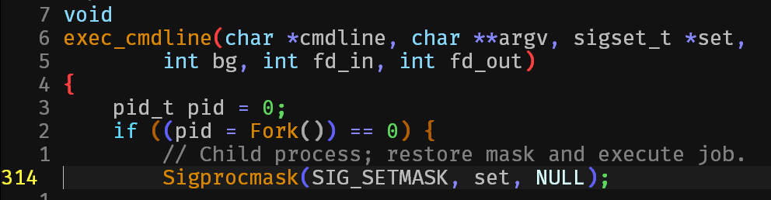

Signals
who would win?
several hundred lines of tshlab code
one asynchronous boi
Notes:
TAKEAWAY:
It’s non-deterministic. It depends on whether the signal is received by the process first, or whether it isn’t. We must keep in mind that this is an asynchronous signal, i.e. it is sent and received non-deterministically.

Slide 17
Signals
Examples in these slides are important “gotchas”
  NOT an all inclusive list
  In particular, these do NOT go over signals sent between multiple processes
Many more examples in:
  Recitation slides
  Lecture slides
  Past exams
Reminder: solve the questions on your own when studying before looking at the answer

Slide 18
Signals
Does the following code ever terminate?
void handler(int sig) {
while(1);
}
int main() {
Signal(SIGUSR1, handler);
Kill(0, SIGUSR1);
return 0;
}

Slide 19
Signals
Does the following code ever terminate?
void handler(int sig) {
while(1); // stuck here forever!
}
int main() {
Signal(SIGUSR1, handler);
// Spec says signal sent to self must be handled
// before kill() returns
Kill(0, SIGUSR1);
return 0;
}
Notes:
TAKEAWAY:
The kill() returns only once the signal has been handled. If there’s a pending call to the handler, the handler is invoked when it is possible to handle that signal, and only then does the kill() call return. Thus, the return 0 is never reached in this case since the handler never returns.
It is important to keep in mind that the kill() call gets processed immediately, i.e. the signal gets sent immediately. However, the signal may or may not be received immediately by the process, depending on whether or not it is blocked. If it is blocked, the bit corresponding to that signal gets set in the process’ pending vector. However, if it isn’t blocked and isn’t pending, the signal can be received immediately (if there isn’t some other signal that needs to be handled first).
In general, we can’t be sure that the signal receives the signal immediately with the kill() system call, and the kill() system call returns only once the signal has been received by the process (and handled, if there’s a handler for it).

Slide 20
Signals
What about now?
void handler(int sig) {
Kill(0, SIGUSR1);
}
int main() {
Signal(SIGUSR1, handler);
Kill(0, SIGUSR1);
return 0;
}
Notes:
TAKEAWAY:
An important point to keep in mind is that SIGKILL cannot be blocked or handled. If it is sent to a process, the process always receives it as soon as possible.

Slide 21
Signals
What about now?
void handler(int sig) {
Kill(0, SIGUSR1);
}
int main() {
Signal(SIGUSR1, handler);
Kill(0, SIGUSR1);
return 0;
}
Does not terminate:
main: Kill(0, SIGUSR1);
<SIGUSR1 handler invoked, SIGUSR1 blocked in handler>
handler: Kill(0, SIGUSR1);
<SIGUSR1 pending>
<handler returns>
<SIGUSR1 unblocked, SIGUSR1 handler invoked, SIGUSR1 blocked in handler>
handler: Kill(0, SIGUSR);
...repeat...
Notes:
TAKEAWAY:
It is important to remember that the signal being handled is always blocked, so if any other signals of the same type are received, only one of them is set to pending and the others are discarded since signal queuing isn’t allowed. This isn’t shown explicitly, but it is to be understood. When the handler returns, the signal is unblocked again.

Slide 22

Processes

Slide 23
Processes
Draw a Process Graph!!!
(it does not have to be like mine)
Notes:
TAKEAWAY:
Remember processes can switch among themselves, but the order of execution of steps within a process is deterministic.

Slide 24
Processes
int main() {
int count = 1;
int pid1 = fork();
int pid2 = fork();
if(pid1 == 0)
count++;
else{
if(pid2 == 0)
count--;
else
count += 2;
}
printf(“%d”, count);
}
What is printed?
Assume printf is atomic, and all system calls succeed.

Slide 25
Processes
int main() {
int count = 1;
int pid1 = fork();
int pid2 = fork();
if(pid1 == 0)
count++;
else{
if(pid2 == 0)
count--;
else
count += 2;
}
printf(“%d”, count);
}
How many processes?

Slide 26
Processes
int main() {
int count = 1;
int pid1 = fork();
int pid2 = fork();
if(pid1 == 0)
count++;
else{
if(pid2 == 0)
count--;
else
count += 2;
}
printf(“%d”, count);
}
How many processes?
Parent: forks child
Parent and child: each fork another child
Total: 4 processes
Notes:
TAKEAWAY:
Any statements after a call to fork() occur in both, the parent and the child - unless there’s a case on the parent or the child. This is the reason why the second fork() happens in both, since there’s no condition on it being in the child or in the parent.

Slide 27
Processes
int main() {
int count = 1;
int pid1 = fork();
int pid2 = fork();
if(pid1 == 0)
count++;
else{
if(pid2 == 0)
count--;
else
count += 2;
}
printf(“%d”, count);
}
What does the process diagram look like?

Slide 28
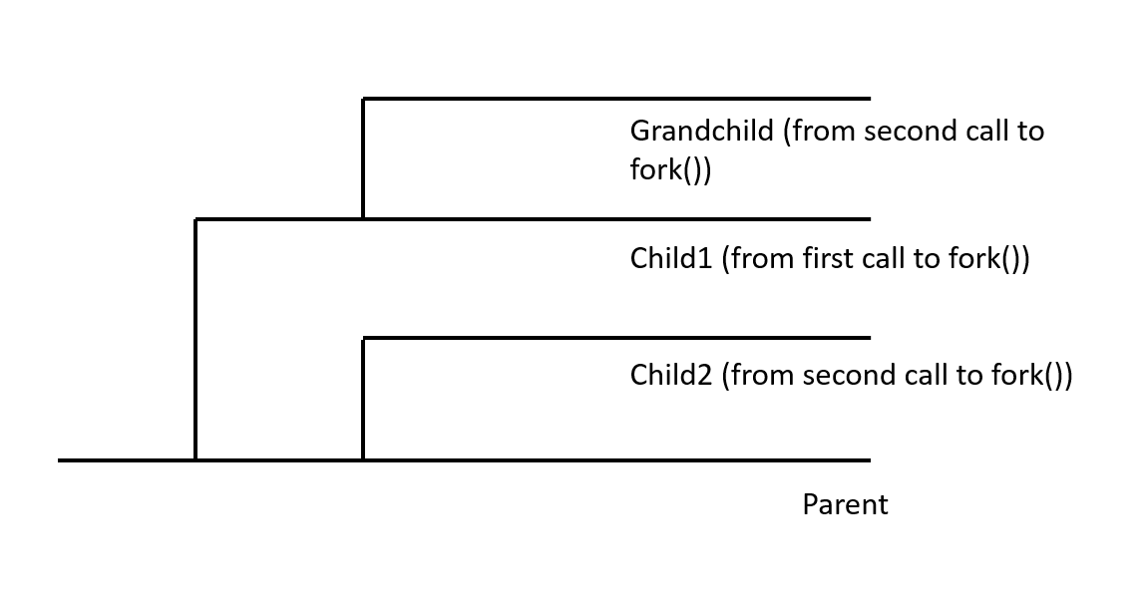
Processes
int main() {
int count = 1;
int pid1 = fork();
int pid2 = fork();
if(pid1 == 0)
count++;
else{
if(pid2 == 0)
count--;
else
count += 2;
}
printf(“%d”, count);
}
What does the process diagram look like?

Slide 29
Processes
int main() {
int count = 1;
int pid1 = fork();
int pid2 = fork();
if(pid1 == 0)
count++;
else{
if(pid2 == 0)
count--;
else
count += 2;
}
printf(“%d”, count);
}
What does count look like?
Parent: pid1 != 0 and pid2 != 0
Child1: pid1 == 0 and pid2 != 0
Child2: pid1 != 0 and pid2 == 0
Grandchild: pid1 == 0 and pid2 == 0
Notes:
TAKEAWAY:
If fork() returns in the child process, the value returned is 0, and the parent’s process ID is obtained using the getppid() function.
If fork() returns in the parent process, the value returned is some positive integer which indicates the child’s PID.
If fork() returns a negative value (-1), it means there’s an error forking a child.
A process can obtain its own PID by using the getpid() function.

Slide 30
Processes
int main() {
int count = 1;
int pid1 = fork();
int pid2 = fork();
if(pid1 == 0)
count++;
else{
if(pid2 == 0)
count--;
else
count += 2;
}
printf(“%d”, count);
}
What does count look like?
Parent: pid1 != 0 and pid2 != 0
count = 3
Child1: pid1 == 0 and pid2 != 0
count = 2
Child2: pid1 != 0 and pid2 == 0
count = 0
Grandchild: pid1 == 0 and pid2 == 0
count = 2

Slide 31
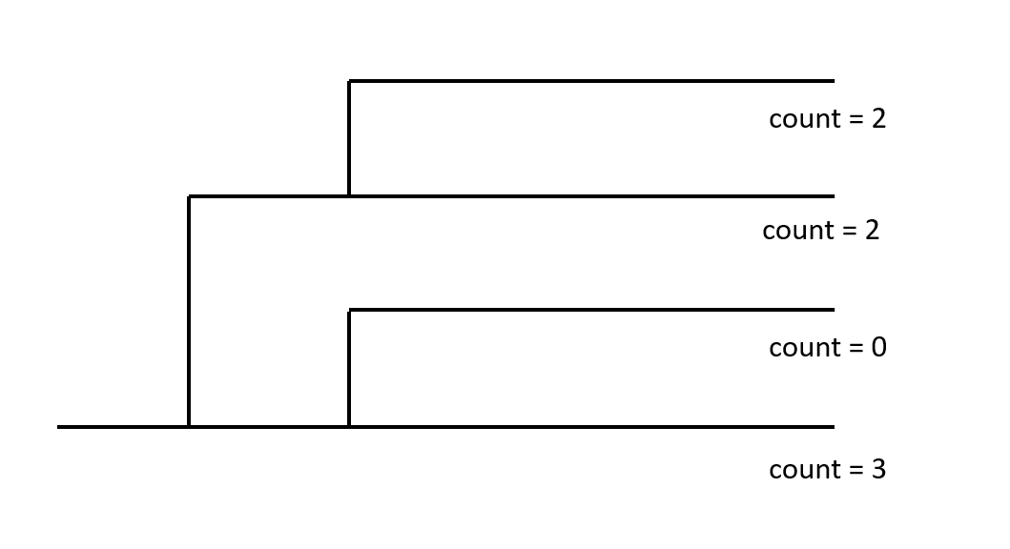
Processes
int main() {
int count = 1;
int pid1 = fork();
int pid2 = fork();
if(pid1 == 0)
count++;
else{
if(pid2 == 0)
count--;
else
count += 2;
}
printf(“%d”, count);
}
Given the process diagram, what are the different permutations that can be printed out?

Slide 32
Processes
Given the process diagram, what are the different permutations that can be printed out?
int main() {
int count = 1;
int pid1 = fork();
int pid2 = fork();
if(pid1 == 0)
count++;
else{
if(pid2 == 0)
count--;
else
count += 2;
}
printf(“%d”, count);
}
Math! 4! / 2 = 12 different possible outcomes
Notes:
TAKEAWAY:
We divided by 2 since 2 of the outcomes are the same. If we have n outcomes of which m outcomes are the same, the number of permutations is given by (n! / m!).
The outcomes are:
3022
3202
3220
0322
0232
0223
2023
2032
2203
2230
2302
2320

Slide 33
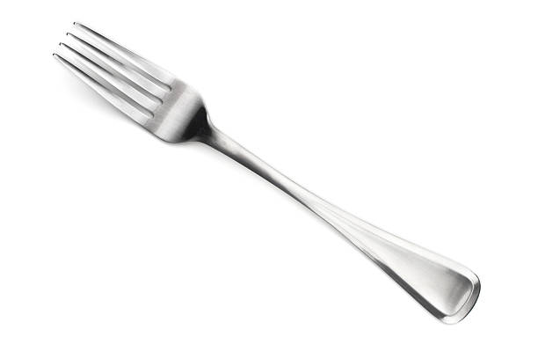
Processes
Remember:
Processes can occur in any order
Watch out for a wait or a waitpid!
  What if I included a wait(NULL) before I printed out count?
Good luck!
Notes:
TAKEAWAY:
The use of a wait or waitpid ensures that all statements after that statement occur only once the child has been run completely. However, another important point to keep in mind is that waitpid isn’t used only for child termination and resource reaping - it is used to indicate a change in the state of the child. This may be one of the following:
Terminated and its resources are reaped
Stopped child has resumed execution
Child has been stopped.
We must remember that the parent can print only after child1 and child2 have terminated. Child1 and child2 can terminate in any order, but between child1 and the grandchild, the grandchild must terminate before the child. Thus, the possible print sequences are:
Grandchild → Child1 → Child2 → Parent - 2203
Grandchild → Child2 → Child1 → Parent - 2023
Child2 → Grandchild → Child1 → Parent - 0223

Slide 34

File IO

Slide 35
File IO
Main ideas:
How does read offset?
How does dup2 work?
  What is the order of arguments?
  Does fd3 share offset with fd2?
foo.txt: abcdefgh...xyz
int main() {
int fd1, fd2, fd3;
char c;
pid_t pid;
fd1 = open(“foo.txt”, O_RDONLY);
fd2 = open(“foo.txt”, O_RDONLY);
fd3 = open(“foo.txt”, O_RDONLY);
read(fd1, &c, sizeof(c)); // c = ?
read(fd2, &c, sizeof(c)); // c = ?
dup2(fd2, fd3);
read(fd3, &c, sizeof(c)); // c = ?
read(fd2, &c, sizeof(c)); // c = ?

Slide 36
File IO
foo.txt: abcdefgh...xyz
int main() {
int fd1, fd2, fd3;
char c;
pid_t pid;
fd1 = open(“foo.txt”, O_RDONLY);
fd2 = open(“foo.txt”, O_RDONLY);
fd3 = open(“foo.txt”, O_RDONLY);
read(fd1, &c, sizeof(c)); // c = a
read(fd2, &c, sizeof(c)); // c = a
dup2(fd2, fd3);
read(fd3, &c, sizeof(c)); // c = b
read(fd2, &c, sizeof(c)); // c = c
How does read offset?
  Incremented by number of bytes read
How does dup2 work?
  Any read/write from fd3 now happen from fd2
  All file offsets are shared
Notes:
TAKEAWAY:
Each process has its own file descriptor table.
Each file descriptor has its own entry in the open file table (this entry is shared between a parent and its children if it was opened before the call to fork(), but not between 2 file descriptors using the same file). It stores the offset in the file.
Each open file has its own entry in the v-node table. If there are multiple open file table entries using the same file, they have the same entry in the v-node table.
When using dup2, the 2nd file descriptor gets redirected to start pointing to the entry in the open file table corresponding to the 1st file descriptor. Thus, file offsets are shared between the 2.
Open file table entries are closed when their reference count becomes 0.

Slide 37
File IO
Main ideas:
How are fd shared between processes?
How does dup2 work from parent to child?
How are file offsets shared between processes?
read(fd1, &c, sizeof(c)); // a
read(fd2, &c, sizeof(c)); // a
dup2(fd2, fd3);
read(fd3, &c, sizeof(c)); // b
read(fd2, &c, sizeof(c)); // c
pid = fork();
if (pid==0) {
read(fd1, &c, sizeof(c));
printf(“c = %c\n”, c);
dup2(fd1, fd2);
read(fd3, &c, sizeof(c));
printf(“c = %c\n”, c);
}
read(fd2, &c, sizeof(c));
printf(“c = %c\n”, c);
read(fd1, &c, sizeof(c));
printf(“c = %c\n”, c);
Notes:
TAKEAWAY:
A file descriptor isn’t closed until the reference count for the open file table entry corresponding to it is 0. In this case, fd3 was redirected to fd2, so the reference count for that file table entry became 3 (1 from the parent and 2 from the child). When fd2 was redirected to fd1, the count for that entry went down to 2 (1 from the parent and 1 from the child), but not 0 so that file is still open.
When sharing fd between processes, they only have their own descriptor tables, but not the open file table entries. If dup2 was done before the fork(), it is reflected in both processes. Otherwise, it is reflected in only the process in which it was called. File offsets are shared between the parent and child processes since they both have the same entry in the open file table.

Slide 38
File IO
read(fd1, &c, sizeof(c)); // a
read(fd2, &c, sizeof(c)); // a
dup2(fd2, fd3);
read(fd3, &c, sizeof(c)); // b
read(fd2, &c, sizeof(c)); // c
pid = fork();
if (pid==0) {
read(fd1, &c, sizeof(c));
printf(“c = %c\n”, c);
dup2(fd1, fd2);
read(fd3, &c, sizeof(c));
printf(“c = %c\n”, c);
}
read(fd2, &c, sizeof(c));
printf(“c = %c\n”, c);
read(fd1, &c, sizeof(c));
printf(“c = %c\n”, c);
What would this program print?

Slide 39
File IO
read(fd1, &c, sizeof(c)); // a
read(fd2, &c, sizeof(c)); // a
dup2(fd2, fd3);
read(fd3, &c, sizeof(c)); // b
read(fd2, &c, sizeof(c)); // c
pid = fork();
if (pid==0) {
read(fd1, &c, sizeof(c));
printf(“c = %c\n”, c);
dup2(fd1, fd2);
read(fd3, &c, sizeof(c));
printf(“c = %c\n”, c);
}
read(fd2, &c, sizeof(c));
printf(“c = %c\n”, c);
read(fd1, &c, sizeof(c));
printf(“c = %c\n”, c);
Possible output 1:
c = d // in parent
c = b // in parent
c = c // in child from fd1
c = e // in child from fd3
c = d // in child
c = e // in child

Slide 40
File IO
read(fd1, &c, sizeof(c)); // a
read(fd2, &c, sizeof(c)); // a
dup2(fd2, fd3);
read(fd3, &c, sizeof(c)); // b
read(fd2, &c, sizeof(c)); // c
pid = fork();
if (pid==0) {
read(fd1, &c, sizeof(c));
printf(“c = %c\n”, c);
dup2(fd1, fd2);
read(fd3, &c, sizeof(c));
printf(“c = %c\n”, c);
}
read(fd2, &c, sizeof(c));
printf(“c = %c\n”, c);
read(fd1, &c, sizeof(c));
printf(“c = %c\n”, c);
Possible output 2:
c = b // in child
c = d // in child
c = c // in child
c = d // in child
c = e // in parent
c = e // in parent

Slide 41
File IO
.
.
pid = fork();
if (pid==0) {
read(fd1, &c, sizeof(c));
printf(“c = %c\n”, c);
dup2(fd1, fd2);
read(fd3, &c, sizeof(c));
printf(“c = %c\n”, c);
}
if (pid!=0) waitpid(-1, NULL, 0);
read(fd2, &c, sizeof(c));
printf(“c = %c\n”, c);
read(fd1, &c, sizeof(c));
printf(“c = %c\n”, c);
return 0;
}
What are the possible outputs now?

Slide 42
File IO
.
.
pid = fork();
if (pid==0) {
read(fd1, &c, sizeof(c));
printf(“c = %c\n”, c);
dup2(fd1, fd2);
read(fd3, &c, sizeof(c));
printf(“c = %c\n”, c);
}
if (pid!=0) waitpid(-1, NULL, 0);
read(fd1, &c, sizeof(c));
printf(“c = %c\n”, c);
read(fd2, &c, sizeof(c));
printf(“c = %c\n”, c);
return 0;
}
Possible output:
c = b // in child
c = d // in child
c = c // in child
c = d // in child
c = e // in parent
c = e // in parent

Slide 43
File IO
Child creates a copy of the parent fd table
  dup2/open/close in parent only before fork() affect the child
  dup2/open/close in child do NOT affect the parent
File descriptors across process share the same file offset.
read(fd1, &c, sizeof(c)); // a
read(fd2, &c, sizeof(c)); // a
dup2(fd2, fd3);
read(fd3, &c, sizeof(c)); // b
read(fd2, &c, sizeof(c)); // c
pid = fork();
if (pid==0) {
read(fd1, &c, sizeof(c));
dup2(fd1, fd2);
read(fd3, &c, sizeof(c));
}
if (pid!=0) waitpid(-1, NULL, 0);
read(fd2, &c, sizeof(c));
read(fd1, &c, sizeof(c));

Slide 44

Virtual Memory

Slide 45
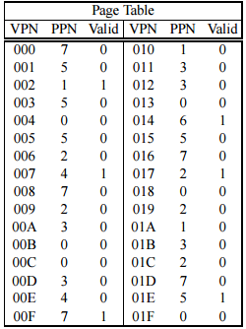
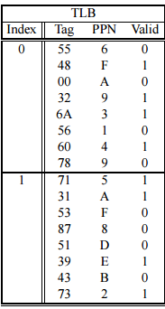
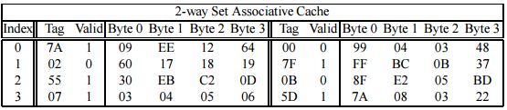
Virtual Memory
Virtual Address - 18 Bits
Physical Address - 12 Bits
Page Size - 512 Bytes
TLB is 8-way set associative
Cache is 2-way set associative
Final S-02 (#5)
Lecture 18: VM - Systems
Notes:
TAKEAWAY:
Set associativity indicates the number of lines per set. Thus, n-way set associative implies there are n lines per set. Fully associative implies all lines are in the same set, i.e. only 1 set. Direct mapped cache implies 1-way set associativity, i.e. 1 line per set.

Slide 46

Virtual Memory
Label the following:
VPO: Virtual Page Offset
VPN: Virtual Page Number
TLBI: TLB Index
TLBT: TLB Tag
Notes:
TAKEAWAY:
Page size is 2^p bytes, so the page offset is represented using p bits.
VPO and PPO are the same, and are both represented using p bits.
The remaining top bits indicate the VPN and the PPN.
If the TLB has (2^n) sets, then the bottom n bits of the VPN indicate the TLB index and the remaining bits indicate the TLB tag.

Slide 47
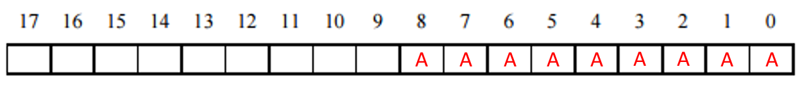
Virtual Memory
Label the following:
VPO: Virtual Page Offset - Location in the page
Page Size = 512 Bytes = 2⁹ → Need 9 bits

Slide 48
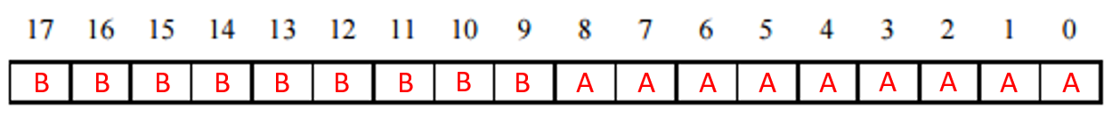
Virtual Memory
Label the following:
VPO: Virtual Page Offset
VPN: Virtual Page Number - Everything Else

Slide 49
Virtual Memory
Label the following:
VPO: Virtual Page Offset
VPN: Virtual Page Number
TLBI: TLB Index - Location in the TLB Cache

Slide 50
Virtual Memory
Label the following:
VPO: Virtual Page Offset
VPN: Virtual Page Number
TLBI: TLB Index - Location in the TLB Cache
2 Indices → 1 Bit
TLBI

Slide 51
Virtual Memory
Label the following:
VPO: Virtual Page Offset
VPN: Virtual Page Number
TLBI: TLB Index
TLBT: TLB Tag - Everything Else
TLBT
TLBI

Slide 52

Virtual Memory
Label the following:
PPO: Physical Page Offset
PPN: Physical Page Number
CO: Cache Offset
CI: Cache Index
CT: Cache Tag

Slide 53
Virtual Memory
Label the following:
PPO: Physical Page Offset

Slide 54
Virtual Memory
Label the following:
PPO: Physical Page Offset - Same as VPO
A
A
A
A
A
A
A
A
A

Slide 55
Virtual Memory
Label the following:
PPO: Physical Page Offset - Same as VPO
PPN: Physical Page Number - Everything Else
B
B
B
A
A
A
A
A
A
A
A
A

Slide 56
Virtual Memory
Label the following:
PPO: Physical Page Offset - Same as VPO
PPN: Physical Page Number - Everything Else
CO: Cache Offset - Offset in Block
B
B
B
A
A
A
A
A
A
A
A
A

Slide 57
Virtual Memory
Label the following:
PPO: Physical Page Offset - Same as VPO
PPN: Physical Page Number - Everything Else
CO: Cache Offset - Offset in Block
4 Byte Blocks → 2 Bits
B
B
B
A
A
A
A
A
A
A
A
A
CO

Slide 58
Virtual Memory
Label the following:
PPO: Physical Page Offset - Same as VPO
PPN: Physical Page Number - Everything Else
CO: Cache Offset - Offset in Block
CI: Cache Index
B
B
B
A
A
A
A
A
A
A
A
A
CO

Slide 59
Virtual Memory
Label the following:
PPO: Physical Page Offset - Same as VPO
PPN: Physical Page Number - Everything Else
CO: Cache Offset - Offset in Block
CI: Cache Index
4 Indices → 2 Bits
B
B
B
A
A
A
A
A
A
A
A
A
CI
CO

Slide 60
Virtual Memory
Label the following:
PPO: Physical Page Offset - Same as VPO
PPN: Physical Page Number - Everything Else
CO: Cache Offset - Offset in Block
CI: Cache Index
CT: Cache Tag - Everything Else
B
B
B
A
A
A
A
A
A
A
A
A
Cache Tag
CI
CO
Notes:
TAKEAWAY:
Cache offset indicates the offset within the block. If there were 2^k bytes in a block, the bottom k bits represent the cache offset. If the cache has 2^m entries and 2^k bytes per block, this means that there are 2^(m-k) blocks. Given that the cache is (2^n)-way set associative, we get that there are (m - k - n) sets in all, so the next (m - n - k) bits represent the cache index. All of the other bits in the physical page address represent the cache tag.

Slide 61
Virtual Memory
Now to the actual question!
Q) Translate the following address: 0x1A9F4

Slide 62
Virtual Memory
Now to the actual question!
Q) Translate the following address: 0x1A9F4
Write down bit representation
1 = 0001 A = 1010 9 = 1001 F = 1111 4 = 0100
0
1
1
0
1
0
1
0
0
1
1
1
1
1
0
1
0
0

Slide 63
Virtual Memory
Now to the actual question!
Q) Translate the following address: 0x1A9F4
Write down bit representation
Extract Information:
VPN: 0x?? TLBI: 0x?? TLBT: 0x??
TLB Hit: Y/N? Page Fault: Y/N? PPN: 0x??
0
1
1
0
1
0
1
0
0
1
1
1
1
1
0
1
0
0

Slide 64
Virtual Memory
Now to the actual question!
Q) Translate the following address: 0x1A9F4
Write down bit representation
Extract Information:
VPN: 0xD4 TLBI: 0x?? TLBT: 0x??
TLB Hit: Y/N? Page Fault: Y/N? PPN: 0x??
0
1
1
0
1
0
1
0
0
1
1
1
1
1
0
1
0
0

Slide 65
Virtual Memory
Now to the actual question!
Q) Translate the following address: 0x1A9F4
Write down bit representation
Extract Information:
VPN: 0xD4 TLBI: 0x00 TLBT: 0x??
TLB Hit: Y/N? Page Fault: Y/N? PPN: 0x??
0
1
1
0
1
0
1
0
0
1
1
1
1
1
0
1
0
0

Slide 66
Virtual Memory
Now to the actual question!
Q) Translate the following address: 0x1A9F4
Write down bit representation
Extract Information:
VPN: 0xD4 TLBI: 0x00 TLBT: 0x6A
TLB Hit: Y/N? Page Fault: Y/N? PPN: 0x??
0
1
1
0
1
0
1
0
0
1
1
1
1
1
0
1
0
0

Slide 67
Virtual Memory
Now to the actual question!
Q) Translate the following address: 0x1A9F4
Write down bit representation
Extract Information:
VPN: 0xD4 TLBI: 0x00 TLBT: 0x6A
TLB Hit: Y! Page Fault: Y/N? PPN: 0x??
0
1
1
0
1
0
1
0
0
1
1
1
1
1
0
1
0
0

Slide 68
Virtual Memory
Now to the actual question!
Q) Translate the following address: 0x1A9F4
Write down bit representation
Extract Information:
VPN: 0xD4 TLBI: 0x00 TLBT: 0x6A
TLB Hit: Y! Page Fault: N! PPN: 0x??
0
1
1
0
1
0
1
0
0
1
1
1
1
1
0
1
0
0

Slide 69
Virtual Memory
Now to the actual question!
Q) Translate the following address: 0x1A9F4
Write down bit representation
Extract Information:
VPN: 0xD4 TLBI: 0x00 TLBT: 0x6A
TLB Hit: Y! Page Fault: N! PPN: 0x3
0
1
1
0
1
0
1
0
0
1
1
1
1
1
0
1
0
0

Slide 70
Virtual Memory
Now to the actual question!
Q) Translate the following address: 0x1A9F4
Write down bit representation
Extract Information
Put it all together: PPN: 0x3, PPO = 0x??
0
1
1

Slide 71
Virtual Memory
Now to the actual question!
Q) Translate the following address: 0x1A9F4
Write down bit representation
Extract Information
Put it all together: PPN: 0x3, PPO = VPO = 0x1F4
0
1
1
1
1
1
1
1
0
1
0
0

Slide 72
Virtual Memory
Q) What is the value of the address?
CO: 0x?? CI: 0x?? CT: 0x?? Cache Hit: Y/N? Value:0x??
0
1
1
1
1
1
1
1
0
1
0
0

Slide 73
Virtual Memory
Q) What is the value of the address?
Extract more information
CO: 0x00 CI: 0x?? CT: 0x?? Cache Hit: Y/N? Value:0x??
0
1
1
1
1
1
1
1
0
1
0
0

Slide 74
Virtual Memory
Q) What is the value of the address?
Extract more information
CO: 0x00 CI: 0x01 CT: 0x?? Cache Hit: Y/N? Value:0x??
0
1
1
1
1
1
1
1
0
1
0
0

Slide 75
Virtual Memory
Q) What is the value of the address?
Extract more information
Go to Cache Table
CO: 0x00 CI: 0x01 CT: 0x7F Cache Hit: Y/N? Value:0x??
0
1
1
1
1
1
1
1
0
1
0
0

Slide 76
Virtual Memory
Q) What is the value of the address?
Extract more information
Go to Cache Table
CO: 0x00 CI: 0x01 CT: 0x7F Cache Hit: Y Value:0x??
0
1
1
1
1
1
1
1
0
1
0
0

Slide 77
Virtual Memory
Q) What is the value of the address?
Extract more information
Go to Cache Table
CO: 0x00 CI: 0x01 CT: 0x7F Cache Hit: Y Value:0xFF
0
1
1
1
1
1
1
1
0
1
0
0
Notes:
TAKEAWAY:
A TLB cache hit doesn’t necessarily imply a cache hit. Similarly, a cache hit may occur even when a TLB cache hit doesn’t. A cache miss, or if the valid bit isn’t set, corresponds to a page fault. The cache offset indicates which byte to pick from the given set when we find it in the cache.

Slide 78

Virtual Memory

Slide 79

Good luck!

Slide 80

Malloc

Slide 81

Malloc
Fit algorithms - first/next/best/good
Fragmentation
  Internal - inside blocks
  External - between blocks
Organization
  Implicit
  Explicit
  Segregated

Slide 82
Malloc - First fit
 | #1 | #2 | #3 | #4 | #5 | #6
a = malloc(32)
b = malloc(16)
c = malloc(16)
d = malloc(40)
free(c)
free(a)
e = malloc(16)
free(d)
f = malloc(48)
free(b)
16 byte align
coalesced
footerless
32 min size
final-f01.pdf: Problem 10 Part A

Slide 83
Malloc - First fit
 | #1 | #2 | #3 | #4 | #5 | #6
a = malloc(32) | 48a
b = malloc(16)
c = malloc(16)
d = malloc(40)
free(c)
free(a)
e = malloc(16)
free(d)
f = malloc(48)
free(b)
16 byte align
coalesced
footerless
32 min size
final-f01.pdf: Problem 10 Part A

Slide 84
Malloc - First fit
 | #1 | #2 | #3 | #4 | #5 | #6
a = malloc(32) | 48a
b = malloc(16) | 48a | 32a
c = malloc(16)
d = malloc(40)
free(c)
free(a)
e = malloc(16)
free(d)
f = malloc(48)
free(b)
16 byte align
coalesced
footerless
32 min size
final-f01.pdf: Problem 10 Part A

Slide 85
Malloc - First fit
 | #1 | #2 | #3 | #4 | #5 | #6
a = malloc(32) | 48a
b = malloc(16) | 48a | 32a
c = malloc(16) | 48a | 32a | 32a
d = malloc(40)
free(c)
free(a)
e = malloc(16)
free(d)
f = malloc(48)
free(b)
16 byte align
coalesced
footerless
32 min size
final-f01.pdf: Problem 10 Part A

Slide 86
Malloc - First fit
 | #1 | #2 | #3 | #4 | #5 | #6
a = malloc(32) | 48a
b = malloc(16) | 48a | 32a
c = malloc(16) | 48a | 32a | 32a
d = malloc(40) | 48a | 32a | 32a | 48a
free(c)
free(a)
e = malloc(16)
free(d)
f = malloc(48)
free(b)
16 byte align
coalesced
footerless
32 min size
final-f01.pdf: Problem 10 Part A

Slide 87
Malloc - First fit
 | #1 | #2 | #3 | #4 | #5 | #6
a = malloc(32) | 48a
b = malloc(16) | 48a | 32a
c = malloc(16) | 48a | 32a | 32a
d = malloc(40) | 48a | 32a | 32a | 48a
free(c) | 48a | 32a | 32f [0] | 48a
free(a)
e = malloc(16)
free(d)
f = malloc(48)
free(b)
16 byte align
coalesced
footerless
32 min size
final-f01.pdf: Problem 10 Part A

Slide 88
Malloc - First fit
 | #1 | #2 | #3 | #4 | #5 | #6
a = malloc(32) | 48a
b = malloc(16) | 48a | 32a
c = malloc(16) | 48a | 32a | 32a
d = malloc(40) | 48a | 32a | 32a | 48a
free(c) | 48a | 32a | 32f [0] | 48a
free(a) | 48f [0] | 32a | 32f [1] | 48a
e = malloc(16)
free(d)
f = malloc(48)
free(b)
16 byte align
coalesced
footerless
32 min size
final-f01.pdf: Problem 10 Part A

Slide 89
Malloc - First fit
 | #1 | #2 | #3 | #4 | #5 | #6
a = malloc(32) | 48a
b = malloc(16) | 48a | 32a
c = malloc(16) | 48a | 32a | 32a
d = malloc(40) | 48a | 32a | 32a | 48a
free(c) | 48a | 32a | 32f [0] | 48a
free(a) | 48f [0] | 32a | 32f [1] | 48a
e = malloc(16) | 48a | 32a | 32f [0] | 48a
free(d)
f = malloc(48)
free(b)
16 byte align
coalesced
footerless
32 min size
final-f01.pdf: Problem 10 Part A
Notes:
TAKEAWAY:
Since the minimum block size is 32, if after allocating the given size we’re left with something of size less than 32, we use the entire space.

Slide 90
Malloc - First fit
 | #1 | #2 | #3 | #4 | #5 | #6
a = malloc(32) | 48a
b = malloc(16) | 48a | 32a
c = malloc(16) | 48a | 32a | 32a
d = malloc(40) | 48a | 32a | 32a | 48a
free(c) | 48a | 32a | 32f [0] | 48a
free(a) | 48f [0] | 32a | 32f [1] | 48a
e = malloc(16) | 48a | 32a | 32f [0] | 48a
free(d) | 48a | 32a | 80f [0]
f = malloc(48)
free(b)
16 byte align
coalesced
footerless
32 min size
final-f01.pdf: Problem 10 Part A

Slide 91
Malloc - First fit
 | #1 | #2 | #3 | #4 | #5 | #6
a = malloc(32) | 48a
b = malloc(16) | 48a | 32a
c = malloc(16) | 48a | 32a | 32a
d = malloc(40) | 48a | 32a | 32a | 48a
free(c) | 48a | 32a | 32f [0] | 48a
free(a) | 48f [0] | 32a | 32f [1] | 48a
e = malloc(16) | 48a | 32a | 32f [0] | 48a
free(d) | 48a | 32a | 80f [0]
f = malloc(48) | 48a | 32a | 80a
free(b)
16 byte align
coalesced
footerless
32 min size
final-f01.pdf: Problem 10 Part A
Notes:
TAKEAWAY:
Remember to count the header (and the footer if it exists) in the total block size.

Slide 92
Malloc - First fit
 | #1 | #2 | #3 | #4 | #5 | #6
a = malloc(32) | 48a
b = malloc(16) | 48a | 32a
c = malloc(16) | 48a | 32a | 32a
d = malloc(40) | 48a | 32a | 32a | 48a
free(c) | 48a | 32a | 32f [0] | 48a
free(a) | 48f [0] | 32a | 32f [1] | 48a
e = malloc(16) | 48a | 32a | 32f [0] | 48a
free(d) | 48a | 32a | 80f [0]
f = malloc(48) | 48a | 32a | 80a
free(b) | 48a | 32f [0] | 80a
16 byte align
coalesced
footerless
32 min size
final-f01.pdf: Problem 10 Part A

Slide 93
Malloc - First fit
 | #1 | #2 | #3 | #4 | #5 | #6
a = malloc(32) | 48a
b = malloc(16) | 48a | 32a
c = malloc(16) | 48a | 32a | 32a
d = malloc(40) | 48a | 32a | 32a | 48a
free(c) | 48a | 32a | 32f [0] | 48a
free(a) | 48f [0] | 32a | 32f [1] | 48a
e = malloc(16) | 48a | 32a | 32f [0] | 48a
free(d) | 48a | 32a | 80f [0]
f = malloc(48) | 48a | 32a | 80a
free(b) | 48a | 32f [0] | 80a
16 byte align
coalesced
footerless
32 min size
fragmentation?
  internal?

Slide 94
Malloc - First fit
 | #1 | #2 | #3 | #4 | #5 | #6
a = malloc(32) | 48a
b = malloc(16) | 48a | 32a
c = malloc(16) | 48a | 32a | 32a
d = malloc(40) | 48a | 32a | 32a | 48a
free(c) | 48a | 32a | 32f [0] | 48a
free(a) | 48f [0] | 32a | 32f [1] | 48a
e = malloc(16) | 48a | 32a | 32f [0] | 48a
free(d) | 48a | 32a | 80f [0]
f = malloc(48) | 48a | 32a | 80a
free(b) | 48a | 32f [0] | 80a
16 byte align
coalesced
footerless
32 min size
fragmentation?
  internal
  (48-16) + (80-48) = 64
  external?

Slide 95
Malloc - First fit
 | #1 | #2 | #3 | #4 | #5 | #6
a = malloc(32) | 48a
b = malloc(16) | 48a | 32a
c = malloc(16) | 48a | 32a | 32a
d = malloc(40) | 48a | 32a | 32a | 48a
free(c) | 48a | 32a | 32f [0] | 48a
free(a) | 48f [0] | 32a | 32f [1] | 48a
e = malloc(16) | 48a | 32a | 32f [0] | 48a
free(d) | 48a | 32a | 80f [0]
f = malloc(48) | 48a | 32a | 80a
free(b) | 48a | 32f [0] | 80a
16 byte align
coalesced
footerless
32 min size
fragmentation?
  internal
  (48-16) + (80-48) = 64
  external
  32

Slide 96
Malloc - Best fit
 | #1 | #2 | #3 | #4 | #5 | #6
a = malloc(32)
b = malloc(16)
c = malloc(16)
d = malloc(40)
free(c)
free(a)
e = malloc(16)
free(d)
f = malloc(48)
free(b)
16 byte align
coalesced
footerless
32 min size
final-f01.pdf: Problem 10 Part A

Slide 97
Malloc - Best fit
 | #1 | #2 | #3 | #4 | #5 | #6
a = malloc(32) | 48a
b = malloc(16) | 48a | 32a
c = malloc(16) | 48a | 32a | 32a
d = malloc(40) | 48a | 32a | 32a | 48a
free(c) | 48a | 32a | 32f [0] | 48a
free(a) | 48f [0] | 32a | 32f [1] | 48a
e = malloc(16)
free(d)
f = malloc(48)
free(b)
16 byte align
coalesced
footerless
32 min size
final-f01.pdf: Problem 10 Part A

Slide 98
Malloc - Best fit
 | #1 | #2 | #3 | #4 | #5 | #6
a = malloc(32) | 48a
b = malloc(16) | 48a | 32a
c = malloc(16) | 48a | 32a | 32a
d = malloc(40) | 48a | 32a | 32a | 48a
free(c) | 48a | 32a | 32f [0] | 48a
free(a) | 48f [0] | 32a | 32f [1] | 48a
e = malloc(16) | 48f [0] | 32a | 32a | 48a
free(d)
f = malloc(48)
free(b)
16 byte align
coalesced
footerless
32 min size
final-f01.pdf: Problem 10 Part A

Slide 99
Malloc - Best fit
 | #1 | #2 | #3 | #4 | #5 | #6
a = malloc(32) | 48a
b = malloc(16) | 48a | 32a
c = malloc(16) | 48a | 32a | 32a
d = malloc(40) | 48a | 32a | 32a | 48a
free(c) | 48a | 32a | 32f [0] | 48a
free(a) | 48f [0] | 32a | 32f [1] | 48a
e = malloc(16) | 48f [0] | 32a | 32a | 48a
free(d) | 48f [1] | 32a | 32a | 48f [0]
f = malloc(48)
free(b)
16 byte align
coalesced
footerless
32 min size
final-f01.pdf: Problem 10 Part A

Slide 100
Malloc - Best fit
 | #1 | #2 | #3 | #4 | #5 | #6
a = malloc(32) | 48a
b = malloc(16) | 48a | 32a
c = malloc(16) | 48a | 32a | 32a
d = malloc(40) | 48a | 32a | 32a | 48a
free(c) | 48a | 32a | 32f [0] | 48a
free(a) | 48f [0] | 32a | 32f [1] | 48a
e = malloc(16) | 48f [0] | 32a | 32a | 48a
free(d) | 48f [1] | 32a | 32a | 48f [0]
f = malloc(48) | 48f [0] | 32a | 32a | 54a
free(b)
16 byte align
coalesced
footerless
32 min size
final-f01.pdf: Problem 10 Part A
Notes:
Change the answer to 64a.

Slide 101
Malloc - Best fit
 | #1 | #2 | #3 | #4 | #5 | #6
a = malloc(32) | 48a
b = malloc(16) | 48a | 32a
c = malloc(16) | 48a | 32a | 32a
d = malloc(40) | 48a | 32a | 32a | 48a
free(c) | 48a | 32a | 32f [0] | 48a
free(a) | 48f [0] | 32a | 32f [1] | 48a
e = malloc(16) | 48f [0] | 32a | 32a | 48a
free(d) | 48f [1] | 32a | 32a | 48f [0]
f = malloc(48) | 48f [0] | 32a | 32a | 54a
free(b) | 48f [1] | 32f [0] | 32a | 54a
16 byte align
coalesced
footerless
32 min size
final-f01.pdf: Problem 10 Part A

Slide 102
Malloc - Best fit
 | #1 | #2 | #3 | #4 | #5 | #6
a = malloc(32) | 48a
b = malloc(16) | 48a | 32a
c = malloc(16) | 48a | 32a | 32a
d = malloc(40) | 48a | 32a | 32a | 48a
free(c) | 48a | 32a | 32f [0] | 48a
free(a) | 48f [0] | 32a | 32f [1] | 48a
e = malloc(16) | 48f [0] | 32a | 32a | 48a
free(d) | 48f [1] | 32a | 32a | 48f [0]
f = malloc(48) | 48f [0] | 32a | 32a | 54a
free(b) | 48f [1] | 32f [0] | 32a | 54a
16 byte align
coalesced
footerless
32 min size
fragmentation?
  internal?
Notes:
Remember to coalesce

Slide 103
Malloc - Best fit
 | #1 | #2 | #3 | #4 | #5 | #6
a = malloc(32) | 48a
b = malloc(16) | 48a | 32a
c = malloc(16) | 48a | 32a | 32a
d = malloc(40) | 48a | 32a | 32a | 48a
free(c) | 48a | 32a | 32f [0] | 48a
free(a) | 48f [0] | 32a | 32f [1] | 48a
e = malloc(16) | 48f [0] | 32a | 32a | 48a
free(d) | 48f [1] | 32a | 32a | 48f [0]
f = malloc(48) | 48f [0] | 32a | 32a | 54a
free(b) | 48f [1] | 32f [0] | 32a | 54a
16 byte align
coalesced
footerless
32 min size
fragmentation?
  internal
  (32-16) + (54-48) = 24
  external?

Slide 104
Malloc - Best fit
 | #1 | #2 | #3 | #4 | #5 | #6
a = malloc(32) | 48a
b = malloc(16) | 48a | 32a
c = malloc(16) | 48a | 32a | 32a
d = malloc(40) | 48a | 32a | 32a | 48a
free(c) | 48a | 32a | 32f [0] | 48a
free(a) | 48f [0] | 32a | 32f [1] | 48a
e = malloc(16) | 48f [0] | 32a | 32a | 48a
free(d) | 48f [1] | 32a | 32a | 48f [0]
f = malloc(48) | 48f [0] | 32a | 32a | 54a
free(b) | 48f [1] | 32f [0] | 32a | 54a
16 byte align
coalesced
footerless
32 min size
fragmentation?
  internal
  (32-16) + (54-48) = 24
  external
  48+32 = 80

Slide 105
Good luck!

