Slide 1
set S of edges is “safe”: there is an MST that contains S

Slide 2
set S of edges is “safe”: there is an MST that contains S
choose a component C in G[S]
e $←$min-weight edge crossing from C to its complement, then $S∪\{e\}$ is also safe

Slide 3
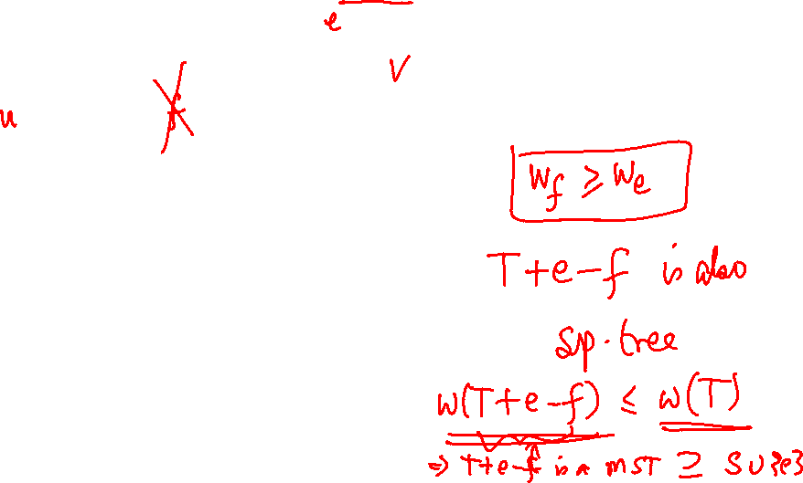
set S of edges is “safe”: there is an MST that contains S
choose a component C in G[S]
e $←$min-weight edge crossing from C to its complement, then $S∪\{e\}$ is also safe
Suppose not

Slide 4
set S of edges is “safe”: there is an MST that contains S
choose a component C in G[S]
e $←$min-weight edge crossing from C to its complement, then $S∪\{e\}$ is also safe
Suppose not

Slide 5
set S of edges is “safe”: there is an MST that contains S
choose a component C in G[S]
e $←$min-weight edge crossing from C to its complement, then $S∪\{e\}$ is also safe
Kruskal’s algorithm: sort the edges in increasing order of weight
Add an edge if it does not create a cycle with previously added edges, else reject it.

Slide 6
set S of edges is “safe”: there is an MST that contains S
choose a component C in G[S]
e $←$min-weight edge crossing from C to its complement, then $S∪\{e\}$ is also safe
Prim’s algorithm: Start with a “root node”
Each time chosen component = connected component of root node.

Slide 7
set S of edges is “safe”: there is an MST that contains S
choose a component C in G[S]
e $←$min-weight edge crossing from C to its complement, then $S∪\{e\}$ is also safe
Boruvka’s algorithm: (assume distinct edge weights for simplicity)
Each time, for each component choose the cheapest edge leaving it

