Slide 1
Synchronization: Basics
15-213/14-513/15-513: Introduction to Computer Systems
24th Lecture, November 29, 2022
Instructors:
Dave Andersen (15-213)
Zack Weinberg (15-213)
Brian Railing (15-513)
David Varodayan (14-513)

Slide 2
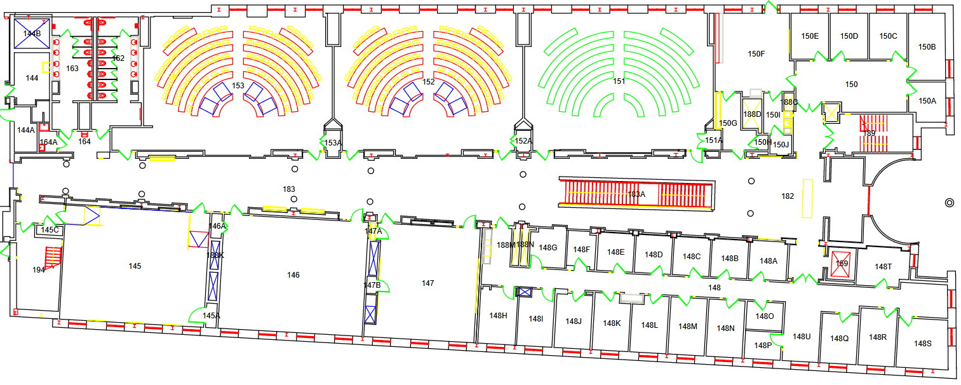
Final Exam Logistics
Meet TAs here
Friday, 16 December, 5:30–8:30pm (Pgh time)
Go to Posner Hall first floor main corridor
We will meet you and direct you to rooms

Slide 3
More Final Exam Logistics
Make-up final exam session Monday 19 December
  Location and time TBD
Final exam review session: not yet scheduled
If you have disability accommodations
  Make sure they’re on file with the disabilities office
  Also fill out the form below
  You will take the exam at the Disability Resources Testing Center (5136 Margaret Morrison Street); do not go to Posner
Need any sort of adjustment to exam logistics?
  https://forms.gle/UVutWayszmxM89JP9
More details:
  https://piazza.com/class/l6ff8gpm6nt247/post/1950
  https://www.cs.cmu.edu/~213/exams.html

Slide 4
Today
Threads review
Sharing and Data Races
Fixing Data Races
  Mutexes
  Semaphores
  Atomic memory operations

Slide 5
Traditional View of a Process
Process = process context + code, data, and stack
Process context
Code, data, and stack
Program context:
Data registers
Condition codes
Stack pointer (SP)
Program counter (PC)
SP
Stack
Shared libraries
brk
Run-time heap
Kernel context:
VM structures
Descriptor table
brk pointer
Read/write data
PC
Read-only code/data
0

Slide 6
Alternate View of a Process
Process = thread + (code, data, and kernel context)
Thread (main thread)
Code, data, and kernel context
Shared libraries
SP
Stack
brk
Run-time heap
Thread context:
Data registers
Condition codes
Stack pointer (SP)
Program counter (PC)
Read/write data
PC
Read-only code/data
0
Kernel context:
VM structures
Descriptor table
brk pointer

Slide 7
A Process With Multiple Threads
Multiple threads can be associated with a process
  Each thread has its own logical control flow
  Each thread shares the same code, data, and kernel context
  Each thread has its own stack for local variables
    but not protected from other threads
  Each thread has its own thread id (TID)
Thread 1 (main thread)
Thread 2 (peer thread)
Shared code and data
shared libraries
stack 1
stack 2
run-time heap
Thread 1 context:
Data registers
Condition codes
SP₁
PC₁
Thread 2 context:
Data registers
Condition codes
SP₂
PC₂
read/write data
read-only code/data
0
Kernel context:
VM structures
Descriptor table
brk pointer

Slide 8
Don’t let picture confuse you!
Thread 1 (main thread)
Thread 2 (peer thread)
Shared code and data
shared libraries
stack 1
stack 2
run-time heap
Thread 1 context:
Data registers
Condition codes
SP₁
PC₁
Thread 2 context:
Data registers
Condition codes
SP₂
PC₂
read/write data
read-only code/data
0
Kernel context:
VM structures
Descriptor table
brk pointer
Memory is shared between all threads

Slide 9
Today
Threads review
Sharing and Data Races
Fixing Data Races
  Mutexes
  Semaphores
  Atomic memory operations

Slide 10
Shared Variables in Threaded C Programs
Question: Which variables in a threaded C program are shared?
  The answer is not as simple as “global variables are shared” and
  “stack variables are private”
Def: A variable x is shared if and only if multiple threads reference some instance of x.
Requires answers to the following questions:
  What is the memory model for threads?
  How are instances of variables mapped to memory?
  How many threads might reference each of these instances?

Slide 11
Threads Memory Model: Conceptual
Multiple threads run within the context of a single process
Each thread has its own separate thread context
  Thread ID, stack, stack pointer, PC, condition codes, and GP registers
All threads share the remaining process context
  Code, data, heap, and shared library segments of the process virtual address space
  Open files and installed handlers
Thread 1
(private)
Thread 2
(private)
Shared code and data
stack 1
stack 2
shared libraries
Thread 1 context:
Data registers
Condition codes
SP₁
PC₁
Thread 2 context:
Data registers
Condition codes
SP₂
PC₂
run-time heap
read/write data
read-only code/data

Slide 12
Threads Memory Model: Actual
Separation of data is not strictly enforced:
  Register values are truly separate and protected, but…
  Any thread can read and write the stack of any other thread
The mismatch between the conceptual and operation model
is a source of confusion and errors
stack 1
stack 2
Virtual Address Space
Shared code and data
Thread 1
(private)
Thread 2
(private)
shared libraries
Thread 1 context:
Data registers
Condition codes
SP₁
PC₁
Thread 2 context:
Data registers
Condition codes
SP₂
PC₂
run-time heap
read/write data
read-only code/data

Slide 13
Three Ways to Pass Thread Arg
Malloc/free
  Producer malloc’s space, passes pointer to pthread_create
  Consumer dereferences pointer, frees space
  Always works; necessary for passing large amounts of data
Cast of int
  Producer casts an int/long to void*, passes to pthread_create
  Consumer casts void* argument back to int/long
  Works for small amounts of data (one number)
INCORRECT: Pointer to stack slot
  Producer passes address to producer’s stack in pthread_create
  Consumer dereferences pointer
  Why is this unsafe?

Slide 14
Passing an argument to a thread
int hist[N] = {0};
int main(int argc, char *argv[]) {
long i;
pthread_t tids[N];
for (i = 0; i < N; i++)
Pthread_create(&tids[i],
NULL,
thread,
&hist[i]);
for (i = 0; i < N; i++)
Pthread_join(tids[i], NULL);
check();
}
void *thread(void *vargp)
{
*(int *)vargp += 1;
return NULL;
}
Each thread receives a unique pointer
void check(void) {
for (int i=0; i<N; i++) {
if (hist[i] != 1) {
printf("Failed at %d\n", i);
exit(-1);
}
}
printf("OK\n");
}

Slide 15
Passing an argument to a thread – Also OK
int hist[N] = {0};
int main(int argc, char *argv[]) {
long i;
pthread_t tids[N];
for (i = 0; i < N; i++)
Pthread_create(&tids[i],
NULL,
thread,
(void *)i);
for (i = 0; i < N; i++)
Pthread_join(tids[i], NULL);
check();
}
void *thread(void *vargp)
{
hist[(long)vargp] += 1;
return NULL;
}
Each thread receives a unique array index
Casting from long to void* and back is safe

Slide 16
Passing an argument to a thread – Also OK
int hist[N] = {0};
int main(int argc, char *argv[]) {
long i;
pthread_t tids[N];
for (i = 0; i < N; i++)
long* p = Malloc(sizeof(long));
*p = i;
Pthread_create(&tids[i],
NULL,
thread,
p);
for (i = 0; i < N; i++)
Pthread_join(tids[i], NULL);
check();
}
void *thread(void *vargp)
{
hist[*(long *)vargp] += 1;
free(vargp);
return NULL;
}
Each thread receives a unique array index
Malloc in parent, free in thread
Necessary if passing structs

Slide 17
Passing an argument to a thread – WRONG!
int hist[N] = {0};
int main(int argc, char *argv[]) {
long i;
pthread_t tids[N];
for (i = 0; i < N; i++)
Pthread_create(&tids[i],
NULL,
thread,
&i);
for (i = 0; i < N; i++)
Pthread_join(tids[i], NULL);
check();
}
void *thread(void *vargp)
{
hist[*(long *)vargp] += 1;
return NULL;
}
Each thread receives
the same pointer, to i in main
Data race: each thread
may or may not read a unique array index from i in main

Slide 18
Shared Variables in Threaded C Programs
Question: Which variables in a threaded C program are shared?
  The answer is not as simple as “global variables are shared” and
  “stack variables are private”
Def: A variable x is shared if and only if multiple threads reference some instance of x.
Requires answers to the following questions:
  What is the memory model for threads?
  How are instances of variables mapped to memory?
  How many threads might reference each of these instances?

Slide 19
Mapping Variable Instances to Memory
Global variables
  Variable declared outside of a function
  Virtual memory contains exactly one instance of any global variable
Local automatic variables
  Variable declared inside function without static attribute
  Each thread stack contains one instance of each local variable
Local static variables
  Variable declared inside function with the static attribute
  Virtual memory contains exactly one instance of any local static variable.
errno is special
  Declared outside a function, but each thread stack contains one instance

Slide 20
Mapping Variable Instances to Memory
char **ptr; /* global var */
int main(int main, char *argv[])
{
long i;
pthread_t tid;
char *msgs[2] = {
"Hello from foo",
"Hello from bar"
};
ptr = msgs;
for (i = 0; i < 2; i++)
Pthread_create(&tid,
NULL,
thread,
(void *)i);
Pthread_exit(NULL);
}
void *thread(void *vargp)
{
long myid = (long)vargp;
static int cnt = 0;
printf("[%ld]: %s (cnt=%d)\n",
myid, ptr[myid], ++cnt);
return NULL;
}
sharing.c

Slide 21
Mapping Variable Instances to Memory
Global var: 1 instance (ptr [data])
Local auto vars: 1 instance (i.m, msgs.m, tid.m)
char **ptr; /* global var */
int main(int main, char *argv[])
{
long i;
pthread_t tid;
char *msgs[2] = {
"Hello from foo",
"Hello from bar"
};
ptr = msgs;
for (i = 0; i < 2; i++)
Pthread_create(&tid,
NULL,
thread,
(void *)i);
Pthread_exit(NULL);
}
Local auto var: 2 instances (
myid.p0 [peer thread 0’s stack],
myid.p1 [peer thread 1’s stack]
)
void *thread(void *vargp)
{
long myid = (long)vargp;
static int cnt = 0;
printf("[%ld]: %s (cnt=%d)\n",
myid, ptr[myid], ++cnt);
return NULL;
}
Local static var: 1 instance (cnt [data])
sharing.c

Slide 22
Shared Variable Analysis
Which variables are shared?
Answer: A variable x is shared iff multiple threads reference at least one instance of x. Thus:
  ptr, cnt, and msgs are shared
  i and myid are not shared
Variable Referenced by Referenced by Referenced by
instance main thread? peer thread 0? peer thread 1?
ptr
cnt
i.m
msgs.m
myid.p0
myid.p1
yes
yes
yes
no
yes
yes
yes
no
no
yes
yes
yes
no
yes
no
no
no
yes
char **ptr; /* global var */
int main(int main, char *argv[]) {
long i; pthread_t tid;
char *msgs[2] = {"Hello from foo",
"Hello from bar" };
ptr = msgs;
for (i = 0; i < 2; i++)
Pthread_create(&tid,
NULL, thread,(void *)i);
Pthread_exit(NULL);}
void *thread(void *vargp)
{
long myid = (long)vargp;
static int cnt = 0;
printf("[%ld]: %s (cnt=%d)\n",
myid, ptr[myid], ++cnt);
return NULL;
}

Slide 23
Shared Variable Analysis
Which variables are shared?
Answer: A variable x is shared iff multiple threads reference at least one instance of x. Thus:
  ptr, cnt, and msgs are shared
  i and myid are not shared
Variable Referenced by Referenced by Referenced by
instance main thread? peer thread 0? peer thread 1?
ptr
cnt
i.m
msgs.m
myid.p0
myid.p1
yes
yes
yes
no
yes
yes
yes
no
no
yes
yes
yes
no
yes
no
no
no
yes

Slide 24
Synchronizing Threads
int main(int argc, char **argv) {
unsigned long niters =
strtoul(argv[1], NULL, 10);
pthread_t t1, t2;
Pthread_create(&t1, NULL,
incr_thread,
(void *)niters);
Pthread_create(&t2, NULL,
incr_thread,
(void *)niters);
Pthread_join(&t1, NULL);
Pthread_join(&t2, NULL);
if (cnt != 2*niters) {
printf("FAIL: cnt=%lu not %lu\n",
cnt, 2*niters;
return 1;
} else {
printf("OK: cnt=%lu\n", cnt);
return 0;
}
}
Shared variables are handy...
…but you risk data races
and synchronization errors.
static unsigned long cnt = 0;
void *incr_thread(void *arg) {
unsigned long i;
unsigned long niters =
(unsigned long) arg;
for (i = 0; i < niters; i++) {
cnt++;
}
}
Coding demo 1:
Counting to 20,000 incorrectly
(with threads)

Slide 25
Assembly Code for Counter Loop
C code for counter loop in thread i
for (i = 0; i < niters; i++)
cnt++;
Asm code for thread i
movq (%rdi), %rcx
testq %rcx,%rcx
jle .L2
movl $0, %eax
.L3:
movq cnt(%rip),%rdx
addq $1, %rdx
movq %rdx, cnt(%rip)
addq $1, %rax
cmpq %rcx, %rax
jne .L3
.L2:
H_{i} : Head
L_{i} : Load cnt
U_{i} : Update cnt
S_{i} : Store cnt
T_{i} : Tail

Slide 26
Concurrent Execution
Key idea: Any interleaving of instructions is possible,
and some give an unexpected result!
  I_{i} denotes that thread i executes instruction I
  %rdx_{i} is the content of %rdx in thread i’s context
i (thread)
instr_{i}
%rdx₁
%rdx₂
cnt
1
H₁
-
-
0
Thread 1 critical section
1
L₁
0
-
0
1
U₁
1
-
0
1
S₁
1
-
1
Thread 2 critical section
2
H₂
-
-
1
2
L₂
-
1
1
2
U₂
-
2
1
2
S₂
-
2
2
2
T₂
-
2
2
1
T₁
1
-
2
OK

Slide 27
Concurrent Execution (cont)
Incorrect ordering: two threads increment the counter, but the result is 1 instead of 2
i (thread)
instr_{i}
%rdx₁
%rdx₂
cnt
1
H₁
-
-
0
1
L₁
0
-
0
1
U₁
1
-
0
2
H₂
-
-
0
2
L₂
-
0
0
1
S₁
1
-
1
1
T₁
1
-
1
2
U₂
-
1
1
2
S₂
-
1
1
2
T₂
-
1
1
Oops!

Slide 28
Concurrent Execution (cont)
How about this ordering?
We can analyze the behavior using a progress graph
i (thread)
instr_{i}
%rdx₁
%rdx₂
cnt
1
H₁
0
1
L₁
0
2
H₂
2
L₂
0
2
U₂
1
2
S₂
1
1
1
U₁
1
1
S₁
1
1
1
T₁
1
1
Oops!
2
T₂

Slide 29
Progress Graphs
Thread 2
A progress graph depicts
the discrete execution
state space of concurrent
threads.
Each axis corresponds to
the sequential order of
instructions in a thread.
Each point corresponds to
a possible execution state
(Inst₁, Inst₂).
E.g., (L₁, S₂) denotes state
where thread 1 has
completed L₁ and thread
2 has completed S₂.
T₂
(L₁, S₂)
S₂
U₂
L₂
H₂
Thread 1
H₁
L₁
U₁
S₁
T₁

Slide 30
Trajectories in Progress Graphs
Thread 2
A trajectory is a sequence of legal state transitions that describes one possible concurrent execution of the threads.
Example:
H1, L1, U1, H2, L2, S1, T1, U2, S2, T2
T₂
S₂
U₂
L₂
H₂
Thread 1
H₁
L₁
U₁
S₁
T₁

Slide 31
Trajectories in Progress Graphs
Thread 2
A trajectory is a sequence of legal state transitions that describes one possible concurrent execution of the threads.
Example:
H1, L1, U1, H2, L2, S1, T1, U2, S2, T2
T₂
S₂
U₂
L₂
H₂
Thread 1
H₁
L₁
U₁
S₁
T₁

Slide 32
Critical Sections and Unsafe Regions
Thread 2
L, U, and S form a critical section with respect to the shared variable cnt
Instructions in critical sections (wrt some shared variable) should not be interleaved
Sets of states where such interleaving occurs form unsafe regions
T₂
S₂
critical section wrt cnt
U₂
Unsafe region
L₂
H₂
Thread 1
H₁
L₁
U₁
S₁
T₁
critical section wrt cnt

Slide 33
Critical Sections and Unsafe Regions
Thread 2
safe
T₂
Def: A trajectory is safe iff it does not enter any unsafe region
Claim: A trajectory is correct (wrt cnt) iff it is safe
S₂
critical section wrt cnt
U₂
Unsafe region
L₂
unsafe
H₂
Thread 1
H₁
L₁
U₁
S₁
T₁
critical section wrt cnt

Slide 34
Quiz time!
https://canvas.cmu.edu/courses/30386/quizzes/86859

Slide 35
Today
Threads review
Sharing and Data Races
Fixing Data Races
  Mutexes
  Semaphores
  Atomic memory operations

Slide 36
Enforcing Mutual Exclusion
Question: How can we guarantee a safe trajectory?
Answer: We must synchronize the execution of the threads so that they can never have an unsafe trajectory.
  Need to guarantee mutually exclusive access to each critical section.
static unsigned long cnt = 0;
static pthread_mutex_t lock =
PTHREAD_MUTEX_INITIALIZER;
void *incr_thread(void *arg) {
unsigned long i;
unsigned long niters =
(unsigned long) arg;
for (i = 0; i < niters; i++) {
pthread_mutex_lock(&lock);
cnt++;
pthread_mutex_unlock(&lock);
}
}
Coding demo 2:
Counting to 20,000 correctly
(with threads and a mutex)

Slide 37
MUTual EXclusion (mutex)
Mutex: opaque object which is either locked or unlocked
  Boolean value, but cannot do math on it
  Starts out unlocked
  Two operations:
lock(m)
  If the mutex is currently not locked, lock it and return
  Otherwise, wait until it becomes unlocked, then retry
unlock(m)
  Can only be called when mutex is locked, by the code that locked it
  Change mutex to unlocked

Slide 38
Mutex implementation (partial)
/**
* void pthread_mutex_lock(pthread_mutex_t *mtx)
* Lock the mutex pointed to by MTX. If it is already locked,
* first sleep until it becomes unlocked.
*/
pthread_mutex_lock:
call gettid // current thread ID now in %eax
mov $1, %edx // increment
lock xadd %edx, MUTEX_CONTENDERS(%rdi)
// %edx now holds _previous_ value of mtx->contenders
test %edx, %edx
jne .Lcontended
// The lock was unlocked, and now we hold it.
mov %eax, MUTEX_HOLDER(%rdi)
ret
.Lcontended:
// Sleep until another thread calls pthread_mutex_unlock
// (30 more machine instructions and a system call)
Just one of many ways to implement (discussed in 15-410, -418, etc)
All require assistance from the CPU (special instructions)

Slide 39
Why Mutexes Work
Thread 2
Provide mutually exclusive access to shared variable by surrounding critical section with lock and unlock operations
Mutex invariant creates a forbidden region that encloses unsafe region and that cannot be entered by any trajectory.
T₂
un(m)
S₂
U₂
Unsafe region
L₂
-1
lo(m)
0
H₂
1
0
0
0
Thread 1
H₁
lo(m)
L₁
U₁
S₁
un(m)
T₁
Initially
m = 1

Slide 40
Why Mutexes Work
Thread 2
Provide mutually exclusive access to shared variable by surrounding critical section with lock and unlock operations
Mutex invariant creates a forbidden region that encloses unsafe region and that cannot be entered by any trajectory.
T₂
un(m)
S₂
U₂
Unsafe region
L₂
0
lo(m)
0
1
0
H₂
1
0
0
0
Thread 1
H₁
lo(m)
L₁
U₁
S₁
un(m)
T₁
Initially
m = 1

Slide 41
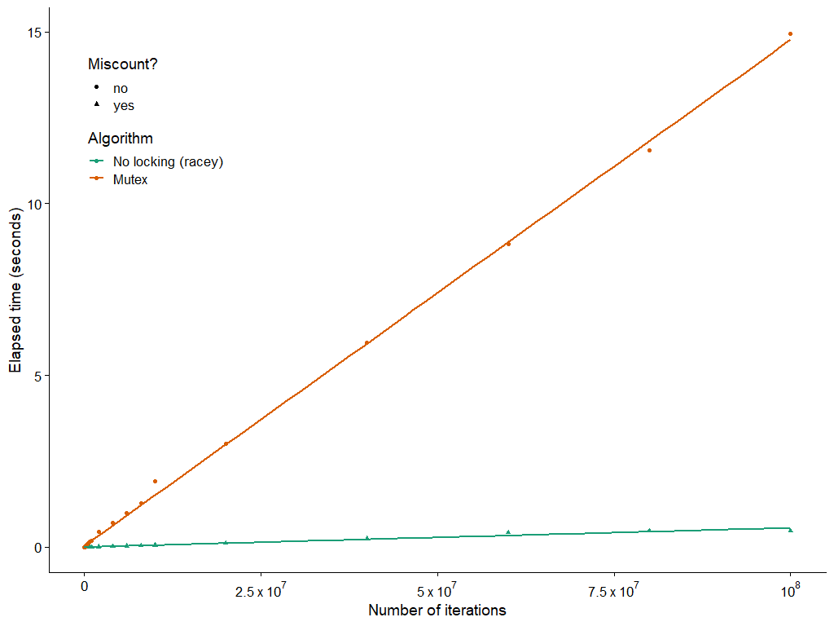
The Cost of Mutexes
15 s
0.48 s
Notes:
30x slower

Slide 42
Today
static unsigned long cnt = 0;
static sem_t lock;
void *incr_thread(void *arg) {
unsigned long i;
unsigned long niters =
(unsigned long) arg;
for (i = 0; i < niters; i++) {
sem_wait(&lock);
cnt++;
sem_post(&lock);
}
}
Threads review
Sharing and Data Races
Fixing Data Races
  Mutexes
  Semaphores
  Atomic memory operations
int main(int argc, char **argv) {
unsigned long niters =
strtoul(argv[1], NULL, 10);
sem_init(&lock, 0, 1);
// ...
}
Coding demo 3:
Counting to 20,000 correctly
(with threads and a semaphore)

Slide 43
Semaphores
Semaphore: generalization of mutex
  Unsigned integer value, but cannot do math on it.
  Created with some value >= 0
  Two operations:
P(s) [“Prolaag,” Dutch shorthand for “try to reduce”]
  If s is zero, wait for a V operation to happen.
  Then subtract 1 from s and return.
V(s) [“Verhogen,” Dutch for “increase”]
  Add 1 to s.
  If there are any threads waiting inside a P operation,
  resume one of them
Unlike mutexes, no requirement to call P before calling V
Notes:
Just like with mutexes, the implementation requires

Slide 44
C Semaphore Operations
Pthreads functions:
#include <semaphore.h>
int sem_wait(sem_t *s); /* P(s) */
int sem_post(sem_t *s); /* V(s) */
int sem_init(sem_t *s, int pshared, unsigned int val);
Share among processes?
(normally you want to pass zero, see manpage for details)
Initial semaphore value

Slide 45
Semaphore implementation (partial)
/**
* void sem_wait(sem_t *sem)
* Decrement the count of the semaphore pointed to by SEM. If this
* would make the count negative, first sleep until it is possible to
* decrement the count without making it negative.
*/
sem_wait:
mov $-1, %edx // decrement
lock xadd %edx, SEM_COUNT(%rdi)
// %edx now holds _previous_ value of sem->count
test %edx, %edx
jle .Lclosed
// The semaphore was open.
ret
.Lclosed:
// Sleep until another thread calls sem_post
// (30 more machine instructions and a system call)
Suspiciously similar to a mutex, huh?
(This implementation makes sem_post do most of the work)

Slide 46
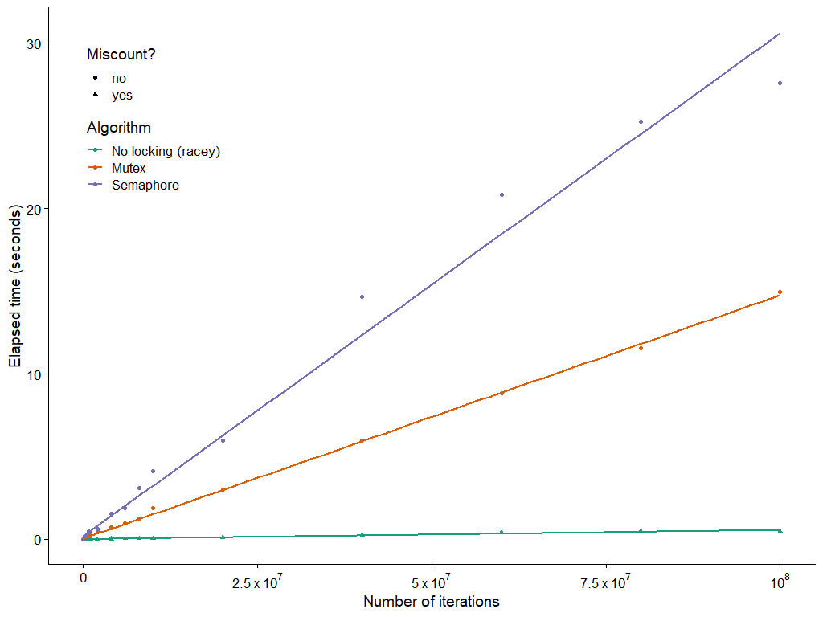
The cost of semaphores
27.6 s
15 s
0.48 s
Notes:
Oh no, it’s even slower with a semaphore.

Slide 47
Today
Threads review
Sharing and Data Races
Fixing Data Races
  Mutexes
  Semaphores
  Atomic memory operations

Slide 48
Atomic memory operations
Special hardware instructions
  “Test and set,” “compare and swap”, “exchange and add”, …
  Do a read-modify-write on memory; hardware prevents data races
  Used to implement mutexes, semaphores, etc.
Not going to get into details, but…
  Wouldn’t it be nice if we could use them directly?
  Especially when we just want to increment a counter?
static _Atomic unsigned long cnt = 0;
void *incr_thread(void *arg) {
unsigned long i;
unsigned long niters =
(unsigned long) arg;
for (i = 0; i < niters; i++) {
cnt++;
}
}
Coding demo 4:
Counting to 20,000 correctly
(with threads and C2011 atomics)

Slide 49
Assembly Code for Counter Loop
C code
for (i = 0; i < niters; i++)
cnt++;
Assembly (unsigned long)
Assembly (_Atomic unsigned long)
movq (%rdi), %rcx
testq %rcx,%rcx
jle .L2
movl $0, %eax
.L3:
movq cnt(%rip),%rdx
addq $1, %rdx
movq %rdx, cnt(%rip)
addq $1, %rax
cmpq %rcx, %rax
jne .L3
.L2:
movq (%rdi), %rcx
testq %rcx,%rcx
jle .L2
movl $0, %eax
.L3:
lock addq $1, cnt(%rip)
addq $1, %rax
cmpq %rcx, %rax
jne .L3
.L2:
Notes:
The three instructions that were so troublesome are replaced with a single instruction that does the same thing, but the hardware promises no data races. Each thread’s lock addq waits for the other thread’s lock addq, as part of the process of accessing the cache.
X86 has lots of atomic memory operations. Other ISAs are not so generous. Traditional RISC would make you write a loop with two special memory access instructions plus the ADD.

Slide 50
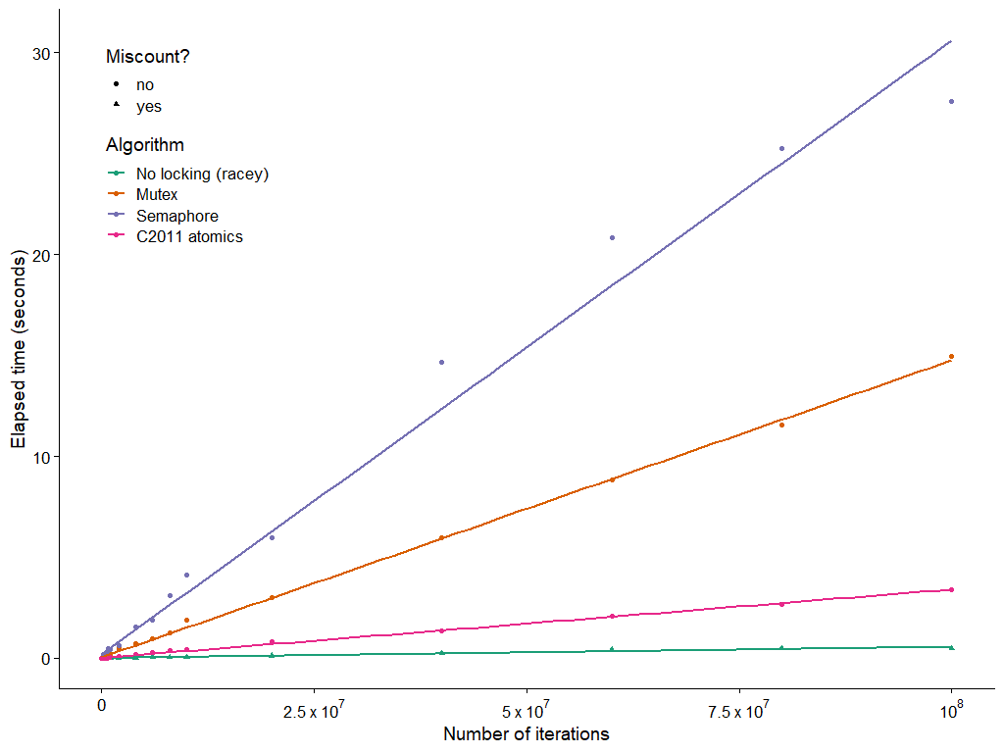
The cost of atomic memory operations
27.6 s
15 s
3.41 s
0.48 s

Slide 51
Summary
Access shared variables with care to avoid data races.
  Crucial to understand which variables are shared in the first place
  Avoid sharing, if you can
  Avoid writing from multiple threads, if you can
Mutexes help, but…
  They’re slow
  (Next time: They can cause problems as well as solve them)
Don’t use a semaphore when a mutex will do
  They’re even slower
  (Next time: When is a semaphore actually useful?)
Atomic memory ops are handy, but…
  The hardware might not provide the operation you need
  (Later courses: Tricky to use correctly)

