Slide 1
Virtual Memory: Details
15-213/14-513/15-513: Introduction to Computer Systems
17th Lecture, November 1, 2022
Instructors:
Dave Andersen (15-213)
Zack Weinberg (15-213)
Brian Railing (15-513)
David Varodayan (14-513)

Slide 2
Review: Virtual Addressing
Each process has its own virtual address space
Page tables map virtual to physical addresses
Physical memory can be shared among processes
0
Address
translation
0
Virtual Address Space for Process 1:
Physical
Address
Space (DRAM)
VP 1
VP 2
PP 2
...
N-1
PP 6
(e.g., read-only
library code)
Virtual Address Space for Process 2:
0
PP 8
VP 1
...
...
N-1
VP k
M-1

Slide 3
Today
Multi-level page tables
Translation lookaside buffers
Activity 1
Concrete examples of virtual memory systems
  “Simple memory system” from CSAPP 9.6.4
  Intel Core i7
Activity 2
Nifty things virtual memory makes possible
  Paging/swapping (disk as extra RAM)
  Memory-mapped files (RAM as cache for disk)
  Copy-on-write sharing
Activity 3

Slide 4
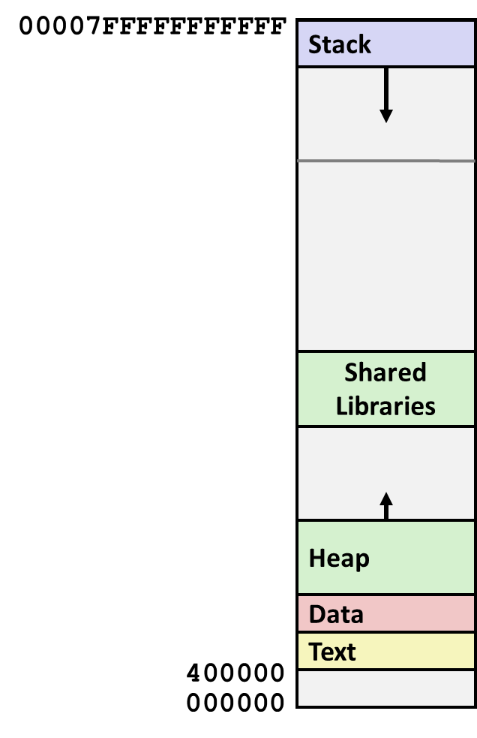
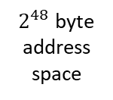
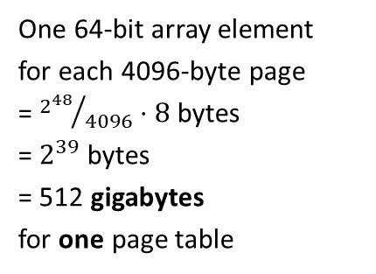
The problem (with one-level page tables)
One 64-bit array element
for each 4096-byte page
= ${2^{48}}/{4096}⋅8$ bytes
= $2^{39}$ bytes
= 512 gigabytes
for one page table
$2^{48}$ byte address space

Slide 5
A Two-Level Page Table Hierarchy
32-bit address space, 4-byte PTEs, 4096-byte pages
Virtual
memory
PTE 0 (null)
PTE 0
VP 0…1023 (unmapped)
PTE 1
...
1024 unallocated pages
PTE 2
PTE 1023
1020 more
null PTEs
VP 1024
PTE 0
...
...
VP 2047
2048 allocated pages
for code and data
PTE 1023
VP 2048
...
VP 3072
1023
null PTEs
VP 3073… 1048575 (unmapped)
PTE 1023
PTE 1023
1021 · 1024 + 1023 unallocated pages
Level 1
page table
Level 2
page tables
1 allocated page
for the stack
VP 1048576

Slide 6
Translating with a k-level Page Table
Page table
base register
(PTBR)
n-1
VIRTUAL ADDRESS
p-1
0
VPN 1
VPN 2
...
VPN k
VPO
the Level 1
page table
a Level 2
page table
a Level k
page table
...
...
PPN
m-1
p-1
0
PPN
PPO
PHYSICAL ADDRESS

Slide 7
The problem (with k-level page tables)
Page table
base register
(PTBR)
n-1
VIRTUAL ADDRESS
p-1
0
VPN 1
VPN 2
...
VPN k
VPO
the Level 1
page table
a Level 2
page table
a Level k
page table
...
...
PPN
Cache miss!
Cache miss!
Cache miss!
Cache miss!
Cache miss!
PPN
PPO

Slide 8
Speeding up Translation with a TLB
Page table entries (PTEs) are cached
like any other memory word
  PTEs may be evicted by other data references
  PTE hit still costs cache delay
Solution: Translation Lookaside Buffer (TLB)
  Dedicated cache for page table entries
  TLB hit = page table not consulted
  Can be fairly small: one TLB entry covers 4k or more

Slide 9
Accessing the TLB
MMU uses the VPN portion of the virtual address to access the TLB:
T = 2^{t} sets
VPN
TLBT matches tag of line within set
n-1
p+t
p+t-1
p
p-1
0
TLB tag (TLBT)
TLB index (TLBI)
VPO
Set 0
v
tag
PTE
v
tag
PTE
TLBI selects the set
Set 1
v
tag
PTE
v
tag
PTE
…
Set T-1
v
tag
PTE
v
tag
PTE

Slide 10
TLB Hit
CPU Chip
TLB
2
PTE
VPN
3
Cache/
Memory
1
MMU
CPU
VA
PA
4
Data
5
A TLB hit eliminates memory accesses to the page table

Slide 11
TLB Miss
CPU Chip
TLB
4
2
PTE
VPN
Cache/
Memory
1
MMU
3
CPU
VA
PTEA
PA
5
Data
6
A TLB miss incurs additional memory accesses (PTE lookup)
Fortunately, TLB misses are rare. Why?

Slide 12
Today
Multi-level page tables
Translation lookaside buffers
Activity 1
Concrete examples of virtual memory systems
  “Simple memory system” from CSAPP 9.6.4
  Intel Core i7
Activity 2
Nifty things virtual memory makes possible
  Paging/swapping (disk as extra RAM)
  Memory-mapped files (RAM as cache for disk)
  Copy-on-write sharing
Activity 3

Slide 13
Simple Memory System Example
Addressing
  14-bit virtual addresses
  12-bit physical address
  Page size = 64 bytes
13
12
11
10
9
8
7
6
5
4
3
2
1
0
VPN
VPO
Virtual Page Number
Virtual Page Offset
11
10
9
8
7
6
5
4
3
2
1
0
PPN
PPO
Physical Page Number
Physical Page Offset

Slide 14
Simple Memory System TLB
16 entries
4-way associative
TLBT
TLBI
13
12
11
10
9
8
7
6
5
4
3
2
1
0
0
0
0
0
1
1
0
1
VPN
VPO
VPN = 0b1101 = 0x0D
Translation Lookaside Buffer (TLB)
Set
Tag
PPN
Valid
Tag
PPN
Valid
Tag
PPN
Valid
Tag
PPN
Valid
Set
Tag
PPN
Valid
Tag
PPN
Valid
Tag
PPN
Valid
Tag
PPN
Valid
0
03
–
0
09
0D
1
00
–
0
07
02
1
0
03
–
0
09
0D
1
00
–
0
07
02
1
1
03
2D
1
02
–
0
04
–
0
0A
–
0
1
03
2D
1
02
–
0
04
–
0
0A
–
0
2
02
–
0
08
–
0
06
–
0
03
–
0
2
02
–
0
08
–
0
06
–
0
03
–
0
3
07
–
0
03
0D
1
0A
34
1
02
–
0
3
07
–
0
03
0D
1
0A
34
1
02
–
0

Slide 15
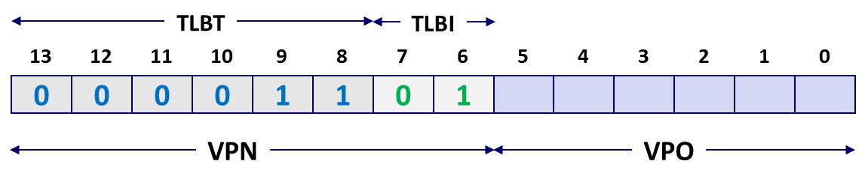
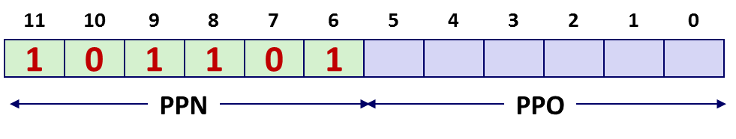
Simple Memory System Page Table
Only showing the first 16 entries (out of 256)
VPN
PPN
Valid
VPN
PPN
Valid
00
28
1
08
13
1
01
–
0
09
17
1
02
33
1
0A
09
1
03
02
1
0B
–
0
04
–
0
0C
–
0
05
16
1
0D
2D
1
0x0D → 0x2D
06
–
0
0E
11
1
07
–
0
0F
0D
1

Slide 16
Simple Memory System Cache
16 lines, 4-byte cache line size
Physically addressed
Direct mapped
V[0b00001101101001] = V[0x369]
P[0b101101101001] = P[0xB69] = 0x15
CT
CI
CO
11
10
9
8
7
6
5
4
3
2
1
0
1
0
1
1
0
1
1
0
1
0
0
1
PPN
PPO
Idx
Tag
Valid
B0
B1
B2
B3
Idx
Tag
Valid
B0
B1
B2
B3
Idx
Tag
Valid
B0
B1
B2
B3
Idx
Tag
Valid
B0
B1
B2
B3
0
19
1
99
11
23
11
8
24
1
3A
00
51
89
0
19
1
99
11
23
11
8
24
1
3A
00
51
89
1
15
0
–
–
–
–
9
2D
0
–
–
–
–
1
15
0
–
–
–
–
9
2D
0
–
–
–
–
2
1B
1
00
02
04
08
A
2D
1
93
15
DA
3B
2
1B
1
00
02
04
08
A
2D
1
93
15
DA
3B
3
36
0
–
–
–
–
B
0B
0
–
–
–
–
3
36
0
–
–
–
–
B
0B
0
–
–
–
–
4
32
1
43
6D
8F
09
C
12
0
–
–
–
–
4
32
1
43
6D
8F
09
C
12
0
–
–
–
–
5
0D
1
36
72
F0
1D
D
16
1
04
96
34
15
5
0D
1
36
72
F0
1D
D
16
1
04
96
34
15
6
31
0
–
–
–
–
E
13
1
83
77
1B
D3
6
31
0
–
–
–
–
E
13
1
83
77
1B
D3
7
16
1
11
C2
DF
03
F
14
0
–
–
–
–
7
16
1
11
C2
DF
03
F
14
0
–
–
–
–

Slide 17
Address Translation Example
Virtual Address: 0x03D4
  VPN ___ TLBI ___ TLBT ____ TLB Hit? __ Page Fault? __ PPN: ____
Physical Address
TLBT
TLBI
13
12
11
10
9
8
7
6
5
4
3
2
1
0
0
0
0
0
1
1
1
1
0
1
0
1
0
0
VPN
VPO
0x0F
0x3
0x03
Y
N
0x0D
TLB
Set
Tag
PPN
Valid
Tag
PPN
Valid
Tag
PPN
Valid
Tag
PPN
Valid
0
03
–
0
09
0D
1
00
–
0
07
02
1
1
03
2D
1
02
–
0
04
–
0
0A
–
0
2
02
–
0
08
–
0
06
–
0
03
–
0
3
07
–
0
03
0D
1
0A
34
1
02
–
0
11
10
9
8
7
6
5
4
3
2
1
0
0
0
1
1
0
1
0
1
0
1
0
0
PPN
PPO

Slide 18
Intel Core i7 Memory System
Processor package
Core x4
Registers
Instruction
fetch
MMU
(addr translation)
L1 d-cache
32 KB, 8-way
L1 i-cache
32 KB, 8-way
L1 d-TLB
64 entries, 4-way
L1 i-TLB
128 entries, 4-way
L2 unified cache
256 KB, 8-way
L2 unified TLB
512 entries, 4-way
QuickPath interconnect
4 links @ 25.6 GB/s each
To other
cores
To I/O
bridge
L3 unified cache
8 MB, 16-way
(shared by all cores)
DDR3 Memory controller
3 x 64 bit @ 10.66 GB/s
32 GB/s total (shared by all cores)
Main memory

Slide 19
End-to-end Core i7 Address Translation
CPU
32/64
L2, L3, and
main memory
Result
Virtual address (VA)
36
12
VPN
VPO
L1
hit
L1
miss
32
4
TLBT
TLBI
L1 d-cache
(64 sets, 8 lines/set)
TLB
hit
TLB
miss
...
...
L1 TLB (16 sets, 4 entries/set)
9
9
9
9
40
12
40
6
6
VPN1
VPN2
VPN3
VPN4
PPN
PPO
CT
CI
CO
Physical
address
(PA)
CR3
PTE
PTE
PTE
PTE
Page tables

Slide 20
Core i7 Level 1-3 Page Table Entries
63
62
52
51
12
11
9
8
7
6
5
4
3
2
1
0
XD
Unused
Page table physical base address
Unused
G
PS
A
CD
WT
U/S
R/W
P=1
Available for OS (page table location on disk)
P=0
Each entry references a 4K child page table. Significant fields:
P: Child page table present in physical memory (1) or not (0).
R/W: Read-only or read-write access access permission for all reachable pages.
U/S: user or supervisor (kernel) mode access permission for all reachable pages.
WT: Write-through or write-back cache policy for the child page table.
A: Reference bit (set by MMU on reads and writes, cleared by software).
PS: Page size either 4 KB or 4 MB (defined for Level 1 PTEs only).
Page table physical base address: 40 most significant bits of physical page table address (forces page tables to be 4KB aligned)
XD: Disable or enable instruction fetches from all pages reachable from this PTE.
Notes:
Reference bit – used in LRU

Slide 21
Core i7 Level 4 Page Table Entries
63
62
52
51
12
11
9
8
7
6
5
4
3
2
1
0
XD
Unused
Page physical base address
Unused
G
D
A
CD
WT
U/S
R/W
P=1
Available for OS (page location on disk)
P=0
Each entry references a 4K child page. Significant fields:
P: Child page is present in memory (1) or not (0)
R/W: Read-only or read-write access permission for child page
U/S: User or supervisor mode access
WT: Write-through or write-back cache policy for this page
A: Reference bit (set by MMU on reads and writes, cleared by software)
D: Dirty bit (set by MMU on writes, cleared by software)
G: Global page (don’t evict from TLB on task switch)
Page physical base address: 40 most significant bits of physical page address (forces pages to be 4KB aligned)
XD: Disable or enable instruction fetches from this page.

Slide 22
Core i7 Page Table Translation
9
9
9
9
12
Virtual
address
VPN 1
VPN 2
VPN 3
VPN 4
VPO
L1 PT
Page global
directory
L2 PT
Page upper
directory
L3 PT
Page middle
directory
L4 PT
Page
table
40
40
40
40
CR3
/
/
/
/
Physical
address
of L1 PT
Offset into
physical and
virtual page
/
L4 PTE
12
L1 PTE
L2 PTE
L3 PTE
Physical
address
of page
512 GB
region
per entry
1 GB
region
per entry
2 MB
region
per entry
4 KB
region
per entry
40
/
40
12
Physical
address
PPN
PPO

Slide 23
Cute Trick for Speeding Up L1 Access
CT
Tag Check
40
6
6
Physical
address
(PA)
CT
CI
CO
PPN
PPO
Address
Translation
No
Change
Virtual
address
(VA)
CI
VPN
VPO
L1 Cache
36
12
Observation
  Bits that determine CI identical in virtual and physical address
  Can index into cache while address translation taking place
  Generally we hit in TLB, so PPN bits (CT bits) available quickly
  “Virtually indexed, physically tagged”
  Cache carefully sized to make this possible

Slide 24
Today
Multi-level page tables
Translation lookaside buffers
Activity 1
Concrete examples of virtual memory systems
  “Simple memory system” from CSAPP 9.6.4
  Intel Core i7
Activity 2
Nifty things virtual memory makes possible
  Paging/swapping (disk as extra RAM)
  Memory-mapped files (RAM as cache for disk)
  Copy-on-write sharing
Activity 3

Slide 25
Paging (aka Swapping)
Use (part of) disk as additional working memory
Adds another layer to the memory hierarchy, but…
  “Main memory” is 10–1000x slower than the caches
  Disk is 10,000x slower than main memory
  Enormous miss penalty drives design
Consequences
  Large page (block) size: 4KB and bigger
  Always write-back and fully associative
  Managed entirely in software
    Plenty of time to execute complex replacement algorithms

Slide 26
Locality to the Rescue Again!
Paging is terribly inefficient
Only works because of locality
At any point in time, programs tend to access a set of active virtual pages called the working set
  Programs with good temporal locality will have small working sets
If working set size < main memory size
  Good performance after compulsory misses
If working set size > main memory size
  Thrashing: Performance meltdown, computer spends most of its time copying pages in and out of RAM
  In the worst case, no forward progress at all (livelock)

Slide 27
Memory-Mapped Files
Paging = every page of a program’s physical RAM is backed by some page of disk*
Normally, those pages belong to swap space
But what if some pages were backed by … files?
* This is how it used to work 20 years ago.
Nowadays, not always true.

Slide 28
Memory-Mapped Files
Process
virtual memory
Physical
memory
Swap space
File on disk

Slide 29
Memory-Mapped Files
Process 2
virtual memory
Process 1
virtual memory
Physical
memory
Swap space
File on disk

Slide 30
Copy-on-write sharing
fork creates a new process by copying the entire address space
of the parent process
  That sounds slow
  It is slow
Parent
virtual memory
Physical
memory
Swap space
File on disk
Clever trick:
  Just duplicate the page tables
  Mark everything read only
  Copy only on write faults

Slide 31
Copy-on-write sharing
Child
virtual memory
Parent
virtual memory
Physical
memory
Swap space
File on disk
Clever trick:
  Just duplicate the page tables
  Mark everything read only
  Copy only on write faults

Slide 32
Copy-on-write sharing
Child
virtual memory
Parent
virtual memory
Physical
memory
Child wrote to this page
Swap space
File on disk
Clever trick:
  Just duplicate the page tables
  Mark everything read only
  Copy only on write faults

Slide 33
Today
Multi-level page tables
Translation lookaside buffers
Activity 1
Concrete examples of virtual memory systems
  “Simple memory system” from CSAPP 9.6.4
  Intel Core i7
Activity 2
Nifty things virtual memory makes possible
  Paging/swapping (disk as extra RAM)
  Memory-mapped files (RAM as cache for disk)
  Copy-on-write sharing
Activity 3

