Slide 1
Machine-Level Programming IV: Data 15-213: Introduction to Computer Systems 7th Lecture, September 20, 2022
Instructors:
Dave Andersen (15-213)
Zack Weinberg (15-213)
Brian Railing (15-513)
David Varodayan (14-513)

Slide 2
Today
Partial recap: Integers
Word size
Addresses
One-Dimensional Arrays
Structs
Alignment
Arrays of Structs
Multi-Dimensional Arrays
Nested (Arrays of Arrays)
(Arrays of) Pointers to Arrays
If we have time:
Endianness
Machine Instructions

Slide 3
Byte-Oriented Memory Organization
00•••0
FF•••F
• • •
Programs refer to data by address
Imagine all of RAM as an enormous array of bytes
An address is an index into that array
A pointer variable stores an address
System provides a private address space to each “process”
A process is an instance of a program, being executed
An address space is one of those enormous arrays of bytes
Each program can see only its own code and data within its enormous array
We’ll come back to this later (“virtual memory” classes)

Slide 4
Machine Words
Any given computer has a “Word Size”
Nominal size of integer-valued data
and of addresses
Until recently, most machines used 32 bits (4 bytes) as word size
Limits addresses to 4GB (2³² bytes)
Increasingly, machines have 64-bit word size
Potentially, could have 16 EB (exabytes) of addressable memory
That’s $18.4×{10}^{18}$ bytes
Machines still support multiple data formats
Fractions or multiples of word size
Always integral number of bytes

Slide 5
Addresses Always Specify Byte Locations
32-bit
Words
64-bit
Words
Bytes
Addr.
Address of a word is address of the first byte in the word
Addresses of successive words differ by 4 (32-bit) or 8 (64-bit)
0000
Addr
=
??
0001
0000
0002
Addr
=
??
0003
0000
0004
Addr
=
??
0005
0004
0006
0007
0008
Addr
=
??
0009
0008
0010
Addr
=
??
0011
0008
0012
Addr
=
??
0013
0012
0014
0015

Slide 6
Today
Activity break: pick a partner (just one other student this time),
open activity (https://canvas.cmu.edu/courses/30386/assignments/528617), do parts 1 and 2
Partial recap: Integers
Word size
Addresses
One-Dimensional Arrays
Structs
Alignment
Arrays of Structs
Multi-Dimensional Arrays
Nested (Arrays of Arrays)
(Arrays of) Pointers to Arrays
If we have time:
Endianness
Machine Instructions

Slide 7
Array Allocation
Basic Principle
T A[L];
Array of data type T and length L
Contiguously allocated region of L * sizeof(T) bytes in memory
char string[12];
x
x + 12
int val[5];
x
x + 4
x + 8
x + 12
x + 16
x + 20
double a[3];
x
x + 8
x + 16
x + 24
char *p[3];
x
x + 8
x + 16
x + 24

Slide 8
Array Access
Basic Principle
T A[L];
Array of data type T and length L
Identifier A can be used as a pointer to array element 0: Type T*
Reference Type Value
val[4] int 3
val int * x
val+1 int * x + 4
&val[2] int * x + 8
val[5] int ??
*(val+1) int 5 //val[1]
val + i int * x + 4 * i //&val[i]
int val[5];
1
5
2
1
3
x
x + 4
x + 8
x + 12
x + 16
x + 20

Slide 9
Array Example
#define ZLEN 5
typedef int zip_dig[ZLEN];
zip_dig cmu = { 1, 5, 2, 1, 3 };
zip_dig mit = { 0, 2, 1, 3, 9 };
zip_dig ucb = { 9, 4, 7, 2, 0 };
zip_dig cmu;
1
5
2
1
3
16
20
24
28
32
36
zip_dig mit;
0
2
1
3
9
36
40
44
48
52
56
zip_dig ucb;
9
4
7
2
0
56
60
64
68
72
76
Declaration “zip_dig cmu” equivalent to “int cmu[5]”
Example arrays were allocated in successive 20 byte blocks
Not guaranteed to happen in general

Slide 10
Array Accessing Example
zip_dig cmu;
1
5
2
1
3
16
20
24
28
32
36
int get_digit
(zip_dig z, int digit)
{
return z[digit];
}
Register %rdi contains starting address of array
Register %rsi contains array index
Desired digit at %rdi + 4*%rsi
Use memory reference (%rdi,%rsi,4)
x86-64
# %rdi = z
# %rsi = digit
movl (%rdi,%rsi,4), %eax # z[digit]

Slide 11
Array Loop Example
# %rdi = z
movl $0, %eax # i = 0
jmp .L3 # goto middle
.L4: # loop:
addl $1, (%rdi,%rax,4) # z[i]++
addq $1, %rax # i++
.L3: # middle
cmpq $4, %rax # i:4
jbe .L4 # if <=, goto loop
rep; ret

Slide 12
Array Loop Example
void zincr(zip_dig z) {
size_t i;
for (i = 0; i < ZLEN; i++)
z[i]++;
}
# %rdi = z
movl $0, %eax # i = 0
jmp .L3 # goto middle
.L4: # loop:
addl $1, (%rdi,%rax,4) # z[i]++
addq $1, %rax # i++
.L3: # middle
cmpq $4, %rax # i:4
jbe .L4 # if <=, goto loop
rep; ret

Slide 13
Understanding Pointers & Arrays #1
Decl | An |  |  | *An
 | Cmp | Bad | Size | Cmp | Bad | Size
int A1[3]
int *A2
Cmp: Compiles (Y/N)
Bad: Possible bad pointer reference (Y/N)
Size: Value returned by sizeof

Slide 14
Understanding Pointers & Arrays #1
Decl | An |  |  | *An
 | Cmp | Bad | Size | Cmp | Bad | Size
int A1[3] | Y | N | 12 | Y | N | 4
int *A2 | Y | N | 8 | Y | Y | 4
A1
Allocated pointer
Unallocated pointer
A2
Allocated int
Unallocated int
Cmp: Compiles (Y/N)
Bad: Possible bad pointer reference (Y/N)
Size: Value returned by sizeof

Slide 15
Understanding Pointers & Arrays #2
Decl | An |  |  | *An |  |  | **An
 | Cmp | Bad | Size | Cmp | Bad | Size | Cmp | Bad | Size
int A1[3]
int *A2[3]
int (*A3)[3]
int (*A4[3])
Cmp: Compiles (Y/N)
Bad: Possible bad pointer reference (Y/N)
Size: Value returned by sizeof

Slide 16
Understanding Pointers & Arrays #2
Decl | An |  |  | *An |  |  | **An
 | Cmp | Bad | Size | Cmp | Bad | Size | Cmp | Bad | Size
int A1[3] | Y | N | 12 | Y | N | 4 | N | - | -
int *A2[3] | Y | N | 24 | Y | N | 8 | Y | Y | 4
int (*A3)[3] | Y | N | 8 | Y | Y | 12 | Y | Y | 4
int (*A4[3]) | Y | N | 24 | Y | N | 8 | Y | Y | 4
A1
A2/A4
A3
Allocated pointer
Unallocated pointer
Allocated int
Unallocated int

Slide 17
Today
Activity break: do parts 3 and 4 now
Partial recap: Integers
Word size
Addresses
One-Dimensional Arrays
Structs
Alignment
Arrays of Structs
Multi-Dimensional Arrays
Nested (Arrays of Arrays)
(Arrays of) Pointers to Arrays
If we have time:
Endianness
Machine Instructions

Slide 18
Structure Representation
r
struct rec {
int a[4];
size_t i;
struct rec *next;
};
a
i
next
0
16
24
32
Structure represented as block of memory
Big enough to hold all of the fields
Fields ordered according to declaration
Even if another ordering could yield a more compact representation
Compiler determines overall size + positions of fields
Machine-level program has no understanding of the structures in the source code

Slide 19
Generating Pointer to Structure Member
r
r+4*idx
struct rec {
int a[4];
size_t i;
struct rec *next;
};
a
i
next
0
16
24
32
Generating Pointer to Array Element
Offset of each structure member determined at compile time
Compute as r + 4*idx
int *get_ap
(struct rec *r, size_t idx)
{
return &r->a[idx];
}
# r in %rdi, idx in %rsi
leaq (%rdi,%rsi,4), %rax
ret

Slide 20
Following Linked List
struct rec {
int a[4];
int i;
struct rec *next;
};
C Code
r
void set_val
(struct rec *r, int val)
{
while (r) {
int i = r->i;
r->a[i] = val;
r = r->next;
}
}
a
i
next
0
16
24
32
Element i
Register | Value
%rdi | r
%rsi | val
.L11: # loop:
movslq 16(%rdi), %rax # i = M[r+16]
movl %esi, (%rdi,%rax,4) # M[r+4*i] = val
movq 24(%rdi), %rdi # r = M[r+24]
testq %rdi, %rdi # Test r
jne .L11 # if !=0 goto loop

Slide 21
Structures & Alignment
Unaligned Data
Aligned Data
Primitive data type requires K bytes
Address must be multiple of K
struct S1 {
char c;
int i[2];
double v;
} *p;
c
i[0]
i[1]
v
p
p+1
p+5
p+9
p+17
c
3 bytes
i[0]
i[1]
4 bytes
v
p+0
p+4
p+8
p+16
p+24
Multiple of 4
Multiple of 8
Multiple of 8
Multiple of 8

Slide 22
Alignment Principles
Aligned Data
Primitive data type requires K bytes
Address must be multiple of K
Required on some machines; advised on x86-64
Motivation for Aligning Data
Memory accessed by (aligned) chunks of 4 or 8 bytes (system dependent)
Inefficient to load or store datum that spans quad word boundaries
Virtual memory trickier when datum spans 2 pages
Compiler
Inserts gaps in structure to ensure correct alignment of fields

Slide 23
Specific Cases of Alignment (x86-64)
1 byte: char, …
no restrictions on address
2 bytes: short, …
lowest 1 bit of address must be 0₂
4 bytes: int, float, …
lowest 2 bits of address must be 00₂
8 bytes: double, long, char *, …
lowest 3 bits of address must be 000₂

Slide 24
Satisfying Alignment with Structures
Within structure:
Must satisfy each element’s alignment requirement
Overall structure placement
Each structure has alignment requirement K
K = Largest alignment of any element
Initial address & structure length must be multiples of K
Example:
K = 8, due to double element
struct S1 {
char c;
int i[2];
double v;
} *p;
c
3 bytes
i[0]
i[1]
4 bytes
v
p+0
p+4
p+8
p+16
p+24
Multiple of 4
Multiple of 8
Multiple of 8
Multiple of 8

Slide 25
Meeting Overall Alignment Requirement
For largest alignment requirement K
Overall structure must be multiple of K
struct S2 {
double v;
int i[2];
char c;
} *p;
 | v |  |  |  |  |  |  | i[0] |  |  |  | i[1] |  |  |  | c | 7 bytes
p+0 |  |  |  |  |  |  | p+8 |  |  |  |  |  |  |  | p+16 |  |  |  |  |  |  |  | p+24
Multiple of K=8

Slide 26
Saving Space
Put large data types first
Effect (K=4)
struct S4 {
char c;
int i;
char d;
} *p;
struct S5 {
int i;
char c;
char d;
} *p;
c
3 bytes
i
d
3 bytes
i
c
d
2 bytes

Slide 27
Arrays of Structures
struct S2 {
double v;
int i[2];
char c;
} a[10];
Overall structure length multiple of K
Satisfy alignment requirement for every element
 | a[0] |  |  |  |  | a[1] |  |  |  |  | a[2] |  |  |  |  | • • •
a+0 |  |  |  |  | a+24 |  |  |  |  | a+48 |  |  |  |  | a+72
 | v |  |  |  |  |  |  | i[0] |  |  |  | i[1] |  |  |  | c | 7 bytes
a+24 |  |  |  |  |  |  | a+32 |  |  |  |  |  |  |  | a+40 |  |  |  |  |  |  |  | a+48

Slide 28
Accessing Array Elements
struct S3 {
short i;
float v;
short j;
} a[10];
Compute array offset 12*idx
sizeof(S3), including alignment spacers
Element j is at offset 8 within structure
Assembler gives offset a+8
Resolved during linking
 | a[0] |  |  |  |  | • • • |  |  |  | a[idx] |  |  |  | • • |  |  | •
a+0 |  |  |  |  | a+12 |  |  |  | a+12*idx
 |  |  |  |  | i | 2 bytes |  | v |  |  | j | 2 bytes
 |  |  |  | a+12*idx |  |  |  |  |  | a+12*idx+8
short get_j(int idx)
{
return a[idx].j;
}
# %rdi = idx
leaq (%rdi,%rdi,2),%rax # 3*idx
movzwl a+8(,%rax,4),%eax
Notes:
Give the pseudo-code for the assembly, which field / element is being accessed?

Slide 29
Today
Activity break: do part 5 now
Partial recap: Integers
Word size
Addresses
One-Dimensional Arrays
Structs
Alignment
Arrays of Structs
Multi-Dimensional Arrays
Nested (Arrays of Arrays)
(Arrays of) Pointers to Arrays
If we have time:
Endianness
Machine Instructions

Slide 30
Multidimensional (Nested) Arrays
Declaration
T A[R][C];
2D array of data type T
R rows, C columns
Type T element requires K bytes
Array Size
R * C * K bytes
Arrangement
Row-Major Ordering
A[0][0]
• • •
A[0][C-1]
•
•
•
•
•
•
A[R-1][0]
• • •
A[R-1][C-1]
int A[R][C];
• • •
A
[0]
[0]
A
[0]
[C-1]
• • •
A
[1]
[0]
A
[1]
[C-1]
• • •
• • •
A
[R-1]
[0]
A
[R-1]
[C-1]
4*R*C Bytes
Notes:
Board: show 3D example: a[2][3][2] to illustrate the idea of row major as enumerating indices from right to left

Slide 31
Nested Array Example
#define PCOUNT 4
zip_dig pgh[PCOUNT] =
{{1, 5, 2, 0, 6},
{1, 5, 2, 1, 3 },
{1, 5, 2, 1, 7 },
{1, 5, 2, 2, 1 }};
zip_dig
pgh[4];
1
5
2
0
6
1
5
2
1
3
1
5
2
1
7
1
5
2
2
1
76
96
116
136
156
“zip_dig pgh[4]” equivalent to “int pgh[4][5]”
Variable pgh: array of 4 elements, allocated contiguously
Each element is an array of 5 int’s, allocated contiguously
“Row-Major” ordering of all elements in memory

Slide 32
Nested Array Row Access
Row Vectors
A[i] is array of C elements
Each element of type T requires K bytes
Starting address A + i * (C * K)
int A[R][C];
A[0]
A[i]
A[R-1]
• • •
A
[0]
[0]
A
[0]
[C-1]
• • •
• • •
A
[i]
[0]
A
[i]
[C-1]
• • •
• • •
A
[R-1]
[0]
A
[R-1]
[C-1]
A
A+(i*C*4)
A+((R-1)*C*4)

Slide 33
Nested Array Row Access Code
1
5
2
0
6
1
5
2
1
3
1
5
2
1
7
1
5
2
2
1
pgh
pgh[2]
int *get_pgh_zip(int index)
{
return pgh[index];
}
# %rdi = index
leaq (%rdi,%rdi,4),%rax # 5 * index
leaq pgh(,%rax,4),%rax # pgh + (20 * index)
Row Vector
pgh[index] is array of 5 int’s
Starting address pgh+20*index
Machine Code
Computes and returns address
Compute as pgh + 4*(index+4*index)

Slide 34
Nested Array Element Access
Array Elements
A[i][j] is element of type T, which requires K bytes
Address A + i * (C * K) + j * K = A + (i * C + j) * K
int A[R][C];
A[0]
A[i]
A[R-1]
• • •
A
[0]
[0]
A
[0]
[C-1]
• • •
• • • • • •
A
[i]
[j]
• • •
• • •
A
[R-1]
[0]
A
[R-1]
[C-1]
A
A+(i*C*4)
A+((R-1)*C*4)
A+(i*C*4)+(j*4)

Slide 35
Nested Array Element Access Code
1
5
2
0
6
1
5
2
1
3
1
5
2
1
7
1
5
2
2
1
pgh
pgh[1][1]
int get_pgh_digit(int index, int dig)
{
return pgh[index][dig];
}
leaq (%rdi,%rdi,4), %rax # 5*index
addl %rax, %rsi # 5*index+dig
movl pgh(,%rsi,4), %eax # M[pgh + 4*(5*index+dig)]
Array Elements
pgh[index][dig] is int
Address: pgh + 20*index + 4*dig
= pgh + 4*(5*index + dig)

Slide 36
Multi-Level Array Example
zip_dig cmu = { 1, 5, 2, 1, 3 };
zip_dig mit = { 0, 2, 1, 3, 9 };
zip_dig ucb = { 9, 4, 7, 2, 0 };
Variable univ denotes array of 3 elements
Each element is a pointer
8 bytes
Each pointer points to array of int’s
#define UCOUNT 3
int *univ[UCOUNT] = {mit, cmu, ucb};
cmu
1
5
2
1
3
univ
16
20
24
28
32
36
160
36
mit
0
2
1
3
9
168
16
ucb
36
40
44
48
52
56
176
56
9
4
7
2
0
56
60
64
68
72
76

Slide 37
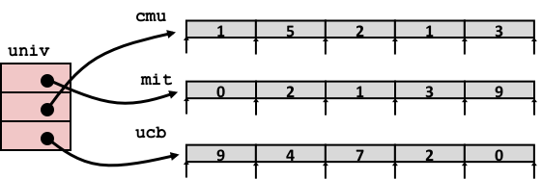
Element Access in Multi-Level Array
int get_univ_digit
(size_t index, size_t digit)
{
return univ[index][digit];
}
salq $2, %rsi # 4*digit
addq univ(,%rdi,8), %rsi # p = univ[index] + 4*digit
movl (%rsi), %eax # return *p
ret
Computation
Element access Mem[Mem[univ+8*index]+4*digit]
Must do two memory reads
First get pointer to row array
Then access element within array

Slide 38
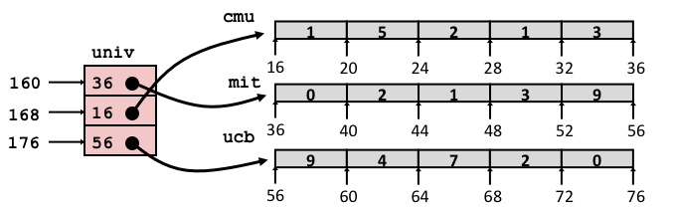
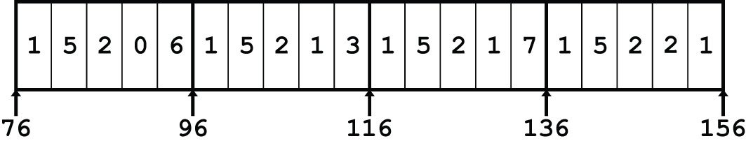
Array Element Accesses
Nested array
Multi-level array
int get_pgh_digit
(size_t index, size_t digit)
{
return pgh[index][digit];
}
int get_univ_digit
(size_t index, size_t digit)
{
return univ[index][digit];
}
Accesses looks similar in C, but address computations very different:
Mem[pgh+20*index+4*digit]
Mem[Mem[univ+8*index]+4*digit]

Slide 39
N X N Matrix Code
#define N 16
typedef int fix_matrix[N][N];
/* Get element A[i][j] */
int fix_ele(fix_matrix A,
size_t i, size_t j)
{
return A[i][j];
}
Fixed dimensions
Know value of N at compile time
Variable dimensions, explicit indexing
Traditional way to implement dynamic arrays
Variable dimensions, implicit indexing
“New” feature in C99
#define IDX(n, i, j) ((i)*(n)+(j))
/* Get element A[i][j] */
int vec_ele(size_t n, int *A,
size_t i, size_t j)
{
return A[IDX(n,i,j)];
}
/* Get element a[i][j] */
int var_ele(size_t n, int A[n][n],
size_t i, size_t j) {
return A[i][j];
}

Slide 40
Summary
Arrays
Elements packed into contiguous region of memory
Use index arithmetic to locate individual elements
Structures
Elements packed into single region of memory
Access using offsets determined by compiler
Possible require internal and external padding to ensure alignment
Combinations
Can nest structure and array code arbitrarily

Slide 41
Today
Activity break: do part 6 now
Partial recap: Integers
Word size
Addresses
One-Dimensional Arrays
Structs
Alignment
Arrays of Structs
Multi-Dimensional Arrays
Nested (Arrays of Arrays)
(Arrays of) Pointers to Arrays
If we have time:
Endianness
Machine Instructions

Slide 42
Byte Ordering
So, how are the bytes within a multi-byte word ordered in memory?
Conventions
Big Endian: Sun, PPC Mac, network packet headers
Least significant byte has highest address
Little Endian: x86, ARM processors running Android, iOS, and Windows
Least significant byte has lowest address

Slide 43
Byte Ordering Example
Example
Variable x has 4-byte value of 0x01234567
Address given by &x is 0x100
Big Endian
0x100
0x101
0x102
0x103
01
01
23
23
45
45
67
67
Little Endian
0x100
0x101
0x102
0x103
67
67
45
45
23
23
01
01

Slide 44
Examining Data Representations
Code to Print Byte Representation of Data
Casting pointer to unsigned char * allows treatment as a byte array
void show_bytes(unsigned char *start, size_t len){
size_t i;
for (i = 0; i < len; i++) {
printf("%p\t%.2x\n",
(void *)&start[i], start[i]);
} }
Printf directives:
%p: Print pointer (must be void *)
%.2x: Print integer in hexadecimal, with at least two digits

Slide 45
show_bytes Execution Example
int a = 15213;
printf("int a = %d;\n“, a);
show_bytes((unsigned char *) &a, sizeof(int));
Result (Linux x86-64):
int a = 15213;
0x7fffb7f71dbc 6d
0x7fffb7f71dbd 3b
0x7fffb7f71dbe 00
0x7fffb7f71dbf 00

Slide 46
Representing Pointers
int B = -15213;
int *P = &B;
Sun
IA32
x86-64
EF
FF
FB
2C
AC
28
F5
FF
3C
1B
FE
82
FD
7F
00
00
Different compilers & machines assign different locations to objects
May even get different results each time program is run (ASLR)

Slide 47
Representing Strings
char S[6] = "18213";
Strings in C
Represented by array of characters
Each character encoded in ASCII format
Standard 7-bit encoding of character set
Character “0” has code 0x30
Digit i has code 0x30+i
String should be null-terminated
Final character = 0
Compatibility
Byte ordering not an issue
IA32
Sun
31
38
32
31
33
00
31
38
32
31
33
00

Slide 48
A note about x86 machine code
x86 machine code is a sequence of bytes
Grouped into variable-length instructions, which look like strings…
But they contain embedded little-endian numbers…
Example Fragment
Deciphering Numbers
Value: 0x12ab
Pad to 32 bits: 0x000012ab
Split into bytes: 00 00 12 ab
Reverse: ab 12 00 00
Address Instruction Code Assembly Rendition
8048365: 5b pop %ebx
8048366: 81 c3 ab 12 00 00 add $0x12ab,%ebx
804836c: 83 bb 28 00 00 00 00 cmpl $0x0,0x28(%ebx)

Slide 49
A peek at x86 instruction encoding
and its long, complex history
64-bit mode…
88 0f mov %cl, (%rdi)
66 89 0f mov %cx, (%rdi)
89 0f mov %ecx, (%rdi)
48 89 0f mov %rcx, (%rdi)
44 88 0f mov %r9b, (%rdi)
66 44 89 0f mov %r9w, (%rdi)
44 89 0f mov %r9d, (%rdi)
4c 89 0f mov %r9, (%rdi)
Same bytes interpreted in 32-bit mode…
88 0f mov %cl, (%edi)
66 89 0f mov %cx, (%edi)
89 0f mov %ecx, (%edi)
48 dec %eax
44 inc %esp
66 44 inc %sp
4c dec %esp
Address size changes to 32 bits
REX becomes a set of primary opcodes
and 16-bit mode …
88 0f mov %cl, (%bx)
66 89 0f mov %ecx, (%bx)
89 0f mov %cx, (%bx)
44 inc %sp
66 44 inc %esp
Operand size = 16 bits
ModRM byte: cx/r9, di, “addressing mode”
REX prefix: adjust sizes and register numbers
Primary opcode: MOV reg → mem + some operand size info
Address size changes to 16 bits, register numbering is different
Now means: Operand size = 32 bits

Slide 50
Extra material
None of this will be on the exam, but you might be curious…

Slide 51
16 X 16 Matrix Access
Array Elements
int A[16][16];
Address A + i * (C * K) + j * K
C = 16, K = 4
/* Get element A[i][j] */
int fix_ele(fix_matrix A, size_t i, size_t j) {
return A[i][j];
}
# A in %rdi, i in %rsi, j in %rdx
salq $6, %rsi # 64*i
addq %rsi, %rdi # A + 64*i
movl (%rdi,%rdx,4), %eax # M[A + 64*i + 4*j]
ret

Slide 52
n X n Matrix Access
Array Elements
size_t n;
int A[n][n];
Address A + i * (C * K) + j * K
C = n, K = 4
Must perform integer multiplication
/* Get element A[i][j] */
int var_ele(size_t n, int A[n][n], size_t i, size_t j) {
return A[i][j];
}
# n in %rdi, A in %rsi, i in %rdx, j in %rcx
imulq %rdx, %rdi # n*i
leaq (%rsi,%rdi,4), %rax # A + 4*n*i
movl (%rax,%rcx,4), %eax # A + 4*n*i + 4*j
ret
Notes:
Why multiply?

Slide 53
Example: Array Access
#include <stdio.h>
#define ZLEN 5
#define PCOUNT 4
typedef int zip_dig[ZLEN];
int main(int argc, char** argv) {
zip_dig pgh[PCOUNT] =
{{1, 5, 2, 0, 6},
{1, 5, 2, 1, 3 },
{1, 5, 2, 1, 7 },
{1, 5, 2, 2, 1 }};
int *linear_zip = (int *) pgh;
int *zip2 = (int *) pgh[2];
int result =
pgh[0][0] +
linear_zip[7] +
*(linear_zip + 8) +
zip2[1];
printf("result: %d\n", result);
return 0;
}
linux> ./array
result: 9
Notes:
Stop and ask students to work out what this might print.

Slide 54
Example: Array Access
#include <stdio.h>
#define ZLEN 5
#define PCOUNT 4
typedef int zip_dig[ZLEN];
int main(int argc, char** argv) {
zip_dig pgh[PCOUNT] =
{{1, 5, 2, 0, 6},
{1, 5, 2, 1, 3 },
{1, 5, 2, 1, 7 },
{1, 5, 2, 2, 1 }};
int *linear_zip = (int *) pgh;
int *zip2 = (int *) pgh[2];
int result =
pgh[0][0] +
linear_zip[7] +
*(linear_zip + 8) +
zip2[1];
printf("result: %d\n", result);
return 0;
}
linux> ./array
result: 9

Slide 55
Understanding Pointers & Arrays #3
Decl | An |  |  | *An |  |  | **An
 | Cmp | Bad | Size | Cmp | Bad | Size | Cmp | Bad | Size
int A1[3][5]
int *A2[3][5]
int (*A3)[3][5]
int *(A4[3][5])
int (*A5[3])[5]
Decl | ***An
 | Cmp | Bad | Size
int A1[3][5]
int *A2[3][5]
int (*A3)[3][5]
int *(A4[3][5])
int (*A5[3])[5]
Cmp: Compiles (Y/N)
Bad: Possible bad pointer reference (Y/N)
Size: Value returned by sizeof

Slide 56
Allocated pointer
Declaration
int A1[3][5]
int *A2[3][5]
int (*A3)[3][5]
int *(A4[3][5])
int (*A5[3])[5]
Allocated pointer to unallocated int
Unallocated pointer
Allocated int
Unallocated int
A1
A2/A4
A3
A5

Slide 57
Understanding Pointers & Arrays #3
Decl | An |  |  | *An |  |  | **An
 | Cmp | Bad | Size | Cmp | Bad | Size | Cmp | Bad | Size
int A1[3][5] | Y | N | 60 | Y | N | 20 | Y | N | 4
int *A2[3][5] | Y | N | 120 | Y | N | 40 | Y | N | 8
int (*A3)[3][5] | Y | N | 8 | Y | Y | 60 | Y | Y | 20
int *(A4[3][5]) | Y | N | 120 | Y | N | 40 | Y | N | 8
int (*A5[3])[5] | Y | N | 24 | Y | N | 8 | Y | Y | 20
Decl | ***An
 | Cmp | Bad | Size
int A1[3][5] | N | - | -
int *A2[3][5] | Y | Y | 4
int (*A3)[3][5] | Y | Y | 4
int *(A4[3][5]) | Y | Y | 4
int (*A5[3])[5] | Y | Y | 4
Cmp: Compiles (Y/N)
Bad: Possible bad pointer reference (Y/N)
Size: Value returned by sizeof

Slide 58
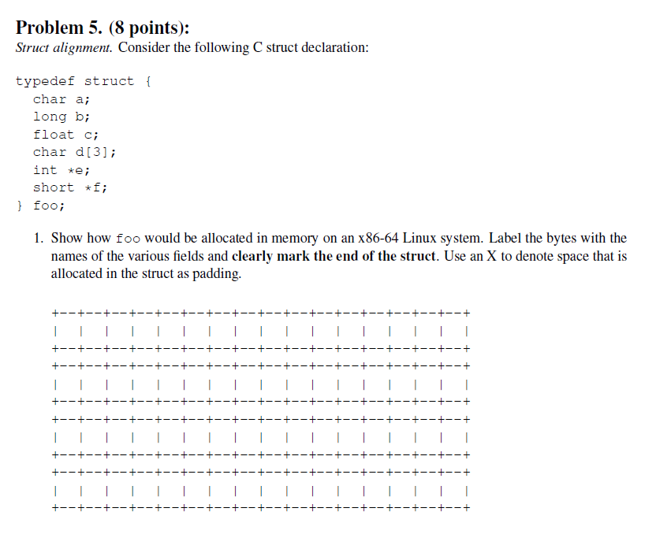
Example Struct Exam Question
http://www.cs.cmu.edu/~213/oldexams/exam1-f12.pdf

Slide 59
Example Struct Exam Question
a
X
X
X
X
X
X
X
b
b
b
b
b
b
b
b
c
c
c
c
d
d
d
X
e
e
e
e
e
e
e
e
f
f
f
f
f
f
f
f
http://www.cs.cmu.edu/~213/oldexams/exam1-f12.pdf

Slide 60
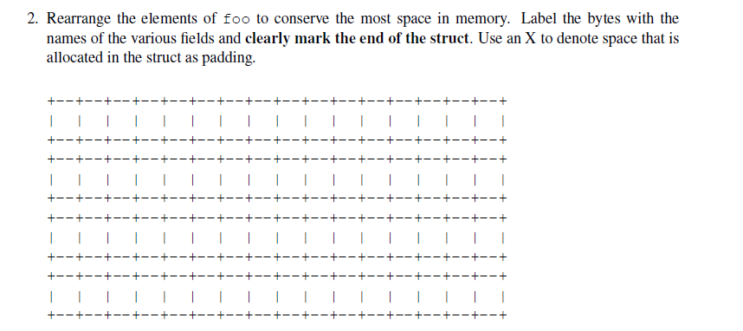
Example Struct Exam Question (Cont’d)
http://www.cs.cmu.edu/~213/oldexams/exam1-f12.pdf

Slide 61
Example Struct Exam Question (Cont’d)
a
d
d
d
c
c
c
c
b
b
b
b
b
b
b
b
e
e
e
e
e
e
e
e
f
f
f
f
f
f
f
f
http://www.cs.cmu.edu/~213/oldexams/exam1-f12.pdf

Slide 62
Background
History
x87 FP
Legacy, very ugly
SSE FP
Supported by Shark machines
Special case use of vector instructions
AVX FP
Newest version
Similar to SSE
Documented in book

Slide 63
Programming with SSE3
XMM Registers
16 total, each 16 bytes
16 single-byte integers
8 16-bit integers
4 32-bit integers
4 single-precision floats
2 double-precision floats
1 single-precision float
1 double-precision float

Slide 64
Scalar & SIMD Operations
Scalar Operations: Single Precision
SIMD Operations: Single Precision
Scalar Operations: Double Precision
addss %xmm0,%xmm1
%xmm0
+
%xmm1
addps %xmm0,%xmm1
%xmm0
+
+
+
+
%xmm1
addsd %xmm0,%xmm1
%xmm0
+
%xmm1

Slide 65
FP Basics
Arguments passed in %xmm0, %xmm1, ...
Result returned in %xmm0
All XMM registers caller-saved
float fadd(float x, float y)
{
return x + y;
}
double dadd(double x, double y)
{
return x + y;
}
# x in %xmm0, y in %xmm1
addss %xmm1, %xmm0
ret
# x in %xmm0, y in %xmm1
addsd %xmm1, %xmm0
ret

Slide 66
FP Memory Referencing
Integer (and pointer) arguments passed in regular registers
FP values passed in XMM registers
Different mov instructions to move between XMM registers, and between memory and XMM registers
double dincr(double *p, double v)
{
double x = *p;
*p = x + v;
return x;
}
# p in %rdi, v in %xmm0
movapd %xmm0, %xmm1 # Copy v
movsd (%rdi), %xmm0 # x = *p
addsd %xmm0, %xmm1 # t = x + v
movsd %xmm1, (%rdi) # *p = t
ret

Slide 67
Other Aspects of FP Code
Lots of instructions
Different operations, different formats, ...
Floating-point comparisons
Instructions ucomiss and ucomisd
Set condition codes CF, ZF, and PF
Using constant values
Set XMM0 register to 0 with instruction xorpd %xmm0, %xmm0
Others loaded from memory

