Slide 1
Machine-Level Programming I: Basics
15-213/14-513/15-513: Introduction to Computer Systems
4th Lecture, September 8, 2022
Instructors:
Dave Andersen (15-213)
Zack Weinberg (15-213)
Brian Railing (15-513)
David Varodayan (14-513)

Slide 2
Announcements
Lab 0 deadline extended to today Thursday 11:59pm ET
Lab 1 (datalab) is due Thursday September 15
  Hand in via Autolab
Lab 2 (bomblab) is due Thursday September 22
  Available on Autolab
Written Assignment 1 is due Wednesday September 14
  Available and hand in on Canvas
Look out for info on GDB bootcamp
  Exceptionally useful for labs–you’ll really want it for Lab 2.

Slide 3
Today: Machine Programming I: Basics
History of Intel processors and architectures
Assembly Basics: Registers, operands, move
Arithmetic & logical operations
C, assembly, machine code

Slide 4
Intel x86 Processors
Dominate laptop/desktop/server market
  ARM architecture is a promising newcomer
Evolutionary design
  Backwards compatible up until 8086, introduced in 1978
  Added more features as time goes on
    Now 3 volumes, about 5,000 pages of documentation
Complex instruction set computer (CISC)
  Many different instructions with many different formats
    But, only small subset encountered with Linux programs
  Hard to match performance of Reduced Instruction Set Computers (RISC)
  But, Intel has done just that!
    In terms of speed. Less so for low power.

Slide 5
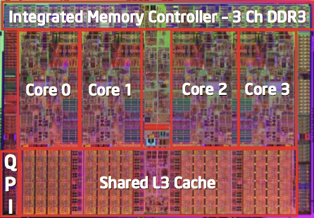
Intel x86 Processors, briefly
Machine Evolution
  8086 (16 bit) 1978 29k
  386 (32 bit!) 1985 0.3M
  Pentium 4e (64 bit) 2004 55M
  Core 2 (multicore!) 2006 291M
  Core i7 2008 731M
  Core i9 2019 3.5B
Added Features
  Instructions to support multimedia operations
  Instructions to enable more efficient conditional operations
  Transition from 32 bits to 64 bits
  More cores

Slide 6
Intel x86 Processors, cont.
Past Generations
  1st Pentium Pro 1995 600 nm
  1st Pentium III 1999 250 nm
  1st Pentium 4 2000 180 nm
  1st Core 2 Duo 2006 65 nm
Recent & Upcoming Generations
  Nehalem 2008 45 nm
  Sandy Bridge 2011 32 nm
  Ivy Bridge 2012 22 nm
  Haswell 2013 22 nm
  Broadwell 2014 14 nm
  Skylake 2015 14 nm
  Kaby Lake 2016 14 nm
  Coffee Lake 2017 14 nm
  Cannon Lake 2018 10 nm
  Ice Lake 2019 10 nm
  Tiger Lake 2020 10 nm
  Alder Lake 2022 “intel 7” (10nm+++)
Process technology
Process technology dimension
= width of narrowest wires
(10 nm ≈ 100 atoms wide)
(But this is changing now.)

Slide 7
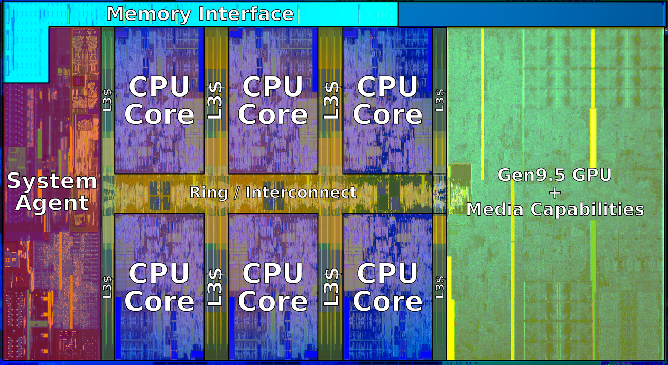
2018 State of the Art: Coffee Lake
Mobile Model: Core i7
  2.2-3.2 GHz
  45 W
Server Model: Xeon E
  Integrated graphics
  Multi-socket enabled
  3.3-3.8 GHz
  80-95 W
Desktop Model: Core i7
  Integrated graphics
  2.4-4.0 GHz
  35-95 W

Slide 8
x86 Clones: Advanced Micro Devices (AMD)
Historically
  AMD has followed just behind Intel
  A little bit slower, a lot cheaper
Then
  Recruited top circuit designers from Digital Equipment Corp. and other downward trending companies
  Built Opteron: tough competitor to Pentium 4
  Developed x86-64, their own extension to 64 bits – which won!
Recent Years
  Intel got its act together
    1995-2011: Lead semiconductor “fab” in world
    2018: #2 largest by $$ (#1 is Samsung)
    2019: reclaimed #1
  AMD fell behind: Spun off GlobalFoundaries
  2019-20: Pulled ahead! Used TSMC for part of fab
  2022: Intel re-took the lead

Slide 9
Intel’s 64-Bit History
2001: Intel Attempts Radical Shift from IA32 to IA64
  Totally different architecture (Itanium)
  Executes IA32 code only as legacy
  Performance disappointing
2003: AMD Steps in with Evolutionary Solution
  AMD makes x86 clones but then .. started innovating
  x86-64 (now called “AMD64”)
Intel Felt Obligated to Focus on IA64
  Hard to admit mistake or that AMD is better
2004: Intel Announces EM64T extension to IA32
  Extended Memory 64-bit Technology
  Almost identical to x86-64!
All but low-end x86 processors support x86-64
  But, lots of code still runs in 32-bit mode

Slide 10
Our Coverage
IA32
  The traditional x86
  For 15/18-213: RIP, Summer 2015
x86-64
  The standard
  shark> gcc hello.c
  shark> gcc –m64 hello.c
Presentation
  Book covers x86-64
  Web aside on IA32
  We will only cover x86-64

Slide 11
Today: Machine Programming I: Basics
History of Intel processors and architectures
Assembly Basics: Registers, operands, move
Arithmetic & logical operations
C, assembly, machine code

Slide 12
How Does a Computer Understand Code?
Short answer: Bits!
Not the complete picture, let’s take it bit by bit

Slide 13
How Does a Person Understand English?
Let’s see how humans understand English
  English uses an alphabet
    A, B, C …
  Examine a sentence:
    Subject: (I) core noun of the sentence
    Object: (15213) supporting noun
    Verbs: (love) actions associating subject and object
I love 15213!

Slide 14
How Does a CPU Understand Code (cont)?
What’s the language of the CPU? Instructions
  Basic building block is bits
  A sentence in English is like a program
  Subject and Object?
    Data: some specific Integers, Floats, …
  Verb?
    Arithmetic Operations: +, -, /, *, <<, >>, …
CPU: Take data, apply action, use result
  Let’s encode: 1 + 2
    (+, 1, 2)
Notes:
Ask students on verbs.

Slide 15
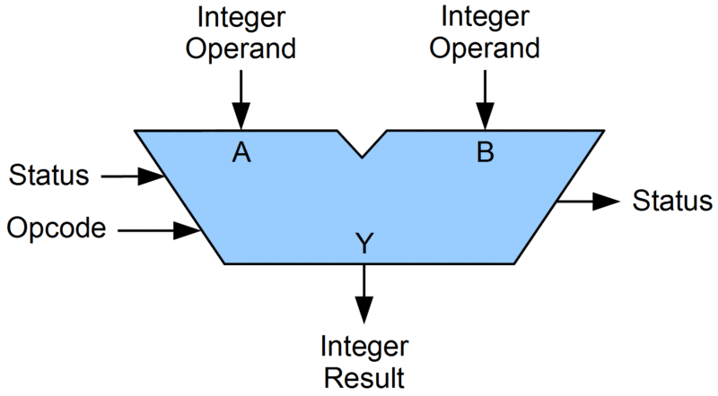
Generalize Our Encoding
1 + 2
1 + 2 -> (+, 1, 2)
3 + 4 -> (+, 3, 4)
Let’s make specialized hardware in our CPU for +, -, …
Separate operations from data
  p = 1
  q = 2
  (+, p, q)
p
q
+

Slide 16
Generalize Our Data Pipeline
p
q
+
CPU needs to supply p, q to our arithmetic unit
CPU uses registers to store information for the ALU
  (+, %p, %q)
But where do the registers get information?
  From the program, and in memory
    (Load, 0x1, %p)
    (Load, &0x7FFFF7AFCBA0, %q)

Slide 17
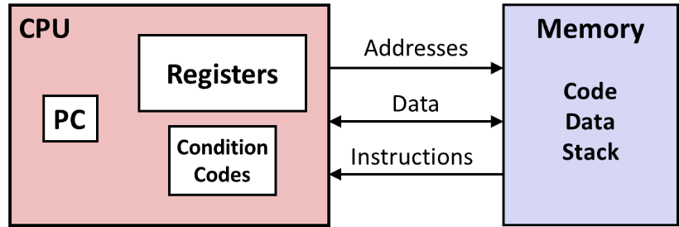
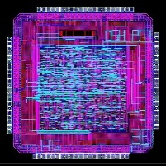
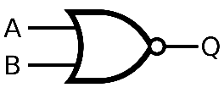
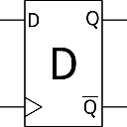
Levels of Abstraction
#include <stdio.h>
int main(){
int i, n = 10, t1 = 0, t2 = 1, nxt;
for (i = 1; i <= n; ++i){
printf("%d, ", t1);
nxt = t1 + t2;
t1 = t2;
t2 = nxt; }
return 0; }
C programmer
Assembly programmer
Computer Designer
Gates, clocks, circuit layout, …

Slide 18
Definitions
Architecture: (also ISA: instruction set architecture) The parts of a processor design that one needs to understand for writing assembly/machine code.
  Examples: instruction set specification, registers
Microarchitecture: Implementation of the architecture
  Examples: cache sizes and core frequency
Code Forms:
  Machine Code: The byte-level programs that a processor executes
  Assembly Code: A text representation of machine code
Example ISAs:
  Intel: x86, IA32, Itanium, x86-64
  ARM: Used in almost all mobile phones
  RISC V: New open-source ISA

Slide 19

Assembly/Machine Code View
CPU
Memory
Registers
Addresses
Data
Code
Data
Stack
PC
Condition
Codes
Instructions
Programmer-Visible State
  PC: Program counter
    Address of next instruction
    Called “RIP” (x86-64)
  Register file
    Heavily used program data
  Condition codes
    Store status information about most recent arithmetic or logical operation
    Used for conditional branching
  Memory
    Byte addressable array
    Code and user data
    Stack to support procedures
Rest in
Instruction Pointer
Notes:
IP: instruction pointer

Slide 20
Assembly Characteristics: Data Types
“Integer” data of 1, 2, 4, or 8 bytes
  Data values
  Addresses (untyped pointers)
Floating point data of 4, 8, or 10 bytes
Code: Byte sequences encoding series of instructions
No aggregate types such as arrays or structures
  Just contiguously allocated bytes in memory
Notes:
10 bytes: extended precision, allows better calculation of double-precision

Slide 21
Class Activity
Form teams of 2 (3 is ok)
Look at the activity on Canvas
One person should take notes / advise / etc
  Download worksheet https://www.cs.cmu.edu/~213/activities/gdb-and-assembly.pdf
One person should ssh to a shark machine
  wget http://www.cs.cmu.edu/~213/activities/gdb-and-assembly.tar
  tar xf gdb-and-assembly.tar
  cd gdb-and-assembly
  ./act1
STOP AFTER ACT1

Slide 22
x86-64 Integer Registers
%rax
%r8
%eax
%r8d
%rbx
%r9
%ebx
%r9d
%rcx
%r10
%ecx
%r10d
%rdx
%r11
%edx
%r11d
%rsi
%r12
%esi
%r12d
%rdi
%r13
%edi
%r13d
%rsp
%r14
%esp
%r14d
%rbp
%r15
%ebp
%r15d
  Can reference low-order 4 bytes (also low-order 1 & 2 bytes)
  Not part of memory (or cache)

Slide 23
Some History: IA32 Registers
Origin
(mostly obsolete)
%eax
%ax
%ah
%al
accumulate
%ecx
%cx
%ch
%cl
counter
%edx
%dx
%dh
%dl
data
general purpose
%ebx
%bx
%bh
%bl
base
%esi
source
index
%si
%edi
destination
index
%di
%esp
stack
pointer
%sp
%ebp
base
pointer
%bp
16-bit virtual registers
(backwards compatibility)

Slide 24
Assembly Characteristics: Operations
Transfer data between memory and register
  Load data from memory into register
  Store register data into memory
Perform arithmetic function on register or memory data
Transfer control
  Unconditional jumps to/from procedures
  Conditional branches
  Indirect branches

Slide 25
Moving Data
%rax
%rcx
Moving Data
  movq Source, Dest
Operand Types
  Immediate: Constant integer data
    Example: $0x400, $-533
    Like C constant, but prefixed with ‘$’
    Encoded with 1, 2, or 4 bytes
  Register: One of 16 integer registers
    Example: %rax, %r13
    But %rsp reserved for special use
    Others have special uses for particular instructions
  Memory: 8 consecutive bytes of memory at address given by register
    Simplest example: (%rax)
    Various other “addressing modes”
%rdx
%rbx
%rsi
%rdi
%rsp
%rbp
%rN
Warning: Intel docs use
mov Dest, Source

Slide 26
movq Operand Combinations
Source
Dest
Src,Dest
C Analog
Reg
movq $0x4,%rax
temp = 0x4;
Imm
Mem
movq $-147,(%rax)
*p = -147;
Reg
movq %rax,%rdx
temp2 = temp1;
movq
Reg
Mem
movq %rax,(%rdx)
*p = temp;
Mem
Reg
movq (%rax),%rdx
temp = *p;
Cannot do memory-memory transfer with a single instruction

Slide 27
Simple Memory Addressing Modes
Normal (R) Mem[Reg[R]]
  Register R specifies memory address
  Aha! Pointer dereferencing in C
  movq (%rcx),%rax
Displacement D(R) Mem[Reg[R]+D]
  Register R specifies start of memory region
  Constant displacement D specifies offset
  movq 8(%rbp),%rdx

Slide 28
Example of Simple Addressing Modes
void
whatAmI(<type> a, <type> b)
{
????
}
whatAmI:
movq (%rdi), %rax
movq (%rsi), %rdx
movq %rdx, (%rdi)
movq %rax, (%rsi)
ret
%rsi
%rdi

Slide 29
Example of Simple Addressing Modes
void swap
(long *xp, long *yp)
{
long t0 = *xp;
long t1 = *yp;
*xp = t1;
*yp = t0;
}
swap:
movq (%rdi), %rax
movq (%rsi), %rdx
movq %rdx, (%rdi)
movq %rax, (%rsi)
ret

Slide 30
Understanding Swap()
Memory
void swap
(long *xp, long *yp)
{
long t0 = *xp;
long t1 = *yp;
*xp = t1;
*yp = t0;
}
Registers
%rdi
%rsi
%rax
%rdx
Register Value
%rdi xp
%rsi yp
%rax t0
%rdx t1
swap:
movq (%rdi), %rax # t0 = *xp
movq (%rsi), %rdx # t1 = *yp
movq %rdx, (%rdi) # *xp = t1
movq %rax, (%rsi) # *yp = t0
ret

Slide 31
Understanding Swap()
Memory
Registers
Address
123
0x120
%rdi
0x120
0x118
%rsi
0x100
0x110
%rax
0x108
%rdx
456
0x100
swap:
movq (%rdi), %rax # t0 = *xp
movq (%rsi), %rdx # t1 = *yp
movq %rdx, (%rdi) # *xp = t1
movq %rax, (%rsi) # *yp = t0
ret

Slide 32
Understanding Swap()
Memory
Registers
Address
123
0x120
%rdi
0x120
0x118
%rsi
0x100
0x110
%rax
123
0x108
%rdx
456
0x100
swap:
movq (%rdi), %rax # t0 = *xp
movq (%rsi), %rdx # t1 = *yp
movq %rdx, (%rdi) # *xp = t1
movq %rax, (%rsi) # *yp = t0
ret

Slide 33
Understanding Swap()
Memory
Registers
Address
123
0x120
%rdi
0x120
0x118
%rsi
0x100
0x110
%rax
123
0x108
%rdx
456
456
0x100
swap:
movq (%rdi), %rax # t0 = *xp
movq (%rsi), %rdx # t1 = *yp
movq %rdx, (%rdi) # *xp = t1
movq %rax, (%rsi) # *yp = t0
ret

Slide 34
Understanding Swap()
Memory
Registers
Address
456
0x120
%rdi
0x120
0x118
%rsi
0x100
0x110
%rax
123
0x108
%rdx
456
456
0x100
swap:
movq (%rdi), %rax # t0 = *xp
movq (%rsi), %rdx # t1 = *yp
movq %rdx, (%rdi) # *xp = t1
movq %rax, (%rsi) # *yp = t0
ret

Slide 35
Understanding Swap()
Memory
Registers
Address
456
0x120
%rdi
0x120
0x118
%rsi
0x100
0x110
%rax
123
0x108
%rdx
456
123
0x100
swap:
movq (%rdi), %rax # t0 = *xp
movq (%rsi), %rdx # t1 = *yp
movq %rdx, (%rdi) # *xp = t1
movq %rax, (%rsi) # *yp = t0
ret

Slide 36
Simple Memory Addressing Modes
Normal (R) Mem[Reg[R]]
  Register R specifies memory address
  Aha! Pointer dereferencing in C
  movq (%rcx),%rax
Displacement D(R) Mem[Reg[R]+D]
  Register R specifies start of memory region
  Constant displacement D specifies offset
  movq 8(%rbp),%rdx

Slide 37
Complete Memory Addressing Modes
Most General Form
D(Rb,Ri,S) Mem[Reg[Rb]+S*Reg[Ri]+ D]
  D: Constant “displacement” 1, 2, or 4 bytes
  Rb: Base register: Any of 16 integer registers
  Ri: Index register: Any, except for %rsp
  S: Scale: 1, 2, 4, or 8 (why these numbers?)
Special Cases
(Rb,Ri) Mem[Reg[Rb]+Reg[Ri]]
D(Rb,Ri) Mem[Reg[Rb]+Reg[Ri]+D]
(Rb,Ri,S) Mem[Reg[Rb]+S*Reg[Ri]]
Notes:
Scale by byte, short, int, or long

Slide 38
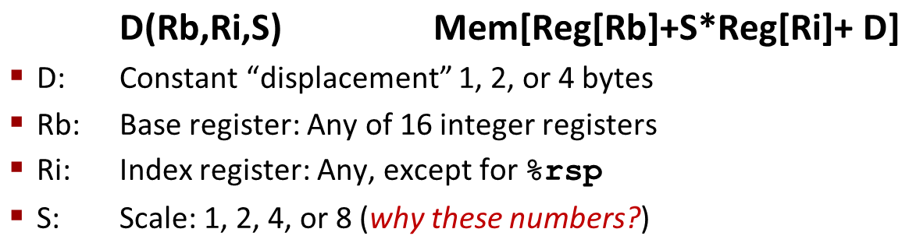
Address Computation Examples
%rdx | 0xf000
%rcx | 0x0100
Expression | Address Computation | Address
0x8(%rdx)
(%rdx,%rcx)
(%rdx,%rcx,4)
0x80(,%rdx,2)
Expression | Address Computation | Address
0x8(%rdx) | 0xf000 + 0x8 | 0xf008
(%rdx,%rcx) | 0xf000 + 0x100 | 0xf100
(%rdx,%rcx,4) | 0xf000 + 4*0x100 | 0xf400
0x80(,%rdx,2) | 2*0xf000 + 0x80 | 0x1e080
Notes:
0xf000 + 0x8 = 0xf008
0xf000 + 0x0100 = 0xf100
0xf000 + 4*0x0100 = 0xf400
2*0xf000 + 0x80 = 0x1d080

Slide 39
Address Computation Examples
%rdx | 0xf000
%rcx | 0x0100
Expression | Address Computation | Address
0x8(%rdx)
(%rdx,%rcx)
(%rdx,%rcx,4)
0x80(,%rdx,2)
Expression | Address Computation | Address
0x8(%rdx) | 0xf000 + 0x8 | 0xf008
(%rdx,%rcx) | 0xf000 + 0x100 | 0xf100
(%rdx,%rcx,4) | 0xf000 + 4*0x100 | 0xf400
0x80(,%rdx,2) | 2*0xf000 + 0x80 | 0x1e080
Notes:
0xf000 + 0x8 = 0xf008
0xf000 + 0x0100 = 0xf100
0xf000 + 4*0x0100 = 0xf400
2*0xf000 + 0x80 = 0x1d080

Slide 40
Today: Machine Programming I: Basics
History of Intel processors and architectures
Assembly Basics: Registers, operands, move
Arithmetic & logical operations
C, assembly, machine code

Slide 41
Address Computation Instruction
leaq Src, Dst
  Src is address mode expression
  Set Dst to address denoted by expression
Uses
  Computing addresses without a memory reference
    E.g., translation of p = &x[i];
  Computing arithmetic expressions of the form x + k*y
    k = 1, 2, 4, or 8
Example
long m12(long x)
{
return x*12;
}
Converted to ASM by compiler:
leaq (%rdi,%rdi,2), %rax # t = x+2*x
salq $2, %rax # return t<<2

Slide 42
Activity 2!

Slide 43
Some Arithmetic Operations
Two Operand Instructions:
  Format Computation
    addq Src,Dest Dest = Dest + Src
    subq Src,Dest Dest = Dest − Src
    imulq Src,Dest Dest = Dest * Src
    salq Src,Dest Dest = Dest << Src Also called shlq
    sarq Src,Dest Dest = Dest >> Src Arithmetic
    shrq Src,Dest Dest = Dest >> Src Logical
    xorq Src,Dest Dest = Dest ^ Src
    andq Src,Dest Dest = Dest & Src
    orq Src,Dest Dest = Dest | Src
Watch out for argument order! Src,Dest
(Warning: Intel docs use “op Dest,Src”)
No distinction between signed and unsigned int (why?)

Slide 44
Some Arithmetic Operations
One Operand Instructions
    incq Dest Dest = Dest + 1
    decq Dest Dest = Dest − 1
    negq Dest Dest = − Dest
    notq Dest Dest = ~Dest
See book for more instructions

Slide 45
Arithmetic Expression Example
arith:
leaq (%rdi,%rsi), %rax
addq %rdx, %rax
leaq (%rsi,%rsi,2), %rdx
salq $4, %rdx
leaq 4(%rdi,%rdx), %rcx
imulq %rcx, %rax
ret
long arith
(long x, long y, long z)
{
long t1 = x+y;
long t2 = z+t1;
long t3 = x+4;
long t4 = y * 48;
long t5 = t3 + t4;
long rval = t2 * t5;
return rval;
}
Interesting Instructions
  leaq: address computation
  salq: shift
  imulq: multiplication
    But, only used once

Slide 46
Understanding Arithmetic Expression Example
arith:
leaq (%rdi,%rsi), %rax # t1
addq %rdx, %rax # t2
leaq (%rsi,%rsi,2), %rdx
salq $4, %rdx # t4
leaq 4(%rdi,%rdx), %rcx # t5
imulq %rcx, %rax # rval
ret
long arith
(long x, long y, long z)
{
long t1 = x+y;
long t2 = z+t1;
long t3 = x+4;
long t4 = y * 48;
long t5 = t3 + t4;
long rval = t2 * t5;
return rval;
}
Register | Use(s)
%rdi | Argument x
%rsi | Argument y
%rdx | Argument z, t4
%rax | t1, t2, rval
%rcx | t5

Slide 47
Today: Machine Programming I: Basics
History of Intel processors and architectures
Assembly Basics: Registers, operands, move
Arithmetic & logical operations
C, assembly, machine code

Slide 48
Turning C into Object Code
  Code in files p1.c p2.c
  Compile with command: gcc –Og p1.c p2.c -o p
    Use debugging-friendly optimizations (-Og)
    Put resulting binary in file p
text
C program (p1.c p2.c)
Compiler (gcc –Og -S)
text
Asm program (p1.s p2.s)
Assembler (gcc –c or as)
binary
Object program (p1.o p2.o)
Static libraries (.a)
Linker (gcc or ld)
binary
Executable program (p)

Slide 49
Compiling Into Assembly
C Code (sum.c)
Generated x86-64 Assembly
long plus(long x, long y);
void sumstore(long x, long y,
long *dest)
{
long t = plus(x, y);
*dest = t;
}
sumstore:
pushq %rbx
movq %rdx, %rbx
call plus
movq %rax, (%rbx)
popq %rbx
ret
Obtain (on shark machine) with command
  gcc –Og –S sum.c
Produces file sum.s
Warning: Will get very different results on non-Shark machines (Andrew Linux, Mac OS-X, …) due to different versions of gcc and different compiler settings.

Slide 50
What it really looks like
.globl sumstore
.type sumstore, @function
sumstore:
.LFB35:
.cfi_startproc
pushq %rbx
.cfi_def_cfa_offset 16
.cfi_offset 3, -16
movq %rdx, %rbx
call plus
movq %rax, (%rbx)
popq %rbx
.cfi_def_cfa_offset 8
ret
.cfi_endproc
.LFE35:
.size sumstore, .-sumstore

Slide 51
What it really looks like
Things that look weird and are preceded by a ‘.’ are generally directives.
.globl sumstore
.type sumstore, @function
sumstore:
.LFB35:
.cfi_startproc
pushq %rbx
.cfi_def_cfa_offset 16
.cfi_offset 3, -16
movq %rdx, %rbx
call plus
movq %rax, (%rbx)
popq %rbx
.cfi_def_cfa_offset 8
ret
.cfi_endproc
.LFE35:
.size sumstore, .-sumstore
sumstore:
pushq %rbx
movq %rdx, %rbx
call plus
movq %rax, (%rbx)
popq %rbx
ret
Notes:
Directives are notes to the assembler. They do not represent instructions are not translated to machine code.

Slide 52
Object Code
Code for sumstore
Assembler
  Translates .s into .o
  Binary encoding of each instruction
  Nearly-complete image of executable code
  Missing linkages between code in different files
Linker
  Resolves references between files
  Combines with static run-time libraries
    E.g., code for malloc, printf
  Some libraries are dynamically linked
    Linking occurs when program begins execution
0x0400595:
0x53
0x48
0x89
0xd3
0xe8
0xf2
0xff
0xff
0xff
0x48
0x89
0x03
0x5b
0xc3
  Total of 14 bytes
  Each instruction 1, 3, or 5 bytes
  Starts at address 0x0400595
Notes:
Object code is almost executable but lacks certain references across files. Linker resolves this.

Slide 53
Machine Instruction Example
C Code
  Store value t where designated by dest
Assembly
  Move 8-byte value to memory
    Quad words in x86-64 parlance
  Operands:
    t: Register %rax
    dest: Register %rbx
    *dest: Memory M[%rbx]
Object Code
  3-byte instruction
  Stored at address 0x40059e
*dest = t;
movq %rax, (%rbx)
0x40059e: 48 89 03

Slide 54
Disassembling Object Code
Disassembled
0000000000400595 <sumstore>:
400595: 53 push %rbx
400596: 48 89 d3 mov %rdx,%rbx
400599: e8 f2 ff ff ff callq 400590 <plus>
40059e: 48 89 03 mov %rax,(%rbx)
4005a1: 5b pop %rbx
4005a2: c3 retq
Disassembler
  objdump –d sum
  Useful tool for examining object code
  Analyzes bit pattern of series of instructions
  Produces approximate rendition of assembly code
  Can be run on either a.out (complete executable) or .o file

Slide 55
Alternate Disassembly
Disassembled
Dump of assembler code for function sumstore:
0x0000000000400595 <+0>: push %rbx
0x0000000000400596 <+1>: mov %rdx,%rbx
0x0000000000400599 <+4>: callq 0x400590 <plus>
0x000000000040059e <+9>: mov %rax,(%rbx)
0x00000000004005a1 <+12>:pop %rbx
0x00000000004005a2 <+13>:retq
Within gdb Debugger
  Disassemble procedure
  gdb sum
  disassemble sumstore

Slide 56
Alternate Disassembly
Disassembled
Object
Code
Dump of assembler code for function sumstore:
0x0000000000400595 <+0>: push %rbx
0x0000000000400596 <+1>: mov %rdx,%rbx
0x0000000000400599 <+4>: callq 0x400590 <plus>
0x000000000040059e <+9>: mov %rax,(%rbx)
0x00000000004005a1 <+12>:pop %rbx
0x00000000004005a2 <+13>:retq
0x0400595:
0x53
0x48
0x89
0xd3
0xe8
0xf2
0xff
0xff
0xff
0x48
0x89
0x03
0x5b
0xc3
Within gdb Debugger
  Disassemble procedure
  gdb sum
  disassemble sumstore
  Examine the 14 bytes starting at sumstore
  x/14xb sumstore

Slide 57
What Can be Disassembled?
% objdump -d WINWORD.EXE
WINWORD.EXE: file format pei-i386
No symbols in "WINWORD.EXE".
Disassembly of section .text:
30001000 <.text>:
30001000: 55 push %ebp
30001001: 8b ec mov %esp,%ebp
30001003: 6a ff push $0xffffffff
30001005: 68 90 10 00 30 push $0x30001090
3000100a: 68 91 dc 4c 30 push $0x304cdc91
Reverse engineering forbidden by
Microsoft End User License Agreement
Anything that can be interpreted as executable code
Disassembler examines bytes and reconstructs assembly source
Notes:
EULA’s are particularly harmful: disassembly is a US federal right for educational purposes.

Slide 58
Machine Programming I: Summary
History of Intel processors and architectures
  Evolutionary design leads to many quirks and artifacts
C, assembly, machine code
  New forms of visible state: program counter, registers, ...
  Compiler must transform statements, expressions, procedures into low-level instruction sequences
Assembly Basics: Registers, operands, move
  The x86-64 move instructions cover wide range of data movement forms
Arithmetic
  C compiler will figure out different instruction combinations to carry out computation

