Slide 1
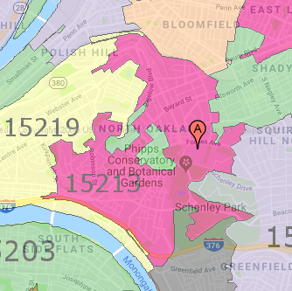
Course Overview 15-213/14-513/15-513:
Introduction to Computer Systems 1st Lecture, August 30, 2022
Instructors:
Dave Andersen (15-213)
Brian Railing (15-513)
David Varodayan (14-513)
Zack Weinberg (15-213)
The course that gives CMU its “Zip”!

Slide 2
Overview
Introductions
Big Picture
Course theme
Five realities
How the course fits into the CS/ECE/INI curriculum
Academic integrity
Logistics and Policies

Slide 3
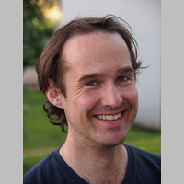

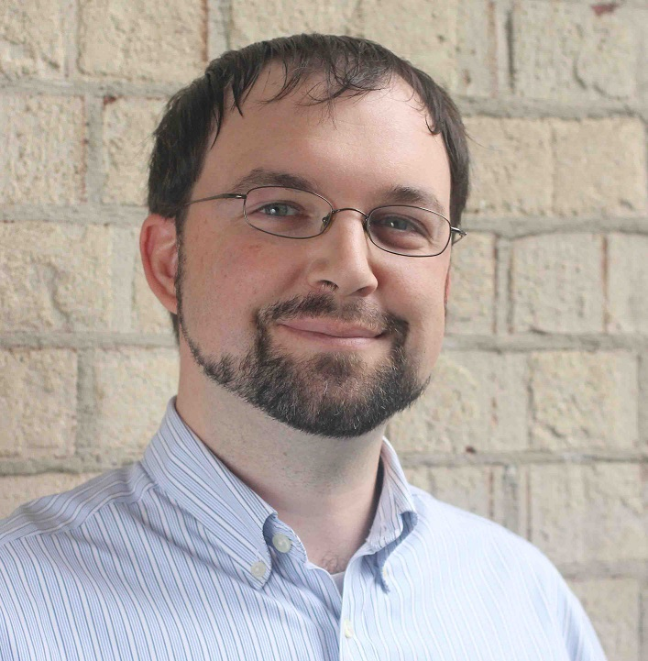
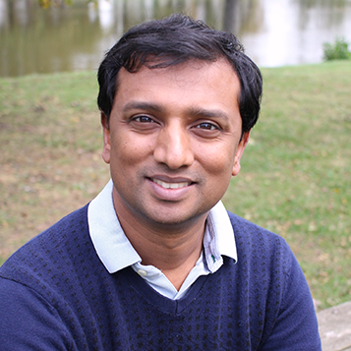
Instructors
Carnegie Mellon
Dave Andersen
Zack Weinberg
15-213
Brian Railing
David Varodayan
15-513
14-513

Slide 4
The Big Picture

Slide 5
Course Theme: (Systems) Knowledge is Power!
Systems Knowledge
How hardware (processors, memories, disk drives, network infrastructure) plus software (operating systems, compilers, libraries, network protocols) combine to support the execution of application programs
How you as a programmer can best use these resources
Useful outcomes from taking 213/513
Become more effective programmers
Able to find and eliminate bugs efficiently
Able to understand and tune for program performance
Prepare for later “systems” classes in CS & ECE
Compilers, Operating Systems, Networks, Computer Architecture, Embedded Systems, Storage Systems, etc.

Slide 6
It’s Important to Understand How Things Work
Why do I need to know this stuff?
Abstraction is good, but don’t forget reality
Most CS and CE courses emphasize abstraction
Abstract data types
Asymptotic analysis
These abstractions have limits
Especially in the presence of bugs
Need to understand details of underlying implementations
Sometimes the abstract interfaces don’t provide the level of control or performance you need

Slide 7
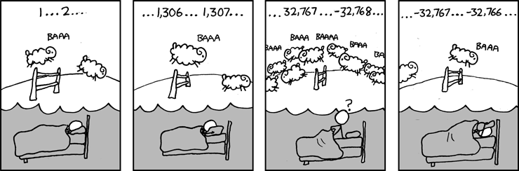
Great Reality #1: Ints are not Integers, Floats are not Reals
Example 1: Is x² ≥ 0?
Float’s: Yes!
Int’s:
40000 * 40000 --> 1600000000
50000 * 50000 --> ?
Example 2: Is (x + y) + z = x + (y + z)?
Unsigned & Signed Int’s: Yes!
Float’s:
(1e20 + -1e20) + 3.14 --> 3.14
1e20 + (-1e20 + 3.14) --> ??
Source: xkcd.com/571

Slide 8
Computer Arithmetic
Does not generate random values
Arithmetic operations have important mathematical properties
Cannot assume all “usual” mathematical properties
Due to finiteness of representations
Integer operations satisfy “ring” properties
Commutativity, associativity, distributivity
Floating point operations satisfy “ordering” properties
Monotonicity, values of signs
Observation
Need to understand which abstractions apply in which contexts
Important issues for compiler writers and serious application programmers

Slide 9
Great Reality #2: You’ve Got to Know Assembly
Chances are, you’ll never write programs in assembly
Compilers are much better & more patient than you are
But: Understanding assembly is key to machine-level execution model
Behavior of programs in presence of bugs
High-level language models break down
Tuning program performance
Understand optimizations done / not done by the compiler
Understanding sources of program inefficiency
Implementing system software
Compiler has machine code as target
Operating systems must manage process state
Creating / fighting malware
x86 assembly is the language of choice!

Slide 10
Great Reality #3: Memory Matters Random Access Memory Is an Unphysical Abstraction
Memory is not unbounded
It must be allocated and managed
Many applications are memory dominated
Memory referencing bugs especially pernicious
Effects are distant in both time and space
Memory performance is not uniform
Cache and virtual memory effects can greatly affect program performance
Adapting program to characteristics of memory system can lead to major speed improvements

Slide 11
Memory Referencing Bug Example
typedef struct {
int a[2];
double d;
} struct_t;
double fun(int i) {
volatile struct_t s;
s.d = 3.14;
s.a[i] = 1073741824; /* Possibly out of bounds */
return s.d;
}
fun(0) --> 3.14
fun(1) --> 3.14
fun(2) --> 3.1399998664856
fun(3) --> 2.00000061035156
fun(4) --> 3.14
fun(6) --> Segmentation fault
Result is system specific

Slide 12
Memory Referencing Bug Example
typedef struct {
int a[2];
double d;
} struct_t;
fun(0) --> 3.14
fun(1) --> 3.14
fun(2) --> 3.1399998664856
fun(3) --> 2.00000061035156
fun(4) --> 3.14
fun(6) --> Segmentation fault
Explanation:
Critical State | 6
? | 5
? | 4
d7 ... d4 | 3
d3 ... d0 | 2
a[1] | 1
a[0] | 0
Location accessed by fun(i)
struct_t

Slide 13
Memory Referencing Errors
C and C++ do not provide any memory protection
Out of bounds array references
Invalid pointer values
Abuses of malloc/free
Can lead to nasty bugs
Whether or not bug has any effect depends on system and compiler
Action at a distance
Corrupted object logically unrelated to one being accessed
Effect of bug may be first observed long after it is generated
How can I deal with this?
Program in Java, Ruby, Python, ML, …
Understand what possible interactions may occur
Use or develop tools to detect referencing errors (e.g. Valgrind)

Slide 14
Great Reality #4: There’s more to performance than asymptotic complexity
Constant factors matter too!
And even exact op count does not predict performance
Easily see 10:1 performance range depending on how code written
Must optimize at multiple levels: algorithm, data representations, procedures, and loops
Must understand system to optimize performance
How programs compiled and executed
How to measure program performance and identify bottlenecks
How to improve performance without destroying code modularity and generality

Slide 15
Memory System Performance Example
void copyij(int src[2048][2048],
int dst[2048][2048])
{
int i,j;
for (i = 0; i < 2048; i++)
for (j = 0; j < 2048; j++)
dst[i][j] = src[i][j];
}
void copyji(int src[2048][2048],
int dst[2048][2048])
{
int i,j;
for (j = 0; j < 2048; j++)
for (i = 0; i < 2048; i++)
dst[i][j] = src[i][j];
}
4.3ms
81.8ms
2.0 GHz Intel Core i7 Haswell
Hierarchical memory organization
Performance depends on access patterns
Including how step through multi-dimensional array

Slide 16
Why The Performance Differs
copyij
copyji

Slide 17
Great Reality #5: Computers do more than execute programs
They need to get data in and out
I/O system critical to program reliability and performance
They communicate with each other over networks
Many system-level issues arise in presence of network
Concurrent operations by autonomous processes
Coping with unreliable media
Cross platform compatibility
Complex performance issues

Slide 18
Course Perspective
Most Systems Courses are Builder-Centric
Computer Architecture
Design pipelined processor in Verilog
Operating Systems
Implement sample portions of operating system
Compilers
Write compiler for simple language
Networking
Implement and simulate network protocols

Slide 19
Course Perspective (Cont.)
Our Course is Programmer-Centric
By knowing more about the underlying system, you can be more effective as a programmer
Enable you to
Write programs that are more reliable and efficient
Incorporate features that require hooks into OS
E.g., concurrency, signal handlers
Cover material in this course that you won’t see elsewhere
Not just a course for dedicated hackers
We bring out the hidden hacker in everyone!

Slide 20
Role within CS/ECE Curriculum
CS 122
Imperative
Programming
Foundation of Computer Systems Underlying principles for hardware, software, and networking
213/513
ECE Systems
18-330 Computer Security
18-349 Intro to Embedded Systems
18-441 Computer Networks
18-447 Computer Architecture
18-452 Wireless Networking
18-451 Cyberphysical Systems
CS Systems
15-319 Cloud Computing
15-330 Computer Security
15-410 Operating Systems
15-411 Compiler Design
15-415 Database Applications
15-418 Parallel Computing
15-440 Distributed Systems
15-441 Computer Networks
15-445 Database Systems
CS Graphics
15-462 Computer Graphics
15-463 Comp. Photography
Notes:
And take ~5 to get a systems concentration

Slide 21
Systems Concentration
For CS undergrads (currently)
Take ~5 systems courses
Chance to learn about wide range of systems and systems issues

Slide 22
Academic Integrity
Please pay close attention, especially if this is your first semester at CMU

Slide 23
Cheating/Plagiarism: Description
Unauthorized use of information
Borrowing code: by copying, retyping, looking at a file
Describing: verbal description of code from one person to another
Even if you just describe/discuss how to put together CS:APP code snippets to solve the problem
Searching the Web for solutions, discussions, tutorials, blogs, other universities’ 213 instances,… in English or any other language
Copying code from a previous course or online solution
Reusing your code from a previous semester (here or elsewhere)
If you take the course this semester, all work has to be done this semester (unless you have special permission from the instructors)
Using AI to generate your code (e.g., GitHub CoPilot)

Slide 24
Cheating/Plagiarism: Description (cont.)
Unauthorized supplying of information
Providing copy: Giving a copy of a file to someone
Providing access:
Putting material in unprotected directory
Putting material in unprotected code repository (e.g., Github)
Or, letting protections expire
Applies to this term and the future
There is no statute of limitations for academic integrity violations
Collaborations beyond high-level, strategic advice
Anything more than block diagram or a few words
Code / pseudo-code is NOT high level
Coaching, arranging blocks of allowed code is NOT high level
Code-level debugging is NOT high level

Slide 25
Cheating/Plagiarism: Description
What is NOT cheating?
Explaining how to use systems or tools
Helping others with high-level design issues High means VERY high
Using code supplied by us
Using code from the CS:APP web site
Using books from the library, Unix manpages, other published material
Except the “Solutions Manual for CS:APP”
Using general online references
OK: The GNU C Library Manual, Beej’s Guide to C, cplusplus.com
Not OK: searching for “213 malloc solution”

Slide 26
Cheating/Plagiarism: Attribution
If you copy code (that you’re allowed to copy), you MUST credit the author
Starter code: No
Any other allowed code (course, CS:APP, etc): Yes
Indicate source, beginning, and end
Here’s what it should look like:
/** Hash a 4-byte integer. * This is the “6 shifts” function from
* https://burtleburtle.net/bob/hash/integer.html
* (second from the top on that page)
*/
uint32_t hash( uint32_t a)
{
a = (a+0x7ed55d16) + (a<<12);
// ...
}

Slide 27
Cheating: Consequences
Penalty for cheating:
Best case: -100% for assignment
You would be better off to turn in nothing
Worst case: Removal from course with failing grade
This is the default
Permanent mark on your record
Loss of respect by you, the instructors and your colleagues
If you do cheat – come clean asap!
Detection of cheating:
We have sophisticated tools for detecting code plagiarism
In Fall 2015, 20 students were caught cheating and failed the course.
Some were expelled from the University
In January 2016, 11 students were penalized for cheating violations that occurred as far back as Spring 2014.
In May 2019, we gave an AIV to a student who took the course in Fall 2018 for unauthorized coaching of a Spring 2019 student. His grade was changed retroactively.
Don’t do it!
Manage your time carefully
Ask the staff for help when you get stuck

Slide 28
Cheating Notes
We have written over 100 letters for cheating cases
Don’t add to this total
Some have been for years earlier
Your work is sophisticated enough that there are many different solutions
Things that look the same are very suspicious
If you do your own work and commit regularly, your work is unique
We use PhD-level research to detect similarities
Inputs include: multiple tools, online searches, past semester submissions

Slide 29
Some Concrete Examples:
This is Cheating:
Searching the internet with the phrase 15-213, 15213, 213, 18213, 513, malloclab, etc.
That’s right, just entering it in a search engine
Looking at someone’s code on the computer next to yours
Giving your code to someone else, now or in the future
Posting your code in a publicly accessible place on the Internet, now or in the future
Hacking the course infrastructure
This is OK (and encouraged):
Googling a man page for fputs
Asking a friend for help with gdb
Asking a TA or course instructor for help, showing them your code, …
Looking in the textbook for a code example
Talking about a (high-level) approach to the lab with a classmate

Slide 30
How it Feels: Student and Instructor
Fred is desperate. He can’t get his code to work and the deadline is drawing near. In panic and frustration, he searches the web and finds a solution posted by a student at U. Oklahoma on Github. He carefully strips out the comments and inserts his own. He changes the names of the variables and functions. Phew! Got it done!
The course staff run checking tools that compare all submitted solutions to the solutions from this and other semesters, along with ones that are on the Web.
Remember: We are as good at web searching as you are
Meanwhile, Fred has had an uneasy feeling: Will I get away with it? Why does my conscience bother me?
Fred gets email from an instructor: “Please see me tomorrow at 9:30 am.”
Fred does not sleep well that night

Slide 31
How it Feels: Student and Instructor
The instructor feels frustrated. His job is to help students learn, not to be police. Every hour he spends looking at code for cheating is time that he cannot spend providing help to students. But, these cases can’t be overlooked
At the meeting:
Instructor: “Explain why your code looks so much like the code on Github.”
Fred: “Gee, I don’t know. I guess all solutions look pretty much alike.”
Instructor: “I don’t believe you. I am going to file an academic integrity violation.”
Fred will have the right to appeal, but the instructor does not need him to admit his guilt in order to penalize him.
Consequences
Fred may (most likely) will be given a failing grade for the course
Fred will be reported to the university
A second AIV will lead to a disciplinary hearing
Fred will go through the rest of his life carrying a burden of shame
The instructor will experience a combination of betrayal and distress

Slide 32
Why It’s a Big Deal
This material is best learned by doing
Even though that can, at times, be difficult and frustrating
Starting with a copy of a program and then tweaking it is very different from writing from scratch
Planning, designing, organizing a program are important skills
We are the gateway to other system courses
Want to make sure everyone completing the course has mastered the material
Industry appreciates the value of this course
We want to make sure anyone claiming to have taken the course is prepared for the real world
Working in teams and collaboration is an important skill
But only if team members have solid foundations
This course is about foundations, not teamwork

Slide 33
A Scenario: Cheating or Not?
Alice is working on malloc lab and is just plain stuck. Her code is seg faulting and she doesn't know why. It is only 2 days until malloc lab is due and she has 3 other assignments due this same week. She is in the cluster.
Bob is sitting next to her. He is pretty much done.
Sitting next to Bob is Charlie. He is also stuck.
1. Charlie gets up for a break and Bob makes a printout of his own code and leaves it on Charlie’s chair.
Who cheated: Charlie? Bob?
2. Charlie finds the copy of Bob’s malloc code, looks it over, and then copies one function, but changes the names of all the variables.
Who cheated: Charlie? Bob?

Slide 34
Another Scenario
Alice is working on malloc lab and is just plain stuck. Her code is seg faulting and she doesn't know why. It is only 2 days until malloc lab is due and she has 3 other assignments due this same week. She is in the cluster.
Bob is sitting next to her. He is pretty much done.
Sitting next to Bob is Charlie. He is also stuck.
1. Bob offers to help Alice and they go over her code together.
Who cheated: Bob? Alice?
2. Bob gets up to go to the bathroom and Charlie looks over at his screen to see how Bob implemented his free list.
Who cheated: Charlie? Bob?

Slide 35
Another Scenario (cont.)
3. Alice is having trouble with GDB. She asks Bob how to set a breakpoint, and he shows her.
Who cheated: Bob? Alice?
4. Charlie goes to a TA and asks for help
Who cheated: Charlie?
If you are uncertain which of these constitutes cheating, and which do not, please read the syllabus carefully. If you’re still uncertain, ask one of the staff

Slide 36
Version Control: Your Good Friend
Starting with cache lab, labs will be distributed via GitHub Classroom
Must be used by all students
Students must commit early and often
If a student is accused of cheating (plagiarism), we will consult the GIT server and look for a reasonable commit history
Missing GIT history will count against you
Please make sure you have one!
Note: Posting your work for this class in a public Git repo (on your personal GitHub account, for instance) is considered an AIV
You’re making it too easy for other people to copy from you
Use a private repo shared with specific people if you want to e.g. show your work to a potential employer

Slide 37
How to Avoid AIVs
Start early
Don’t rely on marathon programming sessions
Your brain works better in small bursts of activity
Ideas / solutions will come to mind while you’re doing other things
Plan for stumbling blocks
Assignment is harder than you expected
Code doesn’t work
Bugs hard to track down
Life gets in the way
Minor health issues
Unanticipated events

Slide 38
Logistics

Slide 39
Education research in this course
We (faculty) use this course as a basis for formal research studies into how we can teach more effectively.
Nothing we do for research purposes will affect your grade.
You have the right to request to be excluded from the studies.
Prof. Railing is here to give more detail.

Slide 40
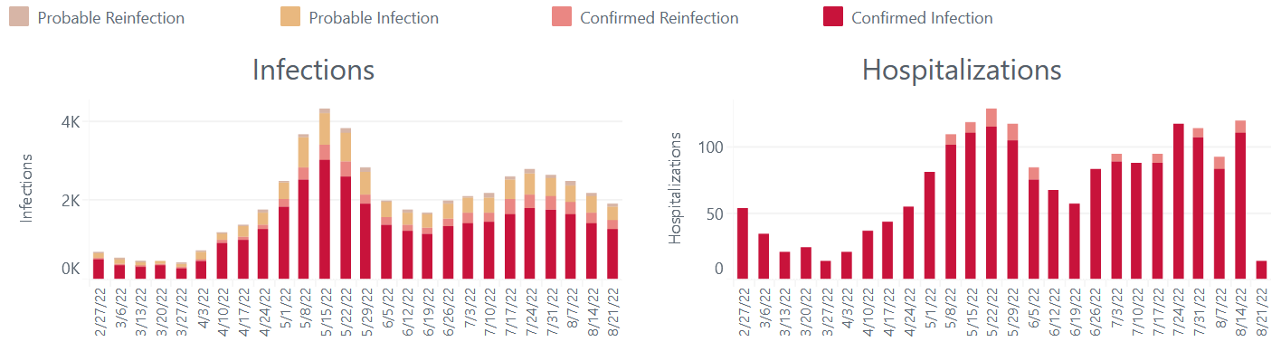
A slide I wish I didn’t have to show you
Mask requirements lifted
Source: https://tableau.alleghenycounty.us/t/PublicSite/views/COVID-19Summary_16222279737570/COVID-19Summary?%3Aembed=y&%3AisGuestRedirectFromVizportal=y
You are formally requested (but not required) to wear a mask in this classroom.
I think you should be wearing a mask whenever you’re indoors and not alone.
It needs to cover your nose (or else it does no good).

Slide 41
15-213, 14-513, 15-513, 18-213, 18-613
Carnegie Mellon
15-213
CS Undergraduates and other Undergraduates
In-class lectures in DH 2315 (with in-class quizzes)
14-513
INI Masters students
In-class lectures in CIC 1201 (with in-class quizzes)
15-513
CS Masters and other Masters students
Watch recorded lectures (no in-class quizzes)
18-213
ECE Undergraduates
In-class lectures in DH A302 (with in-class quizzes)
18-613
ECE Masters students
In-class lectures in HOA 160 / B23 110 (with in-class quizzes)
Same material & labs for all the courses
15-cohort (for TAs, office hours, etc)
18-cohort (for TAs, office hours, etc)

Slide 42
Primary Textbook
Randal E. Bryant and David R. O’Hallaron,
Computer Systems: A Programmer’s Perspective, Third Edition (CS:APP3e), Pearson, 2016
https://csapp.cs.cmu.edu
This book really matters for the course!
How to solve labs
Practice problems typical of exam problems
Electronic editions available (Don’t get paperback/international version!)
On reserve in Sorrells Library
Note: All textbooks have errors
Don’t panic if you see something that seems wrong
Come talk to us about it if you can’t make it make sense

Slide 43
Recommended reading
Brian Kernighan and Dennis Ritchie,
The C Programming Language, Second Edition, Prentice Hall, 1988
Everyone calls this book “K&R”
Guide to C by the designers of the language
Well-written, concise
A little dated
Doesn’t cover additions to C since 1988 (that’s thirty years ago…)
Casual about issues we consider serious problems now
On reserve in Sorrells Library

Slide 44
If you want more books about C
C for Programmers with an introduction to C11
Paul and Harvey Deitel
Opposite of K&R: modern, verbose
Lots of worked-out examples
Ugly code style (compare readability to K&R)
21st Century C
Ben Klemens
Supplement to full C textbooks: goes into the corners of the language
Opinionated
First half is about how to build C programs in the Unix environment
So, if you want to understand the Makefiles we give you…
Learn C the Hard Way
Zed A. Shaw
Extremely opinionated
Also has lots of worked-out examples
Only book I can find that takes “undefined behavior” seriously enough
These books are not on reserve
The library may still have them, or you can borrow a copy from Weinberg

Slide 45
Course Components
Lectures
Higher level concepts
In-class quizzes (except 15-513) could tilt you to a higher grade if borderline
New this semester: more involved in-class activities for some lectures
Labs (8)
1-2+ weeks each
Provide in-depth understanding of an aspect of systems
Programming and measurement
Written Assignments (best 10 of 12)
Reinforce concepts
You earn 1/4 of score by grading your peers’ work according to our rubric
Due Wednesdays at 11:59pm ET with peer grades due the next Wednesday
Final Exam
Test your understanding of concepts & mathematical principles
Covers content from the whole semester

Slide 46
Programs and Data
Topics
Bit operations, arithmetic, assembly language programs
Representation of C control and data structures
Includes aspects of architecture and compilers
Assignments
L0 (C programming Lab): Test/refresh your C programming abilities
L1 (datalab): Manipulating bits
L2 (bomblab): Defusing a binary bomb
L3 (attacklab): The basics of code injection attacks

Slide 47
The Memory Hierarchy
Topics
Memory technology, memory hierarchy, caches, disks, locality
Includes aspects of architecture and OS
Assignments
L4 (cachelab): Building a cache simulator and optimizing for locality.
Learn how to exploit locality in your programs.

Slide 48
Virtual Memory
Topics
Virtual memory, address translation, dynamic storage allocation
Includes aspects of architecture and OS
Assignments
L5 (malloclab): Writing your own malloc package
Get a real feel for systems-level programming

Slide 49
Exceptional Control Flow
Topics
Hardware exceptions, processes, process control, Unix signals, nonlocal jumps
Includes aspects of compilers, OS, and architecture
Assignments
L6 (tshlab): Writing your own Unix shell.
A first introduction to concurrency

Slide 50
Networking, and Concurrency
Topics
High level and low-level I/O, network programming
Internet services, Web servers
concurrency, concurrent server design, threads
I/O multiplexing with select
Includes aspects of networking, OS, and architecture
Assignments
L7 (proxylab): Writing your own Web proxy
Learn network programming and more about concurrency and synchronization.

Slide 51
Lab Rationale
Each lab has a well-defined goal such as solving a puzzle or winning a contest
Doing the lab should result in new skills and concepts
We try to use competition in a fun and healthy way
Set a reasonable threshold for full credit
Post intermediate results (anonymized) on Autolab scoreboard for glory!

Slide 52
Lab0: C Programming
You can start now: see 213 schedule page
It should all be review:
Basic C control flow, syntax, etc.
Explicit memory management, as required in C.
Creating and manipulating pointer-based data structures.
Implementing robust code that operates correctly with invalid arguments, including NULL pointers.
Creating rules in a Makefile
If this lab takes you more than 10 hours, please think hard about taking the course.

Slide 53
Policies: Lab
Work groups
You must work alone on all lab assignments
Handins
Labs due at 11:59pm ET
Electronic handins using Autolab (no exceptions!)

Slide 54
Timeliness
Grace days
5 grace days for the semester
Limit of 0, 1, or 2 grace days per lab used automatically
Covers scheduling crunch, out-of-town trips, illnesses, minor setbacks
Lateness penalties
Once grace day(s) used up, get penalized 15% per day
No handins later than 3 days after due date
Catastrophic events
Major illness, death in family, …
Fill in form (link on Piazza) to request more time
Formulate a plan (with your academic advisor) to get back on track
Advice
Once you start running late, it’s really hard to catch up
Try to save your grace days until the last few labs

Slide 55
Facilities
Labs will use the Intel Computer Systems Cluster
The “shark machines”
linux> ssh shark.ics.cs.cmu.edu
Servers donated by Intel for 213/513
Login using your Andrew ID and password
Storage shared with general-purpose Andrew clusters (AFS)
Please don’t use the general-purpose Andrew clusters for 213 work
They get overloaded
They don’t have the right compilers
You can try to do the labs on your local machine
But it probably doesn’t have the right compilers either
make submit definitely won’t work

Slide 56
Autolab (https://autolab.andrew.cmu.edu)
Labs are provided by the CMU Autolab system
Project page: http://autolab.andrew.cmu.edu
Developed by CMU faculty and students
Key ideas: Autograding and Scoreboards
Autograding: Providing you with instant feedback.
Scoreboards: Real-time, rank-ordered, and anonymous summary.
Used by over 3,000 students each semester
With Autolab you can use your Web browser to:
Download the lab materials
Handin your code for autograding by the Autolab server
View the class scoreboard
View the complete history of your code handins, autograded results, instructor’s evaluations, and gradebook.
View the TA annotations of your code for Style points.

Slide 57
Your grade on autolab is your grade for the lab
Even if you got a better grade on the sharks
Autolab does more stringent tests for some labs
Screenshots can be faked
File timestamps can be faked
Even if you got a better grade earlier
Don’t submit borderline code over and over
All labs are calibrated so it’s possible to get 100% consistently
One more reason to do the labs early!

Slide 58
Autolab accounts
Students enrolled on Monday, August 29 have Autolab accounts
You must be enrolled to get an account
Autolab is not tied into the Hub’s rosters
If you add in, sign up with Google form (check on Piazza)
We will update the autolab accounts once a day, so check back in 24 hours.
For those who are waiting to add in, the first lab (C Programming Lab) is available on the Schedule page of the course Web site.

Slide 59
Getting Help
Carnegie Mellon
Class Web page:
http://www.cs.cmu.edu/~213 for 15-213/14-513/15-513
Complete schedule of lectures, exams, and assignments
Copies of lectures, assignments, exams, solutions
FAQ
Piazza
Best place for questions about assignments
We will fill the FAQ and Piazza with answers to common questions
Be careful about public posts: Remember the AIV policy
Canvas
Recorded lectures
In-class quizzes
Written assignments

Slide 60
Getting Help
Carnegie Mellon
Email
Send email to individual instructors or TAs only to schedule appointments
Office hours
TAs: See separate slide for 15-cohort vs. 18-cohort
Instructors: See course home page
Walk-in Tutoring
Details TBA. Will put information on class webpage.
1:1 Appointments
You can schedule 1:1 appointments with any of the teaching staff

Slide 61
Recitations
Begin Monday September 12
You must go to the recitation the registrar put you in
Check Piazza for Zoom links for first recitation

Slide 62
Office Hours
TA office hours begin Tuesday, Sep. 6 (day after Labor Day)
Both in-person and remote (Zoom) will be offered
Only one or the other, at any particular time
Schedule will be posted on Piazza
TAs can spend only 10 minutes per student
Come prepared – have a specific problem you want to ask about
Need more time? Schedule a 1:1 session, or come to faculty office hours
Faculty office hours also begin Tuesday, Sep. 6
Schedule will also be posted on Piazza and the course website

Slide 63
Policies: Grading
Final Exam (30%)
Labs (50%): weighted according to effort
Written Assignments (20%): drop lowest 2 out of 12
15/20 points from average of the three scores assigned by the peer graders
5/20 points for completing the peer reviews with constructive feedback
In-lecture quizzes and activities are NOT graded
We may look at whether you did the quizzes, for curving only
Final grades based on a straight scale (90/80/70/60) with a small amount of curving
Only upward
No +/- grades are given (university policy)

Slide 64
Bootcamps
Bootcamp #1
Linux, the Command Line and Git
TBD, check Piazza for time and zoom link
Bootcamp #2
Debugging Fundamentals & GDB
See schedule page on the web
Bootcamp #3
GCC & Build Automation (makefiles)
See schedule page on the web
More bootcamps to be announced for specific labs later

Slide 65
Waitlist questions
15-213: Mary Widom (marwidom@cs.cmu.edu)
15-513: Mary Widom (marwidom@cs.cmu.edu)
14-513: INI Enrollment (ini-academic@andrew.cmu.edu)
Please don’t contact the instructors with waitlist questions.

Slide 66
Managing this course
Time management is key
Start early.
Office hours are basically empty the first few days an assignment is out.
If you feel pressured, do appropriate risk analysis
Read the Textbook!
Come to lecture
Go to recitation

Slide 67
Education research: “Prior Exposure” quiz
Homework for you: https://canvas.cmu.edu/courses/30386/quizzes/86863 (goes live at 3pm Pittsburgh time today)
This quiz assesses how much of 213’s material you already know
Every question has an “I don’t know” option
Don’t hesitate to pick that option
Don’t spend more than 20 minutes, total, on this quiz
This quiz will not affect your grade at all
We’ll go over the answers at the beginning of class on Thursday
Consider it a ‘teaser’ for the rest of the course ;-)

Slide 68
Welcome and Enjoy!

