Slide 1
Android Taint Flow
Analysis for App Sets
Will Klieber*, Lori Flynn,
Amar Bhosale , Limin Jia, and Lujo Bauer Carnegie Mellon University
*presenting
Notes:
Welcome!
“Android Taint Flow Analysis for App Sets” Accepted at ACM SIGPLAN International Workshop on
the State Of the Art in Java Program Analysis (SOAP 2014)

Slide 2
Motivation
Detect malicious apps that leak sensitive data.
  E.g., leak contacts list to marketing company.
  “All or nothing” permission model.
Apps can collude to leak data.
  Evades precise detection if only analyzed individually.
We build upon FlowDroid.
  FlowDroid alone handles only intra-component flows.
  We extend it to handle inter-app flows.

Slide 3
Introduction: Android
Android apps have four types of components:
  Activities (our focus)
  Services
  Content providers
  Broadcast receivers
Intents are messages to components.
  Explicit or implicit designation of recipient
Components declare intent filters to receive implicit intents.
Matched based on properties of intents, e.g.:
  Action string (e.g., “android.intent.action.VIEW ”)
  Data MIME type (e.g., “image/png”)
Notes:
An explicit intent designates its recipient by name.
An implicit intent allows the Android OS to try to find a suitable component from among those installed on the device.

Slide 4
Introduction
Taint Analysis tracks the flow of sensitive data.
  Can be static analysis or dynamic analysis.
  Our analysis is static.
We build upon existing Android static analyses:
  FlowDroid [1]: finds intra-component information flow
  Epicc [2]: identifies intent specifications
[1] S. Arzt et al., “FlowDroid: Precise Context, Flow, Field, Object-sensitive and Lifecycle-aware Taint Analysis for Android Apps”. PLDI, 2014.
[2] D. Octeau et al., “Effective inter-component communication mapping in Android with Epicc: An essential step towards holistic security analysis”. USENIX Security, 2013.
Notes:
These tools are the state of the art for the problems they intend to solve
FD: State of art for taint flow analysis for intra-component
Epicc: State of the art for identifying intent specifications

Slide 5
Our Contribution
We developed a static analyzer called “DidFail”
(“Droid Intent Data Flow Analysis for Information Leakage”).
  Finds flows of sensitive data across app boundaries.
  Source code and binaries available at: (or google “DidFail SOAP”)
  http://www.cert.org/secure-coding/tools/didfail.cfm
Two-phase analysis:
  Analyze each app in isolation.
  Use the result of Phase-1 analysis to determine inter-app flows.
We tested our analyzer on two sets of apps.

Slide 6
Terminology
Definition. A source is an external resource (external to the app, not necessarily external to the phone) from which data is read.
Definition. A sink is an external resource to which data is written.
For example,
Sources: Device ID, contacts, photos, current location, etc.
Sinks: Internet, outbound text messages, file system, etc.

Slide 7
Motivating Example
App SendSMS.apk sends an intent (a message) to Echoer.apk, which sends a result back.
SendSMS.apk
Echoer.apk
Device ID
(Source)
intent
getIntent()
startActivityForResult()
onActivityResult()
result
setResult()
Text Message
(Sink)
SendSMS.apk tries to launder the taint through Echoer.apk.
Existing static analysis tools cannot precisely detect such inter-app data flows.

Slide 8
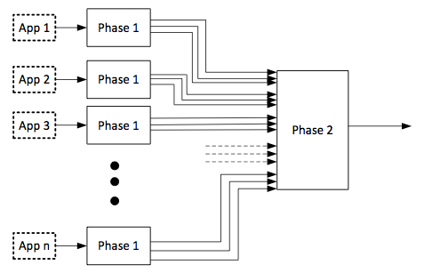
Analysis Design
Phase 1: Each app analyzed once, in isolation.
  FlowDroid: Finds tainted dataflow from sources to sinks.
    Received intents are considered sources.
    Sent intent are considered sinks.
  Epicc: Determines properties of intents.
  Each intent-sending call site is labelled with a unique intent ID.
Phase 2: Analyze a set of apps:
  For each intent sent by a component, determine which components can receive the intent.
  Generate & solve taint flow equations.

Slide 9
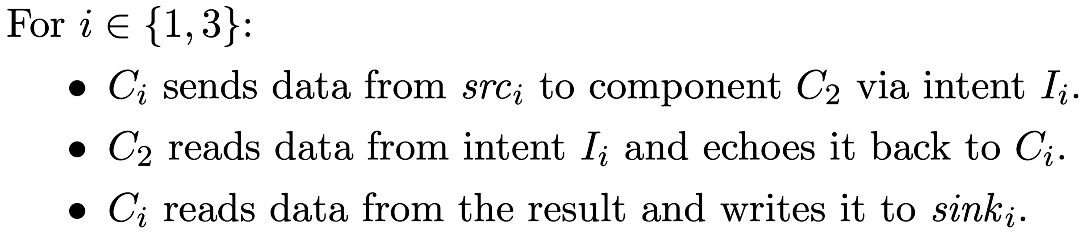
Running Example
src₁
Three components: C₁, C₂, C₃.
C1 = SendSMS
C2 = Echoer
C3 is similar to C1
I₁
C₁
sink₁
C₂
I₃
src₃
C₃
sink₃
sink₁ is tainted with only src₁.
sink₃ is tainted with only src₃.

Slide 10
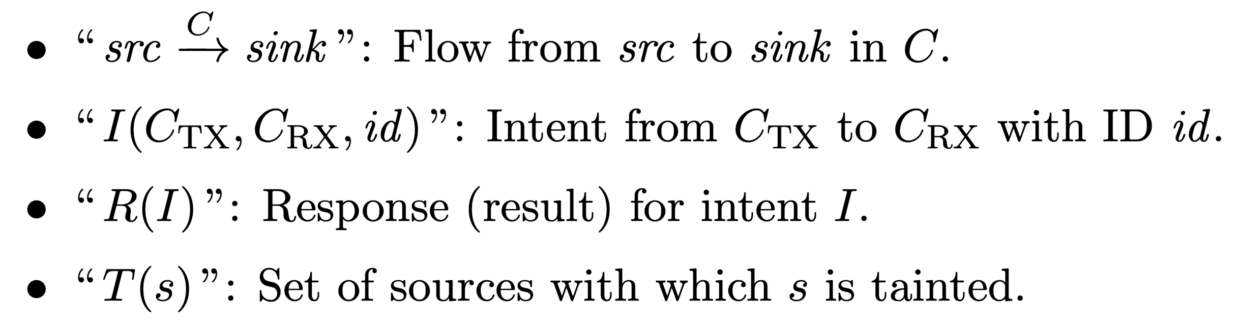
Running Example
src₁
I₁
C₁
sink₁
C₂
I₃
src₃
C₃
sink₃
Notation:
Notes:
We write “source arrow sink” to denote that information flows from src to sink in component C. We write the name of the component above the arrow.
We identify a component of tuple of (the sending component $C_TX$, the receiving component $C_RX$, and the intent ID).
We write “R of I” to denote the response (result) for intent I.
Given a source or sink $s$, we write “T of s” to denote the set of sources from which $s$ has tainted information.

Slide 11
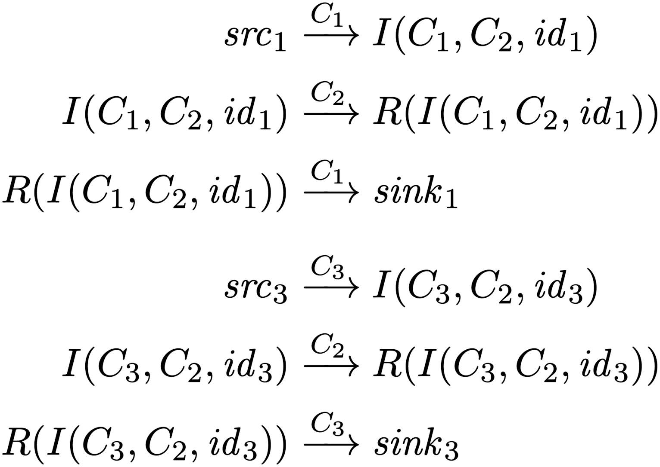
Running Example
src₁
I₁
C₁
sink₁
C₂
I₃
src₃
C₃
sink₃
Notation:

Slide 12
Running Example
src₁
I₁
C₁
sink₁
C₂
I₃
src₃
C₃
sink₃
Final Sink Taints:
T(sink₁) = {src₁}
T(sink₃) = {src₃}
Notation:

Slide 13
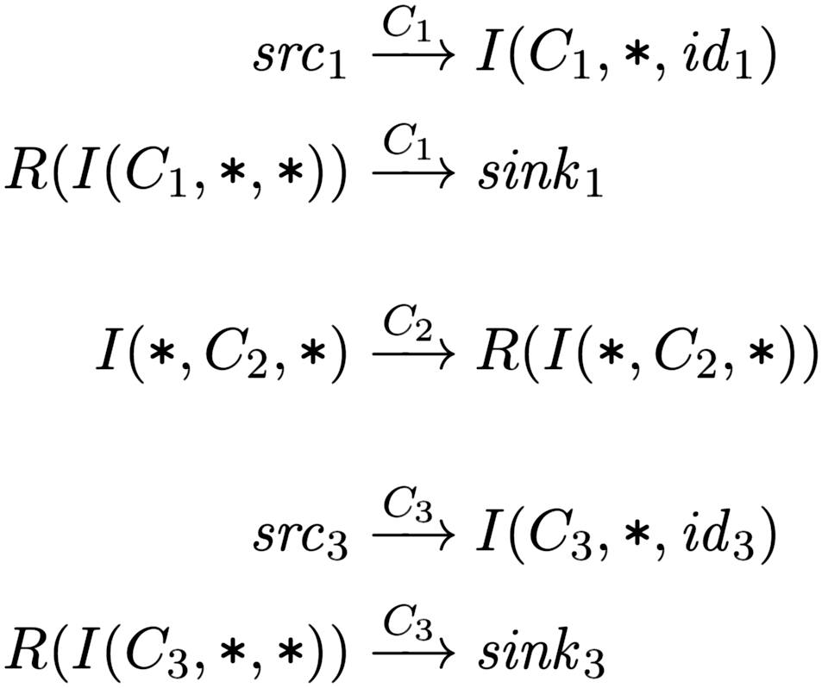
Phase-1 Flow Equations
Analyze each component separately.
Phase 1 Flow Equations:
src₁
C₁
sink₁
C₂
src₃
C₃
sink₃
Notation
• An asterisk (“∗”) indicates an unknown component.
Notes:
Speak about construction of first 3 equations in phase 1.
Each call site (for an intent-sending method) is assigned a unique intent id.

Slide 14
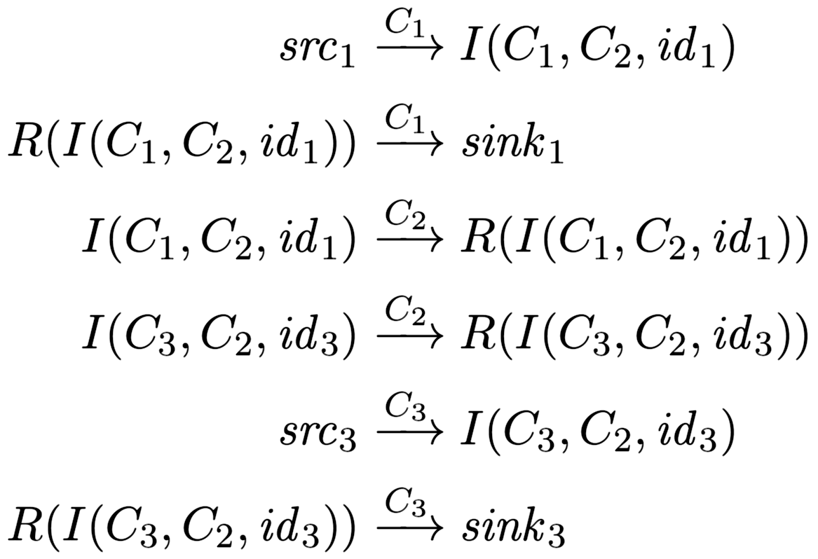
Phase-2 Flow Equations
src₁
I₁
C₁
sink₁
C₂
Instantiate Phase-1 equations for all possible sender/receiver pairs.
I₃
src₃
C₃
sink₃
Phase 1 Flow Equations:
Phase 2 Flow Equations:
Notation
Notes:
(‘Flow equations’, versus next part of phase 2 which is ‘taint equations’.)

Slide 15
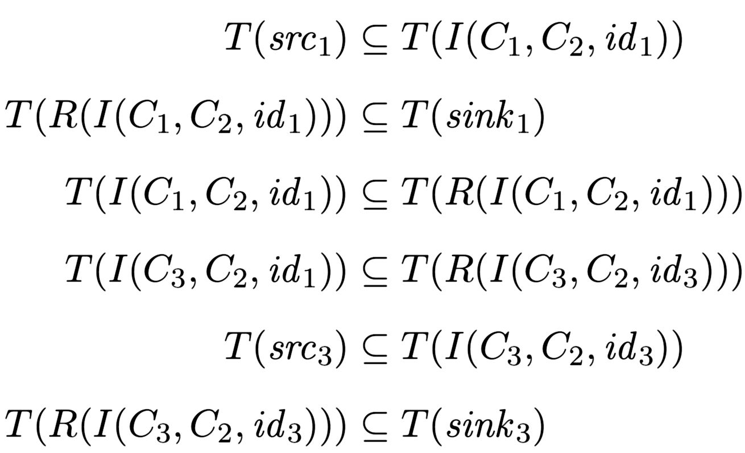
Phase-2 Taint Equations
src₁
I₁
C₁
sink₁
C₂
For each flow equation “src → sink”,
generate taint equation “T(src) ⊆ T(sink)”.
I₃
src₃
C₃
sink₃
Phase 2 Flow Equations:
Phase 2 Taint Equations:
Notation
If s is a non-intent source, then T(s) = {s}.
Notes:
(‘Taint equations’, versus previous part of phase 2 which was ‘flow equations’.)
The flow eqns are isomorphic to the taint eqns.

Slide 16
Phase 1
Epicc
Original APK
TransformAPK
FlowDroid
(modified)
Extract manifest
Notes:
In Phase 1, we first transform the APK to add intent IDs for call sites of methods that send intents. We then run Epicc and FlowDroid on the transformed APK. We also extract the manifest, to get the intent filters of each component.
The Phase-2 analysis takes the output of the Phase-1 analysis and produces the final graph of information flows within the set of apps.

Slide 17
Implementation: Phase 1
APK Transformer
  Assigns unique Intent ID to each call site of intent-sending methods.
    Enables matching intents from the output of FlowDroid and Epicc
  Uses Soot to read APK, modify code (in Jimple), and write new APK.
  Problem: Epicc is closed-source. How to make it emit Intent IDs?
  Solution (hack): Add putExtra call with Intent ID.
Phase 1
Epicc
Original APK
TransformAPK
FlowDroid
(modified)
Extract manifest

Slide 18
Implementation: Phase 1
FlowDroid Modifications:
  Extract intent IDs inserted by APK Transformer, and include in output.
  When sink is an intent, identify the sending component.
    In base.startActivity, assume base is the sending component.
    (Soundness?)
  For deterministic output: Sort the final list of flows.
Phase 1
Epicc
Original APK
TransformAPK
FlowDroid
(modified)
Extract manifest
Notes:
Sources/sinks: Added missing intent sending/receiving methods.

Slide 19
Implementation: Phase 2
Phase 2
  Take the Phase 1 output.
  Generate and solve the data-flow equations.
  Output:
    Directed graph indicating information flow between
    sources, intents, intent results, and sinks.
    Taintedness of each sink.

Slide 20
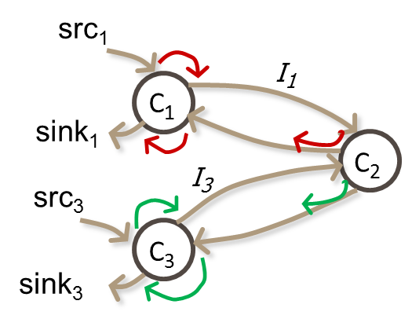
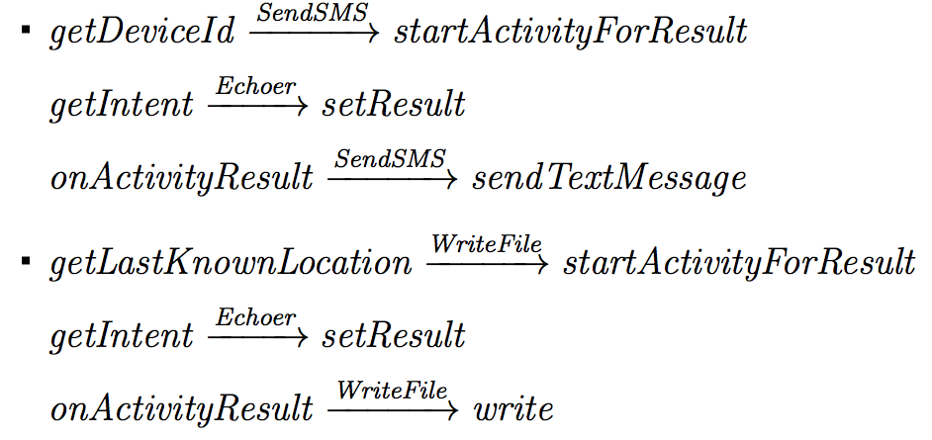
Testing DidFail analyzer: App Set 1
SendSMS.apk
  Reads device ID, passes through Echoer,
  and leaks it via SMS
Echoer.apk
  Echoes the data received via an intent
WriteFile.apk
  Reads physical location (from GPS),
  passes through Echoer, and writes it to a file
Notes:
App Set 1 corresponds to the running example discussed on previous slides.

Slide 21
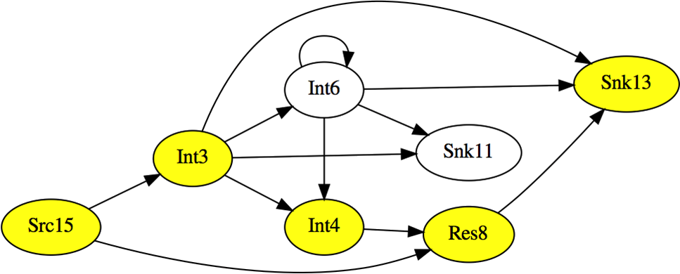
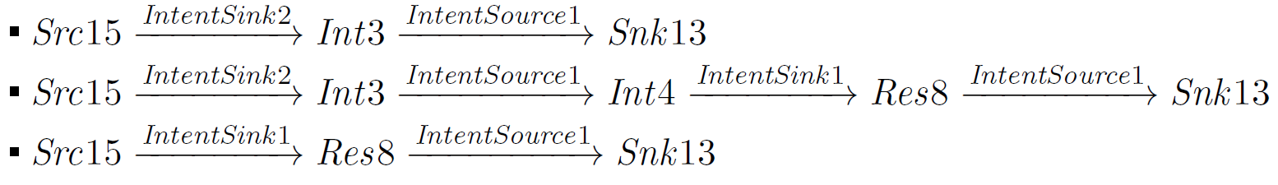
Testing DidFail analyzer: App Set 2 (DroidBench)
Int3 = I(IntentSink2.apk, IntentSource1.apk, id3)
Int4 = I(IntentSource1.apk, IntentSink1.apk, id4)
Res8 = R(Int4)
Src15 = getDeviceId
Snk13 = Log.i
Graph generated using GraphViz.
Some taint flows:
Notes:
The yellow highlighted nodes are along three possible taintflow paths between source 15 and sink 13.
Those paths are written on the bottom of the slide.
The white nodes and all the other links can be used for additional taintflow paths (to both sink 13 and sink 11).

Slide 22
Limitations
Unsoundness
  Inherited from FlowDroid/Epicc
    Native code, reflection, etc.
  Shared static fields
  Implicit flows
  Currently, only activity intents
  Bugs
Imprecision
  Inherited from FlowDroid/Epicc
  DidFail doesn’t consider permissions when matching intents
  All intents received by a component are conflated together as a single source
Notes:
Our analyzer does not consider permissions which can be used to restrict intent data flow.
If two running instances of a component use shared static fields to communicate, we miss these flows.
We miss implicit flows, such as where the mere receipt of an intent conveys tainted information, even if the intent itself doesn’t contain any tainted data.
If received intents with different properties (e.g., action string) have different taints, then we could be more precise by distinguishing between these intents.

Slide 23
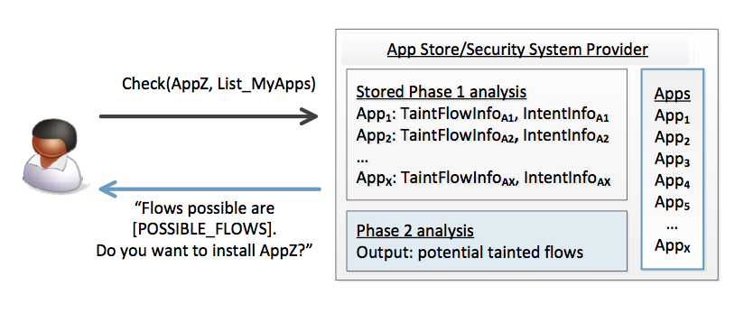
Use of Two-Phase Approach in App Stores
We envision that the two-phase analysis can be used as follows:
  An app store runs the phase-1 analysis for each app it has.
  When the user wants to download a new app, the store runs the phase-2 analysis and indicates new flows.
  Fast response to user.

Slide 24
DidFail vs IccTA
IccTA was developed (at roughly the same time as DidFail) by:
  Li Li, Alexandre Bartel, Jacques Klein, Yves Le Traon (Luxembourg);
  Steven Arzt, Siegfried Rasthofer, Eric Bodden (EC SPRIDE);
  Damien Octeau, Patrick McDaniel (Penn State).
IccTA uses a one-phase analysis
  IccTA is more precise than DidFail’s two-phase analysis.
  Two-phase DidFail analysis allows fast 2nd-phase computation.
Future collaboration between IccTA and DidFail teams?

Slide 25
Conclusion
We introduced a new analysis that integrates and enhances existing Android app static analyses.
Demonstrated feasibility by implementing a prototype and testing it.
Two-phase analysis can be used by app store to provide fast response.
Future work:
  Implicit flows
  Static fields
  Distinguish different received intents
  Other data channels (file system, non-activity intents)
  Etc.

Slide 26
Thank You

