Slide 1
Visual Manipulation and Synthesis
on the Natural Image Manifold
Jun-Yan Zhu
UC Berkeley

Slide 2
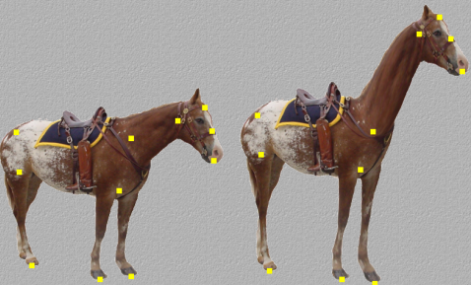
What is visual manipulation?
Image Editing Program
input photo
User Input
result
Desired output:
stay close to the input.
satisfy user’s constraint.
[Schaefer et al. 2006]
Notes:
Image editing is a well established area in computer graphics where an input image is manipulated to achieve a certain goal specified by the user.
Realistic image manipulation is challenging because it requires modifying the image appearance in a user-controlled way, while preserving the realism of the result.
Let’s take warping as an example

Slide 3
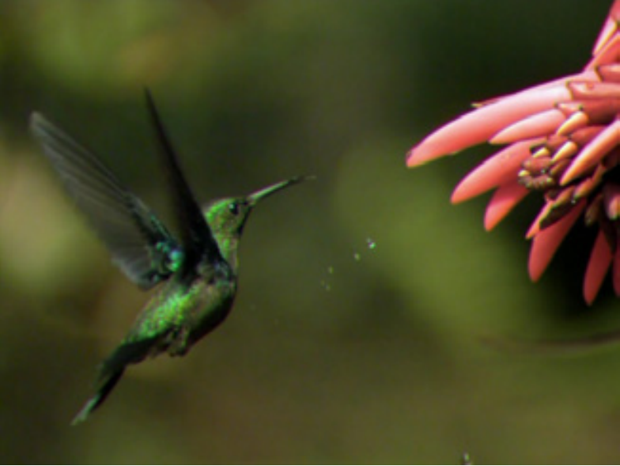
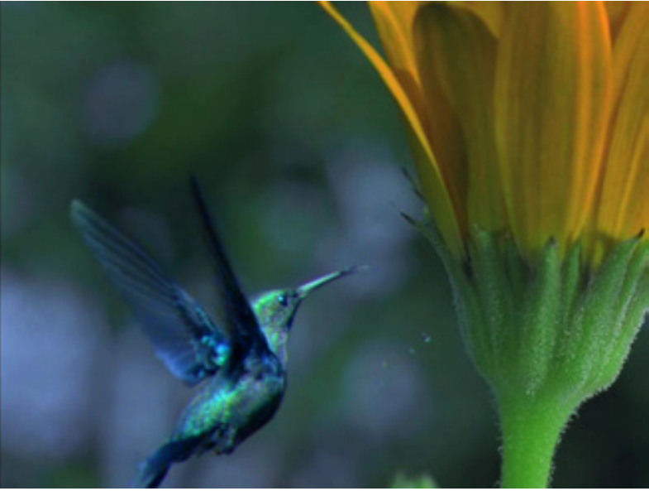
Classic Visual Manipulation Paradigm
Image Editing Program
input photo
result
User Input
Desired output:
stay close to the input.
satisfy user’s constraint.
[Tao et al. 2014]
Notes:
Here is another example: image compositing

Slide 4
So far so good
Image Warping
Image Composition
Notes:
While achieving impressive results, when these methods fail they often produce results that look nothing like a real image
classic visual manipulation paradigm does not prevent the user from “falling off” the manifold of natural images.
Any less-than-perfect edit immediately makes the image look completely unrealistic
Classic image manipulation paradigm does not prevent the user from “falling off” the manifold of natural images.
P.S:
Training wheels are an additional wheel or wheels mounted parallel to the rear wheel of a bicycle that assist learners until they have developed a usable sense of balance on the bicycle. Typically they are used in teaching very young children to ride a bike.

Slide 5
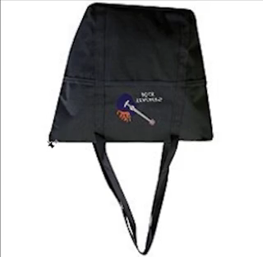
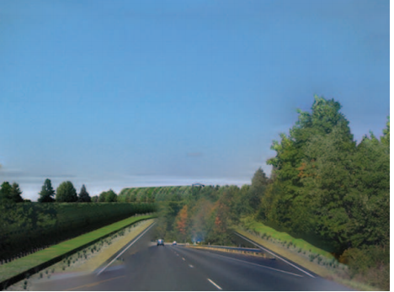
The lack of “safety wheels”
Things can get really bad
Image Warping
Image Composition

Slide 6
Adding the “safety wheels”
Image Editing Program
Input Photo
Output Result
User Input
A desired output:
stay close to the input.
satisfy user’s constraint.
Lie on the natural image manifold
Natural Image Manifold

Slide 7
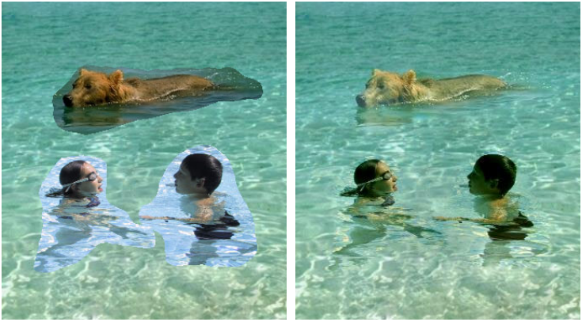
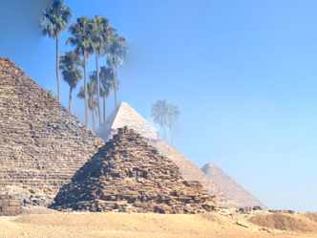
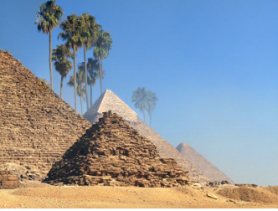
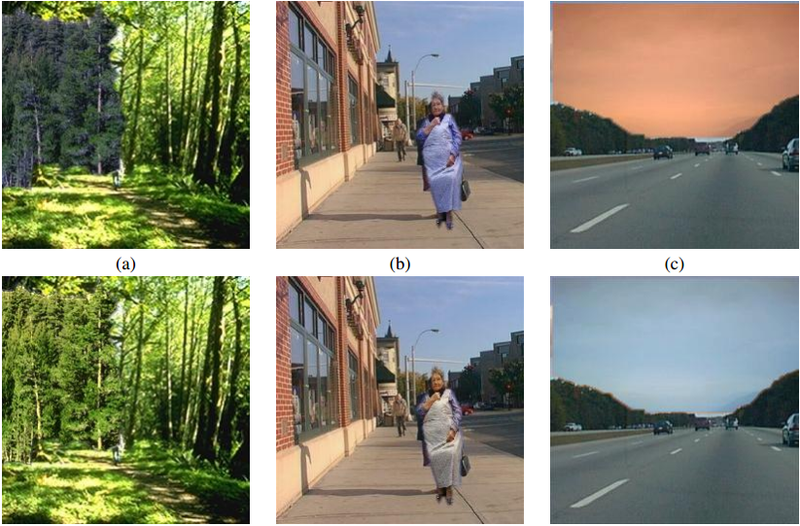
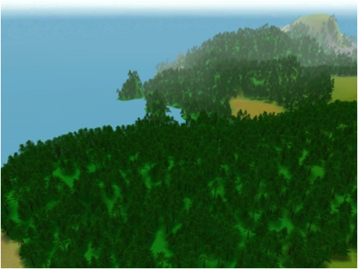
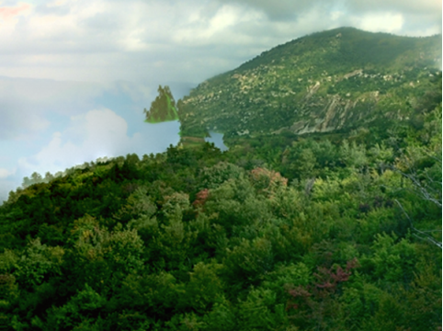
Prior work: Heuristic-based
Gradient [Perez et al. 2003]
“Bleeding” artifacts [Tao et al. 2010]
Color [Reinhard et al. 2004]
Color and Texture [Johnson et al. 2011]
Notes:
Lots of work tries to improve image compositing. The first successful idea is to make the boundary look seamless and artifacts-free. Another idea is to make the object’s color and texture compatible with background. However, none of these methods tries to directly improve or measure the realism of their results.

Slide 8
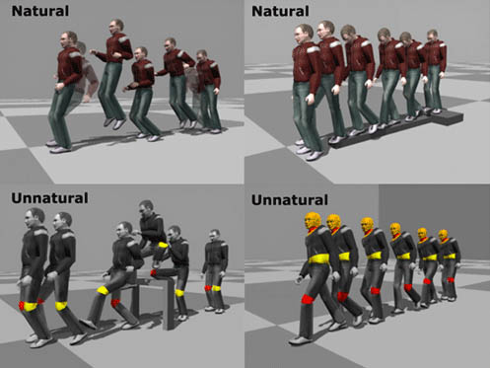
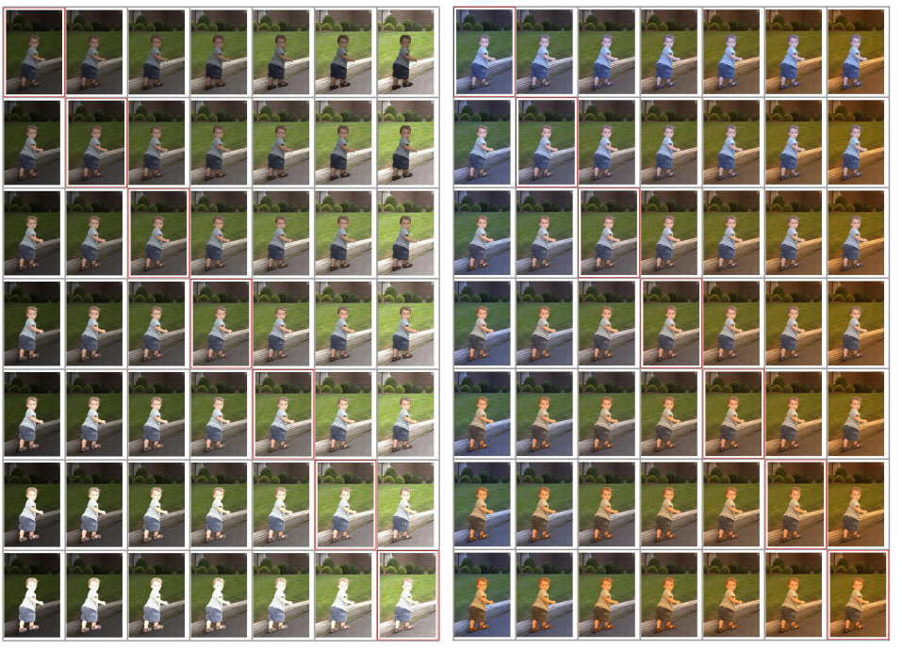
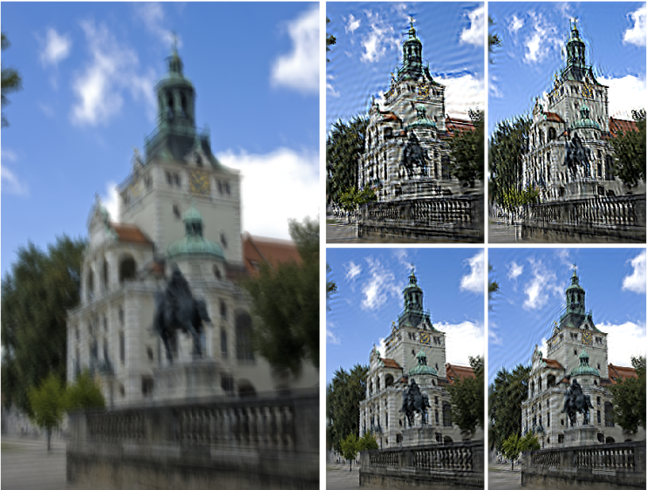
Prior work: Discriminative Learning
Natural Human Motion
(34 subjects)
[Ren et al. 2005]
Image Compositing
(20 images)
[Xue et al. 2012]
Image Deblurring
(40 images)
[Liu et al. 2013]
Notes:
Other researchers tries to use learning methods to predict the quality of their results. They typically generate a bunch of examples (1,000) with different parameters, and ask a human to label if results look nice or not. Since the space of parameters is exponential, usually a few of images are used. Instead, we try to use large-scale data without requiring expensive human annotation.

Slide 9
Our Goal:
Learn the manifold of natural images
without direct human annotations.
Improve visual manipulation and synthesis by constraining the result to lie on that learned manifold.
Notes:
The first goal is to learn natural image manifold from large-scale data collection directly. This is possible due to the recent advance in deep generative models, and discriminative ones. Second, once we learn a model of natural image manifold, we can use this model to further improve image editing and synthesis tools.

Slide 10
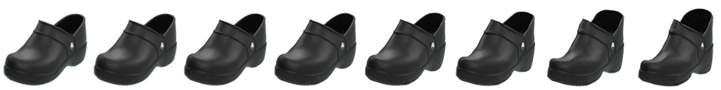
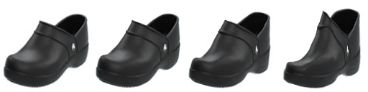




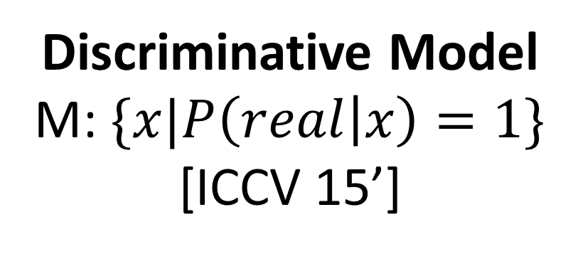
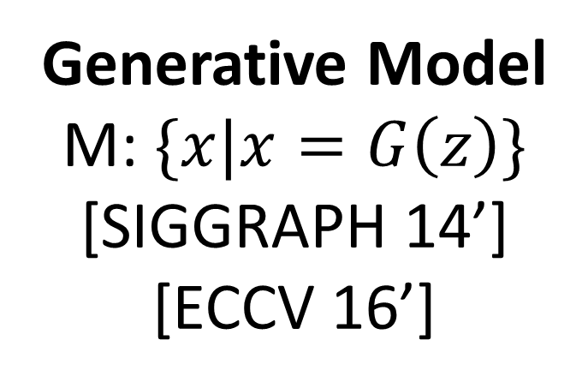
Discriminative Model
M: $\{x|P\left(real | x\right)=1\}$
[ICCV 15’]
Realism
CNN
Image Editing Model
Predict Realism
Improve
Editing
Generative Model
M: $\{x|x=G\left(z\right)\}$
[SIGGRAPH 14’]
[ECCV 16’]
Project
Editing UI
Edit Transfer
Notes:
We present two kinds of ways of modeling natural image manifold: in the first part, we consider a realistic image lie on the manifold if it is predicted as realistic by a CNN classifier. In the second part, we will use image generation model to represent the natural image manifold.

Slide 11
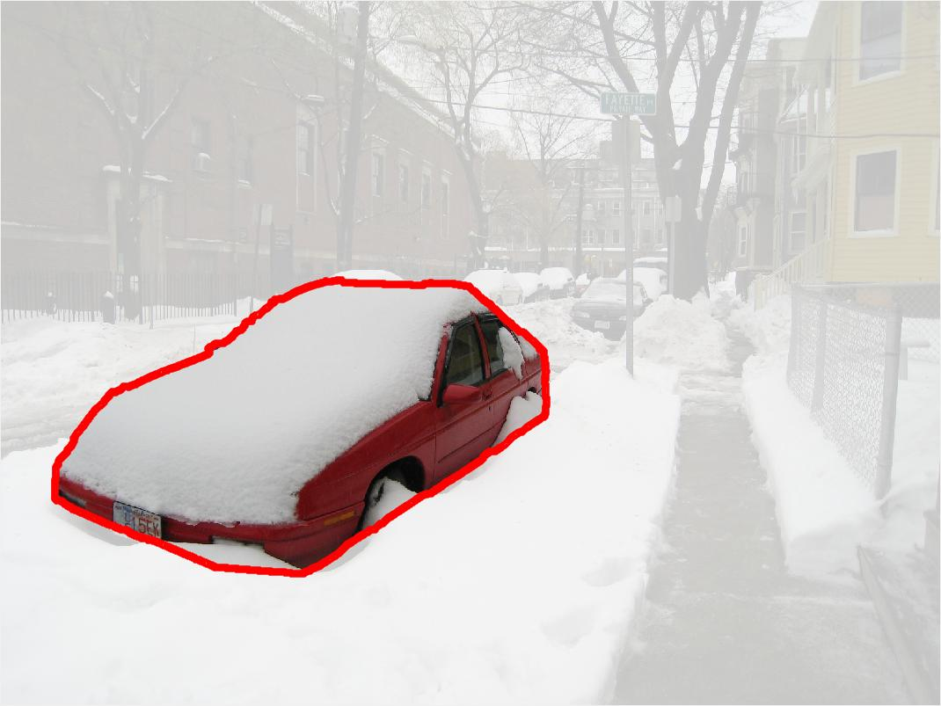
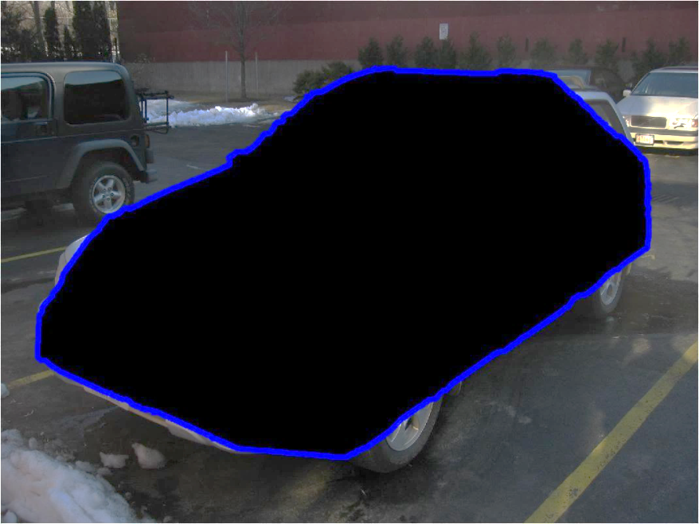
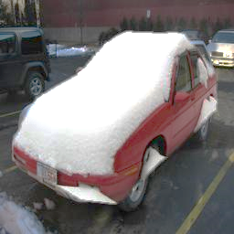
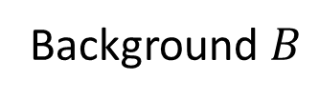
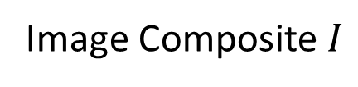
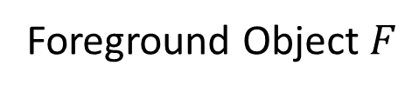
Discriminative Model
M: $\{x|P\left(real | x\right)=1\}$
[ICCV 15’]
Realism
CNN
Image Editing Model
Predict Realism
Improve
Editing
Foreground Object $F$
Background $B$
Image Composite $I$
Notes:
We take image compositing as a study case.
So what is a composite image?
To produce a composite image, we combine a foreground object (such as this red car) with a masked background (such as this parking lot) together.

Slide 12
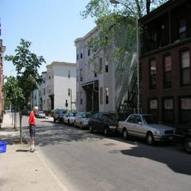
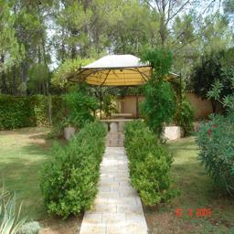
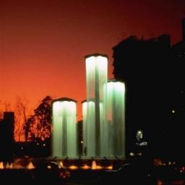
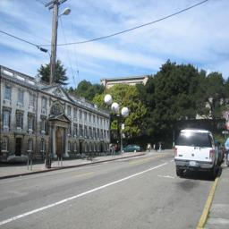
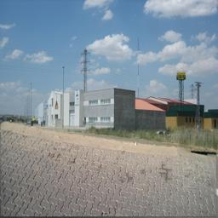
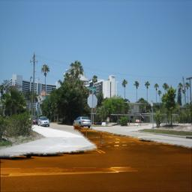
Learning Visual Realism
More Realistic
CNN Training
Classifying
25K natural photos
vs.
25k composite images
Composite images
Natural Photos
Notes:
In our implementation, we train a convolutional neural network to distinguish natural from automatically generated image composites. In fact, our model seems to pick up on cues about visual realism. For example, our model places these two green composites close to the decision boundary – these turn out to be composites which most of our human subjects thought were real images

Slide 13
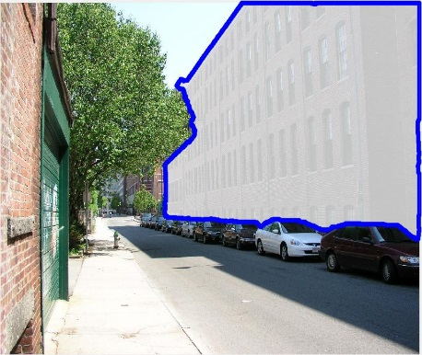
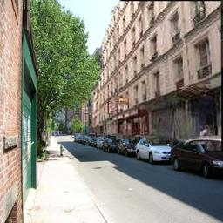
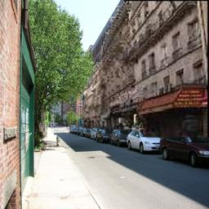
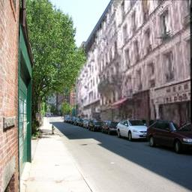
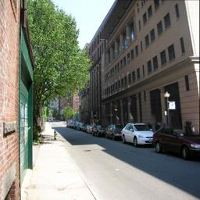
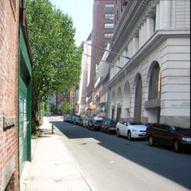

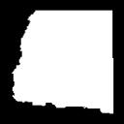




How do we get composite images?
Target Object
Composite Images
Object Mask
Object Masks with Similar Shapes
Object Mask: (1) Human Annotation (2) Object Proposal
[Lalonde and Efros 2007]
Notes:
How can we automatically generate composite images for training?
Given an original photo with an object and its object mask, we search for new objects whose object mask matches well the shape of original object, and replace the target object with them.
The object mask comes from either human annotation or region proposal.

Slide 14
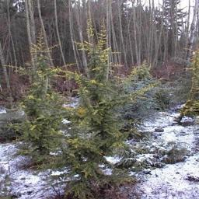
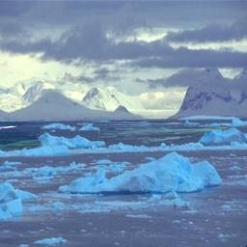
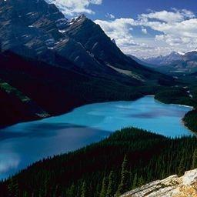
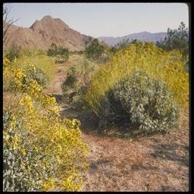
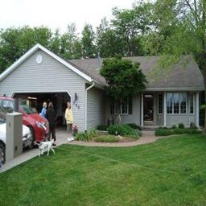
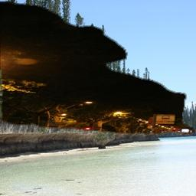
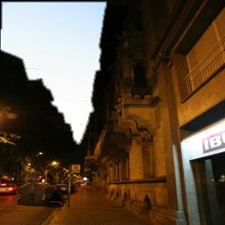
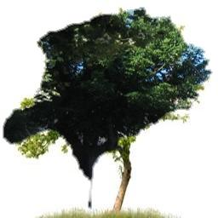
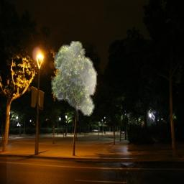
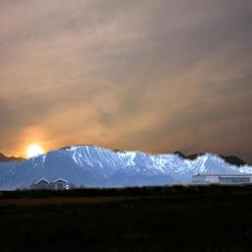
Ranking of Training Composites
Most realistic composites
Least realistic composites

Slide 15
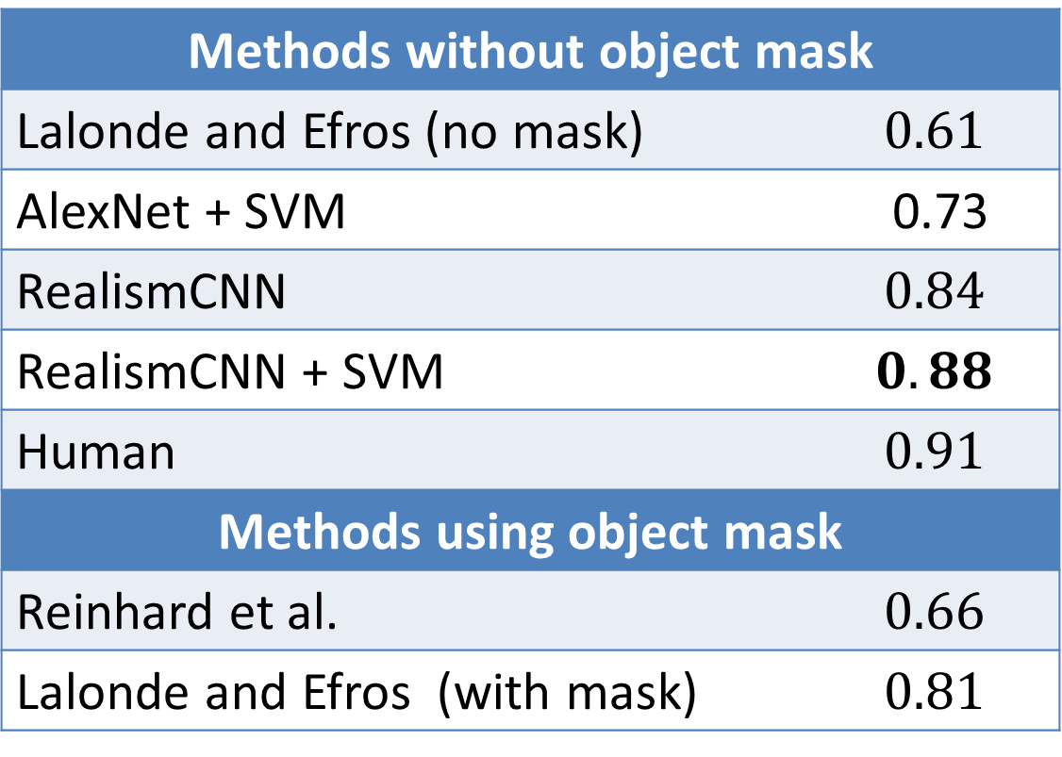
Evaluation
Dataset
[Lalonde and Efros 2007]
Task: binary classification
360 realistic photos (natural images + realistic composites)
360 unrealistic photos
Area under ROC Curve
Methods without object mask
Lalonde and Efros (no mask) | $$0.61$$
AlexNet + SVM | 0.73
RealismCNN | $$0.84$$
RealismCNN + SVM | $$0.88$$
Human | $$0.91$$
Methods using object mask
Reinhard et al. | $$0.66$$
Lalonde and Efros (with mask) | $$0.81$$
Notes:
We then evaluate our method in a public dataset with human annotations on a binary classification task of unrealistic photos versus realistic ones. Our model outperforms previous methods, and the results are close to human performance. Without any human annotation on visual realism, our model already outperforms previous methods
We then fine-tune our model with additional small amount of human realism labeling, and use the human annotation, and train a linear SVM on top of the fc7 feature, and outperform the previous method by a large margin.

Slide 16
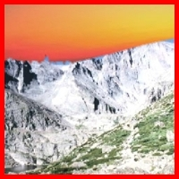
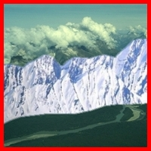













Visual Realism Ranking
Least Realistic
Most Realistic
Snowy
Mountain
Highway
Ocean
Red: unrealistic composite, Green: realistic composite, Blue: natural image

Slide 17
Our Pipeline
Realism
CNN
Predict Realism
Image Editing Model
Improve Composites
Notes:
Here is our pipeline. We first train a classifier to tell if a photo is natural or generated by a image editing model. Given the trained classifier, we then improve the image editing model so that the classifier outputs higher realism score.

Slide 18



Improving Visual Realism
Editing model:
Color adjustment $g$
Foreground object F
Realism
CNN
Original Composite
(Realism score: 0.0)
Improved Composite
(Realism score: 0.8)
$$E(g,F)=E_{CNN}+E_{reg}$$
Quasi-Newton (L-BFGS)
Notes:
For this, we add a composition layer between original image and CNN model. This composition model encodes the object instance, color and segmentation. This summer, we mainly focus on improving the color, and optimizing the foreground segmentation. We want to minimize the energy function that contains the CNN loss, and added regulation terms for the parameter prior.

Slide 19










Selecting Suitable Objects
Best-fitting object selected by RealismCNN
Object with most similar shape

Slide 20









Optimizing Color Compatibility
Object mask
Cut-n-paste
Lalonde et al.
Xue et al.
Ours

Slide 21










Sanity Check: Real Photos
Object mask
Cut-n-paste
Lalonde et al.
Xue et al.
Ours

Slide 22










Visualizing and Localizing Errors ($\frac{∂E}{∂I_{p}}$)
Number of L-BFGS iterations
Result
Gradient
Map
$$E=$$
$$50.73$$
$$9.38$$
$$5.05$$
$$3.44$$
$$3.00$$
Notes:
Here we would like to visualize locally what the model captures. We show a gradient map (partial of energy with respect to each pixel), Our model seems to mainly capture the color inconsistency along the boundary. we show in each optimization iteration, the result improves as the energy function decreases.

Slide 23

Discriminative Model $\{x|P\left(real | x\right)=1\}$
Pros:
  CNN is easy to train.
  Graphics programs often produce better images than generative models.
  General framework for many tasks (e.g. deblurring, retargeting, etc.)
Cons:
  Task-specific: cannot apply pre-trained model to other tasks.
  Graphics programs are often non-parametric and non-differentiable.
  Graphics programs often require user in the loop: thus automatically generating results for CNN training is challenging.

Slide 24
Discriminative Model
M: $\{x|P\left(real | x\right)=1\}$
[ICCV 15’]
Realism
CNN
Image Editing Model
Predict Realism
Improve
Editing
Generative Model
M: $\{x|x=G\left(z\right)\}$
[SIGGRAPH 14’]
[ECCV 16’]
Project
Editing UI
Edit Transfer

Slide 25

Learning Natural Image Manifold
Deep generative models: $G\left(z\right):z→x$
  Generative Adversarial Network (GAN)
  [Goodfellow et al. 2014] [Radford et al. 2015]
  Laplacian GAN [Denton et al 2015]
  Variational Auto-Encoder (VAE) [Kingma and Welling 2013]
  DRAW (Recurrent Neural Network) [Gregor et al 2015]
  …
Notes:
Understanding the natural image manifold has been a longstanding open research problem. In the last two years, there has been rapid advancement thanks to the new development in deep generative models. (e.g. restricted Boltzmann machines, variational auto-encoder. )
Popular for unsupervised feature learning/pre-training

Slide 26





Learning Natural Image Manifold
Deep generative models: $G\left(z\right):z→x$
  Generative Adversarial Network (GAN)
  [Goodfellow et al. 2014] [Radford et al. 2015]
Natural Images
$$N\left(0, Σ\right), Unif{\left[−1, 1\right]}^{d}, etc.$$
Generative network x $=G(z)$
Trained to generate an image x given a latent sample vector z
Discriminative network $D\left(x\right)$
Trained to distinguish between real and generated samples
Notes:
In our work, we use Generative adversarial networks (GANs), which was proposed by Goodfellow et al. and later improved by [Radford et al.] at Facebook. The basic idea is simple. We have a model G to generate an image from a latent vector. In addition to that, a second adversarial network is learned to discriminate between the generated samples and natural image
samples.

Slide 27



GAN as Manifold Approximation
Sample training images
from “Amazon Shirts”
Random image samples
from Generator $G(z$)
[Radford et al. 2015]
Notes:
GAN has some nice properties: first it produces pretty good images although sometimes it messed up details and structure

Slide 28




Traverse on the GAN Manifold
$$G(z_{0})$$
Linear Interpolation in z space: $G(z_{0}+t⋅(z_{1}−z_{0}))$
$$G(z_{1})$$
Limitations:
not photo-realistic enough, low resolution
produce images randomly, no user control
[Radford et al. 2015]
Notes:
Furthermore, the interpolation is easy: We see a smooth and meaningful image sequence generated by interpolating between two points in the latent space.
Limitations:
First, the generated images, while good, are still not photo-realistic enough, and there are also practical issues in making them high resolution. Second, these generative models are setup to produce images by sampling a latent vector-space, typically at random. So, these methods cannot be used to create and/or manipulate visual content in a user-controlled fashion.

Slide 29
Overview
original photo
different degree of image manipulation
Project
Edit Transfer
Editing UI
projection on manifold
transition between the original and edited projection
Notes:
Given a original photo, we first project it onto a low-dimensional latent vector representation by regenerating it using GAN. We then [CLICK ] use our real-time editing interface to modify the color and shape of the generated image using various brush tools (for example, dragging the top of the shoe). Finally, we apply the same amount of geometric and color changes to the original photos to achieve the final result.

Slide 30
Overview
original photo
different degree of image manipulation
Project
Edit Transfer
Editing UI
projection on manifold
transition between the original and edited projection

Slide 31










Projecting an Image onto the Manifold
Input: real image $x^{R}$
Output: latent vector z
Optimization
0.196
0.238
0.332
Reconstruction loss $L$
Generative model $G(z)$
Notes:
L2 of raw pixel colors
L2 of AlexNet $conv4$

Slide 32






Projecting an Image onto the Manifold
Input: real image $x^{R}$
Output: latent vector z
Optimization
0.196
0.238
0.332
Inverting Network $z=P\left(x\right)$
Auto-encoder
with a fixed decoder $G$
0.218
0.242
0.336

Slide 33



Projecting an Image onto the Manifold
Input: real image $x^{R}$
Output: latent vector z
Optimization
0.196
0.238
0.332
Inverting Network $z=P\left(x\right)$
0.218
0.242
0.336
Hybrid Method
Use the network as initialization
for the optimization problem
0.153
0.167
0.268

Slide 34
Overview
original photo
different degree of image manipulation
Project
Edit Transfer
Editing UI
projection on manifold
transition between the original and edited projection

Slide 35















Manipulating the Latent Vector
constraint violation loss $L_{g}$
user guidance image
Objective:
Guidance
$$v_{g}$$
$G(z$)
$$z_{0}$$
Notes:
With the image xR 0 projected onto the manifold M ˜ as x0, we can now modify the image on that manifold. We update the initial projection x0 by simultaneously matching user intentions while staying on the manifold close to the original image x0.
where the data term measures constraint violation and the smoothness term enforces smooth transition on the manifold.
Color: L2 + raw pixel colors
Sketching: L2 + HOG
Warping: L2 + AlexNet $conv4$

Slide 36
Overview
original photo
different degree of image manipulation
Project
Edit Transfer
Editing UI
projection on manifold
transition between the original and edited projection
Notes:
Given a original photo, we first project it onto a low-dimensional latent vector representation by regenerating it using GAN. We then [CLICK ] use our real-time editing interface to modify the color and shape of the generated image using various brush tools (for example, dragging the top of the shoe). Finally, we apply the same amount of geometric and color changes to the original photos to achieve the final result.

Slide 37














Edit Transfer
Motion (u, v)+ Color ($A_{3×4}$): estimate per-pixel geometric and color variation
$$G(z_{0})$$
Linear Interpolation in $z$ space
$$G(z_{1})$$
Input
Notes:
explain the flow algorithm
Then transfer
The generated image G(z1) captures the roughly change we want, albeit the quality is degraded w.r.t the original image. We develop a dense correspondence algorithm to estimate both the geometric and color changes induced by the editing process
We estimate the changes between nearby frames, and concatenate these changes frame by frame to obtain long-range changes between any two frames along the interpolation sequence z0 → z1.

Slide 38

Edit Transfer
Motion (u, v)+ Color ($A_{3×4}$): estimate per-pixel geometric and color variation
$$G(z_{0})$$
Linear Interpolation in $z$ space
$$G(z_{1})$$
Input
Notes:
The generated image G(z1) captures the roughly change we want, albeit the quality is degraded w.r.t the original image. We develop a dense correspondence algorithm to estimate both the geometric and color changes induced by the editing process. We estimate the changes between nearby frames, and concatenate these changes frame by frame to obtain long-range changes between any two frames along the interpolation sequence z0 → z1.

Slide 39




Edit Transfer
Motion (u, v)+ Color ($A_{3×4}$): estimate per-pixel geometric and color variation
$$G(z_{0})$$
Linear Interpolation in $z$ space
$$G(z_{1})$$
Input
Result

Slide 40

Image Manipulation Demo
Notes:
With our intuitive interface, a user can simply sketch the shape of the handbag in her mind, and our system is able to automatically adjust the handbag keeping all edits as realistic as possible. A user can further drag the slider to see all the intermediate results interpolated between the original and the final manipulated photo, and choose the one she likes.

Slide 41

Image Manipulation Demo
Notes:
Supposed you are looking for shoes, and you have found one that mostly suits suits you, but you would like to be a little bit more slim. You can simply use our warping tool to drag down the shoe tongue. (It usually takes 5 seconds to render the final result). A user can then adjust the slider to see shoes with different degree of slimness. Now the color seems somewhat boring. Let’s make it exciting by adding some color strokes.

Slide 42

Interactive Image Generation
Notes:
A by product of our method is that if there is no image to begin with and all we have are the user brush strokes, the method would generate a natural image that best satisfies the user constraints Let’s do some drawing of an outdoor scene. We first create a grassland by painting something greenish at the bottom. Here we can see different samples, all with a grassland. Let’s sketch a mountain on top. Let’s add a blue sky. A snow on the mountain makes a perfect scene.

Slide 43


Slide 44

Interactive Image Generation
Notes:
We can use our drawing interface to design products as well. The user sketches some desired shape. Now we can browse different shoes with the same shape, but different color and texture. How about a shoe with red vamp and white outsole? Finally, we can add fine details like shoelaces with our sketching tool.

Slide 45


The Simplest Generative Model: Averaging
AverageExplorer: $\{x|x=\sum_{n}{w_{n}⋅I_{n}^{warp}\} }$
Generative model: weighted average of warped images.
Limitations: cannot synthesize novel content.

Slide 46

Generative Image Transformation
Notes:
An interesting outcome of the editing process is the sequence of intermediate generated images that can be seen as a new kind of image morphing. We call it “generative transformation”. We use this sequence to transform the shape and color of one image to look like another image automatically.
Here the source on the left is transformed to have the shape and color of the target image on the right, and then transformed back.
Finally, we compare our morphing results to the optical flow based interpolation methods implemented in Adobe Premiere Pro. We can see our method produces smoother transition between two images with less artifacts.

Slide 47
iGAN (aka. interactive GAN)
Get the code: github.com/junyanz/iGAN
Intelligent drawing tools via GAN.
Debugging tools for understanding and visualizing deep generative networks.
Work in progress: supporting more models (GAN, VAE, theano/tensorflow).

Slide 48


Generative Model $\{x|x=G\left(z\right), z∈Z\}$
Pros:
  Task-independent: offline generative model training is independent of the graphics applications.
  Optimizing $z$ is easier than optimizing $x$.
  Generative models are better and better.
Cons:
  Low quality, low res => post-processing (still engineering work).
  Limitations of current generative models: cannot produce good texture.

Slide 49

Cat Paper Collection
GitHub: github.com/junyanz/CatPapers
90% data is visual; most of visual data are about Cats.
60+ vision, learning and graphics papers.

Slide 50


Slide 51







Thank You!
Eli
Yong Jae
Philipp
Alyosha
Aquarius

