Slide 1
Introduction to SMV
Part 2
Arie Gurfinkel (SEI/CMU)
based on material by Prof. Clarke and others

Slide 2
Useful Links
NuSMV home page
  http://nusmv.fbk.eu/
NuSMV tutorial
  http://nusmv.fbk.eu/NuSMV/tutorial/v25/tutorial.pdf
NuSMV user manual
  http://nusmv.fbk.eu/NuSMV/userman/v25/nusmv.pdf
NuSMV FAQ
  http://nusmv.fbk.eu/faq.html
NuSMV on Andrew
  /afs/andrew.cmu.edu/usr11/arieg/public/nusmv/2.5.3/
NuSMV examples
  <NuSMV>/share/nusmv/examples
Ken McMillan, Symbolic Model Checking: An Approach to the State Explosion Problem, 1993
  http://www.kenmcmil.com/pubs/thesis.pdf

Slide 3
MODULE main
VAR
send : {s0,s1,s2};
recv : {r0,r1,r2};
ack : boolean;
req : boolean;
ASSIGN
init(ack):=FALSE;
init(req):=FALSE;
init(send):= s0;
init(recv):= r0;
next (send) :=
case
send=s0:{s0,s1};
send=s1:s2;
send=s2&ack:s0;
TRUE:send;
esac;
next (recv) :=
case
recv=r0&req:r1;
recv=r1:r2;
recv=r2:r0;
TRUE: recv;
esac;
next (ack) :=
case
recv=r2:TRUE;
TRUE: ack;
esac;
next (req) :=
case
send=s1:FALSE;
TRUE: req;
esac;
SPEC AG (req -> AF ack)

Slide 4
Can A TRUE Result of Model Checker be Trusted
Antecedent Failure [Beatty & Bryant 1994]
  A temporal formula AG (p ⇒ q) suffers an antecedent failure in model M iff M ⊧ AG (p ⇒ q) AND M ⊧ AG (¬p)
Vacuity [Beer et al. 1997]
  A temporal formula ϕ is satisfied vacuously by M iff there exists a sub-formula p of ϕ such that M ⊧ ϕ[p←q] for every other formula q
  e.g., M ⊧ AG (r ⇒ AF a) and M ⊧ AG (r ⇒ AF ¬a) and AG (r ⇒ AF ¬r) and AG (r ⇒ AF FALSE), …

Slide 5
Vacuity Detection: Single Occurrence
ϕ is vacuous in M iff there exists an occurrence of a subformula p such that
  M ⊧ ϕ[p ← TRUE] and M ⊧ ϕ[p ← FALSE]
M ⊧ AG (req ⇒ AF TRUE)
M ⊧ AG TRUE
M ⊧ AG (req ⇒ AF FALSE)
M ⊧ AG ¬req
M ⊧ AG (TRUE ⇒ AF ack)
M ⊧ AG AF ack
M ⊧ AG (FALSE ⇒ AF ack)
M ⊧ AG TRUE

Slide 6
Detecting Vacuity in Multiple Occurrences
Is AG (req ⇒ AF req) vacuous? Should it be?
Is AG (req ⇒ AX req) vacuous? Should it be?
M ⊧ AG (TRUE ⇒ AF TRUE)
M ⊧ AG TRUE
M ⊧ AG (FALSE ⇒ AF FALSE)
M ⊧ AG TRUE
M ⊧ AG (TRUE ⇒ AX TRUE)
M ⊧ AG TRUE
M ⊧ AG (FALSE ⇒ AX FALSE)
M ⊧ AG TRUE

Slide 7
Detecting Vacuity in Multiple Occurrences: ACTL
An ACTL ϕ is vacuous in M iff there exists an a subformula p such that
  M ⊧ ϕ[p ← x] , where x is a non-deterministic variable
Is AG (req ⇒ AF req) vacuous? Should it be?
Is AG (req ⇒ AX req) vacuous? Should it be?
Always vacuous!!!
M ⊧ AG (x ⇒ AF x)
M ⊧ AG TRUE
Can be vacuous!!!
M ⊧ AG (x ⇒ AX x)
can’t reduce

Slide 8
Example 1: Mutual Exclusion
Two processes want access to a shared resource
  they go through idle, trying, critical states
Safety (Mutual Exclusion)
  Only one process can be in the critical section at any given time
    AG ( !(p0 = critical & p1 = critical) )
Liveness (No Starvation)
  If a process is trying to enter critical section, it eventually enters it
    AG (p0 = trying -> AF p0 = critical)

Slide 9
Traffic Light Controller
based on slides by Himanshu Jain

Slide 10
Outline
Modeling Traffic Light Controller in SMV
Properties to Check
Four different SMV models for traffic light controller

Slide 11
Scenario
N
W
S

Slide 12
N
No turning
✗
✗
W
S

Slide 13
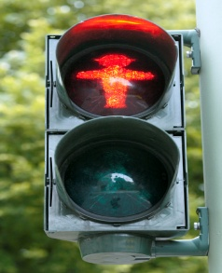
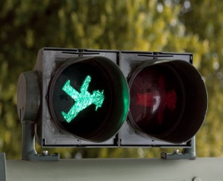
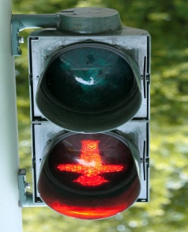
Binary
traffic
lights
N
W
S

Slide 14
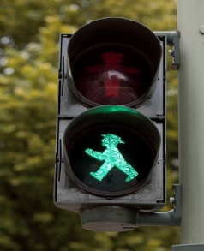
Safety
Property
N
W
This should not
happen
S

Slide 15

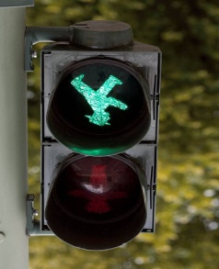
Safety
Property
N
W
This should not
happen
S

Slide 16
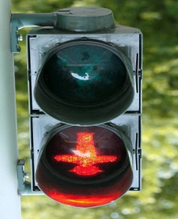
Liveness
Property
N
W
When will the stupid light become green again
S

Slide 17
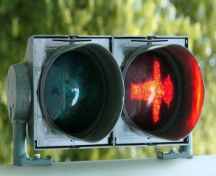
Liveness
Property
N
W
Thank God!
Traffic in each direction must be served
S

Slide 18
Let’s Model all of this in NuSMV

Slide 19
SMV variables
N
North.Go=F
Three Boolean
variables track the
status of the lights
W
South.Go=F
West.Go=T
S

Slide 20
SMV variables
N
Three Boolean
variables sense
the traffic in each
direction
South.Sense =T
W
West.Sense =F
North.Sense =T
S

Slide 21
Properties 1/2
Mutual exclusion
  No green light in conflicting directions
  AG !(West.Go & (North.Go | South.Go))
Liveness (e.g., in North direction)
  All cars waiting for a green light eventually get it
  AG (North.Sense & !North.Go -> AF North.Go)
Similarly for South and West directions

Slide 22
Properties 2/2
No strict sequencing
  We don’t want the traffic lights to give turns to each other (if there is no need for it)
  For example, if there is no traffic on west lane, we do not want West.Go becoming TRUE periodically
We can specify such properties partially
  AG (West.Go -> A[West.Go U !West.Go & A[!West.Go U South.Go | North.Go]])
  See code for other such properties
  We want these properties to FAIL

Slide 23
SMV modules
N
West module
will control
North module
will control
W
Main module
Initialize variables
Start s all modules
South module
will control
S

Slide 24
N
What if north light
is always green
and there is always
traffic in north
direction???
W
S

Slide 25
Fairness Constraints
What if a light is always green and there is always traffic in its direction
We will avoid such scenarios by means of fairness constraints
  FAIRNESS !(Sense & Go)
  FAIRNESS running
In any infinite execution, there are infinite number of states where either the light is red or there is no traffic in its direction

Slide 26
Implementations…

Slide 27
Some more variables
To ensure mutual exclusion
  We will have two Boolean variables
  NS_lock: denotes locking of north/south lane
  EW_lock: denotes locking of west lane
To remember that there is traffic on a lane
  Boolean variable: North.Req
    If North.Sense becomes TRUE, then North.Req is set to TRUE
  Similarly, for South.Req and West.Req

Slide 28
traffic1.smv: main module
MODULE main
VAR
-- lock for North-South direction
NS_lock : boolean;
-- lock for East-West direction
EW_lock : boolean;
North : process North (NS_lock, EW_lock, South.Go);
South : process South (NS_lock, EW_lock, North.Go);
West : process West (EW_lock, NS_lock);
ASSIGN
init (NS_lock) := FALSE;
init (EW_lock) := FALSE;
…

Slide 29
traffic1.smv: North module 1/2
MODULE North (NS_lock, EW_lock, FriendGo)
VAR
Go : boolean;
Sense : boolean;
Req : boolean;
State : {idle, entering, critical, exiting};
ASSIGN
init (State) := idle;
next (State) :=
case
State = idle & Req : entering;
State = entering & !EW_lock : critical;
State = critical & !Sense : exiting;
State = exiting : idle;
TRUE : State;
esac;

Slide 30
traffic1.smv: North module 2/2
next (NS_lock) :=
case
State = entering & !EW_lock : TRUE;
State = exiting & !FriendGo : FALSE;
TRUE: NS_lock;
esac;
init (Req) := FALSE;
next (Req) :=
case
State = exiting : FALSE;
Sense: TRUE;
TRUE: Req;
esac;
init (Go) := FALSE;
next (Go) :=
case
State = critical : TRUE;
State = exiting : FALSE;
TRUE : Go;
esac;

Slide 31
South is symmetric
West is a bit simpler (no East)
Let’s run NuSMV!!!

Slide 32
Mutual Exclusion CEX
1. All variables FALSE
2. North.Sense = T (North Run)
3. North.Sense=F, North.Req = T
4. North.State = entering
5. NS_lock=T, North.Sense=T,North.State=critical
6. South.Sense=T (South Run)
7. South.Sense=F, South.Req=T
8. South.State = entering
9. South.State = critical
10. South.Go = T, South.State = exiting
11. West.Sense=T (West Run)
12. West.Sense=F, West.Req=T
13. West.State=entering
14. NS_lock=F, South.Go=F,South.Req=F, South.State=idle (South Run)
15. EW_lock=T, West.State=critical,West.Sense=T (West Run)
16. North.Go=T, North.Sense=F (North Run)
17. West.Go=T, West.Sense=F (West Run)

Slide 33
traffic1.smv: North module 1/2
MODULE North (NS_lock, EW_lock, FriendGo)
VAR
Go : boolean;
Sense : boolean;
Req : boolean;
State : {idle, entering, critical, exiting};
ASSIGN
init (State) := idle;
next (State) :=
case
State = idle & Req : entering;
State = entering & !EW_lock : critical;
State = critical & !Sense : exiting;
State = exiting : idle;
TRUE : State;
esac;
init (Go) := FALSE;
next (Go) :=
case
State = critical : TRUE;
State = exiting : FALSE;
TRUE : Go;
esac;

Slide 34
traffic2.smv: fix
DEFINE
EnterCritical := State = entering & !EW_lock;
ASSIGN
init (State) := idle;
next (State) :=
case
State = idle & Req : entering;
EnterCritical : critical;
State = critical & !Sense : exiting;
State = exiting : idle;
TRUE : State;
esac;
init (Go) := FALSE;
next (Go) :=
case
EnterCritical : TRUE;
State = exiting : FALSE;
TRUE : Go;
esac;

Slide 35
Model checking traffic2.smv
Mutual exclusion property is satisfied
Liveness property for North direction fails
  AG ( (Sense & !Go) -> AF Go) IN North

Slide 36
CEX for Liveness is a Fair Cycle
1.6
North.State = entering
North.EnterCritical = T
all others are idle
1.10
South is given a turn,
but does nothing
1.19
West.State = idle
1.16
North is given a turn,
but can’t get a lock
1.15
West.State = critical

Slide 37
Add ‘Turn’ to Ensure Liveness
This is in traffic3.smv
Use Peterson’s mutual exclusion algorithm
Introduce a variable Turn
  Turn : {nst, wt}
  If I have just exited the critical section, offer Turn to others

Slide 38
traffic3.smv: Adding Turn
DEFINE
EnterCritical :=
State = entering & !EW_lock & (Turn = nst | !OtherReq);
next (Turn) :=
case
State = exiting & Turn = nst & !FriendReq : wt;
TRUE : Turn;
esac;
Similar change in West module

Slide 39
Model check again…
Mutual still exclusion holds!
What about liveness properties
  In north direction? HOLDS
  In south direction? HOLDS
  In west direction? FAILS ☹

Slide 40
traffic4.smv
Two extra variables to distinguish between North and South completion
  North.Done, South.Done
When North exits critical section
  North.Done is set to TRUE
  Similarly for South.Done
When West exits
  both South.Done and North.Done are set to FALSE

Slide 41
traffic4.smv: North Module
init (Done) := FALSE;
next (Done) :=
case
State = exiting : TRUE;
TRUE : Done;
esac;
next (Turn) :=
case
State = exiting & Turn = nst & !FriendReq : wt;
State = exiting & Turn = nst &
FriendDone & OtherReq : wt;
TRUE : Turn;
esac;

Slide 42
Hurray!
Mutual exclusion holds
Liveness for all three directions holds
No Strict sequencing

Slide 43
Possible extensions
Allow for north, south, east, and west traffic
Allow for cars to turns
Replace specific modules by a single generic one
  Instantiate it four times
  Once for each direction
Ensure properties without using fairness constraints

