Slide 1
Large Graph Mining - Patterns, Tools and Cascade Analysis
Christos Faloutsos
CMU

Slide 2
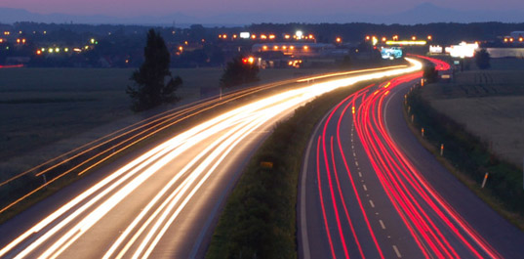
Roadmap
Introduction – Motivation
  Why study (big) graphs?
Part#1: Patterns in graphs
Part#2: Cascade analysis
Conclusions
[Extra: ebay fraud; tensors; spikes]

Slide 3
EXTRAS - Tools
ebay fraud detection: network effects (‘Belief propagation’)
NELL analysis (Never Ending Language Learner): Tensors – GigaTensor
Spike analysis and forecasting: ‘SpikeM’

Slide 4

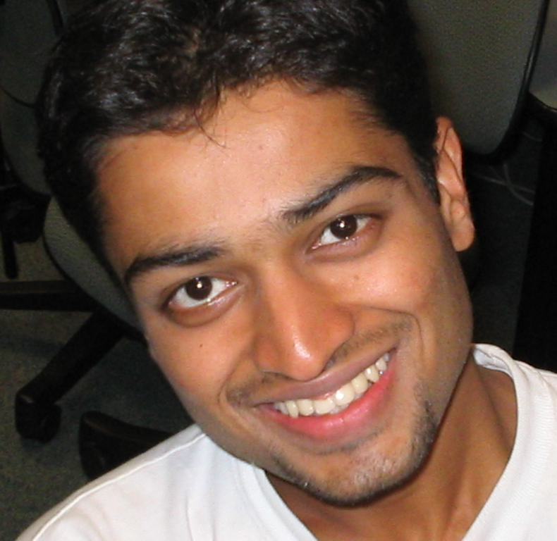
E-bay Fraud detection
w/ Polo Chau &
Shashank Pandit, CMU
[www’07]

Slide 5
E-bay Fraud detection

Slide 6
E-bay Fraud detection

Slide 7
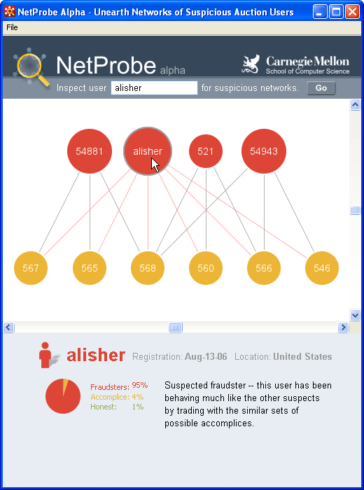
E-bay Fraud detection - NetProbe

Slide 8
E-bay Fraud detection - NetProbe
details
Compatibility
matrix
 | F | A | H
F |  | 99%
A | 99%
H |  | 49% | 49%
heterophily

Slide 9



Popular press
And less desirable attention:
E-mail from ‘Belgium police’ (‘copy of your code?’)

Slide 10
EXTRAS - Tools
ebay fraud detection: network effects (‘Belief propagation’)
NELL analysis (Never Ending Language Learner): Tensors – GigaTensor
Spike analysis and forecasting: ‘SpikeM’

Slide 11
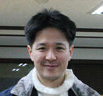
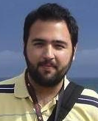
GigaTensor: Scaling Tensor Analysis Up By 100 Times –
Algorithms and Discoveries
U
Kang
Evangelos
Papalexakis
Abhay
Harpale
Christos
Faloutsos
KDD’12
Notes:
17 min talk, 3 min q&a

Slide 12
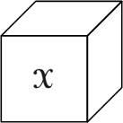
Background: Tensor
Tensors (=multi-dimensional arrays) are everywhere
  Hyperlinks &anchor text [Kolda+,05]
Anchor Text
1
1
1
C#
1
URL 2
1
C++
1
1
Java
URL 1

Slide 13
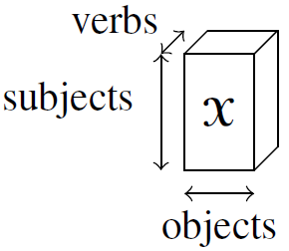
Background: Tensor
Tensors (=multi-dimensional arrays) are everywhere
  Sensor stream (time, location, type)
  Predicates (subject, verb, object) in knowledge base
“Eric Clapton plays
guitar”
(48M)
“Barack Obama is the president of U.S.”
NELL (Never Ending Language Learner) data
Nonzeros =144M
(26M)
(26M)

Slide 14
Background: Tensor
Tensors (=multi-dimensional arrays) are everywhere
  Sensor stream (time, location, type)
  Predicates (subject, verb, object) in knowledge base
Time-stamp
Anomaly
Detection in
Computer
networks
IP-source
IP-destination

Slide 15
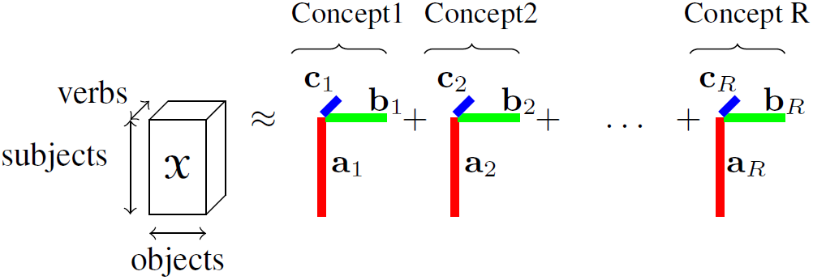
Problem Definition
How to decompose a billion-scale tensor?
  Corresponds to SVD in 2D case

Slide 16
Problem Definition
How to decompose a billion-scale tensor?
  Corresponds to SVD in 2D case

Slide 17
Problem Definition
  Q1: Dominant concepts/topics?
  Q2: Find synonyms to a given noun phrase?
  (and how to scale up: |data| > RAM)
(48M)
NELL (Never Ending Language Learner) data
Nonzeros =144M
(26M)
(26M)

Slide 18

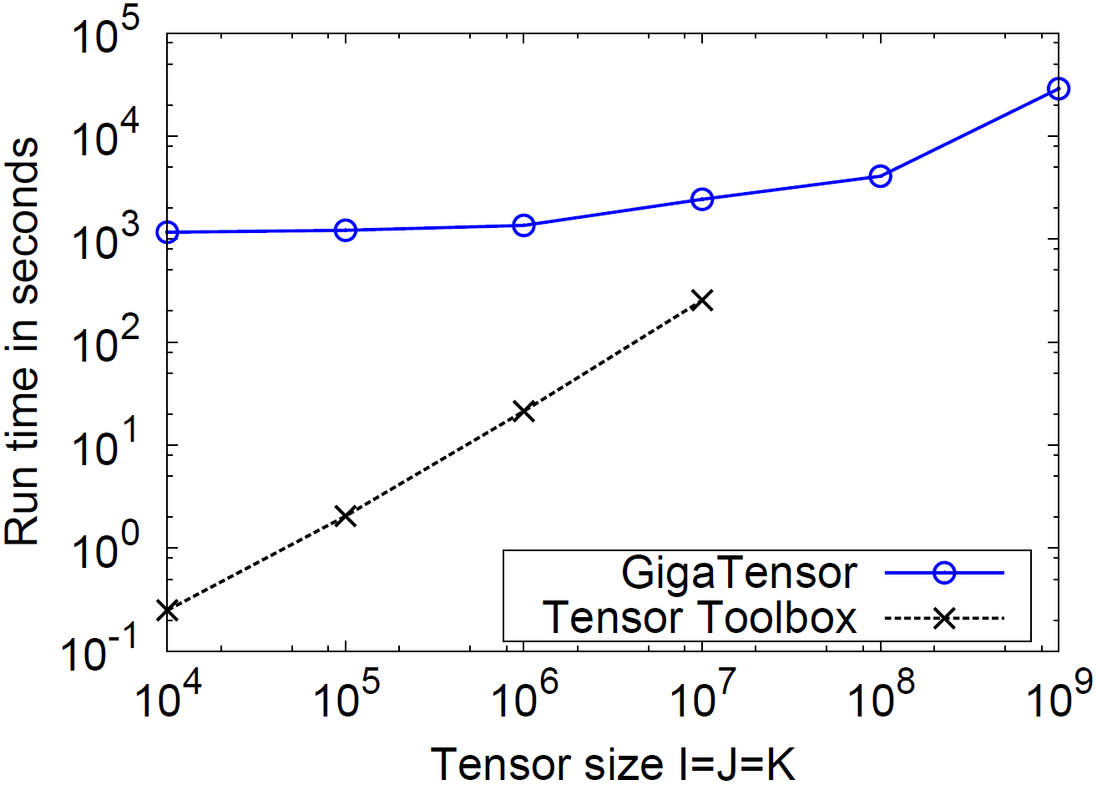
Experiments
GigaTensor solves 100x larger problem
(K)
(J)
GigaTensor
(I)
100x
Number of
nonzero
= I / 50
Tensor
Out of
Toolbox
Memory

Slide 19
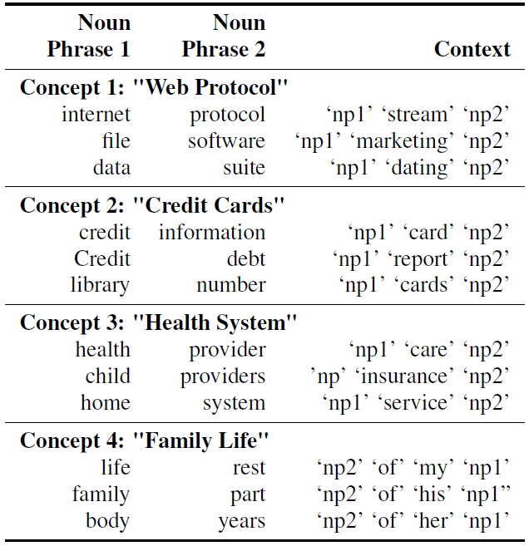
A1: Concept Discovery
Concept Discovery in Knowledge Base

Slide 20
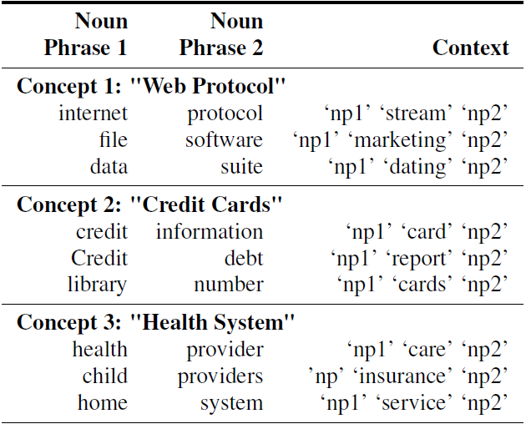
A1: Concept Discovery

Slide 21
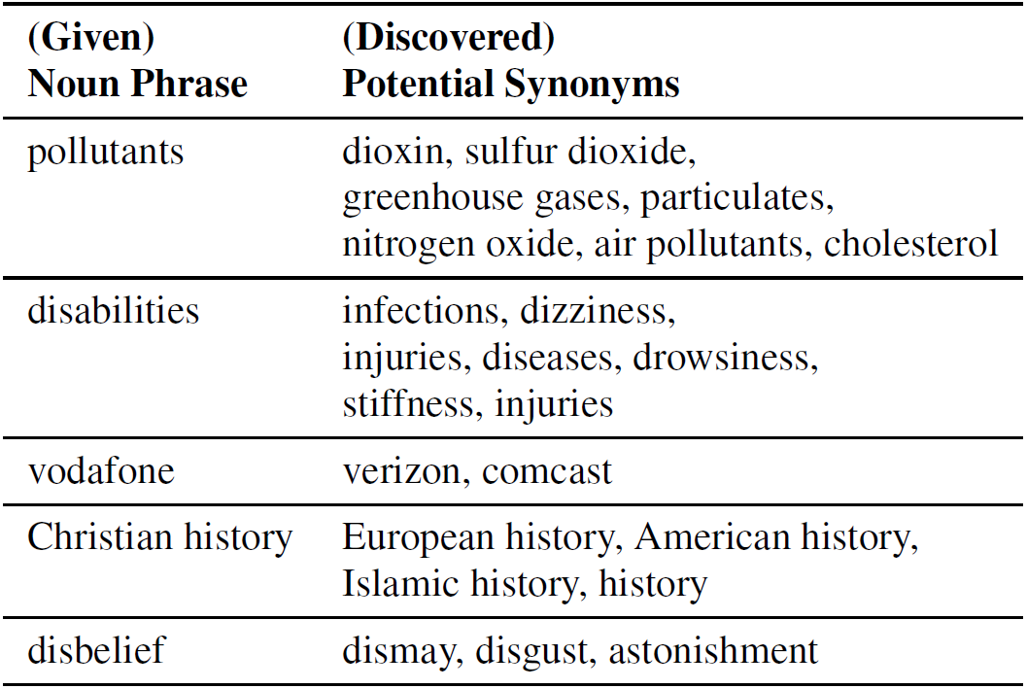
A2: Synonym Discovery

Slide 22
EXTRAS - Tools
ebay fraud detection: network effects (‘Belief propagation’)
NELL analysis (Never Ending Language Learner): Tensors – GigaTensor
Spike analysis and forecasting: ‘SpikeM’

Slide 23
Rise and fall patterns in social media
Meme (# of mentions in blogs)
  short phrases Sourced from U.S. politics in 2008
“you can put lipstick on a pig”
“yes we can”

Slide 24
Rise and fall patterns in social media
Can we find a unifying model, which includes these patterns?
  four classes on YouTube [Crane et al. ’08]
  six classes on Meme [Yang et al. ’11]

Slide 25
Rise and fall patterns in social media
Answer: YES!
We can represent all patterns by single model
In Matsubara+ SIGKDD 2012

Slide 26
Main idea - SpikeM
1. Un-informed bloggers (uninformed about rumor)
2. External shock at time nb (e.g, breaking news)
3. Infection (word-of-mouth)
β
Time n=0
Time n=nb
Time n=nb+1
Infectiveness of a blog-post at age n:
    Strength of infection (quality of news)
    Decay function

Slide 27
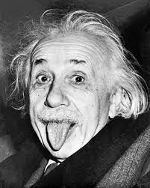
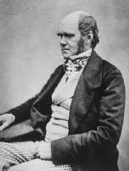
Main idea - SpikeM
1. Un-informed bloggers (uninformed about rumor)
2. External shock at time nb (e.g, breaking news)
3. Infection (word-of-mouth)
β
Time n=0
Time n=nb
Time n=nb+1
Infectiveness of a blog-post at age n:
    Strength of infection (quality of news)
    Decay function

Slide 28
-1.5 slope
J. G. Oliveira & A.-L. Barabási Human Dynamics: The Correspondence Patterns of Darwin and Einstein. Nature 437, 1251 (2005) . [PDF]
Prob(RT > x)
(log)
Response time (log)

Slide 29
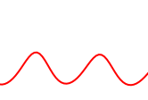
SpikeM - with periodicity
Details
Full equation of SpikeM
Periodicity
noon
Peak
Bloggers change their activity over time
(e.g., daily, weekly, yearly)
3am
Dip
activity
Time n

Slide 30
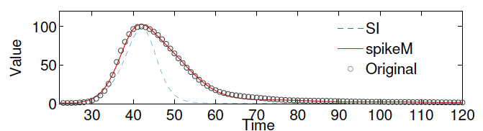
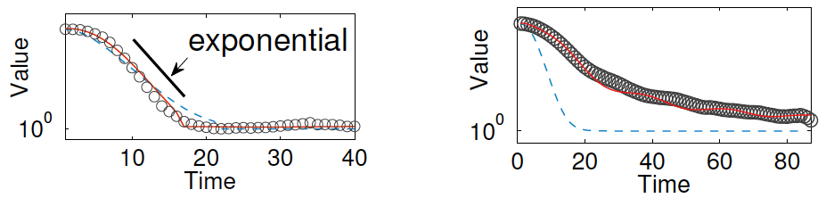
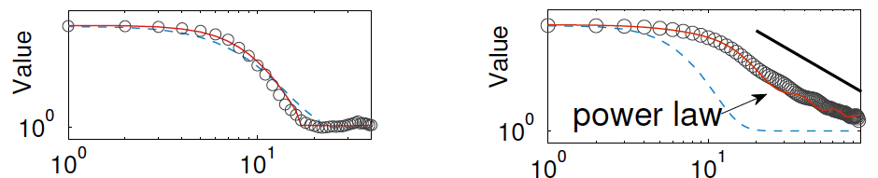
Details
Analysis – exponential rise and power-raw fall
Rise-part
SI -> exponential
SpikeM -> exponential
Lin-log
Log-log

Slide 31
Details
Analysis – exponential rise and power-raw fall
Fall-part
SI -> exponential
SpikeM -> power law
Lin-log
Log-log

Slide 32
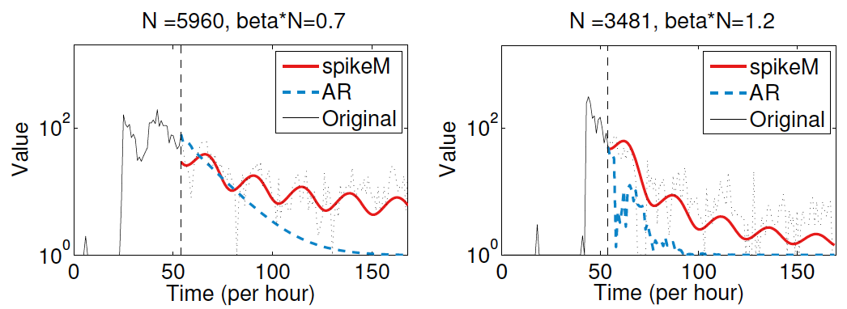
Tail-part forecasts
SpikeM can capture tail part

Slide 33
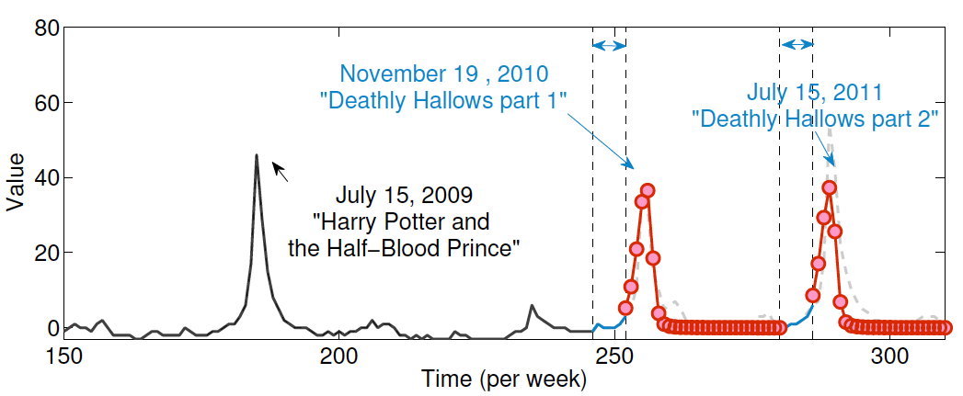
“What-if” forecasting
(1) First spike
(2) Release date
(3) Two weeks before release
e.g., given (1) first spike,
(2) release date of two sequel movies
(3) access volume before the release date
?
?

Slide 34
“What-if” forecasting
(1) First spike
(2) Release date
(3) Two weeks before release
SpikeM can forecast upcoming spikes

Slide 35
References
Leman Akoglu, Christos Faloutsos: RTG: A Recursive Realistic Graph Generator Using Random Typing. ECML/PKDD (1) 2009: 13-28
Deepayan Chakrabarti, Christos Faloutsos: Graph mining: Laws, generators, and algorithms. ACM Comput. Surv. 38(1): (2006)

Slide 36
References
Deepayan Chakrabarti, Yang Wang, Chenxi Wang, Jure Leskovec, Christos Faloutsos: Epidemic thresholds in real networks. ACM Trans. Inf. Syst. Secur. 10(4): (2008)
Deepayan Chakrabarti, Jure Leskovec, Christos Faloutsos, Samuel Madden, Carlos Guestrin, Michalis Faloutsos: Information Survival Threshold in Sensor and P2P Networks. INFOCOM 2007: 1316-1324

Slide 37
References
Christos Faloutsos, Tamara G. Kolda, Jimeng Sun: Mining large graphs and streams using matrix and tensor tools. Tutorial, SIGMOD Conference 2007: 1174

Slide 38
References
T. G. Kolda and J. Sun. Scalable Tensor Decompositions for Multi-aspect Data Mining. In: ICDM 2008, pp. 363-372, December 2008.

Slide 39
References
Jure Leskovec, Jon Kleinberg and Christos Faloutsos Graphs over Time: Densification Laws, Shrinking Diameters and Possible Explanations, KDD 2005 (Best Research paper award).
Jure Leskovec, Deepayan Chakrabarti, Jon M. Kleinberg, Christos Faloutsos: Realistic, Mathematically Tractable Graph Generation and Evolution, Using Kronecker Multiplication. PKDD 2005: 133-145

Slide 40
References
Yasuko Matsubara, Yasushi Sakurai, B. Aditya Prakash, Lei Li, Christos Faloutsos, "Rise and Fall Patterns of Information Diffusion: Model and Implications", KDD’12, pp. 6-14, Beijing, China, August 2012

Slide 41
References
Jimeng Sun, Dacheng Tao, Christos Faloutsos: Beyond streams and graphs: dynamic tensor analysis. KDD 2006: 374-383

Slide 42
References
Hanghang Tong, Christos Faloutsos, Brian Gallagher, Tina Eliassi-Rad: Fast best-effort pattern matching in large attributed graphs. KDD 2007: 737-746
(Best paper award, CIKM'12) Hanghang Tong, B. Aditya Prakash, Tina Eliassi-Rad, Michalis Faloutsos and Christos Faloutsos Gelling, and Melting, Large Graphs by Edge Manipulation, Maui, Hawaii, USA, Oct. 2012.

Slide 43
References
Hanghang Tong, Spiros Papadimitriou, Christos Faloutsos, Philip S. Yu, Tina Eliassi-Rad: Gateway finder in large graphs: problem definitions and fast solutions. Inf. Retr. 15(3-4): 391-411 (2012)

Slide 44
THE END
(Really, this time)

