Slide 1
Lecture 4:
Other Output Models:
Structured Graphics;
Object-Oriented Techniques
Brad Myers
05-830
Advanced User Interface Software
Spring 2020

Slide 2
Logistics
HW #1 due today
Start on Homework 2
  Homework 2 is hard
  You have 2½ weeks for a reason
    Don’t leave it until the last minute
Ask questions with Piazza

Slide 3
Structured Graphics
Saves a list of all the graphical objects
  Edit the screen by editing the saved list
Also called "display list" or "retained object model"
Provided by many toolkits and graphics packages early vector displays
  CORE (~1977), GKS (1985), PHIGS (1988)
  Optional in InterViews, CLIM, etc.
  Required in Amulet, Garnet, Rendezvous, etc.
SVG for JavaScript
HTML document object model (DOM)
  Display tree

Slide 4
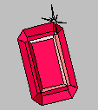

Aside: Garnet and Amulet
Garnet: (link)
  1987 to 1994
  Common Lisp and X11 or Macintosh
  Generating an Amalgam of Real-time, Novel Editors and Toolkits
Amulet:
  1994 to 1997
  C++ and X11, Windows or Macintosh
  Automatic Manufacture of Usable and Learnable Editors and Toolkits
Novel object, graphics, constraint, input, output, undo, command, and animation models
Were widely used for a while

Slide 5
Amulet and Garnet Papers and Videos
Brad A. Myers, Dario A. Giuse, Roger B. Dannenberg, Brad Vander Zanden, David S. Kosbie, Ed Pervin, Andrew Mickish, and Philippe Marchal. "Garnet: Comprehensive Support for Graphical, Highly-Interactive User Interfaces," IEEE Computer. vol. 23, no. 11. November, 1990. pp. 71-85. Translated into Japanese and reprinted in Nikkei Electronics, No. 522, March 18, 1991, pp. 187-205. Also reprinted in: R.Baecker, J.Grudin, W.Buxton, and S. Greenberg, eds. Readings in Human-Computer Interaction: Toward the Year 2000. Second Edition. San Francisco: Morgan Kaufmann Publishers, Inc., 1995. pp. 357-372. pdf. See also YouTube video or OpenVideo.
Brad A. Myers, Richard G. McDaniel, Robert C. Miller, Alan Ferrency, Andrew Faulring, Bruce D. Kyle, Andrew Mickish, Alex Klimovitski, and Patrick Doane. "The Amulet Environment: New Models for Effective User Interface Software Development", IEEE Transactions on Software Engineering, Vol. 23, no. 6. June, 1997. pp. 347-365. IEEE pdf or tech report or abstract only. See also YouTube video or OpenVideo

Slide 6
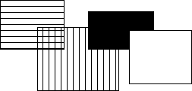
Structured Graphics, cont.
Advantages:
  Simpler to program with: don't call "draw" and "erase"
    Just add and remove objects
  Automatic refresh of windows when uncovered, etc.
  Automatic redisplay of objects when change and also of other overlapping objects
Before
After

Slide 7
Structured Graphics Can Support
Ability to support:
  high-level behaviors like move, grow, cut/copy/paste, etc.
  high-level widgets like selection handles
  constraints among objects
  automatic layout
  grouping: "Groups" in Garnet
  automatic printing
  tutors and monitors
  external scripting, ...
  accessibility

Slide 8
Structured Graphics Disadvantages
Disadvantages:
  Significant space penalties
    objects take up to 1000 bytes each
    imagine a scene with 40,000 dots (200x200 fat bits)
  Time penalties
    Redisplay doesn't take advantage of special properties of data:
      regularity
      non-overlapping

Slide 9
Basic Idea: Graphical objects retained in a hierarchy
Primitives: text, rectangles, circles, …
Groups
  Also called “aggregates”, “collections”, …
  In HTML: <div>, <ux>, …
  SVG: “Group”
  The size of a group includes all of its “children” objects.
    Also called “components”
    Bounding box of group
  Group is “parent”, elements are “children”
Foo

Slide 10
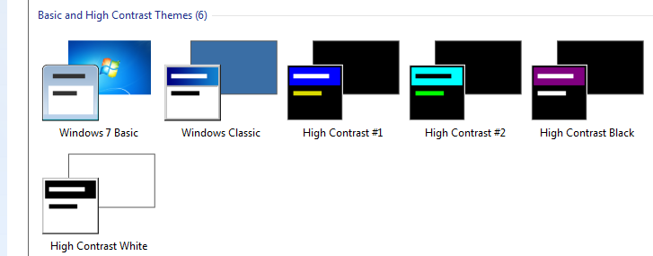
Design Issues: Hierarchies
& Inheritance
How many hierarchies for OO graphics systems?
  Inheritance (class-instance or prototype-instance)
  Components / Groups
  Style hierarchies, like from CSS classes or Windows themes
Where do properties come from?
  Color, size, shape
    From aggregate or inheritance hierarchy?
  Issue: changing type of object – rectangle → polygon
  Windows widget
  properties
    Size, color scheme,
    transparency, …

Slide 11
Redisplay Algorithms
Redisplay everything each time
  Most appropriate for small numbers of objects, and if drawing is really quick compared to computation
  Used on the Macintosh and many others
  Used by Amulet
  Used by homework 2

Slide 12
Redisplay only the affected areas of the screen
Requires computing what areas are affected
Garnet:
  keep track of objects that change any "interesting" slot
  compute the bounding box of all these changed objects in their old and new locations
  assert this as the clipping region (must not self-intersect; Garnet uses 2 regions)
  erase the area
  go through objects from top-to-bottom, back to front draw those which overlap the bounding box
  goes through all top level aggregates, and any children of the aggregates that intersect (recursively)
Other techniques: quad trees

Slide 13
Overview of Redisplay Algorithm
Foo
Simplest algorithm: draw all objects from back to front
More sophisticated: Can clip to boundary of changed objects
  1st pass – collect all the objects which have changed
    Combine into one or more clipping rectangles
  2nd pass – go through all objects from back to front and redraw them
    Will be clipped to affected regions
    Optimization – only do components if group intersects changed area

Slide 14
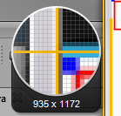
Issue: Anti-Aliasing and special effects
Drop shadows, highlights, other special effects
Can draw outside of the normal display area
  Have to be more careful in computing bounding boxes
MacOS & iOS & Web use
anti-aliasing by default
and seem to redraw lots
of windows

Slide 15
Object-Oriented Techniques
Motivation
  Became popular along with GUIs, Direct Manipulation
  Icons, graphics seem like objects:
    have internal state, persistance
  OO was originally developed (SmallTalk) and became popular (C++) mostly due to GUIs.

Slide 16
Object Oriented
As a UI technique:
  Same as GUI, Direct Manipulation = icons, graphical objects, widgets
Here, as a programming paradigm (often in a language)
A form of "data abstraction"
"Classes" describe the basic structure of the data
Also, the methods that can be called
Usually no direct access to the data, only the methods

Slide 17
OO
Create "instances" of the classes
  local copy of data
  may also be class data -- all instances share the same value
  shares all methods
"Inheritance": create a new class "like" the superclass
  by default has all the same methods and data
  can add new data and methods and re-program inherited methods
Example: graphical_object.draw ... circle.draw

Slide 18
OO
New style of programming; thinking about the problem
  Many books about how to do it right.
  OO design; getting the classes and protocols right
    So subclasses don't have extra, wasted data space
    Methods make sense to all sub-classes
    So external classes don't need to know inside description.
  Also OO databases, etc.
Implementation:
  object in memory, starts with pointer to table of methods, etc.
  lots of tricks and extra declarations in C++, Java etc. to avoid overhead of lookups at run-time ("virtual", "pure virtual")

Slide 19
Multiple inheritance
Class has multiple parent classes
Combine all the methods and data of all
Special rules for when conflict (same method, same name of data with different types, etc.)
Example: circle inherits from graphical-object and moveable-object
Complex so often not used even when available
  “Diamond problem”
Amulet uses constraints to provide flexible copying of values instead
Java, etc. use “interfaces”
  No inheritance of implementations, but ability to have arbitrary “mix-ins”
  No confusion about which superclass to inherit from

Slide 20
Prototype-Instance model
Instead of the class-instance model
All objects are instances
Can use any object as a prototype for other objects
  Inherits all slots it doesn't override (= instance variables, member variables, fields, attributes).
  Methods are just a value in a slot
  Dynamic changing of methods
Easy to implement using structures.
Usually, changing prototype data also changes all instances that do not override it.
Now used by JavaScript, ActionScript (Flash)
  Older uses: SELF, NewtonScript,

Slide 21
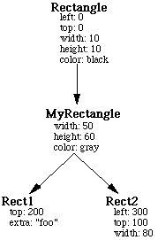
Prototype-Instance model

Slide 22
Prototype-Instance model
May provide adding and removing of slots dynamically to any instance
Simpler model, easy to implement
More dynamic
But much less efficient
  Can't usually compile slot accesses into structure access; may need a search
  Type checking on slots
  Methods looked up at run-time
  Space for names of slots, extra pointers, etc.

Slide 23
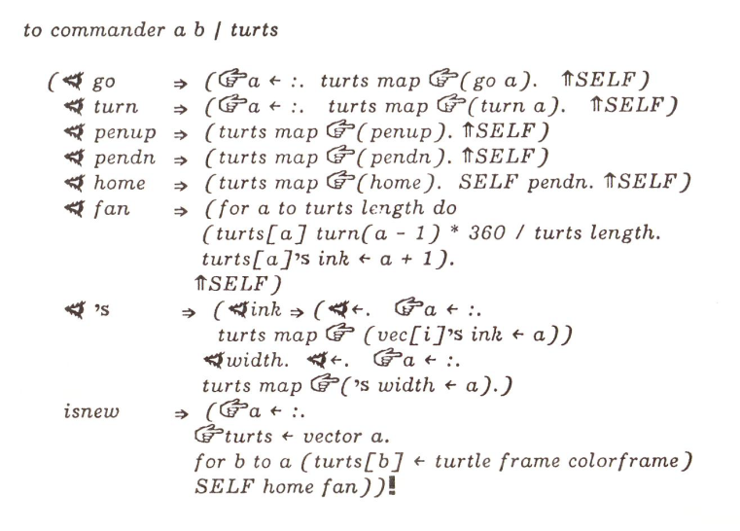
Examples of OO Systems
OO in SmallTalk
  First "pure" example
  Everything is an object
  (numbers, strings, etc.)
  Single inheritance
  Methods dispatched on a single parameter
    3 + "4.5" different from "4.5" + 3
  Dynamic method lookup at run-time
    => "Message not understood"
  Smalltalk 72 had strange syntax with special characters
  Whole environment (windows, browsers, MVC, etc.)
Notes:
Stopped here

Slide 24
Examples of OO Systems
OO in C++
  Numbers, strings, etc. not objects
  Lots of mess to make it fit with C
  Statically (compile-time) determine types, methods
  Originally a pre-processor (new syntax)
  Multiple-inheritance

Slide 25
Examples of OO Systems
OO in MacApp (approx. 1985 – 1994)
  Because OO so natural for UIs, invented their own language: Object Pascal with help from Niklaus Werth (inventor of Pascal)
  Used in MacApp
  SmallTalk model, but more compile-time checkable
  Eventually abandoned in favor of Objective C (NeXT)
    Third-party company (“StepStone”) by Brad Cox
    NeXT acquired Objective-C and Cox’s company
    Now supported directly by Apple

Slide 26
Examples of OO Systems
OO in Andrew and Motif
  GUI systems for X Window System on Unix in the late 1980’s
  Invented their own object systems in C
    Similar to GTK+ from homework 1 presentations
  Before C++ was popular, available
  Mainly is a method and inheritance protocol
  Andrew: (ATK) pre-processor for header files
    single inheritance
    "_" = new syntax: class_method(xxx)
    dynamic loading of object implementations
    querying an object's class at run-time
    Andrew converted to C++
    Now defunct
  Motif
    just a set of conventions; no preprocessor
    not "real" inheritance, overriding

Slide 27
Examples of OO Systems
Amulet provides a prototype-instance object system embedded in C++
Java
C#
Objective C
ActionScript
JavaScript

Slide 28
Hints for Homework 2
JavaScript: client side only, no NPM, node
  No libraries other than Canvas, html, css
Main event loop
  (Handle input), Set properties, redraw
Redraw = erase screen, draw everything back to front
  Recursively go down group tree
Need to deal with clipping and coordinate transformations at the group level
  Clipping region will only get smaller as recurse

