Slide 1
Lecture 3:
Basic Computer Graphics
For User Interfaces
Brad Myers
05-830
Advanced User Interface Software
Spring, 2020

Slide 2
Logistics
Fixed due date for HW #1 on Canvas
Discussions and questions on Piazza:
  http://piazza.com/cmu/spring2020/05830/
  Please tag with HW1, etc.
  Linked from class homepage

Slide 3
Why talk about Graphics?
To draw application-specific graphical objects
Lines, rectangles, text
Mac, Windows, Linux, Android, iOS, web (html, canvas, svg) … all have approximately the same model
There are some complexities that are worth looking at

Slide 4
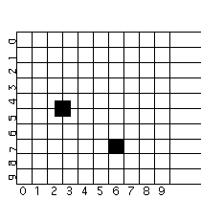
Coordinates for Drawing
Origin
  Typically 0,0 in top left
  Comes from text handling and raster scan
  Java 2D allows customization
Different from conventional axes
Coordinates of pixels:
  Center of pixel?
  Corner of pixel?
Matters for lines

Slide 5
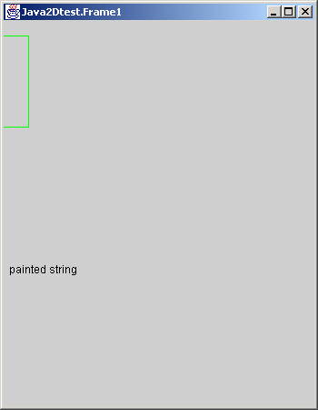
Issue: Window Coordinates
Where is 0,0 with respect to the window’s inside or outside border?
CreateWindow (10, 10, 100, 100)
  Inside or outside?
  Different for point vs. W/H?
  What is the size of window
  border?
JS – just inside

Slide 6
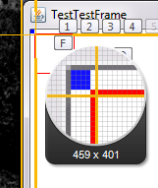
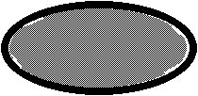
Drawing Primitives
Drawing Objects:
  Graphics, graphics2D java APIs: http://docs.oracle.com/javase/8/docs/api/
  Canvas / svg for JavaScript
  P1 and P2 or P1 and W/H?
    void graphics.drawRect (int x, int y, int width, int height)
    Draws the outline of the specified rectangle. (also fillRect)
  Inclusive or exclusive?
  Which pixels are turned on for DrawRectangle (2,2, 8,8)?
  Suppose you draw another rectangle next to it?
  Suppose draw filled and outline rectangle with the same coordinates?
  What about for ellipse?
graphics.setColor(Color.red);
graphics.drawRect(4, 4, 40, 40);
graphics.setColor(Color.blue);
graphics.fillRect(0,0,4,4);

Slide 7
Primitives, 2
DrawLine has similar concerns
  Thick lines often go to both sides of the coordinates
  Option in JavaScript for fully inside
drawPolyline takes a sequence of points
  Endpoints of each segment drawn?
  Last end-point drawn?
  Closed vs. open; may draw first point twice

Slide 8

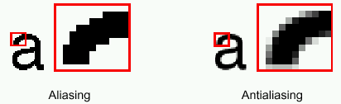
Anti-Aliasing
Making edges appear smooth by using blended colors
Useful for text and all lines
Supported by Java RenderingHints parameter to Graphics2D
JS – always on, controlled by the browser

Slide 9


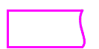
Java2D & Canvas Path Model
Others (AWT) draw by drawing shapes (drawRect, etc.)
Java2D: Define a path first, then draw it
  Also used in Macintosh, Postscript, JS
  g2.setStroke(dashed);
  g2.draw(new RoundRectangle2D.Double(x, y, rectWidth,
  rectHeight, 10, 10));
Can create a GeneralPath and add moveTo, lineTo’s, curveTo (etc.) to it, and then call draw.

Slide 10
JavaScript Canvas
Build up a path and then “stroke” or “fill” it
  Implicit “default” path, or explicit path

Slide 11

JavaScript Canvas examples
<body>
<canvas id="myCanvas" width="100%" height="100%"></canvas>
…
<script>
ctx.strokeStyle = "red";
ctx.moveTo(10, 10);
ctx.lineTo(20, 200);
ctx.stroke();
ctx.fillStyle = "green";
ctx.fillRect(20, 20, 150, 100);
</script>
</body>

Slide 12

JavaScript Canvas
<body>
<canvas id="myCanvas" width="100%" height="100%"></canvas>
…
<script>
ctx.strokeStyle = "red";
ctx.moveTo(10, 10);
ctx.lineTo(20, 200);
ctx.stroke();
ctx.fillStyle = "green";
ctx.fillRect(20, 20, 150, 100);
ctx.moveTo(0,0);
ctx.lineWidth = 5;
ctx.strokeStyle = "blue";
ctx.lineTo(0,100);
ctx.stroke();
</script>
</body>

Slide 13
JavaScript Canvas
<body>
<canvas id="myCanvas" width="100%" height="100%"></canvas>
…
<script>
ctx.strokeStyle = "red";
ctx.moveTo(10, 10);
ctx.lineTo(20, 200);
ctx.stroke();
ctx.fillStyle = "green";
ctx.fillRect(20, 20, 150, 100);
ctx.moveTo(0,0);
ctx.lineWidth = 5;
ctx.strokeStyle = "blue";
ctx.lineTo(0,100);
ctx.stroke();
</script>
</body>
  Redraws previous stroke!

Slide 14

JavaScript Canvas
<body>
<canvas id="myCanvas" width="100%" height="100%"></canvas>
…
<script>
ctx.strokeStyle = "red";
ctx.moveTo(10, 10);
ctx.lineTo(20, 200);
ctx.stroke();
ctx.beginPath();
ctx.moveTo(10, 250);
ctx.fillStyle = "green";
ctx.fillRect(20, 20, 150, 100);
ctx.moveTo(0,0);
ctx.lineWidth = 5;
ctx.strokeStyle = "blue";
ctx.lineTo(0,100);
ctx.stroke();
</script>
</body>
  Need beginPath() between strokes!

Slide 15
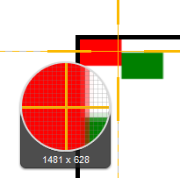
JavaScript Canvas
…
ctx.fillStyle = "red";
ctx.fillRect(0, 0, 20, 20);
ctx.fillStyle = "green";
ctx.fillRect(20, 10, 20, 20);
…
  Anti-aliasing makes
  it hard to control
  which pixels are on

Slide 16
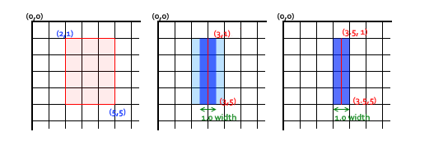
Anti-aliasing discussion
https://developer.mozilla.org/en-US/docs/Web/API/Canvas_API/Tutorial/Applying_styles_and_colors

Slide 17
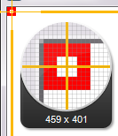
Inside or outside?
How many pixels across are painted for line width = 3, rectangle width = 7?
graphics.setStroke(new BasicStroke(3));
graphics.setColor(Color.red);
graphics.drawRect(1, 1, 7, 7);
10 !

Slide 18
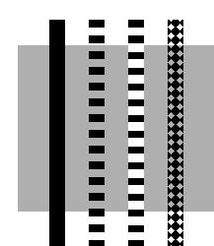
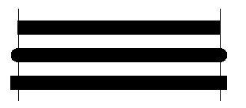
Line Properties
LineStyles
  Width
  Solid, dashed 111000111000111000, "double-dashed", patterned
Cap-style: butt, round, projecting (by 1/2 linewidth):

Slide 19
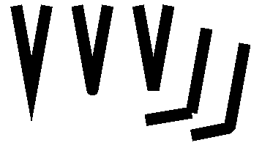
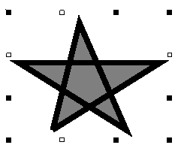
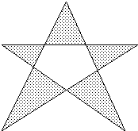
Polylines
End-caps: miter, round, bevel:
  Miter = point, up to 11 degrees
    JS miterLimit
  Round = circle of the line width
  Bevel = fill in notch with straight line
Filled, what parts?
  “Winding rule”
    JS: fill-rule:nonzero
  “Odd parity rule”
    JS: fill-rule:evenodd
    Used by Java

Slide 20
Splines
Curves defined by “cubic” equation
  x(t) = a_{x}t³ + b_{x}t² + c_{x}t + d_{x}
  y(t) = a_{y}t³ + b_{y}t² + c_{y}t + d_{y}
  Well-defined techniques from graphics (not covered here – see Foley&vanDam)
Defined to go through the “control” points
curveTo(float x1, float y1, float x2, float y2, float x3, float y3)
Adds a curved segment, defined by three new points, to the path by drawing a Bézier curve that intersects both the current coordinates and the coordinates (x3, y3), using the specified points (x1, y1) and (x2, y2) as Bézier control points.
Similar in SVG:
  path C = curveto (reference)

Slide 21
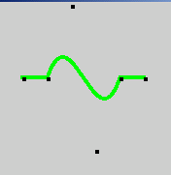
Spline Example
g2.setStroke(new BasicStroke(4.0f));
g2.setPaint(Color.green);
p.moveTo(50, 100);
p.lineTo(75, 100);
p.curveTo(100, 25, 125, 175, 150, 100);
p.lineTo(175, 100);
g2.draw(p);
g2.setPaint(Color.black);
g.fillRect(50, 100 ,4,4);
g.fillRect(75, 100 ,4,4);
g.fillRect(100, 25 ,4,4);
g.fillRect(125, 175 ,4,4);
g.fillRect(150, 100 ,4,4);
g.fillRect(175, 100 ,4,4);
Note that Bezier curves do not go through the intermediate control points

Slide 22

Color Models
RGB -- Additive color primaries
CMY -- Cyan, Magenta, Yellow
  complements of red, green, blue; subtractive primaries
  colors are specified that are removed from white light, instead of added to black (no light) as in RGB
YIQ -- used in color TVs in US (NTSC)
  Y is luminance, what is shown on black and white TVs
  I and Q encode chromaticity
Notes:
Stopped here

Slide 23
Color, cont.
HSV -- Hue, Saturation and Value (brightness) or HSL (Luminance)
  user oriented, intuitive appear of artist's hint, shade, tone
  simple algorithm in text to convert, but not a linear mapping
Interpolating between colors can be done using different models, with different resulting intermediate colors

Slide 24
Transparency of Color
Original model used only opaque paint
  Modeled hardcopy devices this was developed for (at Xerox PARC)
Current systems now support “paint” that combines with “paint” already under it
  e.g., translucent paint (“alpha” values)
Intermediate
  Icons and images can select one “transparent” color
    E.g, “transparent gifs”

Slide 25
Paint with transparency
Postscript model originated the “alpha blending” approach
  Dominant model for hardcopy
Java2D and JS drawing models also takes this approach

Slide 26
Paint with transparency, 2
Advantages
  Flexible display
Disadvantages
  Slower
    Less and less of an issue
    But interactive response tends to be dominated by redraw time
  Much harder to implement

Slide 27
Alpha Blending
Alpha is percent of this picture used
  Color (float r, float g, float b, float a)
  Creates an sRGB color with the specified red, green, blue, and alpha values in the range (0.0 - 1.0).

Slide 28

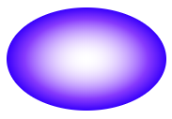
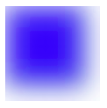
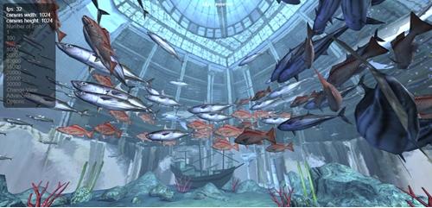
Other painting parameters
Shadows
Many kinds of gradients
Filters and blurring
3D (WebGL) …..

Slide 29
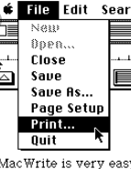
Historical reference
Early machines were all monochrome
  Each pixel was black or white
Slow graphics
Tricks for highlighting
and “grey”

Slide 30
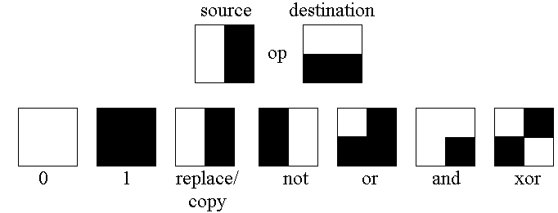

Draw Function
Replace (COPY)
XOR
And, OR, NOT, etc.
Makes it important to do the points only once
Anything XOR BLACK = inverted anything, XOR again and get original:
AND useful for making holes
Doesn’t work well in color
Java: Paint or XOR (setXORMode or setPaintMode)

Slide 31
RasterOp (BitBlt, CopyArea)
Copy an area of the screen
graphics.copyArea (int x, int y, int width, int height, int dx, int dy)
Copies an area of the component by a distance specified by dx and dy.
Used to have ability to combine with destination using Boolean combinations
Useful for moving, scrolling, erasing & filling rectangles, etc.
SmallTalk investigated using it for rotate, scaling, etc.
Not nearly as useful in color

Slide 32
Double Buffering
Save an extra picture offscreen
  Smoother animations
  Save hidden parts of windows
= “Backing store”
Use two buffers for special effects, faster refresh
“Save-under” for pop-ups

Slide 33
Fonts and drawing strings
Font provides description of the shape of a collection of chars
  Shapes are called “glyphs”
Plus information e.g. about how to advance after drawing a glyph
And aggregate info for the whole collection

Slide 34
Fonts
Typically specified by:
  A family or typeface
    e.g., courier, helvetica, times roman
  A size (normally in “points”)
  A style
    e.g., plain, italic, bold, bold & italic
    other possibles (from mac): underline, outline, shadow

Slide 35
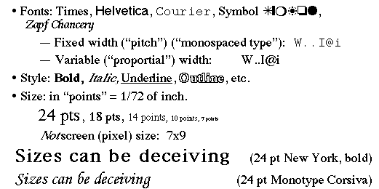
Font examples

Slide 36
Points
An odd and archaic unit of measurement
  72.27 points per inch
    Origin: 72 per French inch (!)
  Postscript rounded to 72/inch
    Most have followed
  Early Macintosh: point==pixel (1/75th)

Slide 37
FontMetrics
Objects that allow you to measure characters, strings, and properties of whole fonts

Slide 38
Reference point and baseline
Each glyph has a reference point
  Draw a character at x,y, reference point will end up at x,y (not top-left)
  Reference point defines a “baseline”
p

Slide 39
Advance width
Each glyph has an “advance width”
  Where reference point of next glyph goes along baseline
pa

Slide 40
Ascent and decent
Glyphs are drawn both above and below baseline
  Distance below: “decent” of glyph
  Distance above: “ascent” of glyph
p
Ascent
Decent

Slide 41
Standard ascent and decent
Font as a whole has a standard ascent and standard decent
pM
Std Ascent
Std Decent

Slide 42

Leading
Leading = space between lines of text
  Pronounce “led”-ing after the lead strips that used to provide it
  space between bottom of standard decent and top of standard ascent
    i.e. interline spacing

Slide 43
Height
Height of character or font
  ascent + decent + leading
  not standard across systems: on some systems doesn’t include leading (but does in Java)
    New question: is the leading above or below the text in Java?

Slide 44
Other Parameters
Kerning: overlapping of characters: VA, ff, V.
Stroke: Element of a character that would have originally been created with a single pen stroke
Em: Equal to the font's point size. So an "Em-dash" in a 18 point font is 18points wide: (option-shift-underline on Mac)
En: Half font's point size. "En-dash" is 9 points wide in 18 point font: (Mac: option-underline)
  - DASHES – DASHES—DASHES

Slide 45

Types of Fonts
Bitmap fonts: look bad when scaled up. Best appearance at native resolution.
Times vs.
  Sometimes used for dingbats, wingdings
Postscript fonts: by Adobe, described by curves and lines so look good at any resolution, often hard to read when small
TrueType fonts: similar to Postscript: font is a program abcd
  Supported by Java: java.awt.font.TRUETYPE_FONT
OpenType, etc. – web fonts are scalable

Slide 46
Encoding of Characters
Conventional ASCII
  One byte per character
  Various special characters in lower and upper part of fonts
    Depends on OS, font, etc.
Unicode: http://www.unicode.org
  16 bits per character
  All the world’s languages
  Java and web use Unicode

Slide 47
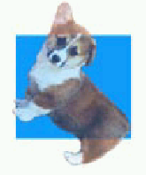
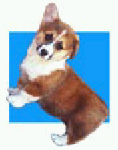
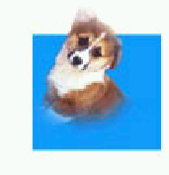
Images
Pictures created externally
  “Bitmaps”, “Pixmaps”
Various encodings
  bmp, pict, gif, tiff, jpeg, png, …
Issues:
  Origin for when used as a cursor
  Encodings for transparency
    Windows cursors and gif files
    Java uses alpha compositing
    gif & png do support it, jpg does not
Java drawImage

Slide 48
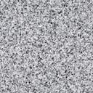

Clipping and “Stencils”
X windows, Mac, etc. can clip drawing to a set of rectangles
  Must be non-overlapping
  Important for refresh
  Can make drawing more efficient
Java:
  a single clip rectangle:
  setClip(int x, int y, int width, int height)
  Sets the current clip to the rectangle specified by the given coordinates.
  clipRect(int x, int y, int width, int height)
  Intersects the current clip with the specified rectangle.
  Clip to arbitrary shape
  setClip(Shape clip)
  Sets the current clipping area to an arbitrary clip shape.
JS: ctx.clip();

Slide 49
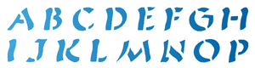

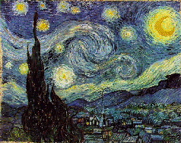


“Stencils”
Model is like the stencils used in
crafts
  Only see paint through the “holes”
Used for transparency, icons, other effects
Uses alpha compositing and shape clip mechanisms in Java

Slide 50


Coordinate Transformations
Supports
  Translate - move
  Rotate
  Scale – change size (including flip = -scale)
  Shear
Can modify any shape, including text
To fully understand, need matrix algebra:
  Affine transformations are based on two-dimensional matrices of the following form:
        a c t_{x} x
        b d t_{y} y where x′ = ax + cy + t_{x} and y′ = bx + dy + t_{y}
        1

Slide 51
Units for locations, sizes
Screen (pixels) versus “real” measures (inches)
  Depends on screen resolution
  Not necessarily known to system
    Easier for Postscript
  Java provides inches, millimeters, etc. as a transform
    Default is pixels
Visual Basic uses “twip” = 1/20 of a point =
1/1440 inch
  Conventional screen = 1280 / 15” = 90 pixels/inch
  Laser printers are 600 dots/inch
Windows = “dialog box units” – DBU
  based on the default system font: one vertical dbu is 1/8 of the font height, and one horizontal dbu is 1/4 of the font's average width

Slide 52
How Parameters are Passed
How pass parameters for drawing operations?
Issue: Lots of parameters control the drawing of objects.
  X drawline has at least 19
  How many for Java swing?
    Adds (at least): transformation matrix, antialiasing and other renderinghints, what else?

Slide 53
DrawLine Parameters
Window in which to draw
X1
Y1
X2
Y2
relative-p
line-width
draw function
background-color
foreground-color
cap style
line style (solid, dashed, double-dashed)
dash pattern
dash offset
stipple bitmap
stipple origin X
stipple origin Y
clip mask
plane mask (for drawing on specific planes)

Slide 54
How Pass Parameters?
Three basic possibilities
  Pass all parameters with each operation
    DrawLine(70,30,70,200, Red, ......)
    - too many parameters
    Not really used by any modern system

Slide 55
Passing Parameters, 2
  All parameters stored in the system
    Used by Macintosh, Display Postscript, JavaScript, etc.
    Sometimes called the “pen”
    Example (pseudo code):
      SetColor(Red)
      MoveTo(70, 30)
      DrawTo(70, 200)
    + Fewer parameters to calls
    + Don't have to set properties don't care about
    - Interrupts, multi-processing, may result in unexpected settings

Slide 56
Passing Parameters, 3
  Store parameters in an object
    X = “graphics context”
      Can have more than one
    Windows = “device context”
      corresponds to surface, but can push and pop
    Java
      “Graphics”, Graphics2D, Graphics3D objects
        Lots of settings
    Android
      Has BOTH graphics object and Paint object
      Parameters are in the Paint object

