Slide 1
Lecture 2:
Why are User Interfaces Hard to Design and Implement?
Brad Myers
05-830
Advanced User Interface Software
Spring, 2020

Slide 2
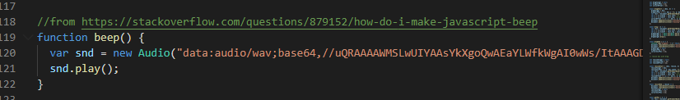
Homework 1 hints
Long and detailed specification
Setting and removing listeners
  Move / grow mouse-move and mouse-up events needs to listen on window, not object
  But start (mouse-down) on objects
Pressing in background deselects and can start new drawing
  Typical of UI software – down press does both
  But pressing on box should not – need to stop “propagation”
Watch out for UI errors – math and max/min
Watch out for zero height or width objects
If JS, look into SVG, AngularJS, ReactJS
OK to look up how to do things, please cite sources:

Slide 3
Homework 1 hints – overview of GUI pipeline: output
Graphics output
  Window = “JFrame“ in Java or “Document” in JS
    Java:
    class MyFrame extends Jframe
    private JComponent canvas;
    JS: have index.html with <div> etc. that reference by id in JS code
    document.getElementById("canvas-area")
  Drawing use Graphics2D in java
  Recommend using SVG and html in JS

Slide 4
Homework 1 hints – overview of GUI pipeline: input
Write code for “event handlers” (“listeners”)
  “call back procedures” that you write that happen on “events” like mouse down or mouse move
  Java:
MouseListener ml = new MouseAdapter() {
public void mousePressed(MouseEvent event) {
// do something with event
}
}
  JS
button.addEventListener("click", function () { … } );
document.addEventListener('keyup', function(event) { … } );
rect.mousedown(function(event) { … } )
document.addEventListener("mousemove", drag);

Slide 5
Who are “Users”?
People who will use a product or web site.
As opposed to the “Designers”
  People who create the system or web site
Designers ≠ Users
You are the designer
Have to make an effort to Know The User

Slide 6
What is the “User Interface”?
Everything the user encounters
  Functionality & Usefulness
  Content
  Labels
  Presentation
  Layout
  Navigation
  Speed of response
  Emotional Impact
  Documentation & Help

Slide 7
What is “Usability”?
= Quality!
Learnability
Efficiency
  Productivity
Memorability
  Little “re-learning” required
Errors
Satisfaction
  Pleasurable

Slide 8
User “Experience” (UX)
Even more than “usability”
  Usability focuses on performance
User Experience
  Emotion, Heritage
  Fun, Style, Art
  Branding, Reputation
  Political, social personal connections
  Beyond just the device itself – “Service Design”
Blends: usability engineering, software engineering, ergonomics, hardware engineering, marketing, graphic design

Slide 9
Why Hard to Design UIs?
“It is easy to make things hard. It is hard to make things easy.”
No silver bullet
Seems easy, common sense, but seldom done right
  Once done right, however, seems “obvious”
User Interface design is a creative process
Designers have difficulty thinking like users
  Often need to understand task domain
  Can’t “unlearn” something

Slide 10
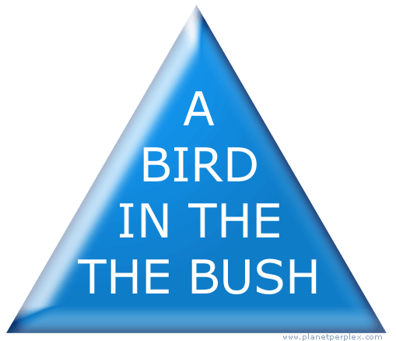
Can’t Unlearn Something

Slide 11
Why Difficult, 2
Specifications are always wrong:
  "Only slightly more than 30% of the code developed in application software development ever gets used as intended by end-users. The reason for this statistic may be a result of developers not understanding what their users need."
    -- Hugh Beyer and Karen Holtzblatt, "Contextual Design: A Customer-Centric Approach to Systems Design,“
    ACM Interactions, Sep+Oct, 1997, iv.5, p. 62.
  Need for prototyping and iteration

Slide 12
Why Difficult, 3
Tasks and domains are complex
  Word 1 (100 commands) vs. Word 2013 (>2000)
  MacDraw 1 vs. Illustrator
  BMW iDrive adjusts over 700 functions
Adding graphics can make worse
  Pretty ≠ Easy to use
Can’t necessarily just copy other designs
  Legal issues
All design/development involves tradeoffs
  Add Features
  Test/Fix Bugs
  Test/Fix usability
  Time-to-market

Slide 13
Why are User Interfaces Difficult to Implement?

Slide 14
What are the most difficult kinds of programs, in general?
What properties make a task difficult to program?

Slide 15
What are the most difficult kinds of programs, in general?
What properties make a task difficult to program?
GUI programming has most of them!

Slide 16
Why Are User Interfaces
Hard to Implement?
They are hard to design, requiring iterative implementation
  Not the waterfall model: specify, design, implement, test, deliver
They are reactive and are programmed from the "inside-out"
  Event based programming
  More difficult to modularize
They generally require multi-processing
  To deal with user typing; aborts
  Window refresh
  Window system as a different process
  Multiple input devices

Slide 17
Why Hard to Implement? cont.
There are real-time requirements for handling input events
  Output 60 times a second
  Keep up with mouse tracking
  Video, sound, multi-media
Need for robustness
  No crashing, on any input
  Helpful error messages and recover gracefully
  Aborts
  Undo

Slide 18
Why Hard to Implement? cont.
Lower testability
  Few tools for regression testing
Little language support
  Primitives in computer languages make bad user interfaces
  Enormous, complex libraries
  Features like object-oriented, constraints, multi-processing
Complexity of the tools
  Full bookshelf for documentation of user interface frameworks
  MFC, Java Swing, VB .Net, etc.
Difficulty of Modularization

Slide 19
Examples
Difference between displaying “hello” in console and displaying a blue rectangle in a window
Difficulty to read a file name
  Readln() in Pascal, Java, C++, etc.
  Vs. tool in modern toolkits
    Complexity of the file dialog itself
    You must deal with aborting, undo, etc.

Slide 20
Common Patterns are Hard to Use
Our research shows that software that uses design patterns is usually hard to learn and to use
Most UI software uses the listener pattern (also called the observer pattern)
  Set up methods (often call-backs procedures) when events happen, like mouse-down, mouse-move
  Hard to trace the control flow
  Static analysis and control flow graphs are less useful
  Debugging is difficult when not called

Slide 21
PhD research of Stephen Oney:
var isDragLocked = false,
mm_listener = function(mm_event) {
draggable.attr({ x: mm_ev.x, y: mm_ev.y });
},
mu_listener = function(mu_event) {
removeEventListener("mousemove", mm_listener);
removeEventListener("mouseup", mu_listener);
};
draggable.mousedown(function(md_ev) {
draggable.attr({ x: md_ev.x, y: md_ev.y });
addEventListener("mousemove", mm_listener);
addEventListener("mouseup", mu_listener);
}).dblclick(function(md_event) {
if(isDragLocked) {
removeEventListener("mousemove", mm_listener);
} else {
addEventListener ("mousemove", mm_listener);
}
isDragLocked = !isDragLocked;
});
Notes:
Implemented in JavaScript with event-callback code, drag-lock is only about 20 lines of code, but these lines are difficult to follow, and as we found in our user study, even more difficult to implement correctly.
I’m putting this code on screen not because I expect you to immediately read and understand it, because as I’ll show in a bit, it’s difficult to reason about. To start to understand why, consider the order in which code is executed during a typical user interaction.

Slide 22
PhD research of Stephen Oney:
var isDragLocked = false,
mm_listener = function(mm_event) {
draggable.attr({ x: mm_ev.x, y: mm_ev.y });
},
mu_listener = function(mu_event) {
removeEventListener("mousemove", mm_listener);
removeEventListener("mouseup", mu_listener);
};
draggable.mousedown(function(md_ev) {
draggable.attr({ x: md_ev.x, y: md_ev.y });
addEventListener("mousemove", mm_listener);
addEventListener("mouseup", mu_listener);
}).dblclick(function(md_event) {
if(isDragLocked) {
removeEventListener("mousemove", mm_listener);
} else {
addEventListener ("mousemove", mm_listener);
}
isDragLocked = !isDragLocked;
});
Notes:
When the user double clicks their mouse to initiate a drag lock the fist time, the flow of the program jumps between mouse event callbacks. I’ve illustrated that control flow here with orange arrows…

Slide 23
PhD research of Stephen Oney:
var isDragLocked = false,
mm_listener = function(mm_event) {
draggable.attr({ x: mm_ev.x, y: mm_ev.y });
},
mu_listener = function(mu_event) {
removeEventListener("mousemove", mm_listener);
removeEventListener("mouseup", mu_listener);
};
draggable.mousedown(function(md_ev) {
draggable.attr({ x: md_ev.x, y: md_ev.y });
addEventListener("mousemove", mm_listener);
addEventListener("mouseup", mu_listener);
}).dblclick(function(md_event) {
if(isDragLocked) {
removeEventListener("mousemove", mm_listener);
} else {
addEventListener ("mousemove", mm_listener);
}
isDragLocked = !isDragLocked;
});
Notes:
…then after they drag and double click again to end the drag lock

Slide 24
PhD research of Stephen Oney:
var isDragLocked = false,
mm_listener = function(mm_event) {
draggable.attr({ x: mm_ev.x, y: mm_ev.y });
},
mu_listener = function(mu_event) {
removeEventListener("mousemove", mm_listener);
removeEventListener("mouseup", mu_listener);
};
draggable.mousedown(function(md_ev) {
draggable.attr({ x: md_ev.x, y: md_ev.y });
addEventListener("mousemove", mm_listener);
addEventListener("mouseup", mu_listener);
}).dblclick(function(md_event) {
if(isDragLocked) {
removeEventListener("mousemove", mm_listener);
} else {
addEventListener ("mousemove", mm_listener);
}
isDragLocked = !isDragLocked;
});
Notes:
And overall, the control flow of even those two double clicks is a jumble when visualized.
And that’s why we call code like this…

Slide 25
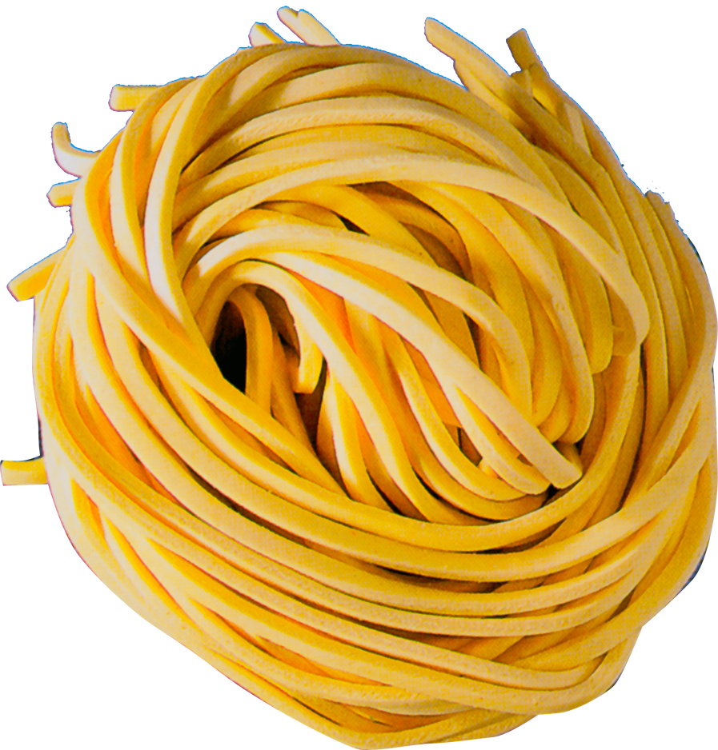
var isDragLocked = false,
mm_listener = function(mm_event) {
draggable.attr({ x: mm_ev.x, y: mm_ev.y });
},
mu_listener = function(mu_event) {
removeEventListener("mousemove", mm_listener);
removeEventListener("mouseup", mu_listener);
};
draggable.mousedown(function(md_ev) {
draggable.attr({ x: md_ev.x, y: md_ev.y });
addEventListener("mousemove", mm_listener);
addEventListener("mouseup", mu_listener);
}).dblclick(function(md_event) {
if(isDragLocked) {
removeEventListener("mousemove", mm_listener);
} else {
addEventListener ("mousemove", mm_listener);
}
isDragLocked = !isDragLocked;
});
[Letondal 2010, Myers 1991]
Notes:
“spaghetti code”. It’s not spaghetti code because it’s poor quality. This example was actually improved from the best implementation of 20 participants in our user study; it’s well-written.
It’s spaghetti code because the control flow is difficult to follow. Also, this code is highly interdependent; multiple places reference and modify the same variables in a way that depends very strictly on this control flow.
For example, suppose I said that rather than a double click taking the user out of drag lock, I wanted a click to exit from drag lock. Intuitively, it seems like such a small change should require adjusting a couple of lines at the most.

Slide 26
We called this “the Spaghetti of Call-Backs” back in 1991!
Brad A. Myers. "Separating Application Code from Toolkits: Eliminating the Spaghetti of Call-Backs," ACM Symposium on User Interface Software and Technology: UIST'91, Hilton Head, SC, Nov. 11-13, 1991. pp. 211-220. pdf or YouTube video or local video
Need callbacks for all event types
  Mouse down, up, move, double-tap, etc.
Also for:
  Data validation
  Error handling
  Final action (for “submit”, OK, Cancel)
Still the way most UI toolkits work

Slide 27
Goal: Gentle Slope Systems
High
Ceiling
Web Development
Java
Machine Learning
pandas
Server-side APIs
Visual Basic
numpy API
Client-side APIs
Swing
matplotlib.pyplot API
Difficulty
of
Use
csv loader
C or C# Programming
scikit-lean API
JavaScript
Machine Learning techniques
Python
CSS & HTML
Goal
Low
Threshold
Email
Filters
editor
Basic
Program Complexity and Sophistication

Slide 28
Why Tools?
The quality of the interfaces will be higher. This is because:
  Designs can be rapidly prototyped and implemented, possibly even before the application code is written.
  It is easier to incorporate changes discovered through user testing.
  More effort can be expended on the tool than may be practical on any single user interface since the tool will be used with many different applications.
  Different applications are more likely to have consistent user interfaces if they are created using the same user interface tool.
  A UI tool will make it easier for a variety of specialists to be involved in designing the user interface.

Slide 29
Why Tools, cont.
The user interface code will be easier and more economical to create and maintain. This is because:
  There will be less code to write, because much is supplied by the tools.
  There will be better modularization due to the separation of the user interface component from the application.
  The level of expertise of the interface designers and implementers might be able to be lower, because the tools hide much of the complexities of the underlying system.
  The reliability of the user interface may be higher, since the code for the user interface is created automatically from a higher level specification.
  It may be easier to port an application to different hardware and software environments since the device dependencies are isolated in the user interface tool.

Slide 30
What should tools do?
Help design the interface given a specification of the tasks.
Help implement the interface given a design.
Help evaluate the interface after it is designed and propose improvements, or at least provide information to allow the designer to evaluate the interface.
Create easy-to-use interfaces.
Allow the designer to rapidly investigate different designs.
Allow non-programmers to design and implement user interfaces.
Provide portability across different machines and devices.
Be easy to use themselves.

Slide 31
Tools might do:
Provide sets of standard UI components
Guide the implementation
Help with screen layout and graphic design.
Validate user inputs
Handle user errors
Handle aborting and undoing of operations
Provide help and prompts
Deal with field scrolling and editing
Insulate the application from all device dependencies and the underlying software and hardware systems.
Support features in the interface that allow the end user to customize the interface.

