Slide 1
From Automated Interface Generation to End-User Programming
Jeffrey Nichols
http://www.jeffreynichols.com/
jeff@jeffreynichols.com
05-830 – Advanced User Interface Software
April 25, 2017
Notes:
Add SCS

Slide 2
DISCLAIMER:
Some of the content in these slides is rather old.
Also, these slides come from several different decks. The format may change randomly and for no obvious reason. Just roll with it…

Slide 3
Outline
Automatically adapting user interfaces with the Personal Universal Controller
Letting people do that work instead (end-user programming)
  Highlight
  CoScripter
  CoCo
Conclusions
Notes:
I recognize that not all engineering of interactive systems requires models, but from looking through the proceedings of EICS, I think that’s most of what this community does.

Slide 4
The Personal Universal Controller
Notes:
Add SCS

Slide 5
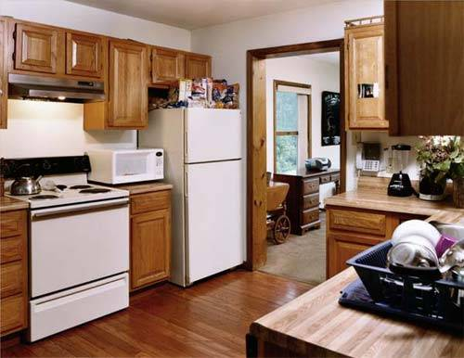
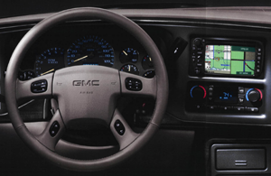
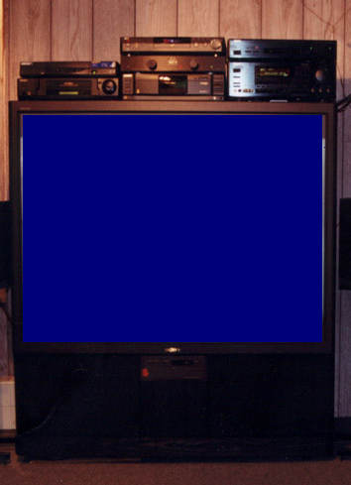
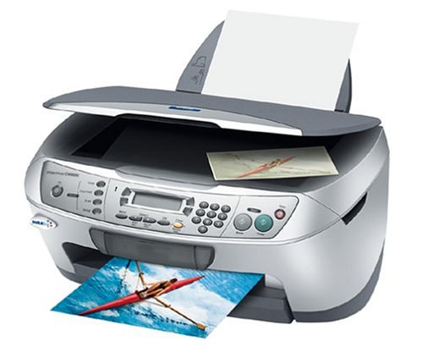
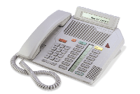
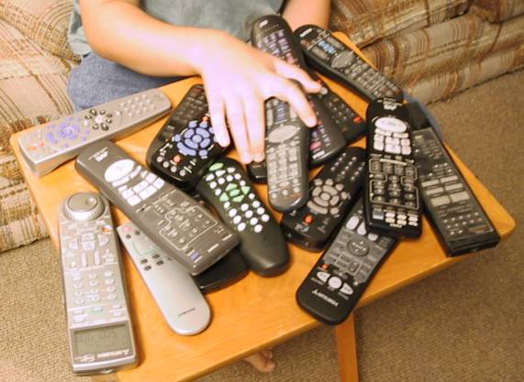
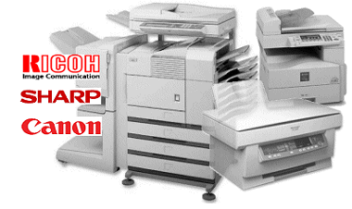
Motivation
Notes:
The number of computerized devices in our homes and offices are increasing

Slide 6
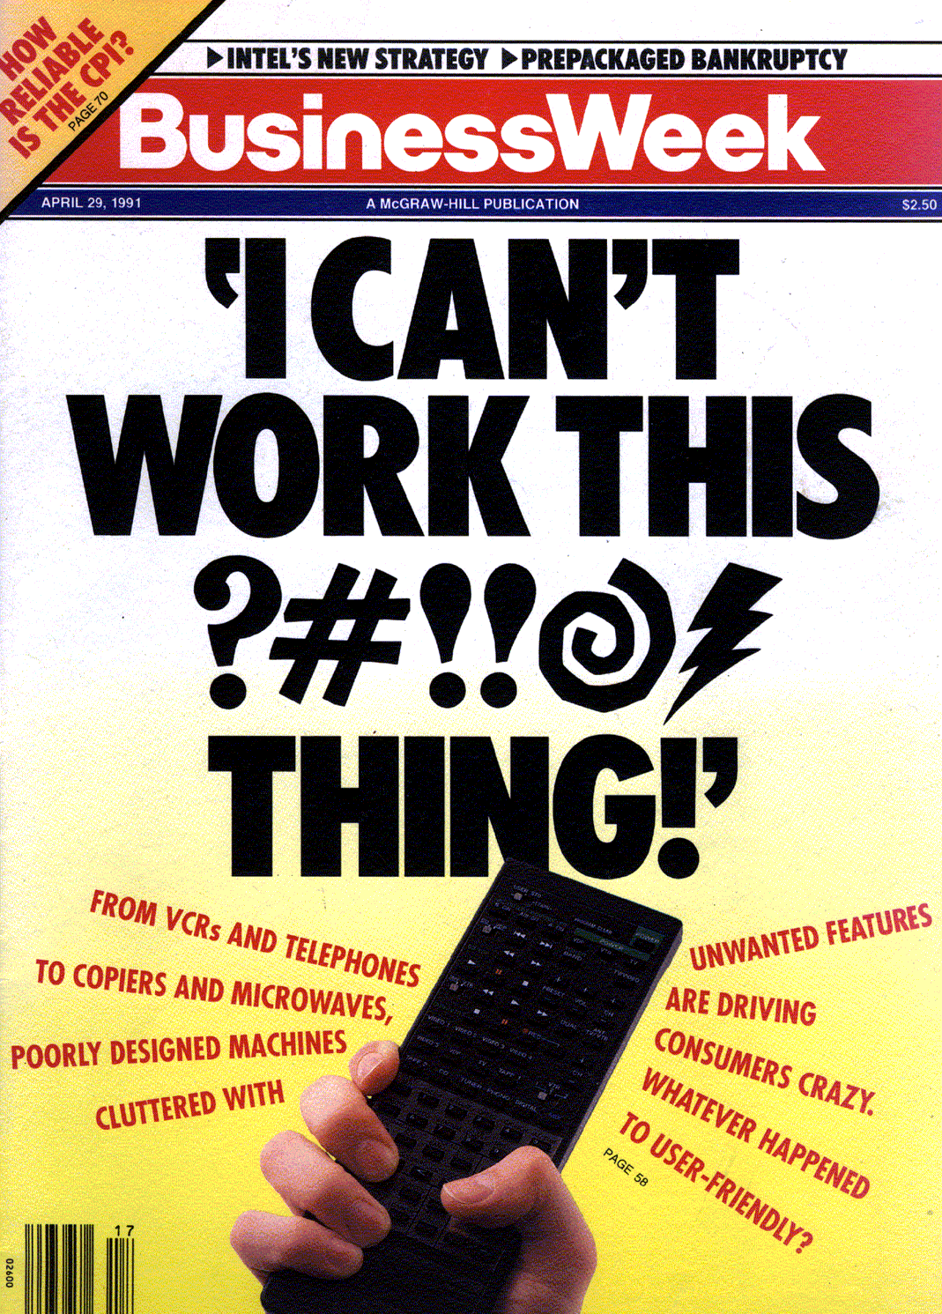
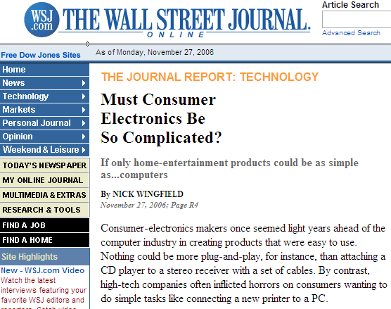
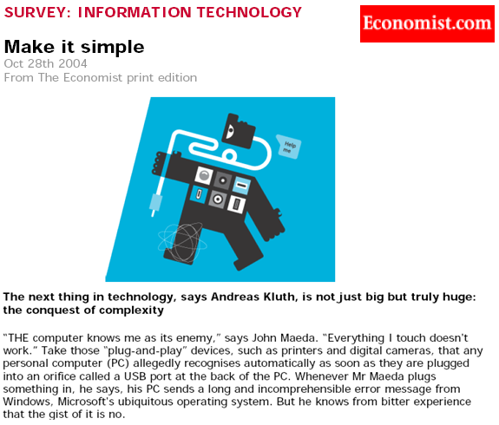
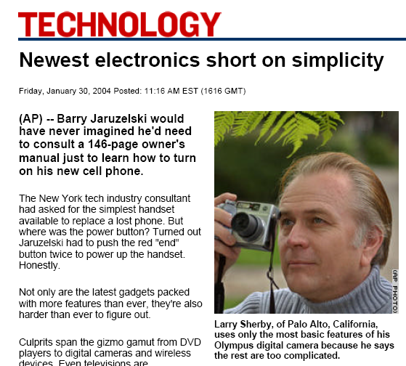
Motivation
Nov 27, 2006
Economist – Oct 2004
CNN – Jan 2004
April 29, 1991
Notes:
This has been a known problem for a long time, and it still hasn’t been solved. BusinessWeek is from 1991, and the popular press still seems to complain about the problem on a regular basis.
TODO: Put in article from WSJ

Slide 7
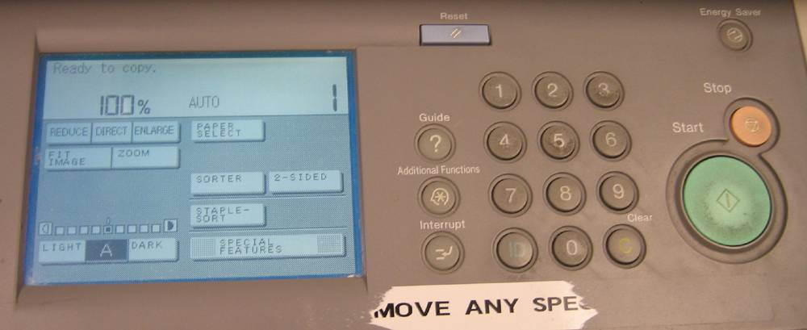
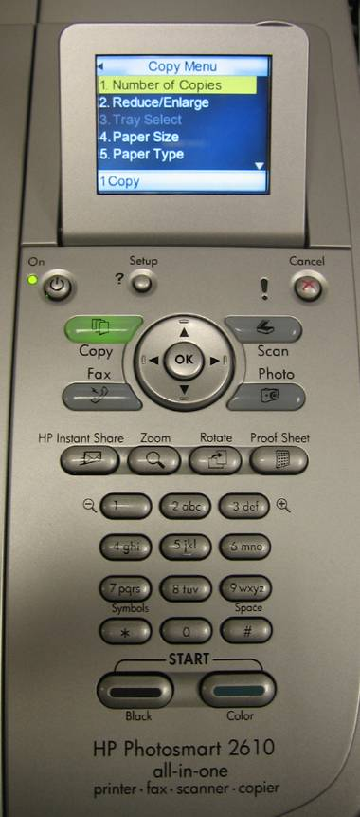
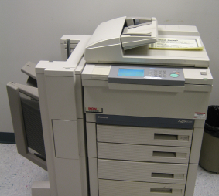
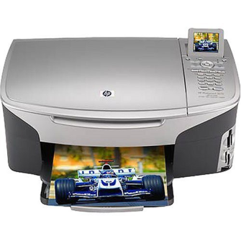
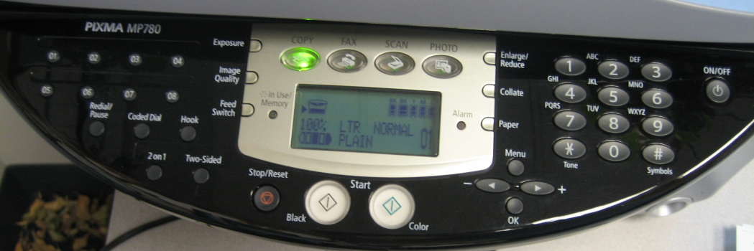
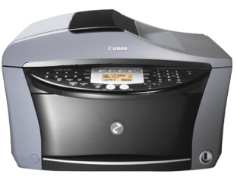
Inconsistent Interfaces

Slide 8
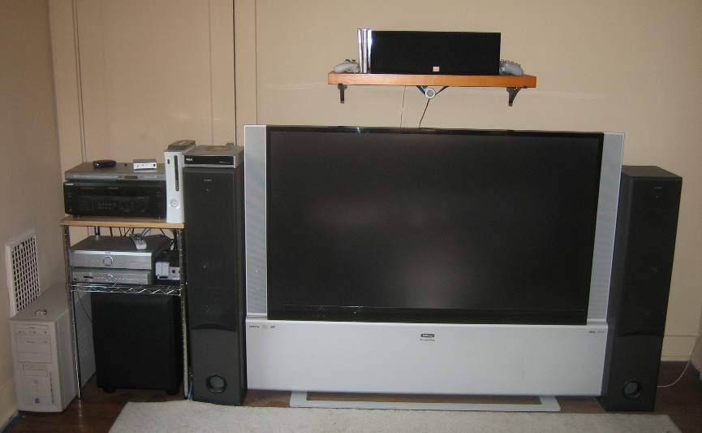
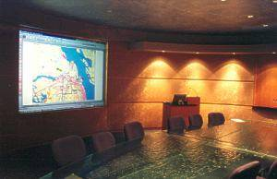
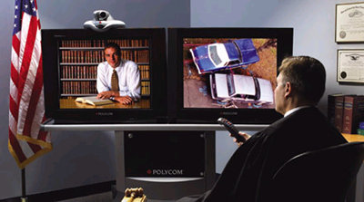
Multiple appliances used together
Notes:
Make a better title (devices are constituents)
Better image for video-conferencing

Slide 9
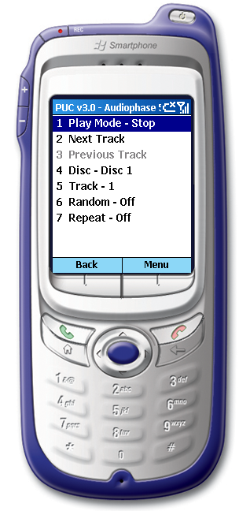
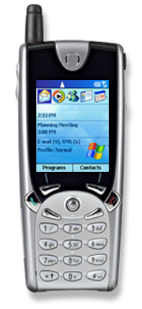
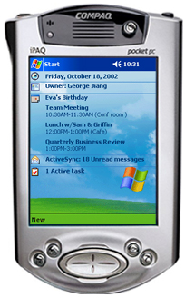
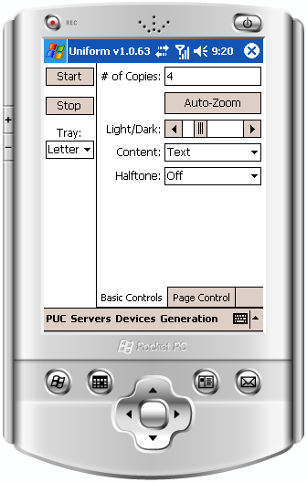

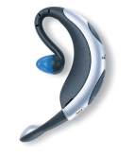
Approach: Move Interfaces to Mobile Devices
Common, cheap, and often have ability to communicate
203 million mobile phone subscribers (US)
75% always within reach of phone while awake
17.8 million smart phones and 3.65 million PDAs shipped in Q1’06
Notes:
TODO:
Instead of having these mobile devices be part of the problem, they could be part of the solution
Mention US (check the stats)

Slide 10
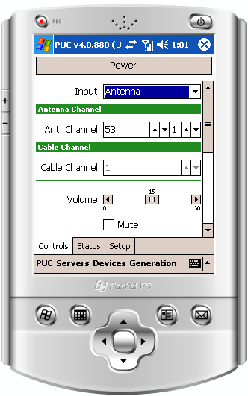
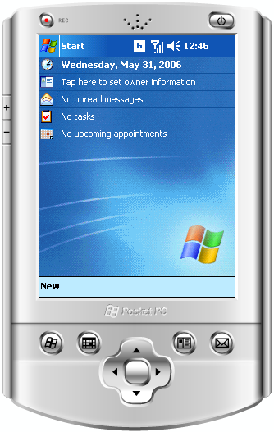
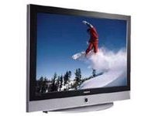


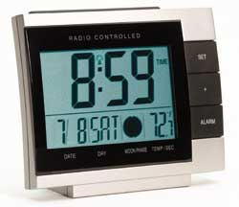
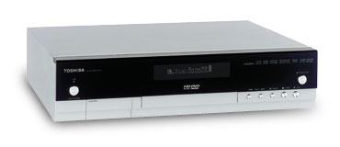
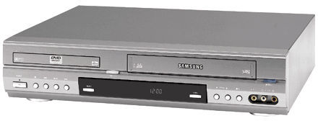
Personal Universal Controller
PUC
[Nichols, UIST 02]
Personal Mobile
Device
Automatically
Generated
Interface
Control
Abstract
Specification
State Feedback
Notes:
Say “PUC”
Should I bring the speech back sometime later
Put a reference here

Slide 11
Outline
Introduction
Basic Architecture
Uniform: Generating User Interfaces with Consistency
Huddle: Combining Interfaces from Multiple Appliances
Evaluation
Notes:
TODO:
Revise outline
Say PUC sooner than this?
This is not high-level enough
And I haven’t really made consistency a focus

Slide 12
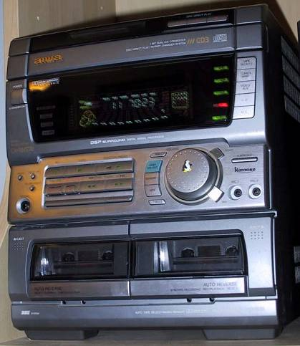
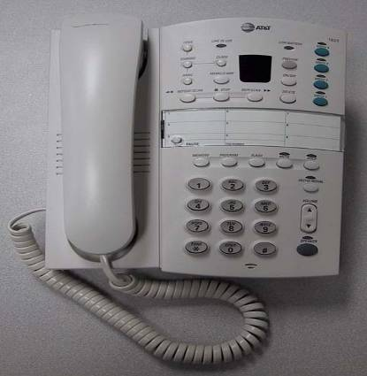
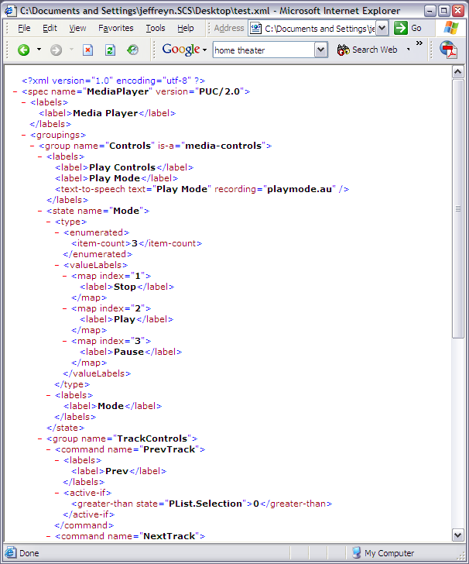
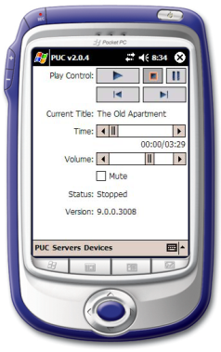
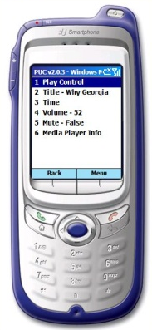
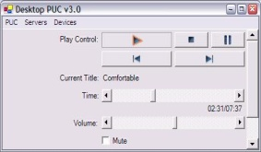
Overview
Started by exploring appliance user interfaces
  Created handheld interfaces for two appliances
  Found these interfaces to be better than manufacturers’ interfaces
  Analyzed the interfaces for functional information
Designed appliance specification language
  Support complete functionality of appliances
  No specific layout information
  Minimize work needed to write specification
Built interface generators
  Uses dependency information to infer structure of user interface
  Smart Templates allow rendering of high-level design conventions
Notes:
Say speech…certainly say more about it later
Move Smart Templates onto a slide by themselves (few points, more pictures)
Mention that the PUC is rule-based

Slide 13
Specification Language
Language
  Functional information
  XML-based
Elements
  State variables & commands
  Group tree
  Multiple labels per object
  Dependency information
Full documentation available at:
http://www.pebbles.hcii.cmu.edu/puc/
Notes:
Say why I don’t want the developers to tailor the UI to a particular interface generator
Maybe just talk about making the design process easier
Say something about how we’ve suceeded with the first goal
Maybe the last goal is not the same as “no specific information in the specification language”

Slide 14
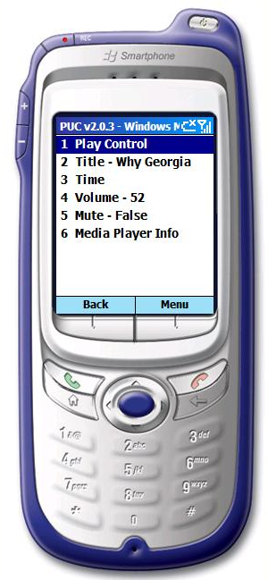

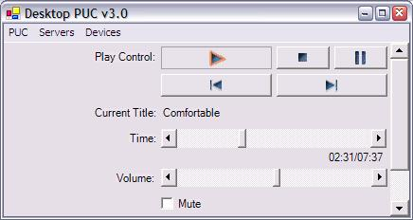
Interface Generation
Graphical Interface Generators
  Runs on today’s handheld devices
  .NET Compact Framework 2.0
Speech Interface Generator
  Masters work of Thomas Harris
  Built on top of the PUC framework
  Implemented using Universal Speech Interface (USI) techniques
  [Rosenfeld 2001]
Notes:
Say the graphical platforms

Slide 15
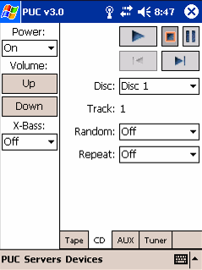
Dependency Information
Useful for determining structure of user interface
  Some groups are never available simultaneously
  Nondependent controls can be split into more accessible side-panels
  Mutually exclusive groups can be placed on overlapping panels
Improves usability and robustness of specification language
  Reduces emphasis on group tree for structuring interfaces
  Dependency information is objective
Notes:
Say that this is a new result
Emphasize that usefulness of dependency information is an important contribution
Decomposed
Maybe use a PUC-generated interface here

Slide 16
Outline
Introduction
Personal Universal Controller
Uniform: Generating User Interfaces with Consistency
Huddle: Combining Interfaces from Multiple Appliances
Evaluation
Discussion and Future Work
Notes:
TODO:
Revise outline
Say PUC sooner than this?
This is not high-level enough
And I haven’t really made consistency a focus

Slide 17
Problem
Users cannot transfer knowledge from previous interfaces!
We want interfaces to be personally consistent
Leverage previous work on consistency
  Loosely defined as “doing similar things in similar ways” [Reisner 90]
  “Common elements” theory of knowledge transfer applies to consistent interfaces [Polson 86, Polson 88]
    Steps to complete a task must be similar on each interface
    External cues must indicate to user that previous knowledge may apply
  Previous automatic generation systems have been able to achieve some consistency within an application or family of applications
    ITS [Wiecha 90], PUC [Nichols 02], and others…

Slide 18
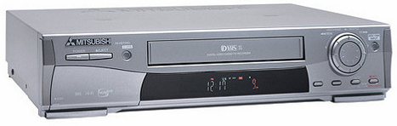
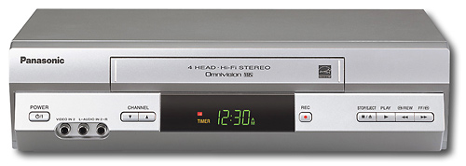
Specification Authoring Study
Study of Authoring Appliance Specifications
  How can specifications vary for different appliances with similar functions?
  How can specifications vary for different authors?
Two User Studies
  Study #1: An expert user (me!) wrote specs for
  three different VCRs
  Study #2: Three subjects wrote specifications
  for the same VCR
Results show that specifications can differ substantially, both functionally and structurally,
leading to inconsistent interfaces
High-End: Mitsubishi DVCR
Mid-Range: Samsung DVD-VCR
Low End: Panasonic VCR
What consistency issues arise in our domain?
Notes:
Since previous systems have relied on consistency of the model, we wanted to examine this with a study
Work on layout of this slide

Slide 19
How to achieve consistency?
Understand similarities between appliances
  Developed a language for describing mappings between specifications
    Six types of mappings based on results of authoring study
    XML-based
  Mappings may be automatically found or specified by users/manufacturers
  Knowledge base stores mappings in multiple mapping graphs
    Mapping graphs group similar functions together, store usage history and allow users to control system
  Function-based, not appliance-based
Apply knowledge of similarity to generate new interfaces taking into account previous interfaces

Slide 20
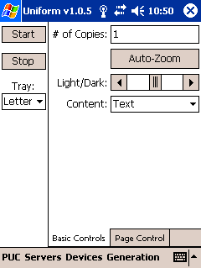
Uniform Architecture
PUC Appliance
Specification
Build Abstract Interface
Build Concrete Interface
Fix Layout Problems
User Interface
How do we modify an interface to achieve consistency?

Slide 21
Uniform Architecture
PUC Appliance
Specification
Build Abstract Interface
Previous Specifications
Functional Mappings Between Specifications
Previously Generated UIs
Build Concrete Interface
Fix Layout Problems
Knowledge Base
User Interface
How do we modify an interface to achieve consistency?

Slide 22
Uniform Architecture
PUC Appliance
Specification
Find Mappings
Build Abstract Interface
Modify Abstract Interface
Previous Specifications
Functional Mappings Between Specifications
Previously Generated UIs
Build Concrete Interface
Fix Layout Problems
Modify Concrete Interface
Knowledge Base
Personally Consistent
User Interface
How do we modify an interface to achieve consistency?

Slide 23
Modifying the Abstract Interface
Two parts:
  Functional modification
    Similar functions are assigned similar labels
    Similar functions are converted, if possible, to a consistent representation
  Abstract structural modification
    Similar functions are moved to similar groups
    Groups are reordered to match previous
Heuristics for unique functions
  Move unique functions only with their siblings
  Unique functions at the beginning or end of a group are not reordered
  Unique functions in the middle of a group follow their preceding sibling
How do we modify an interface to achieve consistency?

Slide 24
Moving
Base
Base
Base
Samsung DVD-VCR
Mitsubishi DVCR
Status
Setup
Clock
Channel
How do we modify an interface to achieve consistency?
Notes:
Two trees?

Slide 25
Moving
Base
Setup
Setup
Base
Base
Samsung DVD-VCR
Mitsubishi DVCR
Status
Setup
Clock
Channel
How do we modify an interface to achieve consistency?

Slide 26
Moving
Clock
Base
Clock
Setup
Status
Base
Base
Samsung DVD-VCR
Mitsubishi DVCR
Status
Setup
Clock
Channel
How do we modify an interface to achieve consistency?
Notes:
Make status background gray, or something

Slide 27
Moving
Clock
Base
Clock
Status
Setup
Status
Base
Base
Samsung DVD-VCR
Mitsubishi DVCR
Status
Setup
Clock
Channel
How do we modify an interface to achieve consistency?

Slide 28
Moving
Channel
Channel
Clock
Base
Channel
Status
Setup
Setup
Base
Base
Samsung DVD-VCR
Mitsubishi DVCR
Status
Setup
Clock
Channel
How do we modify an interface to achieve consistency?

Slide 29
Re-Ordering
How do we modify an interface to achieve consistency?

Slide 30
Re-Ordering
Timed Recordings for the Samsung DVD-VCR
When
Length
Type
Source
Channel
Speed
Conflict
Date
Time
Timed Recordings for the Mitsubishi DVCR
Conflict
VCR+
Channel
Day
Start
Stop
Speed
How do we modify an interface to achieve consistency?

Slide 31
Re-Ordering
Timed Recordings for the Samsung DVD-VCR
When
When
Type
Type
Channel
Channel
Speed
Speed
Conflict
Conflict
Timed Recordings for the Mitsubishi DVCR
Conflict
VCR+
Channel
When
Speed
How do we modify an interface to achieve consistency?
Notes:
Not easier, useful abstraction

Slide 32
Re-Ordering
Timed Recordings for the Samsung DVD-VCR
Conflict
Source
Channel
When
Length
Type
Speed
Date
Time
Timed Recordings for the Mitsubishi DVCR
Conflict
VCR+
Channel
Day
Start
Stop
Speed
How do we modify an interface to achieve consistency?

Slide 33
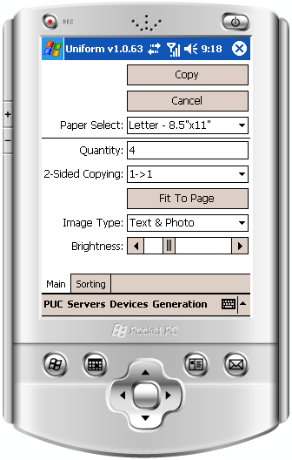
Uniform
Original (PUC) Interfaces
Copier A
Copier B
Notes:
Need to mention that consistency is designed to help user of first device use the second

Slide 34
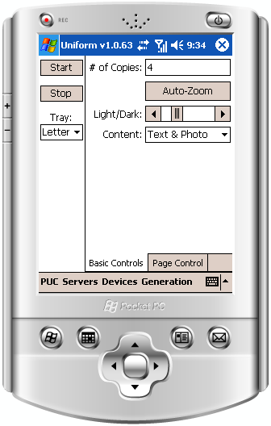
Uniform
Consistency enabled – Copier A used first
Original (PUC) Interfaces
Copier A
Original
Copier B
Copier B
Consistent Copier B
Notes:
Original interfaces
Definite “personally consistent” first, and then say that we’re doing this work on handhelds
We “personal consistency” so we need “personal” device (e.g. PUC)
Add one slide on the PUC with background

Slide 35
Outline
Introduction
Personal Universal Controller
Uniform: Generating User Interfaces with Consistency
Huddle: Combining Interfaces from Multiple Appliances
Evaluation
Discussion and Future Work
Notes:
TODO:
Revise outline
Say PUC sooner than this?
This is not high-level enough
And I haven’t really made consistency a focus

Slide 36
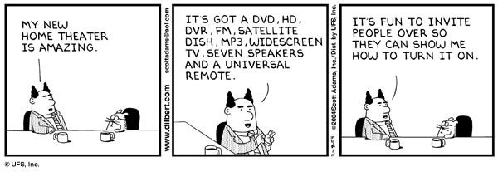
Multi-Appliance Interfaces
How can we address this problem?
  Generate task-based interfaces that span all appliances
  Need to know how appliances are used together
    … in a scalable way

Slide 37
Content Flow Model
Home Theater
DVD
Receiver
Broadcast
Television
TV
VCR #1
VCR #2
Notes:
Maybe I need to differentiate the content flow model from existing techniques

Slide 38
Modeling Tasks
Home Theater: Watching Television
DVD
Receiver
Broadcast
Television
TV
VCR #1
VCR #2

Slide 39
Modeling Tasks
Home Theater: Watching Television
DVD
Receiver
Broadcast
Television
TV
VCR #1
VCR #2

Slide 40
Modeling Tasks
Home Theater: Watching Television
DVD
Receiver
Broadcast
Television
TV
VCR #1
VCR #2

Slide 41
Modeling Tasks
Home Theater: Watch DVD
DVD
Receiver
Broadcast
Television
TV
VCR #1
VCR #2

Slide 42
Modeling Tasks
Home Theater: Watch DVD + Copy Tape
DVD
Receiver
Broadcast
Television
TV
VCR #1
VCR #2

Slide 43
Modeling Tasks
Presentation Room
VCR
PowerPoint
Projector
Laptop Task Manager
External Video Control
Media Player

Slide 44
Modeling Tasks
Presentation Room: Presenting PowerPoint
VCR
PowerPoint
Projector
Laptop Task Manager
External Video Control
Media Player

Slide 45
Where does the model come from?
DVD
Receiver
Broadcast
Television
TV
VCR #1
VCR #2
Notes:
Maybe I need to differentiate the content flow model from existing techniques

Slide 46
Where does the model come from?
DVD
Receiver
TV
VCR #1
VCR #2
Notes:
Maybe I need to differentiate the content flow model from existing techniques

Slide 47

Where does the model come from?
VCR #1
VCR #2
DVD
Receiver
TV
Notes:
Maybe I need to differentiate the content flow model from existing techniques

Slide 48
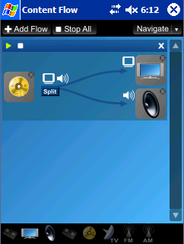
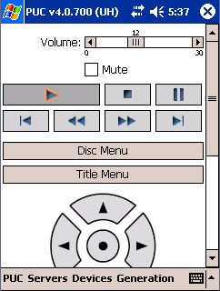
Interfaces From Content Flow
Flow-Based Interface
Aggregate User Interfaces

Slide 49
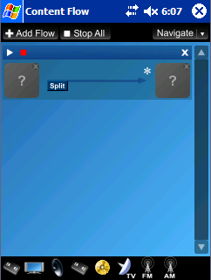
Flow-Based Interface

Slide 50
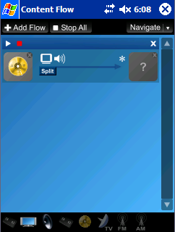
Flow-Based Interface

Slide 51

Flow-Based Interface

Slide 52

Flow-Based Interface

Slide 53

Flow-Based Interface

Slide 54

Flow-Based Interface

Slide 55

Flow-Based Interface

Slide 56
Flow-Based Interface

Slide 57
Aggregate User Interfaces
Allow users to manage low-level details
Three kinds:
  Control of active flows
  Setup of active flows
  General setup of all appliances
Also explored merging similar functions from all appliances into single controls
  E.g. one clock control sets all clocks on all appliances
Notes:
Describe the flow-based interface bullets during the demonstration
Maybe get rid of the details

Slide 58
Aggregate User Interfaces
Control of Active Flows
DVD
Receiver
Broadcast
Television
VCR #1
VCR #2
TV
Notes:
Say what aggregate interfaces are here (low-level etc)

Slide 59

Aggregate User Interfaces
Control of Active Flows
DVD
Receiver
Broadcast
Television
VCR #1
VCR #2
TV

Slide 60
Aggregate User Interfaces
Control of Active Flows
DVD
Receiver
Broadcast
Television
VCR #1
VCR #2
TV

Slide 61
Aggregate User Interfaces
Control of Active Flows
DVD
Receiver
Broadcast
Television
VCR #1
VCR #2
TV

Slide 62

Aggregate User Interfaces
Control of Active Flows
DVD
Receiver
Broadcast
Television
VCR #1
VCR #2
TV
Notes:
Scroll it up and show the TV controls

Slide 63

Aggregate User Interfaces
Setup of Active Flows
Two screens of “Watch DVD” setup

Slide 64

Aggregate User Interfaces
General Setup of all Appliances
Two screens of General Setup for the home theater config.
Notes:
Maybe take this out

Slide 65

Aggregate User Interfaces
Merged Functions
  Most functions shouldn’t be
  merged
  Some should:
    clock, language, sleep timer…
  Future work…
    Baudisch’s flat volume control
    General merging
Some merged functions

Slide 66
Outline
Introduction
Personal Universal Controller
Uniform: Generating User Interfaces with Consistency
Huddle: Combining Interfaces from Multiple Appliances
Evaluation
Discussion and Future Work
Notes:
TODO:
Revise outline
Say PUC sooner than this?
This is not high-level enough
And I haven’t really made consistency a focus

Slide 67
Evaluation
Dimensions
  Completeness
    What appliances can we write specifications for?
    What specifications can we generate interfaces for?
  Usability of Generated Interfaces
    How good are the generated interfaces?
  Usability of Specification Language
  Performance

Slide 68






Completeness
We have written 33 complete specifications for a wide variety of appliances
  Home theater appliances
    InFocus Television, VCRs, DVD players,
    Sony receiver, Audiophase shelf stereo,
    Sony camcorder, Windows Media Player
  Copiers, All-in-one printers
  Lighting controls (X10, Lutron, UPnP)
  AT&T telephone/answering machine
  Alarm clocks
  Elevator
  Desktop computer applications
    PowerPoint, Photo browser, To-do list
  In-vehicle systems for GMC Yukon Denali
    Driver Information Console, Climate Controls, Navigation System
PUC can generate interfaces for all of these specifications
Notes:
Complete functionality

Slide 69



















Completeness: Navigation Interface
Notes:
This interface is still pretty good
Show an interface generated for the phone

Slide 70



Usability
Evaluation of Generated Interfaces
  Users perform tasks with two all-in-one printer interfaces (HP and Canon)
  Two comparisons
    Physical interface to PUC interface
    Without consistency and with consistency
  48 participants (28 male, 20 female)
    Divided into 6 groups, 8 per group
    Recruited through CBDR web page
  Metrics
    Completion time
    Failures
HP printer
Canon printer

Slide 71
Interfaces
HP printer
without consistency
Canon printer
without consistency
Canon printer
consistent with HP

Slide 72



Interfaces – Full View
HP printer
Consistent Canon printer
Canon printer

Slide 73
Procedure
Subject performs all 8 tasks on appliance #1 (HP or Canon)
  Five minutes maximum allowed for each task
Subject is instructed on the optimal way to perform each task
  Subject performs the task again until completed correctly.
  Additional instruction given as necessary
Subject performs all 8 tasks on appliance #2 (Canon or HP)

Slide 74
Three Interface Conditions
Built-In
  User sees only physical appliance interfaces
  Physical HP → Physical Canon
  Physical Canon → Physical HP
AutoGen
  User sees only PUC interfaces without consistency
  PUC HP → PUC Canon
  PUC Canon → PUC HP
Consistent
  User sees a PUC interface without consistency followed by a Uniform interface generated to be consistent with the previous PUC interface
  PUC HP → Uniform Canon generated to be consistent with HP
  PUC Canon → Uniform HP generated to be consistent with Canon

Slide 75
Conditions
3 interface conditions * 2 appliance orderings = 6 groups
 | #1 - HP | #2 - Canon
Built-In | Physical | Physical
AutoGen | PUC | PUC
Consistent | PUC | Uniform
 | #1 - Canon | #2 - HP
Built-In | Physical | Physical
AutoGen | PUC | PUC
Consistent | PUC | Uniform

Slide 76




Comparing Usability
Focus primarily on the first set of tasks
First set not affected by earlier tasks or instruction
 | #1 - HP | #2 - Canon
Built-In | Physical | Physical
AutoGen | PUC | PUC
Consistent | PUC | Uniform
 | #1 - Canon | #2 - HP
Built-In | Physical | Physical
AutoGen | PUC | PUC
Consistent | PUC | Uniform

Slide 77

Usability Results
 | #1 - HP | #2 - Canon
Built-In | Physical | Physical
AutoGen | PUC | PUC
Consistent | PUC | Uniform
 | #1 - Canon | #2 - HP
Built-In | Physical | Physical
AutoGen | PUC | PUC
Consistent | PUC | Uniform
*
*
*
†
*
*
*
*
*
*
†
Failures per subject also significantly less for PUC than Physical
(Fisher’s Exact Test, p < 0.05)
  HP: 1.125 Built-In vs. 0.125 PUC
  Canon: 2.0 Built-In vs. 0.625 PUC
*
*
* = p < 0.05
† = p < 0.1

Slide 78




Comparing Consistency
Focus only on the second set of tasks
Previous experience during study should influence results
 | #1 - HP | #2 - Canon
Built-In | Physical | Physical
AutoGen | PUC | PUC
Consistent | PUC | Uniform
 | #1 - Canon | #2 - HP
Built-In | Physical | Physical
AutoGen | PUC | PUC
Consistent | PUC | Uniform

Slide 79

Consistency Results
 | #1 - HP | #2 - Canon
Built-In | Physical | Physical
AutoGen | PUC | PUC
Consistent | PUC | Uniform
 | #1 - Canon | #2 - HP
Built-In | Physical | Physical
AutoGen | PUC | PUC
Consistent | PUC | Uniform
*
*
†
*
*
†
Very few failures in these conditions: 4 total for all tasks performed by 32 subjects (256 tasks, 1.5% failure rate)
*
*
* = p < 0.05
† = p < 0.1

Slide 80
Questions about the PUC?

Slide 81
Highlight:
Mobilizing Existing Web Sites
Jeffrey Nichols
IBM Research - Almaden
November 11, 2009 – Google

Slide 82



Mobile Internet
Notes:
Although the mobile internet has been around for awhile, it’s recently gotten a lot of attention and interest. Device manufacturers and content providers are beginning to figure out how to create experiences that are attractive to consumers, networks are reaching reasonable speeds and beginning to mature, and the cost of accessing the internet from a mobile device is becoming more acceptable to typical consumers.

Slide 83
Accessing the Mobile Web
Site designed for mobile use
  Designed for low-end devices
  Limited functionality chosen by designer
  Costly to create
    Only available for popular, consumer sites
Normal site through a mobile viewport
  Most functionality of existing site
  Greater costs of navigation
    Many items per page
    More pages than needed
Notes:
Designer of a mobile site will optimize for some mobile device and some set of functionality, but that may not match the needs of all users

Slide 84

Previous Work: Transcoding
Traditional proxy server techniques
  Mostly automated
    www.skweezer.com
    mobile google search
  Quality of result varies based on site
  Often includes all content of a page
Doesn’t work with AJAX/dynamic JavaScript sites

Slide 85
Goals
Allow end users to create their own mobile “applications” for particular tasks
  No programming required
  Possible for any existing site
  All design decisions made by users
Allow programmers to extend capabilities of mobile applications
Notes:
Low floor/high ceiling

Slide 86




Highlight
mobile app designer
(browser extension)
user
web
server
mobile user
web server
proxy browser
proxy server

Slide 87
Overview
Introduction
Creating a mobile application
Deploying a mobile application
Evaluation
Conclusion

Slide 88


AA.com – Flight Tracking

Slide 89


AA.com – Flight Tracking

Slide 90






amazon.com – Buy one item
Notes:
Need to think about whether there is a better example to use here

Slide 91

amazon.com – Buy one item
Notes:
Need to think about whether there is a better example to use here

Slide 92

amazon.com – Buy one item
Notes:
Need to think about whether there is a better example to use here

Slide 93

amazon.com – Buy one item
Notes:
Need to think about whether there is a better example to use here

Slide 94

amazon.com – Buy one item
Notes:
Need to think about whether there is a better example to use here

Slide 95

amazon.com – Buy one item
Notes:
Need to think about whether there is a better example to use here

Slide 96
How do end users create applications?
Highlight Designer
  Built into Firefox web browser
  Allows user to demonstrate a “trace” of interaction
  Direct manipulation tools
  Generalization allows creation of mobile apps with complex structure

Slide 97
Highlight Designer
Storyboard View
Sidebar
Main Browser Area
Toolbar
Preview Browser

Slide 98
http://www.youtube.com/watch?v=1H1wIIbXtec

Slide 99

Creating complex structures
Additional traces allow for:
  Branching
  Looping
  Generalization

Slide 100
Some Supported Page Structures
Query/results/detail
Multiple result pages
Diverge/converge
Query/error/result
Query/results/detail
Multiple result pages
Diverge/converge
Query/error/result

Slide 101
Ceiling on End User Authoring
Complex page manipulations
Sites with Ajax/dynamic JavaScript
Adding new functionality
Mashing up multiple sites

Slide 102
Highlight
mobile app designer
(browser extension)
user
web
server
mobile user
web server
proxy browser
proxy server

Slide 103
Highlight Server Architecture
mobile application
description
web
server
mobile user
web server
proxy browser
proxy server

Slide 104



Remote Control Metaphor

Slide 105

Remote Control Metaphor
144

Slide 106


Remote Control Metaphor
144

Slide 107


Remote Control Metaphor

Slide 108
Remote Control Metaphor Discussion
Benefits
Drawbacks
No need to understand underlying code or describe application with complex models
Working at the interactive level lets authors work with what they can “see.”
Possible for end users, extensible by programmers
If easy enough, allows users to create user interfaces that reflect their own needs and abilities
Always running original interface in the background
Constrained by original design
How to communicate those constraints to the author?

Slide 109



Implementation
mobile users
proxy server
web servers

Slide 110

CoScripter
A Wikipedia-style approach to crowdsourcing task traces

Slide 111


CoScripter:
Capture & Reuse Web Tasks
Employees in large enterprises
need to share “how-to” knowledge
This knowledge is typically kept
by a few knowledge hubs
The CoScripter approach:
  Capture web tasks by watching
  people do them
  Automate repetitive tasks to save time
  Use a natural-language scripting
  language for understandability
[Leshed et al, CoScripter: Automating & Sharing
How-To Knowledge in the Enterprise, CHI 2008]

Slide 112
https://www.youtube.com/edit?o=U&video_id=44j8qB-DXEA

Slide 113


CoScripter Key Features
Browser extension for recording and playback
Wiki for storing, sharing, and collaboratively improving scripts
Personal database allows use of sensitive information within scripts without sharing that information

Slide 114

CoScripter Adoption
Deployed inside IBM since Oct 2006
  ~4200 users, ~3500 scripts
Deployed on public internet 2007-2012
  ~13300 users, ~16,000 scripts
Interviews and analysis shows
it addresses pain points
  IBMers use it to automate
  repetitive tasks and share
  process knowledge with each
  other
# scripts
Time

Slide 115
Conclusions
CoScripter provides an inexpensive and lightweight method to adapt existing interfaces
Allows a crowd of users to produce a knowledge base of important interaction traces
Resulting knowledge base could be used for many purposes
  Re-authoring user interfaces for different user groups
  Generating models?

Slide 116
CoCo

Slide 117
The CoCo research vision
Explore the use of conversational user interfaces to web tasks
Design and build intelligent agents that:
  Interact with the web on a user's behalf
  Converse with the user to clarify meaning
  Learn new knowledge over time
  Are personalized for a user's needs
Goal: improve user productivity and increase access to information technology through simpler interfaces
Notes:
JAC: I upped the “Interact” bullet. I think the original ordering is the “systems ordering” on how thing happens, but this new ordering is more natural in understanding what we're doing. The most important fact, that it executes tasks, is on top, and then the clarification is, of course, on which task, etc. I felt it was a bit awkward to point out to the clarification before stating what would Coco need clarification for
TL: That's great. My first version had it at the top too.

Slide 118
Not shown in the talk, but instructive (ACM DL access required):
http://dl.acm.org/ft_gateway.cfm?id=1866067&type=swf

Slide 119




Alice: punch out 17 30
CoCo: Extracted this script from your logs:
Go to timecard.com/cocompany, enter your
password into the textbox, click Go...
Run it?
Alice: yes
CoCo: I don't know what “password” to use
Alice: punch out 17 30 using alice00 as password
CoCo: I will run your script using params
password=alice00
CoCo: 17:30 Exit

Slide 120










CoScripter
Highlight
...
scripts
clips
CRH
(browser logs)
Task knowledge
Web automation

Slide 121
Two paths to determining process:
Automatic
  System finds existing script in database or infers script from web history
  Content is clipped based on heuristics matching original command
Manual
  User creates a script in CoScripter
  Specifies parameters as “personal database” values
  Specifies “clip” commands to return information

Slide 122
Conclusions
Relatively simple understanding is used to facilitate substantial changes to the UI
CoCo leverages crowd-generated scripts. Highlight could have leveraged crowd similar to CoScripter
Models are used to facilitate
re-authoring, but not using a typical approach
More robust underlying models could lead to more robust results

Slide 123
More CoScripter Fun…

Slide 124
A Few Other CoScripter Projects…
PlayByPlay
Vegemite
CoScripter Reusable History (ActionShot)

Slide 125
Thanks!
jeff@jeffreynichols.com
http://www.jeffreynichols.com/

Slide 126
From Automated Interface Generation to End-User Programming
Jeffrey Nichols
http://www.jeffreynichols.com/
jeff@jeffreynichols.com
05-830 – Advanced User Interface Software
April 25, 2017
Notes:
Add SCS

Slide 128





Summary of Contributions
Designed an abstract appliance specification language
  Can describe the complete functionality of appliances
  Easy to learn and use
Built interface generators for multiple platforms and modalities
  Use of dependencies to understand interface structure
  Smart Templates technique for rendering design conventions
  Generates usable interfaces for complex specifications
Generation of personally consistent interfaces
  Means of describing similar functions across appliances
  Algorithms for modifying interfaces to achieve consistency and allowing user control
  Improves usability for users with related experience
Generation of combined interfaces for multiple appliances
  Uses content-flow model to understand tasks across multiple connected appliances
  Flow-based interface allows easy specification of high-level tasks
  Task-specific aggregate interfaces can be generated based on content flows
Notes:
Be sure to note the contributions

Slide 129
Tasks
Send a fax to the number stored in the third speed dial
Configure the fax function so that it will always redial a number that is busy
Configure the fax function so that any document received that is larger than the default paper size will be resized to fit the default
Configure the fax function so that it will only print out an error report when it has a problem receiving a fax
Make two black-and-white copies of the document that has already been placed on the scanner of the printer
Imagine you find the copies too dark. Improve this by changing one setting of the device
Given a page with a picture, determine how to produce one page with several instances of the same picture repeated (demonstrated with actual paper copies)
The device remembers the current date and time. Determine where in the interface these values can be changed (do not change them)

Slide 130
Modifying the Concrete Interface
Address visual inconsistency problems
  Side panels may have different orientations
Re-ordering within panels
  Flattening of abstract hierarchy into panels sometimes creates ordering inconsistencies
Concrete organization decisions
  Different organization may have been used from the abstract interface
How do we modify an interface to achieve consistency?
Notes:
Make this simpler

Slide 131







Complex Phone Interface
a.
b.
c.
d.
e.
f.
g.

Slide 132



Flow-Based Interface

