Slide 1
Lecture 21:
Human-Centered Methods for Improving Programming Tools
Brad Myers
05-830
Advanced User Interface Software
Spring, 2017

Slide 2
Human Centered Approaches?
Concerned with everything the user encounters
  Functionality & Usefulness
  Content
  Labels
  Presentation
  Layout
  Navigation
  Speed of response
  Emotional Impact
  Context (social environment in which use happens)
  Documentation & Help
Measures:
  Learnability, Productivity, Errors, …
Some aspects of this topic covered in Lecture 1
  Focus on new material here

Slide 3
What Can Be Addressed?
Everything the developer encounters
Tools – IDEs & their user interfaces
Languages themselves
  Not necessarily just “taste”, “intuition”
  Error-proneness
APIs (see last lecture)
Documentation for all of the above
Processes & context of development
Consider the whole “system” together
New as well as legacy systems

Slide 4
“Human Centered Approaches” ̶̶
More Than Lab User Studies
Design & aesthetics matter & will affect:
  User’s performance
  Errors
  Adoption of your tool
Many different methods for answering many different questions
  Before design time
  During design & implementation
  After implementation

Slide 5
Human Centered Approaches are
Not Too Difficult for You
Getting some user data better than none
Observing real usage reveals many opportunities
  Insights about new issues to address, not necessarily what originally planned
    Thomas LaToza’s Reachability Questions from Architecture study
    Jeff Stylos’s method placement result from study of class size: from 2.4 to 11.2 times faster
  server.send ( message ) vs.
  mail.send ( server )
Collaborating with Graphic Designers for even a short time can provide significant improvements in aesthetics

Slide 6
Key Decision: What is Your Question?
What do you need to find out or show?
  What claim to do you want to make?
Showing that a tool is usable is different from
whether it is useful
Exploring what people are doing, is different from determining how often an observed behavior happens
CS research claim is often: “it can be done”
Drives what type of method to use, and
tasks to be done with it

Slide 7
Goal: Gentle Slope Systems
High
Ceiling
Web Development
Java
Visual Basic
Flash
Server-side
Swing
C Programming
C or C# Programming
Difficulty
of
Use
JavaScript
ActionScript
CSS & HTML
Goal
Low
Threshold
Basic
Email
Filters
editor
Program Complexity and Sophistication
Notes:
Wide Walls = Mitch Resnick

Slide 8
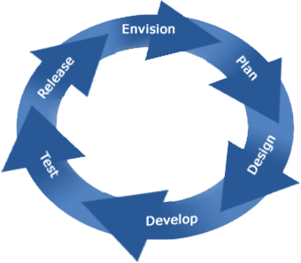
Product Lifecycle
Source: http://www.accordtech.co.in/Product%20Development%20Lifecycle.htm

Slide 9
Product Lifecycle
Exploratory Studies
  Contextual Inquiries
  Interviews
  Surveys
  Lab Studies
  Corpus data mining
Field Studies
  Logs & error reports
Evaluative Studies
  Expert analyses
  Usability Evaluation
  Formal A/B Lab Testing
Design Practices
  “Natural programming”
  Graphic & Interaction Design
  Prototyping

Slide 10
Exploratory Studies
Exploratory Studies
  Contextual Inquiries
  Interviews
  Surveys
  Lab Studies
  Corpus data mining
Identify what is really happening
Discover important problems
Quantify need

Slide 11
Contextual Inquiry
Beyer, H. and Holtzblatt, K., Contextual Design: Defining Custom-Centered Systems. 1998, San Francisco, CA: Morgan Kaufmann Publishers, Inc.
A kind of “ethnographic” or “participatory design” method
Watch developers while they are performing their real tasks
Objective, concrete data about real activities
May be followed by a survey, to establish generality of the issues
Notes:
In contrast to just the researcher’s intuition, or what the technology lets you create

Slide 12
Why Contextual Inquiry?
Usually reveals many barriers and problems in current practice
Helps develop insights
  Be open to inspiration
Not for confirming what you already know
Qualitative data (not quantitative)
  CIs are not for gathering statistics, analytics
    In contrast to surveys & lab studies
But need to be able to observe real tasks

Slide 13
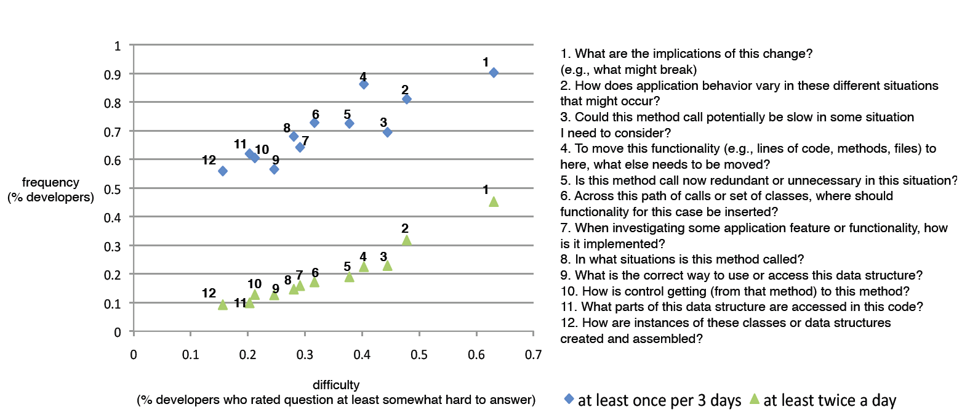
Example of Contextual Inquiry & Surveys
“Developers Ask Reachability Questions”
  Thomas D. LaToza and Brad Myers, ICSE'2010, Cape Town, South Africa, 2-8 May 2010. pp. 185-194.
  “Search across feasible paths through a program for target statements matching search criteria”
    Watched 17 developers investigating unfamiliar code
    Also surveyed 460
    developers
    Over 100 other
    hard-to-answer
    questions

Slide 14
Many hard-to-answer questions about code
(PLATEAU'2010)
Rationale (42)
Testing (20)
Type relationships (15)
History (23)
Why was it done this way? (14) [15][7]
Why wasn’t it done this other way? (15)
Was this intentional, accidental, or a hack? (9)[15]
How did this ever work? (4)
Is this code correct? (6) [15]
How can I test this code or functionality? (9)
Is this tested? (3)
Is the test or code responsible for this test failure? (1)
Is the documentation wrong, or is the code wrong? (1)
What are the composition, ownership, or usage relationships of this type? (5) [24]
What is this type’s type hierarchy? (4) [24]
What implements this interface? (4) [24]
Where is this method overridden? (2)
When, how, by whom, and why was this code changed or inserted? (13)[7]
What else changed when this code was changed or inserted? (2)
How has it changed over time? (4)[7]
Has this code always been this way? (2)
What recent changes have been made? (1)[15][7]
Have changes in another branch been integrated into this branch? (1)
Debugging (26)
Implementing (19)
Data flow (14)
How did this runtime state occur? (12) [15]
What runtime state changed when this executed? (2)
Where was this variable last changed? (1)
How is this object different from that object? (1)
Why didn’t this happen? (3)
How do I debug this bug in this environment? (3)
In what circumstances does this bug occur? (3) [15]
Which team’s component caused this bug? (1)
How do I implement this (8), given this constraint (2)? (10)
Which function or object should I pick? (2)
What’s the best design for implementing this? (7)
What is the original source of this data? (2) [15]
What code directly or indirectly uses this data? (5)
Where is the data referenced by this variable modified? (2)
Where can this global variable be changed? (1)
Where is this data structure used (1) for this purpose (1)? (2) [24]
What parts of this data structure are modified by this code? (1) [24]
What resources is this code using? (1)
Concurrency (9)
Control flow (19)
What threads reach this code (4) or data structure (2)? (6)
Is this class or method thread-safe? (2)
What members of this class does this lock protect? (1)
In what situations or user scenarios is this called? (3) [15][24]
What parameter values does each situation pass to this method? (1)
What parameter values could lead to this case? (1)
What are the possible actual methods called by dynamic dispatch here? (6)
How do calls flow across process boundaries? (1)
How many recursive calls happen during this operation? (1)
Is this method or code path called frequently, or is it dead? (4)
What throws this exception? (1)
What is catching this exception? (1)
Dependencies (5)
Location (13)
What depends on this code or design decision? (4)[7]
What does this code depend on? (1)
Intent and Implementation (32)
Where is this functionality implemented? (5) [24]
Is this functionality already implemented? (5) [15]
Where is this defined? (3)
Method properties (2)
What is the intent of this code? (12) [15]
What does this do (6) in this case (10)? (16) [24]
How does it implement this behavior? (4) [24]
Building and branching (11)
How big is this code? (1)
How overloaded are the parameters to this function? (1)
Contracts (17)
Should I branch or code against the main branch? (1)
How can I move this code to this branch? (1)
What do I need to include to build this? (3)
What includes are unnecessary? (2)
How do I build this without doing a full build? (1)
Why did the build break? (2)[59]
Which preprocessor definitions were active when this was built? (1)
Teammates (16)
Refactoring (25)
What assumptions about preconditions does this code make? (5)
What assumptions about pre(3)/post(2)conditions can be made?
What exceptions or errors can this method generate? (2)
What are the constraints on or normal values of this variable? (2)
What is the correct order for calling these methods or initializing these objects? (2)
What is responsible for updating this field? (1)
Who is the owner or expert for this code? (3)[7]
How do I convince my teammates to do this the “right way”? (12)
Did my teammates do this? (1)
Is there functionality or code that could be refactored? (4)
Is the existing design a good design? (2)
Is it possible to refactor this? (9)
How can I refactor this (2) without breaking existing users(7)? (9)
Should I refactor this? (1)
Are the benefits of this refactoring worth the time investment? (3)
Policies (15)
Architecture (11)
What is the policy for doing this? (10) [24]
Is this the correct policy for doing this? (2) [15]
How is the allocation lifetime of this object maintained? (3)
Performance (16)
How does this code interact with libraries? (4)
What is the architecture of the code base? (3)
How is this functionality organized into layers? (1)
Is our API understandable and flexible? (3)
What is the performance of this code (5) on a large, real dataset (3)? (8)
Which part of this code takes the most time? (4)
Can this method have high stack consumption from recursion? (1)
How big is this in memory? (2)
How many of these objects get created? (1)
Implications (21)
What are the implications of this change for (5) API clients (5), security (3), concurrency (3), performance (2), platforms (1), tests (1), or obfuscation (1)? (21) [15][24]

Slide 15
Many opportunities for better tools
Of all the reported questions
  34% addressed by commercial tools
  25% addressed by research tools
  41% unaddressed by any tools

Slide 16
Example of Interviews: Immutability
Michael Coblenz, Joshua Sunshine, Jonathan Aldrich, Brad Myers, Sam Weber, Forrest Shull, "Exploring Language Support for Immutability" ICSE'2016. pp. 736-747.
Experts recommend making classes immutable so instances cannot change accidentally
  Thread safe, more secure, no unexpected state changes, etc.
Usability studies suggest programmers prefer classes that can change
Various relevant language features
  C++ const, Java final, Obj-C immutable collections, .NET Freezable, etc.
Semi-structured interviews with a convenience sample of 8 software engineers
  Agreed that mutability is a frequent source of bugs
  But none of these features are what is needed
  Preferred transitive, class-based immutability
    Provide this in the Glacier tool

Slide 17
Exploratory Lab Studies
To understand what is happening
More controlled than field studies
  Can compare multiple people on same tasks
Example: studying Eclipse for maintenance tasks
  Andrew J. Ko, Htet Htet Aung, and Brad A. Myers. "Eliciting Design Requirements for Maintenance-Oriented IDEs: A Detailed Study of Corrective and Perfective Maintenance Tasks". ICSE’2005. pp. 126-135. Winner, Distinguished Paper Award.
  Detailed study of fixing bugs and adding features
  Dataset used for 3 different award-winning papers: interruptions, navigation, code editing behaviors
Interactive Bottleneck | Overall Cost
Navigating to fragment in same file (via scrolling) | ~ 11 minutes
Navigating to fragment in different file (via tabs and explorer) | ~ 7 minutes
Recovering working set after returning to a task | ~ 1 minute
Total Costs | ~19 minutes
=35%

Slide 18
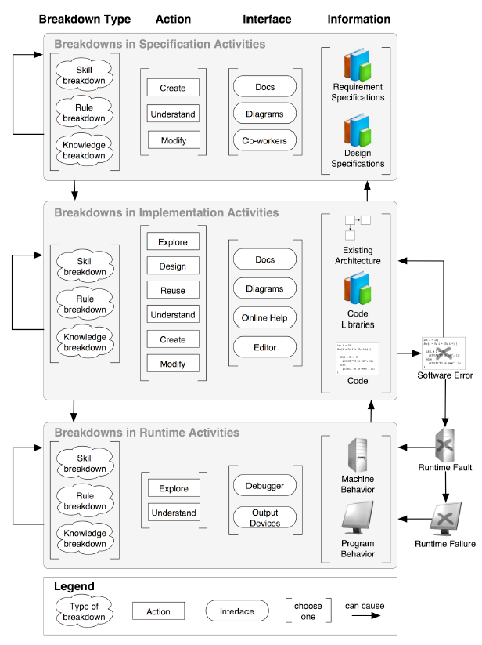
Can Create “Models” from Results
Explanations of observed behaviors
Idealized, but based on real data
Example: causes of breakdowns when trying to debug
  Today, users must guess where bug is or where to look & are often wrong
  Andrew J. Ko and Brad A. Myers. "Development and Evaluation of a Model of Programming Errors". 2003. IEEE Symposium on End-User and Domain-Specific Programming (EUP'03), part of the IEEE Symposia on Human-Centric Computing Languages and Environments (HCC'03). October 28-31, 2003. Auckland, New Zealand. pp. 7-14.

Slide 19
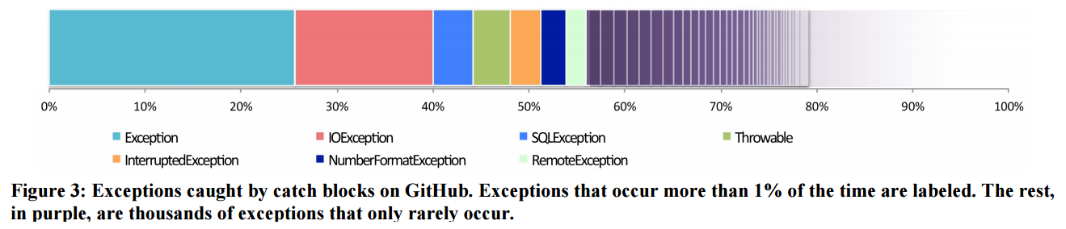
Corpus Data Mining
Mary Beth Kery, Claire Le Goues, Brad A. Myers, "Examining Programmer Practices for Locally Handling Exceptions", Proceedings of the 13th International Conference on Mining Software Repositories (MSR'2016) Mining Challenge Track, Austin, TX, USA, 14-15 May, 2016. pp. 484-487. ACM DL or local pdf.
Studied 11 million Java try/catch blocks from GitHub using Boa tool
12% of catch blocks were completely empty.
25% of all exceptions caught are simply Exception
Motivated a new tool to help programmers write better exception handling code

Slide 20
Editor Log study
YoungSeok Yoon and Brad A. Myers, "A Longitudinal Study of Programmers’ Backtracking," 2014 IEEE Symposium on Visual Languages and Human-Centric Computing (VL/HCC'14),Melbourne, Australia, 28 July - 1 August 2014. pp. 101-108. local pdf
For example, we wondered how often developers backtrack (return code to a previous state) while editing code, possibly by using the editor’s undo command. So, we analyzed 1,460 hours of fine-grained code-editing logs from 21 developers. We detected 15,095 backtracking instances, for an average rate of 10.3 per hour. This motivated us to create Azurite, an Eclipse plug-in that provides more flexible selective undo, in which developers can undo past edits without necessarily undoing more recent ones.11

Slide 21
Design Methods
Now know the problem, what is the solution?
How do I design it so it is attractive and effective?
Design Practices
  “Natural programming”
  Graphic & Interaction Design
  Prototyping

Slide 22
Natural Programming Elicitation
Technique developed by my group to elicit developer’s “natural” expressions
  Mental models of tasks, vocabulary, etc.
When want design to be easily learned by novices
But biased by what they already know
  Graphic designers will think PhotoShop is “natural”
  Programmers will think Java is “natural”
(Introduced in previous lecture)

Slide 23
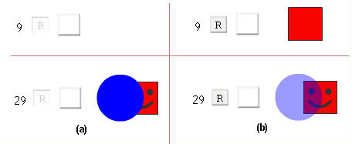
Interactive Behaviors for the Web
Brad Myers, Sunyoung Park, Yoko Nakano, Greg Mueller, Andrew Ko, "How Designers Design and Program Interactive Behaviors," 2008 IEEE Symposium on Visual Languages and Human-Centric Computing, VL/HCC'08. Sept 15-18, 2008, Herrsching am Ammersee, Germany. pp. 177-184. pdf. See also the original survey.
Natural Programming elicitation
Studied natural expression for interactive behaviors & animations
Before and after pictures
of primitives of
interactive behaviors
More use of constraints
Consistent wording -- “appears”,
“fades out”

Slide 24

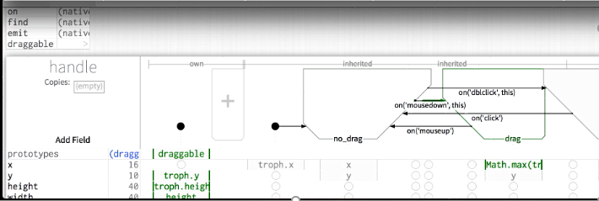
Graphic Design
Importance of graphic design and interaction design
Software Engineers (and researchers) are not necessarily
the best interaction designers
Design can have a big impact even with same functionality
Might involve designers for colors, icons, which controls, layout, …
InterState system combines state transition diagrams and spreadsheets.
Stephen Oney, Brad A. Myers, and Joel Brandt, "InterState: A Language and Environment for Expressing Interface Behavior", UIST'14, October 5-8, 2014, Honolulu, Hawaii. pp. 263-272.
  Carefully designed to
  be usable and
  attractive
  Good graphic design
  Animations on change

Slide 25
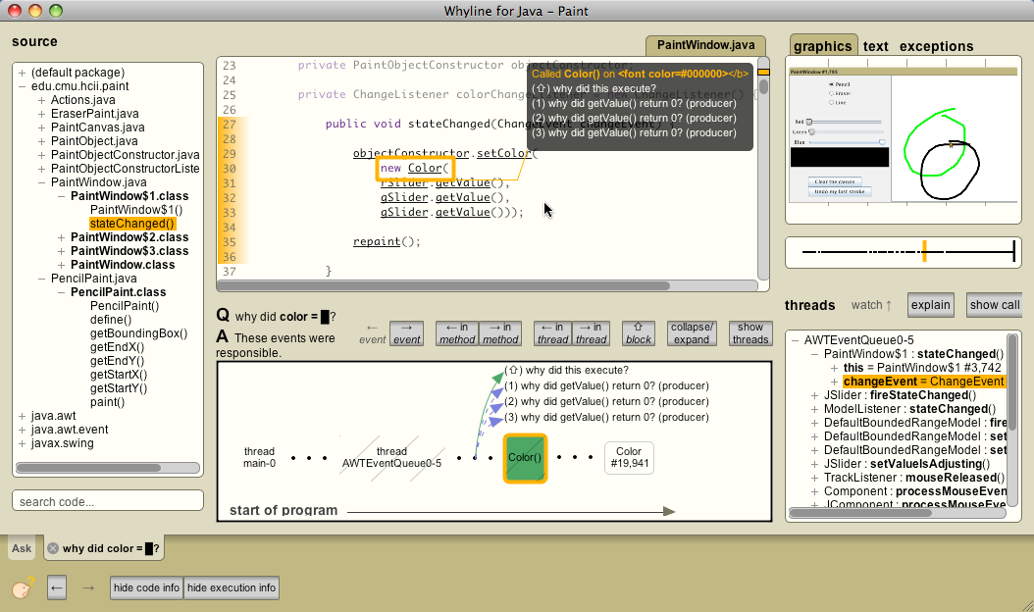
Graphic Design
Whyline for Java designed to be visually appealing even though for programmers
Andrew J. Ko and Brad A. Myers. "Finding Causes of Program Output with the Java Whyline", Proceedings CHI'2009: Human Factors in Computing Systems. Boston, MA, April 4-9, 2009. pp. 1569-1578. pdf and video
Might involve
designers for
colors, icons,
which controls,
layout, …

Slide 26
Prototyping
Try out designs with developers before implementing them
  Paper
    “Low fidelity prototyping”
    Often surprisingly effective
    Experimenter plays the computer
    Drawn on paper → drawn on computer
  Implemented Prototype (“Click through”)
    Balsamiq, Axure, PowerPoint, Web tools (even for non-web UIs)
    (no database)
  Real system
Need to test these with users!
Better if sketchier for early design
  Use paper or “sketchy” tools, not real widgets
  People focus on wrong issues: colors, alignment, labels
  Rather than overall structure and fundamental design
Increasing fidelity

Slide 27
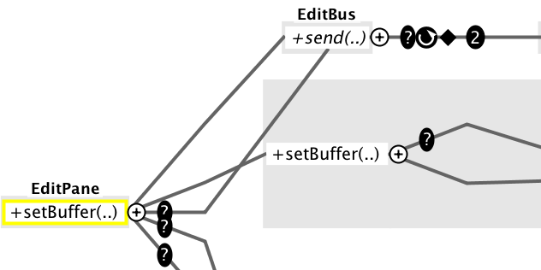
Example of Early Prototyping
Thomas LaToza designing new visualization tool to try to help answer Reachability Questions
Prototypes created with Omnigraffle and printed
Revealed significant usability
problems that were fixed
before implementation
  Graphical presentation
  Controls

Slide 28
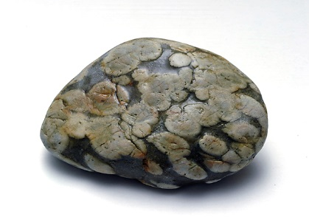
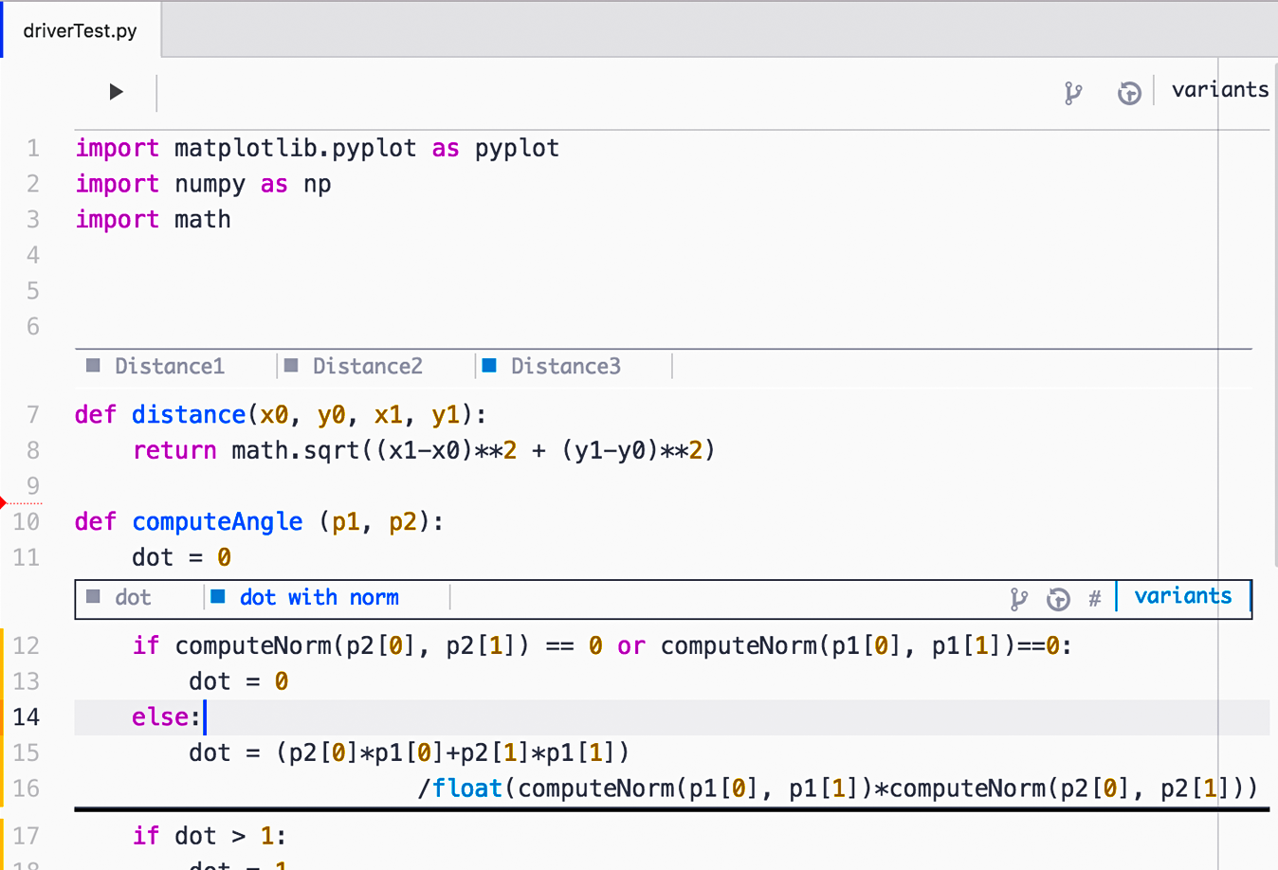
Another Example: Variolite
How to support data scientists with exploratory programming?
Mary Beth Kery, Amber Horvath, Brad Myers. "Variolite: Supporting Exploratory Programming by Data Scientists", Proceedings CHI'2017: Human Factors in Computing Systems, Denver, CO, May 6-11, 2017. To appear. preprint pdf and YouTube video. Best paper Honorable Mention award.
What kind of version control support would be useful?
  Interviews and CIs showed that conventional approaches
  like Git are too heavy-weight
Showed dozens of sketches to
target users to get feedback on
which seemed usable and useful
Variations Augment Real Iterative
Outcomes Letting Information
Transcend Exploration

Slide 29
Evaluation Methods
Evaluative Studies
  Expert analyses
  Usability Evaluation
  Formal A/B Lab Testing
Does my tool work?
Does it solve the developer’s problems?

Slide 30
Expert Analyses
Usability experts evaluating designs to look for problems
  Heuristic Analysis – [Nielsen] set of guidelines
  Cognitive Dimensions – [Green] another set
  Cognitive Walkthroughs – evaluate a task
Can be inexpensive and quick
However, experienced evaluators are better
  22% vs. 41% vs. 60% of errors found [Nielsen]
Disadvantage: “just” opinions, open to arguments

Slide 31
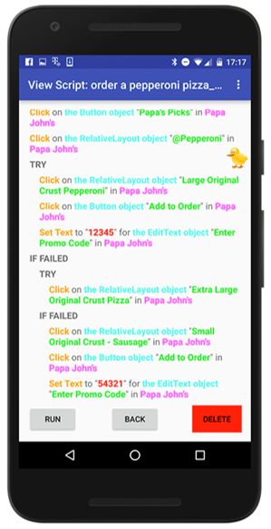
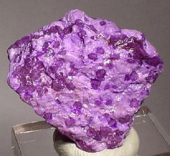
Example of Usability Analysis
Sugilite: Smartphone Users Generating Intelligent Likeable
Interfaces Through Examples
Toby Li, Amos Azaria, and Brad Myers. "SUGILITE: Creating Multimodal Smartphone Automation by Demonstration", Proceedings CHI'2017: Human Factors in Computing Systems, Denver, CO, May 6-11, 2017. To appear. preprint pdf and video. Best paper Honorable Mention award.
Allow end-users to create
automations on Smartphones
Initiate with speech commands
Record scripts by example
Generalizes from one or more examples
19 participants attempted 5 tasks
  All completed at least 2 tasks successfully
  8 (42.1%) succeed in all 4 tasks
  Overall, 65 out of 76 (85.5%) scripts worked
  Feedback on what we need to improve

Slide 32
Formal A/B testing
Formal A/B lab user tests are “gold standard” for academic papers – to show something is better
But many issues in the study design
  “Confounding” factors which were not controlled and are not relevant to study, but affect results
  Tasks or instructions are mis-understood
    Use prototypes & pilot studies to find these

Slide 33
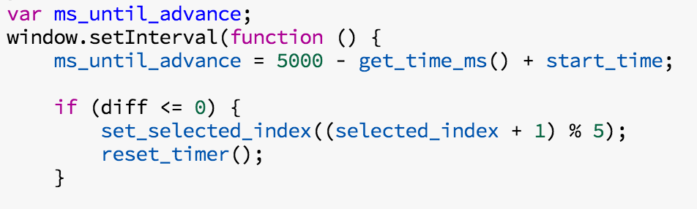
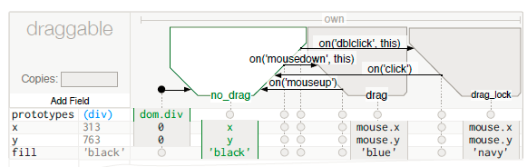
Example of A/B testing
User testing of InterState
compared to JavaScript
40
30
time taken
(minutes)
20
10
0
Task 1*
Task 2**
JavaScript
p < .01**
p < .05 *
InterState
smaller is better
33

Slide 34
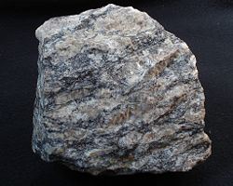
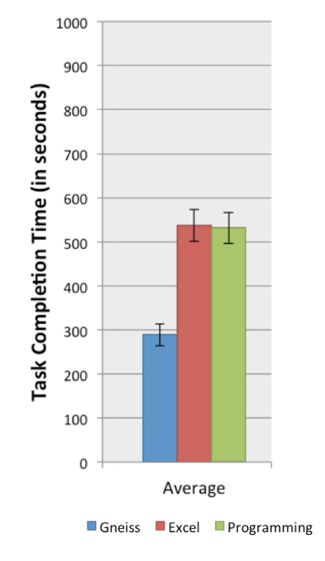
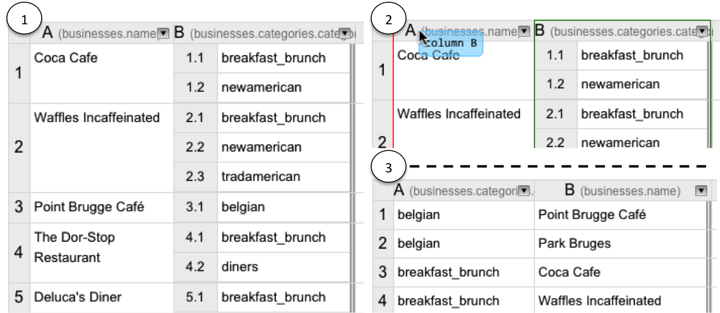
Another Example of A/B testing
Gneiss: Gathering Novel End-user Internet
Services using Spreadsheets
  Kerry Chang and Brad A. Myers, "Using and Exploring Hierarchical Data in Spreadsheets." CHI'2016, pp. 2497-2507.
Novel spreadsheet interface for investigating hierarchical (e.g., JSON) data
  Investigated using conventional spreadsheet formulas and drag-and-drop of columns
Gneiss users significantly outperformed Excel users and programmers (p<.001)

Slide 35
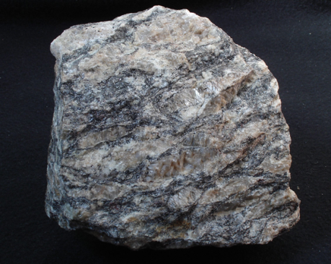
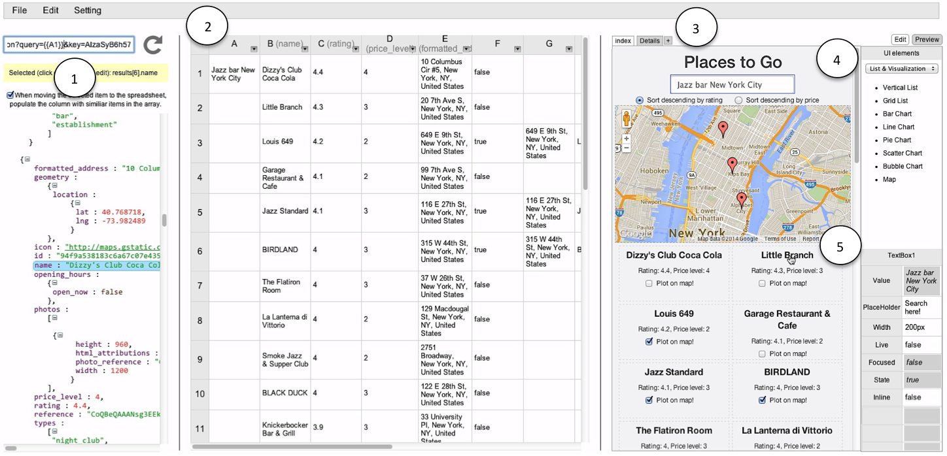
Gneiss Language
Code using familiar spreadsheet language
  Innovation: pull (formula) semantics even
  for user interface elements (instead of events)
Video
(5:00min)

Slide 36
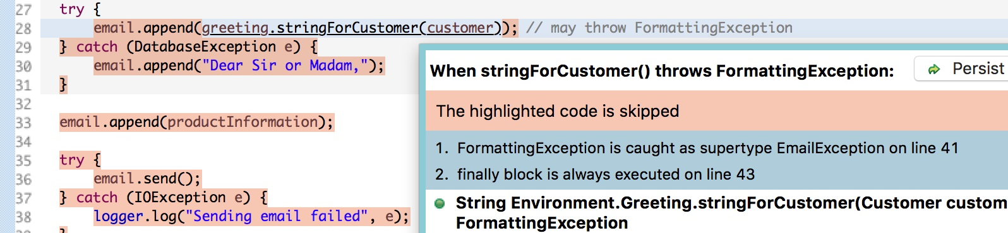
Brand New Example
Florian Kistner, Mary Beth Kery, Michael Puskas, Steven Moore and Brad Myers, "Moonstone: Support for Understanding and Writing Exception Handling Code.“ Submitted for Publication, 2017
Help users understand control flow when exceptions happen
Help user write more correct exception
handlers
Users are more accurate and faster
compared to regular Eclipse

Slide 37
Field Studies of System in Use
Field Studies
  Logs & error reports
Find out what happens when the tool is really used
Requires significant effort to make the tool sufficiently solid

Slide 38
Why Field Studies?
Understand which features are used and how
  Not necessarily why
  Can sometimes follow up with questionnaires, interviews of actual users
  Developers often are surprised at how system is used
Demonstrate that people choose to use the system when optional
Easy to instrument web systems, some on-line tools

Slide 39
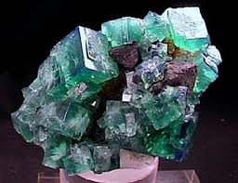
Logging Actual Use
Easier if instrument your tools
Objective use data better than users’ recollections and opinions
Many levels of data can be collected
  Privacy issues
Example: Fluorite logger for Eclipse
  Fluorite: Full of Low-level User Operations Recorded In The Editor
  Records all edits and events, including
  scrolling operations & source code,
  Necessary to identify patterns of backtracking

Slide 40
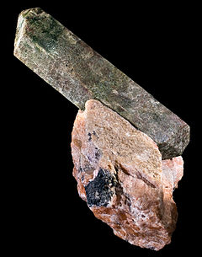
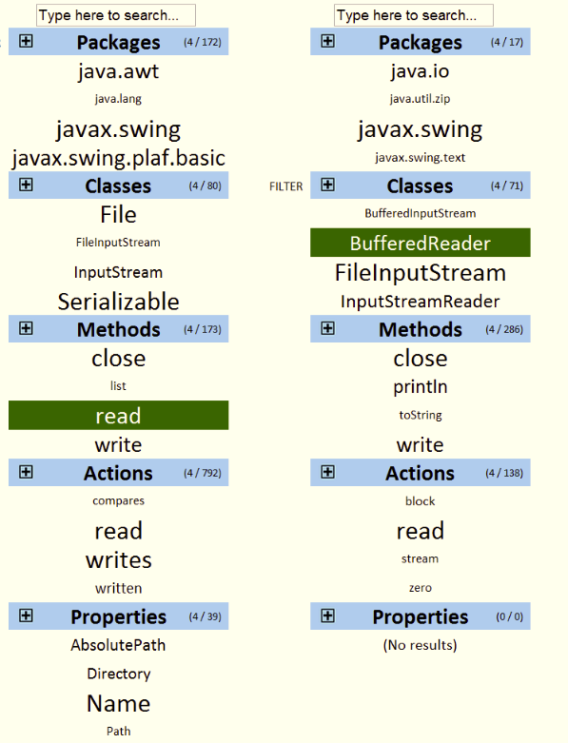
Example of Field Analysis
Apatite (covered last time)
Couldn’t figure out a comparison tool or
or a lab study
Deployed on the web
Mostly used for fast lookup from
partial names
Video (2:45)

Slide 41
Summary of Insights
Field and lab studies can reveal the real questions
  Answering these questions creates tools that are actually useful
Researcher’s intuitions about what might be useful may be wrong
Our experience highlights:
  Developers often have specific questions in mind, which can be exploited in tools
  Code views are central
  Visualizations are often useful as navigation aides for code
  Ability to search is key
    Not just through code, but also through dynamic and static call-graphs, through time, etc.

