Slide 1
Lecture 20:
API Usability
Brad Myers
05-830
Advanced User Interface Software
Spring, 2017

Slide 2
Studying APIs
API = “Application Programming Interfaces”
  Libraries, SDKs, toolkits, Frameworks, …
“Interface” between the programmer (user) and the functionality
Treat the API as an artifact to be evaluated like any other user interface
Started with PhD work of Jeff Stylos
  Now chief API Designer for IBM’s Watson group

Slide 3

Context
Part of the “Natural Programming Project”
Started about 1995
Make programming easier and more correct by making it more natural
  Closer to the way that people think about solving their tasks
Methodology
  Perform studies to inform design
    Provide new knowledge about what people do and think
  Guide the designs from the data
    Design of programming Languages, APIs. Tools, and Environments
  Evaluate results
Target novice, expert and end-user programmers

Slide 4
Importance of APIs
Virtually all code uses APIs
  Internal or Public or Both
Many companies providing their (formerly) internal data through web APIs
Cloud and “services” are all APIs
www.programmableweb.com lists over 17,304 APIs for web services
Apigee: 77% rated APIs as being important, only 1% said “not at all important”
  Total market for API web middleware was $5.5 billion in 2014.
  Apigee was bought by Google in 2016 for $625M
Amazon reported creating 1000 new APIs (“services”) last year alone

Slide 5
Why APIs, cont.
Some design goals for APIs:
  Information Hiding – hide implementation
  Provide device independence
  Enable future changes to low level without requiring changes to application code
  Protection of protected resources
  Consistency for end-user – toolkit can provide commonality
  More robust end-user code – toolkit implemented correctly
  Run-time efficiency: provide services in an efficient way
  Code reuse: Provide useful services only once
  Programmer Productivity
  …
My Goal: Allow API usability to be a first-class quality metric considered by API designers

Slide 6
Importance of API Usability
Anecdotal reports of customers rejecting APIs and using competitor’s due to poor usability
Vendors are competing based on usability
  E.g., in cloud services – Amazon AWS, Google cloud, Microsoft Axure, IBM, SAP, …
APIs are often used incorrectly, resulting in bugs and sometimes significant security problems

Slide 7
Why Apply HCI Techniques?
Programming is a human activity
  Take the human into account
Design should be close to user’s plan
  “Programming is the process of transforming a mental plan into one that is compatible with the computer.”
  — Jean-Michel Hoc
Closeness of mapping
  “The closer the programming world is to the problem world, the easier the problem-solving ought to be.… Conventional textual languages are a long way from that goal.” — Green and Petre
If an API cannot be used effectively by developers, it doesn’t work!

Slide 8
What is “Usability”?
(same as for regular UIs)
Functionality
Learnability, Efficiency, Errors, Preferences

Slide 9
What HCI Techniques
Can Be Used?
“Contextual Inquiry” & Field Studies
  What are the real problems & barriers that developers face?
Natural Programming Elicitation
  Let programmers express how they expect the functionality to be provided
  How should this API be designed?
Expert analyses
  What are some potential problems with this API?
  Heuristic Analysis – evaluate based on guidelines
  Cognitive walkthrough – how hard will this specific task be to learn?
Lab studies of programmers using API
  Does my API work for programmers?
  What problems do the target developers have with my API?
…

Slide 10
Study of API Usability
Duala-Ekoko, E., Robillard, M.P., 2012. Asking and answering questions about unfamiliar APIs: An exploratory study. In: Proceedings of the 34th International Conference on Software Engineering. ICSE ’12, pp. 266–276. http://dl.acm.org/citation.cfm?id=2337223.2337255
Think-aloud protocols, screen captures and interviews
20 participants working on two programming tasks on different APIs
5 hardest problems:
  Which keywords best describe a functionality provided by the API?
  How is the type X related to the type Y?
  Does the API provide a helper-type for manipulating objects of a given type?
  How do I create an object of a given type without a public constructor?
  How do I determine the outcome of a method call?

Slide 11
Coordination / Dependencies
“Discovering Relevant Dependencies” among the classes
Andrew J. Ko, Brad A. Myers, and Htet Htet Aung. "Six Learning Barriers in End-User Programming Systems." VL/HCC'04: IEEE Symposium on Visual Languages and Human-Centric Computing, Rome, Italy, September 26-29, 2004. pp. 199-206. pdf. (Winner, Most Influential Paper Award for important influences on VL/HCC research or commerce over the last 10+/-1 years in 2013.)
  Design - I don’t know what I want the computer to do...
  Selection - I think I know what I want the computer to do, but I don’t know what to use
  Coordination - I think I know what things to use, but I don't know how to make them work together
  Use - I think I know what to use, but I don't know how to use it
  Understanding - I thought I knew how to use this, but it didn’t do what I expected
  Information - I think I know why it didn’t do what I expected, but I don’t know how to check

Slide 12
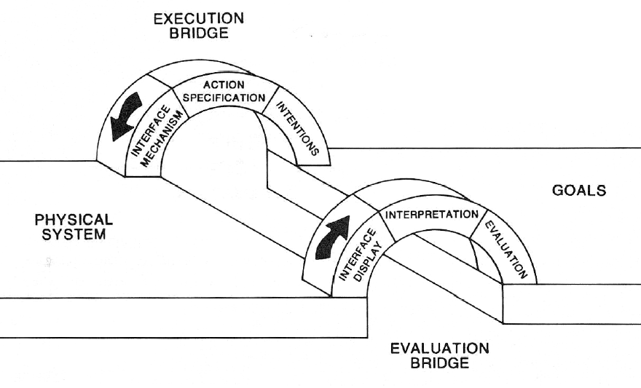
Don Norman’s “Gulfs”
Donald A. Norman and Stephen W. Draper. 1986. User Centered System Design; New Perspectives on Human-Computer Interaction. L. Erlbaum Assoc. Inc., Hillsdale, NJ, USA.
“Gulf of Evaluation”
“Gulf of Execution”
7 stages:
  Form goal
  Form intention
  Specify action
  Execute action
  Perceive state
  Interpret state
  Evaluate outcome

Slide 13
Our Study of APIs
Which programming patterns are most usable? (Stylos’s thesis)
  Default constructors
  Factory pattern
  Object design
E-SOA APIs
Fix by:
  Changing APIs
  Changing documentation
  Better tools in IDEs

Slide 14
Required Constructors
Compared create-set-call (default constructor)
  var foo = new FooClass();
  foo.Bar = barValue;
  foo.Use();
vs. required constructors:
  var foo = new FooClass(barValue);
  foo.Use();
All participants assumed there would be a default constructor
Required constructors interfered with learning
  Want to experiment with what kind of object to use first
Did not insure valid objects – passed in null
Preferred to not use temporary variables

Slide 15
Follow-on Project
“Immutability” in APIs
  Objects that cannot be changed after constructed
    No “set” methods
  E.g., Java Strings, but not Dates
Experts argue should use immutability
  Fewer bugs due to sharing, thread-safe, etc.
Need required constructors
  Seems to contradict required constructor result
Lots of related language constructs
  const, final, readonly, freeze, …

Slide 16

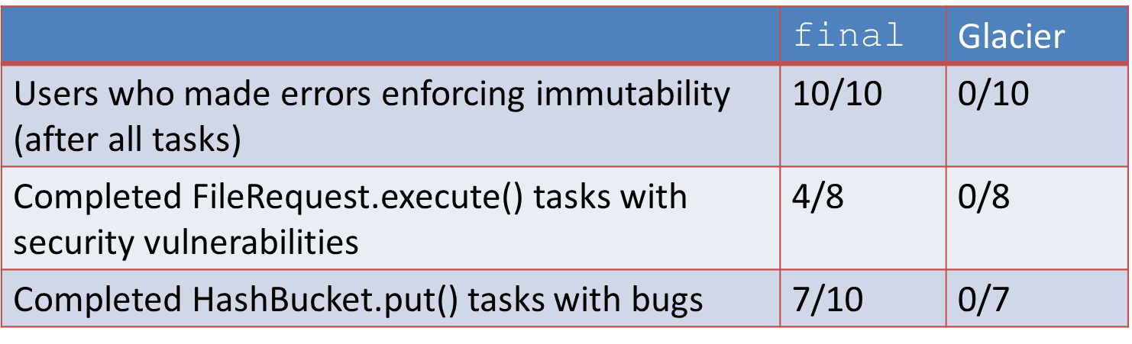
Glacier
Great Languages Allow Class Immutability Easily and Readily
Michael Coblenz, Whitney Nelson, Jonathan Aldrich, Brad Myers and Joshua Sunshine, "Glacier: Transitive Class Immutability for Java", ICSE'2017: The 39th International Conference on Software Engineering, Buenos Aires, Argentina, May 20-28, 2017. To appear.
Use Java annotations to declare objects immutable
Case study showed it can help find bugs
User study showed people used it successfully
  20 experienced Java programmers
  Compared to using Java final as instructed by Josh Bloch

Slide 17
“Factory” Pattern
(Covered in lecture 1)
Instead of “normal” creation: Widget w = new Widget();
Objects must be created by another class:
AbstractFactory f = AbstractFactory.getDefault();
Widget w = f.createWidget();
Used frequently in Java (>61) and .Net (>13) and SAP
Lab study with expert Java programmers
  Five programming and debugging tasks
  Within subject and between subject measures
Results:
  When asked to design on “blank paper”, no one designed a factory
  Time to develop using factories took 2.1 to 5.3 times longer compared to regular constructors (20:05 v 9:31, 7:10 v 1:20)
  All subjects had difficulties getting using factories in APIs
Implications: avoid the factory pattern!

Slide 18
Object Method Placement
(Covered in lecture 1)
Related to the “coordination” barrier
Where to put functions when doing object-oriented design of APIs
  mail_Server.send( mail_Message )
  vs.
  mail_Message.send( mail_Server )
When desired method is on the class that they start with, users were between 2.4 and 11.2 times faster (p < 0.05)
Starting class can be predicted based on user’s tasks

Slide 19

Study of APIs for eSOA
Sponsored by SAP
Study APIs for Enterprise Service-Oriented Architectures (“Web Services”)
Client-server architecture
organized into services using
XML to communicate
Enormously complex
  Requires significant
  flexibility and customizability
Server
Services
XML
WSDL
XML
Client
Stub Code

Slide 20
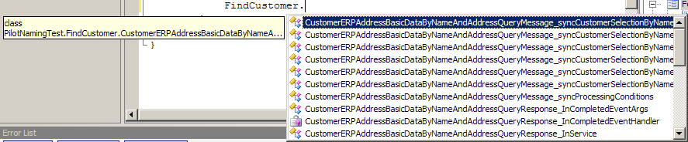
eSOA Studies Results
“Stub generators” that connect code to XML introduce complexities
  No sample code since multiple targets
Naming problems:
  Too long
  Not understandable
  Differences in middle are frequently missed
CustomerAddressBasicDataByNameAndAddressRequestMessageCustomerSelectionCommonName
CustomerAddressBasicDataByNameAndAddressResponseMessageCustomerSelectionCommonName

Slide 21
eSOA Results, cont.
Parameters structured as trees of objects
  Parameter trees can have 20 to 500 nodes
  Developer is responsible for instantiating some intermediate objects using stub code, but not all
  Participants did not know which ones were needed
  Inconsistent for different services
Customer
Customer Name
Customer First Line Name
Customer Common
Information
Customer
Address Information

Slide 22
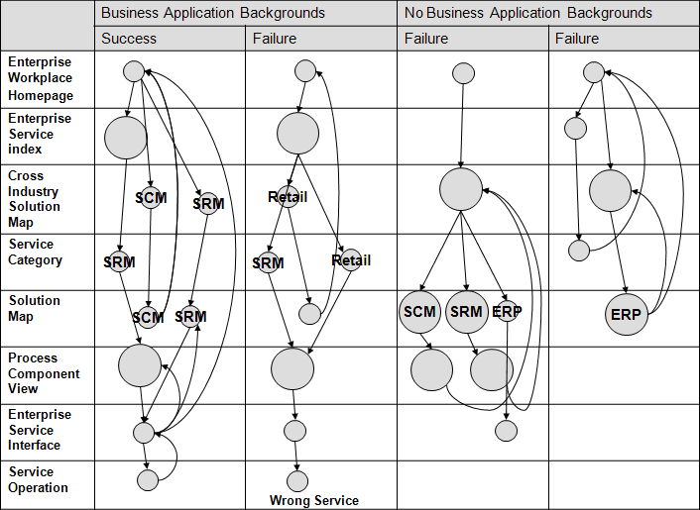
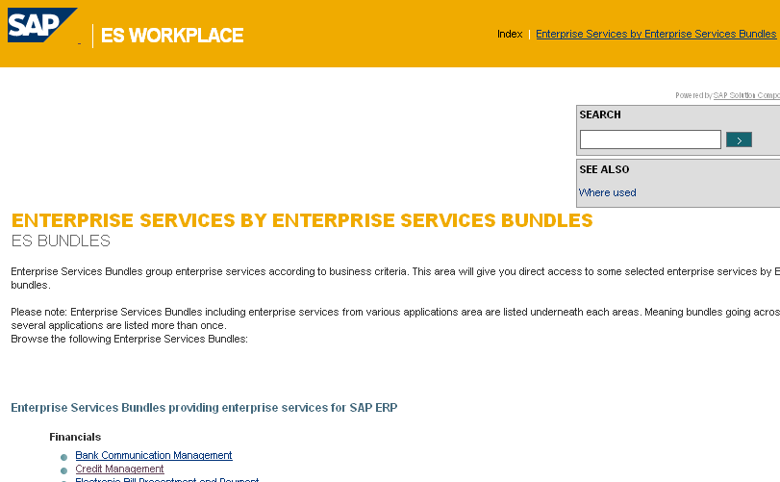
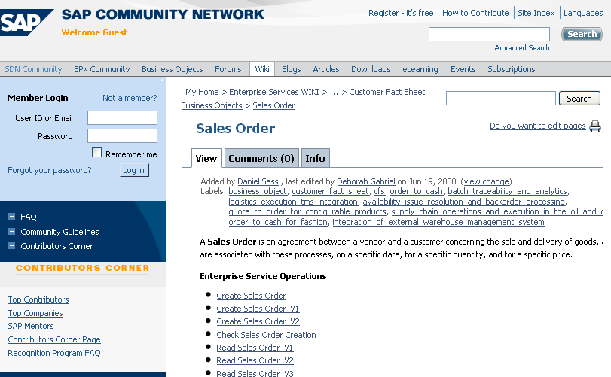
eSOA Documentation Results
Multiple paths: unclear which one to use
Some paths were dead ends
Inconsistent look and feel
caused immediate
abandonment of paths
Hard to find required info.
Business background helped

Slide 23
Another SAP study
Jeff Stylos studied SAP “Business Rules Framework Plus” API (BRFplus) as an intern in Walldorf, in summer 2007
Jeffrey Stylos, Daniela K. Busse, Benjamin Graf, Carsten Ziegler, Ralf Ehret and Jan Karstens. “A Case Study of API Design for Improved Usability,” 2008 IEEE Symposium on Visual Languages and Human-Centric Computing, VL/HCC’08, Herrsching am Ammersee, Germany, Sept 15-18, 2008. pp. 189-192.
Business rules allow EUD to specify behaviors, such as how tax is computed
Identified customers’ real needs
    Found mismatch of abstraction level
    Elicited users’ mental models using “blank notepad” test
  Designed wrapper API
    Dramatically better success than original

Slide 24
SAP Business Rules;
Detailed Results
Pseudo code showed:
  High level of abstraction, 12 lines vs. >100 with the BRFplus
  Separation of structure from constants
  Tables to model the structure of their rules.
  Omitted details such as locking data structures for thread safety, versioning and activation, and explicitly saving rules.

Slide 25



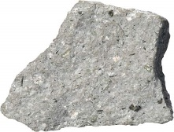
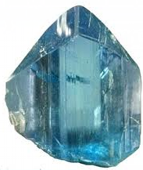


Our Tools to Help with APIs
Mica
Jadeite
Calcite
Dacite
Euklas
Graphite
Apatite

Slide 26
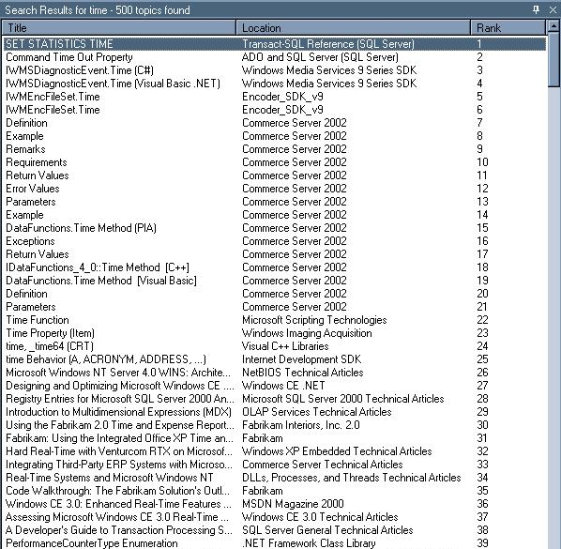
Mica Tool to Help Find Examples
Jeffrey Stylos and Brad A. Myers. "Mica: A Programming Web-Search Aid". 2006 IEEE Symposium on Visual Languages and Human-Centric Computing. Sept 4-8, 2006, Brighton, UK. pp. 195-202. pdf.
Started with study of how people
learn APIs
  People prefer to learn from examples of code
  Use Google to search for example code
Google for finding
  Good for solving vocabulary problem
    What is this method called?
    E.g., transparency, alpha, blend, fade-in, etc.
Lots of irrelevant stuff returned too
  True also with MSDN
Even if get to right term, still are multiple possible methods
Even when have right method, how is it used?
People prefer to use examples to decide

Slide 27
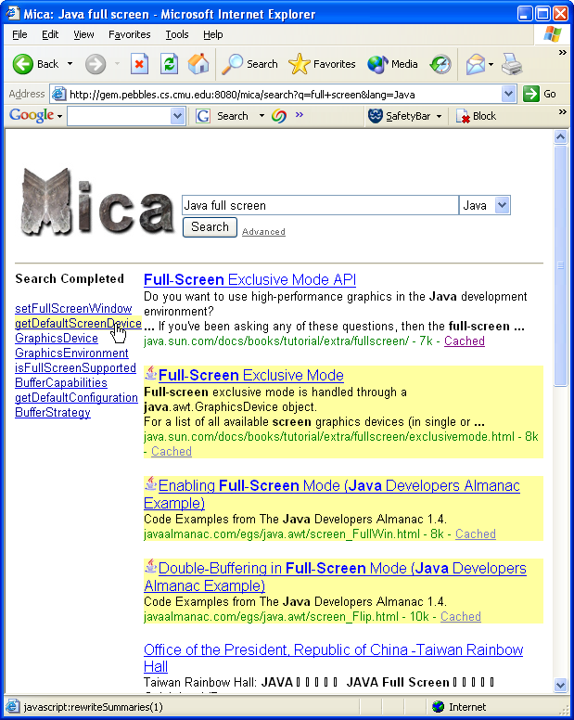
Mica
Makes Interfaces Clear and Accessible
Use Google to find relevant pages
Match pages with Java keywords
Makes finding the right API words easier
Also notes which pages contain example code
www.cs.cmu.edu/~mica

Slide 28
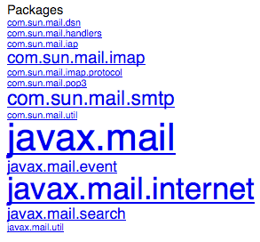
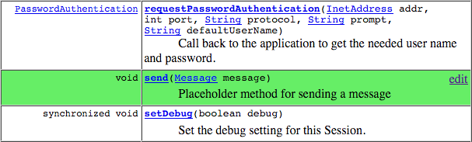
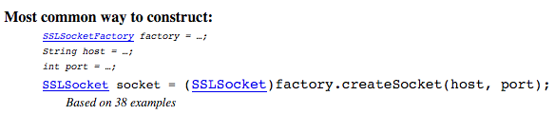

Jadeite: Improved JavaDoc
Jadeite: Java API Documentation with Extra Information Tacked-on for Emphasis
Jeffrey Stylos, Andrew Faulring, Zizhuang Yang, Brad A. Myers. "Improving API Documentation Using API Usage Information". IEEE VL/HCC'09. Sept. 20-24, 2009. Corvallis, Oregon. pp. 119-126. IEEE DL pdf or local pdf
Fix JavaDoc to help address these problems
  Focus attention on most popular packages and
  classes using font size
  “Placeholders” for methods that users want to exist
  Automatically extracted
  code examples for way
  to create classes and
  related classes
  Improved performance
  by factor of 3
  New way to use Google

Slide 29
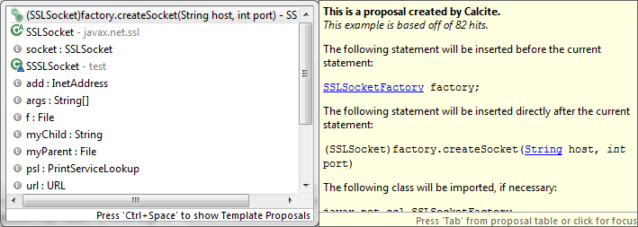
Calcite: Eclipse Plugin for Java
Calcite: Construction And Language Completion Integrated Throughout
  http://www.cs.cmu.edu/~calcite
Mathew Mooty, Andrew Faulring, Jeffrey Stylos and Brad Myers. "Calcite: Completing Code Completion for Constructors using Crowds," 2010 IEEE Symposium on Visual Languages and Human-Centric Computing (VL/HCC'10), Leganés-Madrid, Spain, 21-25 September 2010. pp. 15-22.
Code completion in Eclipse augmented with Jadeite’s information
  How to create objects of specific classes
  SSLSocket s = ???

Slide 30

Dacite
DACITE: Design Annotations for Complementing Interfaces Targeting Effectiveness
André L. Santos and Brad A. Myers, "Design Annotations to Improve API Discoverability", The Journal of Systems & Software, volume 126, April, 2017, Pages 17–33. doi: 10.1016/j.jss.2016.12.036 or local pdf.
Use Java’s “annotation” mechanism to let API designers describe the design patterns in use
Static factories, factory methods, object builders, helper methods, decorators, and composite objects
Focus on API discoverability
Annotations are checked at compile time of API
Creates files used by IDE for Calcite-like auto-completes

Slide 31
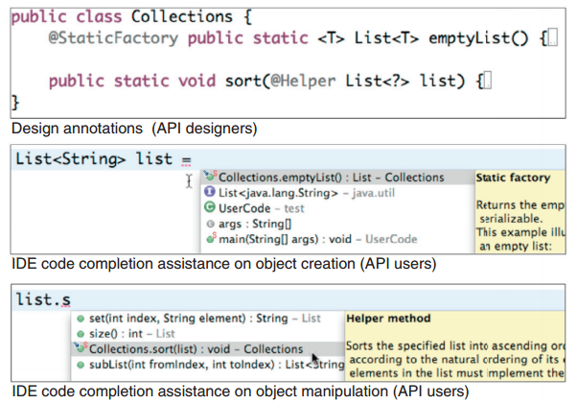
Dacite, cont.

Slide 32
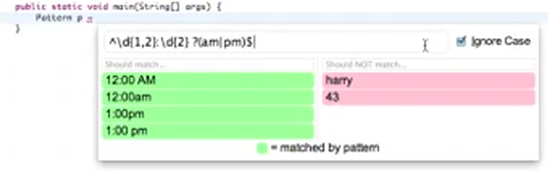
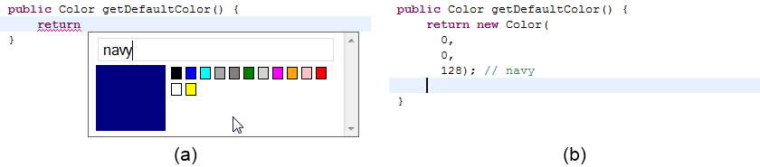
Graphite: Eclipse Plugin for Sub-Languages
Graphite: GRAphical Palettes Help Instantiate Types in the Editor.
Cyrus Omar, YoungSeok Yoon, Thomas D. LaToza, Brad A. Myers, "Active Code Completion." ICSE'2012: 34nd International Conference on Software Engineering, Zurich, Switzerland, 2-9 June 2012. pp. 859-869. local pdf.
Pop up a custom palette for specialized constants (literals) or sublanguages in Eclipse
  Color palettes
  Regular expression
  strings
Customizable
Video (10:24)

Slide 33
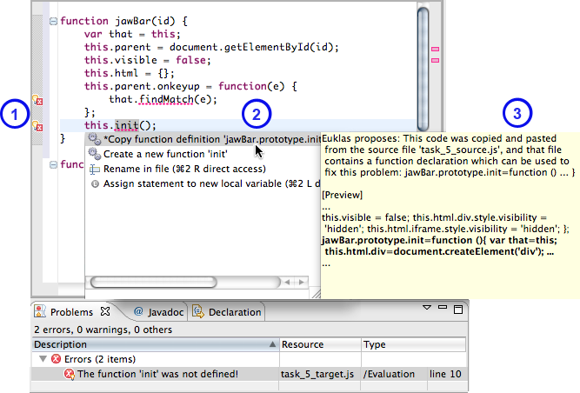
Euklas: Eclipse Plugin for JavaScript
Euklas: Eclipse Users’ Keystrokes Lessened
by Attaching from Samples
  http://www.cs.cmu.edu/~euklas
Christian Dörner, Andrew Faulring, Brad A. Myers. "EUKLAS - Supporting Copy-and-Paste Strategies for Integrating Example Code", The Fifth Workshop on Evaluation and Usability of Programming Languages and Tools (PLATEAU'2014), at SPLASH 2014, 21 Oct 2014, Portland, OR. pp. 13-20. ACM DL or local pdf.
Brings Java-like analysis
to JavaScript
People often copy
from examples in
documentation
Auto-correct uses
copy source context
for errors due to
copy & paste

Slide 34
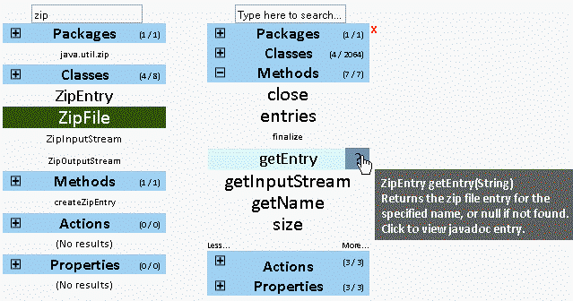
Apatite Documentation Tool
Apatite: Associative Perusing of APIs That Identifies Targets Easily
  http://www.cs.cmu.edu/~apatite
Daniel S. Eisenberg, Jeffrey Stylos, Andrew Faulring, Brad A. Myers. "Using Association Metrics to Help Users Navigate API Documentation," 2010 IEEE Symposium on Visual Languages and Human-Centric Computing (VL/HCC'10), Leganés-Madrid, Spain, 21-25 September 2010. pp. 23-30.
Start with verbs (actions) and properties and find what classes implement them
Find things associated with other things
  E.g., classes that
  are often used
  together
  Classes that
  implement or are
  used by a method
Video (2:45)

Slide 35
New Project
Sponsored by Google
  In collaboration with IBM
  Hopefully, also Amazon, SAP, …
Study what API designers are thinking
  What information do they need?
  How much do they consider usability?
  Barriers to achieving API usability
Processes used for API design seems to differ among companies
  API design guidelines exist but aren’t necessarily followed
Developing a questionnaire to be administered to API designers starting in summer

