Slide 1
Lecture 19:
Simple User Interface Toolkits and EUP for UIs
Brad Myers
05-830
Advanced User Interface Software
Spring, 2017

Slide 2
Overview
Approaches to help novice programmers to be able to create dynamic interfaces
  Static interfaces can just be drawn
Not counting PBD – covered in previous lecture
Typically, also easier to program in general
  Most modern tools to make it easy to program focus on creating interactive software, like games, which have a UI
Reminder: EUP = end-user programmers
  Definition: Visual Programming = “Programming in which more than one dimension* is used to convey semantics.” - [Myers, 1990]

Slide 3
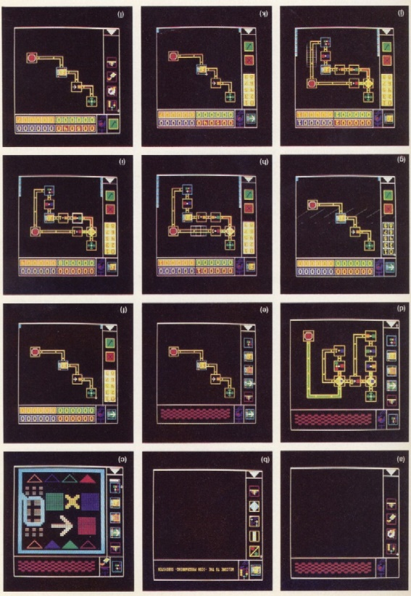
Older Approaches
Older visual language systems did not necessarily help with UIs
E.g., Pict from Ephraim Glinert, 1984 uses conventional flowcharts to program algorithms
Goal: easier to learn programming

Slide 4
Systems Covered
LabVIEW (1991)
SUIT [Pausch, 1992]
Alice [Pausch, 1995]
HANDS [Pane, 2002]
Scratch (2003)
AppInventor (2009)
Yahoo! Pipes (2007 – 2015)

Slide 5
Historical trends
Action Graphics
FORMAL
ThingLab
Hi-Visual
LabView
PROGRAPH
PIGS
Pict
Rehearsal
SmallStar
Forms
Editing by Example
PICT
Lotus 1-2-3
SIL-ICON
VisiCalc
HiGraphs
Miro
StateMaster
AMBIT/G/L
Grail
GAL
Graphical Program Editor
Query by Example
Pygmalion
I/O Pairs
Cube
Cantata
SchemePaint
CODE 2.0
Iconicode
MViews
AVS
Mondrian
ChemTrains
Vampire
VIPR
SPE
LOFI/HIPI
FOXQ
VMQL
GXL
Euler View
Yahoo Pipes
Popfly
1960
1980
1990
2000
Techniques
Graphs
Flowcharts
Flowchart derivatives
FORMS
Demonstrational
Techniques
Graphs
Flowcharts
Flowchart derivatives
FORMS
Demonstrational
Data Flows
Spreadsheets
Matrices
Jigsaw Puzzles
Petri nets
Flowchart derivatives
Techniques/Goals
3D Rendering
Visual Hierarchy
Procedures
Control Structures
Programmable Graphics
Animations
Video Imagery Exploitation
General purpose, declarative language
Audio, video and image processing
Graphical models from behavioral models
Learning and Cognitive abilities in vision processes
Handling Scalability, typing, and imperative design
Collaborative Software Development
Techniques/Goals
Child Learning
Xquery by FORMS
Spreadsheet Analysis
Visual Model Query
Layouts
Specification and Interchange
Mashups
Web-based design
Programming for end-users (non-Professionals
From: Vishal Dwivedi,
05-830 in 2013

Slide 6

LABView
One of the most successful visual programming systems
Started about 1991 on Macintosh, still going
  http://www.ni.com/labview/
  J. Kodosky, J. MacCrisken and G. Rymar. “Visual programming using structured data flow,” Visual Languages, 1991., Proceedings. 1991 IEEE Workshop on, 8-11 Oct 1991, 1991. pp. 34-39.
Focused on scientists and lab equipment
Wiring diagram backend with front panel
  Drag and drop elements
  Data flow programming

Slide 7
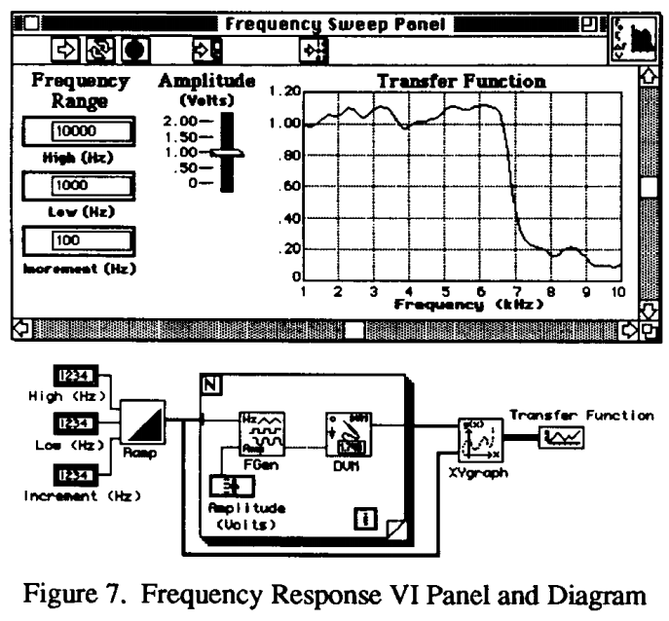
LabVIEW
[Kodosky, 91]
2-view approach
very influential

Slide 8
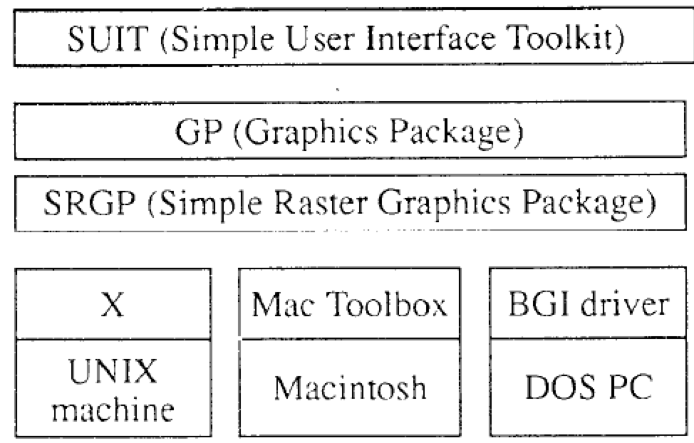
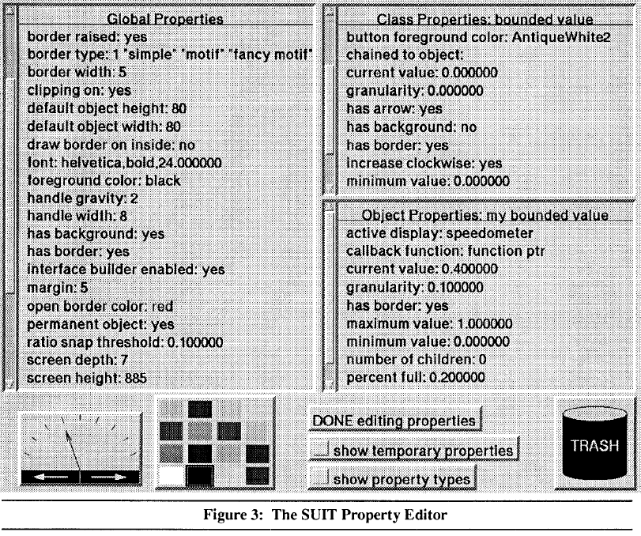
SUIT (1992)
Pausch, R., Conway, M., & DeLine, R. (1992). Lesson Learned
from SUIT, the Simple User Interface Toolkit. ACM Transactions on Information Systems, 10(4), 320-344.
Simple User Interface Toolkit
Implemented in C
  Portable across UNIX, Macintosh, and DOS
Used in many courses at UVA
  Become productive in
  2½ hours, vs. weeks
Iterative user testing
Table of objects
  No inheritance – just global or local
  Property sheets
Uses CTRL-SHIFT to avoid run/build mode
Retained object model
Data-linkages (constraints) through drag-and-drop

Slide 9
Alice
Randy Pausch, Tommy Burnette, A.C. Capehart, Matthew Conway, Dennis Cosgrove, Rob DeLine, Jim Durbin, Rich Gossweiler, Suichi Koga and Jeff White. “Alice: A Rapid Prototyping System for 3D Graphics,” IEEE Computer Graphics and Applications. 1995. 15(3). pp. 8-11. May.
Matthew Conway, Steve Audia, Tommy Burnette, Dennis Cosgrove, Kevin Christiansen, Rob Deline, Jim Durbin, Rich Gossweiler, Shuichi Koga, Chris Long, Beth Mallory, Steve Miale, Kristen Monkaitis, James Patten, Jeff Pierce, Joe Shochet, David Staack, Brian Stearns, Richard Stoakley, Chris Sturgill, John Viega, Jeff White, George Williams and Randy Pausch. “Alice: Lessons Learned from Building a 3D System For Novices,” Proceedings CHI'2000: Human Factors in Computing Systems, The Hague, The Netherlands, Apr 1-6, 2000. pp. 486-493. http://www.alice.org
Started as a 3D extension to SUIT
PhD dissertation of Matthew Conway (1998)
Grown to a large-scale system with books
  Wanda Dann, Steven Cooper and Randy Pausch. Learning to Program With Alice. Prentice-Hall. August, 2003.
Many more user studies of what students found easy and difficult

Slide 10
Alice
Easy 3D with character-centered movement & rotation
  “Bunny.move (up, 1)”, “Turn Around Once” “Bunny.move(forward, 1, speed=4)”
  No matrices! No X, Y and Z
Camera control
  “Point Camera At”, “Get a Good Look At”
Easy parallelism with “do-together”
  ArmsOut = DoTogether(
  Bunny.Body.LeftArm.Turn(Left, 1/8),
  Bunny.Body.RightArm.Turn(Right, 1/8) )
Create scene (by direct manipulation), then script
All commands animated by default, so no sudden jumps, disappearing objects
Early user of Python, switched to Java
Lots of vocabulary fixes:
  Resize, not Scale; Move, not Translate; Speed, not Rate; FrontToBack, not Depth:

Slide 11
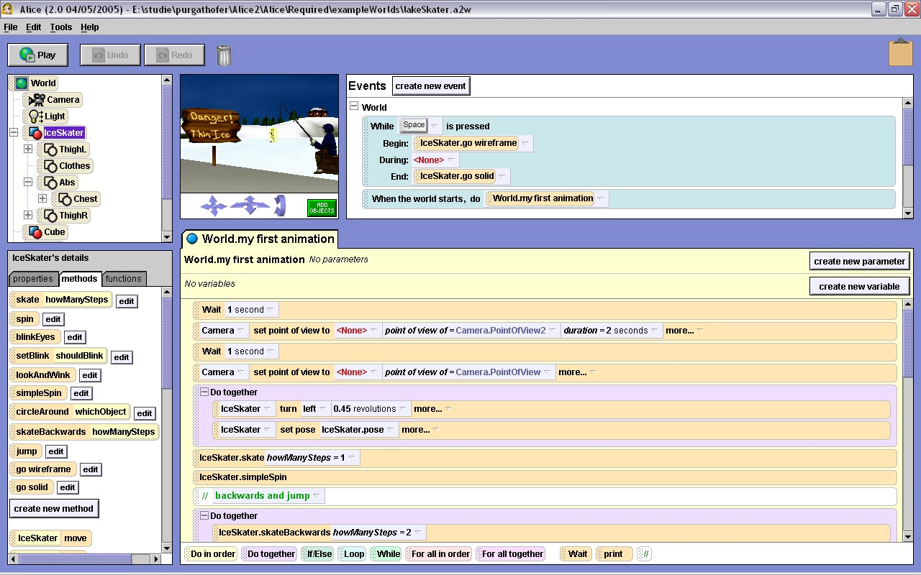
Alice, cont.
Later versions: Avoid syntax issues with drag-and-drop editing
Testing in classrooms showed significantly better learning and retention
Tutorial video
(from 2013)
6:44

Slide 12
HANDS
J.F. Pane, B.A. Myers and L.B. Miller. “Using HCI Techniques to Design a More Usable Programming System,” IEEE 2002 Symposia on Human Centric Computing Languages and Environments (HCC 2002), Arlington, VA, September 3-6, 2002. 198-206.
PhD 2002 of John Pane (now at Rand in Pgh)
Studies:
  How people naturally express programming concepts and algorithms
    1) Nine scenes from PacMan
    2) Transforming and calculating data in a spreadsheet
  Specific issue of language design
    3) Selecting specific objects from a group (“and”, “or”, “not”)
  Lots of interesting results

Slide 13
Examples of Results
Rule-based style
“If PacMan loses all his lives, its game over.”
Set operations instead of iterations
“When PacMan eats all of the dots, he goes to the next level.”
“And”, “Or”, “Not” don’t match computer interpretation
Most arithmetic used natural language style
“When PacMan eats a big dot, the score goes up 100.”
Operations suggest data as lists, not arrays
  People don’t make space before inserting
Objects normally moving
“If PacMan hits a wall, he stops.”
  so objects remember their own state

Slide 14
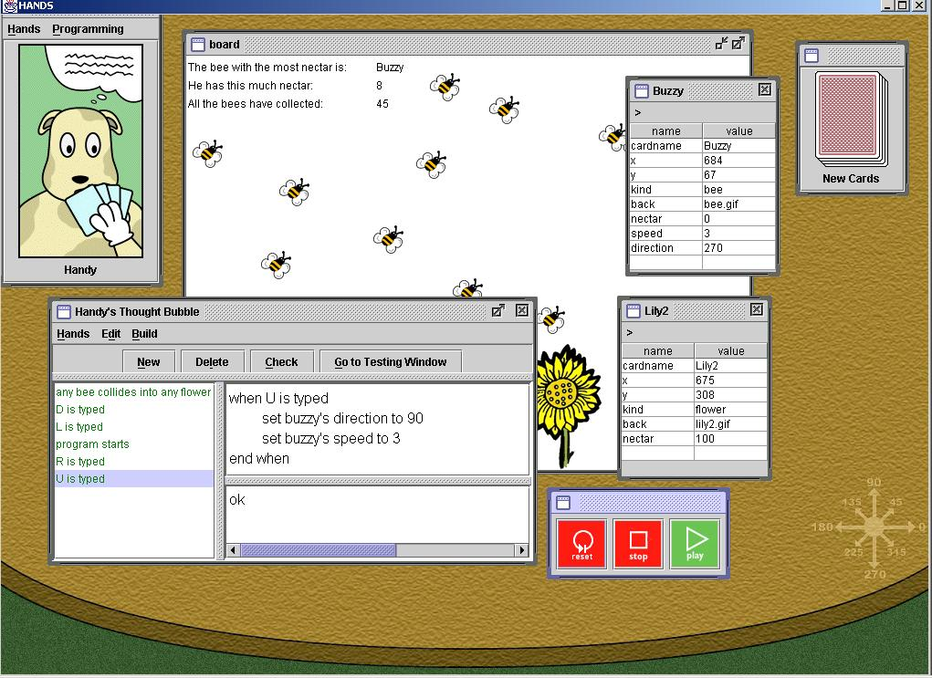
New Language and System: HANDS
Properties:
  All data visible on cards
  Metaphor of agent (Handy
  the dog) operating on cards
  Natural language style for
  code
  Domain-specific operations, like movement in a direction
  All operations can operate on single items or sets of items
  Sets can be dynamically constructed and used
    “Set the speed of all bees to 0”
  Event handlers: “when U is typed”
See the video: YouTube (7:36)

Slide 15
Scratch
Mitchel Resnick, John Maloney, Andrés Monroy-Hernández, Natalie Rusk, Evelyn Eastmond, Karen Brennan, Amon Millner, Eric Rosenbaum, Jay Silver, Brian Silverman and Yasmin Kafai. “Scratch: Programming for All,” Comm. ACM. 2009. 52(11). pp. 60-67. See also: http://scratch.mit.edu/.
MIT has long history of helping kids program
  Logo (Seymour Papert, 1967)
  Lego Mindstorms
  ”Constructionist” movement in education
Scratch comes out of that program (MIT Media Lab) – started about 2003
  https://scratch.mit.edu/
  “Create stories, games, and animations
  Share with others around the world”

Slide 16
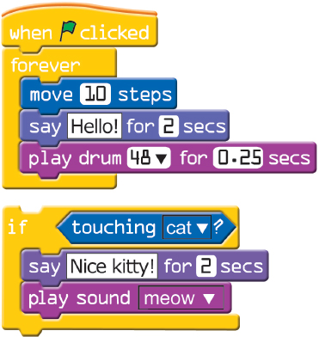
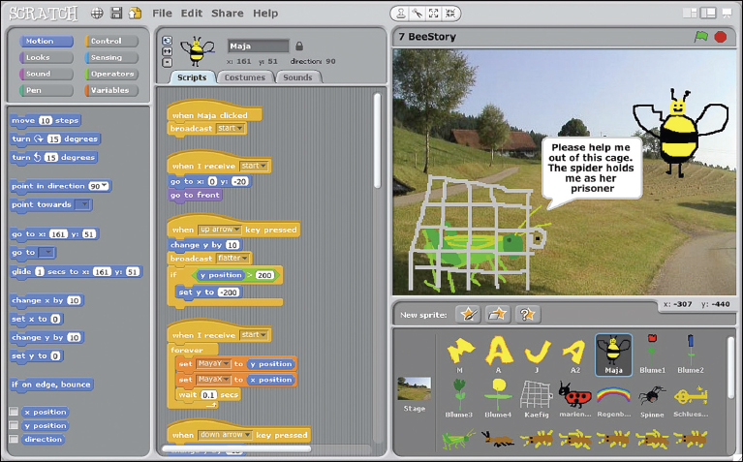
Scratch, cont.
Metaphor of puzzle pieces with properties
  Connectors shaped by type to eliminate type errors
  Control structures wrap around
Uses event handlers
for behaviors
https://vimeo.com/65583694, 1:37

Slide 17
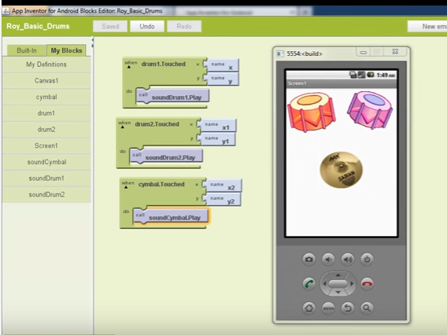
AppInventor
Ideas from Scratch to build real Apps for Android phones
  Briefly was a product from Google, while Hal Abelson was on sabbatical there (2009)
http://appinventor.mit.edu/
2 panel view, like
LabVIEW
  Drag in elements
  for UI
  Blocks view for
  code
  event handlers
  using “when”

Slide 18


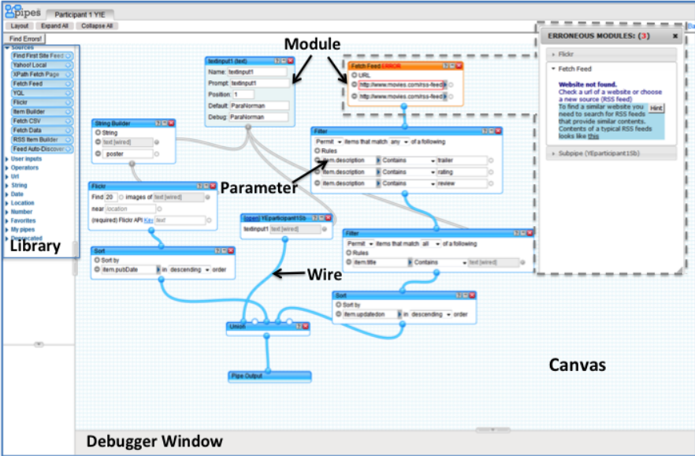
Yahoo! Pipes (2007 – 2015)
Was a web application to process data feeds on the web
  Originally focused on “RSS feeds”
Visual data flow architecture, like LabVIEW
Studies showed wasn’t easy for non-programmers to use
Sandeep K Kuttal, A. Sarma, and G. Rothermel, "Debugging Support for End-User Mashup Programming", in Proceedings of Computer and Human Interactions - CHI, Paris, France,pages 1609 - 1618, April 2013.[pdf]
  Issues with
  connections,
  parameters,
  debugging, etc.
Video (1:50) or
tutorial (5:15)

