Slide 1
Lecture 18:
Component Technologies:
Andrew, OLE, OpenDoc, Java Beans, Service-Oriented Architecture (SOA)
Brad Myers
05-830
Advanced User Interface Software
Spring, 2017

Slide 2
Overview
Andrew Toolkit, OLE, OpenDoc, Java Beans,
Microsoft .Net, Service-Oriented Architecture (SOA)
Goals:
  Allow different applications to co-exist closely
    Data from one to another be "active", unlike Cut and Paste
    No need for an application to have a viewer for all kinds of data
    Just invoke the right editor
  Allow smaller applications because don't have to implement redundant functions
    No need for Microsoft Word to implement a drawing program
    PowerPoint and Excel can share a charting program
    Reusable pieces
  Allow applications from different vendors to cooperate

Slide 3
Concepts
Components -- Andrew "Insets" =
OLE "Embedded Object" =
OpenDoc "Parts" = Java "Beans"
Containers -- also called "Shells", "Frames", "Forms", "BeanBox": what the components are embedded in.

Slide 4
Issues
Sharing and Controlling the menus, which might be global menubars
Sharing and Controlling the mouse pointer: who gets the clicks?
  "Use" vs. "Mention" problem
How save contents to a file ("persistence")
Sharing and Controlling the space: How layout the components?
  How big are components? Who decides?
    Component, user or container?
  Where do they go?

Slide 5
Issues, cont.
Finding relevant components?
  Registry?
How embed a new kind of object?
  Pick from a list of all possible applications?
  Components register themselves when loaded. (network?)
  Dynamic loading of code for component
  Need to dynamically load and link to the code of the new component
Components have to be (one) rectangle?
  Shapes?
  Multi-line text flow? (e.g., for an equation)
Drag and drop among components, and of components
OLE: How find out which protocols the component supports?
JavaBeans: How interface to an Interactive Builder?

Slide 6
Approximate Chronology
Andrew ~1985
Apple Publish & Subscribe (System 7 ~ 1990)
Apple Events & Apple Scripting
OLE 1 ~ 1991
OLE 2 + COM ~ 1992
Active X, VBX Controls, etc. 1996
OpenDoc, ~ 1994 - 1997
Java Beans, ~ 1997 – current?
Microsoft .Net ~ 2001 – current
Service Oriented Architecture, ~2000 – current

Slide 7
Andrew Toolkit
Main development, 1985-1987
  Jim Morris, Nathaniel S. Borenstein, James Gosling, Alfred Spector, ….
  http://www.cs.cmu.edu/~AUIS/
  Palay, A.J., et al. “The Andrew Toolkit - an Overview,” in Proceedings Winter Usenix Technical Conference. 1988. Dallas, Tex: pp. 9-21.
Goal: embed any kind of editor inside of a text editor (recursively)
Custom object system in C
Embedding new kinds of objects: type in the Unix file name
Originally with its own window system, eventually with X/11
Model-View architecture

Slide 8
Andrew, cont.
not WYSIWYG
  fonts correct, but layout based on window size
  assumed tiled window mgr. so user has less control over window size.
External representation for saving documents
  Textual, so easy to mail, etc.
  Protocol to tell components when to start writing to the file
Led to "MIME" types (Multi-purpose Internet Mail Extensions)
  Nathaniel Borenstein, November 1996
Pictures (next slide)
Video (9:51) http://youtu.be/Xt74p7y54po

Slide 9
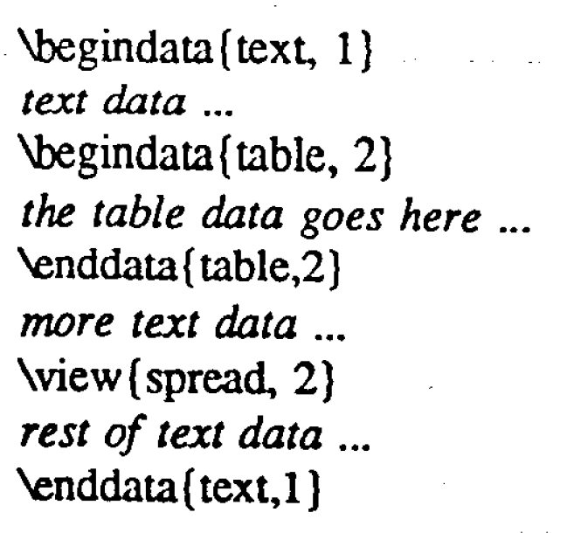
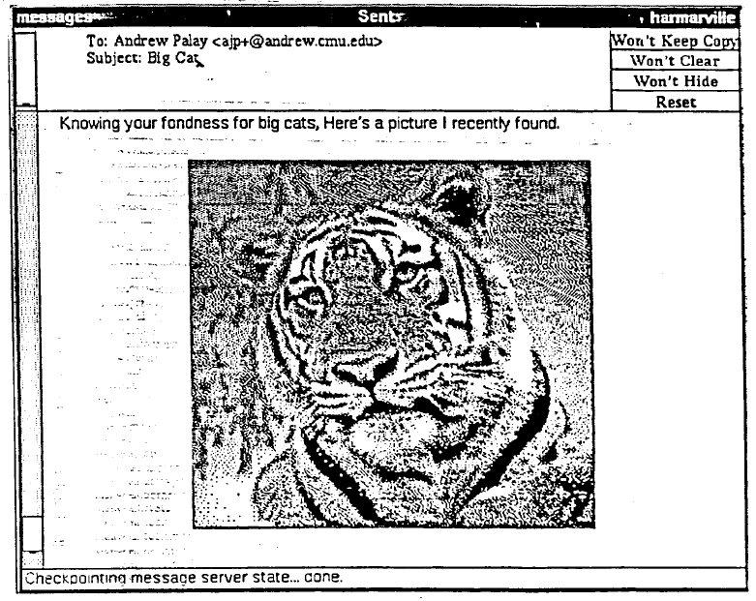
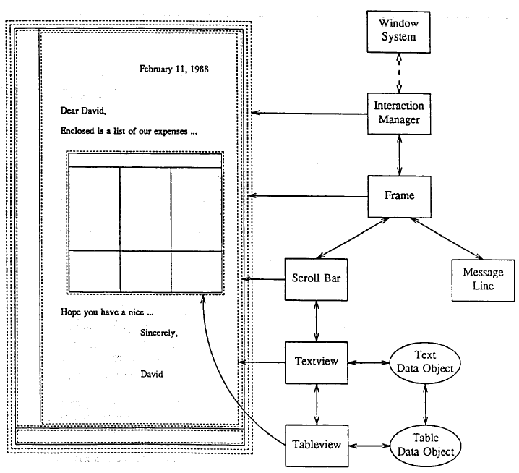
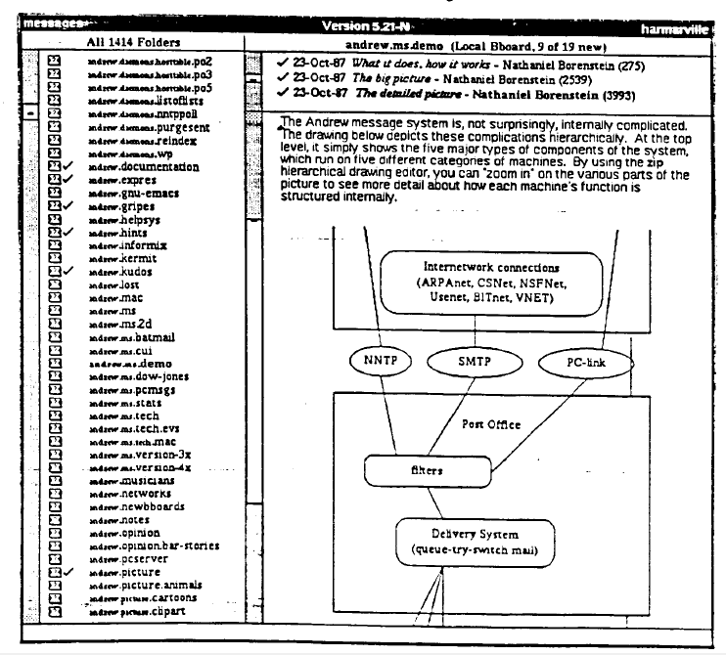
Andrew Pictures

Slide 10
OLE
Microsoft's technology for components
"Object Linking and Embedding"
Quite complicated due to need to be
  backwards compatible
  language independent (multiple programming languages)
  not shared address space
Somewhat easier if use MFC framework rather than raw C or C++ calls
Based on "COM" = "Component Object Model“

Slide 11
Commercial Third-party components
"COM supports the only currently viable component marketplace. The market for third-party components based on COM has been estimated at US$670 million dollars in 1998, with a projected 65 percent compound annual growth rate, growing to approximately US$3 billion dollars by 2001. (Source: Giga Information Group)" http://www.microsoft.com/com/default.asp [as of 1999, still valid in 2017]

Slide 12
OLE, cont.
also:
  OLE Automation (control app from Visual Basic, etc.)
    Also for spell checkers, EndNote, etc.
  OLE Controls (how create new widgets, especially for use with Visual Basic = VBX controls)
Query OLE objects to ask them what "interfaces" (protocols) they support
Then use the protocols for communication
Embedded Object vs. Linked Object -- where the "real" data is
"In-place activation" (not in OLE 1.0)
  Double click to open
  Modifies main menubars

Slide 13
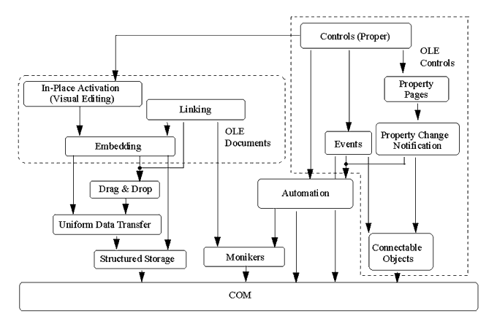
COM + OLE

Slide 14
ActiveX
OLE renamed "ActiveX", which is designed for use with the Web
Allows OLE controls to run inside Internet Explorer and for regular applications
Java (or VB, Delphi, C, etc.) applications in an OLE wrapper
"Encapsulation" of components
Only runs on Win32 machines or in IE
Thousands of controls and components available

Slide 15
Corba
Common Object Requesting Broker Architecture
Object Management Group (OMG) standard for communication across machines
Remote object method calls
Language independent
1991-present
Define protocol in interface definition language (IDL)
  C++ or Java-like

Slide 16
OpenDoc
From Apple
  Officially "CI Labs" consortium (with IBM, Novell, Adobe, 300 others...)
  Now abandoned
  approx, 1994 - 1997
All C++, so easier to use
  True object system with inheritance

Slide 17
OpenDoc, cont.
Addressed some perceived shortcomings of OLE:
  Overlapping and non-rectangular shaped frames
  Editing of multiple objects at same time
  Active ("Live") objects
  Better network support (CORBA compliant)
  Claims less development effort than OLE
OpenDoc provided OLE compatibility
Formerly: http://www.opendoc.apple.com// now disappeared, also www.cilabs.org is gone also.
Pretty cool network browser "CyberDog" made with OpenDoc

Slide 18
Java Beans
Component technology for Java
Approx, late 1996
Different from Applets, since Applets don't interact with each other
Takes advantage of features of Java
  Some added specifically to make components easier
  "Platform Neutral" -- fully portable
  Security for untrusted components
  "Java Core Reflection" - for Introspection - to find out what methods a class supports
    If follow "Design Patterns", then don't have to explicitly specify the interface – conventions that developers have to follow
    e.g., GetFoo, SetFoo for the foo property
  "Java Object Serialization" - to store to files ("persistence")
  AWT/Swing - for layout and graphics

Slide 19
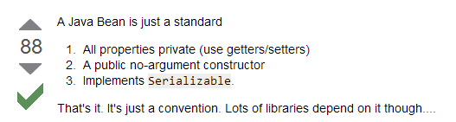
What is a Java Bean exactly?
http://stackoverflow.com/questions/3295496/what-is-a-java-bean-exactly from Oct 30 '12

Slide 20
Java Beans, cont.
Goal: to be simple and small
Can be easily integrated into a builder tool (and edit exposed properties)
"Bridge" to OLE and OpenDoc
Uses CORBA and remote method invocation for networking
"Real" support for networking and distributed computation
Each component runs in a separate address space (for security)
Beans Development Kit (BDK)
"BeanBox" -- container
Implements a kind of constraints with property-change-listeners

Slide 21
Java Beans Features
Introspection: enables a builder tool to analyze how a Bean works
Customization: enables a developer to use an app builder tool to customize the appearance and behavior of a Bean
Events: enables Beans to communicate and connect together
Properties: enable developers to customize and program with Beans
Persistence: enables developers to customize Beans in an app builder, and then retrieve those Beans, with customized features intact, for future use

Slide 22
Java 2
The Extensible Runtime Containment and Services Protocol - find out about the container of the bean
The Drag and Drop Subsystem for the Java Foundation Classes - interoperate with native drag-and-drop
The JavaBeans Activation Framework - find type of data and what operations are available for it

Slide 23
Java Beans Spec
JavaBeans Web Pages (http://docs.oracle.com/javase/8/docs/api/index.html?java/beans/Beans.html)
Not much changed since version 1.01 from December 1996
Never addressed: Menubar merging, etc.
Used to have a list of Commercial Beans from Java site, but all gone:
  http://java.sun.com/products/javabeans/marketing.html
  http://java.sun.com/products/javabeans/directory
  http://beans.cuesta.com/
  332 as of 4/24/00 up from 257 as of 4/19/99
  http://www.jfind.com/listings/c4-1.shtml had 179 java beans (2009)
  (none listed on Wikipedia)

Slide 24
Microsoft's .Net
Announced mid-2000, released Summer 2001
Component technology for the Internet
Focus on putting “web services" together from parts by different vendors
see, for example:
  J2EE vs. Microsoft.NET: A comparison of building XML-based web services, by Chad Vawter and Ed Roman June 2001.
  http://www.theserverside.com/tt/articles/article.tss?l=J2EE-vs-DOTNET

Slide 25
.Net parts
Common Language Runtime (CLR)
  Supports various language implementations
New languages, like C#
New version of Visual Basic, more OO
New SDKs for graphics, etc. accessible from C# and VB.Net
  “.Net Compact Framework” for PocketPCs
SDKs for communicating using XML as if remote procedure calls

Slide 26
Service-Oriented Architecture
Like components on the Web
Also called “web services”
Each “service” (like a component) does a particular thing
  May each be on different machines
  Communicate to the client through messages
  Services do not (usually) communicate with other services
Usually, services access or update a database
Concept: replaceable, composable
  Get a credit card service from one vendor, and combine with ordering from a different vendor

Slide 27
SOA protocols
Communicate to the services using a protocol over the web
  Two popular methods: SOAP & REST
  SOAP: Simple Object Access Protocol uses XML to provide Remote-Procedure Call semantics
    Started ~1998
    Backed by Microsoft
    SOAP for SOA adds WSDL spec of XML
      Web Services Description Language ~ 2000, WSDL 2.0 in 2007
    Complex set up, not flexible, WSDLs tend to be long and hard to understand

Slide 28

Study of APIs for eSOA
Sponsored by SAP
Study APIs for Enterprise Service-Oriented Architectures (“Web Services”)
Client-server architecture
organized into services using
XML to communicate
Enormously complex
  Requires significant
  flexibility and customizability
Server
Services
XML
WSDL
XML
Client
Stub Code

Slide 29
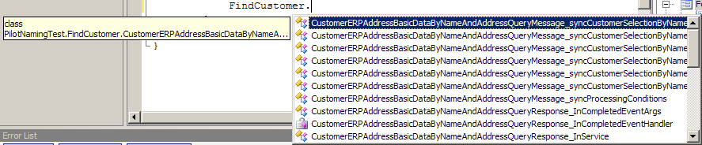
eSOA Studies Results
“Stub generators” that connect code to XML introduce complexities
  No sample code since multiple targets
Naming problems:
  Too long
  Not understandable
  Differences in middle are frequently missed
CustomerAddressBasicDataByNameAndAddressRequestMessageCustomerSelectionCommonName
CustomerAddressBasicDataByNameAndAddressResponseMessageCustomerSelectionCommonName

Slide 30
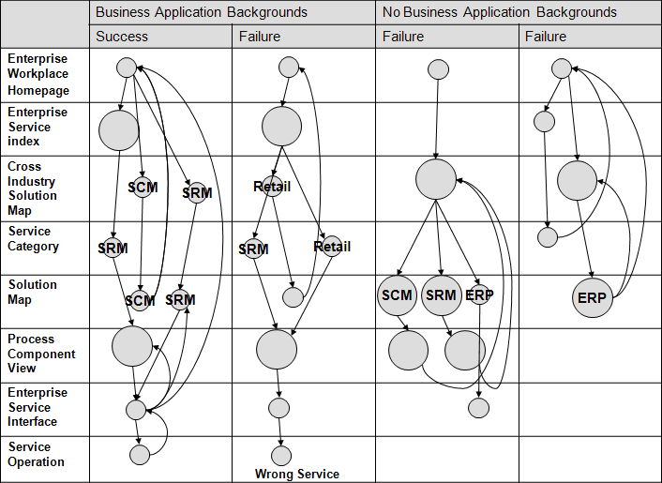
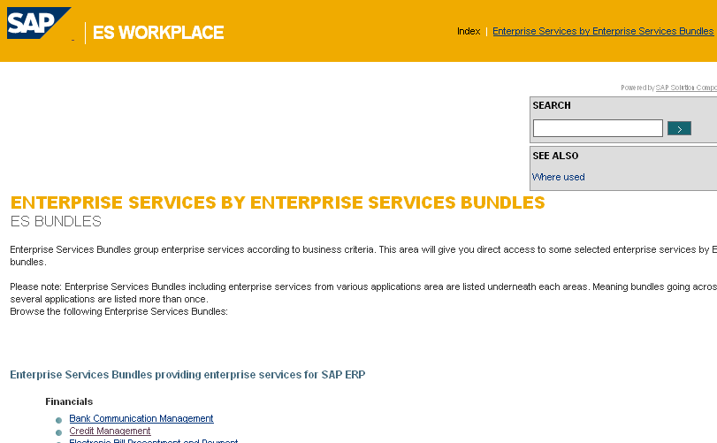
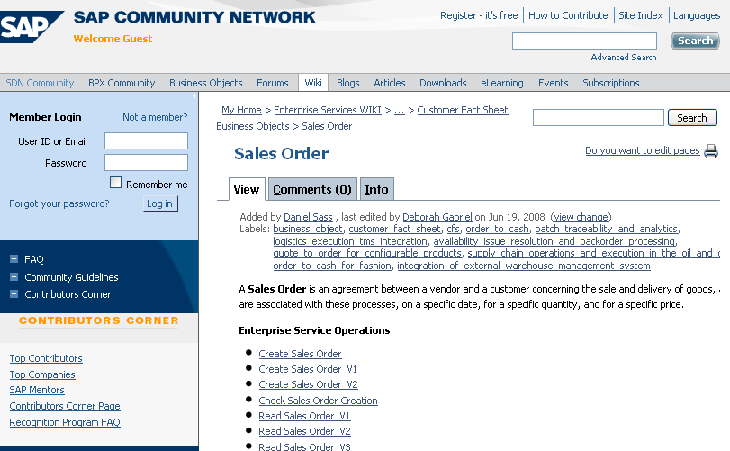
eSOA Documentation Results
Multiple paths: unclear which one to use
Some paths were dead ends
Inconsistent look and feel
caused immediate
abandonment of paths
Hard to find required info.
Business background helped

Slide 31
SOA protocols
REST - Representational state transfer
  PhD thesis of Roy Fielding who helped define http
  Just use the http protocol without extra specifications
    URLs for resources with POST, PUT, GET, DELETE messages
  Flexible but unclear what is allowed
  Now seems to be dominant (only?) protocol used

Slide 32
SOA Examples
Amazon web services
  Can build a store
Facebook
SAP
  Highly complex, over 3000 services
  Complex documentation
  See our papers about it:
  http://www.cs.cmu.edu/~NatProg/apiusability.html#eSOA
  Now renamed

Slide 33
Cloud
Big push now from all vendors now
  Amazon AWS, Microsoft Azure, Google Cloud, IBM, …
Organized as collections of “services” with APIs
Web or native apps put together a collection of services
  Client APIs to make the communication invisible
Easy to create apps without much infrastructure or coding

