Slide 1
Lecture 17:
Demonstrational Tools
Brad Myers
05-830
Advanced User Interface Software
Spring, 2017

Slide 2
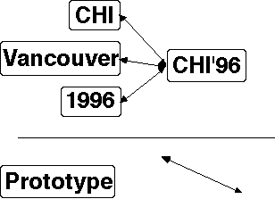
Overview
Direct Manipulation allows properties to be set by directly moving objects with the mouse and setting properties
  Examples: interface builders, Visual Basic (last lecture)
Limited to static parts of the interface
  No way to point at
  objects that will be
  drawn by the user
  How set the color of an
  object in Visual Basic
  at run time?

Slide 3
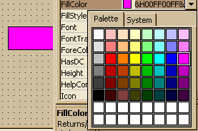
Visual Basic Example
Example:
vs.
VB: Let Shape1.FillColor = &H00FF00FF&
ML: SetColor ( Shape1, 0x00FF00FF )

Slide 4
Demonstrational Tools
Demonstrational Tools allow the user to operate on example objects which represent objects that are created at run-time.
  For example, the system must find out that the size of the boxes depends on the actual labels typed by the user and where the lines attach.
  In general, demonstrational systems allow the user to operate on examples, and then generalizes to produce a general-purpose procedure or prototype.
"Examples":
  draw an example of the objects that will be created at run time
  draw objects in approximately the right places, and systems creates general constraints
This is a hard problem, which is why you don't see many commercial products that do this.
Machine Learning systems generally learn from lots of labeled examples

Slide 5
Demonstrational Interfaces
There are also demonstrational systems for other domains (not for creating UIs):
  My group:
    Text editing (Tourmaline, Andy Werth INI MS thesis)
    Creating shell programs (Francesmary Modugno's PhD thesis on "Pursuit")
    Creating custom business charts and graphs (my patent on this technology)

Slide 6
Demonstrational Interfaces, cont.
Others:
  Text editing (renumber by example, styles)
  Graphical editing (graphical procedures)
  Determining loops in HyperCard ("Eager")
  etc.
"Classic" Reference: Allen Cypher, ed. Watch What I Do, MIT Press. 1993.
Later book: Henry Lieberman, ed. Your Wish is My Command. 2001: Morgan Kaufmann.
My group has chapters in both

Slide 7
Motivation
Demonstrational techniques expand how much of the interface can be specified interactively.
And Interactive editors are much faster to use than programming with toolkits
  Frameworks improve productivity by factors of 3 to 5, interactive tools by factors of 10 to 50!
  It might take an hour to draw an interface interactively, compared to days to program it.
  Because they are faster, this promotes rapid prototyping
It is much more natural to specify the graphical parts of applications using a graphical editor.
Because they do not require programming skills, graphic designers can design the graphical parts of the interface.

Slide 8
Examples (of uses to create UIs)
(chronological order)

Slide 9
Peridot (1986-88)
Myers B. "Creating User Interfaces Using Programming-by-Example, Visual Programming, and Constraints," ACM Transactions on Programming Languages and Systems. vol. 12, no. 2, April, 1990. pp. 143-177. (Peridot)
Myers B., Creating User Interfaces by Demonstration, Academic Press, San Diego, 1988.
Myers B., "Creating Interaction Techniques by Demonstration," IEEE Computer Graphics and Applications, Vol. 7, No. 9, IEEE, September 1987, pp. 51 - 60.
First demonstrational tool, and it used by-example techniques to allow the creation of new widgets.
From the drawings, it infers:
  Graphical constraints among the objects, such as that the boxes should be the same size as the text.
  control structures such as iteration over all the items in a menu
  how the mouse affects the graphics, such as that the check mark should follow the mouse.
feedback: question and answer
video (8 min)

Slide 10
Lapidary (1989-1993)
Myers B., Vander Zanden B. and Dannenberg R., "Creating Graphical Interactive Application Objects by Demonstration," Proceedings of the ACM Symposium on User Interface Software and Technology, UIST'89, Williamsburg, November 1989, pp. 95 - 104.
Brad Vander Zanden and Brad A. Myers. "Demonstrational and Constraint-Based Techniques for Pictorially Specifying Application Objects and Behaviors," ACM Transactions on Computer-Human Interaction. vol. 2, no. 4, Dec, 1995. pp. 308-356.
Extends Peridot to allow the creation of application-specific graphical objects, like nodes in a graphics editor.
Uses less inferencing and more dialog boxes
Is "real" and you get it as part of the Garnet distribution
Problems:
  can only demonstrate "syntactic" parts of application
  hard to set up correct constraints
video (12 min)

Slide 11
DEMO and DEMO II (1991, 1992)
David A. Wolber and Gene L. Fisher, "Demonstrational Technique for Developing Interfaces with Dynamically Created Objects," Proceedings UIST'91: ACM SIGGRAPH Symposium on User Interface Software and Technology, Nov, 1992, Monterey, CA, pp. 89-97.
Gene L. Fisher, Dale E. Busse, and David A. Wolber, "Adding Rule-Based Reasoning to a Demonstrational Interface Builder," Proceedings UIST'92: ACM SIGGRAPH Symposium on User Interface Software and Technology, Nov, 1991, pp. 221-230.
DEMO was first system to support dynamic creation of objects.
Infers graphical relationships by examples of edits
DEMO-II adds extensive inferencing of graphical constraints from examples; guide lines

Slide 12
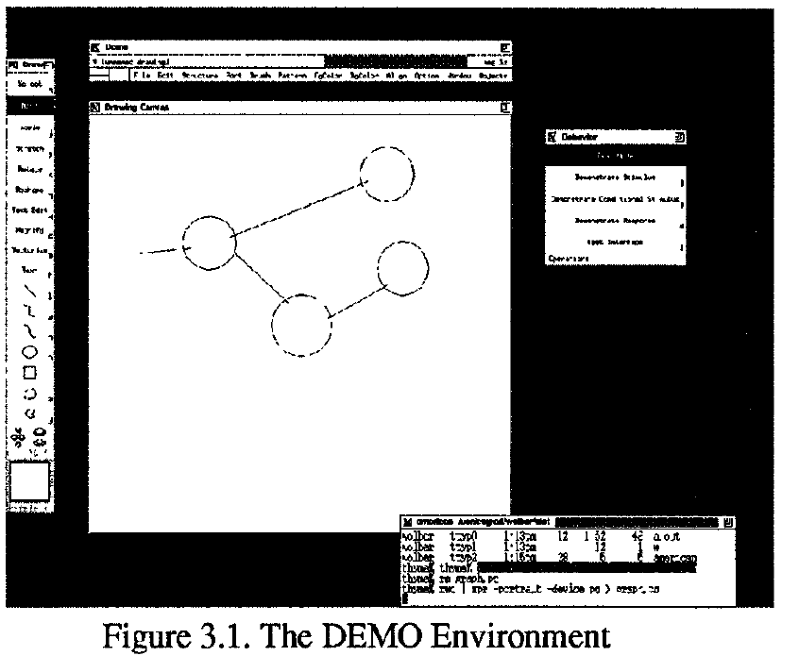
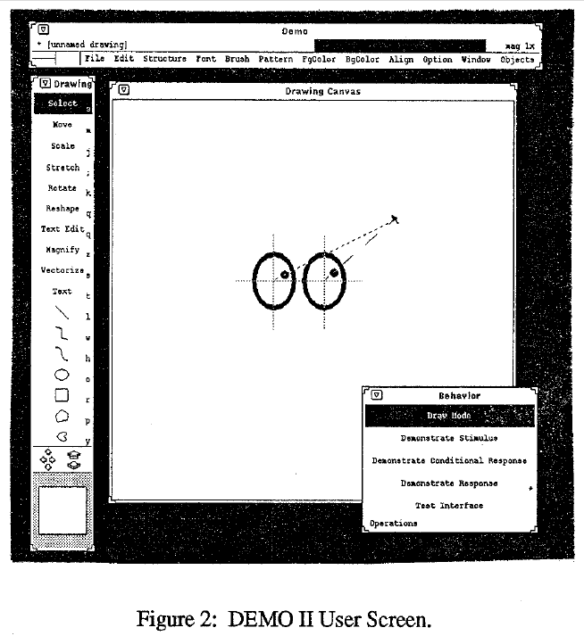
video 2:28 (gone!)

Slide 13
Marquise (1993-1994)
Myers B., McDaniel, R. and Kosbie, D.. "Marquise: Creating Complete User Interfaces by Demonstration," Proceedings CHI'94: Human Factors in Computing Systems. Amsterdam, The Netherlands, April 24-29, 1993. pp. 293-300.
Go back to doing more by demonstration, and just show the way that the interface should operate.
In particular, demonstrate when the behaviors should start and what the feedback looks like.
  mouse button does one of 10 things, depending on where press and global mode.
Demonstrate both behavior and conditions
Built-in support for palettes and modes.

Slide 14
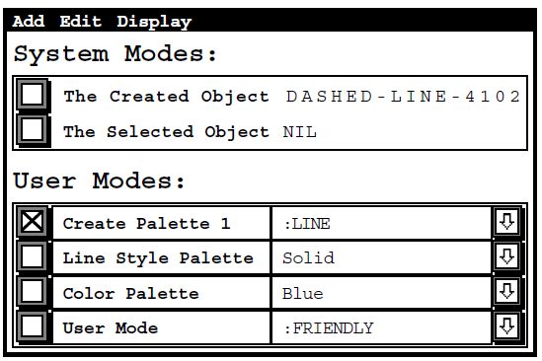

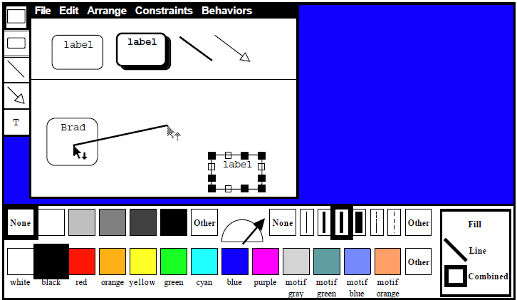
Marquise windows

Slide 15
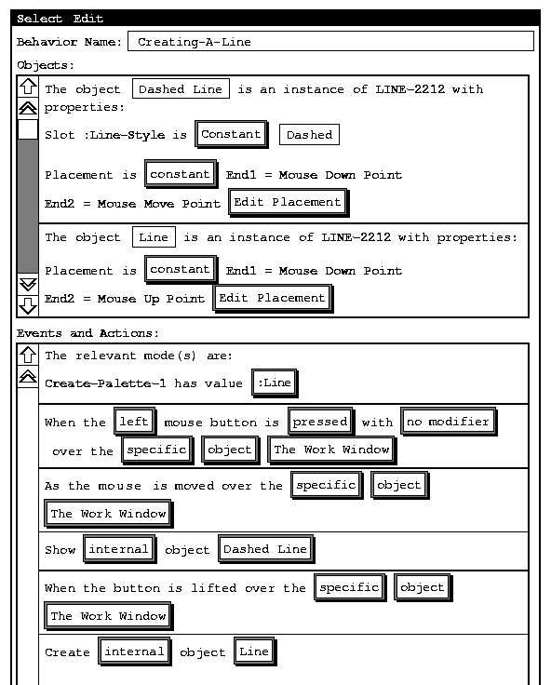
Marquise feedback window
video (12 min)

Slide 16
InferenceBear & Grizzly Bear (1994-1996)
Martin R. Frank, Piyawadee "Noi" Sukaviriya, James D. Foley. “Inference bear: designing interactive interfaces through before and after snapshots,” DIS’95. Ann Arbor, Michigan, pp. 167 – 175. pdf
Martin Frank, Model-Based User Interface Design by Demonstration and By Interview. PhD Thesis, Georgia Tech, 1996.
(Discussed his "Elements, Events & Transitions (EET) language in the event-language lecture)
User control through dialog boxes, edit using textual language: EET
Snapshots of before and after
Multiple examples
  More positive examples to cause generalization
  Negative examples to specify exceptions
Pictures – next slide

Slide 17
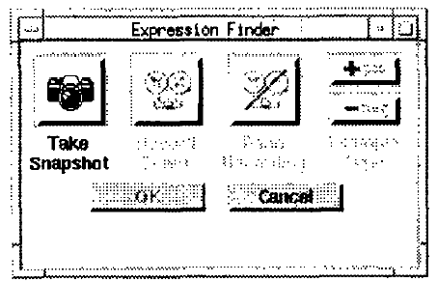
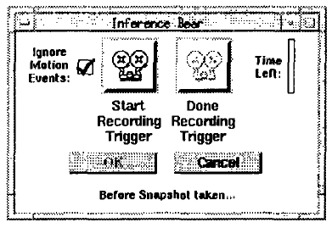
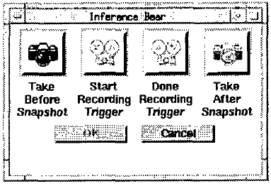
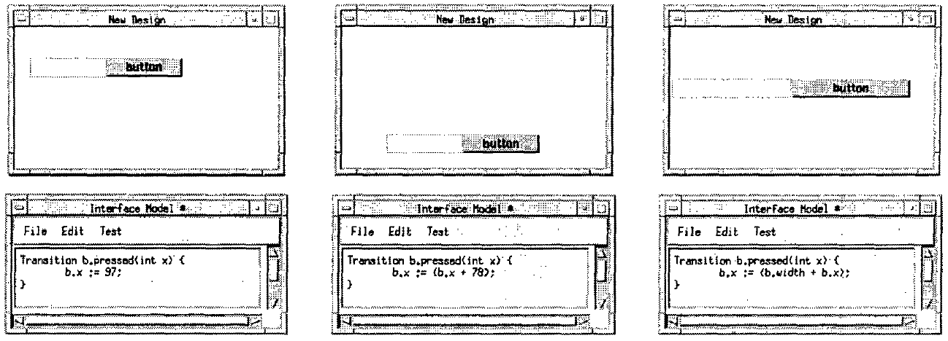
InferenceBear Pictures

Slide 18
Pavlov (1995-97)
David Wolber, "Pavlov: Programming by Stimulus-Response Demonstration," Proceedings CHI'96, Human Factors in Computing Systems. April 1996. pp. 252-259
Stimulus from mouse or time-based
Score editor for feedback and editing
Video (gone)

Slide 19
Gamut (1996 - 1999)
PhD thesis of Rich McDaniel.
Richard G. McDaniel and Brad A. Myers. "Building Applications Using Only Demonstration," IUI'98: 1998 International Conference On Intelligent User Interfaces, January 6-9, 1998, San Francisco, CA. pp. 109-116. pdf
Richard G. McDaniel and Brad A. Myers, "Getting More Out Of Programming-By-Demonstration." Proceedings CHI'99: Human Factors in Computing Systems. Pittsburgh, PA, May 15-20, 1999. pp. 442-449. ACM DL Reference
Domain: "board games" and educational software
Goal: new interaction techniques so can infer more complex behaviors
E.g., how a piece can move in Monopoly / Chess
Reduce number of modes
New interaction techniques to provide hints
  "Do Something!", "Stop That", Hint highlighting, Temporal Ghosts, Guide objects, Deck of Playing Cards, etc.
Better inferencing algorithms
video (4.5 min)

Slide 20
Topes (2004-2009)
Chris Scaffidi’s PhD thesis:
  “topes” = user-level types for end-user programming (EUP)
    Create parsers, data-transformations
  Infers topes from a list of examples

Slide 21
Topes in action
Users create data descriptions (abstract, user-friendly descriptions of data categories)
Users publish data descriptions on repositories.
Other users download data descriptions to cache.
System automatically generates tope implementations from data descriptions.
Tool add-ins help users browse their cache and associate topes with variables and input fields.
Add-ins get topes from local cache and call them at runtime to validate and reformat data.
Introduction • Requirements • Topes • Tools • Evaluation • Conclusion

Slide 22
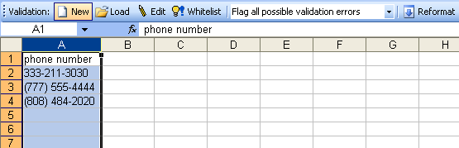
What the user sees
User highlights cells
Clicks “New” button
on our Validation
toolbar
Introduction • Requirements • Topes • Tools • Evaluation • Conclusion

Slide 23
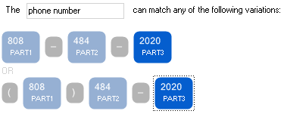
System infers a boilerplate tope and presents it for review and customization
Induction steps:
Identify number & word parts
Align parts based on punctuation
Infer simple constraints on parts
23
Introduction • Requirements • Topes • Tools • Evaluation • Conclusion

Slide 24
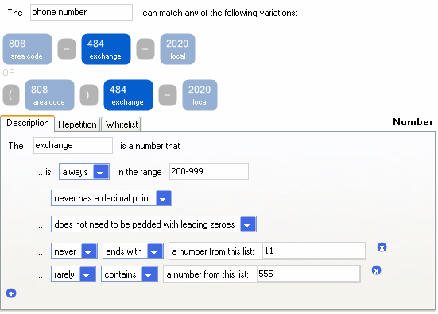

User gives names to the parts and edits constraints
Features
Part names
Value whitelists
Testing features
Soft constraints
(never / rarely / often /
almost always / always)
Introduction • Requirements • Topes • Tools • Evaluation • Conclusion

Slide 25
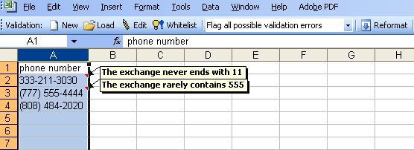
System identifies typos
Features
Targeted messages
Overridable
Filterable
Can add to “whitelist”
Integrated with Excel’s “reviewing” functionality
Checking inputs
Convert description to CFG w/ constraints on productions
Parse each input string
For each constraint violation, downgrade parse’s isa score
Introduction • Requirements • Topes • Tools • Evaluation • Conclusion

Slide 26
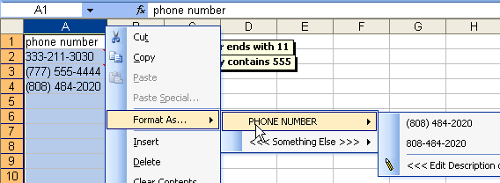
Easy access to reformatting functionality
Reformatting string
Parse with input format’s CFG
For each part in target format,
  Get node from parse tree
  Reformat node if needed (recurse)
  Concatenate (with separators if needed)
Validate result with target format’s CFG
Introduction • Requirements • Topes • Tools • Evaluation • Conclusion

Slide 27
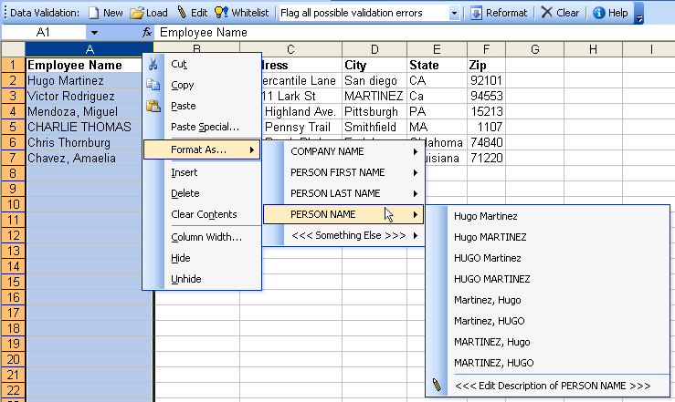
Recommending topes based on label and examples-to-match
Efficient recommendation
Only consider a tope if its instances could possibly have the “character content” of each example string.
(eg.: could this have 12 letters & 1 space?)
Introduction • Requirements • Topes • Tools • Evaluation • Conclusion

Slide 28
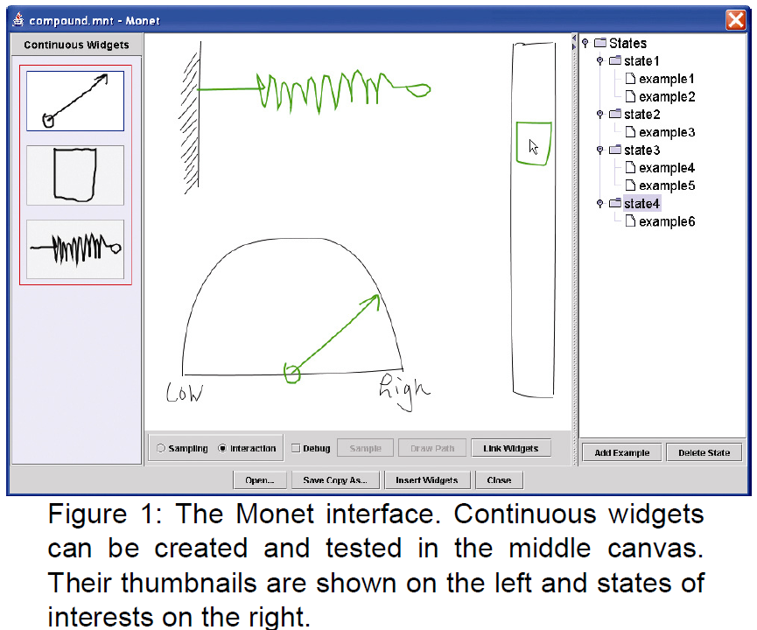
“Monet” by Yang Li &
James A. Landay, UIST’2005
Yang Li and James A. Landay. 2005. Informal prototyping of continuous graphical interactions by demonstration. In Proceedings of the 18th annual ACM symposium on User interface software and technology (UIST '05). ACM, New York, NY, USA, 221-230. http://dx.doi.org/10.1145/1095034.1095071
Infers continuous
behaviors from
examples
  Rotating
  Scaling
  Sliding
Multiple examples
Video, 6:34

Slide 29
Draco, Skuid
Rubaiat Habib Kazi, Fanny Chevalier, Tovi Grossman, Shengdong Zhao, and George Fitzmaurice. 2014. Draco: bringing life to illustrations with kinetic textures. In Proceedings of the SIGCHI Conference on Human Factors in Computing Systems (CHI '14). 351-360. DOI: https://doi.org/10.1145/2556288.2556987
Sketch to show animations and movements
Augmented with dynamic animation effects
Commercialized by AutoDesk
Video (4:57)

Slide 30
Toby Li’s Sugilite
Toby Li, Amos Azaria, and Brad Myers. "SUGILITE: Creating Multimodal Smartphone Automation by Demonstration", Proceedings CHI'2017: Human Factors in Computing Systems, Denver, CO, May 6-11, 2017. To appear. preprint pdf and video. Best paper Honorable Mention award.
Programming by example for Android
Scripts (macros) of common or repetitive tasks
Uses the Android accessibility API
Invoke using Speech or GUI
Generalizes based on other menu items seen
Currently, uses multiple examples only when script fails
  Can replace or add fork
Video (6:48)

Slide 31
Commercial Systems
Excel Flashfill
Adobe Catalyst
  Create menus by giving examples of the items
  Scroll bars by indicating the parts (thumb, track, etc.)
  But discontinued ☹
What else?

Slide 32
General Disadvantages
People are actually not very good at coming up with concrete examples
  examples tend to show the system the same thing over and over
  people can’t think of the edge cases and negative examples
People need to be able to edit the code, so need a representation they can understand

Slide 33
Open Issues
Sometimes examples are harder than specifying
  “and” vs. “or”
How intelligent is enough?
  Predictability
  AI problem
Techniques for feedback and editing
Combining inferencing with direct editing of the code
A “really” successful product using this technology

