Slide 1
Lecture 16:
Interactive Tools: Prototypers (HyperCard, Director, Visual Basic), Interface Builders,
Sketching Tools
Brad Myers
05-830
Advanced User Interface Software
Spring, 2017

Slide 2
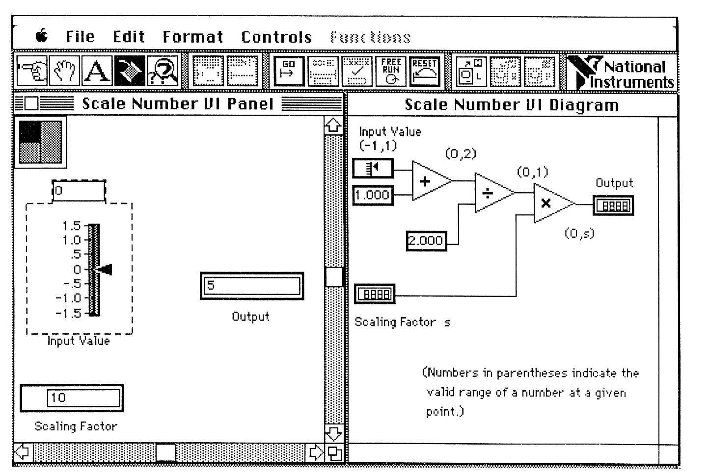
Definition
Tools that Use graphical techniques to specify UI
Usually focus on graphical parts of UI
Not same as “visual” or “graphical programming”

Slide 3
Prototyping Tools
Just show what looks like
  Storyboard of screens
“Click-through prototypes”
Note: differentiate from term "rapid prototyping“
Some support for behavior: typically changing screens
Like a movie of the interaction
Goal: see some of interface very quickly (hours)
Often no possibility of migrating to real application
May not use "real" widgets
"Low Fidelity" Techniques

Slide 4
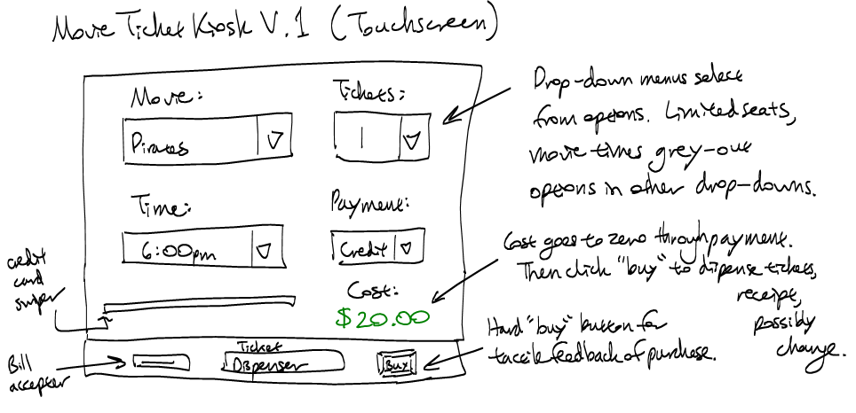
Low Fidelity Prototyping
Just use paper and/or overheads
  No tools
  Experimenter "plays computer"
  Ask the user "what would you
  do now“
  Experimenter shows the
  computer's expected response
  Very cheap and easy and
  gets surprisingly good results
  Find out if users understand organization, how to find desired operations, if understand menu names, etc.
  Easy to change between sessions
Can make a movie of the paper using a regular video camera
  To demonstrate/explain the interface

Slide 5
Early Prototypers
For Character Screens
  24x80 DOS, often no mouse
  Especially for forms-based applications
  Examples: Dan Bricklin’s Demo-It (Windows v2.0 ~1987), Protoscreens for PCs from Bailey&Bailey (~1990)
  Specify characters for each position of screen, or a "character graphics"
  Can specify fields that are editable text
  Can specify that clicking on an area causes changing to a new screen.
  Also menus

Slide 6
Card Programs as Prototypers
Card Programs
  Examples:
    HyperCard and SuperCard for Mac
    OWL's GUIDE for PCs (gone?)
    Toolbook (formerly from Asymetrix then Click2Learn, then SumTotal Systems, Inc. http://www.toolbook.com)
  Sequence of cards
  Paint program (not "draw")
  Draw pictures on each card
  May be multiple layers

Slide 7
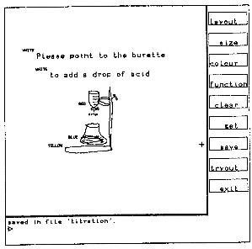
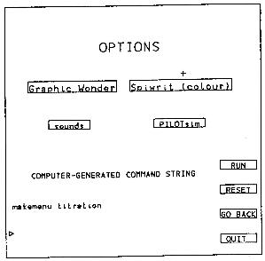
Early Research Card Systems
Menulay
  Buxton, Siggraph’83 pp. 31-38
    http://www.billbuxton.com/menulay.pdf
    http://www.youtube.com/watch?v=Kt0oAg0haU0
  vector screens, widgets, sounds, text,
  output C code and tables
  All actions (including transitions)
  required C
  programming

Slide 8
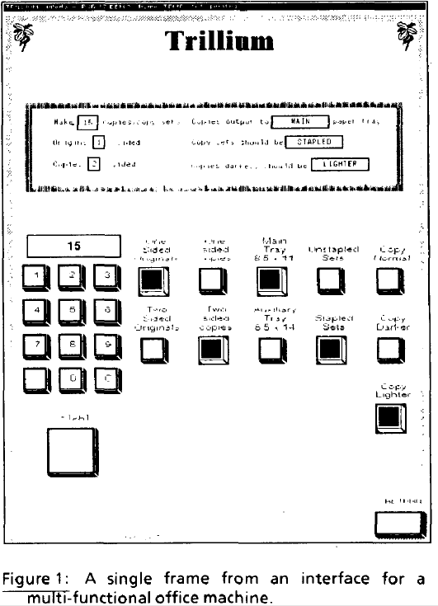
Early Research Card Systems, cont.
Trillium
  Henderson, CHI’86
  http://doi.acm.org/10.1145/22339.22375
  Xerox copier interfaces
  interpreted Lisp
  Transitions defined using the
  interface

Slide 9
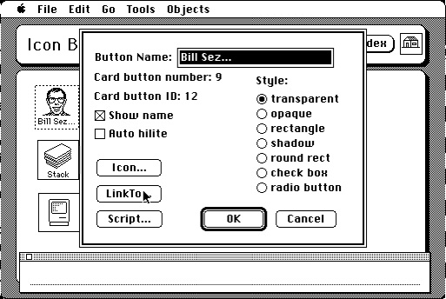
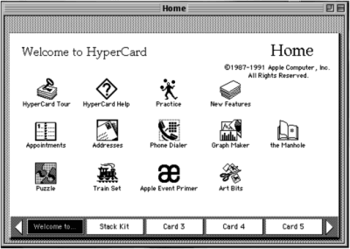
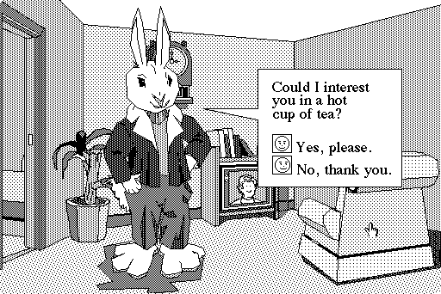
HyperCard
1987 – 2004

Slide 10
HyperCard, details
  Buttons can transition to another card
    Fancy transitions
  Single window
  Buttons can start running a script ("HyperTalk")
    Script can move objects, change cards, animate, compute, etc.
    Code management: who changes what; finding the script
    Not good for dynamically created graphics
  Complete control of individual pixels
    Graphic designers have complete control
    Design new widgets
  Can be "real" application if sufficient power/speed
    Used for original Myst game, etc.

Slide 11
Animation Programs
Example: MacroMedia’s Director (1987) – now Adobe
  Replaced (pretty much) by Adobe Flash
  Discontinued January 27, 2017
Also control individual pixels
Individual paintings can be specified as animation element
  E.g., characters
  Each can be instantiated, moved, etc.
Good control over timing, synchronization
Scripting language
  Can program that when a mouse button is clicked in an area, start an animation or transition
  Scripting language even more primitive than HyperTalk
Good for "Future Scenarios" when want good fidelity with real look
Not for final (real) interface unless Multi-media

Slide 12
Interface Builders
Also called Interface Development Tools (IDTs) or GUI Builders or “resource editors”
Lay out widgets to make dialog boxes, menus.
Have a palette or menu of kinds of widgets
Select widget, place with mouse in a window
Set some properties
Design menus, palettes, dialog boxes, controls
Put in “graphics” pane for main application window
Easy to use, but limited
Connect call-backs with each widget
Generates C code directly or intermediate language
Sometimes connected to an intepreter so can execute call-backs.
  If not, some call-backs can be simulated, e.g. transition to another window; pop-up error

Slide 13
Interface Builders, cont.
Layout mechanisms
  usually a complication
    X's row and columns stuff
    Galaxy's struts and springs
    Java’s Layout Managers
“Resources”
  store information in special files rather than in source code
  positions, colors, text labels, etc.
  allow for easier modification for users, internationalization, etc.
IBs Usually don't support:
  Error checking of values, e.g. for text input fields
  Graying of widgets depending on values and other widgets
  Default values of widgets
  Dynamic changing of widgets (e.g., add more items)
  Dynamic changing layers (groups) of widgets (visibility) depending on values and other widgets
  Any dynamically created graphical objects.

Slide 14
Interface Builders, cont.
  Examples:
    See “Card” systems, e.g., Menulay (1983-research system)
    NeXT Interface Builder (NeXT) - 1988 popularized the name
      By Jean-Marie Hullot who had an IB in Lisp at INRIA in France
    Visual Basic
    Resource editors in programming environments
  Used to be lots of IB products
    Used to be many commercial tools are in this category; over 100
      See my old list (1997): http://www.cs.cmu.edu/~bam/toolnames.html
    Most went out of business
    Microsoft, MetroWorks, etc. include “resource editors” for “free”

Slide 15
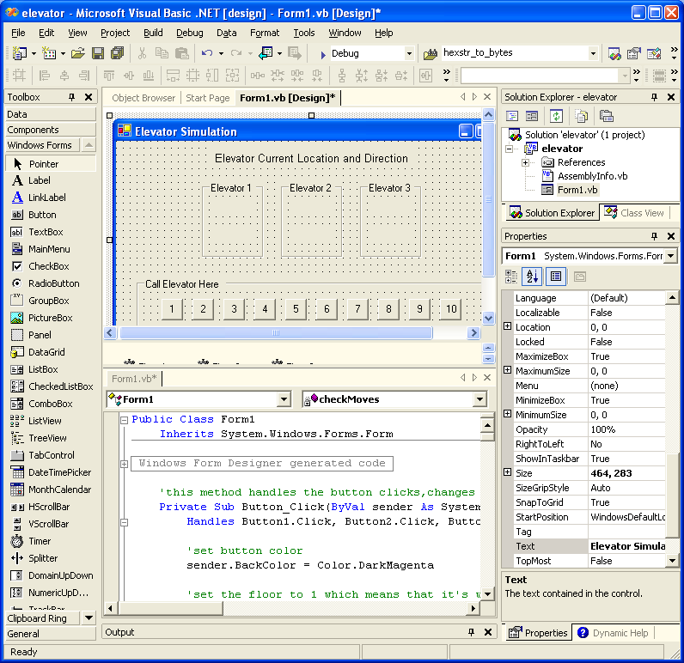
VB
Screen

Slide 16
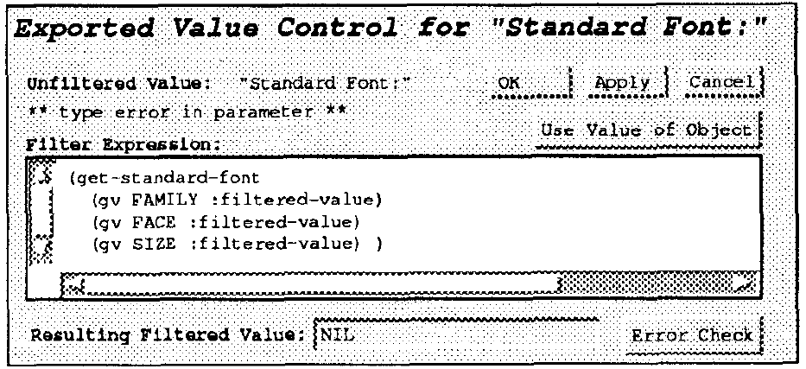
Some Research in IB
Garnet’s GILT interface builder:
  Eliminating Call-backs (UIST’91)
    http://doi.acm.org/10.1145/120782.120805 or
    video (5min) or video of both (9 min)
    Handles error checking, data transformations, connections of widgets to each other

Slide 17
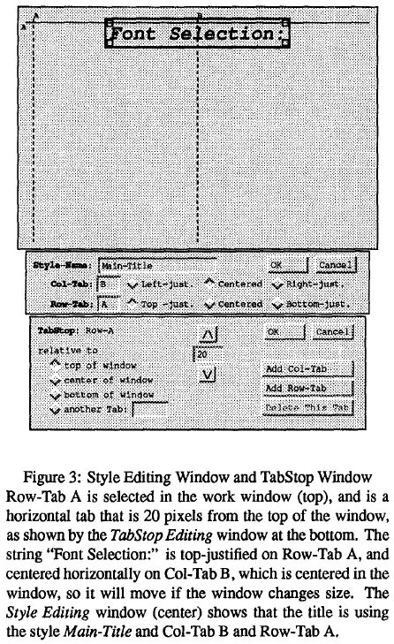
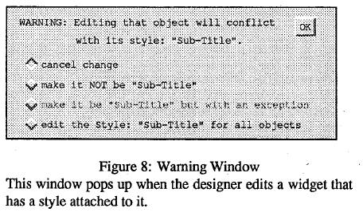
More Research in IB
Garnet’s GILT interface builder:
  Styles by example (Hashimoto, UIST’92)
    http://doi.acm.org/10.1145/142621.142635 or
    video (about 2 min)
    Graphical tab stops, absolute or relative
    Graphical styles for widget properties
    Based on Microsoft Word features, applied to graphics
    Created by example or manually

Slide 18

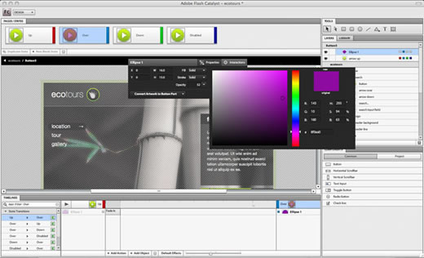
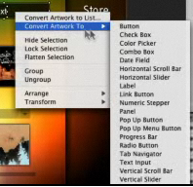
Novel IB
Adobe Flash Catalyst (formerly Thermo)
  Part of CS5.5, then discontinued in CS 6.0
  Associate behaviors with the objects
  Like my Lapidary (see next lecture)

Slide 19
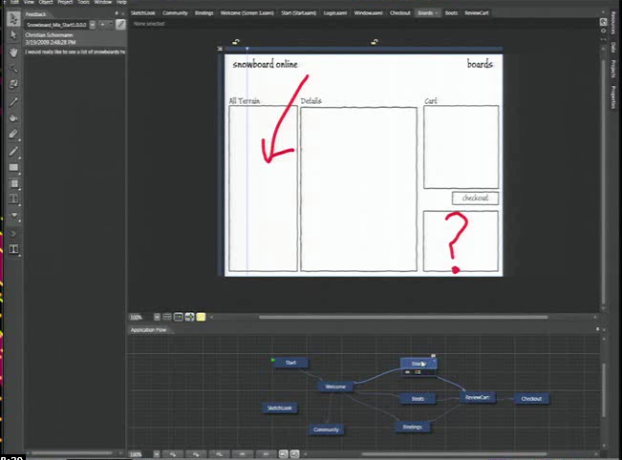
Microsoft’s Expression Blend
Microsoft Silverlight Blend’s SketchFlow
  http://channel9.msdn.com/Events/MIX/MIX09/C01F (1 hour video)
2006-2012
Behaviors, etc.
as well
Landay says this
has “sketching”
(see 3/19/09 blog)
Now discontinued
  Some features
  put into Visual
  Studio

Slide 20
Commercial Prototypers
Search for “Prototyping tools” or “Wireframing Tools”
Here are some lists:
  https://blog.prototypr.io/the-7-best-prototyping-tools-for-ui-and-ux-designers-in-2016-701263ae65e8#.le0arqkey
  http://mashable.com/2010/07/15/wireframing-tools/ - “10 free wireframing tools”
  http://www.uxbooth.com/blog/15-desktop-online-wireframing-tools/
  http://www.tripwiremagazine.com/2010/04/15-best-wireframing-tools-for-designers.html
  http://www.uie.com/articles/prototyping_tools/?link=tips100318_6
  http://c2.com/cgi/wiki?GuiPrototypingTools

Slide 21
Examples:
Axure (downloaded)
On-line tools
  Fluid UI
  Balsamiq (http://www.balsamiq.com/)
  Justinmind
  Moqups
  Mockingbird
  FluidUI
  Mockflow

Slide 22
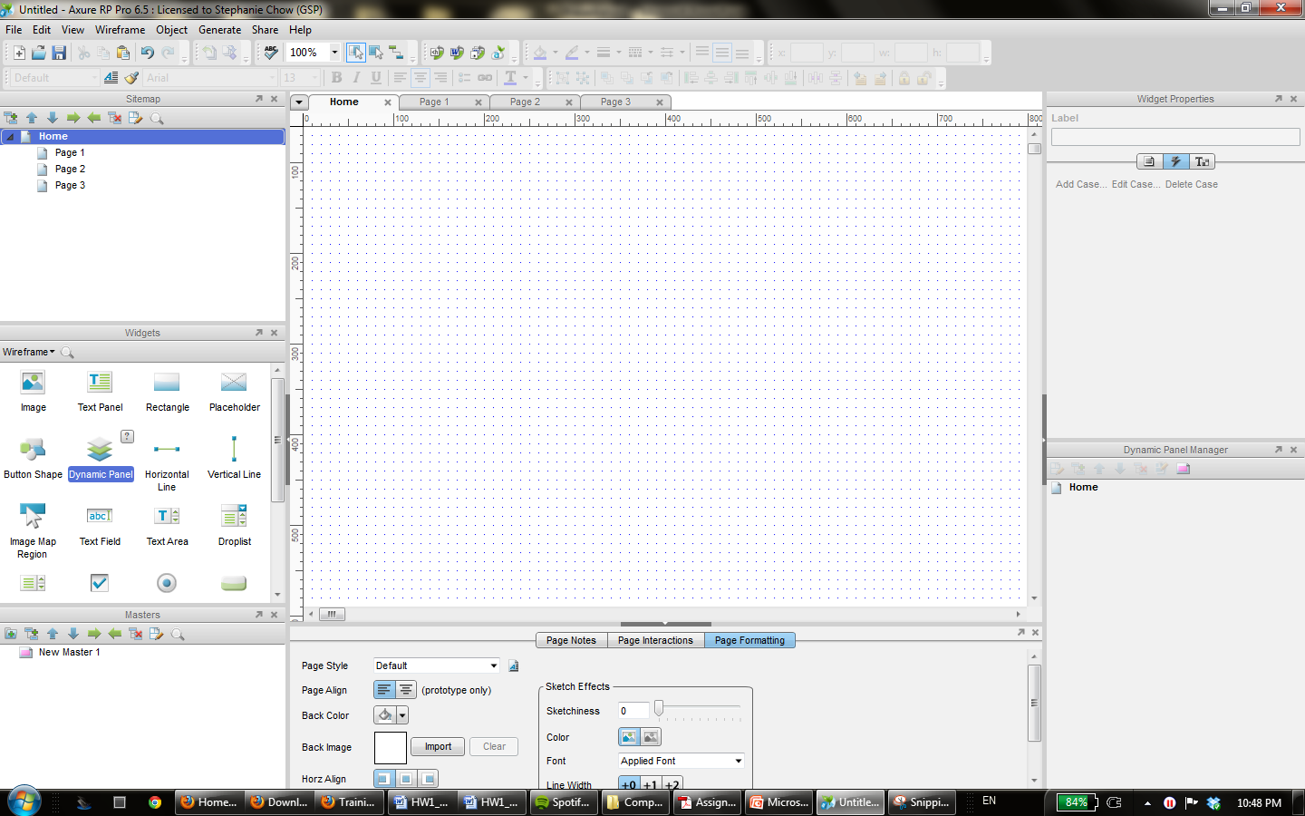
Axure
Drag and drop widgets onto your page

Slide 23
Research in Informal Tools
Sketching tools
Use before interface builders
Designed to help support the ideation phase
Menulay (saw earlier)
James Landay’s SILK tool
  Infer formal widgets and widget groupings from sketches
  Convert to real widgets
  Sketch storyboards for transitions

Slide 24
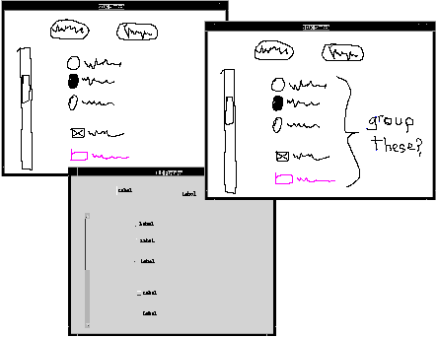
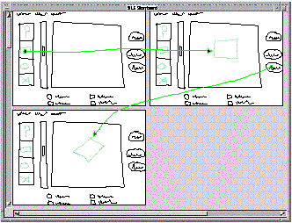
Research in Informal Tools
Main paper: http://doi.acm.org/10.1145/223904.223910
Video from CHI’96 (8:22 min)

Slide 25
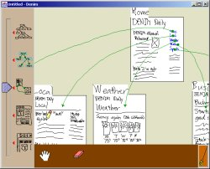
Landay’s later tool: Denim
Denim and its video

