Slide 1
Lecture 11:
Toolkits: Intrinsics, Callbacks,
Resources, Widget hierarchies,
Geometry management
Brad Myers
05-830
Advanced User Interface Software,
Spring, 2017

Slide 2
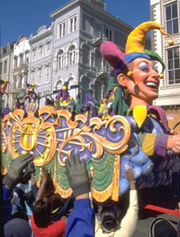
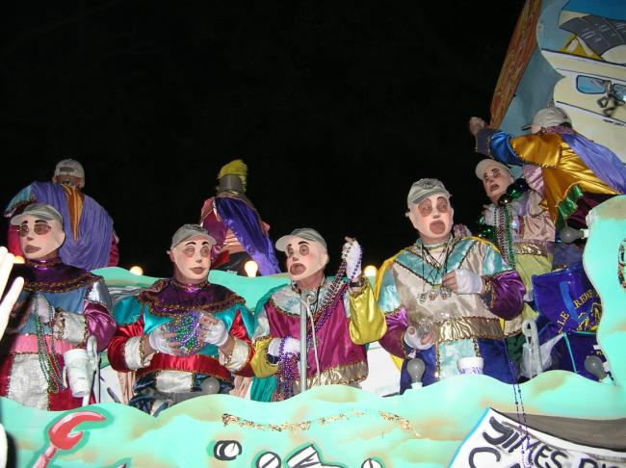
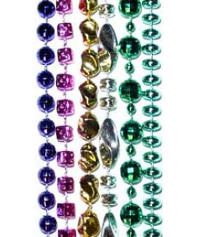
Happy Mardi Gras!
Today!

Slide 3
Homeworks
HW 2 regrade is in progress
HW 3 due next Thursday, right before spring break

Slide 4
Widgets as objects
Menus, buttons, scrollbars
Refresh themselves and handle input, redraw if change
In Unix: Motif and Tk each widget is at least one window
  Since windows already have mechanisms for mouse enter/leave, etc.
    But high overhead
  In most other toolkits, widgets are not windows
Decorative lines, labels and boxes also are "widgets“

Slide 5
Intrinsics
How the widgets are implemented
Motif -- "fake" object system out of C (same in Andrew)
Tk -- Tcl language, and descendents
Amulet -- Prototype-instance object system, constraints, Opal graphics model, Interactors input model, command objects
Java (for swing): graphics2d & awt input events
jQuery, etc. – JavaScript’s Prototype-instance object model

Slide 6
“Resources”
Starting from original Macintosh as “resource fork” – for language independence (& better memory management)
  All natural language strings and their positions in a separate file
Every parameter of widgets in Motif
  Passed as a parameter to the create routine, set afterwards, or read from a configuration file
Called "options" by Tk
Each resource has a default value defined by the class
In an X file =
appl.widget1.resource: value
appl.widget1.widget2.resource: value
*.resource: value

Slide 7
Callbacks
In Motif, associate C procedures with widgets
  Many different callbacks for the same widget
    create, start, abort, finish, destroy, ...
  Registered (set) at widget creation time, invoked at run time
  Are "resources"
  There are also "actions" which are internal to the widget and called by events.
In VB, “event handlers”
  Button: click, focus-in/out, change, etc.
In tk, associate tcl script with "events" in widgets
  or the widget action if it has one
In Amulet, invoke Command Objects on "interactors" or widget finish, and call-back is the DO method.

Slide 8
Widget Hierarchies
Inheritance to give the right methods to widgets
Functions down the parent or class hierarchy
Java swing hierarchy:
  http://docs.oracle.com/javase/8/docs/api/index.html?javax/swing/package-tree.html
  Thousands of interfaces, classes, subclasses, etc.
Separate hierarchies for internal look-and-feel classes
  Visible when debugging

Slide 9
Geometry Management
Widgets don't set their own location.
  Widgets put into special group objects called "geometry managers" that perform the layout by setting the component's positions and size
Each widget negotiates with parent for more room when resize

Slide 10
History: TeX layout model
Typesetting system designed and mostly written by Donald Knuth starting in 1977
Boxes (of type) connected by “glue”
  \vspace also between characters, etc.
Can control the “stretchiness” of the glue

Slide 11
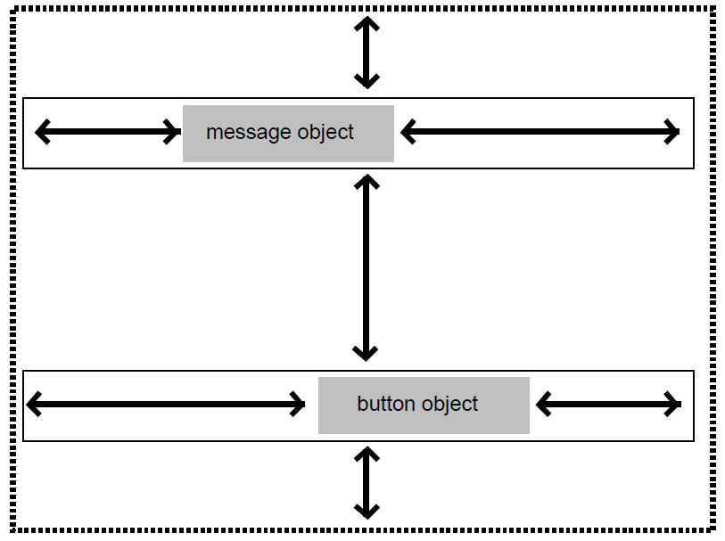
History: Interviews layout model
“Interviews” – one of the first C++ toolkits
  Linton, M.A., Vlissides, J.M., and Calder, P.R., “Composing user interfaces with InterViews.” IEEE Computer, Feb, 1989. 22(2): pp. 8-22.
Adopted the TeX boxes and glue metaphor
hbox tiles its components horizontally
  hglue
vbox tiles them vertically
  Vglue
Controls have a “natural” size
Different glues and controls
have different stretchiness

Slide 12
Motif Geometry Management
Motif
  RowColumn - add widgets and it lays them out
  Treats all children the same, so not for ScrollBars
Form - generic constrained layout
  Put extra resources on the children widgets
  "For details, see the Motif Reference Manual, because the complete behavior of Form is quite complicated."
  Each edge can be constrained
    at a position or offset from an edge of the Form
    at an offset from an edge of another widget
    percent of the way across the Form (edge, not center)
    a percent calculated based on the initial position
  If wrong, widgets are on top of each other

Slide 13
TK Geometry Management
All widgets must be in a geometry manager, or else not displayed
Any widget with any geometry manager
Layout depends on
  widget specified sizes
  programmer specifications,
  size of geometry manager itself
Widgets must adjust themselves to the size given
Geometry manager requests size recursively

Slide 14
TK Geometry, Cont.
Placer - specific location for each widget
  Each widget treated independently
  Place "anchor" in absolute coords or as a % of way across
  then say which part of object is at the anchor
  n, ne, e, se, ... center
Packer - "constraint based"
  specify position of each widget in available space
  side left, right, top, bottom
  fill x, -fill y stretch widget to fill available space
Text
Canvas - mix graphics and widgets

Slide 15
Amulet geometry management
Group can have the Am_LAYOUT slot set with a constraint that depends on other slots
  Sets positions of parts by side effect
  Default layout routines: Horizontal and Vertical layout, for lists or tables.
  (Like the LayoutGroup of HW#2)
Rest done by arbitrary constraints

Slide 16
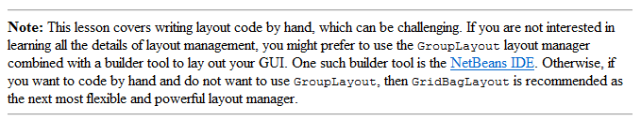
Java Widget Layout
“Using Layout Managers”
BorderLayout – layout around the edges, center gets extra space
BoxLayout – vertical or horizontal columns
CardLayout – overlapping JPanels
FlowLayout – fills row, then goes to next row
GridBagLayout – “one of the most flexible — and complex — layout managers the Java platform provides…. uses a grid of rows and columns, allowing specified components to span multiple rows or columns.” – see funny video (2:42)
GridLayout -- components in a grid of cells. Resizes children to fill cell
GroupLayout – new, designed for use by IBs
SpringLayout -- also new for IBs, constraints for layouts

Slide 17
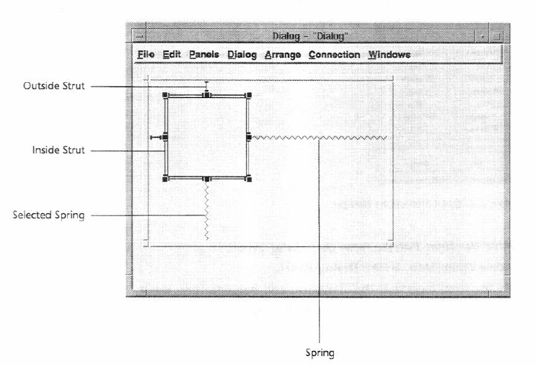
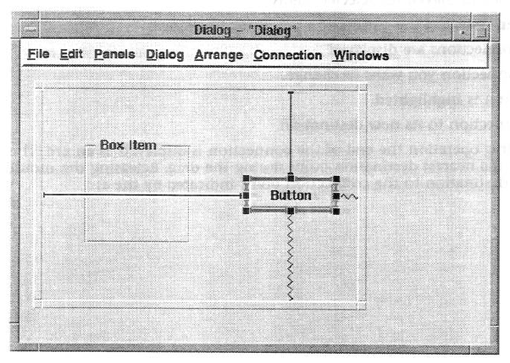
“Struts and Springs” layout
For stretchy or rigid constraints
Graphical interface layouts
NeXTStep (1989), MacOS & Galaxy (~1992)
Notes:
Also : http://doi.acm.org/10.1145/98188.98201
Interactive specification of flexible user interface displays
Scott E. Hudson & Shamim P. Mohamed

Slide 18
Web Layout Model
Html/css elements can be positioned many ways
  Tables, floating “div”, etc.
    Tables no longer recommended for layout
  Position by absolute or % of container:
    div.container {
    width: 100%; …}
    … width: 10px;
    … 1em;
    nav {
    float: left; … }
Many parameters and controls on positions & size: margin-left, padding, …
Can have “responsive design” in CSS3 – depends on container width.

Slide 19
Web call-back model
Form controls (buttons, text field) have various events or “actions”
  Built-in actions like “submit”
  Attach script code to run when used
  <button type="submit" formaction="/action_page2.php">
AngularJS supports “data bindings”
  Like Amulet constraints or ConstraintJS
  Connects JavaScript variable to html element
  <p ng-bind="firstname"></p>
  Can be two-way

Slide 20
jQuery JavaScript toolkit
Widgets can use standard html/css layout mechanisms
jQuery layout plug-in: http://layout.jquery-dev.com/
  Subdivides screen into “panes”
    <div class="ui-layout-center">Center</div>
    <div class="ui-layout-north">North</div> …
  Can be draggable, nestable, etc.

Slide 21
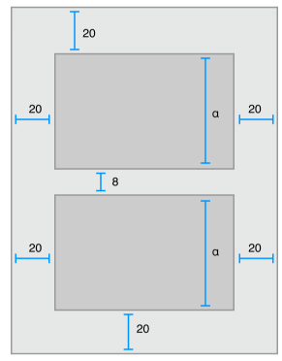
iOS
Can manually place elements of UI
“Auto Layout”
  Constraint-based layout system
  Helps with adaptive UI
Can set up constraints in the
interface builder or
programmatically
cite

Slide 22
Android
Similar to Java Swing
Layout: Different kinds of containers that lay out children
  Linear, grid, etc.
  Attach layouts to “view”s
Listeners for handling events:
button.setOnClickListener(new View.OnClickListener() {
public void onClick(View v) {
// Perform action on click
}

