Slide 1
Lecture 9:
Software Organizations:
Lexical-Syntax-Semantics, Seeheim Model, MVC
Brad Myers
05-830
Advanced User Interface Software
Spring, 2017

Slide 2
Homework 2
Demo of Toby Li’s implementation
Redo by next Tuesday

Slide 3
Software Organizations
Ways to organize code, rather than tools.
"Models"
Helps think about modularization and organization.
Goal: separation of UI and rest of software = “semantics”

Slide 4
Conceptual-Semantic-Syntactic-Lexical-Pragmatic
Derived from compiler theory and language work.
Mostly relevant to older, non-DM interfaces
Pragmatic (as subdivided by Buxton)
  How the physical input devices work
  required "gestures" to make the input.
  Ergonomics
  skilled performance: "muscle memory"
  press down and hold, vs. click-click

Slide 5
Conceptual-Semantic-Syntactic-Lexical-Pragmatic, cont.
Lexical (as subdivided by Buxton)
  spelling and composition of tokens
    “add” vs. “append” vs. “^a” vs.
  Where items are placed on the display
  “Key-stroke” level analysis
  For input, is the design of the interaction techniques:
    how mouse and keyboard combined into menu, button, string, pick, etc.

Slide 6
Conceptual-Semantic-Syntactic-Lexical-Pragmatic, cont.
Syntactic
  sequence of inputs and outputs.
  For input, the sequence may be represented as a grammar:
    rules for combining tokens into a legal sentence
  For output, includes spatial and temporal factors
  Example: prefix vs. postfix

Slide 7
Conceptual-Semantic-Syntactic-Lexical-Pragmatic, cont.
Semantic
  functionality of the system; what can be expressed
  What information is needed for each operation on object
  What errors can occur
  Semantic vs. UI is key issue in UI tools
    but "semantic" is different than meaning in compilers
  "Semantic Feedback“
    Depends on meaning of items
    Example: only appropriate items highlight during drag

Slide 8
Conceptual-Semantic-Syntactic-Lexical-Pragmatic, cont.
Conceptual (definition from Foley & Van Dam text, 1st edition)
  key application concepts that must be understood by user
  User model
    Objects and classes of objects
    Relationships among them
    Operations on them
      Example: text editor
        objects = characters, files, paragraphs
        relationships = files contain paragraphs contain chars
        operations = insert, delete, etc.

Slide 9
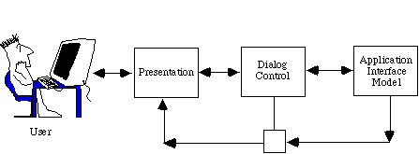
Seeheim Model
Resulted from the 1st UI software tools workshop which took place in Seeheim, Germany. Nov 1-3, 1983.
Logical model of a UIMS
  UIMS = User Interface Management System (old name for user interface software)
  All UI software must support these components, but are they separated? How interface?

Slide 10
Seeheim Model
Presentation Component
  External presentation of the user interface
  Generates the images
  Receives physical input events
  Lexical parsing
Dialog Control
  Parsing of tokens into syntax
  Must maintain state to deal with parsing; modes.
Application Interface Model
  defines interface between UIMS and the rest of the software
  "Semantic feedback" for checking validity of inputs
  Not explicit in UIMSs; fuzzy concept.
  Roughly like today's call-backs.

Slide 11
Card, Mackinlay,
Robertson model
Input device is a six-tuple: (M, In, S, R, Out, W)
  M is a manipulation operator (slide, rotary, force, distance)
  In is the input domain,
  S is the current state of the device,
  R is a resolution function that maps from the input domain set to the output domain set,
  Out is the output domain set, and
  W is a general purpose set of device properties that describe additional aspects of how a device works (perhaps using production systems).
Composition operators – how inputs connected (x and y of mouse, buttons, output of one to input of another)

Slide 12
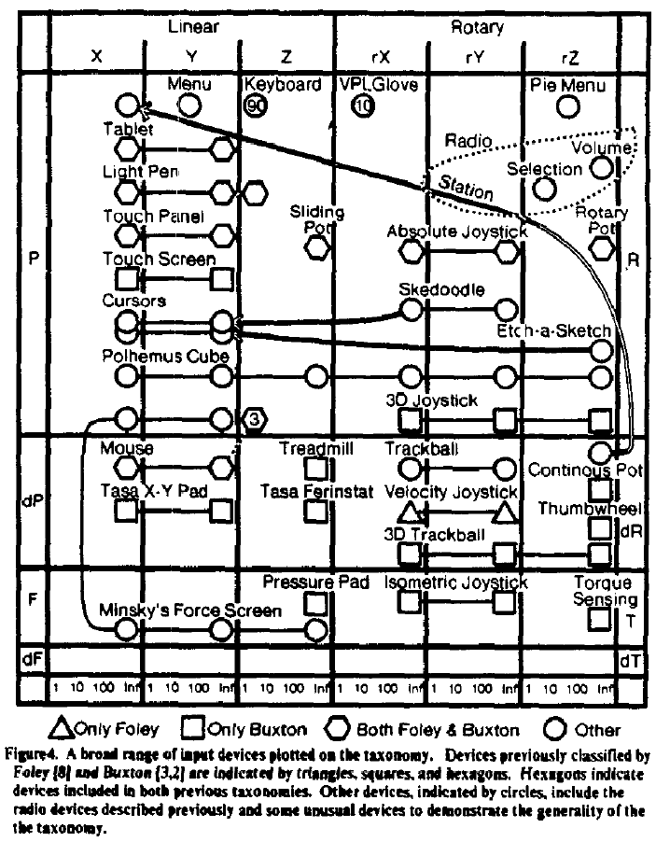
Card, Mackinlay,
Robertson Model, cont.

Slide 13
Model-View-Controller
Invented in Smalltalk, about 1980
Idea: separate out presentation (View), user input handling (Controller) and "semantics" (Model) which does the work
Fairly straightforward in principal, hard to carry through
Never adequately explained (one article, hard to find)
Goals
  program a new model, and then re-use existing views and controllers
  multiple, different kinds of views on same model

Slide 14
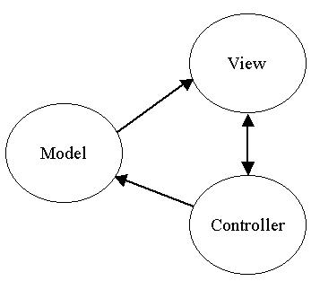
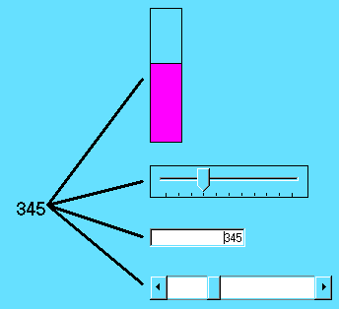
MVC

Slide 15
MVC
Views closely associated with controllers.
Each VC has one M; one M can have many VCs.
  VCs know about their model explicitly, but M doesn't know about views
  Changes in models broadcast to all "dependents" of a model using a standard protocol.

Slide 16
MVC
Model
  Simple as an integer for a counter; string for an editor
  Complex as a molecular simulator
Views
  Everything graphical
  Layout, subviews, composites
Controller
  Schedule interactions with other VCs
  A menu is a controller

Slide 17
MVC
Standard interaction cycle:
  User operates input device, controller notifies model to change, model broadcasts change notification to its dependent views, views update the screen.
  Views can query the model
Problems:
  Views and controllers tightly coupled
  What is in each part?
  Complexities with views with parts, controllers with sub-controllers, models with sub-models...

Slide 18
Model-View
Since hard to separate view and controller
Used by Andrew, InterViews
Primary goal: support multiple views of same data.
  Simply switch views and see data differently
Put into Model "part that needs to be saved to a file"
  but really need to save parts of the view

Slide 19
Later Models of
Software
Organization
“Arch” model
  Bass, R. Faneuf, R. Little, N. Mayer, B. Pellegrino, S. Reed, R. Seacord, S. Sheppard, and M. Szczur, 1992. “A metamodel for the runtime architecture of an interactive system: the UIMS tool developers workshop”, ACM SIGCHI Bulletin. 24 (1), 32–37. Jan, 1992 http://doi.acm.org/10.1145/142394.142401
  Adds abstract interface for the functional core
  Logical interaction layer: widget libraries and user interface toolkits such as Motif or MFC.

Slide 20
Later Models of Software Organization
PAC-Amodeus
  Nigay, L. and Coutaz, J., 1991. Building User Interfaces: Organizing Software Agents. In: ESPRIT'91, Project Nr. 3066: AMODEUS (Assimilating Models of DEsigners, Users and Systems), pp. 707–719. http://citeseer.nj.nec.com/nigay91building.html, or http://iihm.imag.fr/publs/1991/
  Tries to integrate MVC with Arch

Slide 21
Document Model
Provided first by Smalltalk, MacApp
  Also MacOS, Windows, etc.
Provide generic (empty) top-level classes that you subclass to implement the specific kind of application
UI Frameworks
Note: different from Web document object model (DOM)

Slide 22
Other Models
Producer – Consumer
  Like Unix pipes
Client – Server
  X server
Peer to peer
Networking or OS multi-layer models
Service Oriented Architecture
(All of the “Design Patterns” in the “gang of four” book)
“Domain-Driven Design” book
Model-driven design (different use of “model”)
Fitt’s law – model for evaluation

